Slide 1
Knowledge for a better world
Rector NTNU, Gunnar Bovim, 15.05. 2019, Kathmandu University

Slide 2
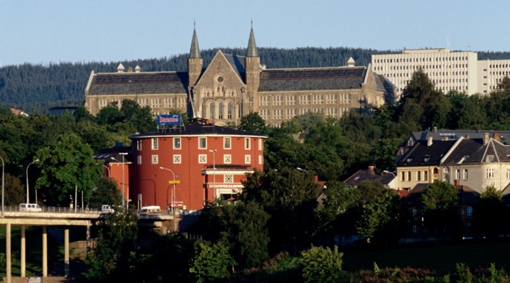
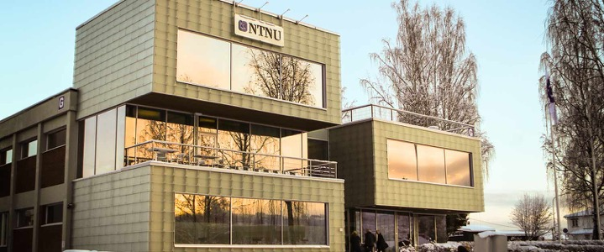
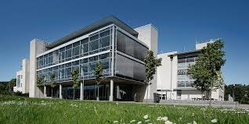
Main profile in science and technology
Academic breadth: humanities, social sciences, medicine, health sciences, science of education, architecture, fine arts and performing arts
Headquartered in Trondheim with campuses in Gjøvik and Ålesund

Slide 3
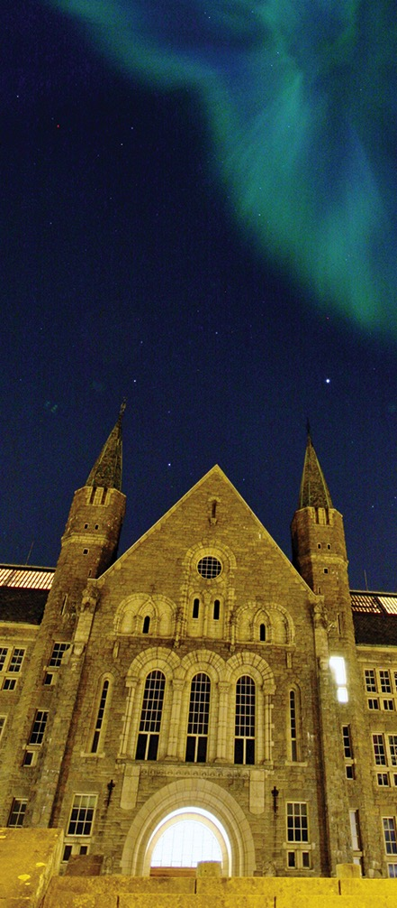
Key figures
8 faculties, 55 departments and NTNU University Museum
7401 person-years (2018)
More than 42 000 students (2018)
7220 completed bachelor’s and master’s degrees (2018)
397 doctoral degrees (2018)
Operating income: 1 billion Euro/year
Operating income: 1 billion Euro/year
Operating income: 1 billion Euro/year

Slide 4
Strategic research areas
NTNU Energy NTNU Health NTNU Oceans NTNU Sustainability
The strategic research areas aim to:
Work together across disciplines, solve complex challenges of great importance
Face global challenges with an interdisciplinary and flexible organization
Strengthen cooperation with the world of work and our innovative capability
Increase NTNU’s
share of international research funds

Slide 5
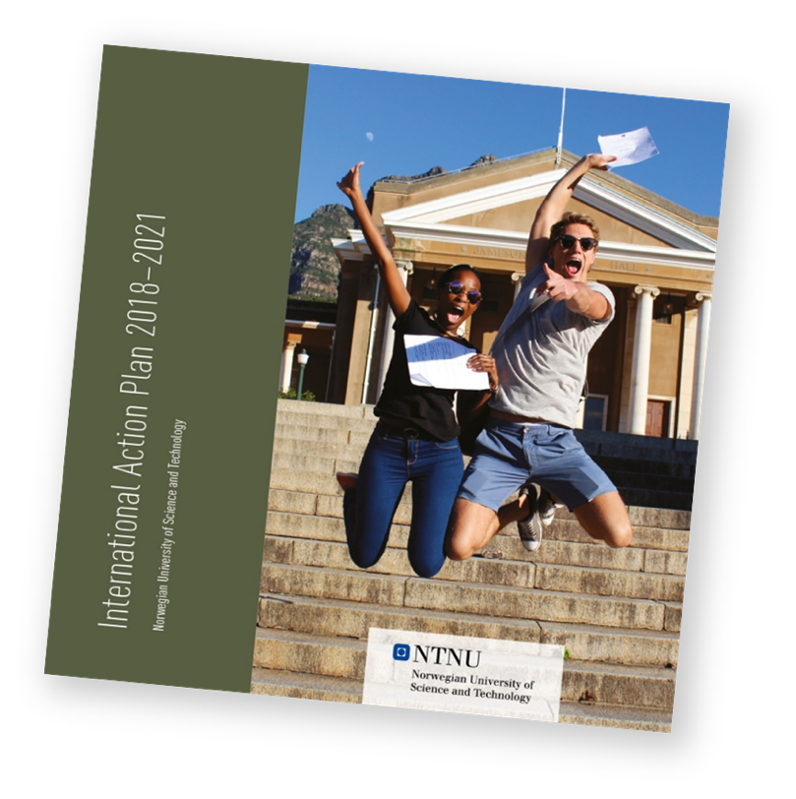
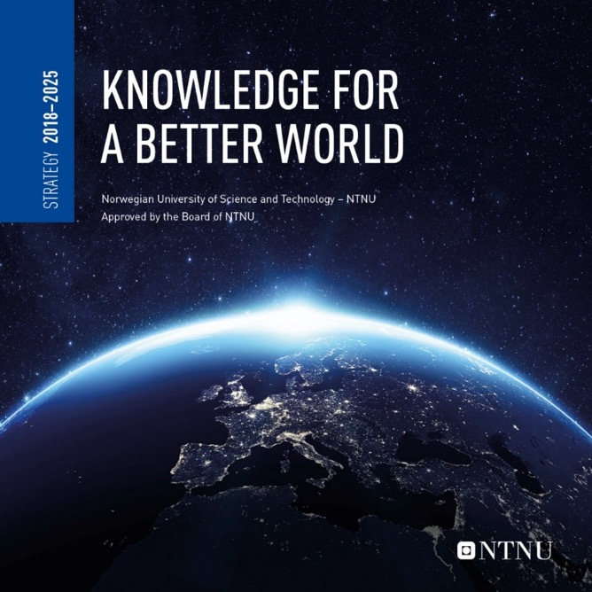
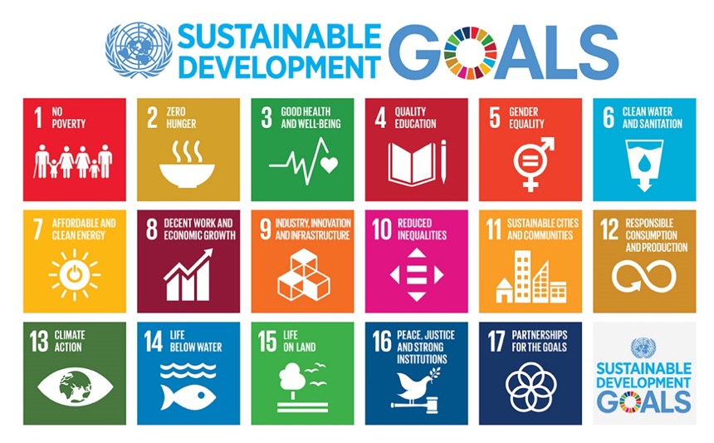

Slide 6
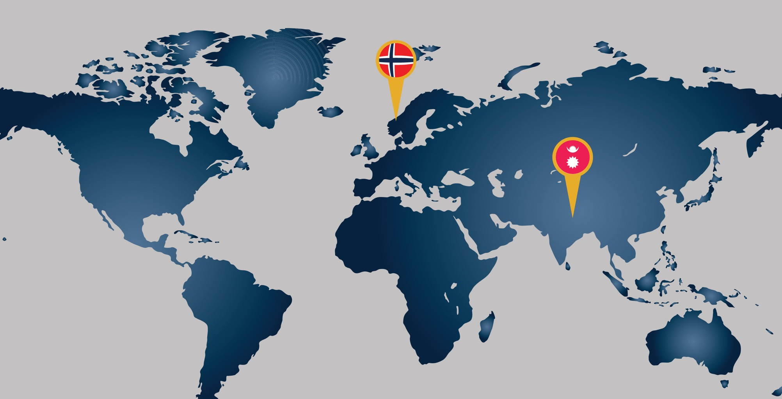

Slide 7
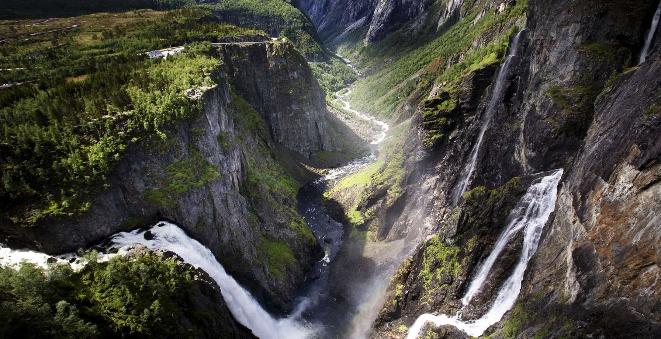

Slide 8
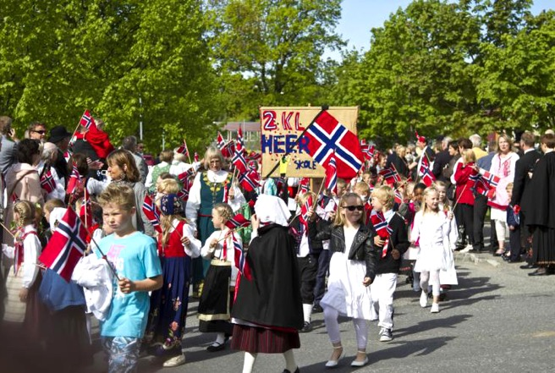
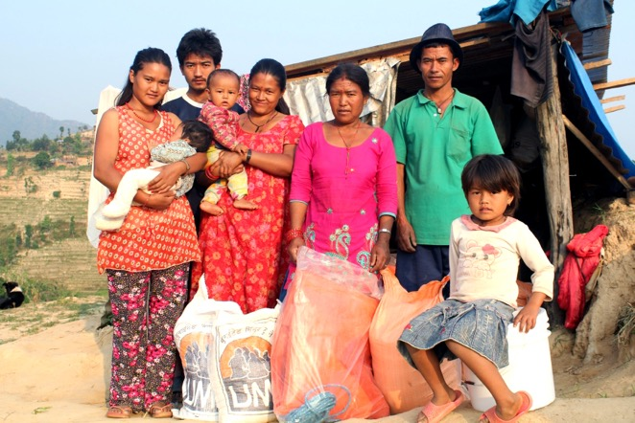
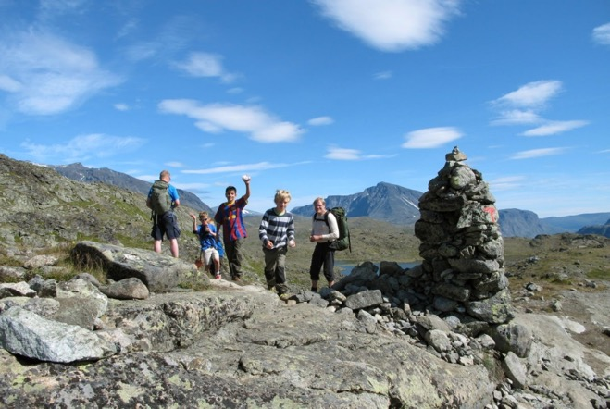
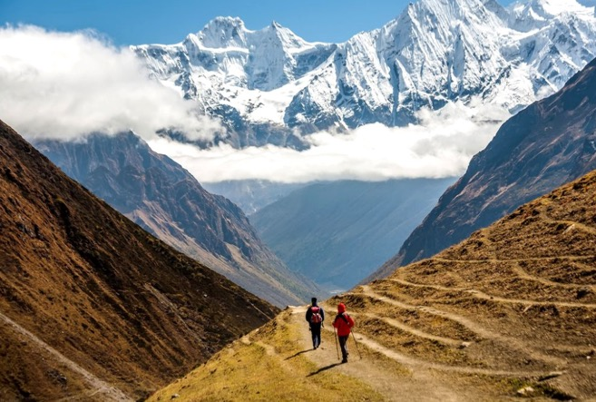
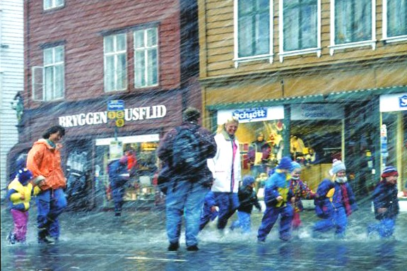
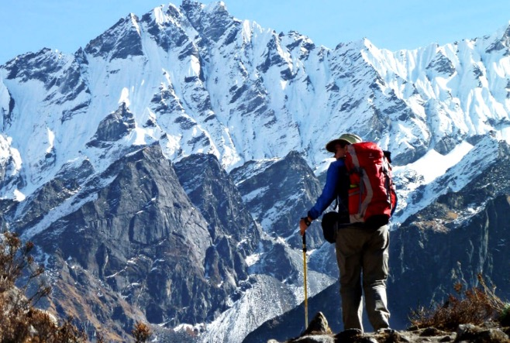

Slide 9
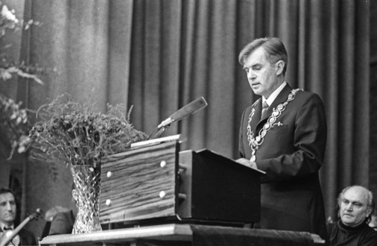
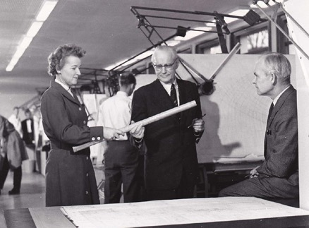
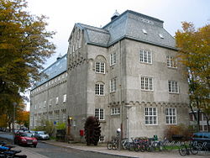
The story of the NTNU – KU cooperation

Slide 10
Today’s cooperation between NTNU and Nepal
Renewable energy
Health
Geology
Biology
Social Sciences
Architecture, design and urban development
Sustainable development

Slide 11
Renewable energy

Slide 12
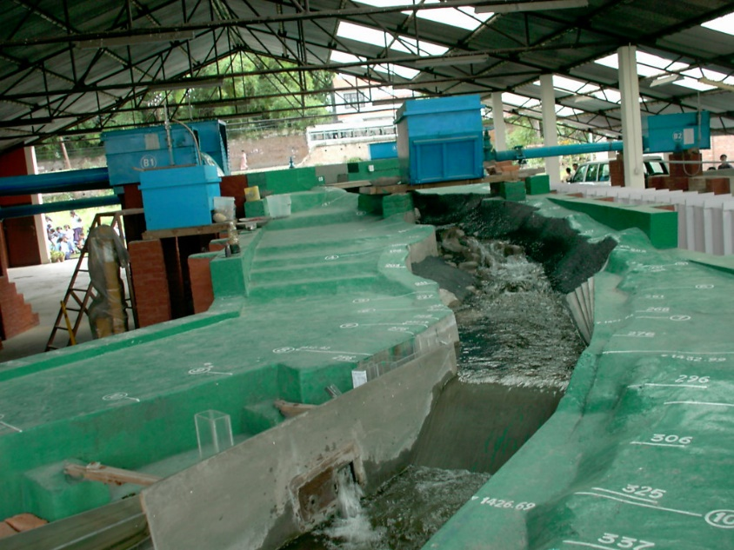
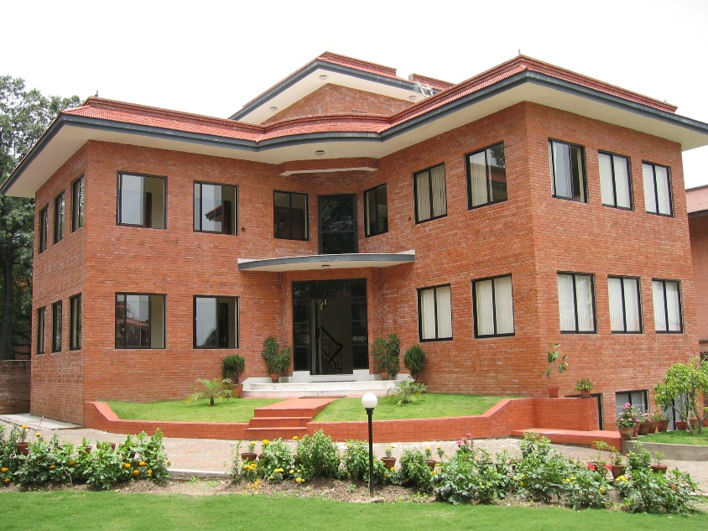
Hydropower and cooperation with Tribhuvan University
Professor Dagfinn K. Lysne from NTNU was a key person in the development of Hydro Lab.
Hydro Lab was established with the financial support from NORAD.
Since its establishment, Hydro Lab has cooperation with NTNU.
Notes:
It was necessary for Nepal to establish a research centre to study and solve the complex issues and problems associated with hydraulics and sediment in its Himalayan steep rivers for sustainable water resources development. Institute of Engineering, A hydraulic laboratory was set up with joint co-operation between NTH and Tribhuvan University to carry out physical hydraulic model study of headworks of a hydropower project. The study continued for the period from1989 to 1991.
Professor Dagfinn K. Lysne from Norwegian University of Science and Technology (NTNU) was instrumental in materializing this hydraulic laboratory. Similarly, the physical model study for the headworks of 60 MW hydropower project was also performed in the same laboratory in 1996 to 1997.
In order to provide continuation to this work, Hydro Lab Private Limited (HydroLab) was established with the financial support from the Norwegian Agency for Development Cooperation (NORAD). Since the establishment, HydroLab has cooperation with the Norwegian University of Science and Technology (NTNU). NTNU has been an still is providing scientific and technical support to the Hydro Lab.

Slide 13
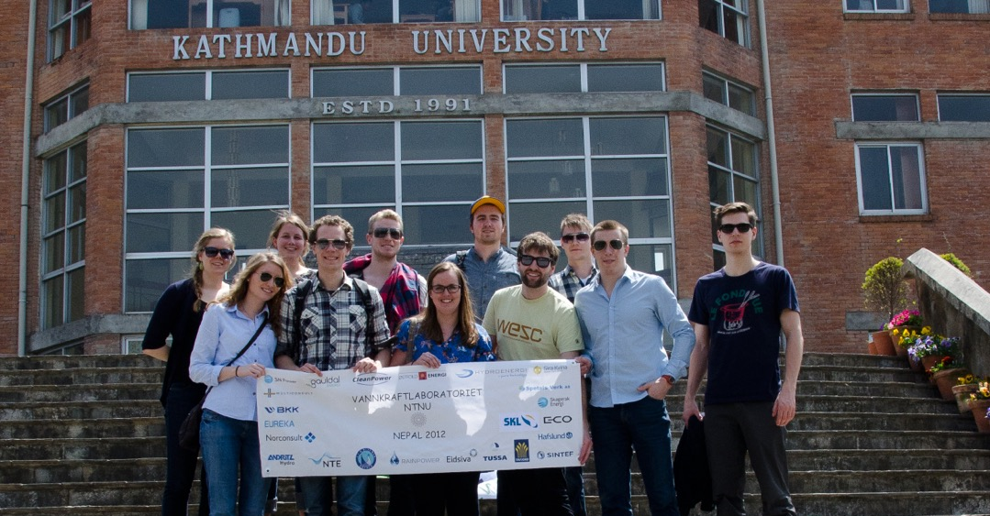
Hydropower and mechanical engineering – cooperation with Kathmandu University
Faculty Development
Education
Student exchanges
Research
Laboratory facilities

Slide 14
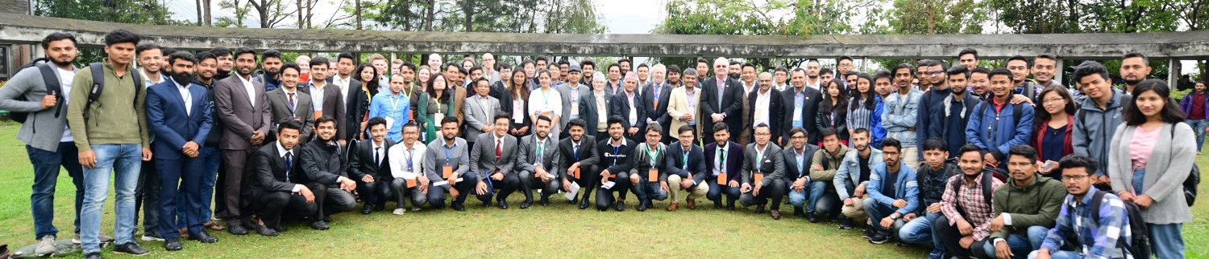
Research dissemination and outreach
International Symposium on Current Research in Hydraulic Turbines
Began in 2010
Students present their ongoing master’s research
PhD-students can present their work
The best papers are published in the IOP-conference series
Attendance in 2019, Ref. Kathmandu University

Slide 15
Health

Slide 16
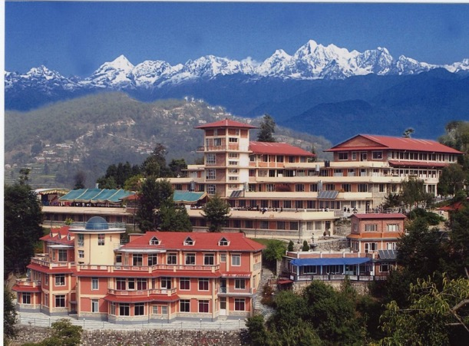
NTNU and Kathmandu University, School of Medical Sciences / Dhulikhel Hospital
2007: Collaboration agreement signed on medical education and research
Projects from the collaboration:
Students education and hospital staff training
Exploration of ideas for future research projects/other projects
Established Masters in Global Health at both KUSMS and NTNU
Four ongoing PhD projects and five PhD have defended their thesis

Slide 17
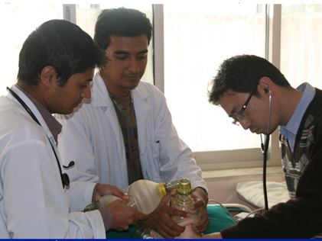
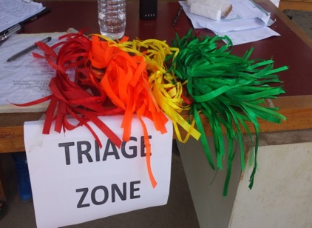
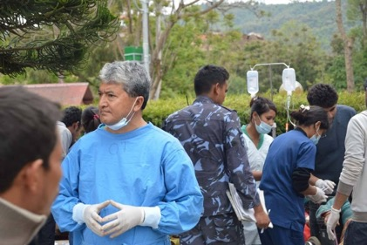
Triage and training to improve emergency care – DHECARE
Aim:
Assess changes in the organization of emergency care and implementation of triage system for the initial evaluation of patients
Systematic training program for staff
Reduce mortality and improve quality and efficiency of care
Earthquake in 2015; important changes
Dhulikhel Hospital was probably better prepared than any other in Nepal, and the patients were triaged and treated as implemented by the DHECARE project

Slide 18
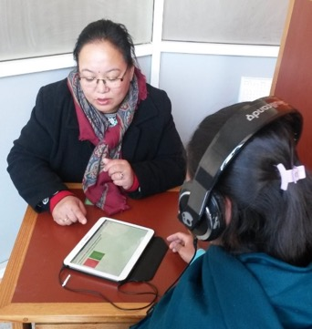
Evaluating interventions in antenatal care to identify and assist victims of gender-based violence in Nepal and Sri Lanka
Aims:
Develop tools that are culturally and contextually sensitive to identify women who experience domestic violence in antenatal care settings.
Assess the feasibility of interventions during antenatal care to increase the safety of pregnant women and assess the impact of safety behaviour interventions on pregnancy outcomes.
Explore community perceptions on domestic violence in general, including men's (partner's) views.
Have applied for follow-up study

Slide 19
Architecture and design

Slide 20
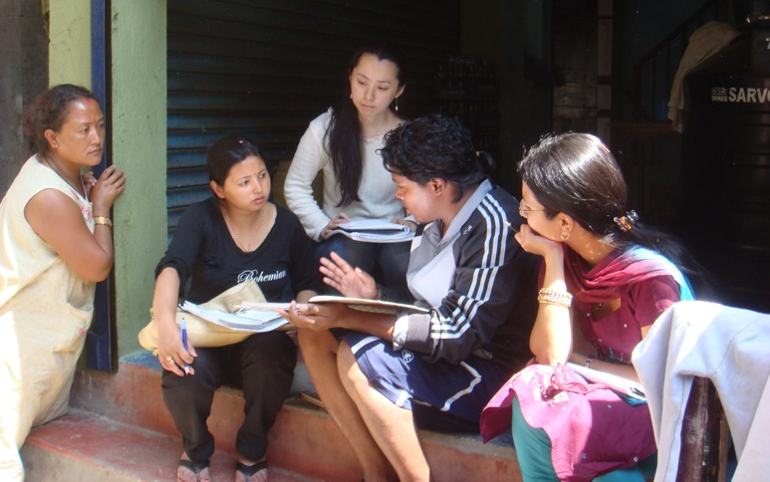
Long term collaboration with Institute of Engeneering, IOE and the Department of Urban Development and Building Construction DUDBC) Master’s programme in Urban Ecological Planning, NTNU
Number of projects with NUFU/NORAD support
Master’s programme in Urban Planning at IOE
Nepalese students at UEP with uota stipends
PhD students at NTNU
Joint fieldwork in Kathmandu for UEP
Notes:
Fieldwork in Kathmandu, 2009, Masters students of UEP, NTNU

Slide 21
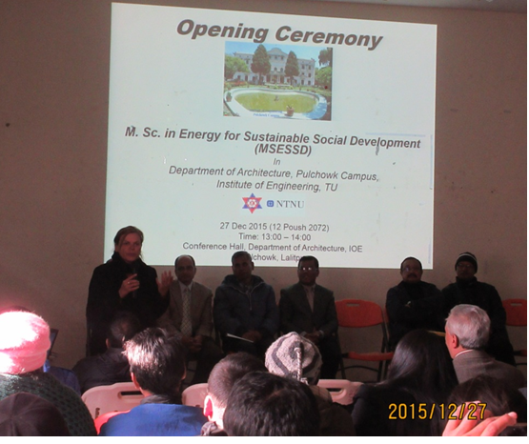
NORAD PROJECT:
Energy for Sustainable Social Development (MSESSD), 2015-2020
Financed by ENPE.

Slide 22
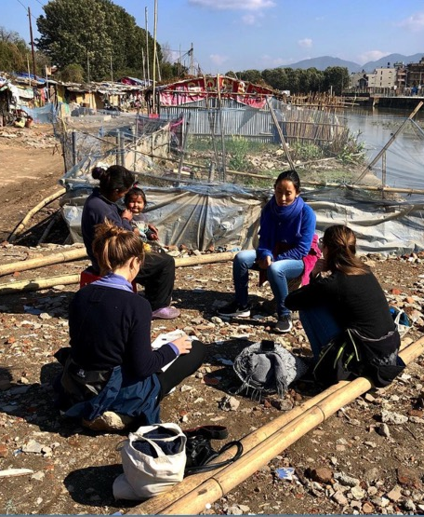
Transdisciplinary Education for a Sustainable Society (SAMAJ)
DIKU/Norpart project 2019-2023
Main purpose:
To integrate UN Sustainable Development Goals in education and research at IOE .
Notes:
NTNU Design Master students 2019 in Nepal: Thesis Topic: Women's health and service design

Slide 23
Engineering Geology
and Tunnelling

Slide 24
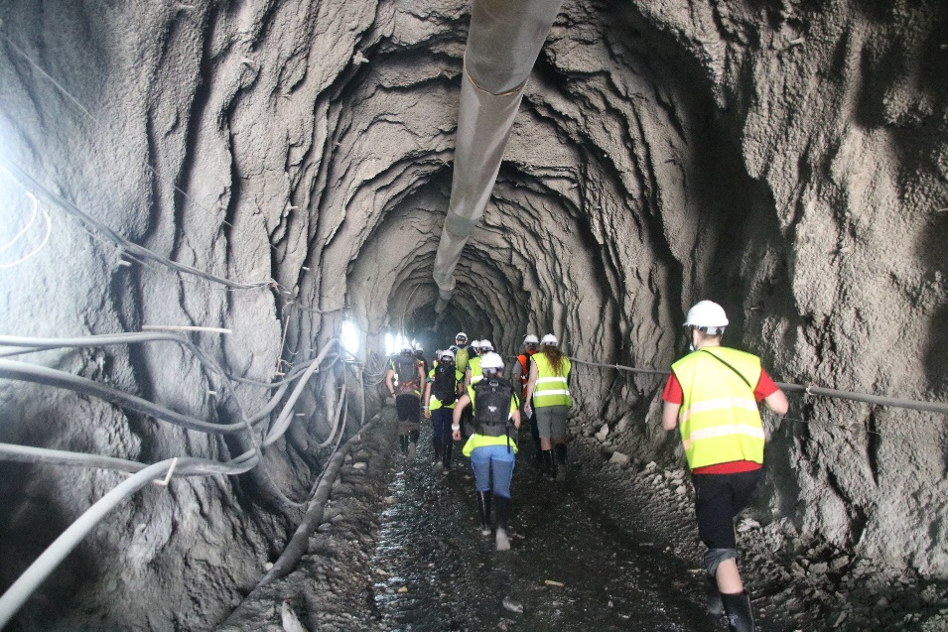
Geoscience and Petroleum
IGP-NTNU plan to collaborate with IoE-TU to start a new MSc program in «Rock and Tunnel Engineering»
IGP-NTNU is collaborating with KU on the «Technical Investigation of Hydropower Plants in Nepal, with special focus on Tunnel Technology” under the Energize Nepal Project
5 Completed PhD Research Projects associated with Nepal from 2003 to 2018
Over 30 HPD MSc fellows completed their thesis in Rock Engineering tunneling for hydropower

Slide 25
Graduated doctoral candidates from Nepal at NTNU 2003–2018
Notes:
Total 27 candidates ( Dr. Ing, degree + PhD degree)
From both universities TU and KU.
In addition, 10-12 PhD on short term visits from TU, IoE and
from KU to NTNU from 2015 till d.d. under EnPe/Norad programmes (These are
exchange students on PhD level)

Slide 26
Outgoing mobility - Total 193 students 2014 - 2018
Notes:
Outgoiung students have visited these institutions:
- Tribhuvan University
- Okhaldhunga Hospital
- Unknown Nepal
- Kathmandu University
- Kathmandu Medical Collage
Incoming mobility from Nepal:
-

Slide 27
Incoming mobility - Nepalese students to NTNU
Total 72 students from Nepal from TU and KU on 2-years master degree programmes
In addition 11 incoming exchange students from 2014-2018 Kathmandu University and 9 from TU.
Total 92 incoming students on degree programmes as well as exchange
Notes:
Total 72 students from Nepal from TU and KU on 2-years master degree programmes
- In addition 11 incoming exchange students from 2014-2018 Kathmandu University and 9 from TU.
- Total 92 incoming students on degree programmes as well as exchange

Slide 28
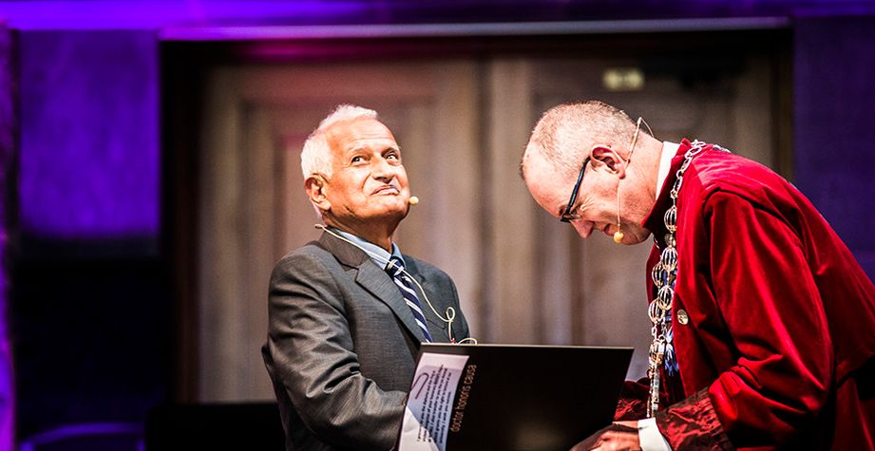
Suresh Raj Sharma was awarded an honorary doctorate at NTNU in 2014.
He is shown here with Rector Gunnar Bovim at the Doctoral Awards Ceremony.

Slide 29
Future plans and challenges:
Bridging academia and local industry
Establish Centre of Excellence on sediment erosion in hydro turbines
How do we establish sustainable cooperation?
Establish network with cooperating partners, preferably former students from NTNU
Common curricula
Student exchanges
Common research
Common publications
Common industry network

Slide 30
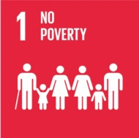
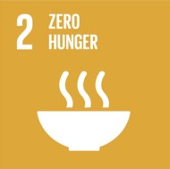
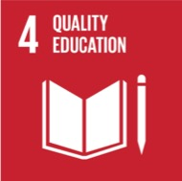
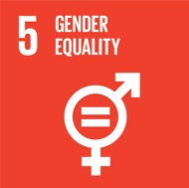
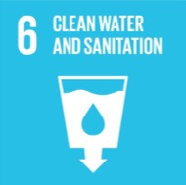
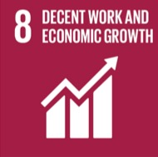
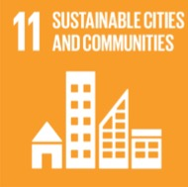
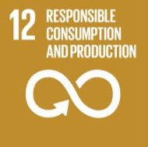
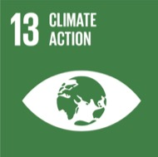
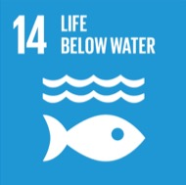
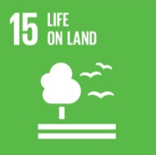
UN’s Sustainable Development Goals

Slide 31
Gender equality

Slide 32
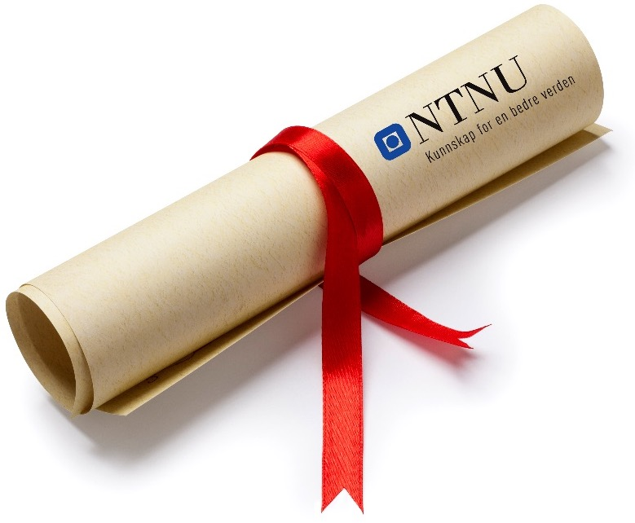
Ethics
All NTNU students should graduate with:
A sound educational foundation
Curiosity
Strong values

Slide 33
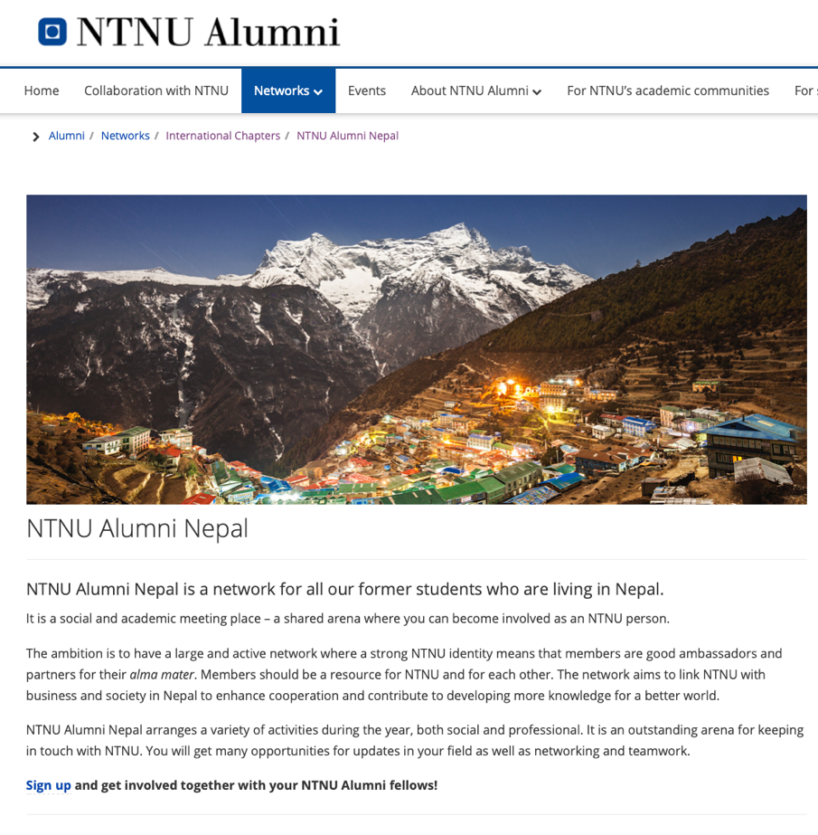
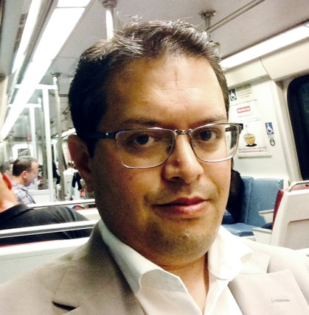
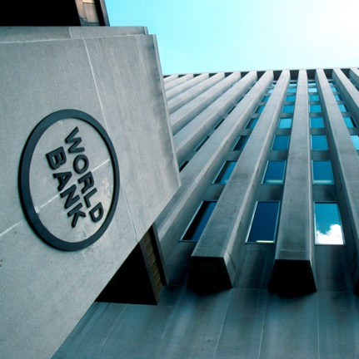

Slide 34
Knowledge for
a better world

