Slide 1
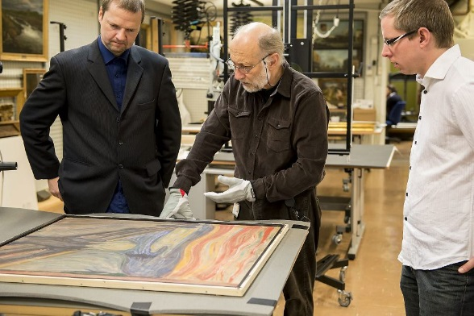
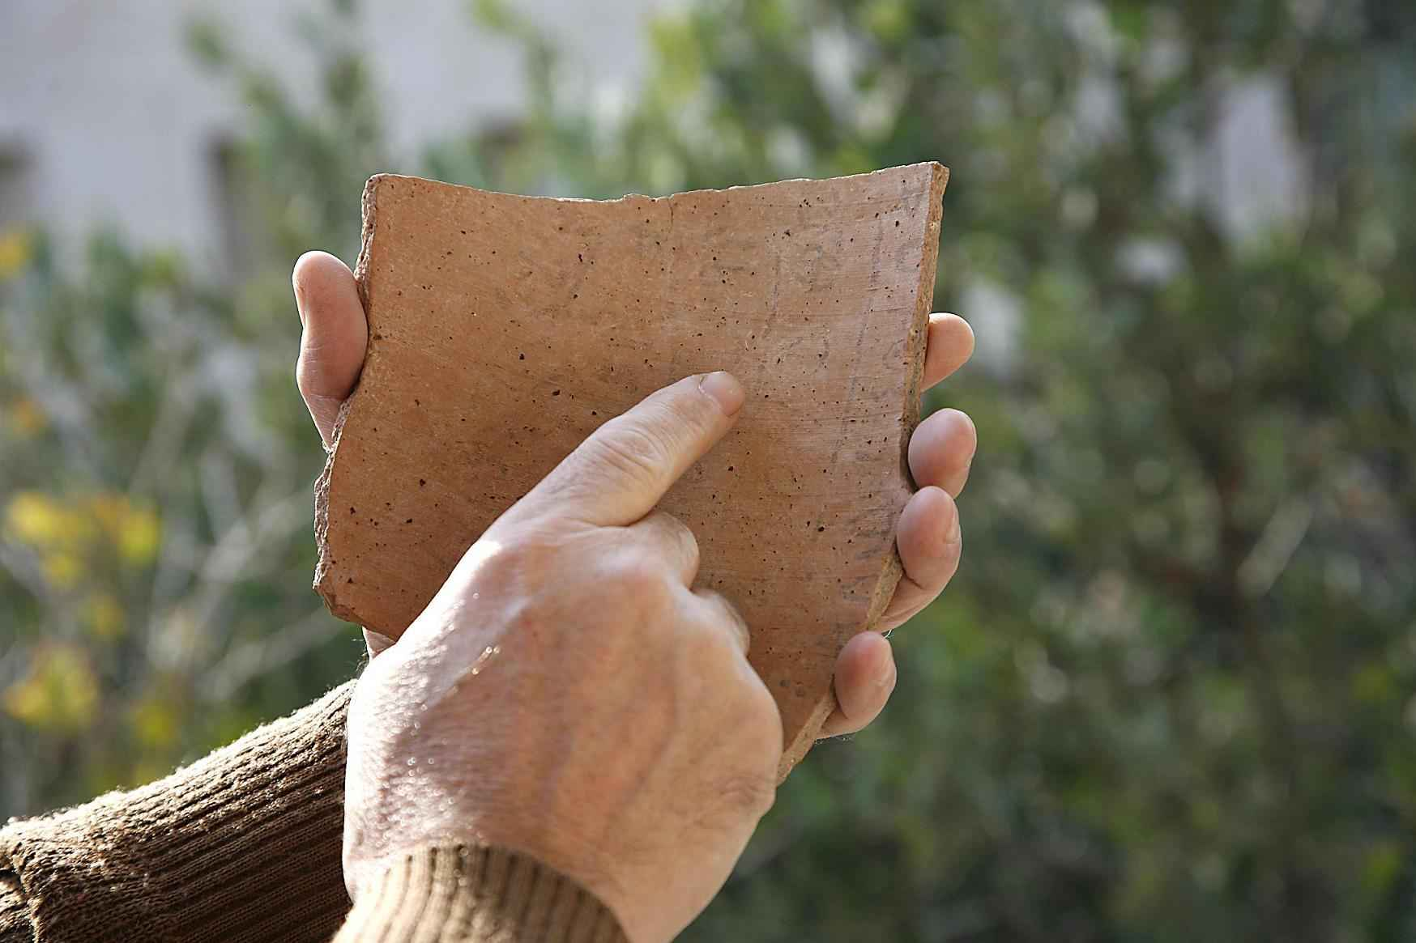
Imaging for cultural heritage applications

Slide 2
Motivation
Accurate documentation
High image resolution and penetration have always been the two most important parameters that conservators
Hi- fi reproduction of art paintings
Investigation the under paintings
Non-destructive Pigment identification
Virtual restoration of paintings
Study the effect of ambient light
Virtual Museum

Slide 3
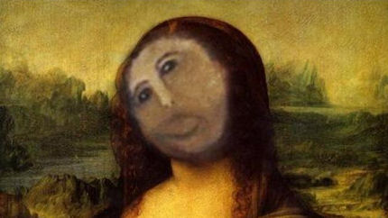
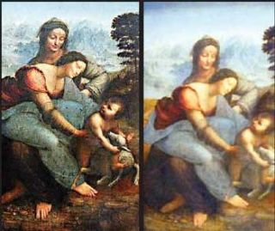
Failed restoration of art paintings
The three versions of the “ecce homo” fresco of Jesus.
The original version by Elías García Martínez, a 19th-century painter; a deteriorated version of the fresco; the restored version by Cecilia Giménez.
Virgin and Saint Anne
August 23, 2012
Overcleaning, 2014

Slide 4
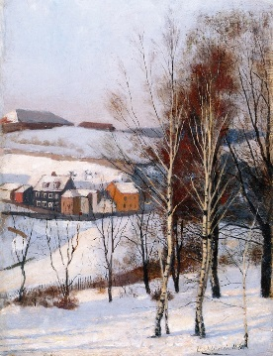
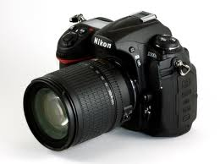
RGB and spectral image acquisition
K= 3
RGB Camera
RGB image
K > 10
Hyperspectral Camera
Hyperspectral image

Slide 6
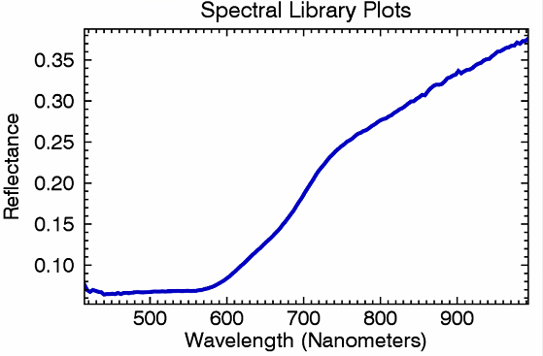
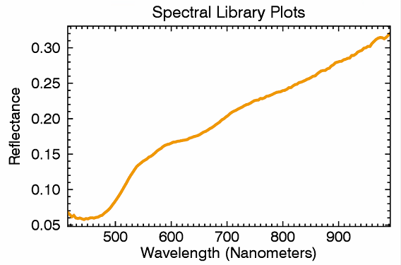
Hyperspectral Imaging
Notes:
See cube. Digital imaging (spatial) + spectroscopy (spectral)
Click, show 2 examples. Obtain full spectrum instead of 1 or 3 values as in digital imaging.

Slide 7
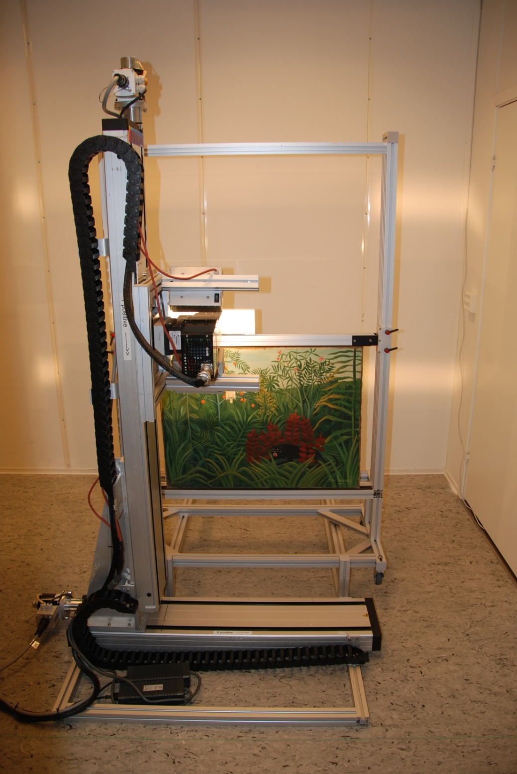
Art scan setup
Main system components:
XY linear skanner: 100cm horizontal, 150cm vertical
HySpex VNIR and/or SWIR camera
Close-up lenses and polarizers
Light source
Data Acquisition Computer
Software:
HySpex for data acquisition
HySpex for calibration
ENVI for analysis (third party)
Optional: Dedicated processing computer and servers for archiving
Full syncronization between camera speed and scanning movement.
Reflectance
reference
Lamps
HySpex
Instrument
Mounting frame
for painting
Y-scanning stage
X-scanning stage

Slide 8
Spectral acqusition

Slide 9
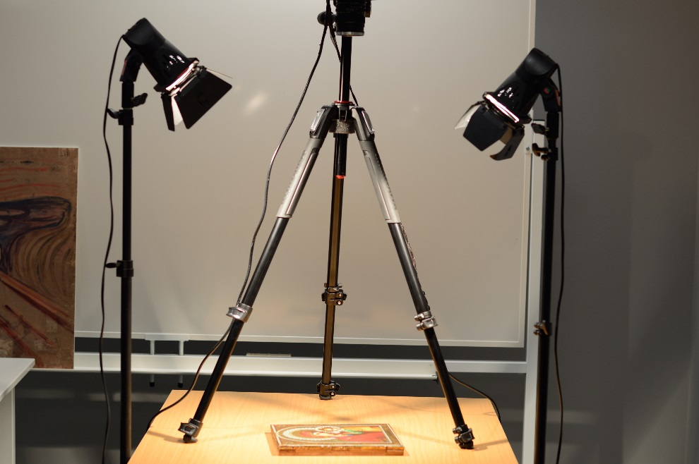
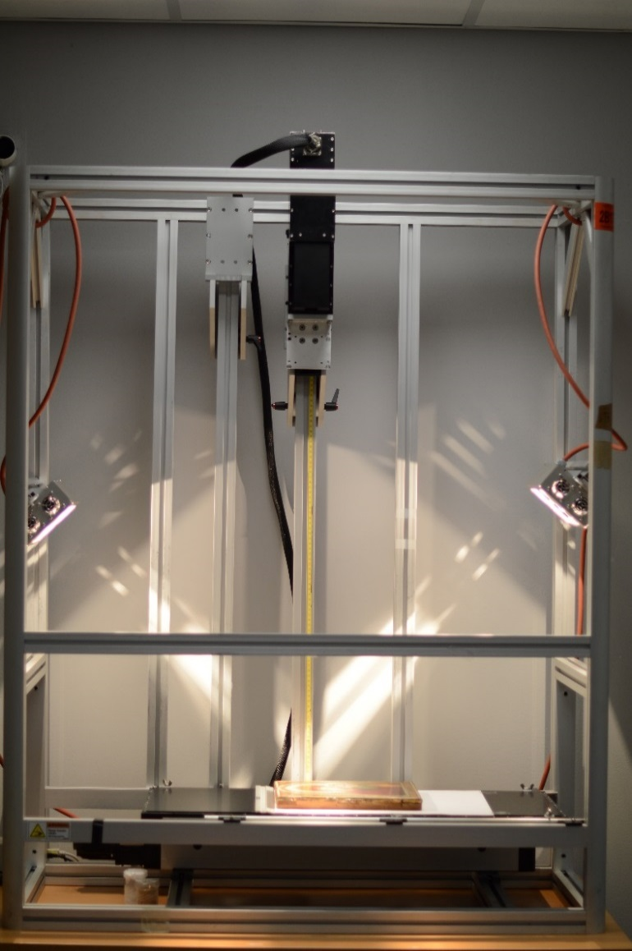
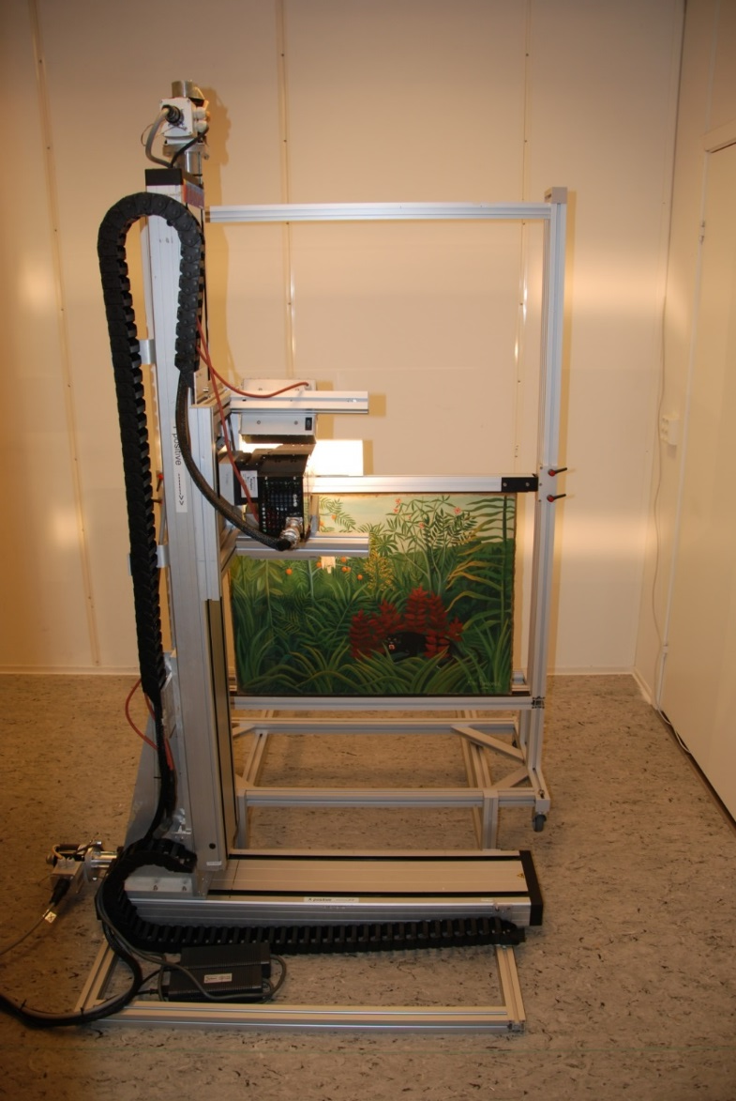
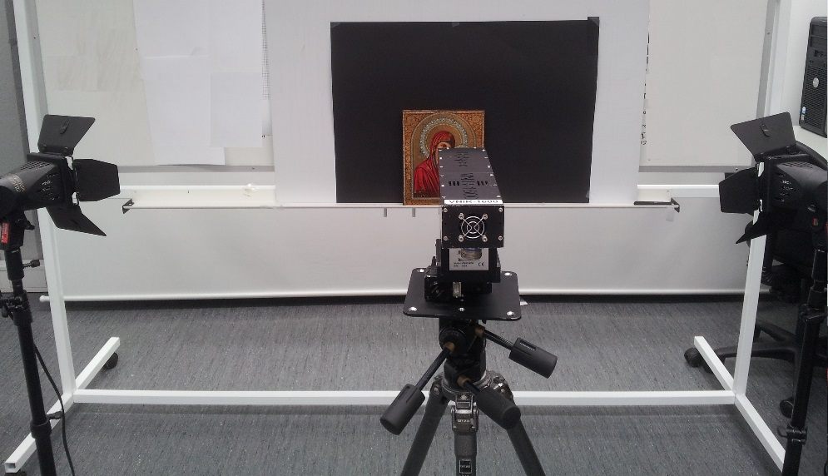
Camera Configurasjons

Slide 10
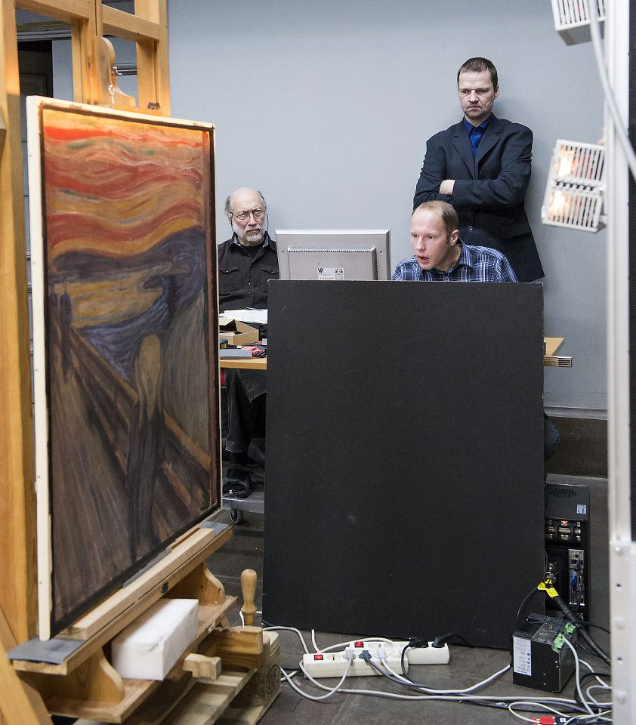
Hyperspectral imaging of ‘The Scream’

Slide 11
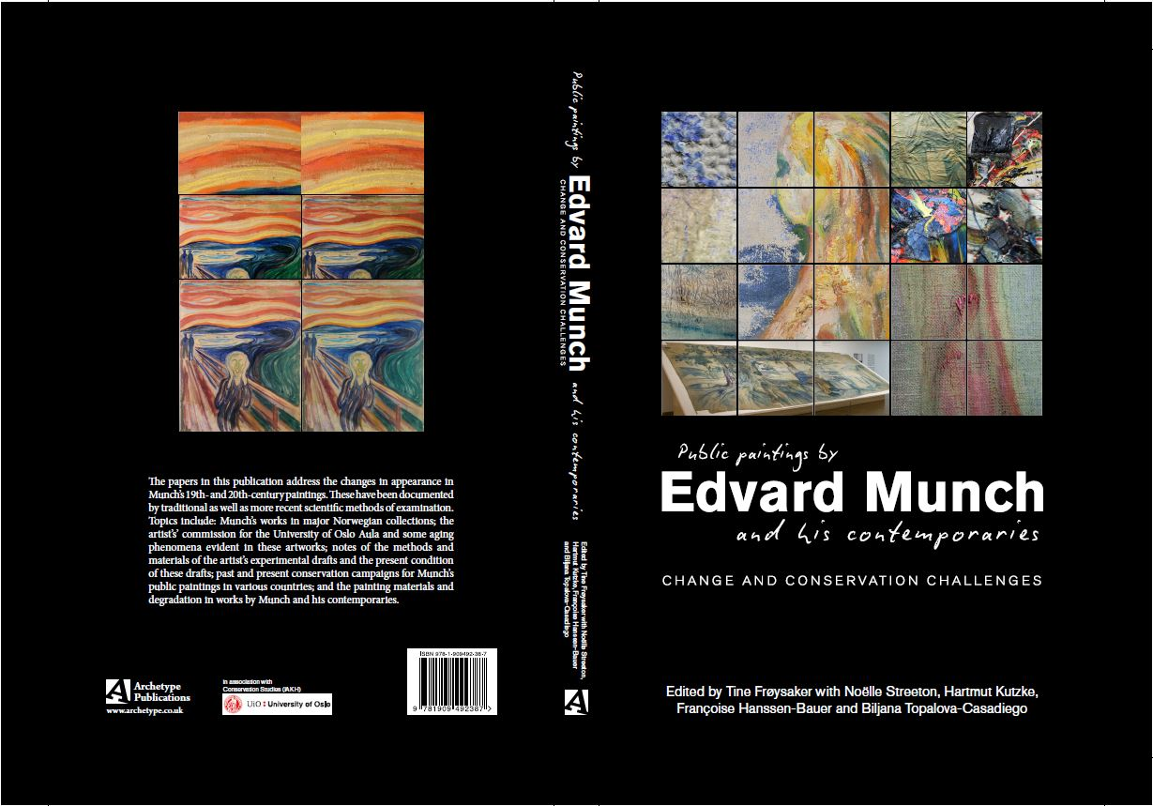
Spectral Scream:Hyperspectral image acquisition and analysis of a masterpiece.
December 2015

Slide 12
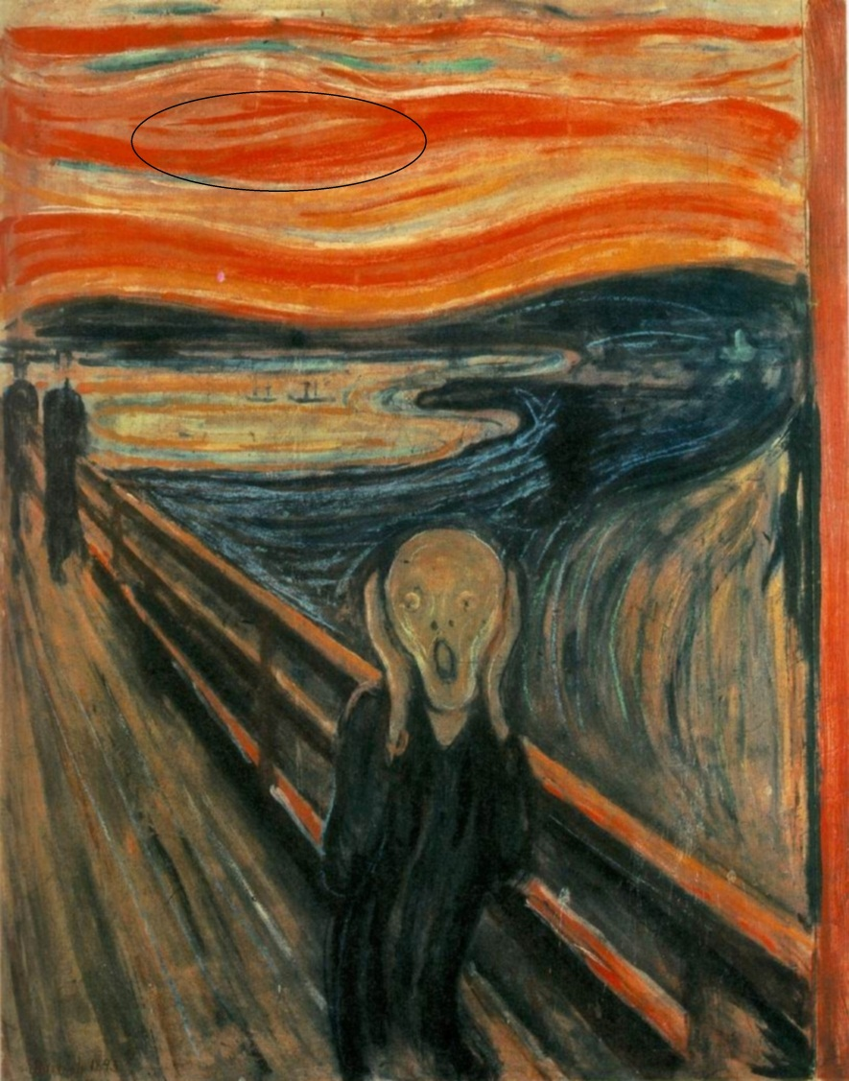
Wordings in ‘The Scream’
Jon Yngve Hardeberg, Sony George, Ferdinand Deger, Ivar Baarstad, Julio Ernesto Hernandez Palacios, Spectral Scream:Hyperspectral image acquisition and analysis of a masterpiece. To appear in “Public paintings by Edvard Munch and some of his contemporaries. Changes and conservation challenges,” Tine Frøysaker, Noëlle Streeton, Hatmut Kutzke, Biljana Topalova‐Casadiego and Françoise Hanssen‐Bauer, eds., Archetype Publications, London, 2014

Slide 13
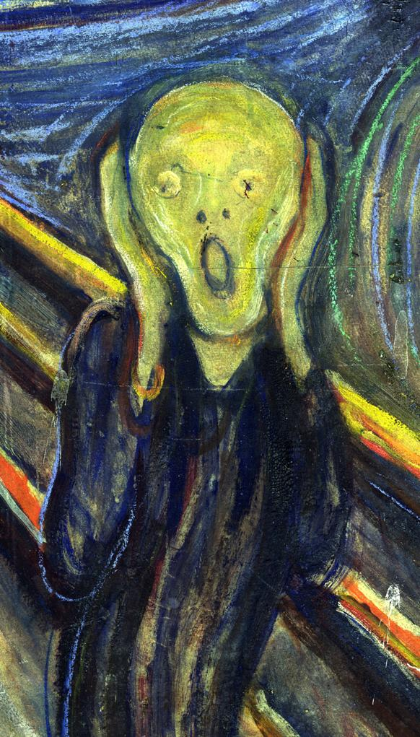
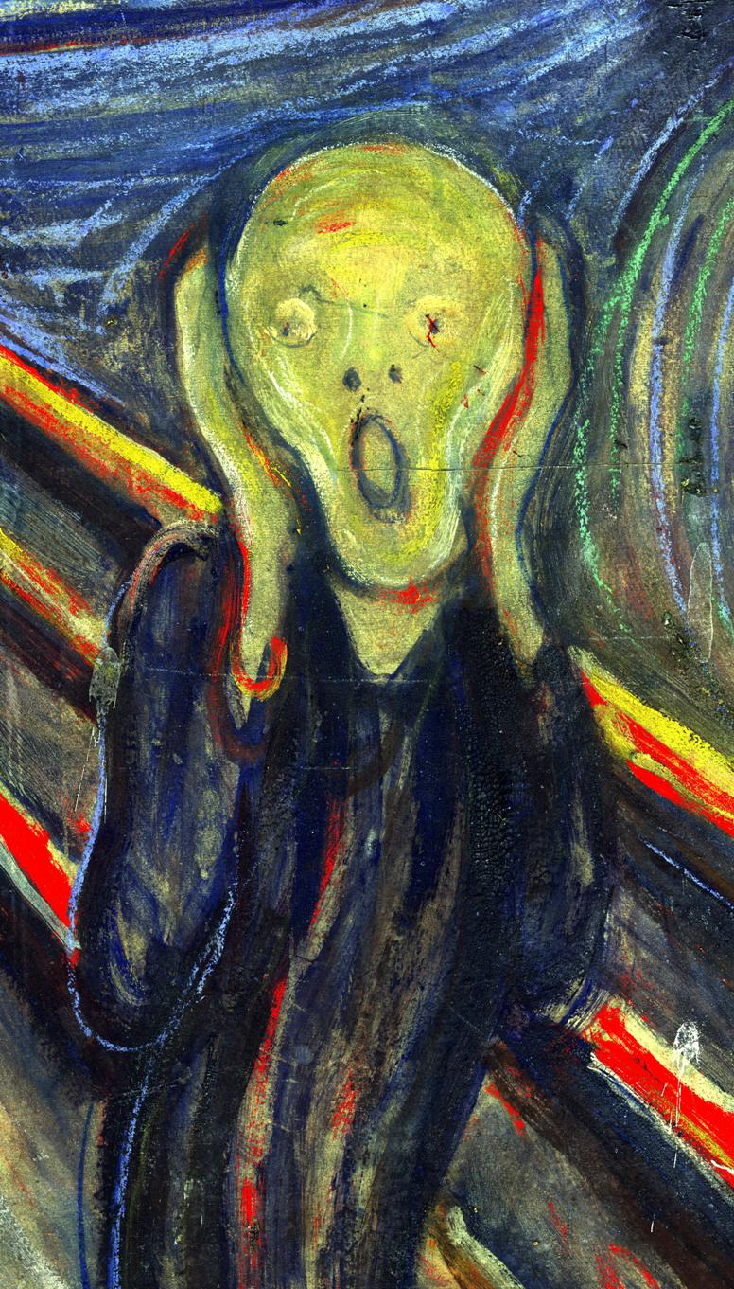
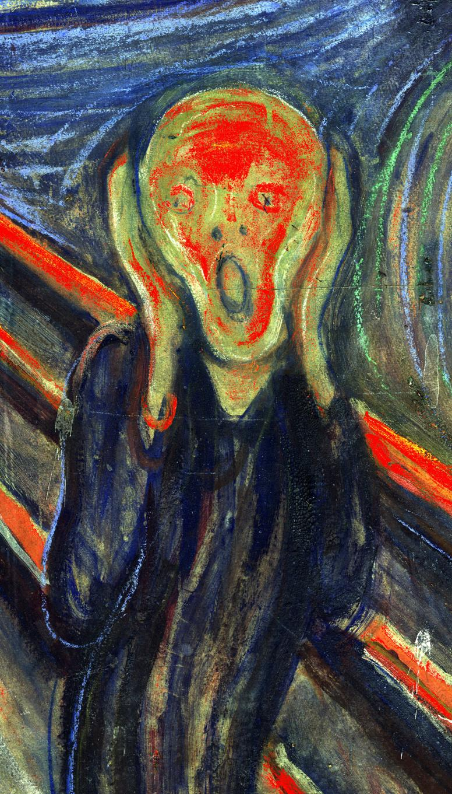
Pigment mapping
Lead white, vermilion
Cadmium yellow
*Pigment Mapping of The Scream (1893) Based on Hyperspectral Imaging , Hilda Deborah, Sony George, Jon Yngve Hardeberg,. Accepted ICISP 2014
Notes:
Vermilion: red pigment
Cadmium yellow: yellow pigment

Slide 14
Pigment locations for invasive studies
*'Investigation of Materials Used by Edvard Munch';Brian Singer, Trond Aslaksby, Biljana Topalova-Casadiego and Eva Storevik Tveit;Studies in conservation 55 (2010)

Slide 15
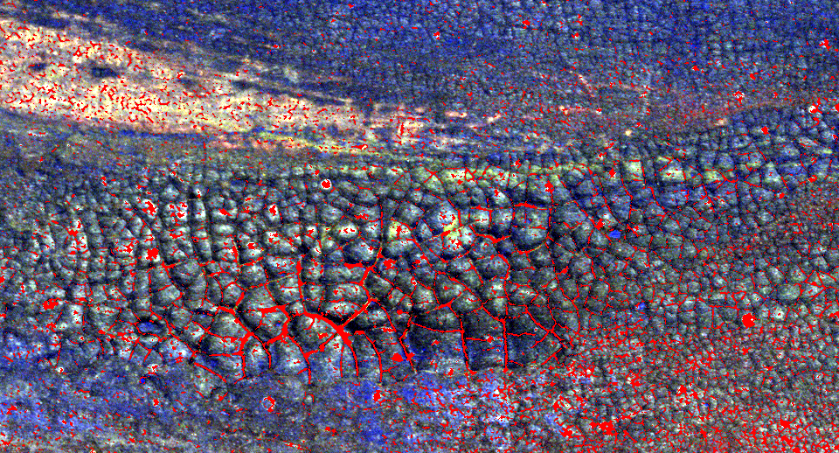
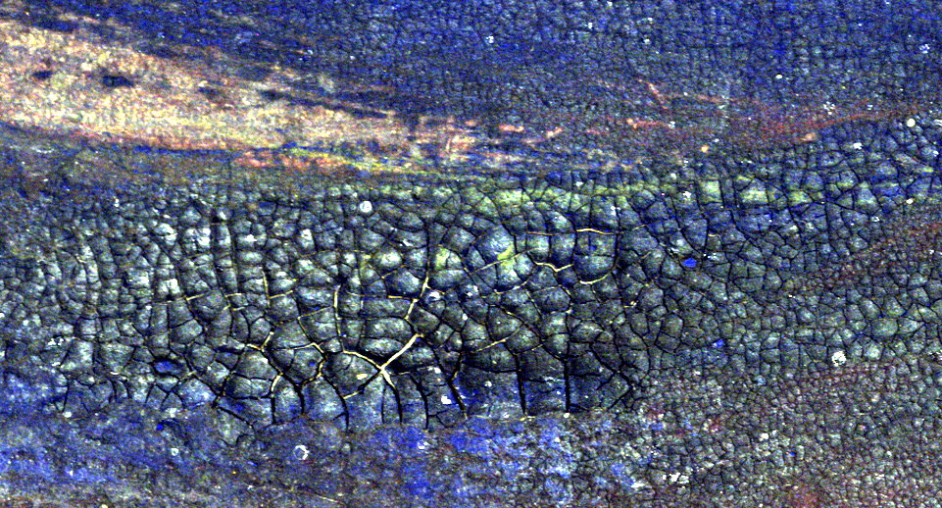
Crack detection

Slide 16
Crack detection

Slide 17
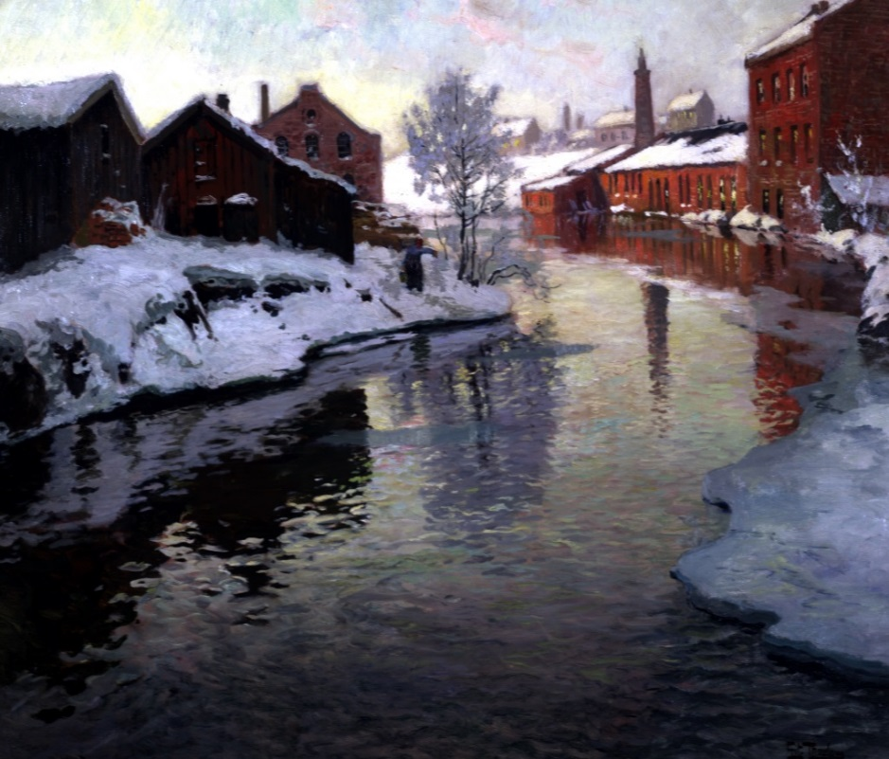
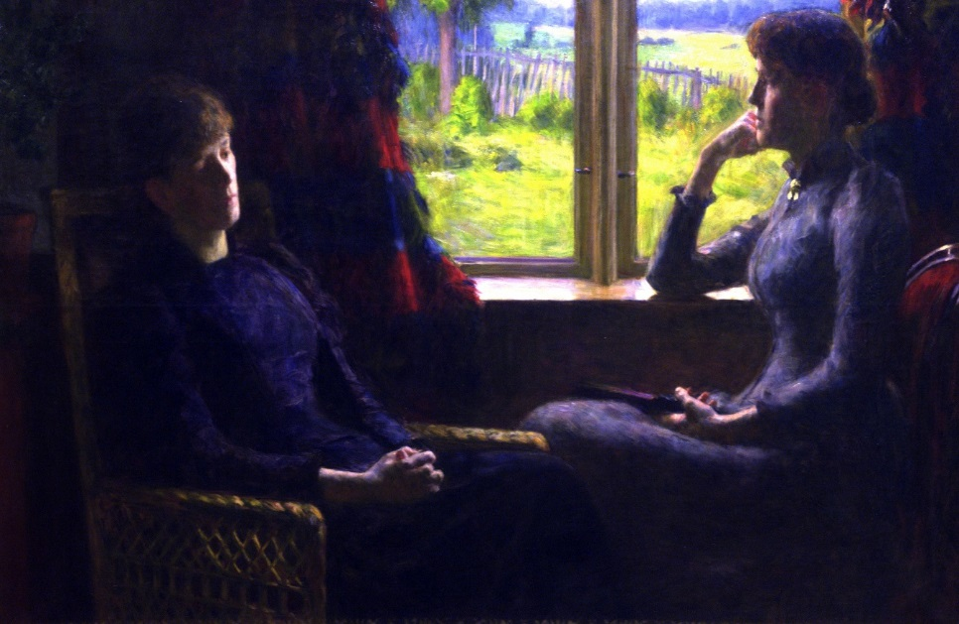
Utsikt fra Fossveien (1881)
Treschows bro (1898)
Minner (1891)

Slide 18
How it looks like if we use these lights?
Calculated_Data_4_LED_with_yellow_LED
GE_F40WAD_FL__6500K__9200_CRI
GE_Standard_Tungsten_TH

Slide 19
How it looks like if we use these lights?
Leelium Daylight_MSR_HMI
Philips Par38_LED
2660K 8400_CRI
ProLite Daylight_SRI30W
Par_30_CFL

Slide 20
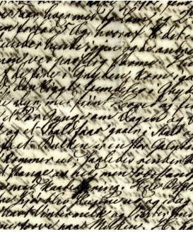
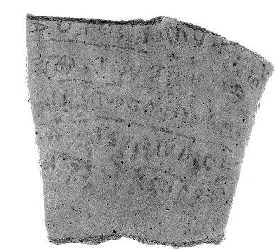
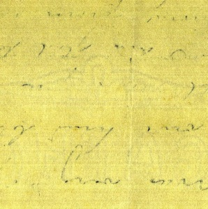
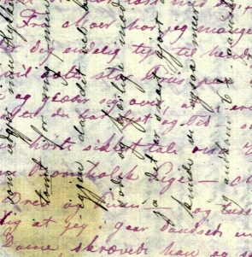
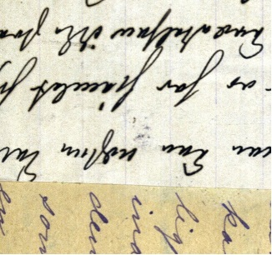
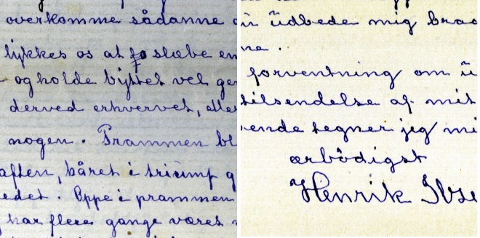
Application of spectral imaging for the analysis of ancient manuscripts
Notes:
My name is Sony George.
Today I would be talking about the Application of spectral imaging for ink separation in ancient manuscripts.
Most of the ancient manuscripts are handwritten and undergoing several kind of changes over time.

Slide 21
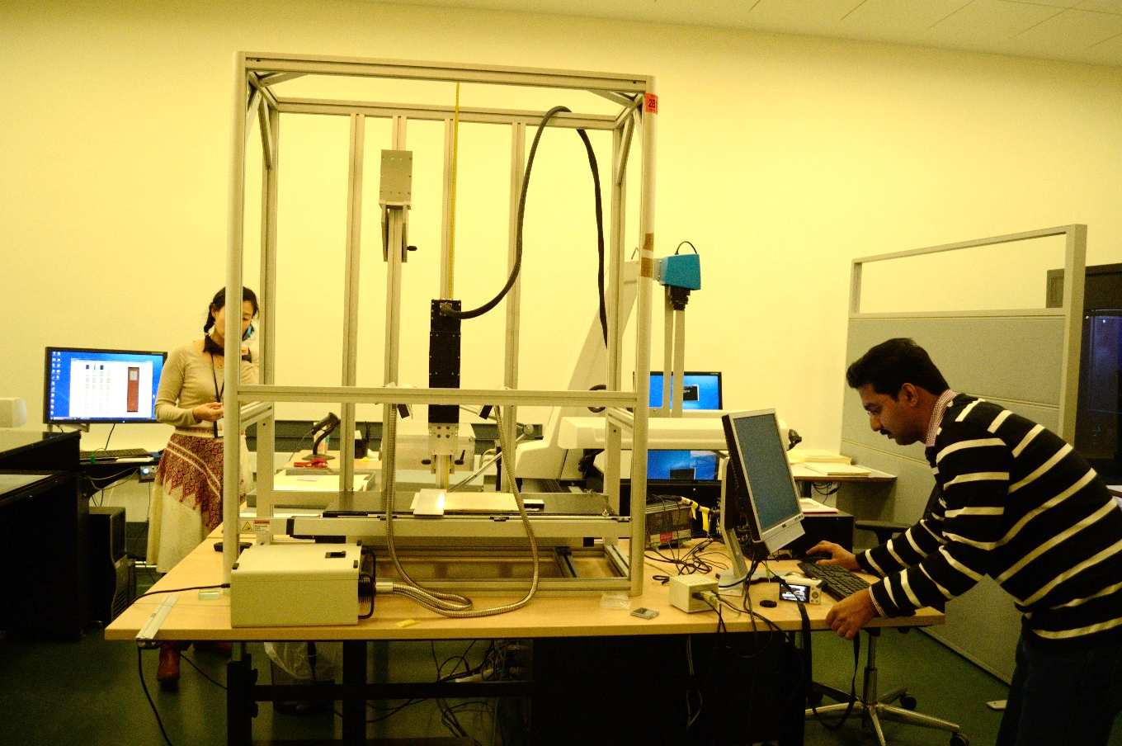
Spectral aquisition at National Library
Notes:
HySpex VNIR 1600

Slide 22
Ink Separation
“Brev fra Munch, Nathalia (1812-1900) til Munch, Peter Andreas (1810-1863)”, dated 27.9.1833

Slide 23
Visualisation at different illuminants
Notes:
We tried to see how the manuscript looks like in different illuminants
Sometimes the ambient light makes things further bad.
Right side, both inks looks like almost the same

Slide 24
Band selection ?
512 nm
730 nm

Slide 25
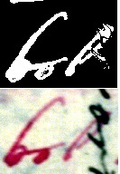
SID

Slide 26
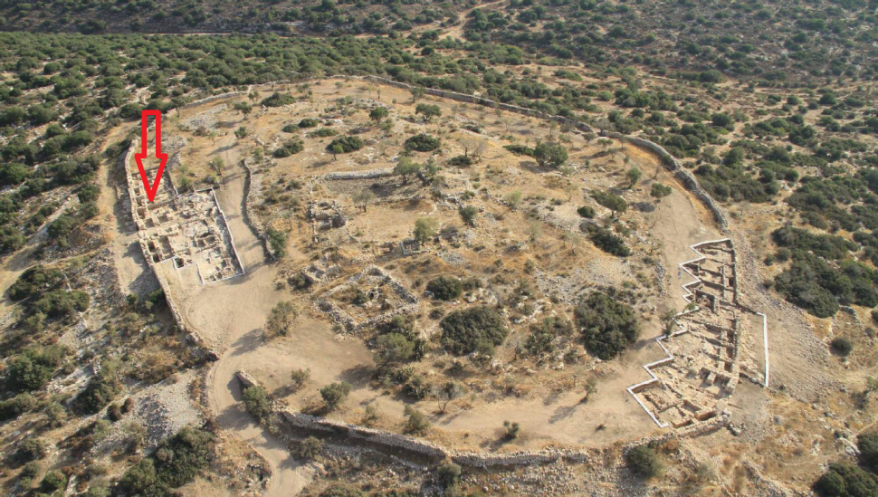
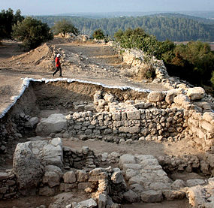
Khirbet Qeiyafa
Khirbet Qeiyafa (Elah Fortress) is the site of an ancient city overlooking the Elah Valle - (32 km) from Jerusalem
Covers nearly 6 acres
Encircled by a 700 meter long city wall constructed of stones weighing up to eight tons
Estimated historical period: 10th-century BCE

Slide 27
Improve readability of Ostracon
Dimension: 15 x 16 cm
The text :
Written in ink
Poorly preserved and difficult to read
5 lines of text separated by draw underlines
The longest Proto-Canaanite Inscription ever found
The earliest Hebrew inscription known to date
*Spectral Image Analysis and Visualisation of the Khirbet Qeiyafa Ostracon, Sony George, Ana Maria Grecicosei, Erik Waaler, and Jon Yngve Hardeberg, -ICISP 2014

Slide 28
Missing characters?

Slide 29
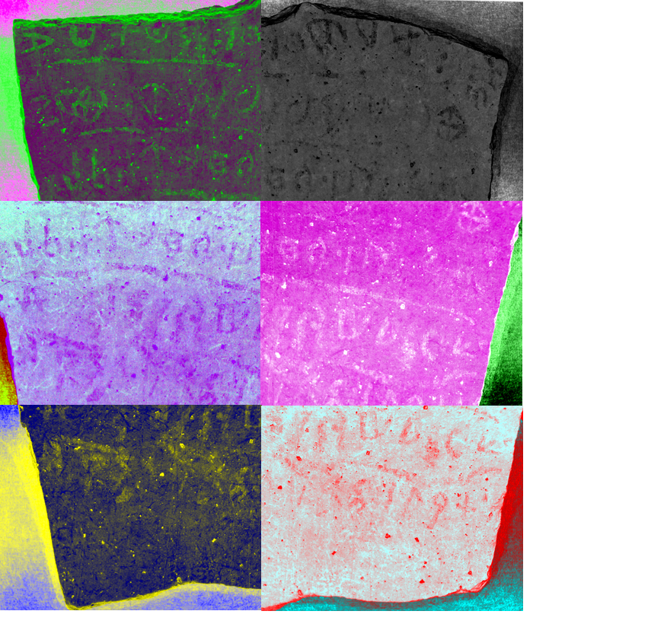
Mathematical image processing and visualization

Slide 30
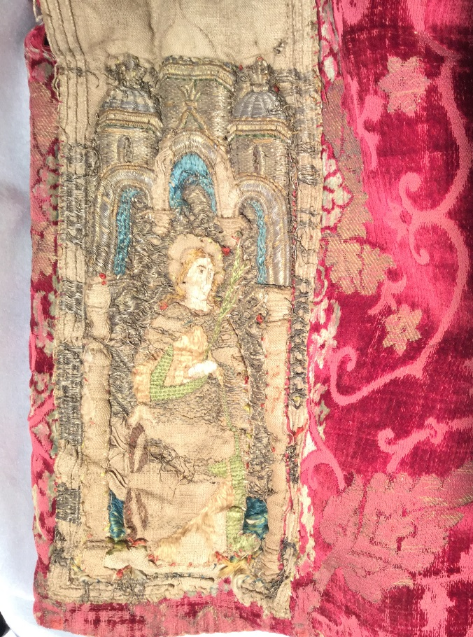
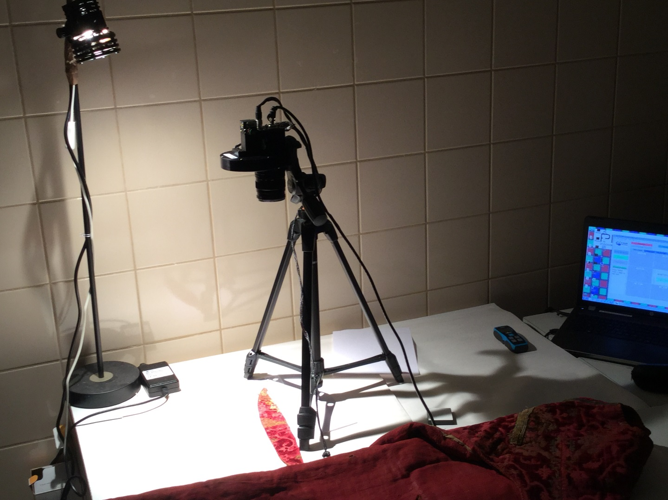
National museum of history: Bucharest

Slide 31
Colour and Space in Cultural Heritage (COSCH)
European Union COST-Action TD 1201:
Precise and complete documentation of artefacts for conservation and preservation of our cultural heritage (CH).
Access to the best possible documentation of artefacts this Action is contributing to the enhanced understanding of material CH and helps its long-term preservation.
http://www.cosch.info
2012-2016

Slide 32
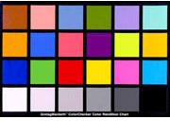
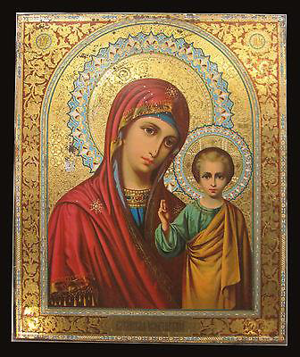
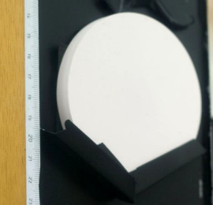
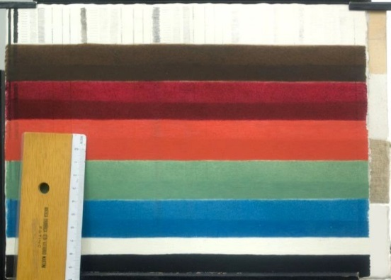
COSCH - RRT test elements
1: Rare Earth Elements panel (Spectralon)
2: X-Rite ColorChecker® CLASSIC
3: X-Rite White Balance
4: Painted test panel – medieval Tuscan technique on wood
SBSAE Restoration Labs, Florence
5: Antique Russian Icon "Virgin of Kazan" (1899) print on copper plate
Notes:
Every target gives different information regarding quality: (Motivation for the selection is in next slide)

Slide 33
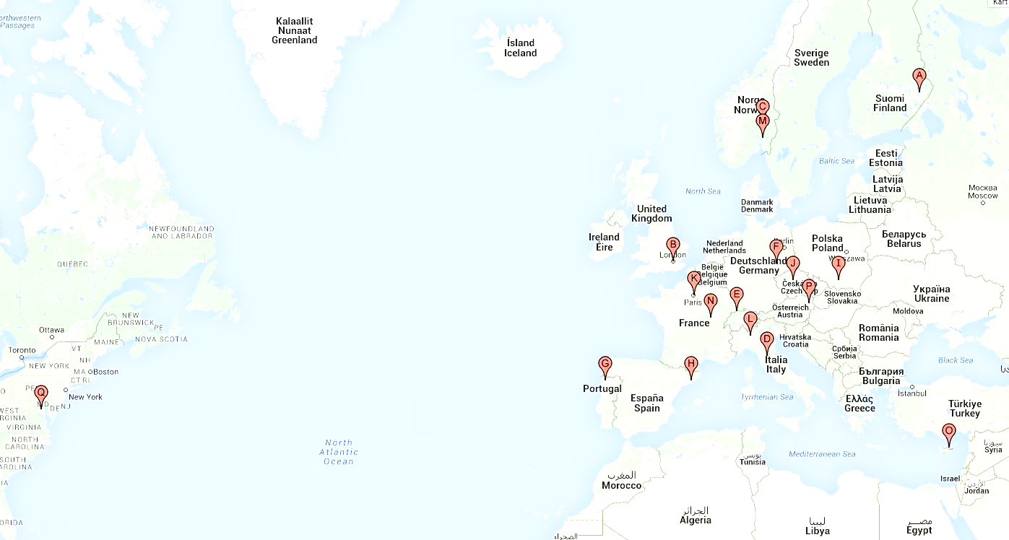
University of Eastern Finland, Joensuu, Finland
UCL London, UK
Gjøvik University College, Norway
IFAC-CNR, Florence, Italy
Imaging & Media Lab, Universität Basel, Switzerland
University of Leipzig, Germany
University of Minho, Braga, Portugal
CD6-UPC, Terrassa, Spain
Museum in Krakow, Poland
Institute of Theoretical and Applied Mechanics of the Academy of Sciences, Czech Republic
Centre de Recherche et de Restauration des Musées de France, Musée du Louvre, Paris, France
CRCC, Paris
University of Milan - Bicocca, Italy
Norsk Elektro Optikk AS, Norway
University of Burgundy, France
STARC, The Cyprus Institute, Cyprus
Academy of Fine Arts, Vienna, Austria
Czech Technical University in Prague, Czech Republic
Smithsonian Institution, Washington DC

