Slide 1
The Norwegian Colour and Visual Computing Laboratory and
Cultural Heritage related activities
Sony George
sony.george@ntnu.no
www.colourlab.no

Slide 2
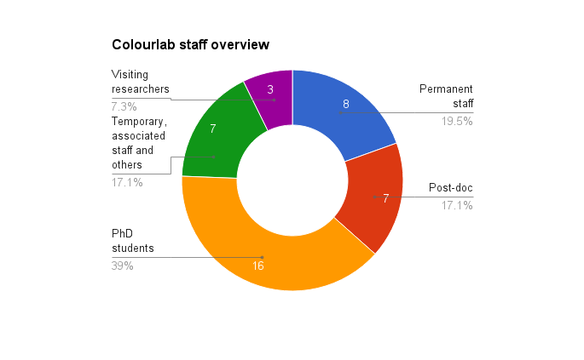
The Norwegian Colour and Visual Computing Laboratory
Established at Gjøvik University College (GUC) in 2001 to serve the graphic arts industry’s need for colour management
Research group at Department of Computer Science, NTNU, Gjøvik
Fundamental and applied research within colour science and image/video processing
Well equipped laboratory facilites
  Colour and spectral measurement, Colour management software, viewing booths, image acquisition and reproduction devices, etc.
International, national, and regional collaboration with industry and academia
Website: www.colourlab.no
Numbers from January 2017

Slide 3
Research areas
Colour, image, video
Cultural heritage
Medical imaging
Graphic arts
Security

Slide 4
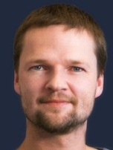
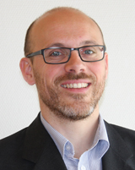
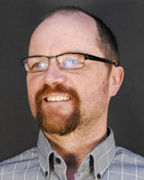
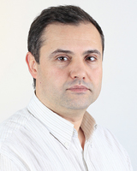
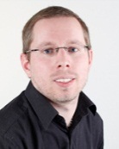
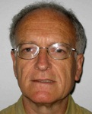
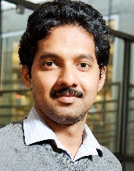
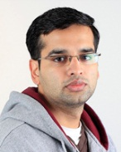
Permanent faculty
Professor Jon Y. Hardeberg
  Multispectral color imaging
  Image difference metrics
Associate Professor Peter Nussbaum
  Colour management
  Print quality
Associate Professor Marius Pedersen (lab director)
  Image quality/difference metrics
  Print Quality
Associate Professor Sony George
  Cultural heritage imaging
  Spectral imaging
Professor Ivar Farup
  Colorimetry
  Spatial gamut mapping
  Colour image processing
Associate professor Faouzi Alaya Cheikh
  Video and image processing
  Compression
  Quality
Professor Phil Green
  Colour management
  Color science
Project manager Aditya Sole
  Printing, soft-proofing
  Gonioradiometry

Slide 5






COSI (COlour in Science and Industry)
A two-year scientific
Erasmus+ Master Degree
Aiming to train the next generation of highly-skilled industrial experts in applied colour science.
Two focus areas:
  spectral technologies and applied colour imaging.
Academic partners:
  University of Saint-Etienne (France, coordinator), the University of Granada (Spain), the University of Joensuu (Finland), and NTNU (Norway)
Associated industrial partners:

Slide 6
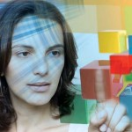
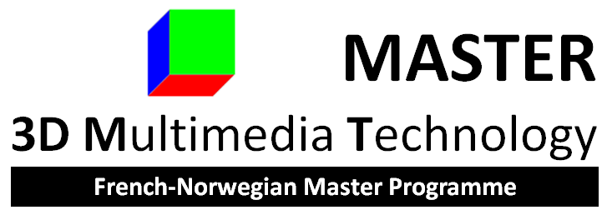
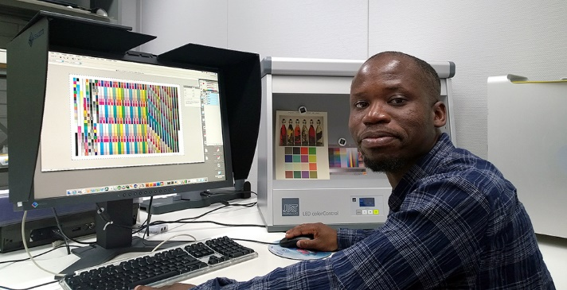
3D multimedia technology
Two-year Master in 3D Multimedia Technology (3DMT).
The objective is to educate students in advanced methodologies and models in computational 3D imaging.
Collaboration between University Jean Monnet Saint-Etienne (France) and NTNU.
  First year in France, third semester in Norway, the fourth semester in France, Norway or another country.

Slide 7
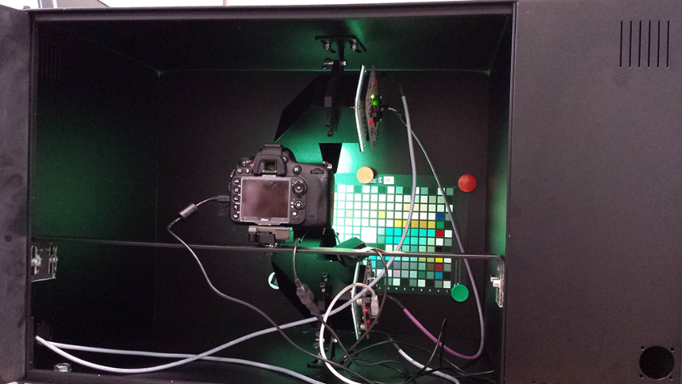
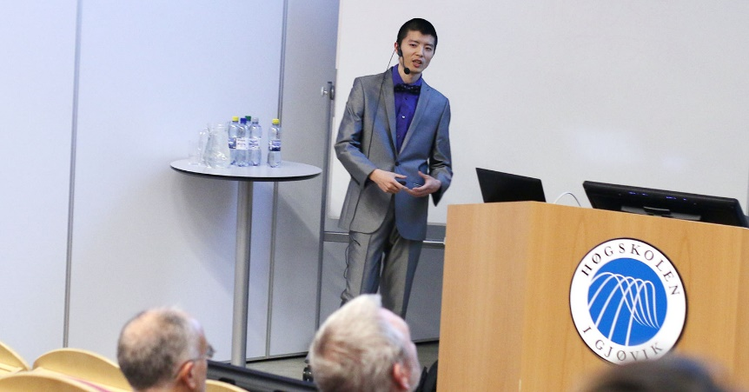
PhD Computer Science
Three year PhD study in Computer Science
The research includes, but not limited, to the following areas:
  Color science and imaging
  Image and video processing
  Computer graphics
  Information security
  Robotics
Two components:
  a research component
  a taught component
Offered as full-time or part-time basis.

Slide 8
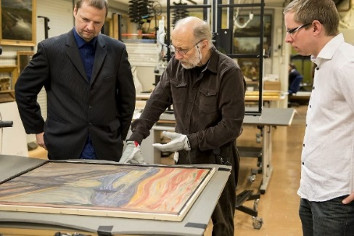
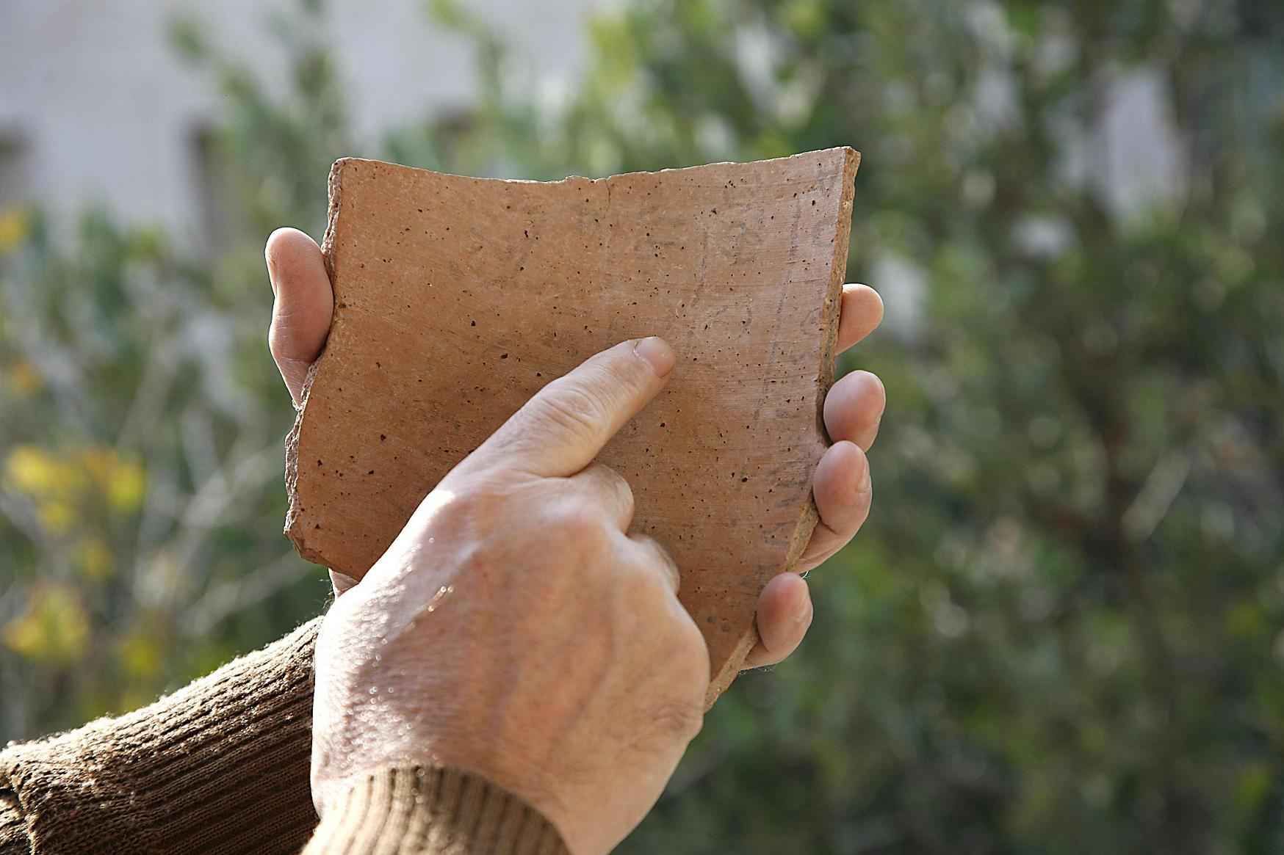
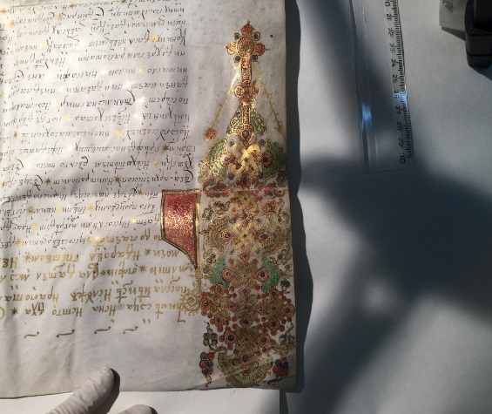
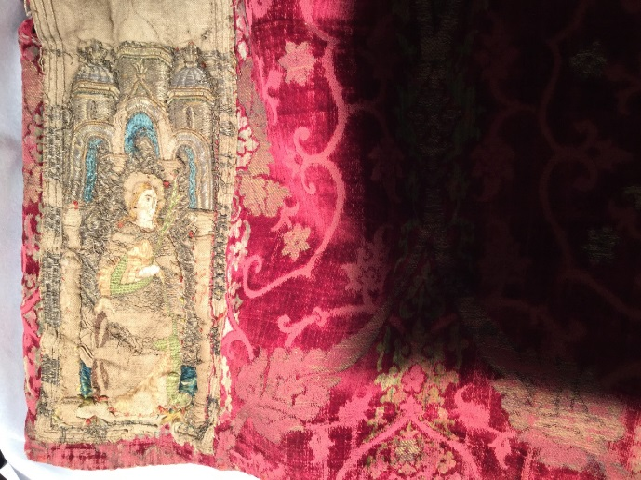
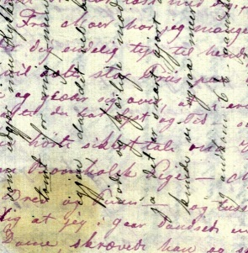
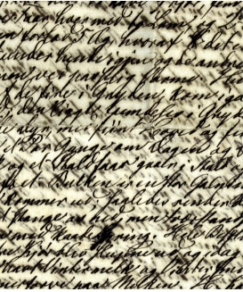
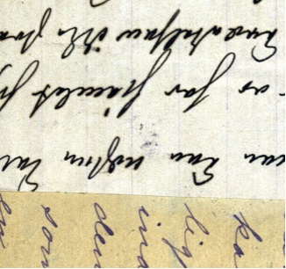
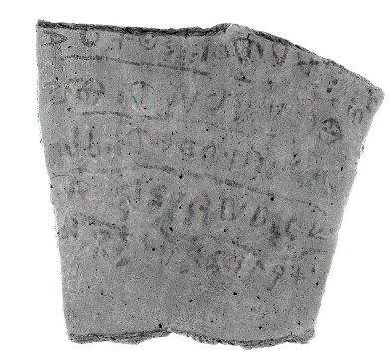
CHI @ Colourlab

Slide 9
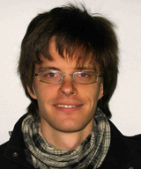
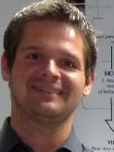
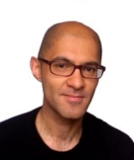
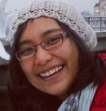
Researchers working on CH topics
Ferdinand Deger
Cultural heritage,
Spectral imaging
Gilles Pitard
  CH and material appearance
Hilda Tobing
  Cultural heritage, multispectral imaging,mathematical morphology
Ruven Pillay
  Cultural heritage,
  multispectral imaging

Slide 10

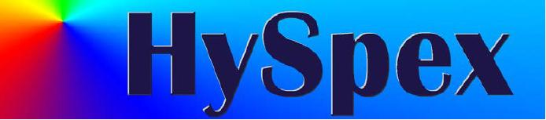




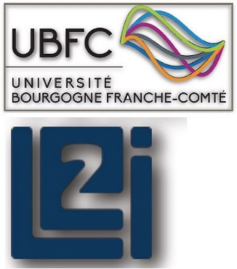


Slide 11
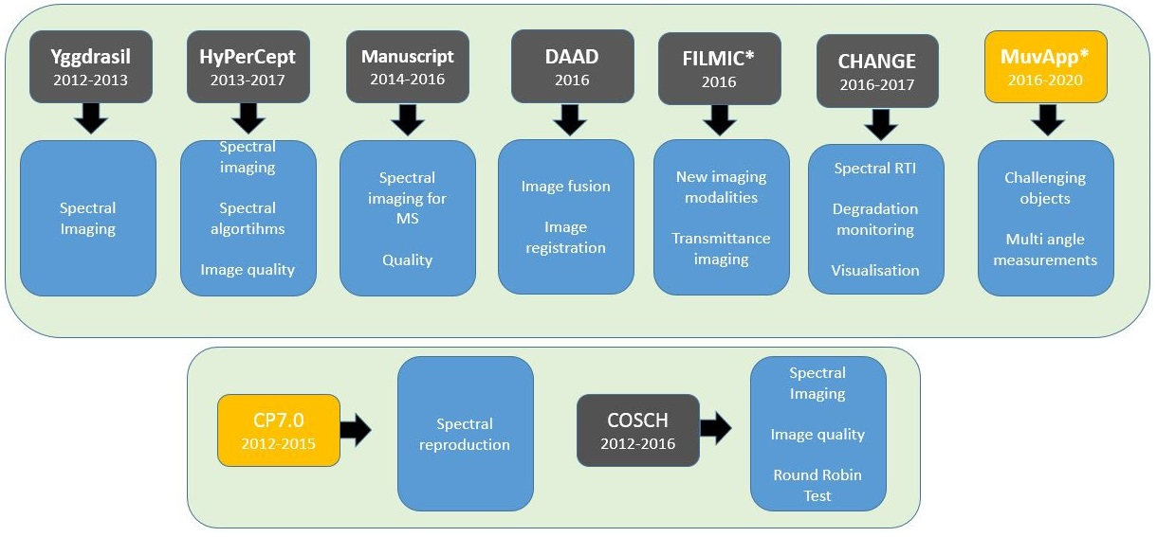
Recent projects related to CH

Slide 12
Why do we do this ?
High image resolution and penetration
Examination the under paintings
Hi- fi reproduction of CH artefacts
Non-destructive material identification
Virtual Museum and virtual restoration
Study the effect of ambient light
Change monitoring
Forgery detection

Slide 13
Acquisition
Analysis

Slide 14
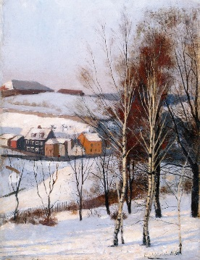
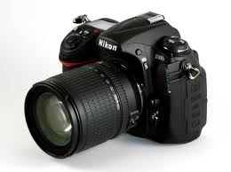
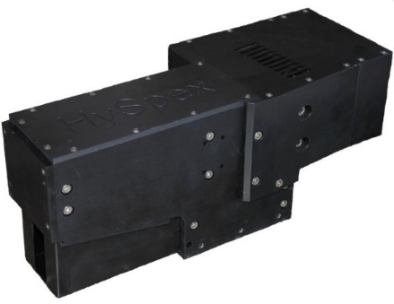
Spectral imaging
Acquisition
K= 3
RGB
Camera
RGB image
K > 10
Hyperspectral
Camera
Hyperspectral image

Slide 15
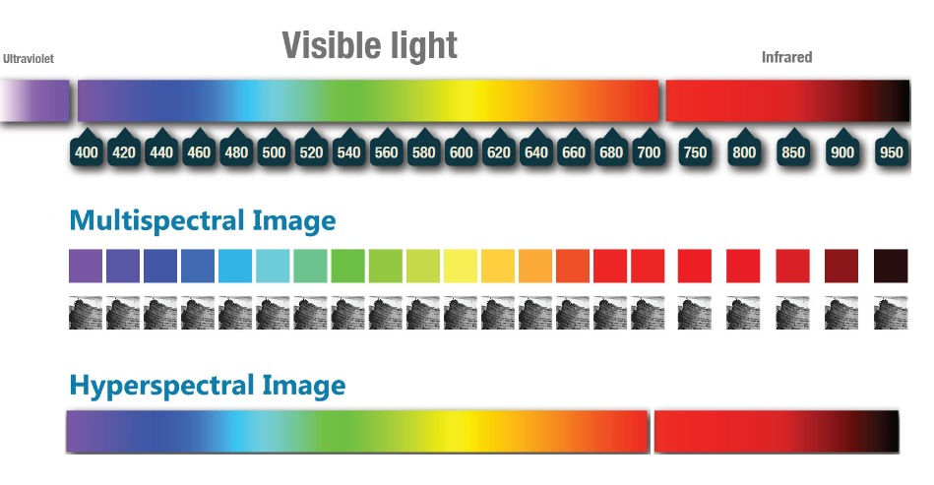

Slide 16

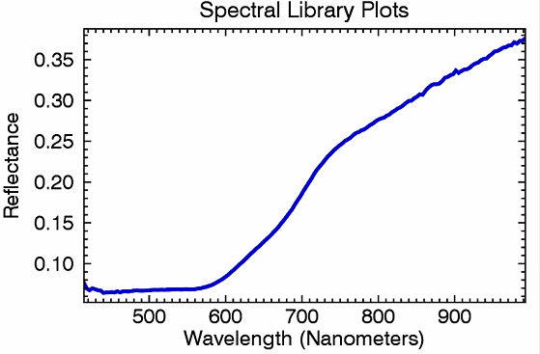
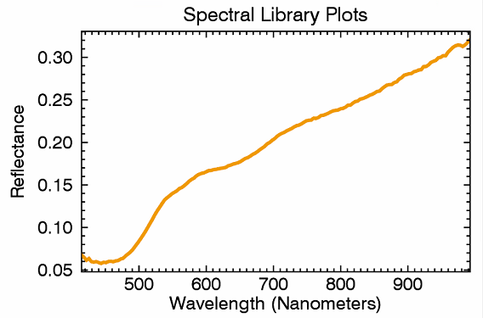
Hyperspectral Imaging

Slide 17
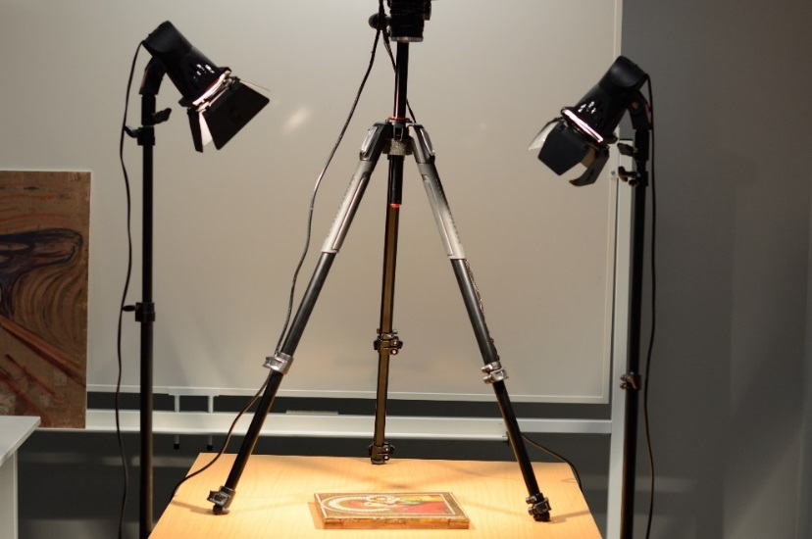
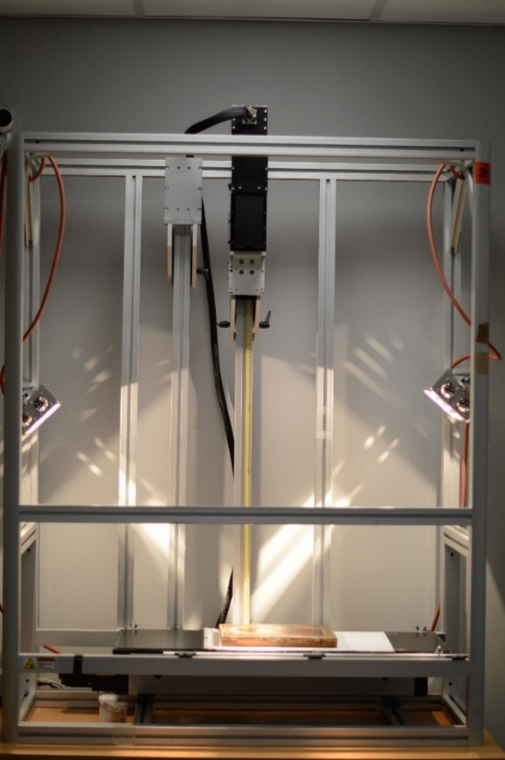
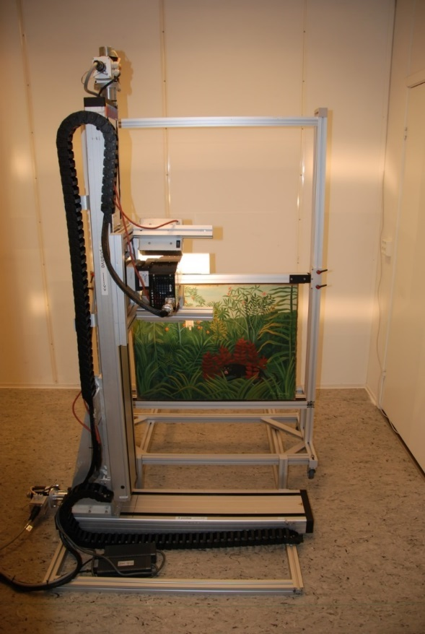
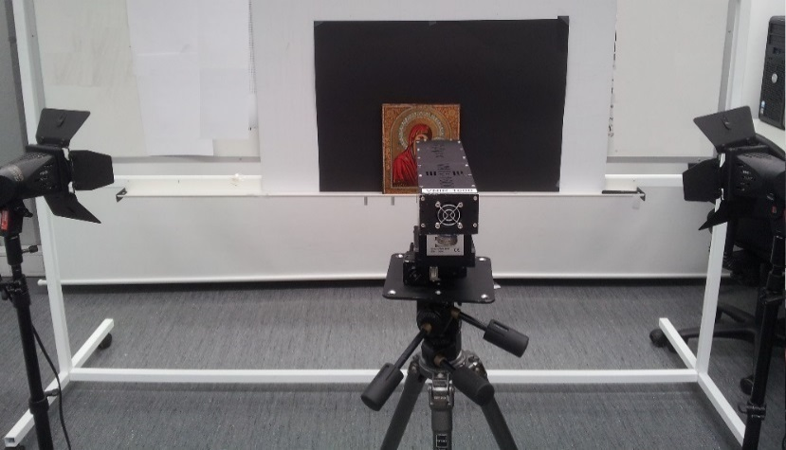
Camera configurasjons

Slide 18
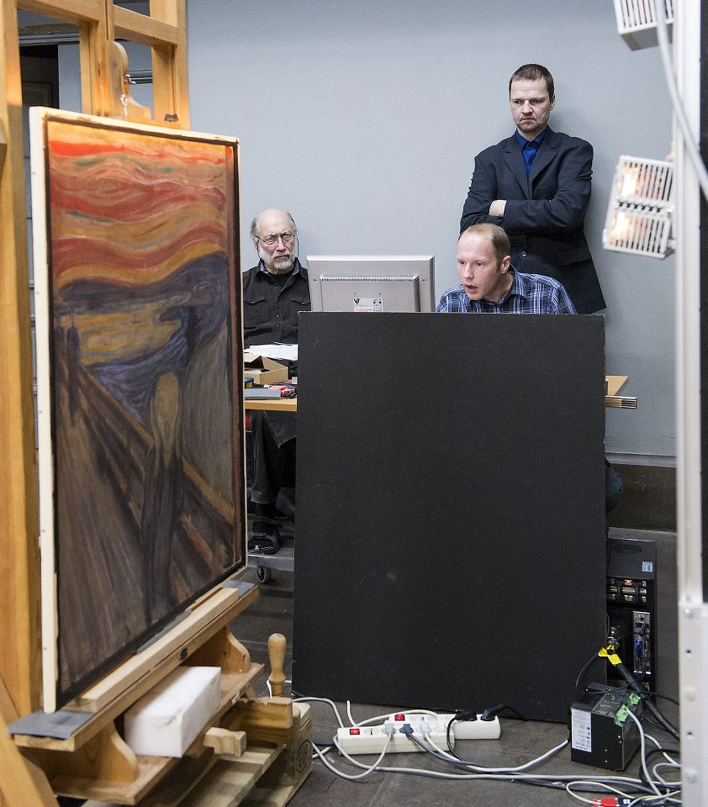

Hyperspectral imaging of ‘The Scream’

Slide 19
Analysis
Visualisation
Material identification
Reproduction
Quality of Digitisation

Slide 20
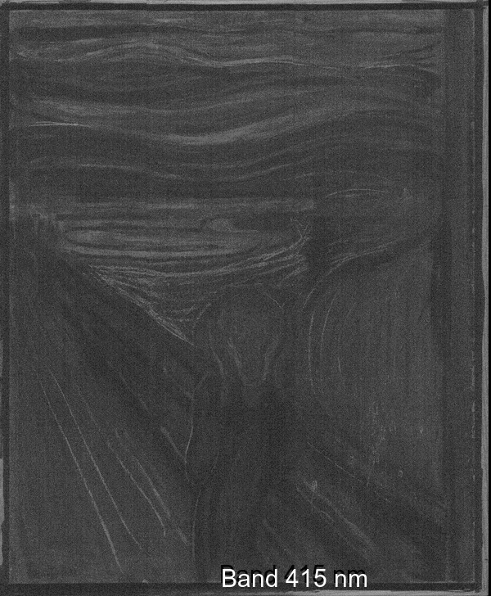


Visualisation
UV Vis
Varnish
Paint layer
Underlaying drawing,
imprimitura
Preparation
Wood support
Attas, Michael, et al., et al. Spectroscopic Imaging in Art Conservation: A New Tool for Materials Investigation. Leonardo: Journal of the International Society for the Arts, Sciences and Technology. 2003, Vol. 36, 4, 304-307.

Slide 21
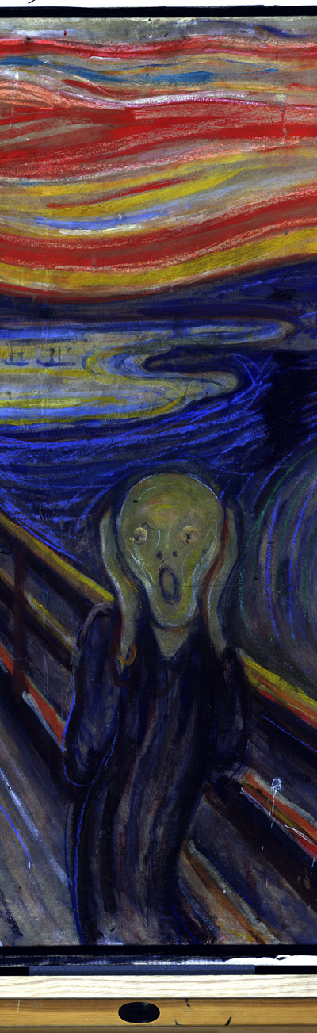
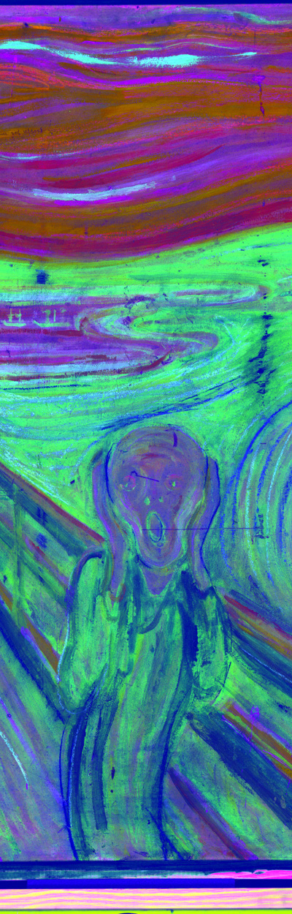
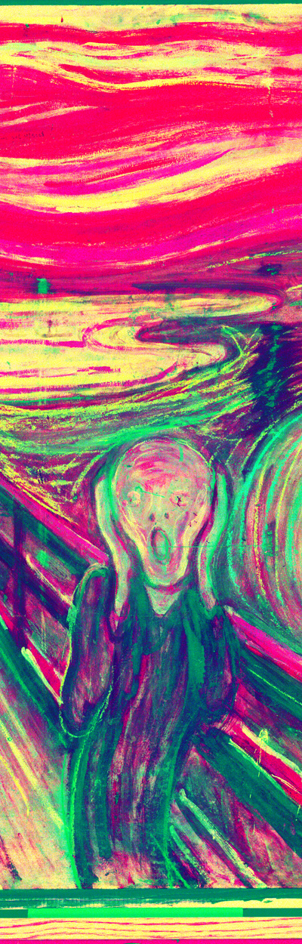
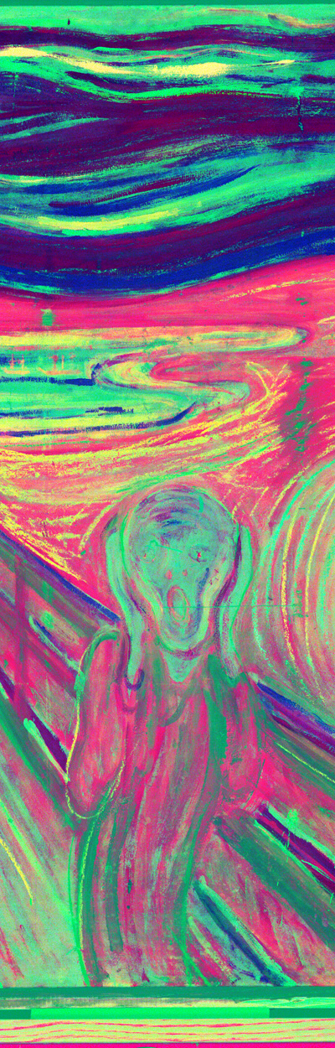
False color visualisation

Slide 22

Improve readability of Ostracon
Dimension: 15 x 16 cm
The text :
  Written in ink
  Poorly preserved and difficult to read
  5 lines of text separated by draw underlines
  The longest Proto-Canaanite Inscription ever found
  The earliest Hebrew inscription known to date
*Spectral Image Analysis and Visualisation of the Khirbet Qeiyafa Ostracon, Sony George, Ana Maria Grecicosei, Erik Waaler, and Jon Yngve Hardeberg, -ICISP 2014

Slide 23
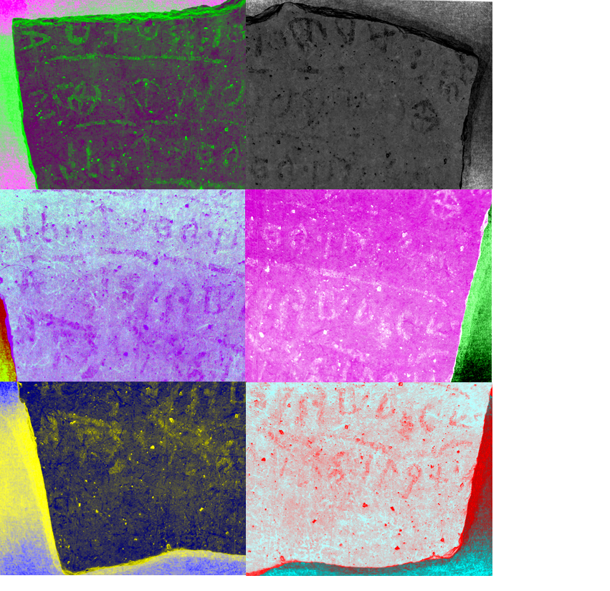
Visualization

Slide 24
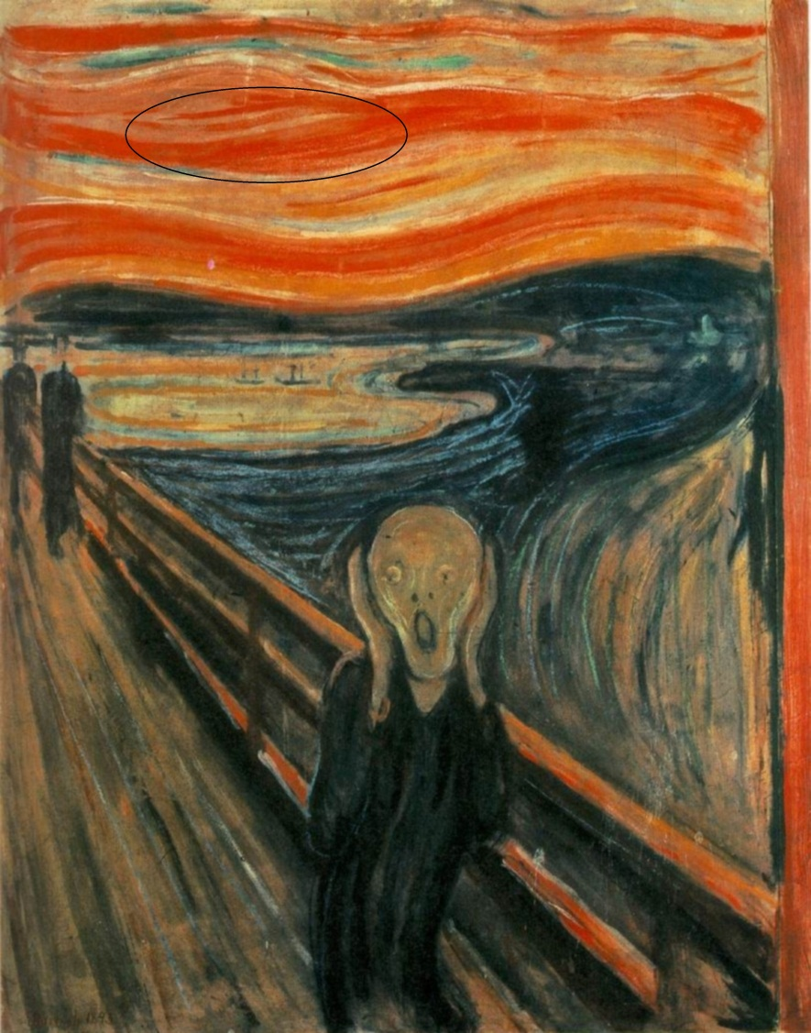
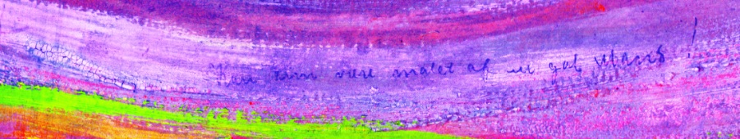
Hidden information?
Jon Yngve Hardeberg, Sony George, Ferdinand Deger, Ivar Baarstad, Julio Ernesto Hernandez Palacios, Spectral Scream:Hyperspectral image acquisition and analysis of a masterpiece. To appear in “Public paintings by Edvard Munch and some of his contemporaries. Changes and conservation challenges,” Tine Frøysaker, Noëlle Streeton, Hatmut Kutzke, Biljana Topalova‐Casadiego and Françoise Hanssen‐Bauer, eds., Archetype Publications, London, 2014

Slide 25
How does the artefact looks like in different illuminants?

Slide 26
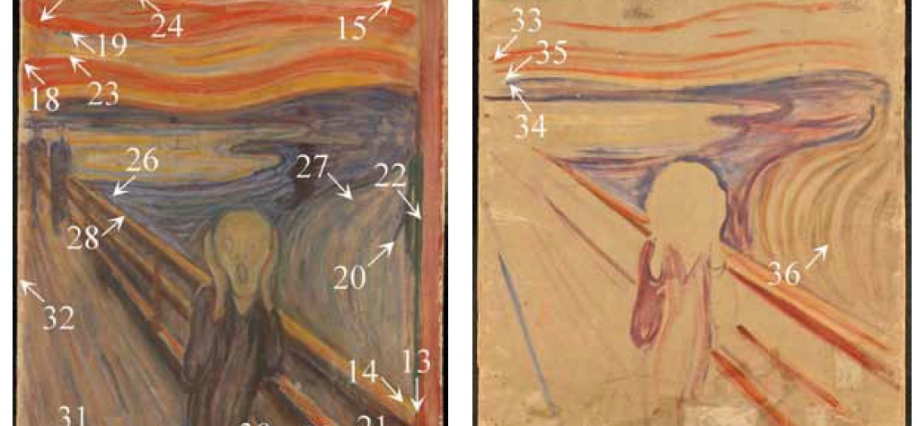
Pigment identification
Pigment locations for invasive studies
*'Investigation of Materials Used by Edvard Munch';Brian Singer, Trond Aslaksby, Biljana Topalova-Casadiego and Eva Storevik Tveit; Studies in conservation 55 (2010)

Slide 27
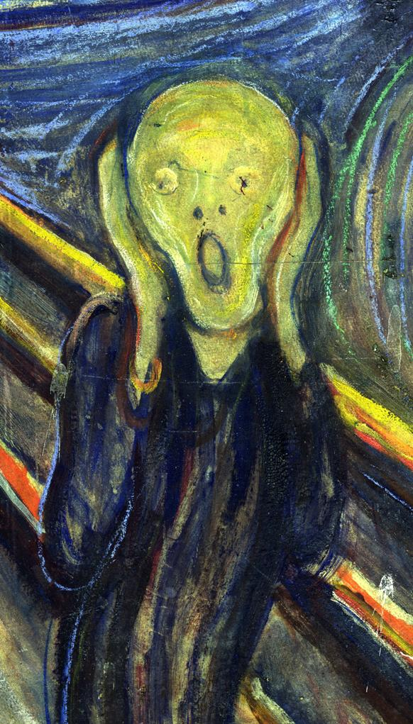


Lead white, vermilion
Cadmium yellow
*Pigment Mapping of The Scream (1893) Based on Hyperspectral Imaging , Hilda Deborah, Sony George, Jon Yngve Hardeberg,. ICISP 2014

Slide 28
Image quality:
Does it satisfies the end user?

Slide 29

Colour and Space in Cultural Heritage (COSCH)
European Union COST-Action TD 1201:
  Precise and complete documentation of artefacts for conservation and preservation of our cultural heritage (CH).
  Access to the best possible documentation of artefacts this Action is contributing to the enhanced understanding of material CH and helps its long-term preservation.
2012-2016
www.cosch.info

Slide 30





COSCH - RRT test elements
1: Rare Earth Elements panel (Spectralon)
2: X-Rite ColorChecker® CLASSIC
3: X-Rite White Balance
4: Painted test panel – medieval Tuscan technique on wood
  SBSAE Restoration Labs, Florence
5: Antique Russian Icon "Virgin of Kazan" (1899) print on copper plate

Slide 31

University of Eastern Finland, Joensuu, Finland
UCL London, UK
Colourlab, NTNU Norway
IFAC-CNR, Florence, Italy
Imaging & Media Lab, Universität Basel, Switzerland
University of Leipzig, Germany
University of Minho, Braga, Portugal
CD6-UPC, Terrassa, Spain
Museum in Krakow, Poland
Institute of Theoretical and Applied Mechanics of the Academy of Sciences, Czech Republic
Centre de Recherche et de Restauration des Musées de France, Musée du Louvre, Paris, France
CRCC, Paris
University of Milan - Bicocca, Italy
Norsk Elektro Optikk AS, Norway
University of Burgundy, France
STARC, The Cyprus Institute, Cyprus
Academy of Fine Arts, Vienna, Austria
Czech Technical University in Prague, Czech Republic
Smithsonian Institution, Washington DC

Slide 32





PushbroomHyper2-UPC
Specim
Colorlab
IFAC-CNR
UEF
C2RMF

Slide 33

A Study of Spectral Imaging Acquisition and Processing for Cultural Heritage; Sony George, Jon Y. Hardeberg, João Linhares, Lindsay MacDonald, Cristina Montagner, Sérgio Nascimento, Marcello Picollo, Ruven Pillay, Tatiana Vitorino and E. Keats Webb; Book chapter (2017)

Slide 34
Future plans
Non flat objects
Appearance capture and reproduction
Digitisation of fims, textiles etc
Dealing with challenging objects
Reuse of existing datasets- Change monitoring
Quality evaluation

Slide 35
Thank you all…..
Acknowledgement
All contributors and collaborators
Funding agencies
Norsk Elektro Optikk AS
COSCH community

