Slide 1
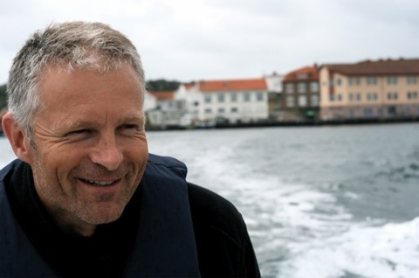
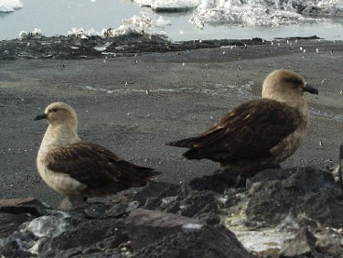
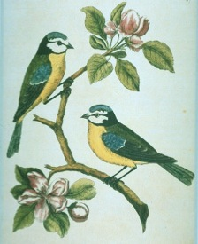
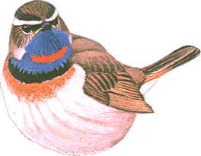
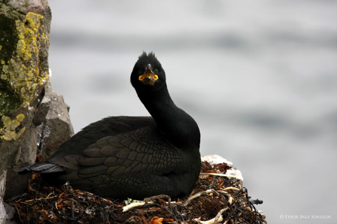
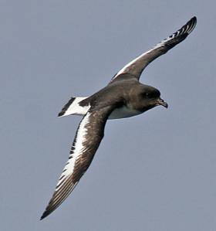
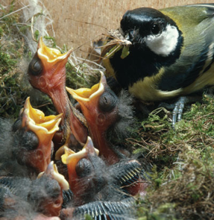
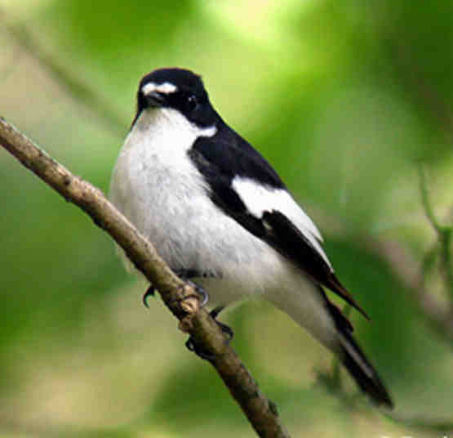
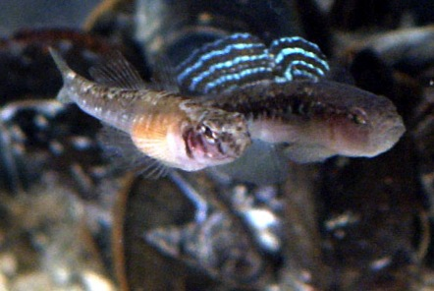
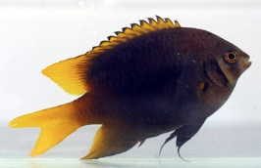

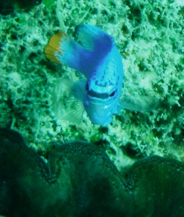




Slide 3
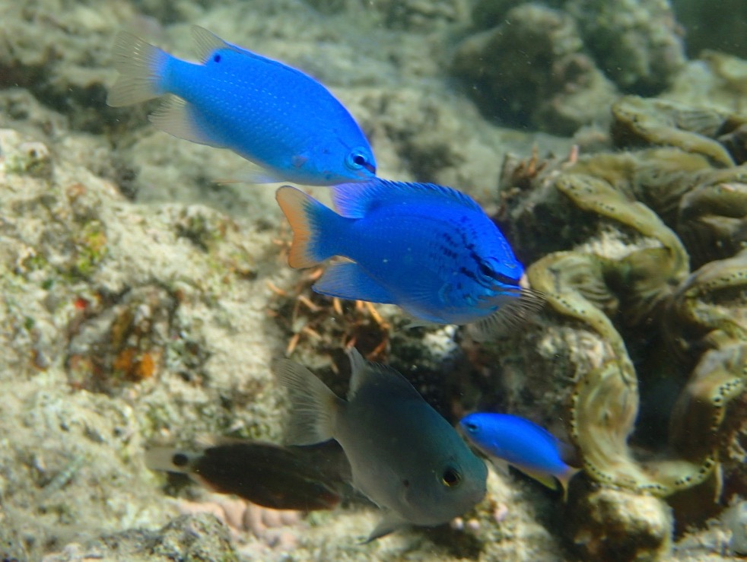

Slide 4
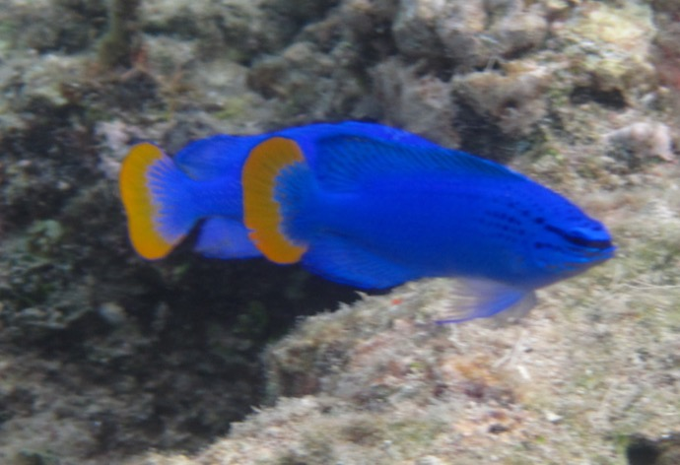
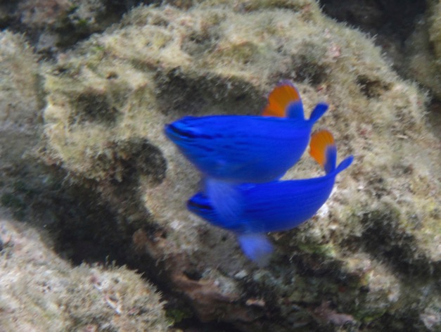
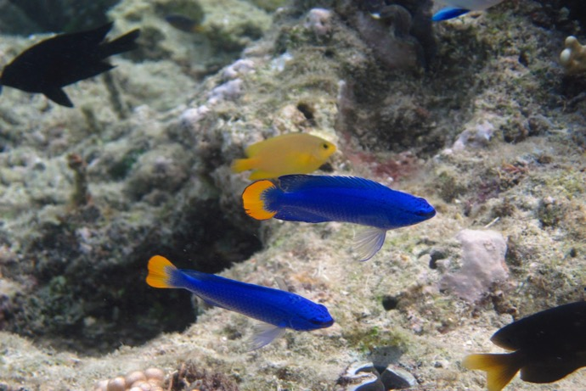
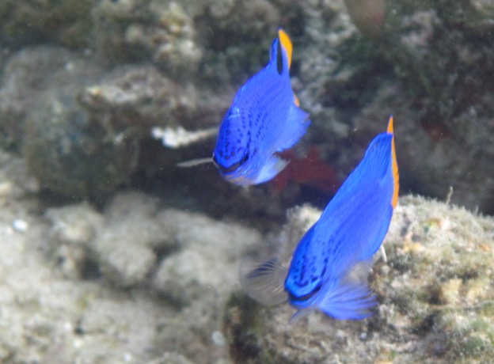

Slide 5
Theories
Hypotheses
Predictions

Slide 6
Slides
I’ll post after lecture
Don’t waste time (and focus) on writing down what’s on the slides

Slide 7
Questions
Respond!

Slide 8
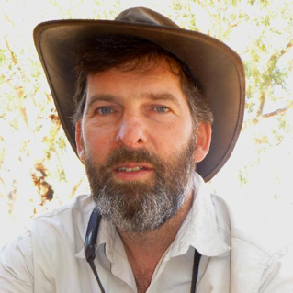


Want more?
BI3052 Study Design
Formulating & Testing Hypotheses
Lab vs Field studies
Experimental vs Observational studies
Experimental Designs
Pitfalls of Study Design
Design vs Statistics
How to Measure Things Correctly
& more

Slide 9
The Scientific Method
Major principles
Major concepts
Theory of Science for Practical Use

Slide 10
Theories
Hypotheses
Predictions

Slide 11
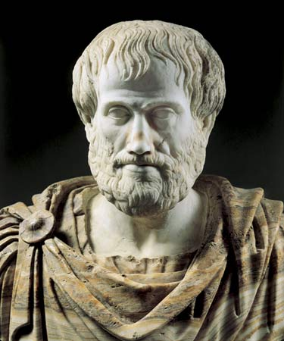
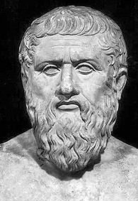
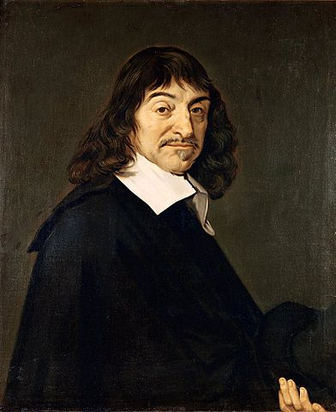
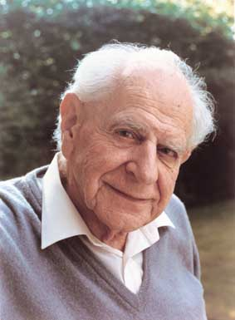
Only for the philosophers?
Aristotle
Plato
Descartes
Popper

Slide 12
What do we have all these terms for?

Slide 13
Why bother?

Slide 14
Abstract?

Slide 15
We’re academics – so we have to know philosphy and theories of science?

Slide 16
We’re academics – so we have to know philosophy and theory of science
But we can’t use it for anything...?

Slide 17
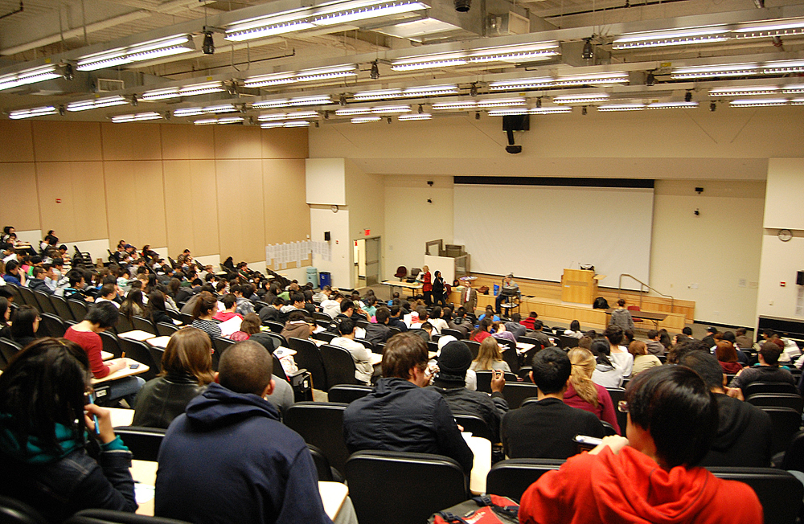
It’s about you!

Slide 18
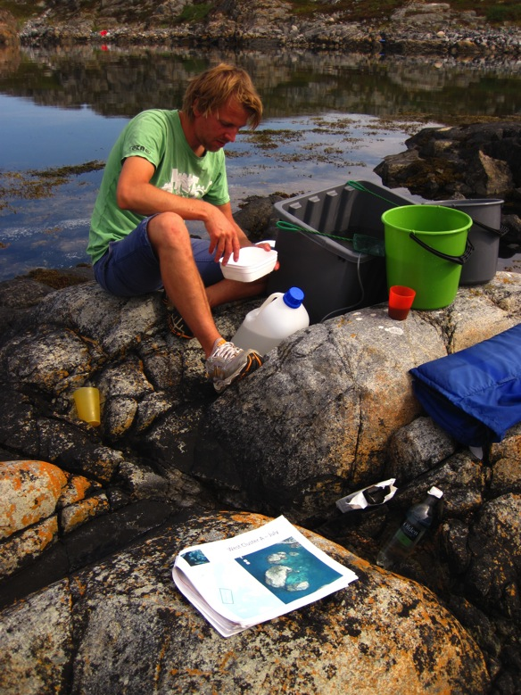
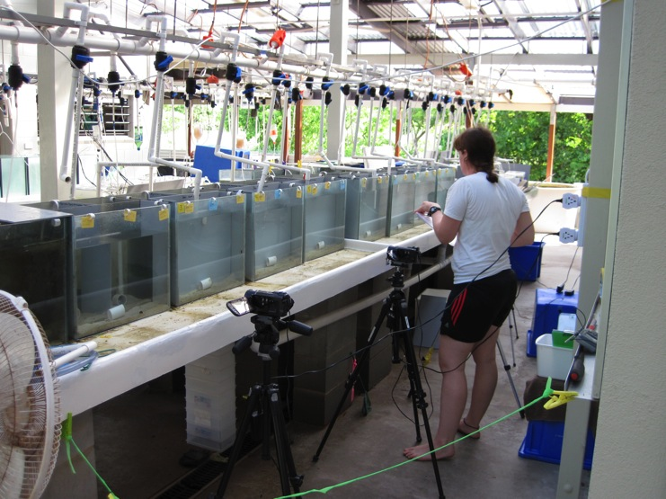
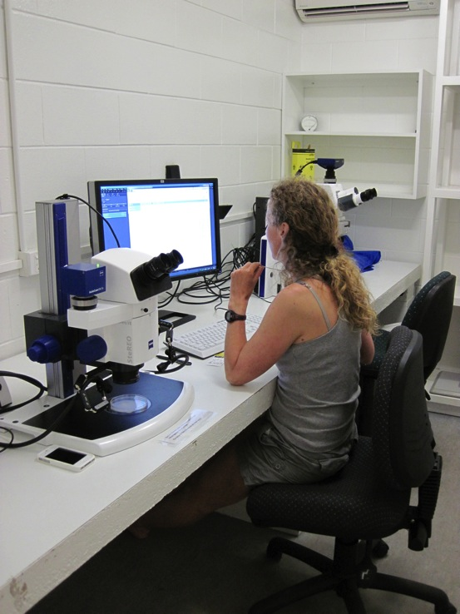

Slide 19
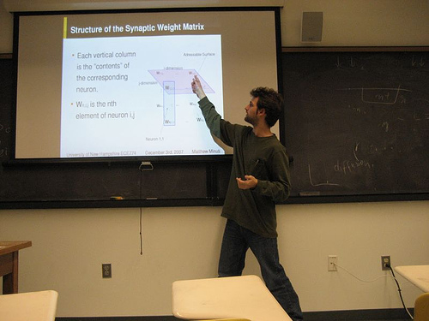

Slide 20
Crucial tools to
Understand science
Do good science
= Produce an excellent thesis
Deal with scientific knowledge in future jobs

Slide 21
Difficult?
The principles are simple!

Slide 22
What’s the aim of Science?

Slide 23
Discuss 1 min

Slide 24
Science is about…
Describing (nature)?
Understanding?
Measuring?
Explaining?
Mapping?
Think 10 sec – vote for 1 term that best describes aim of science!

Slide 25
The aim of science:
To understand what we didn’t understand before
To gain new knowledge about nature (and culture)

Slide 26
The Aim
Understand & Explain Nature – its Phenomena & Processes
The Means
Map, Describe, Measure

Slide 27
Science
Invent/develop/modify theories
  Creative
  Unsystematic?
Put theories on trial
  Systematic, critical
  as opposed to everyday reasoning (common sense)?

Slide 28
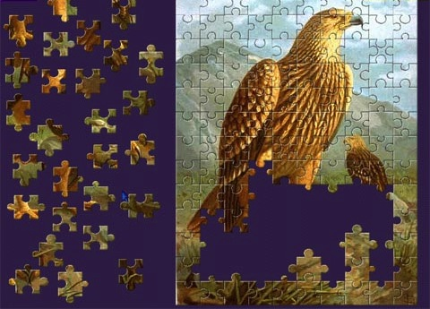
Solving puzzles

Slide 29
Understanding what we didn’t understand before

Slide 30
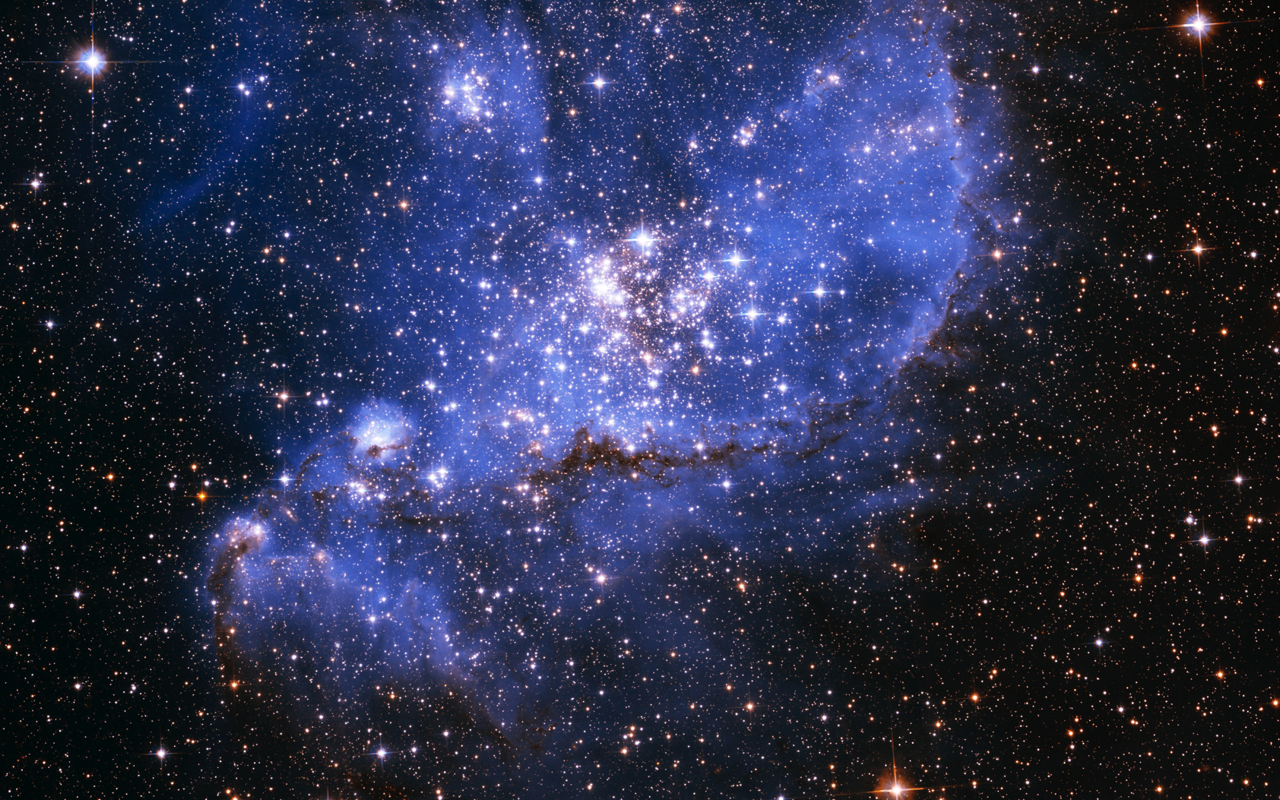

Slide 31
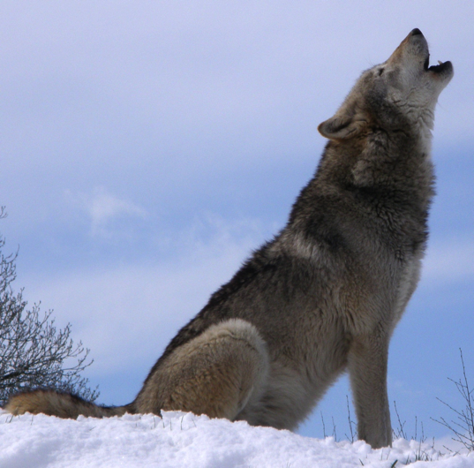
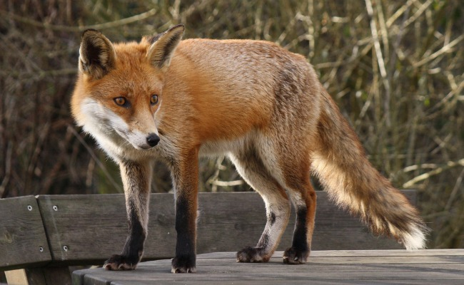
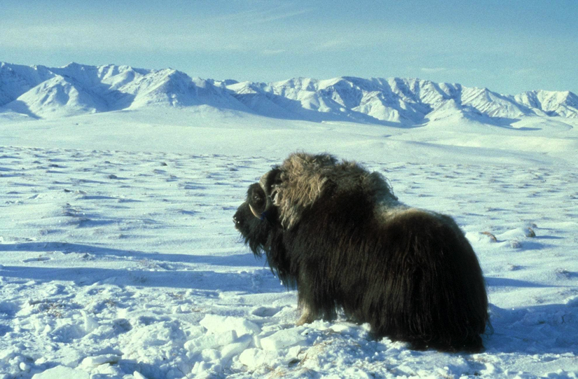

Slide 32
The concepts and terms of science

Slide 33
A theory – what’s that?

Slide 34
Discuss 1 min

Slide 35
Theory
=
(possible)
Explanation

Slide 36
A theory is..
..an
unobservable
explanation of an
observable
phenomenon..
Philip Kosso

Slide 37
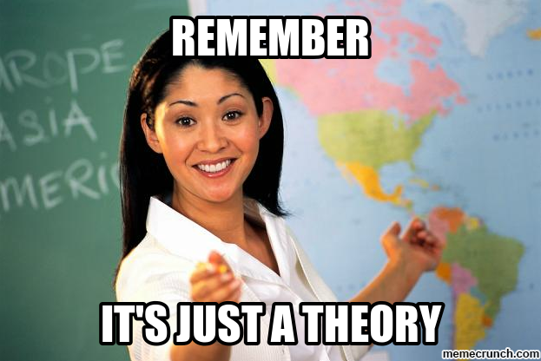

Slide 38
If something is a theory
Should we trust or distrust?

Slide 39
Discuss 1 min

Slide 40
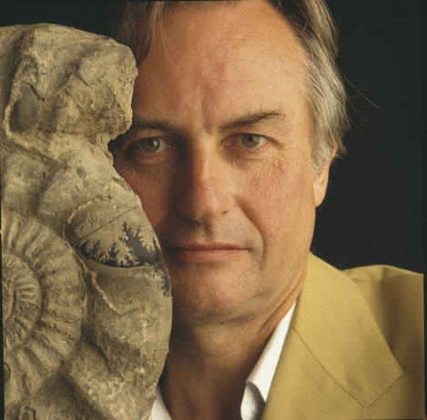
Theory as ’fact’
The theory of evolution – supported beyond doubt
Evolution is a fact
Richard Dawkins
THEORY as
Supported beyond doubt
By conclusive evidence
Universally accepted explanation

Slide 41
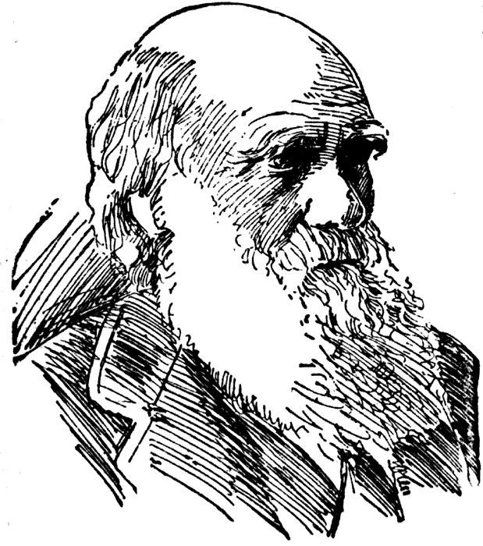
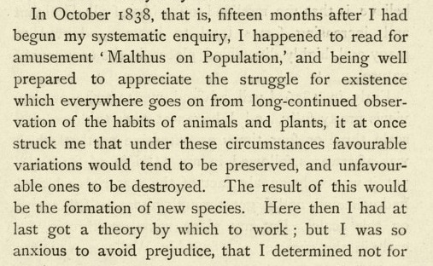
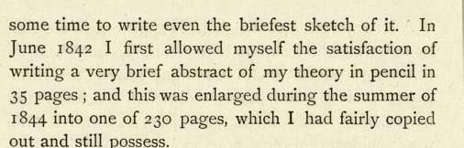
Darwin 1876, Autobiography
THEORY
as
- Idea
- Suggested explanation

Slide 42
Possible explanations to puzzles
Not tested
?

Slide 43
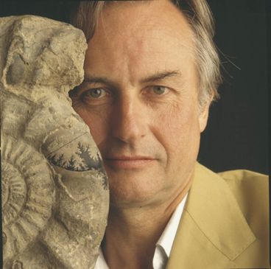
Possible explanations to puzzles
Much tested
Much supported
Not tested
?
‘fact’

Slide 44
Possible explanations to puzzles
Much tested
Much supported
Not tested
?
‘fact’
A theory all the way

Slide 45
A theory all the way?
YES
Because it was always an explanation

Slide 46
What if
Much tested
Little supported
Not tested
?
Does it stop being a theory?

Slide 47
Does it stop being a theory?
NO
Because it is still an explanation
Just a bad one
A theory unlikely to be true

Slide 48
We should neither trust nor distrust something because it’s a theory
The Question: is it a good theory?

Slide 49
Theories approach knowledge if…
Tested repeatedly
By critical tests
Always, or almost always, supported
(Yet: no theory is 100% certain)

Slide 50
Things we know that we didn’t know before
(”we” = science)

Slide 54
Things we try to understand
(”we” = science)

Slide 55
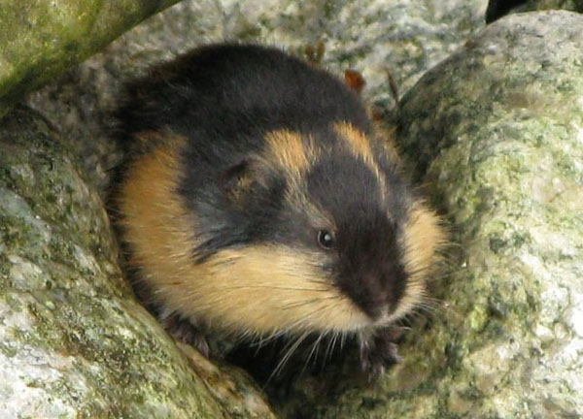
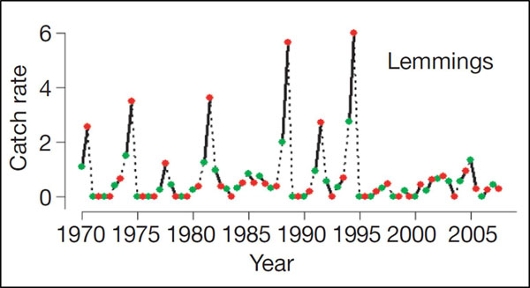

Slide 56
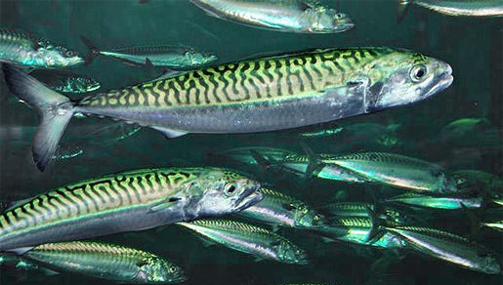
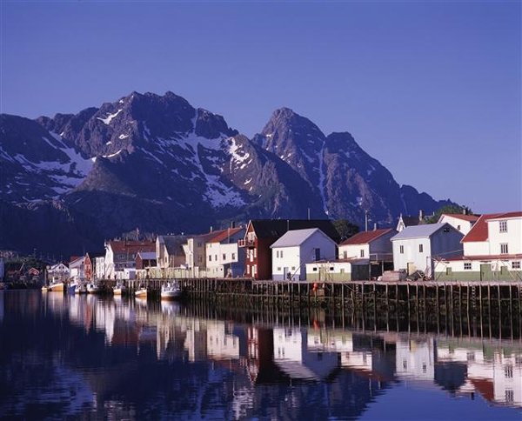

Slide 57
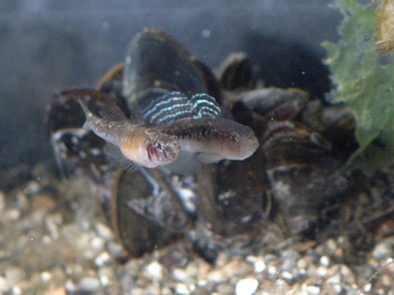
Change in sex ratio: males disappearing
% males
Spring Late summer

Slide 58
Most of us deal with small puzzles & theories
That’s good enough!
Science is mostly about solving ”small” puzzles

Slide 59
A hypothesis– what’s that?

Slide 60
Discuss 1 min

Slide 61
Hypothesis
=
Theory?

Slide 62
Hypothesis
=
Explanation

Slide 63
Hypotheses
less ’sure’ than theories?
a not (yet?) fully supported theory
a theory in need of testing
A theory can be more or less hypothetical

Slide 64
Hypotheses in the real world
= theory
  Subject to testing
  In ’focus’ of research effort
”We test hypotheses X and Y suggested to explain….”

Slide 65
Hypothesis
=
Theory?
Structurally Yes
But when we test a theory, we (mostly) term it a hypothesis

Slide 66
Darwin 1876, Autobiography
THEORY
as
- Idea
- Suggested explanation

Slide 67
data
data
data
data
data
data
data
data
Induction
(= intuition, knowledge & wisdom?)
Hypothesis
Deduction
(= logically necessary or likely implication)
Prediction
Prediction
Prediction

Slide 68
data
data
data
data
data
data
data
data
Exploratorystudies
Hypothesis
Hypothesis-testing studies
Prediction
Prediction
Prediction

Slide 69
Exploratory studies
We wanted to test what is the best start food for salmon larvae?
Why wanted to find out which of toxins X and Y had the greatest impact on reproduction in goshawks
What’s the relationship between female size and clutch size in gobies?

Slide 70
Exploratory study
”How”
”Look at”
”Investigate”
QUESTIONS BUT NOT HYPOTHESES
Results may help form hypotheses
Can be done by observation
  Ie, no manipulation/experiment
Can sometimes be done by (manipulative) experiment
  Eg: Testing toxin effects, start food effects

Slide 71
Hypothesis-testing studies
Why do birds sing in the morning?
Why do fish assemble in schools and shoals?
Why do/did raptor eggs often break?
Why have kelp forests vanished many places along the coast?

Slide 72
Hypothesis-testing studies
Always ”Why”
Questions AND Hypotheses
Can be tested by observation
  Ie, no manipulation/experiment
Can be tested by (manipulative) experiment
  Eg: expose individual and shoaling fish to predation
  Stronger approach but not always feasible

Slide 73
data
data
data
data
data
data
Don’t confuse
data
data
with
Exploratory
Vs
Hypothesis-testing studies
Observational
Vs
Experimental studies
Hypothesis
Prediction
Prediction
Prediction

Slide 74
Aim
Hypothesis-testing
Observational
Exploratory
Observational
Method
Hypothesis-testing
Experimental
Exploratory
Experimental

Slide 75
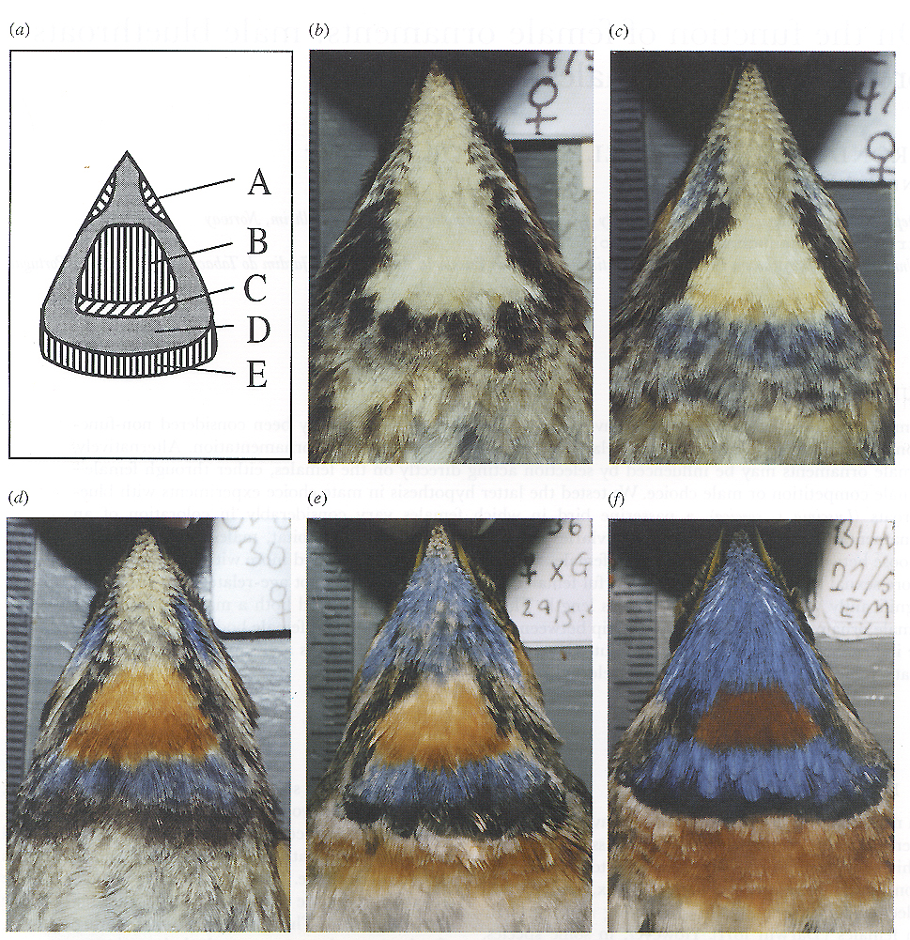
Variable female coloration
Why are some females so colourful?
Male for comparison
(Amundsen et al. 1997; Proc. Roy. Soc. Lond B.)

Slide 76
One hypothesis
Sexual selection by male mate choice of more colorful females
How to test?
What predictions follow?

Slide 77
General prediction
Males should show greater sexual interest in more colourful females

Slide 78
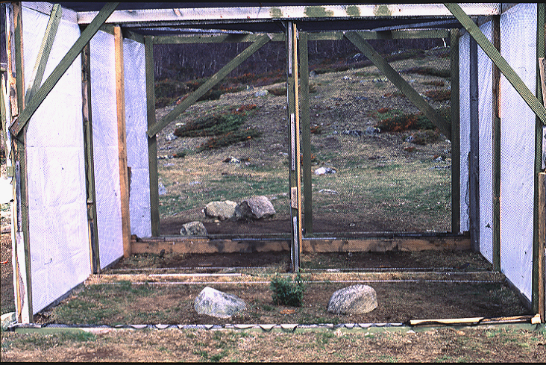

Slide 79
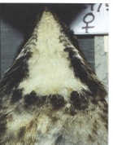
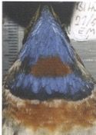
150 150
1
2
140 100

Slide 80
Specific predictions
More time with colourful female
More displays to colourful female

Slide 81
Did the males
associate more
with
colourful females?
*
Did the males
perform more
sexual behaviours
towards
colourful females?
*
Amundsen, Forsgren & Hansen 1997

Slide 82
Mission completed?
Predictions fullfilled – do we know the answer?

Slide 83
Alternative hypotheses
Status signal in female-female competition
Genetic correlation
  side effect of sexual selection on males

Slide 84
Are alternative theories mutually exclusive?
Can more than one be right?

Slide 85
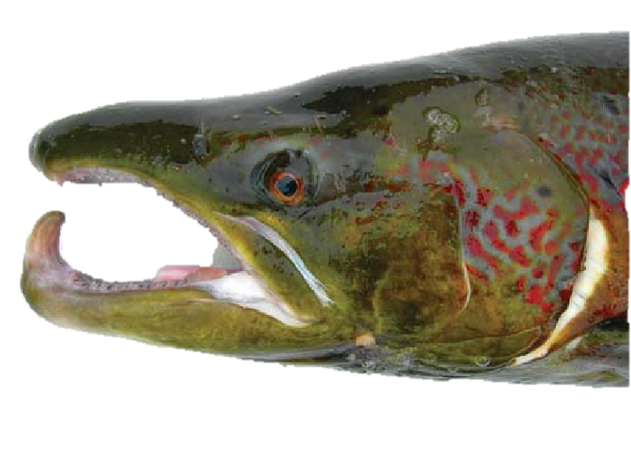
Biology:
Traits are products of evolution
Many selection pressures
Often simultaneous
Mating
Food
Predation
Competitors

Slide 86
Simplistic ideal
Mutually exclusive hypotheses
  If one is ’right’ (well supported) the others must be wrong
Underlying assumption
  1 phenomenon- 1 explanation
Often invalid in biology

Slide 87
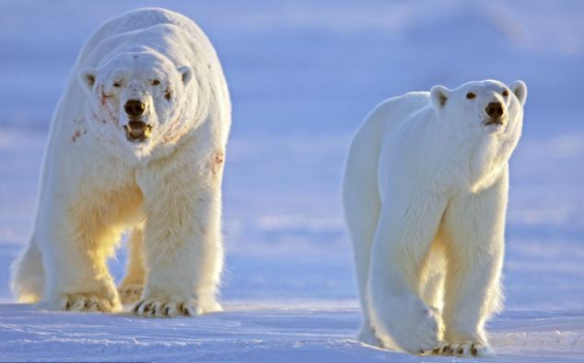
Body size

Slide 88
Body size
Sexual selection

Slide 89
Body size
Sexual selection
Climate/Environment

Slide 90
Body size
Sexual selection
Climate/Environment
Food

Slide 91
Body size
Sexual selection
Climate/Environment
Food
Phylogeny

Slide 92
Is it enough to test one prediction?

Slide 93
Is it enough to test 1 prediction?
(Ideally) No !
Test several predictions (if you can)
  less likely that several predictions are the same from alternative hypotheses
Test strong predictions
  some predictions are stronger tests than others

Slide 94
What if one prediction is not fulfilled?

Slide 95
Judge!
Can there be other reasons than the hypothesis being wrong?

Slide 96
What if the prediction is fulfilled?

Slide 97
Judge!
Could the prediction have been fulfilled for other reasons than the hypothesis being right?

Slide 98
Ideal vs Reality
Ideal Biological reality
Only one explanation YES OFTEN NOT
Predictions follow by YES RARELY
logical necessity
Test results Y/N Y/N/?

Slide 99
Scientific (biological) vs statistical hypotheses
Scientific hypotheses:
  Explanations that we want to test, in order to understand unexplained phenomena
Statistical hypotheses:
  Testing mathematically if patterns and relationships in data are likely to be real or may instead be accidental
These two things are NOT the same

Slide 100
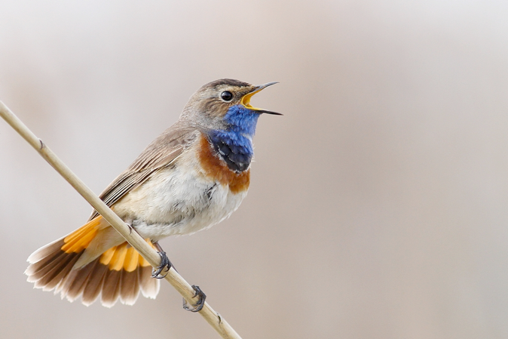
Scientific hypothesis testing
The puzzle:
Why do birds sing in the morning?
Hypothesis (one of many possible)
  Because females are more fertile in the morning
Predictions
  More matings should occur in the morning

Slide 101
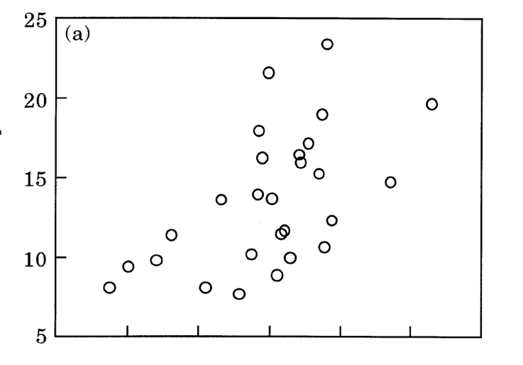
Statistical hypothesis testing
Is the pattern real or can it be accidental?
H₁: There is a relationship
H₀: There is no relationship
r=0.56, n=27, P=0.002

Slide 102

Statistical hypothesis testing
Is the pattern real or can it be accidental?
H₁: There is a relationship
H₀: There is no relationship
r=–0.06, n=28,P=0.78

Slide 103
Support – and non-suppport - for biological explanations come in degrees
Strengthened by evidence as predicted
Strengtnened by more results that fit in a study
Strengthened by more studies that support
Hypothesis ”more and more verified ” = likely to be TRUE, but
Absolutely conclusive verification not possible
Weakened by evidence contra predictions
”More and more falsified ” = likely to be FALSE
Absolutely conclusive falsification not possible (in practice)
TESTING HYPOTHESES CRITICALLY BRINGS US CLOSER TO THE TRUTH

Slide 104
Evidence: what you’ll find in your thesis work – THE DATA
Will they give you clear answers?
Will they fit with one hypothesis only?
Will all evidence point the same way?
Will patterns be clear & always statistically significant?
Hardly! (rarely)
But don’t worry!
We all have it that way...
If you use the methods of science well, your work will bring us closer to knowledge & understanding

Slide 105
If you do it well, your work will be important to science and improve our understanding of nature!
Best of luck with your MSc work!

