Slide 1


Scope and Vision:
Forum of Young Scholars in Sustainability (FYSS)
Paritosh Deshpande

Slide 2
Content
Goal and Scope
Vision Statement
Activities So Far
Proposed Activities
Suggestions
Registration and Reach

Slide 3

FYSS: Scope
For Young Scholars (PhD’s, Post-Docs, Researchers temporary / exchange) working on various aspects of Sustainability at NTNU campuses
(Trondheim, Ålesund and Gjøvik)

Slide 4

Proposed Goals
Platform for idea and knowledge sharing
Capacity building
Social mingle and networking together with DION
Facilitating outreach of internal research work
Suggestions!!!

Slide 5

Vision Statement
«To provide a common platform to share knowledge and facilitate interdisciplinary research activities in the area of sustainability at NTNU»

Slide 6
Activities under FYSS
Monthly meetings
Bi-annual workshops / brainstorming sessions on selected themes
Social networking platform to promote internal research
World Environment Day and Earth Day celebrations
Expert talks
Social mingling events at NTNU
Suggestions????

Slide 7
So Far.. : FYSS Kick-off Events
Date: 5th-6th June, 2016
Day-1 World Environment Day 2016 Celebration
Registered as official UNEP WED celebration event
Documentary show and social mingle
Tree plantation event
Day-2 Kick-off ceremony for FYSS

Slide 8
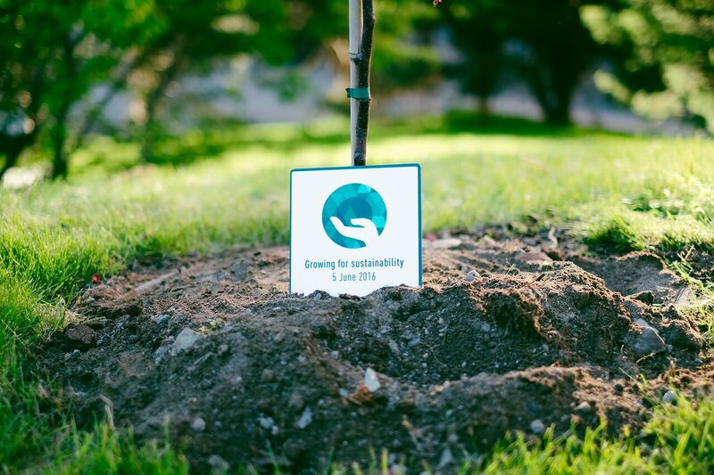
NTNU Sustainability
announces

Slide 9
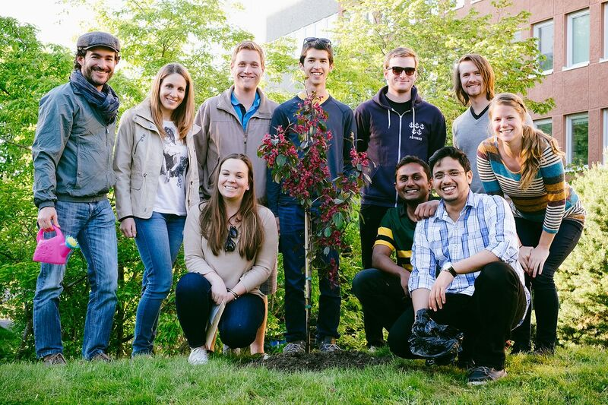

Slide 10
Proposed Future Plan
Outreach among NTNU campuses
Finalizing vision and scope
Organizing FYSS board
Planning on meet-ups
Activity planning with DION
Developing webpage and logo for FYSS

Slide 11
Registration and Reach
Spread the word and help FYSS in outreach
Leave your comments / suggestions / expectations
from FYSS

Slide 12

Thank You!!

