Slide 1
Green competitiveness in the silicon industry?
Professor Leiv Kolbeinsen, Dep. Mat. Sci. & Eng., NTNU
Climate change has gone from If to When to Now (World Bank)
Everyone is entitled to his/her own opinion, but not his/her own facts.

Slide 2
Content of this presentation
Metal production: Reductants/Energy sources
The system Earth is not closed with respect to energy
The Renewable energy leader globally
Silicon Use and Production
Silicon production, Si production and CO₂ emissions, “Triple bypass”, The Solsilc process and The Elkem Solar Route
GasFerroSil
Green (Si-production) economy examples:
Elkem: Carbon Neutral Metal Production (CNMP)/Finnfjord
Sustainable Business Models – Industrial Symbiosis (Clusters)
Summing up

Slide 3
Metal production: Reductants/Energy sources
Stolen from Jean-Pierre Birat (and adapted by me)
Carbon
Coke
Decarburization
BlastFurnace (BF)
Coal
SynGas
Blast furnace + plasma
Ferro-alloys/silicon & Aluminium
Natural Gas
NG reduction
Electro steel (EAF)
H₂ reduction
Electrolysis
H₂
H₂ from water electrolysis
Electricity
Hydrogen
Electrones

Slide 4
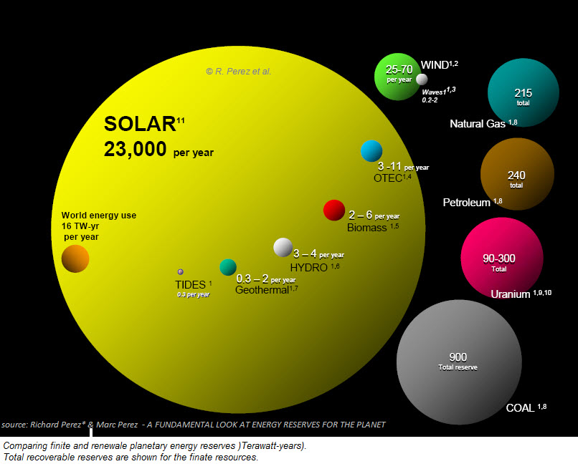
The system Earth is not closed with respect to energy
The annual global energy consumption, for 2009, was estimated at 16 TW-yrs (or 140,160,000,000 KW-hrs) illustrated by the orange sphere on the left-most side

Slide 5
The Renewable energy leader globally ICRIER Working Paper 329 Ashok Gulati, Stuti Manchanda, Rakesh Kacker: Harvesting Solar Power in India! Aug 2016
Germany – The Renewable energy leader in total cumulative installations globally and leads by a successful model. In 2014:
Germany’s 38 GW accounts for nearly 21percent of total solar installed capacity in the world (2014). All this makes Germany a key leader in solar power.
There are 2 key elements in Germany’s solar power success that have contributed to substantial rooftop installations:
guaranteed grid connection to renewable energy producers and
Feed-in-Tariffs (FITs)
By 2013,
23 percent of global residential solar rooftops and
37 percent of global commercial solar rooftop
installations took place in Germany*. Governed by the Renewable Energy Sources Act 2000 (Erneuerbare-Energien-Gesetz EEG), renewables including solar enjoy priority grid connection and are supported through Feed-in-Tariffs (FITs) in Germany. This has enabled even the small producers and farmers to connect to the grid and earn revenue by selling solar power.
Country | Cumulative installed solar capacity [GW] | MW/million people
Germany | 38 | 469
China | 28 | 20
Japan | 23 | 181
India | 3 | 2.3
* http://marketrealist.com/2015/02/german-rooftops-domniate-global-photovoltaic-capacity/ (Accessed: 6th June 2016)

Slide 6
Silicon is used in a number of processes/applications
• Ferrosilicon is used both for removing oxygen from liquid steel and cast iron (de-oxidation), as well as being an alloying element. The end-users are the automotive and construction companies.
• Silicon is mainly used for alloying other metals, especially aluminium (about 45 % of global silicon production is for alloying purposes). As for ferrosilicon, the end-users are automotive and construction companies.
• Silicon is also used as feedstock for the silicone industry (about 40 %). The end products are typically cosmetics, construction, anti-foam, medical equipment, automotive parts, etc.
• Silicon is an essential ingredient in semiconductors and in the solar industry (about 10-15 % and growing). In electronic equipment, the amount of pollution elements must be as low as in the ppb (parts per billion) range. More than 90 % of all electronic components are based on silicon. Another important market for the industry is silicon used in solar cells. Here the pollution level is in the ppm (parts per million) range.

Slide 7
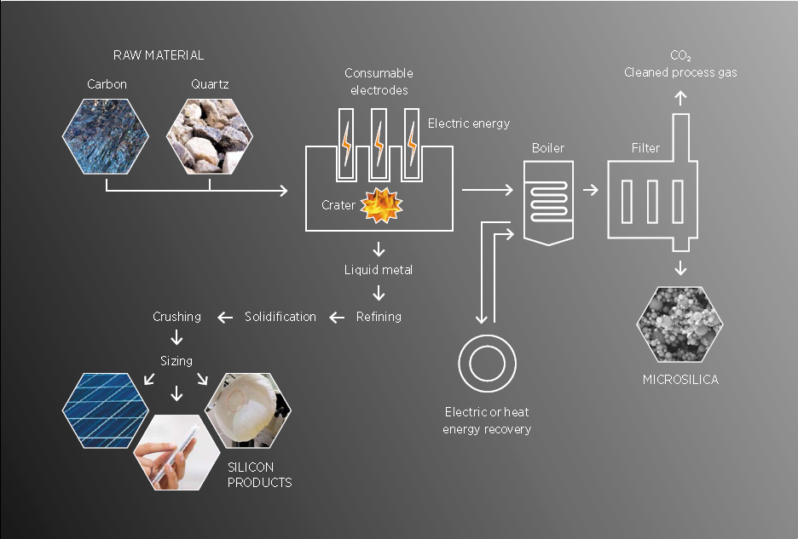

Slide 8
Si production and CO₂ emissions
SiO₂(s)+(1+x)C(s) = xSi+(1-x)SiO(g)+(1+x)CO(g)
Electricity source | Total spec. CO₂ (kg CO₂/kg Si)
Theoretical C - free | [1.6 (1CO₂/Si)] – 3.2 (2 CO => 2CO₂/Si)
Hydro/Nuclear | 4.3
Gas Power | 10.6
Coal power | 17.7

Slide 9
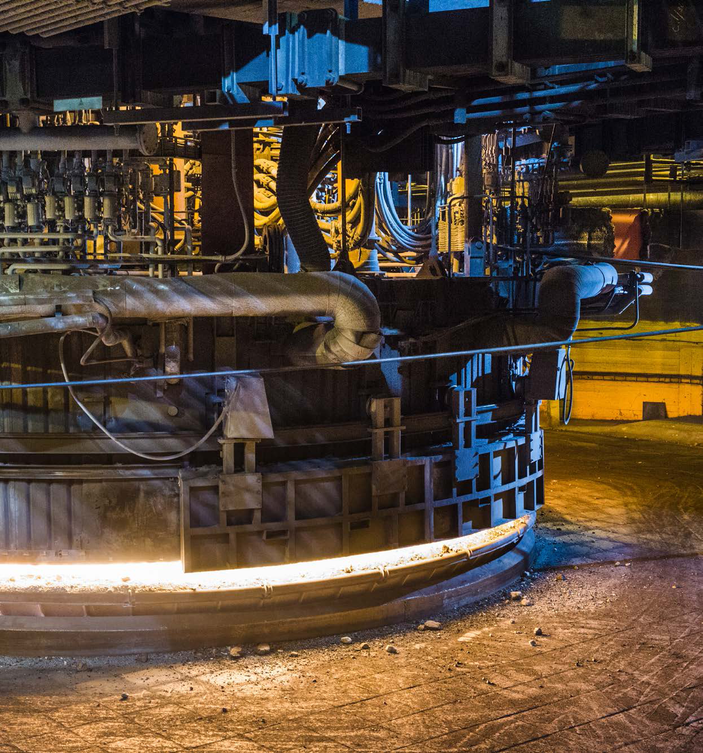
Elkem sustainability report 2014
Main steps in the Si-process (Elkem)

Slide 10
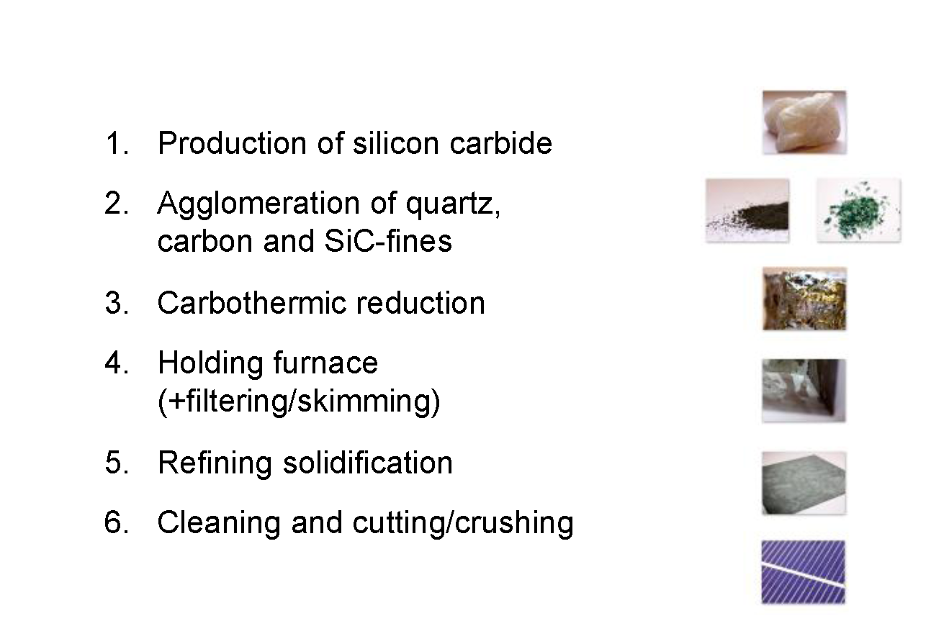
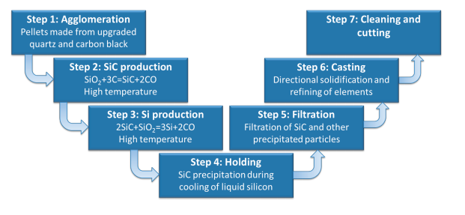

The Solsilc process

Slide 11
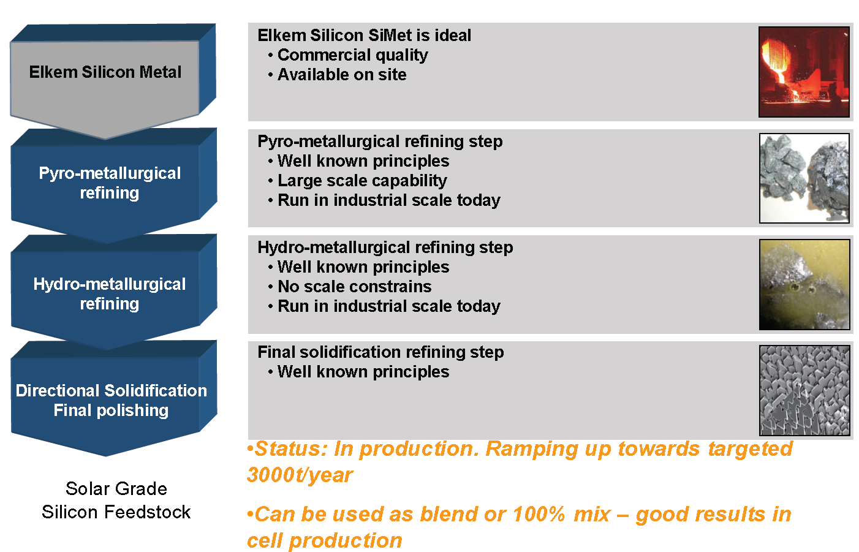
The Elkem Solar Route

Slide 12
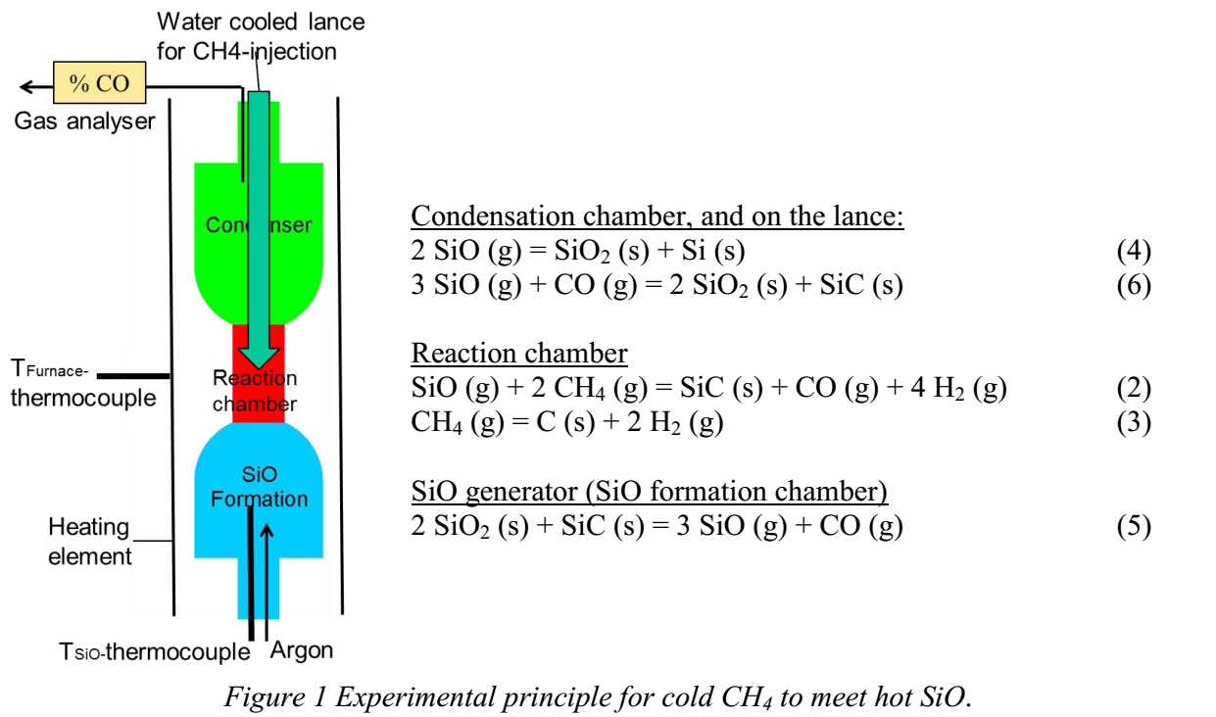
What happens when cold CH₄ (g) meets hot SiO (g)?
Based on a paper by B. Monsen, L. Kolbeinsen, S. Prytz, V. Myrvågnes, and K. Tang at the INFACON conference in Kazakhstan June 2013

Slide 13
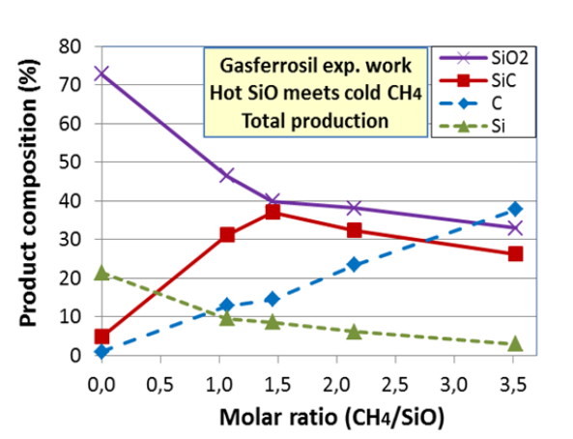
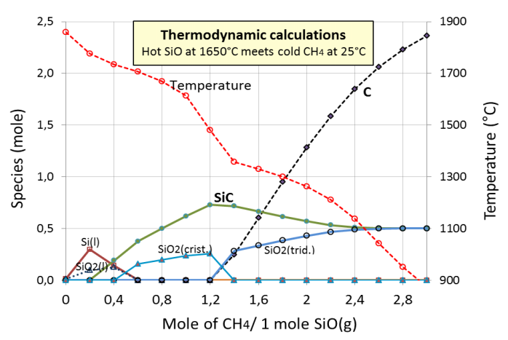
Theory
Practice
Based on a paper by B. Monsen, L. Kolbeinsen, S. Prytz, V. Myrvågnes, and K. Tang at the INFACON conference in Kazakhstan June 2013

Slide 14
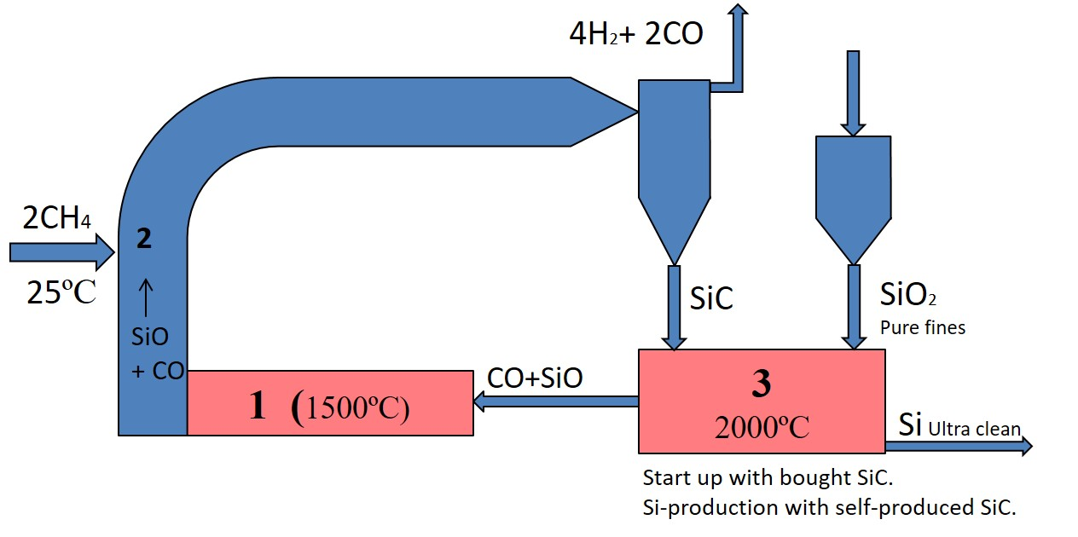
GasFerroSil project
Oxygen in Silica is used to convert CH₄ to “Syn Gas” (H₂ + CO) with Si as bi-product

Slide 15
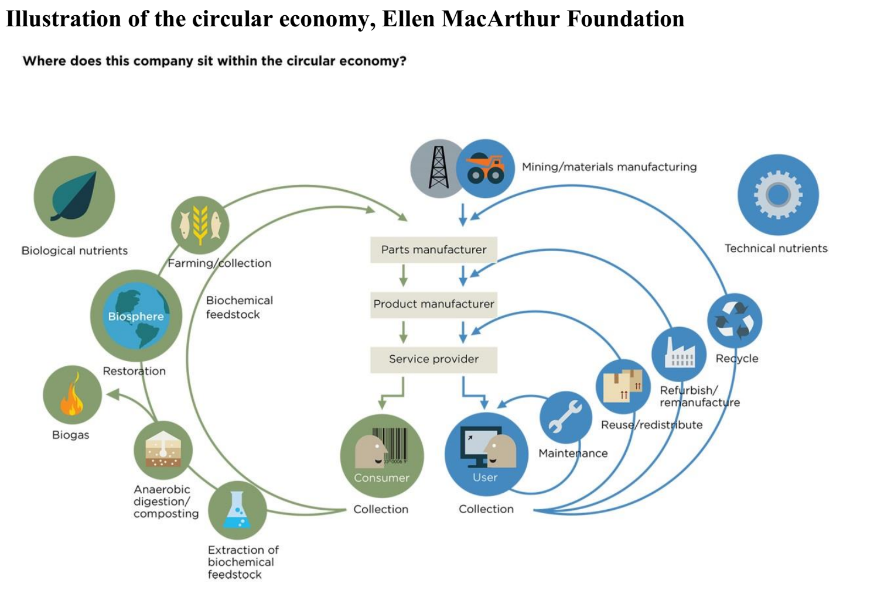
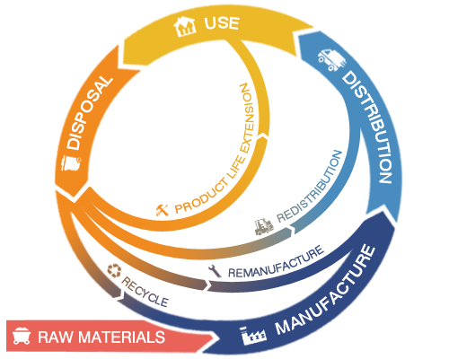
Green = Circular?

Slide 16
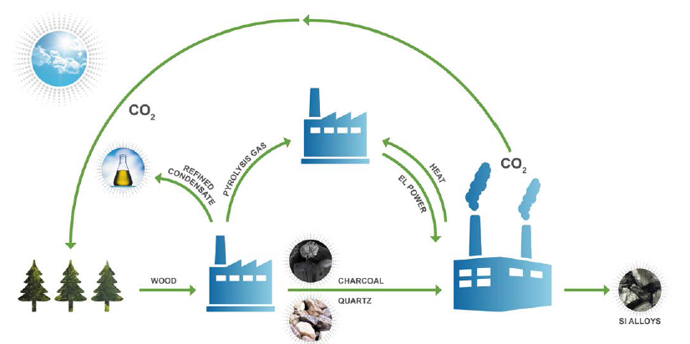
Elkem: Carbon Neutral Metal Production (CNMP)
Elkem sustainability report 2015

Slide 17
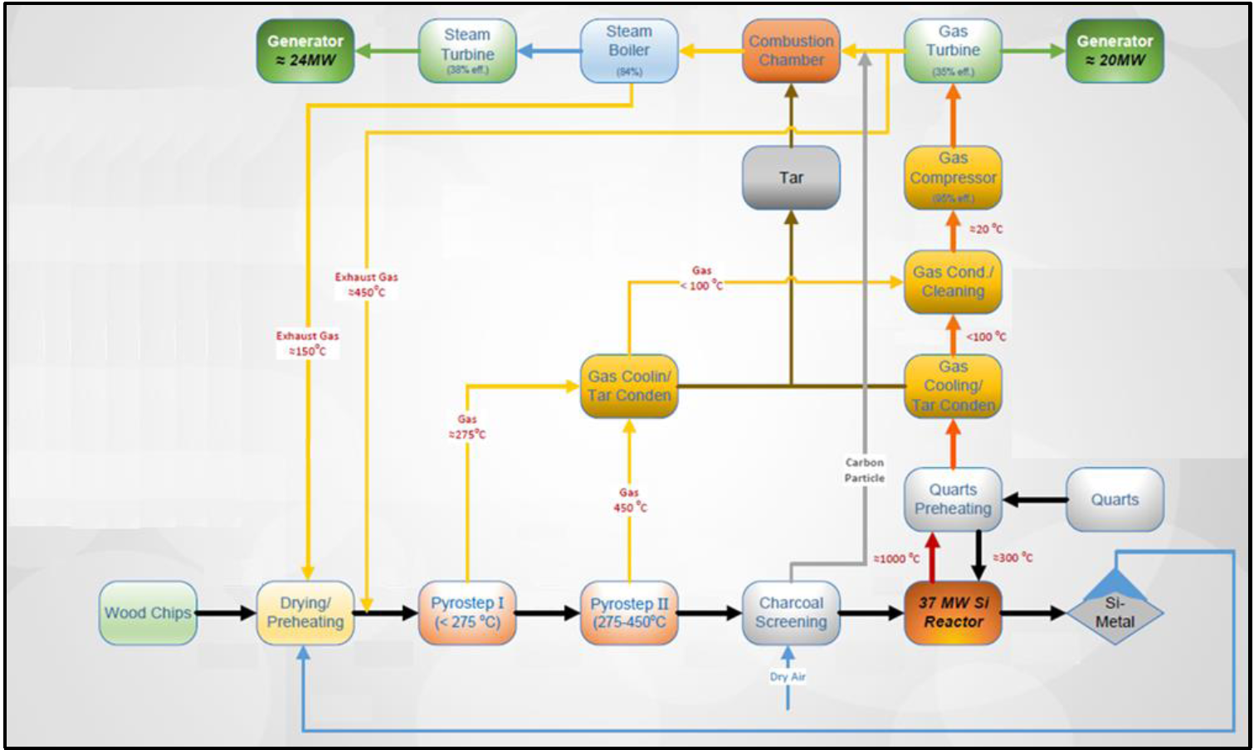
Elkem: Carbon Neutral Metal Production (CNMP)

Slide 18
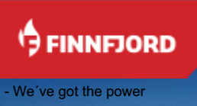
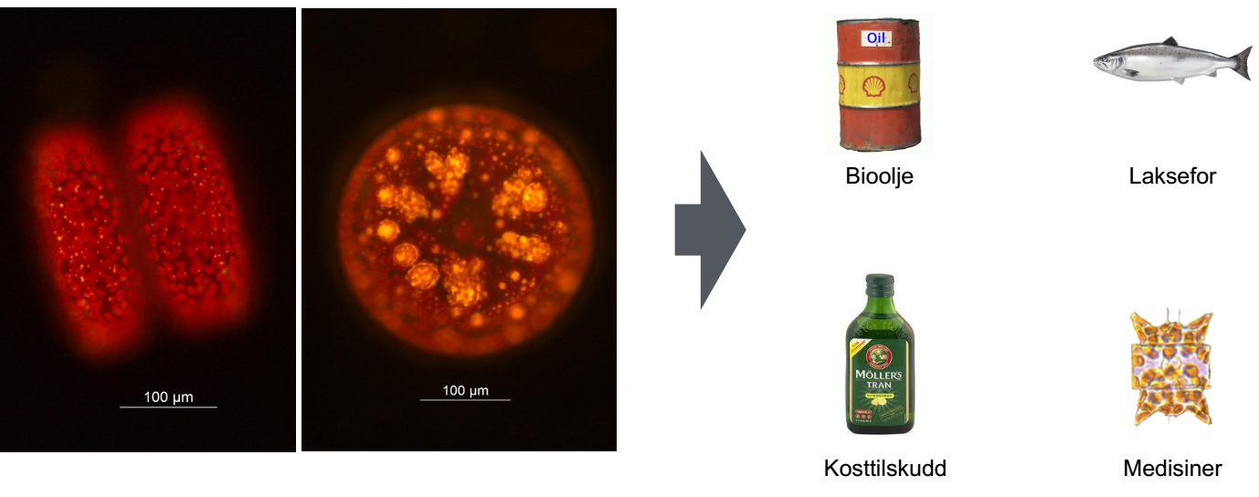

Slide 19
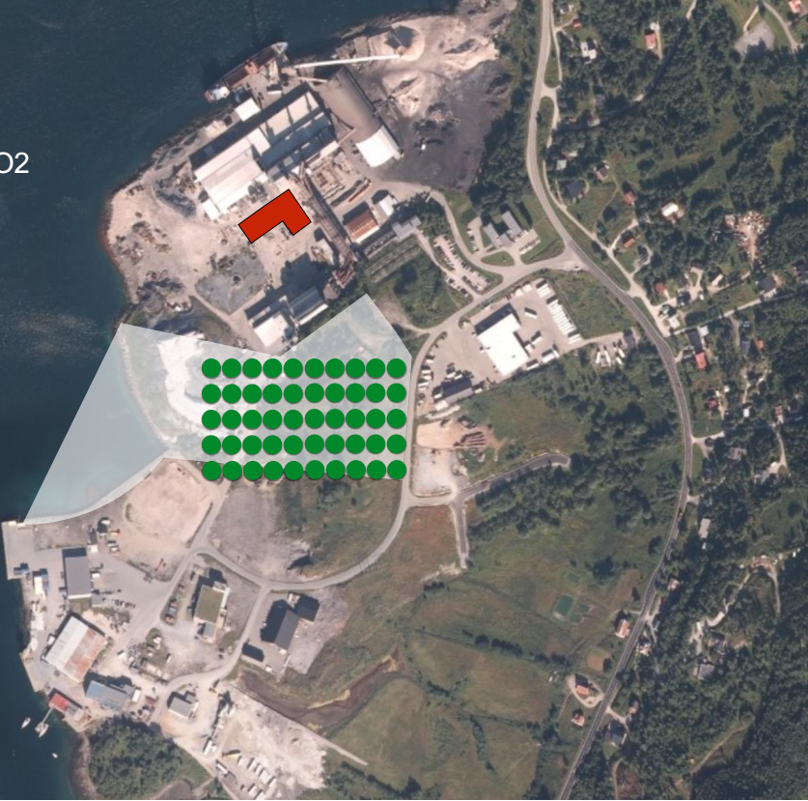
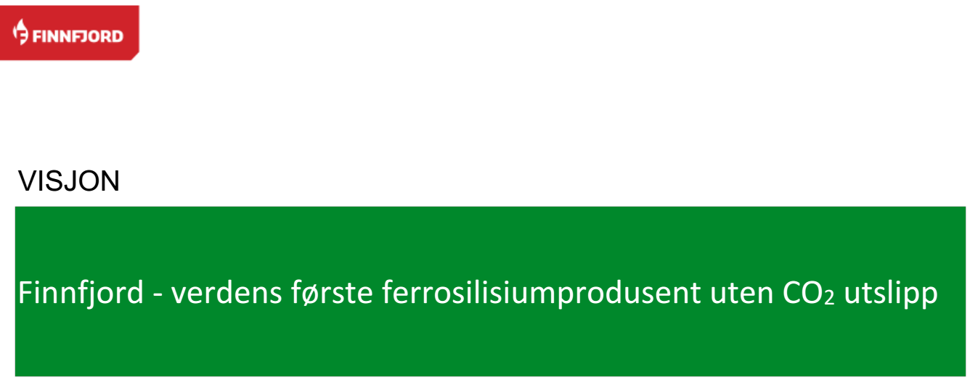
Finnfjord Vision
World’s largest ferrosilicon producer without CO₂ emissions

Slide 20
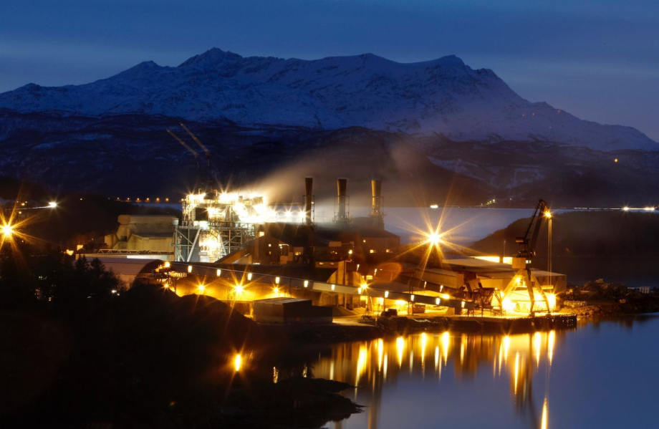
Ambitious
Remote

Slide 21
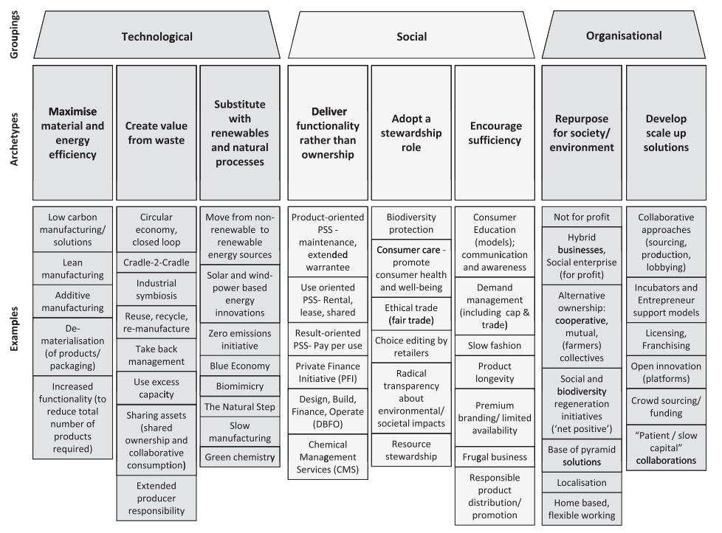
Sustainable business models

Slide 22
Green Clusters – Industry Symbiosis
Corporation C
Corporation A
Corporation B

Slide 23
Industrial Cluster or Symbiosis – links
Corporation C
Bi-prod.
Raw 2
Prod.
Waste
Corporation A
Bi-prod.
Raw 1
Prod.
Waste
Corporation B
Main prod.
Bi-prod.
Waste

Slide 24
The corporations are made of Processes
Corporation C
Process C1
Process C2
Process C3
Process A1
Process C4
Corporation A
Process A2
Process A4
Process A3
Process A5
Process B4
Corporation B
Process B5
Process B1
Process B2
Process B3

Slide 25
“New” corporations by rearranging “old” processes
Process C1
Process C2
Process C3
Process A1
Process C4
Process A2
Process A4
Process A3
Process A5
Process B4
Process B5
Process B1
Process B2
Process B3

Slide 26
The 2052 Forecast: What will happen? How can metal production contribute?
Jorgen Randers Professor Emeritus Climate Strategy BI Norwegian Business School
Make sure production does not include any fossil inputs
Make sure process is suited for solar power – i.e. direct current and intermittent power
Make sure there exist technologies (like CCS) to neutralize greenhouse gas emissions (e.g. CO₂ and CH₄)
Work for a global ban on metals made from fossil fuels – or at least labelling of climate friendly metals

Slide 27
Metal production: Reductants/Energy sources
Stolen from Jean-Pierre Birat (and adapted by me)
Carbon
Coke
Decarburization
BlastFurnace (BF)
Coal
Possible development?
SynGas
Blast furnace + plasma
Ferro-alloys/silicon & Aluminium
Natural Gas
NG reduction
Electro steel (EAF)
H₂ reduction
Electrolysis
H₂
H₂ from water electrolysis
Electricity
Hydrogen
Electrones

Slide 28


Hi, name is Mingus,
Thank you for listening to my «daddy»!

