Slide 1
Open Access for Smarties
Henrik Karlstrøm NTNU University Library

Slide 2
What will I be talking about?
New guidelines for Open Access to research publications
Why Open Access?
Two types of Open Access
Gold Open Access and author fees
NTNU’s publication fund
Green Open Access and self-archiving in NTNU Open
How to self-archive publications
What exactly is a post-print?

Slide 3
NTNU’s new guidelines
All NTNU research publications to be made publically available, either as gold or green OA, starting January 2017.
Preferably, researchers should strive towards publishing in open channels.
As a minimum, publications in subscription channels must be deposited in our institutional repository – this is easily done in Cristin.
If there is no file connected to the Cristin post, institutions might lose funding for that publication.

Slide 4
Why Open Access publishing?
Principle
Publicly funded research should be available to the public. NTNU’s motto is «Knowledge for a better world» – the world must have access to that knowledge.
Self-interest
Open Access publications are more read and more cited.
Money
Subscriptions are very expensive, more so than paying for Open Access.
Pragmatics
It’s coming anyway, from the EU or the NRC, and will factor in funding decisions.

Slide 6
Channel or publication?
All publications
Open publications
Open publications in open channels
Gold Open Access
Publishing in a completely open channel.
Green Open Access
Self-archiving – making accessible – publications in closed channels.
Hybrid Open Access
Paying to make one publication in a closed channel open.
Open Access

Slide 7
Gold Open Access
Completely free to read for all from date of publication
How do they make money if no-one pays to read them?
Majority is run non-profit by professional societies and get funding elsewhere
The authors pay for publication instead of the readers – most often through an Article Processing Charge (APC).
All NTNU employees will get APCs paid for by NTNU’s publication fund if and only if it is a Gold Open Access publication
Hybrid publishing is not supported – that would mean paying for it three times!

Slide 8
When will NTNU pay for your OA publication?
The publication channel is in the Directory of Open Access Journals
Level 1 or 2 in the Norwegian publication register
You are corresponding author
Publication must be deposited
No upper limit
Books are included

Slide 9
Green Open Access (Depositing)
Log in to www.cristin.no using your NTNU username and password
Find your publications
Select one of them and open the Cristin post
Select «deliver full-text document»
Follow the instructions
…
Congratulations, you have deposited your publication and helped us fulfil our mandate!

Slide 10
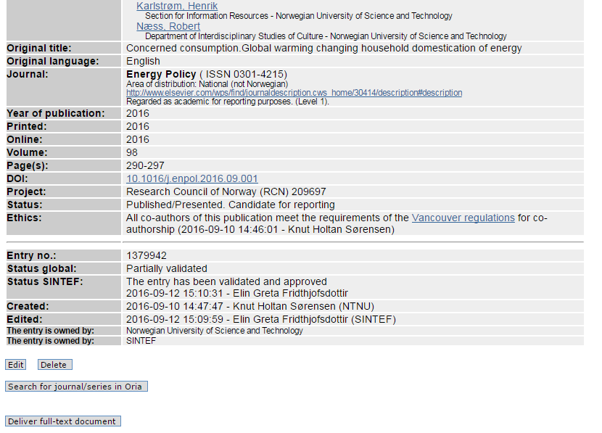

Slide 11
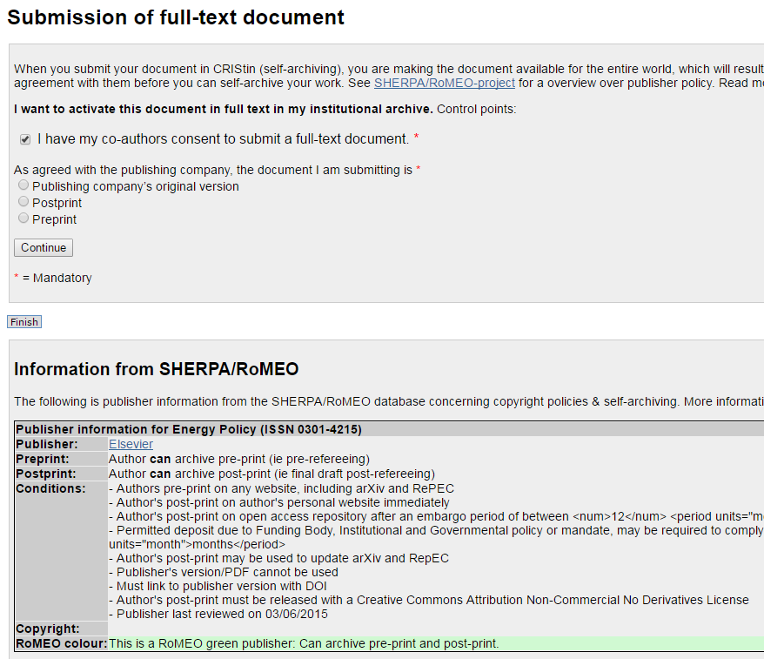

Slide 12
Seems complicated? Don’t panic!
Rule of thumb:
APC paid? Publisher’s version
Not paid? Last version you sent before signing publication agreement
Every submission is checked by library staff within two weeks of submission, and all legal issues and embargo clearance is done by us.
As long as there is a file in your post, you cannot do wrong.

Slide 13
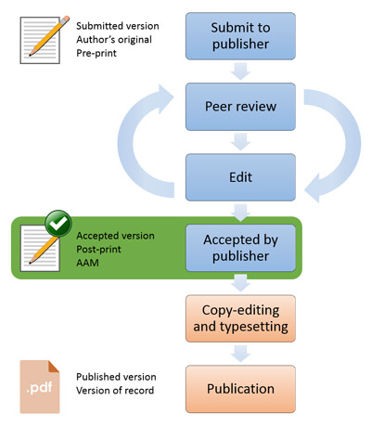
Post what?
Pre-print
– the first submitted version
Post-print
– the last, accepted version
Publisher’s version
- with journal layout

Slide 14
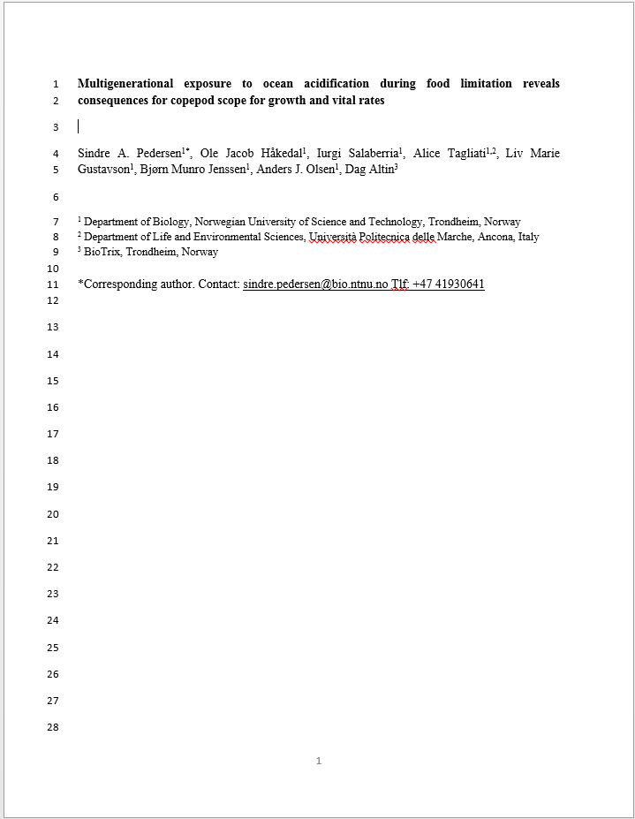
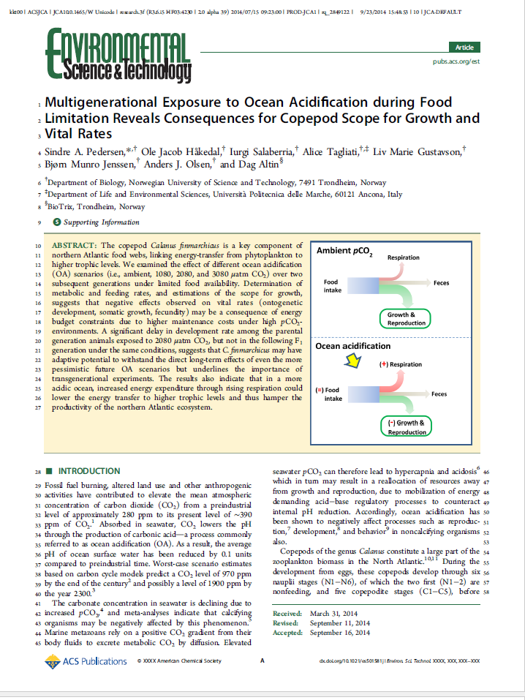
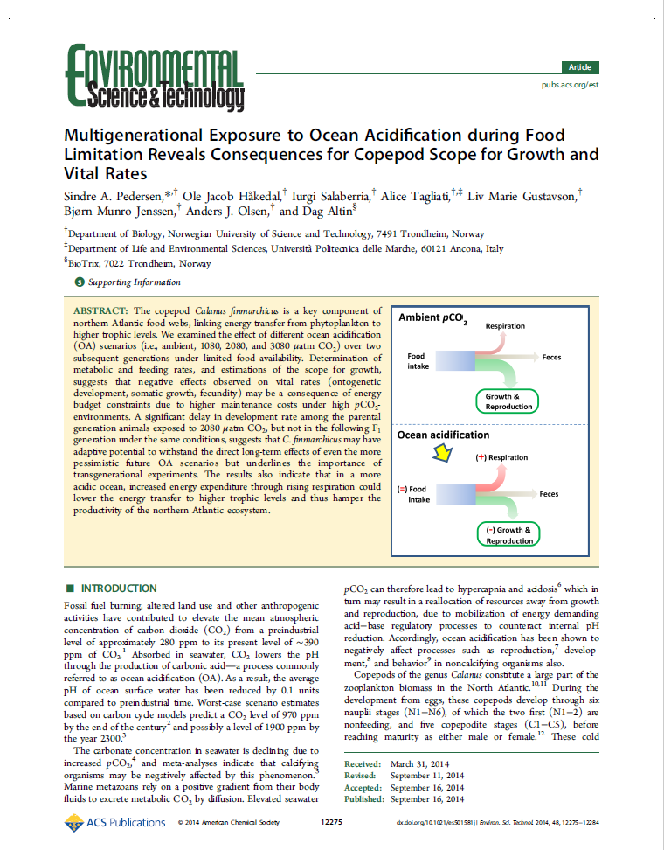
Post-print - not to be confused with «Proof»
Post-print
«Proof»
Publisher’s version

Slide 15
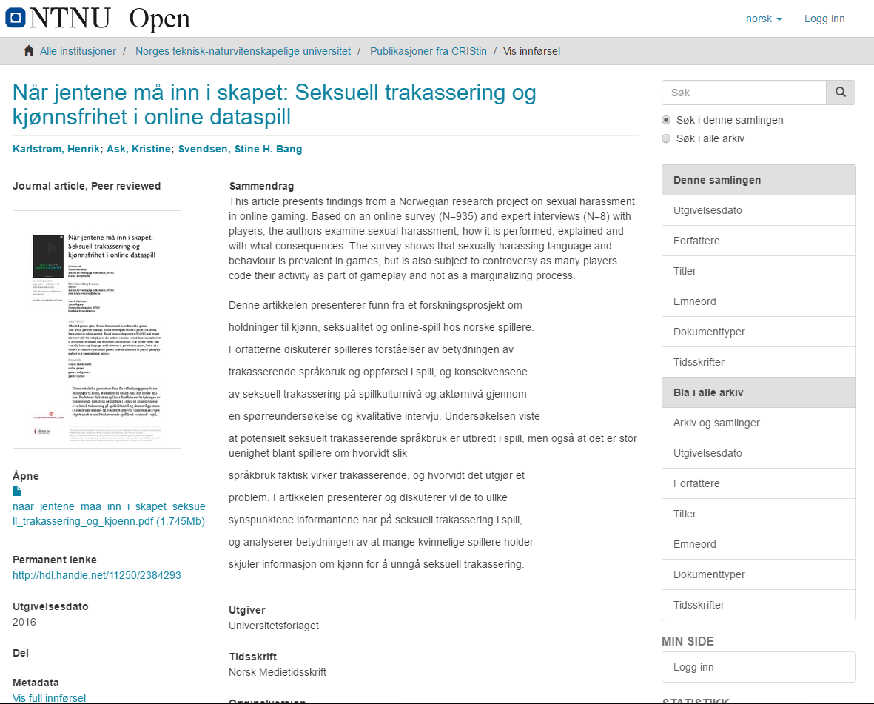

Slide 16
Links
NTNU’s policies on Open Access: https://innsida.ntnu.no/publisering
Directory of Open Access Journals: www.doaj.org
Norwegian registry for publication channels: https://dbh.nsd.uib.no/publiseringskanaler/Forside.action?request_locale=en
Questions?
Help from the library, especially regarding the publication fund: publishing@ub.ntnu.no
Help from Henrik, the friendly bibliometrician: henrik.karlstrom@ub.ntnu.no

Slide 17
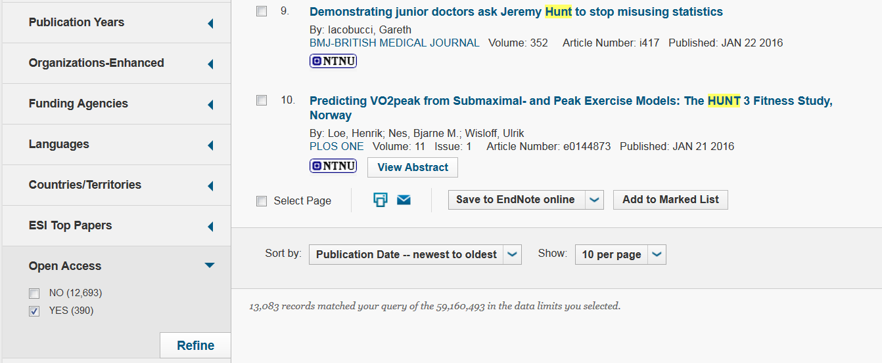
Where do I find OA channels?

Slide 18
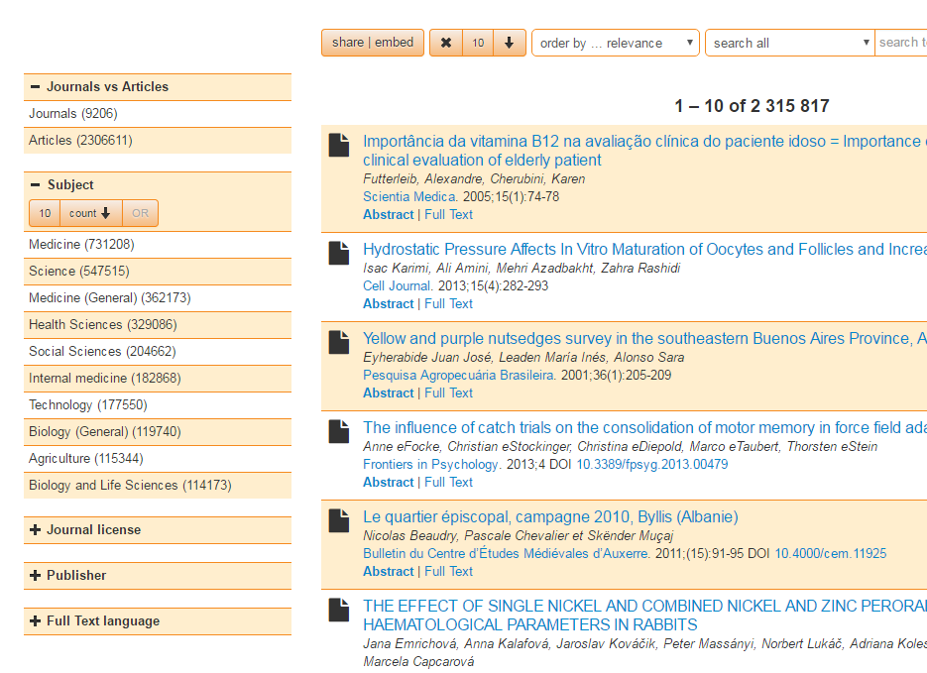

Slide 19
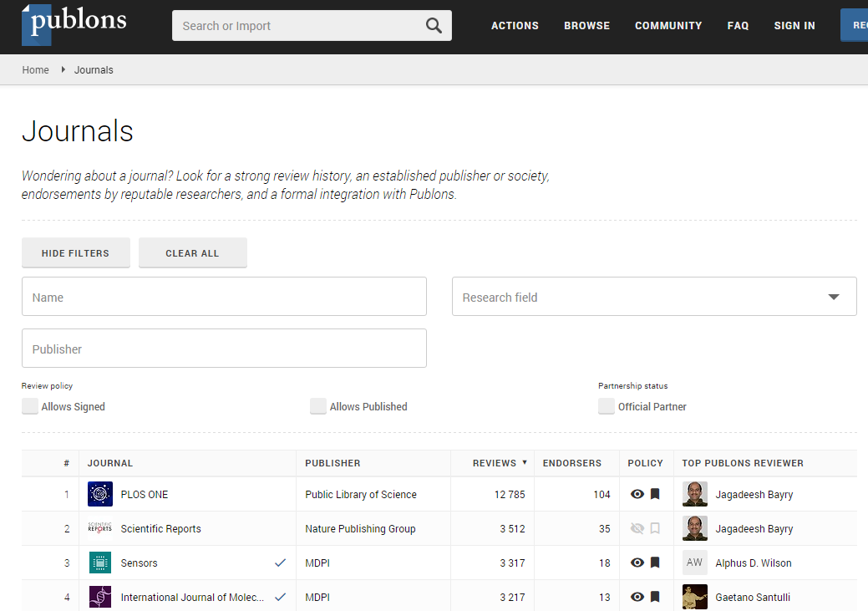
A word about predatory publishers
These do not follow good scientific practice and proper peer review procedures
How to spot them:
They promise extremely quick review processes
They are not found in DOAJ or DBH
There are also journal review process rankings: https://publons.com/journal/?order_by=reviews

