Slide 1

WELCOME TO NTNU ÅLESUND!
Autumn 2024

Slide 2
Self-registration and immigration appointment
Students who are EU/EEA nationals
.
All international students must register with the immigration service to obtain a registration certificate or residence permit.
We have reserved time with the local immigration authorities Tuesday 13th August from 0900-1100 for Exchange students and from 1200-1400 for Master students.
The local immigration office is located at Ålesund police station (or Sunnmøre police district) Adress: Nedre Strandgate 50
Required documents must be brought to this appointment
All EU/EEA students must pre-register at UDI.no – but do not book appointment online
Note: Students arriving later than August 13th, will need to book individual appointment themselves in the online portal.

Slide 3
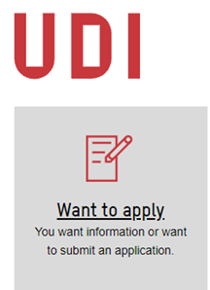
Self-registration and immigration appointment
If you are an EU/EEA national who is going to study and live in Norway for more than three months, you have to register – at Norwegian immigration - UDI.no
Registration is free
Registration at UDI.no, click «Want to apply», enter nationality, choose «Residence according to the EU/EEA regulations», choose «Students who are EU/EEA nationals» and follow instructions.
A print of the registration will need to be brought to the appointment with the immigration services on Tuesday 13th.

Slide 4
Self-registration and immigration appointment
Students who are EU/EEA nationals
.
Non-EU/EEA citizens:
Visa application must be in order before arrival, please follow the instructions in your visa letter. Documents to bring:
1) Confirmation of visa/residence permit received from the Norwegian immigration authorities
2) Original passport
3) If you have stayed in Norway earlier, residence card must be brought
4) Housing contract (with complete address in Norway)
EU/EEA citizens staying over 3 months:
You must have preregistered on the immigration authorities’ self-service portal before arrival Norway (not necessary if you stay less than 3 months): Want to apply - UDI- enter your nationality and follow the steps, category “Students who are EU/EEA national”
Documents to bring:
1) Print-out of your UDI-registration
2) Original passport or national ID-card
3) Admission letter from NTNU
4) European health insurance card – or other health insurance certificate
5) Personal statement that you have enough money to support yourself
6) Housing contract (with complete address in Norway)

Slide 5
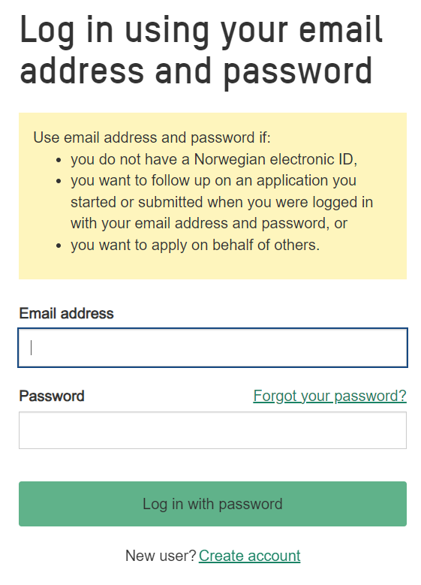
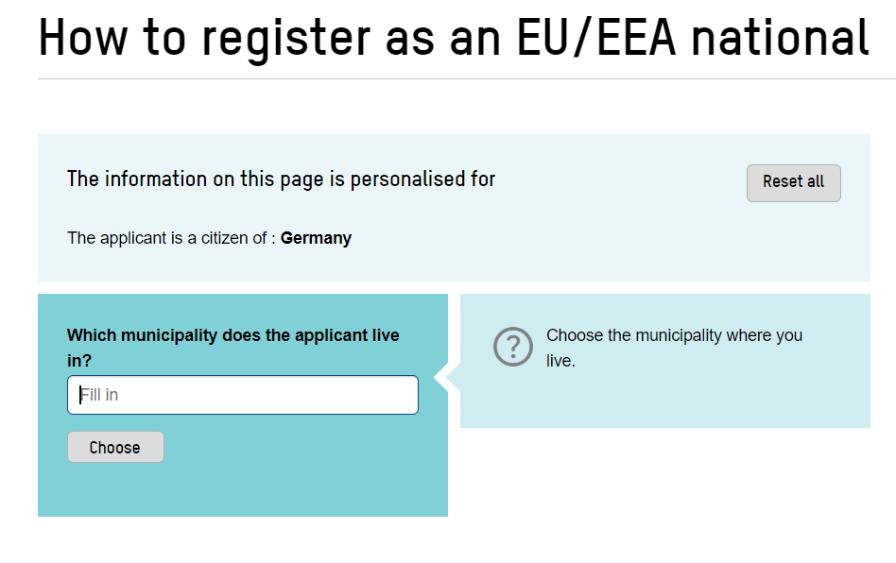
Self-registration and immigration appointment
  EU/EEA students:
Ålesund

Slide 6
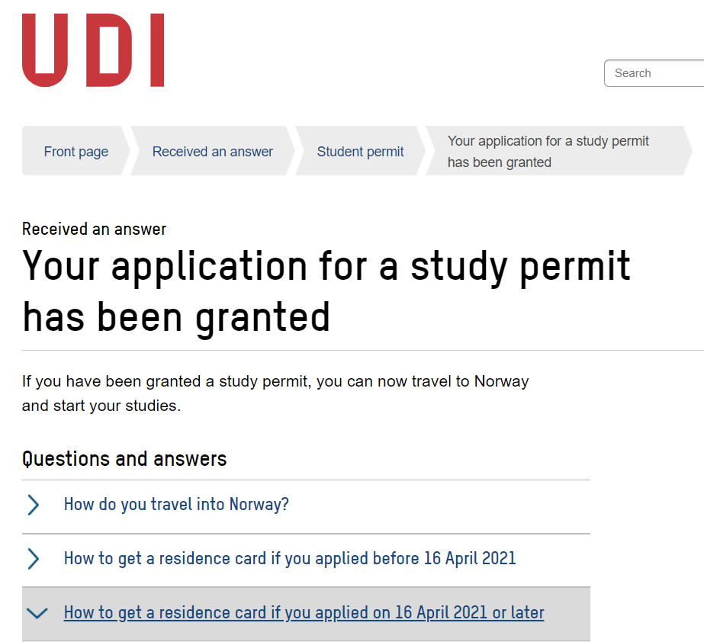
Self-registration and immigration appointment
Students who are EU/EEA nationals
.
International office can print necessary documents for you. Send an email with documents
It is extremely important that you write your name on your mail box exactly as it is written in your residence application. Make sure to write it clearly, capital letters, and with no initials unless it is written with initials in the application.
Register your postal address with the postal service (posten).

Slide 7
Useful links
Postal service
  Adress registration for students
Skatteetaten (tax authorities)
  Skatteetaten for foreign students
Udi.no (immigration authorities)

Slide 8
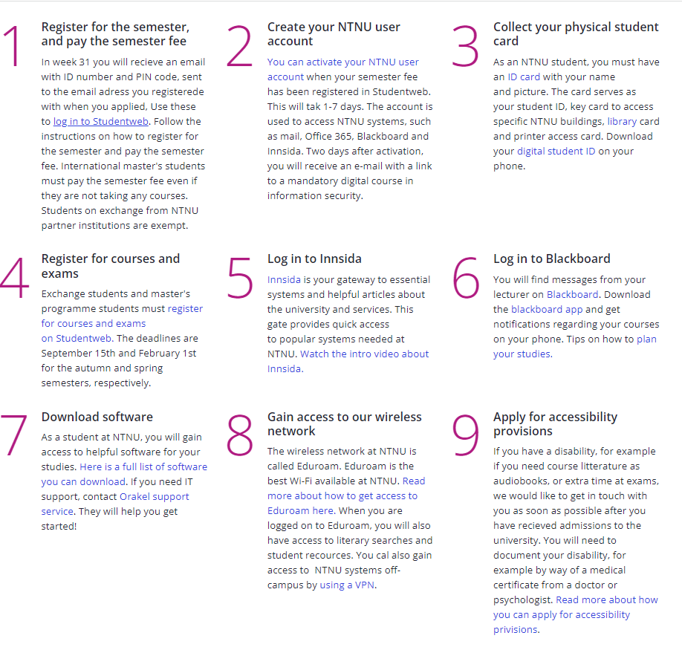

New international student - Arrival checklist
After you have read the Start of studies information for your study programme, there are some practical steps you must follow.
Exchange student? Read also the procedures for exchange students.
https://i.ntnu.no/en/ny-student

Slide 9
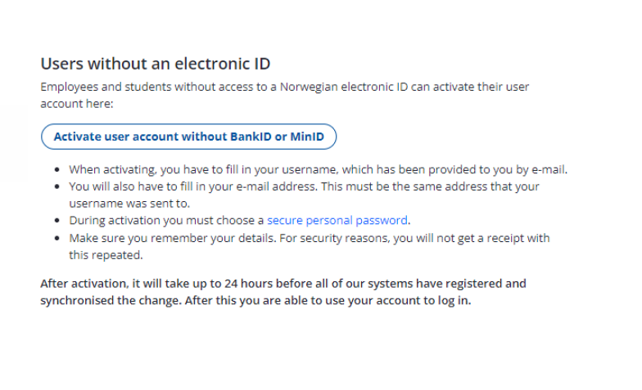
Activating user accounts without Norwegian ID

Slide 10

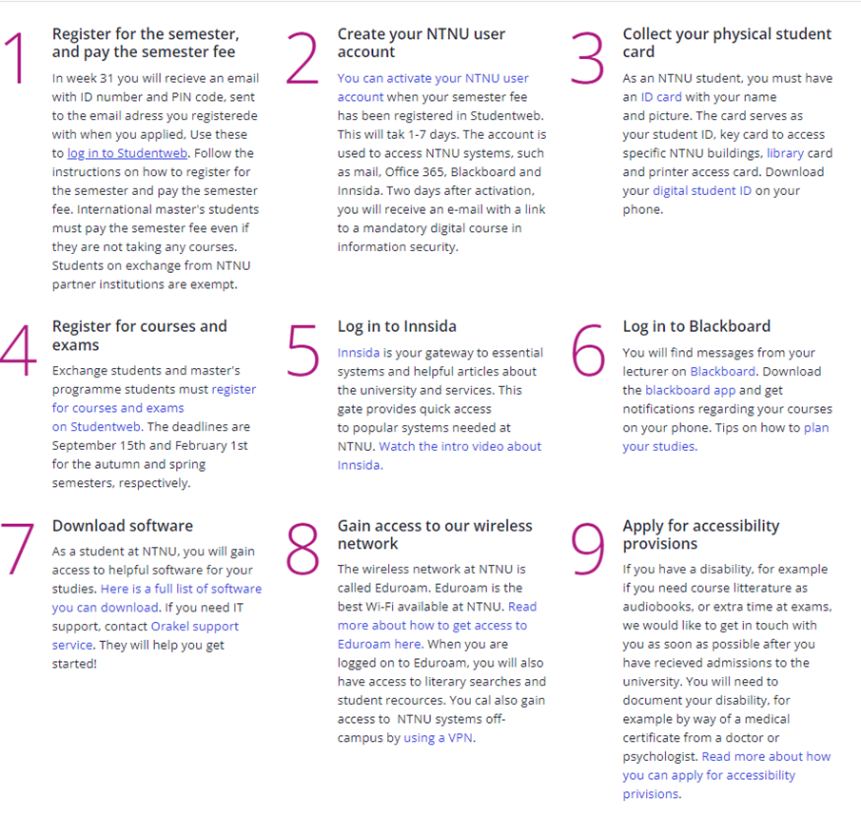
Student ID Card
As an NTNU student, you must have an ID card with your name and picture.
The card serves as your:
student ID
key card to allow you access to specific NTNU buildings
library card
printer access card (not exchange students) (?)
https://i.ntnu.no/studentkort – instructions on how to obtain your student ID card
Digital Student ID – app: https://i.ntnu.no/wiki/-/wiki/English/Student+ID+-+app

Slide 11
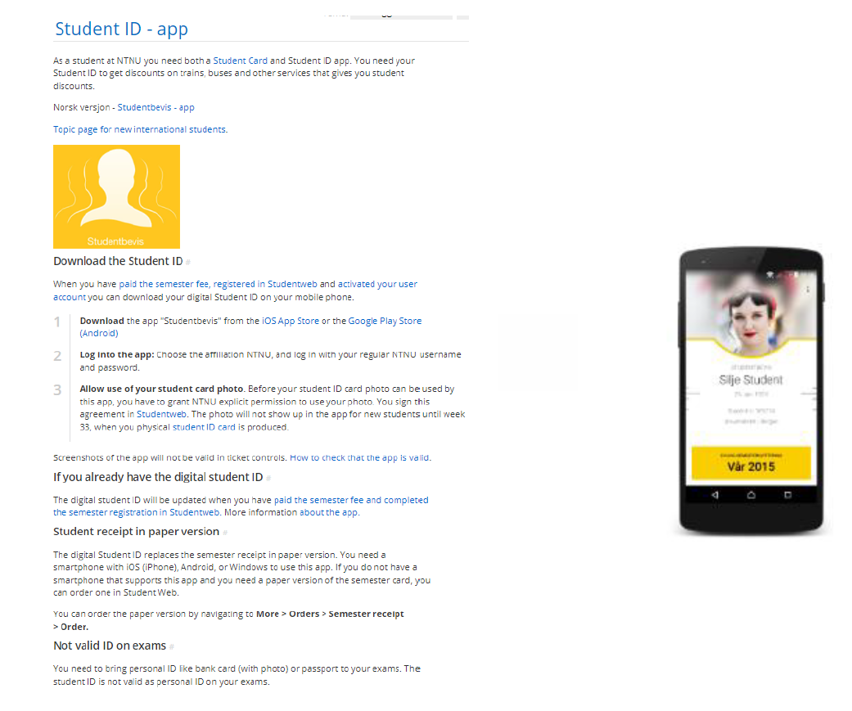
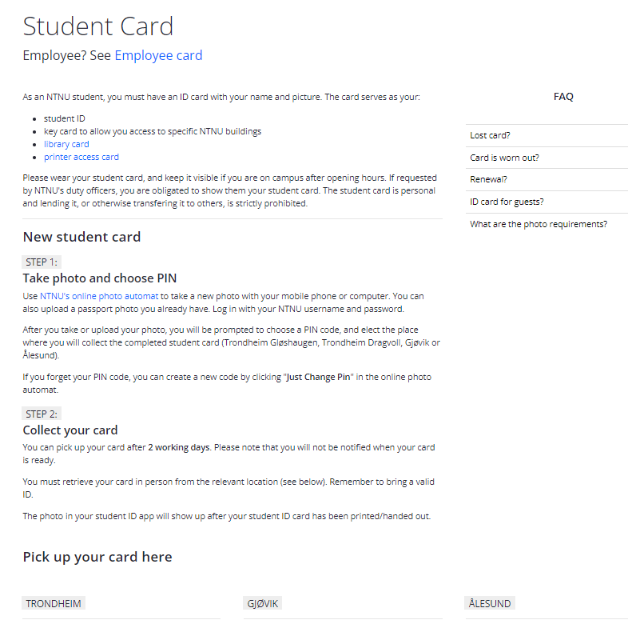
Student card and student ID app

Slide 12
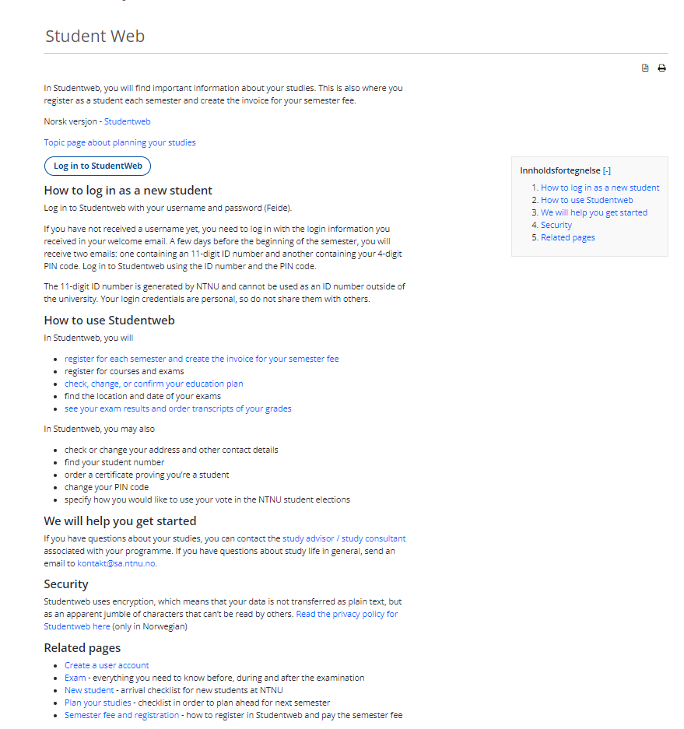
Studentweb
Remember to approve use of picture in order to get a digital student ID in the Student ID App

Slide 13
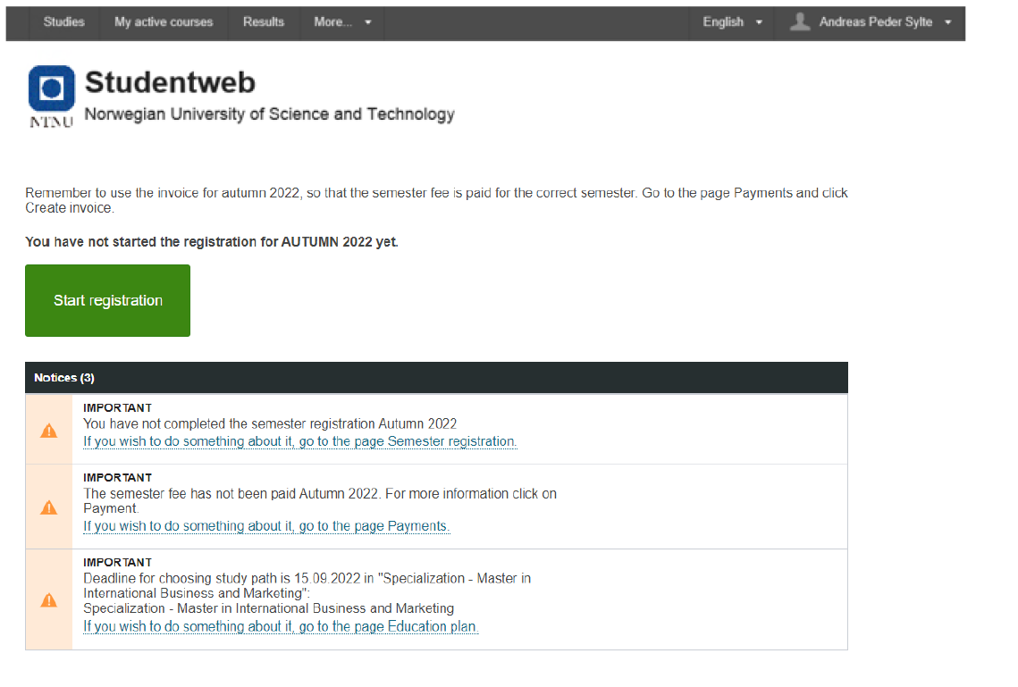

Slide 14
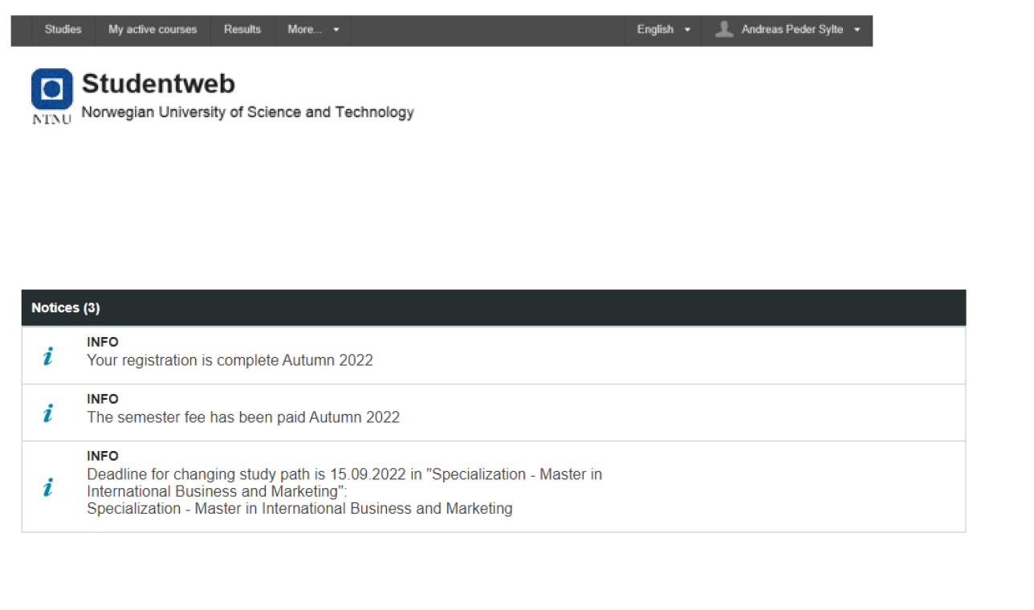

Slide 15
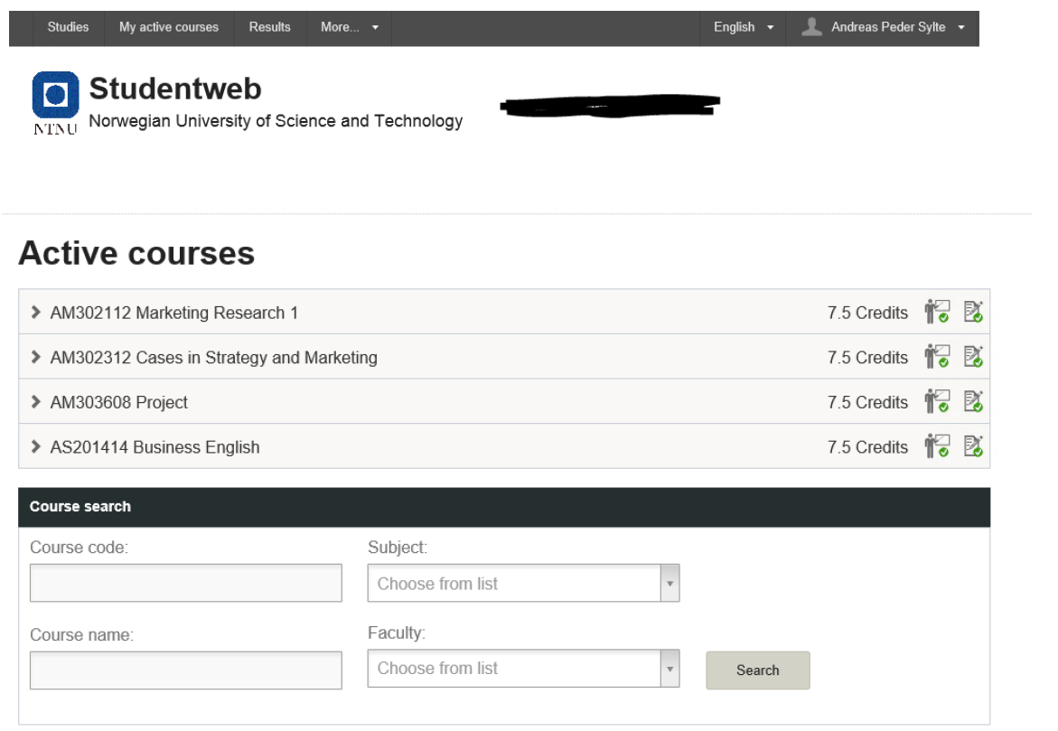

Slide 16
Erasmus+ students: Documents and signatures
Arrival Confirmation​ and Learning agreement
  Mobility Online
  Send the documents by e-mail to karen.m.hovland@ntnu.no or maria.t.valderhaug@ntnu.no
  Bring documents
Learning agreement:
  To be completed when all courses are approved and signed up for
  Changes can be made until 15th September.

Slide 17
Erasmus+ students: Course selection and registration
Course selection and registration
  In your acceptance letter, it should state what courses you have been approved for
  Note: the Norwegian course will have a separate admission
  Changes in course selection can be made until 15th September
  We can assist with registration/changes of courses
  Conflicting class schedules: Check your class schedule (timeplan)
  Many of you will likely have to make changes in your course selection due to conflicting class schedules. This is normal. We will assist you with finding alternative courses.
  You can do your own course registration online from approximately 1. august, after receiving instruction from NTNU on establishing an NTNU profile/account.

Slide 18
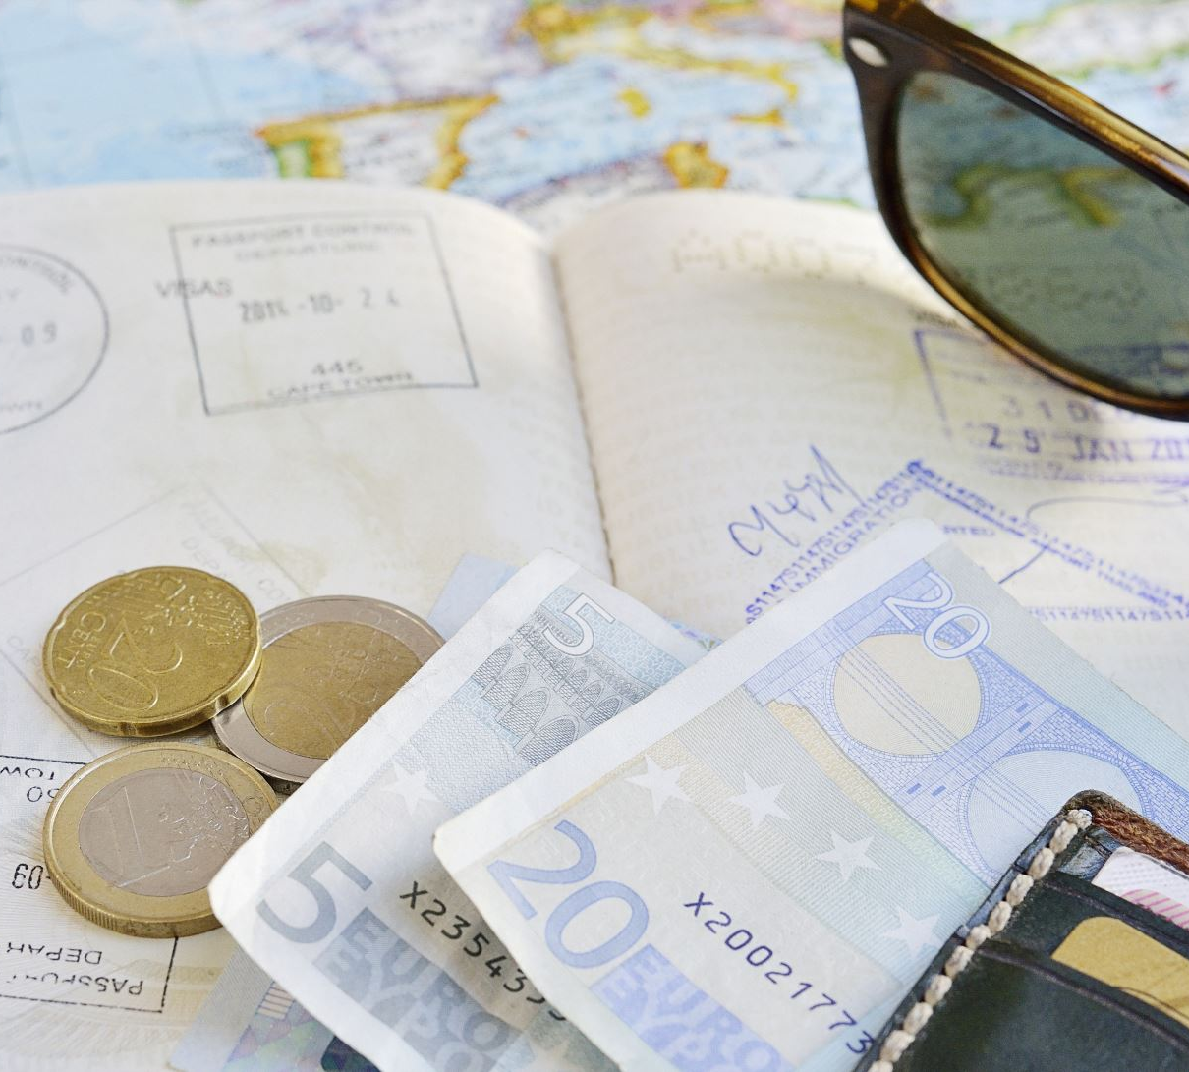
Deposit account, cash card and Norwegian bank account
All students who have made a deposit in the NTNU deposit account will be able to receive a Cash Card. The amount on the card is 50KNOK.
Stop by the office for picking up card.
The remaining money must be transferred to a Norwegian bank account.

Slide 19
Open a Norwegian bank account
In order to open a Norwegian bank account you will need to have your resident permit and have received your D-number (personal identification number).
Once you have these (may take up to a month to receive these
Contact a bank to open an account – may take 1-2 weeks
Contact (email) the international office when you are ready to make a transfer to your Norwegian account.

Slide 21
Expected of you as a student
Time – be on time
Deadlines – uphold deadlines on courses
Communication – contact lecturer/professor
Ask questions, ask for clarification, ask for help, ask for extension
  If you don’t ask beforehand, it might be too late
Responsible student
Honesty – exams as well as in general

Slide 22

Travel card
We recommend you obtain a travel card during your stay at NTNU
You can either order a travel card online or visit the Bus terminal at Moa (5-6 km. from campus)
We recommend to use the Fram App
More information here: Frammr.no

Slide 23
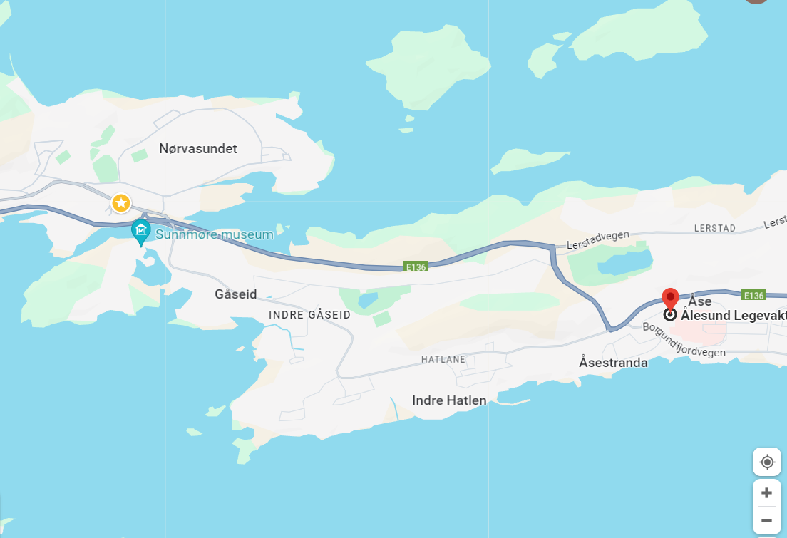
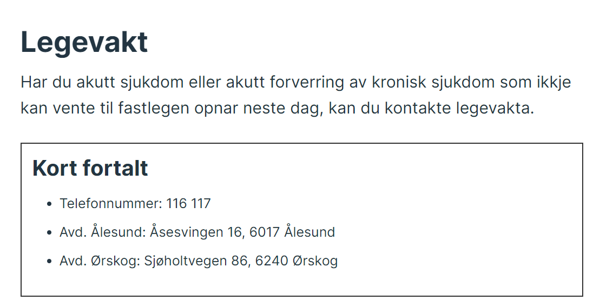
In case of illness
Legevakt
Bring passport, health insurance card (EU students), residence card (or paper)
Call before you go there unless emergency

Slide 24
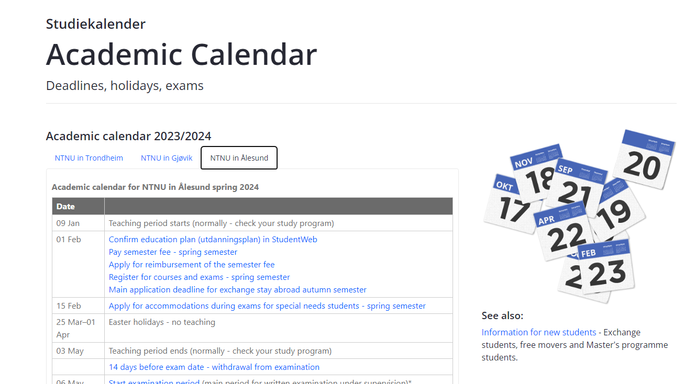
Academic Calendar
Remember to choose Ålesund
Courses start 19th of August
15th September
  Register for class/exam
  Pay semester fee
Exam period
  Withdraw 14 days before exam
  Check each course for exam date

Slide 25
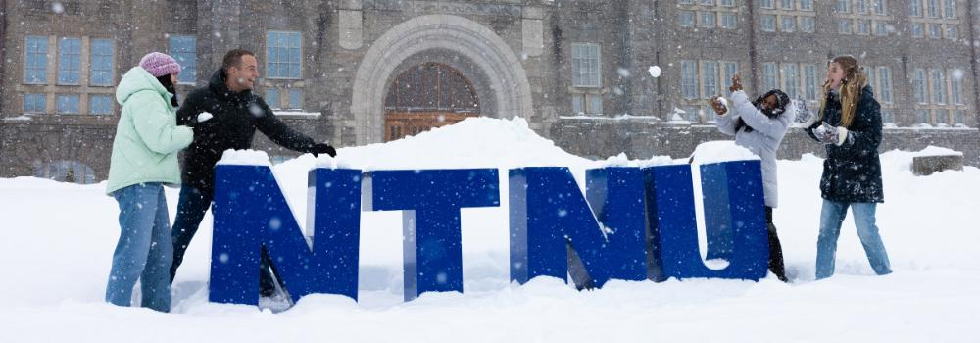
https://www.ntnu.edu/studies/
https://www.ntnu.edu/lifeandhousing/alesund

Slide 26
Internet and Intranet
Internet
Intranet - Innsida
ntnu.no or for English - ntnu.edu
  Search field
  Departments (Institutt)
  Maps
  Services – For students
Student i Ålesund
Log in
Select language
Feed – channels
For students – Shortcuts
Wikis for NTNU information
NTNU – Help (NTNU Hjelp)

Slide 27
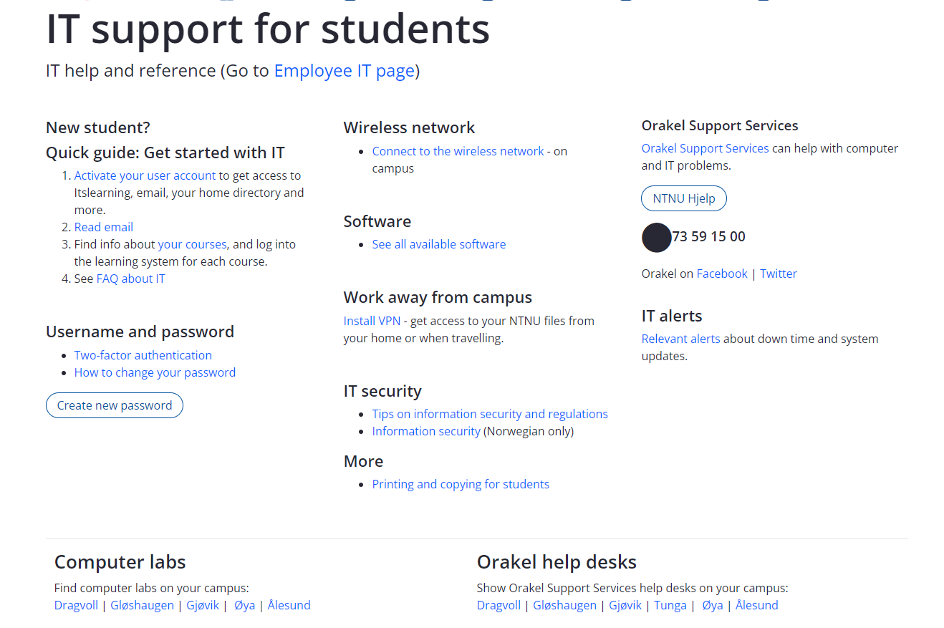
https://i.ntnu.no/en/it-hjelp

Slide 28
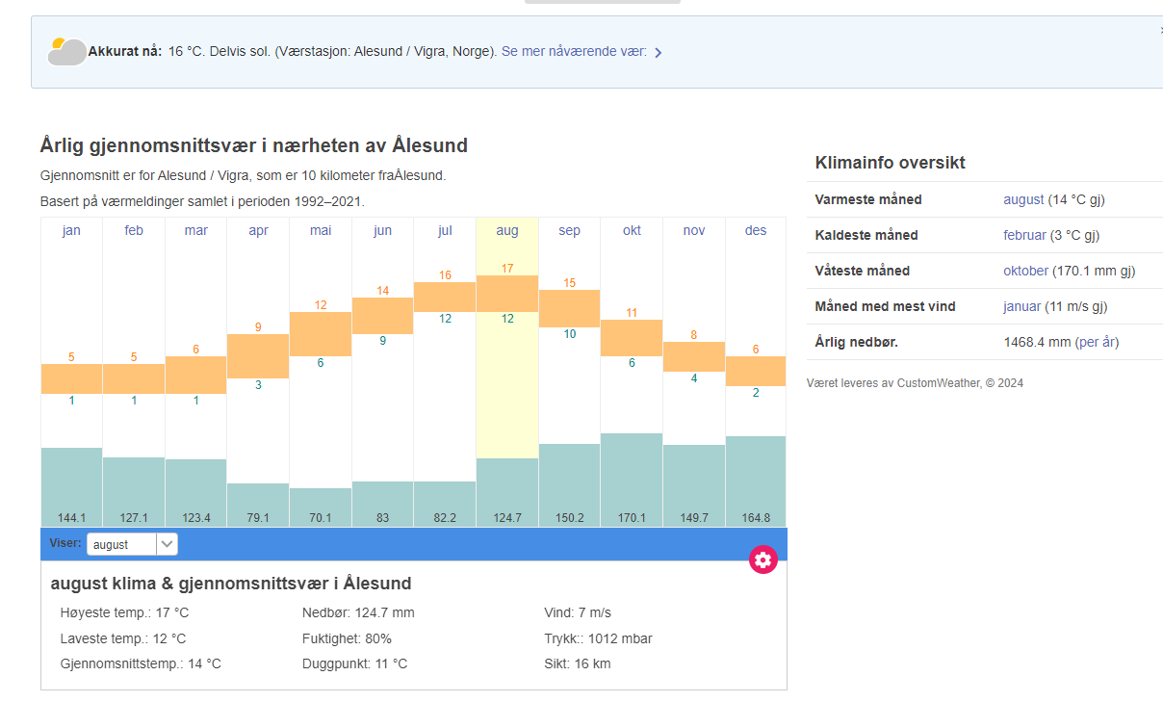

Slide 29



Keep warm and cozy in all weather
All weather jacket
Rain boots
Umbrella – NO!!!
Wool
Winter boots
Winter hat
Mittens/gloves
Layers
«There is no bad weather, only bad clothes»

Slide 30
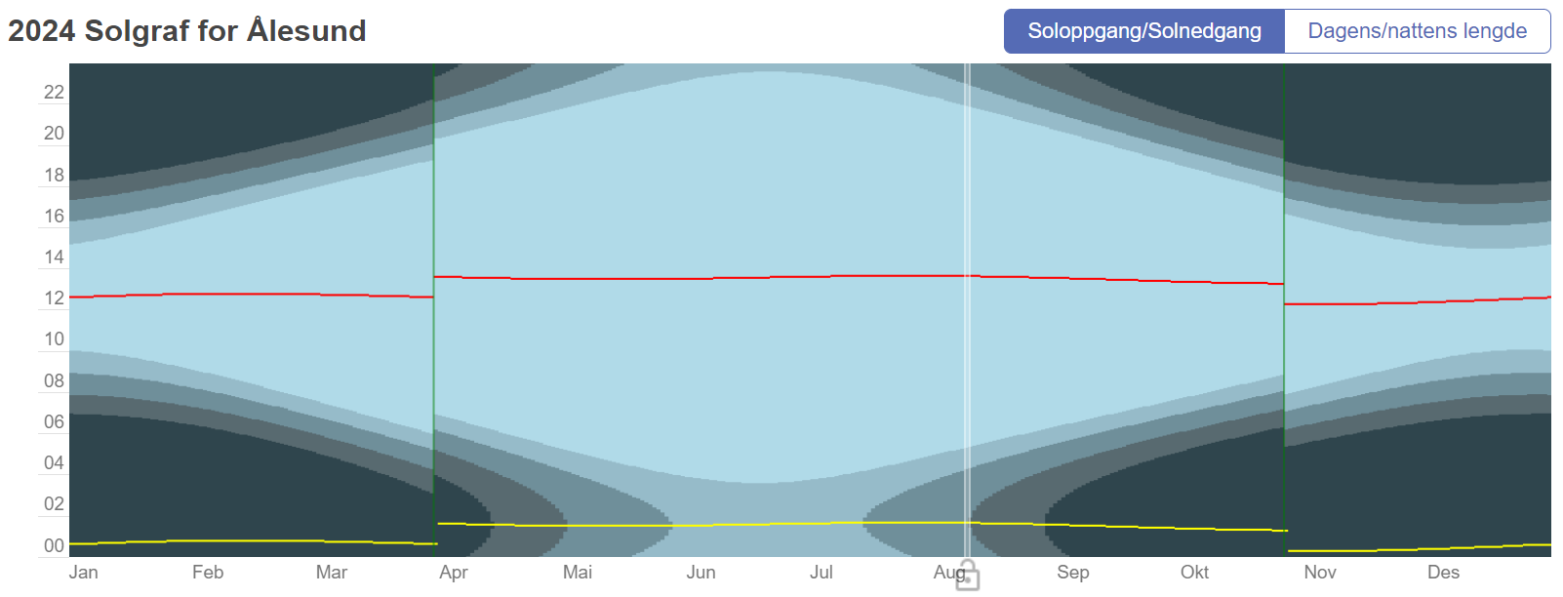
Daylight Ålesund

Slide 31
Mørketid (time of darkness)
November – February
Dark when you go to class and dark when you get home
Make sure to get some daylight during class breaks
Go outside during daytime as much as you can – much higher lux
Do wintercozy activities indoor – Hygge
  Hot choclate, a good movie, lots of blankets, warm socks
  Make a nice meal with friends
  Go for a walk to spot the Aurora Borealis/Northern lights

Slide 32
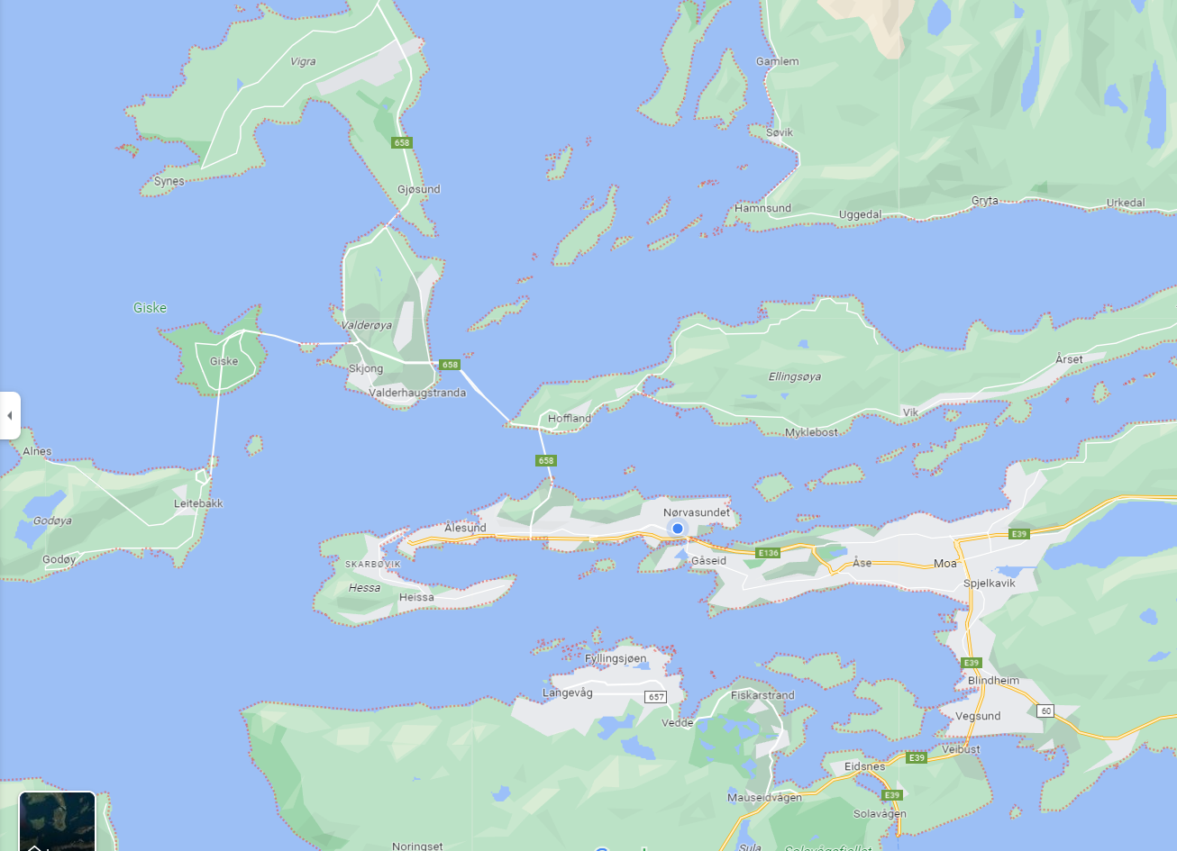




Tourist attractions and bucket list
Giske
Historical island
Church from 11th century
Beaches
Godøy and Alnes
Lighthouse
Fisherman village
Beach
Ålesund
Art Nuveau/
Jugendstihl
Museums
Scenic city center
Guided walking tour
Tueneset
Aquarium
Atlantic Sea Park
Scenic and historical (ww2) area
Sunnmøre Museum
Aksla/Fjellstua
Hiking/stairs
Viewpoint
Café
Legevakt
Emblemsfjellet/
Spjelkavik turheis
Hikingtrails
Ski lift
Sukkertoppen
Hiking
Viewpoint
Langevåg/Sula
Hiking
Viewpoint
Devold outlet stores and
Museum

Slide 33
Ålesund
Jugendstilsenteret/Kube
Ålesund Museum
Fisheries Museum
Sunnmøre Museum
Atlanterhavsparken
Sukkertoppen
Aksla/Fjellstua
Hiking:
  Aksla
  Sukkertoppen
  Emblemsfjellet/Turheisa
  Sulafjellet
  Godøyfjellet
Visitalesund.com
A guide to art nouveau in Ålesund
gofjords.com
Fjordnorway.com - Ålesund and Geiranger
Visit Norway - Ålesund and Geiranger

Slide 34
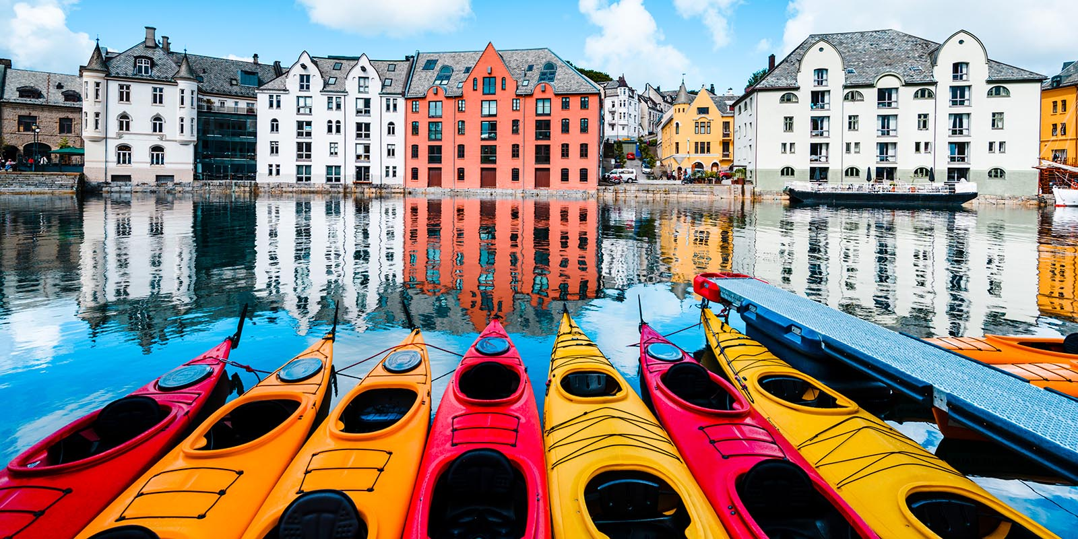

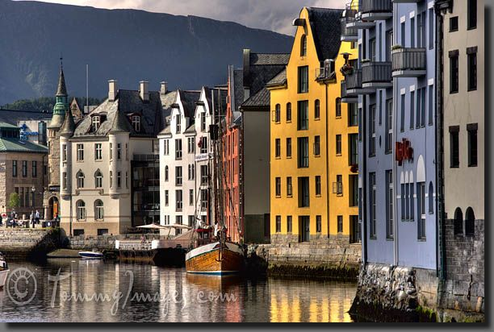

Ålesund

Slide 35
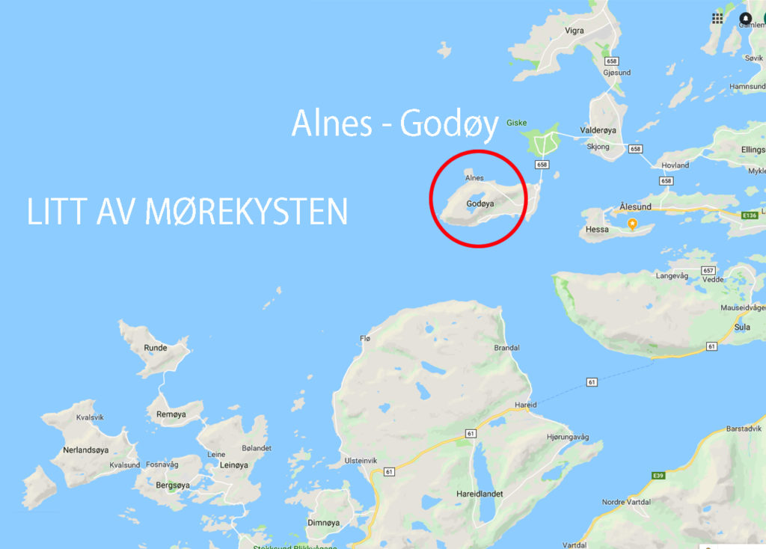
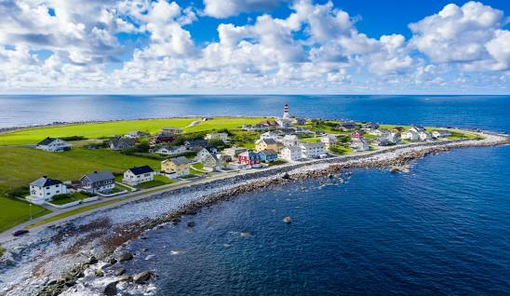
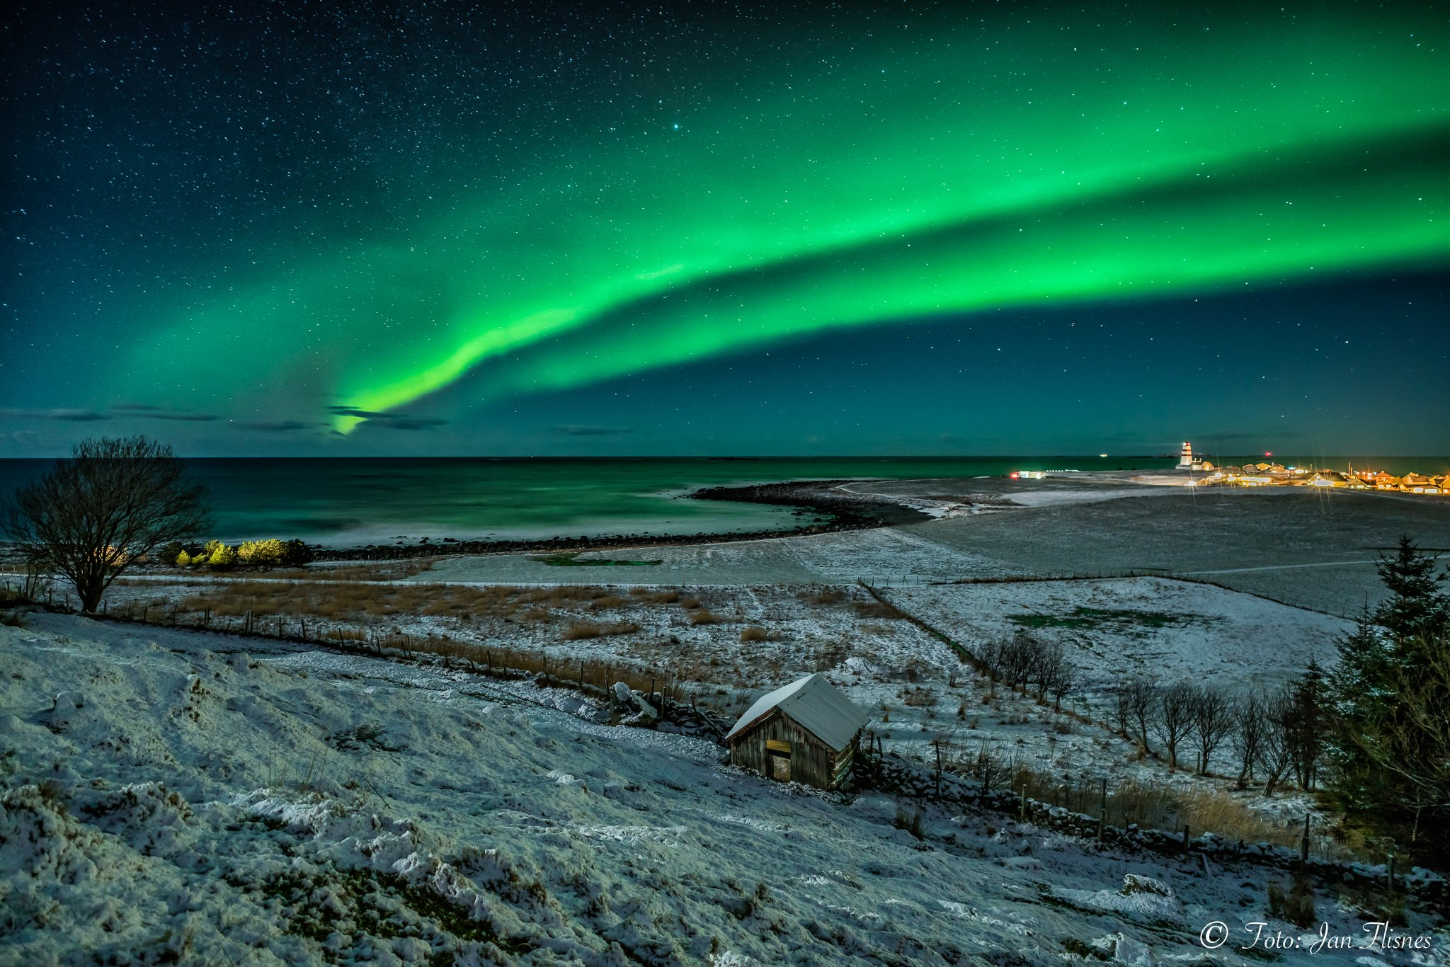
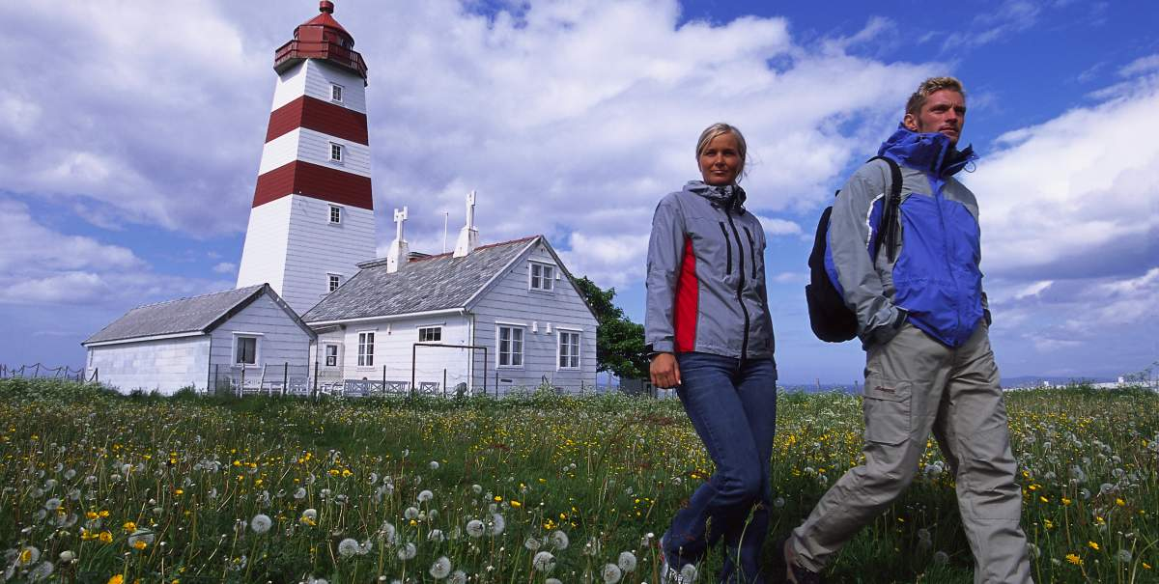
Alnes fyr - Godøy

Slide 36
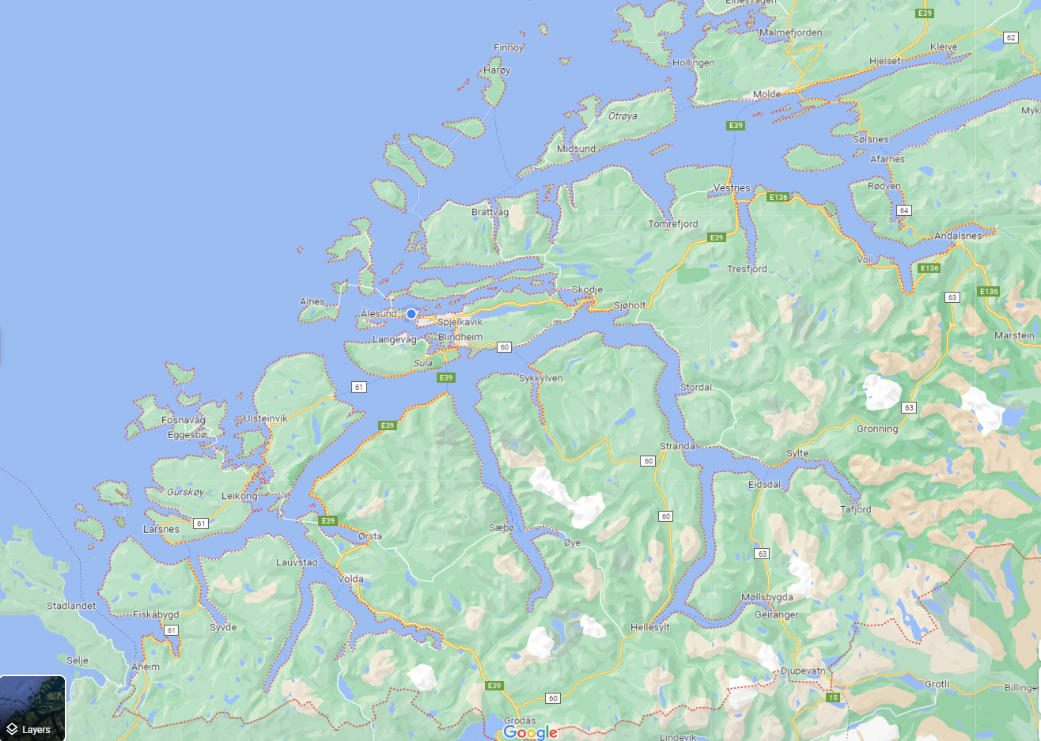
Atlanterhavsvegen
Nordøyane
Ona
Åndalsnes
Trollstigen
Runde
Stranda/Fjellsætra
Valldal
Sunnmørsalpene
Hjørundfjorden
Stadlandet
Geirangerfjorden

Slide 37

Sunnmøre
Geiranger
Hjørundfjord
Sunnmøre Alps (hiking)
Atlanterhavsvegen (from last James Bond film ☺)
Strandafjellet (skiing/lift)
Fjellsætra (skiing)
Runde (bird sanctuary)
Stadtlandet
Valldal
Romsdalen (from Mission Impossible film)
DNT - Den Norske Turistforening
Stikk ut!
Sunnmørsalpene
Strandafjellet
Fjellsætra

Slide 38
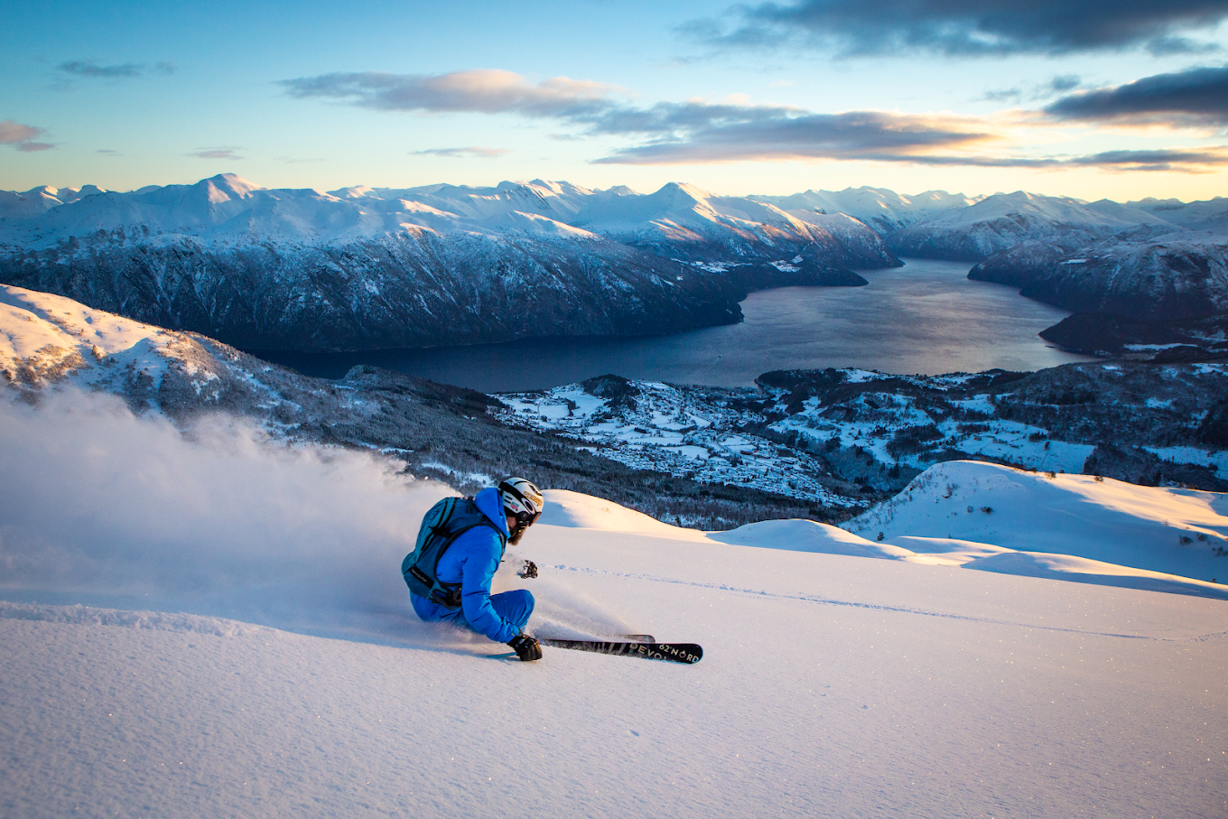
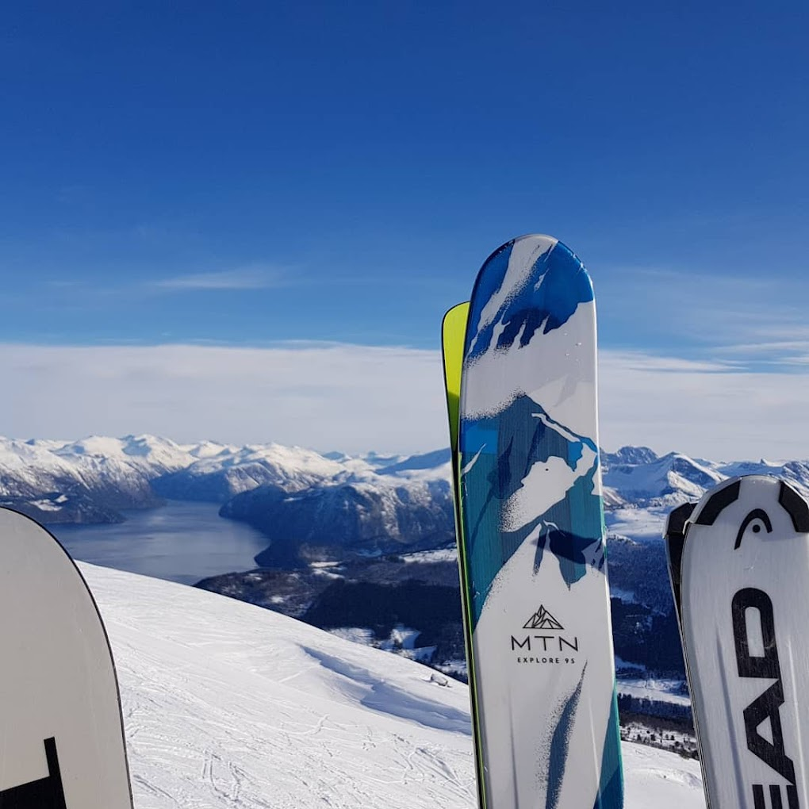
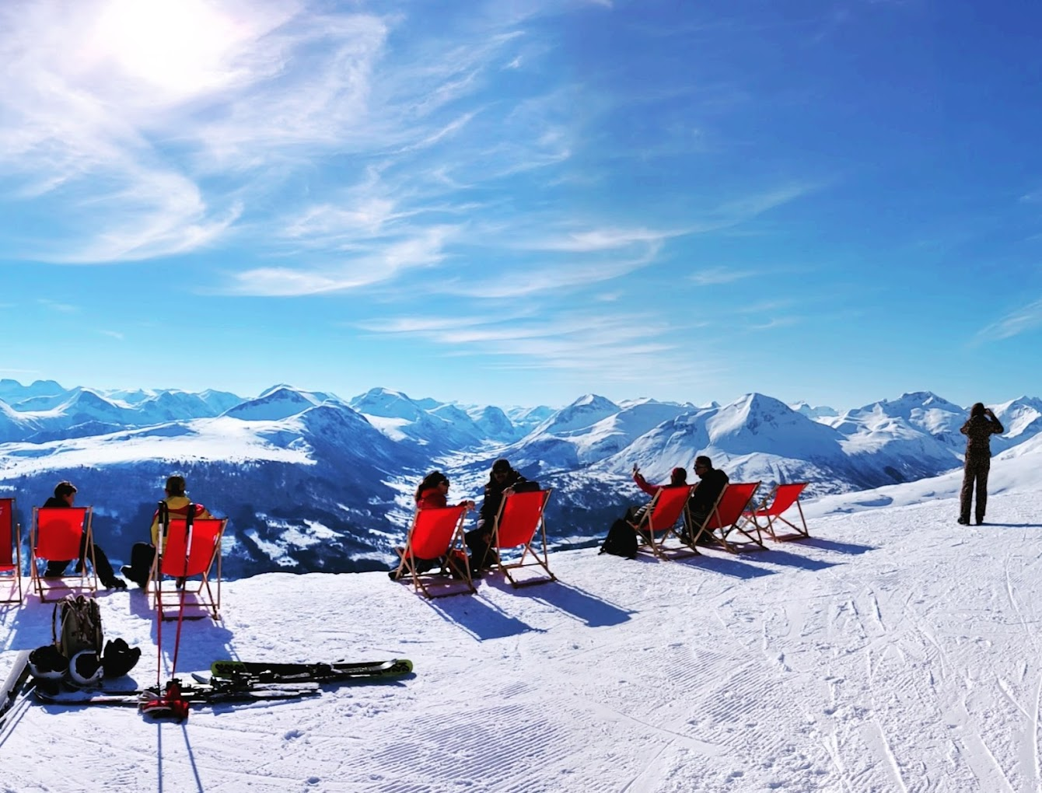
Skiing

Slide 39
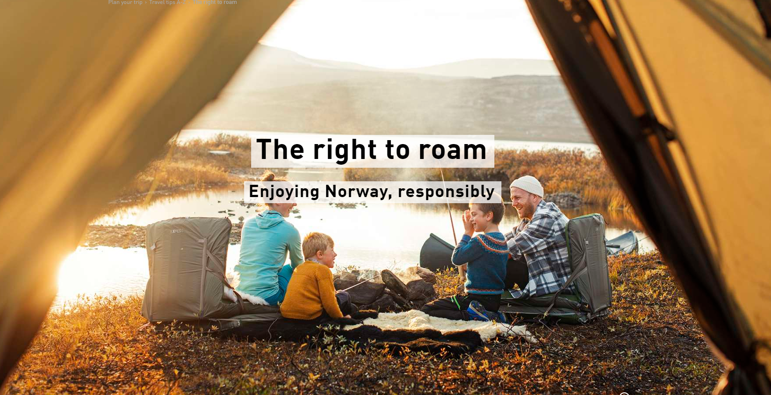
Important knowledge about Rights and Safety while exploring Norway
Right to Roam – Allemannsretten
The Norwegian Mountain Code - Fjellvettreglene

Slide 40
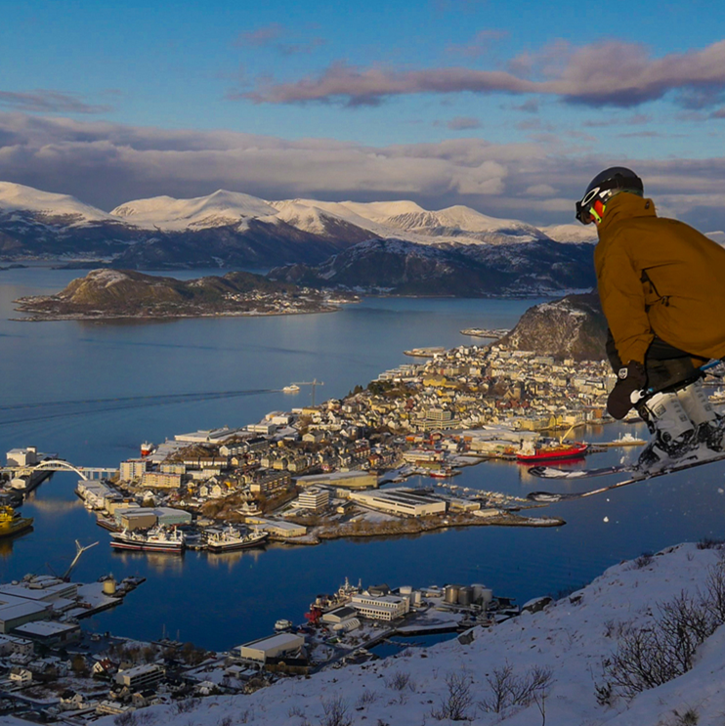
Interested in seeing international students try skiing for the first time ?
Check out this video from a student trip to the mountains:
https://www.wevideo.com/view/1345212441

