Slide 1

WELCOME TO ÅLESUND!
Autumn 2025
Mini-ICT Course

Slide 2



3 information channels at NTNU
E-mail – «It’s personal» – Your student email account – check regularly
Blackboard – information regarding your courses
  Learning material
  Announcements from teacher
  Assignments/hand-ins and other tasks
Innsida (intranet) –
  Announcement channel for NTNU and your institute
  Wikis
  Guidelines, rules and regulations
  General student deadlines
  Time tables/year calendar
  Student events
  Job opportunities etc

Slide 3
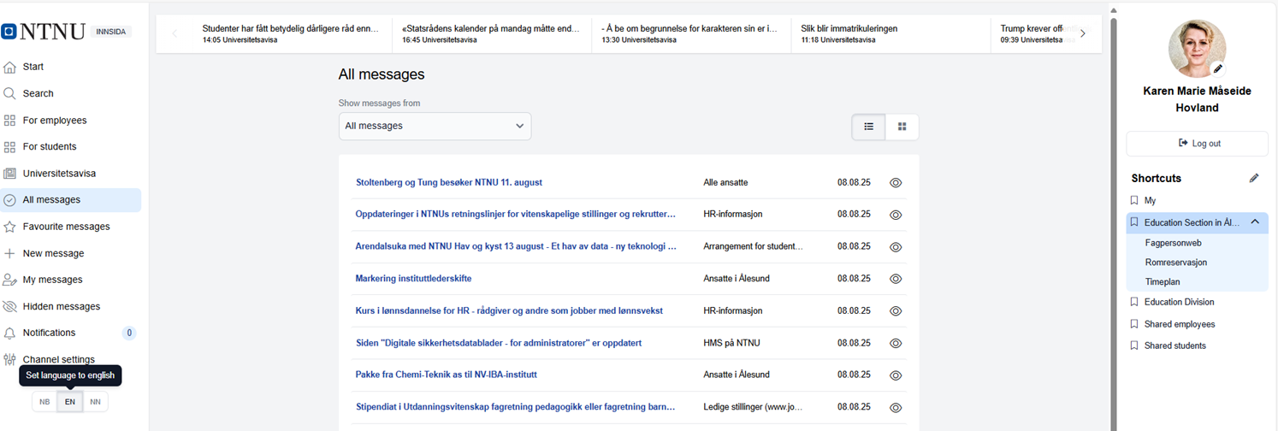
Internet and Intranet
Internet
Intranet - Innsida
ntnu.no or for English - ntnu.edu
  Search field
  Departments (Institutt)
  Maps
  Services – For students
Student in Ålesund
Log in
Select language
News feed – channels
For students – Shortcuts
NTNU – Help (NTNU Hjelp)

Slide 4
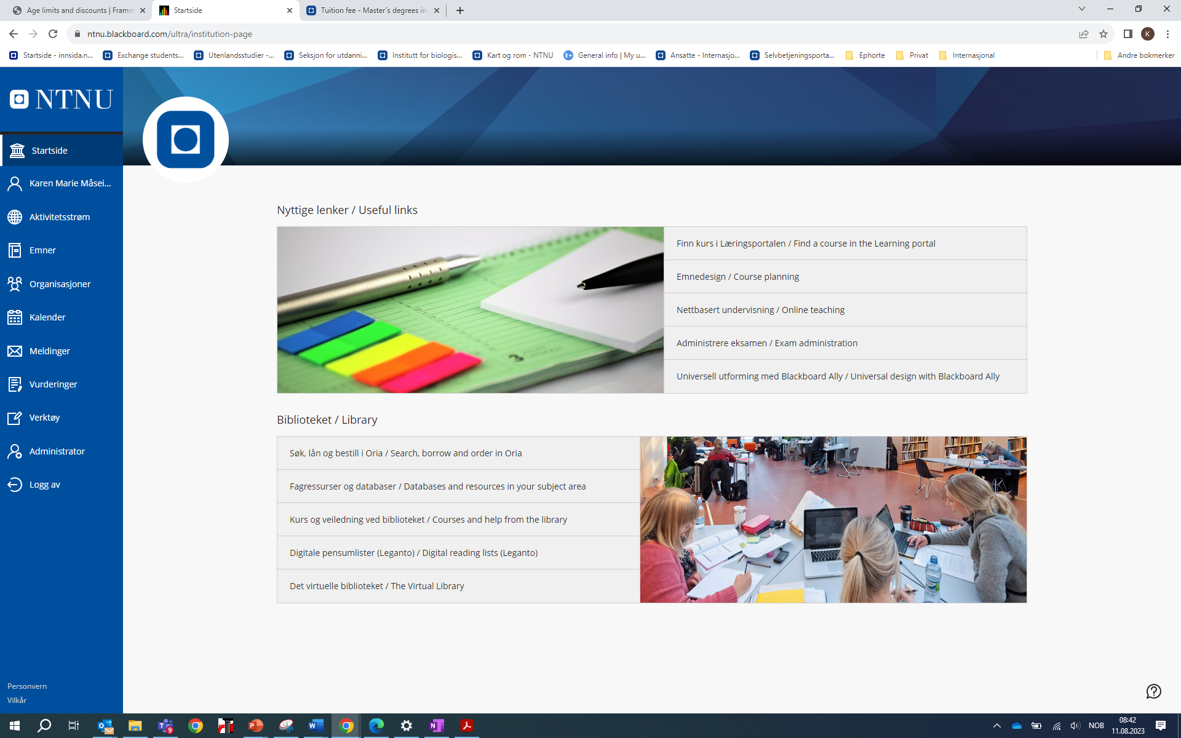
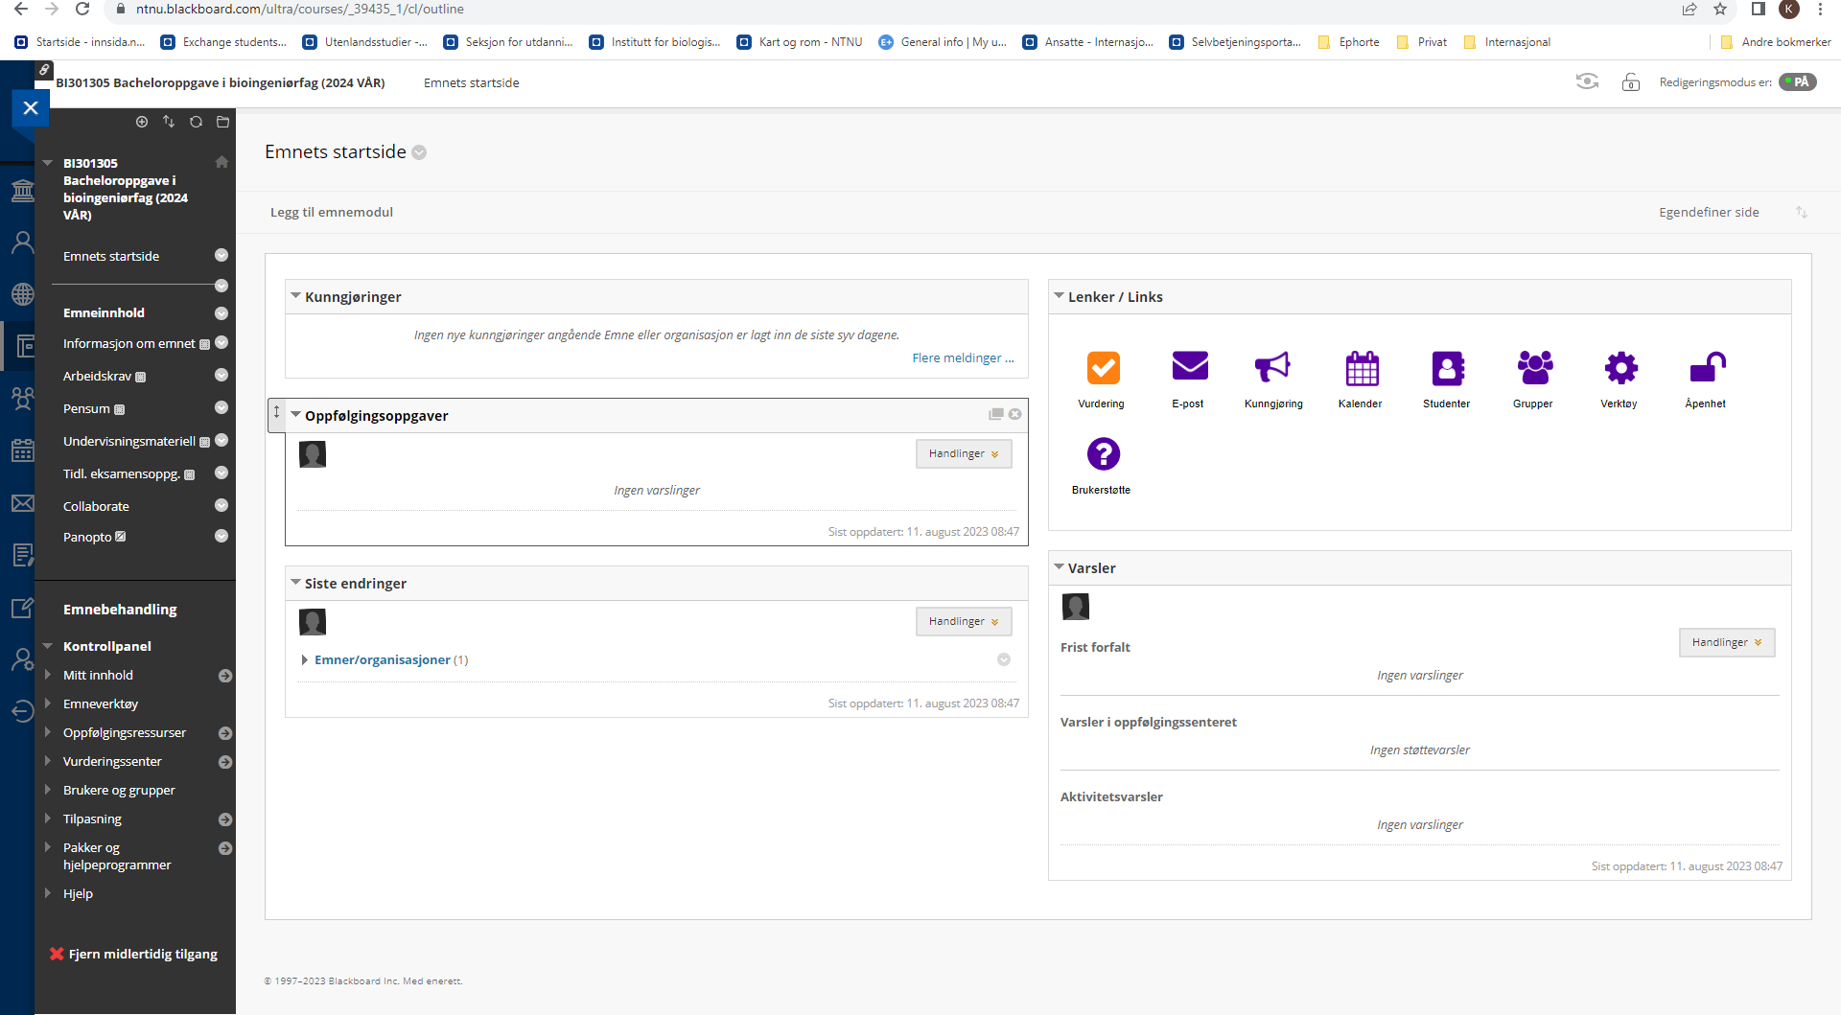
Blackboard

Slide 5
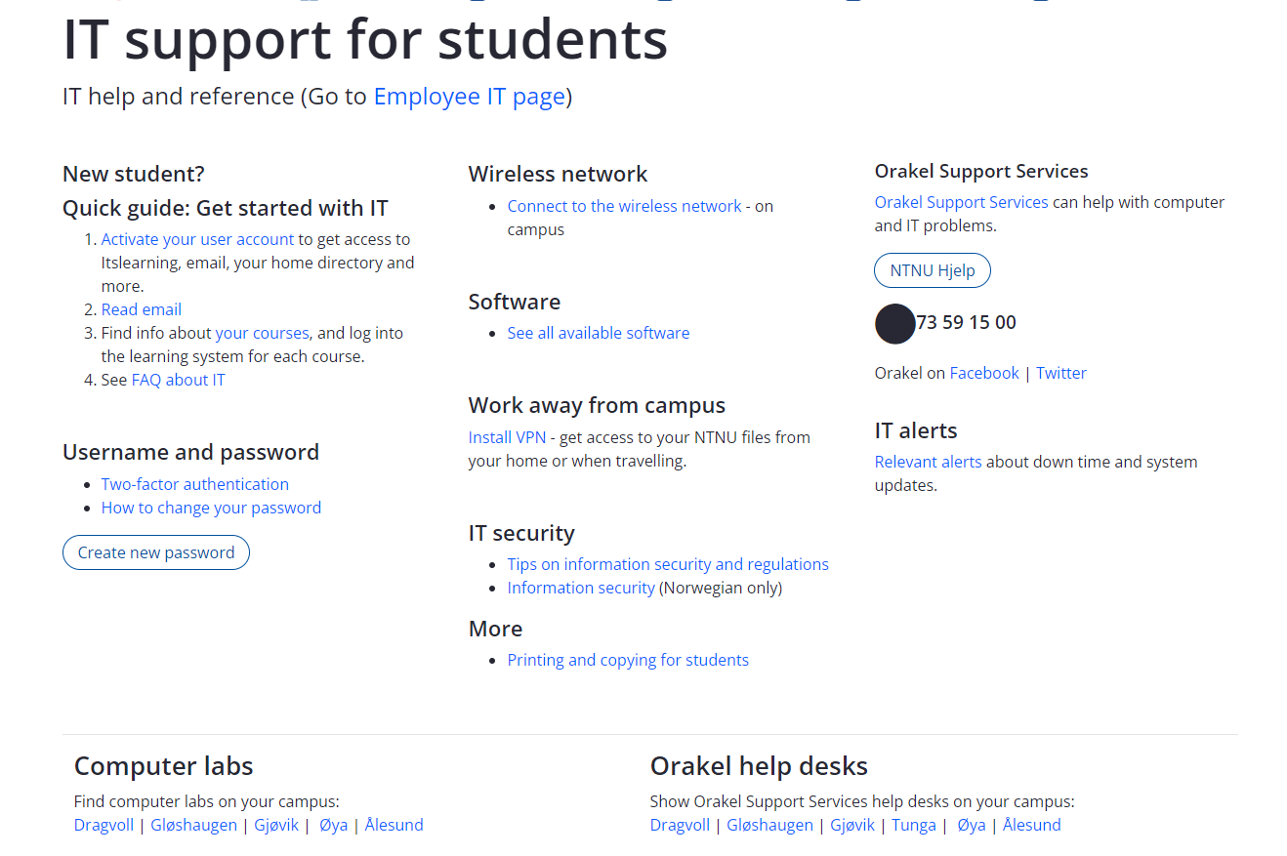
https://i.ntnu.no/en/it-hjelp

Slide 6
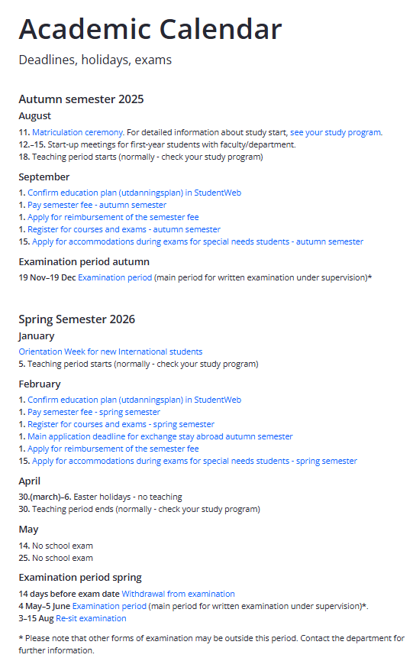
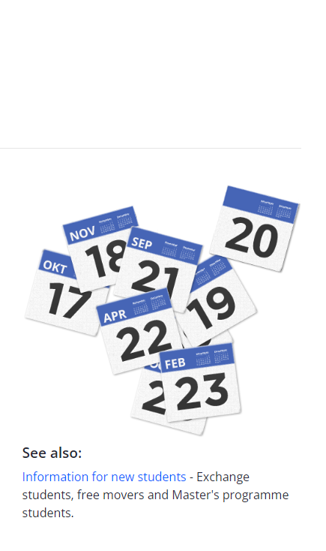
Academic Calendar
Courses start 18th of August
1st September - deadline
  Register for class/exam
  Pay semester fee
Exam period 19 Nov – 19 Dec
  Withdraw 14 days before exam
  Check each course for exam date

Slide 7
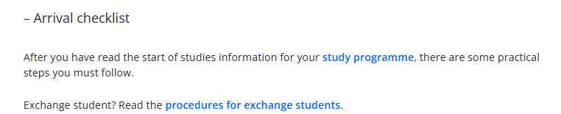
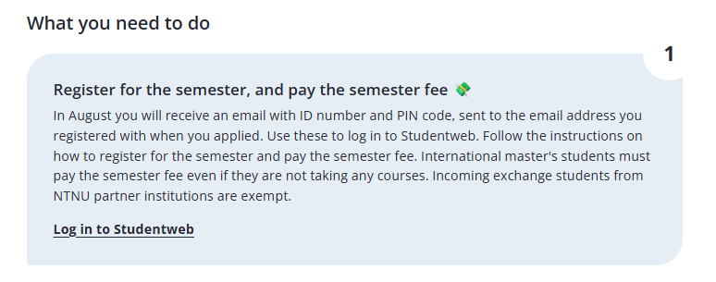
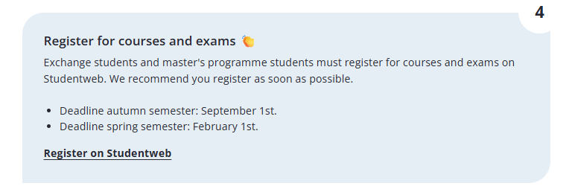
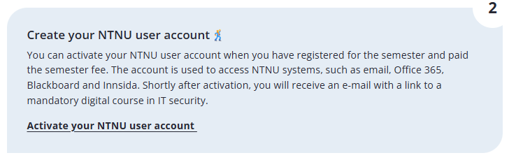
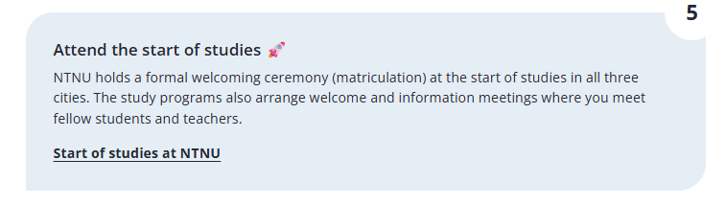
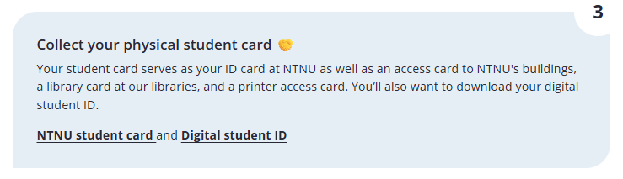
https://i.ntnu.no/ny-student
Welcome as a new student
Master’s degree students
Exchange students

Slide 8
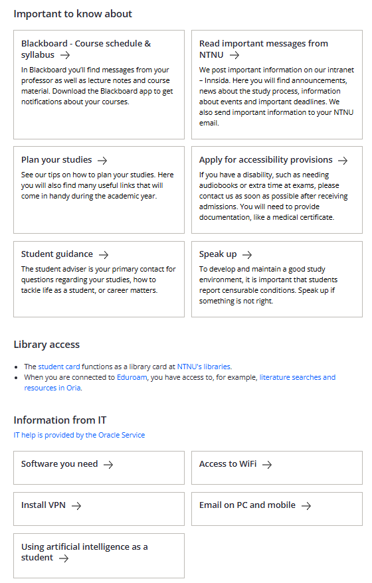


Slide 9
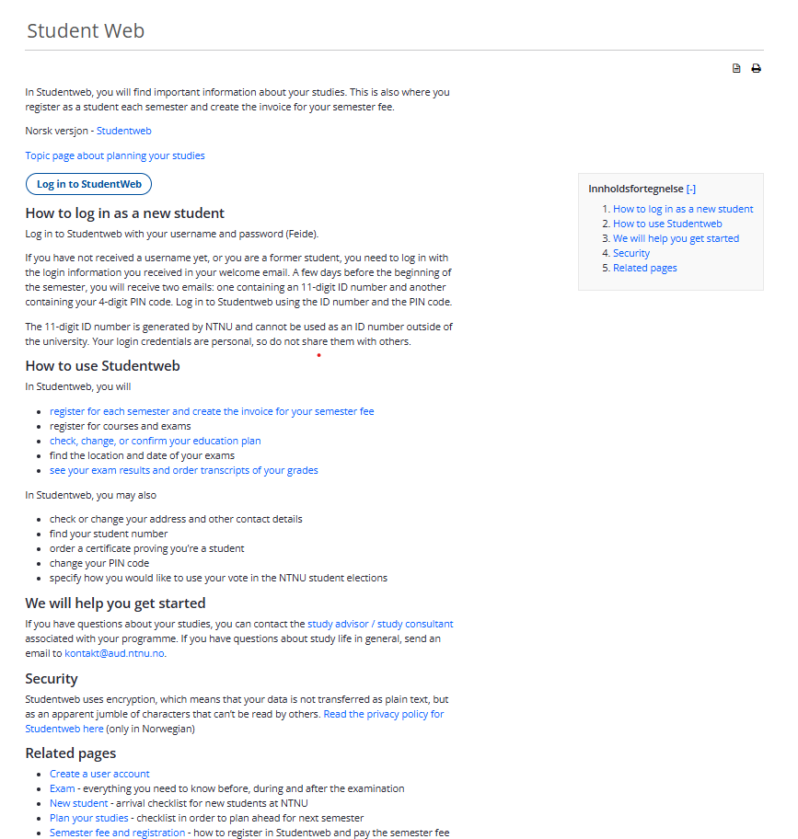

StudentWeb
Remember to approve use of picture in order to get a digital student ID in the Student ID App (My profile – Consent)

Slide 10
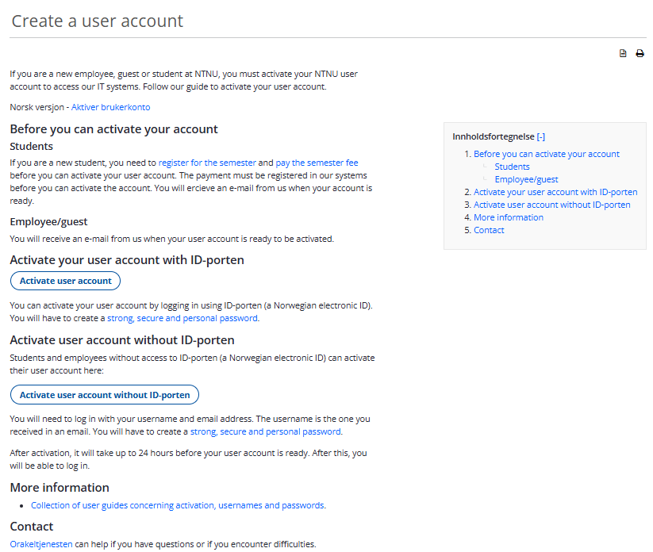

Create a user account

Slide 11

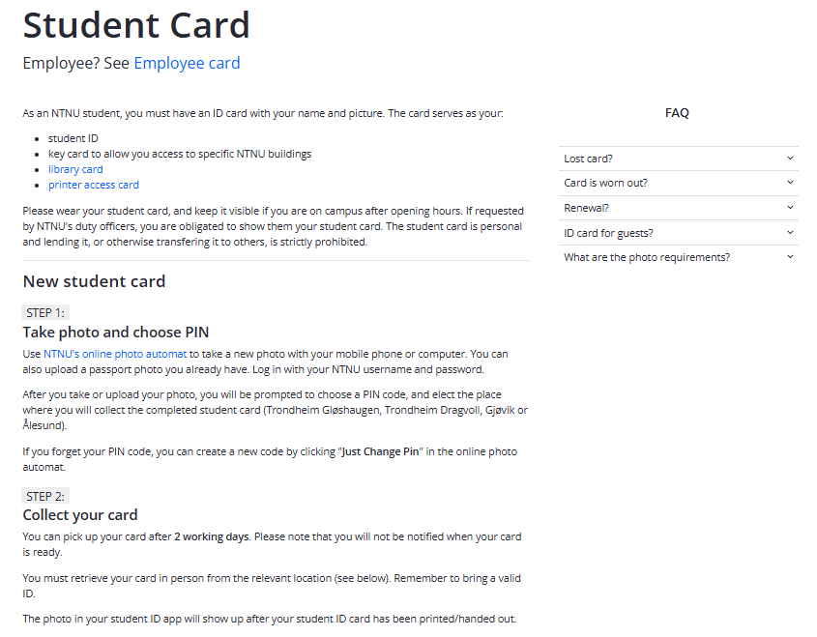

Student card
NTNU’s online photo booth

Slide 12
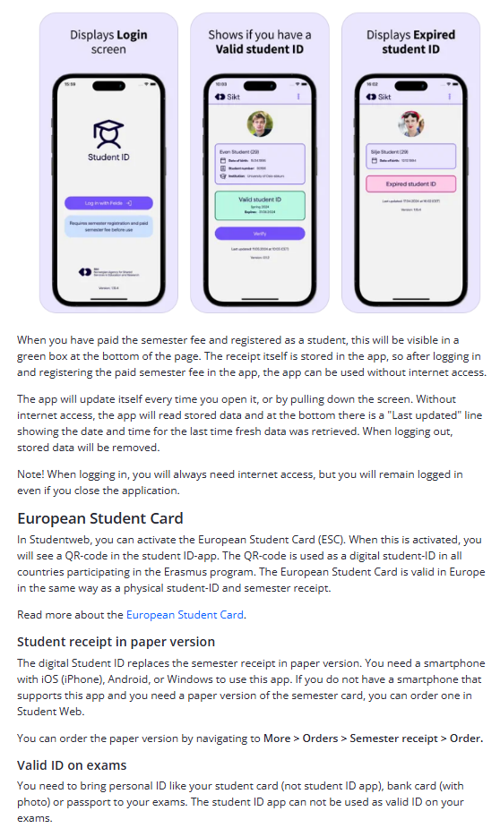
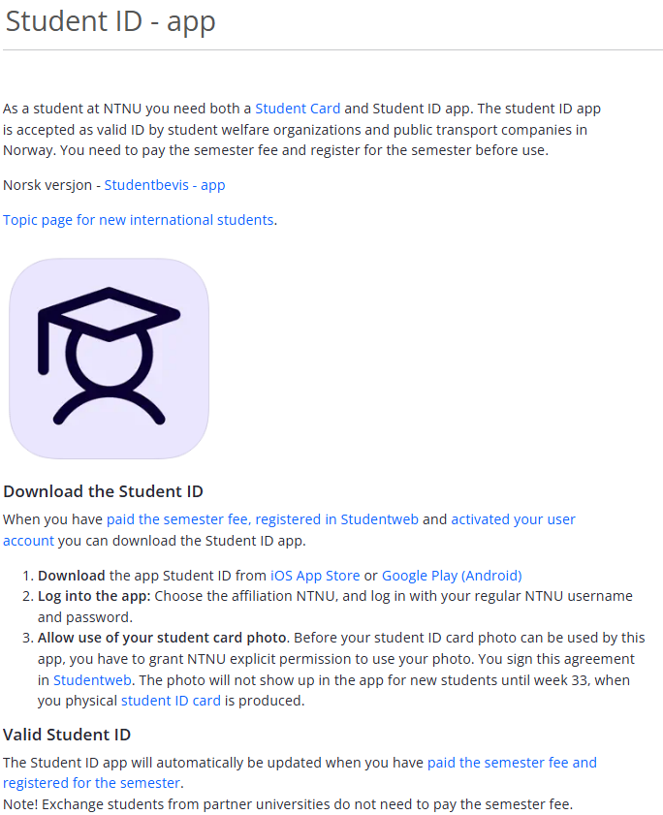
Digital Student ID

Slide 13
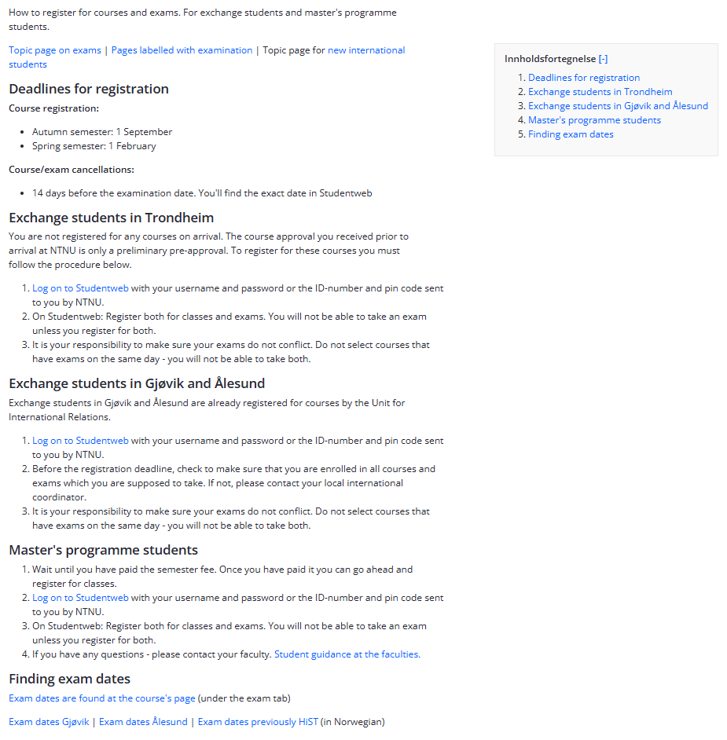

Register for courses and exams
It is YOUR responsibility:
Check that you are enrolled in the right courses
Check that you are registered for both lectures and exams
Check that courses do not have conflicts in
  Weekly lecture (check the whole semester)
  Exams (check exam date/time)

Slide 14
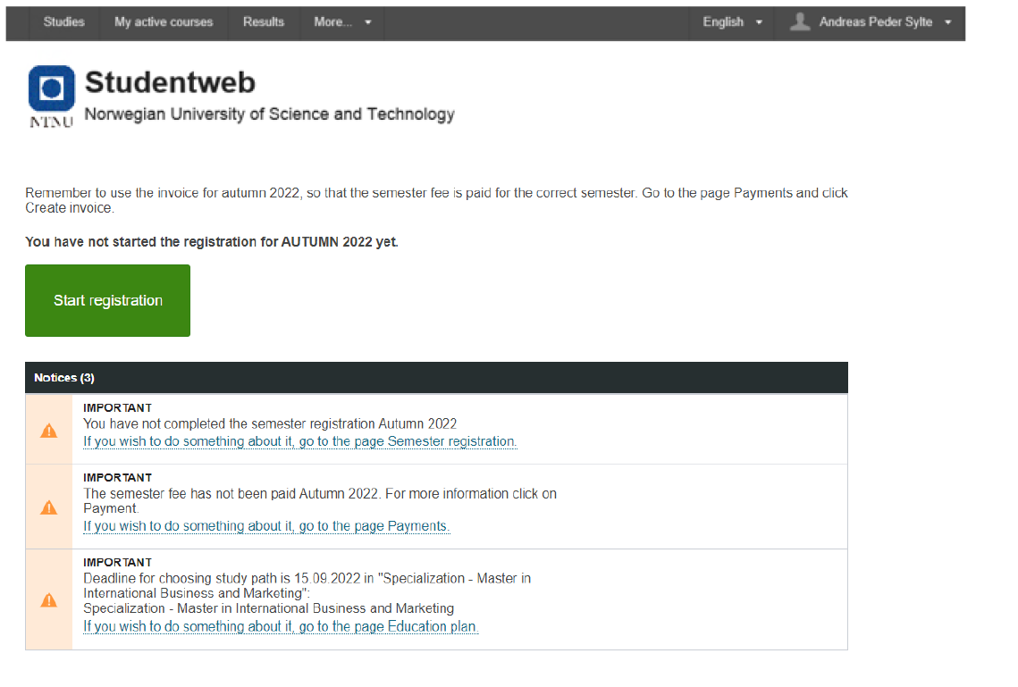

Slide 15
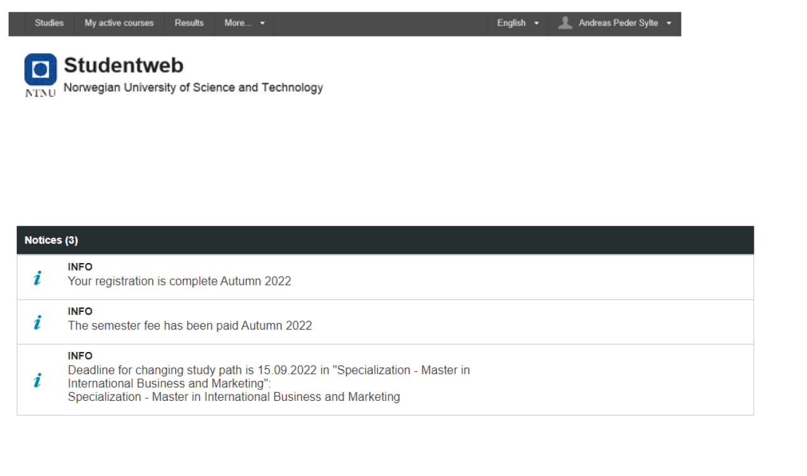

Slide 16
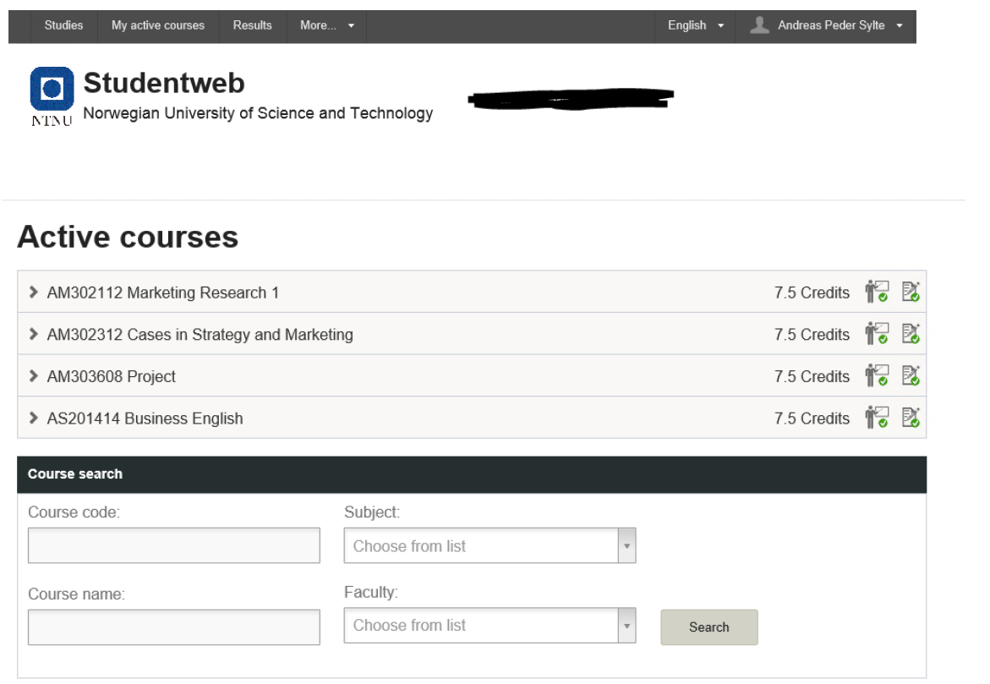

Slide 17
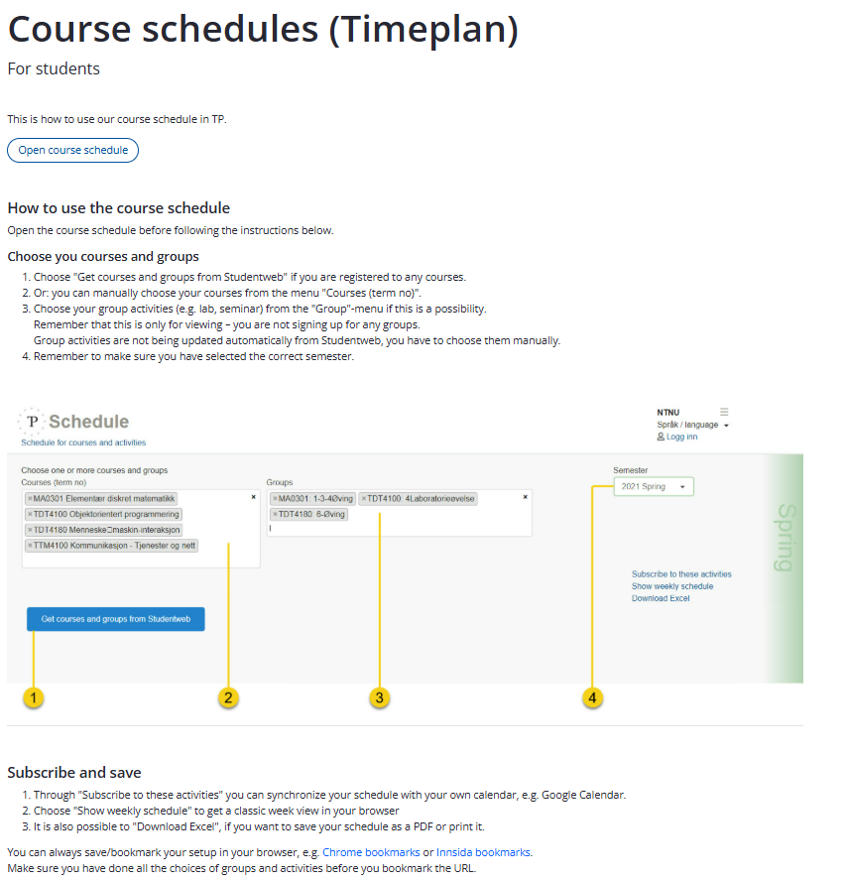
Course schedules (Timeplan)

Slide 18

Erasmus+ students: Course registration, Documents and Signatures
Course registrations:
  You have been registered for pre-approved courses
  You might not be able to register for courses yourself
  Start looking at alternative courses/timetable
Arrival Confirmation​ and Learning agreement
  Many times the courses will be changed after your arrival due to class schedule conflicts = recommend to wait until all courses are in place.

Slide 19
Erasmus+ students: Course selection and registration
Course selection and registration
  In your acceptance letter, it should state what courses you have been approved for
    Note: the Norwegian course will have a separate direct registration – NOTE: Deadline 11. August
  Changes in course selection can be made until 1st September
  We can assist with registration/changes of courses
  Conflicting class schedules: Check your class schedule (timeplan)
  Many of you will likely have to make changes in your course selection due to conflicting class schedules. This is normal. We will assist you with finding alternative courses.
  You can do your own course registration online from approximately 1. august, after receiving instruction from NTNU on establishing an NTNU profile/account.

Slide 20
Process for getting your courses
Check StudentWeb for which courses you are registered
Check course schedule to see if your courses have lecture or exam conflict
If conflict – find alternative courses and check course schedule/exam date/time
When you find ok alternative courses – send email to Maria and Karen Marie to get approval
Once course is approved we will register you for it
If not approved – you will need to seek alternative courses again
You can all take the norwegian course NORSK0500 if timeplan is ok
If you are uncertain, come and talk to us
Remember – it is in the end your responsibility to make sure you are registered for your courses and exams! = check StudentWeb

Slide 21
Erasmus+ students: Documents and signatures
Arrival Confirmation​ and Learning agreement
  In Mobility Online
  Send the documents by e-mail to karen.m.hovland@ntnu.no or maria.t.valderhaug@ntnu.no
  Bring documents
Learning agreement:
  To be completed when all courses are approved and signed up for
  Changes can be made until 1st September.

