Slide 1
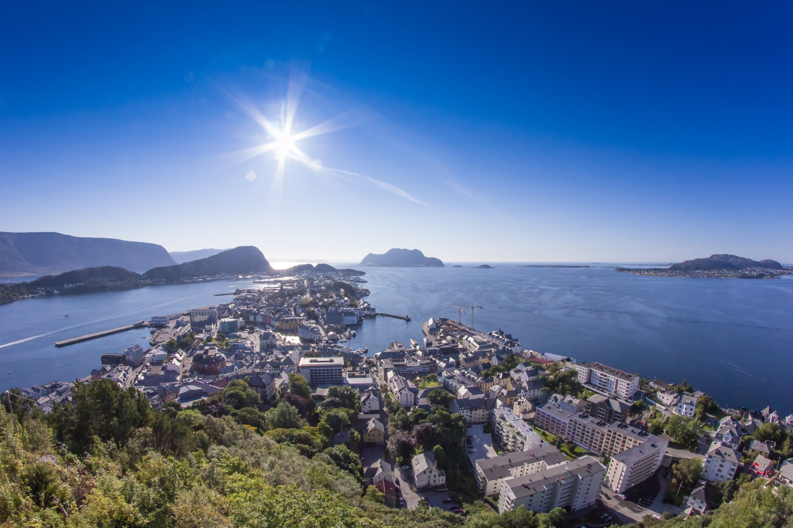
WELCOME TO NTNU ÅLESUND!
Autumn 2025

Slide 2
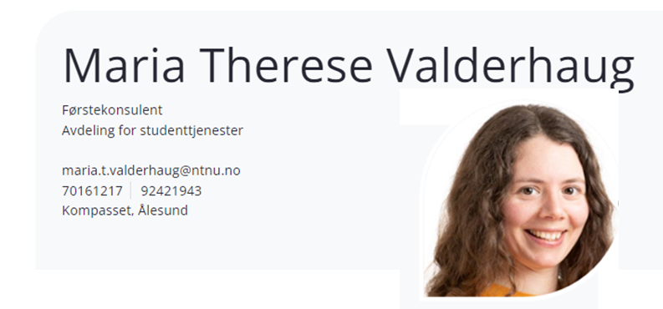
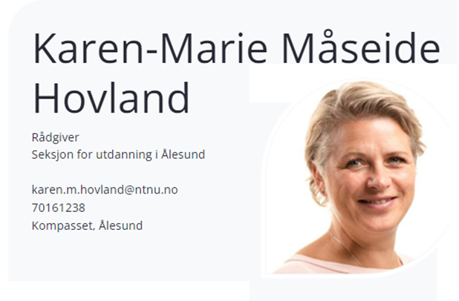
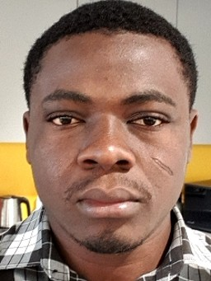
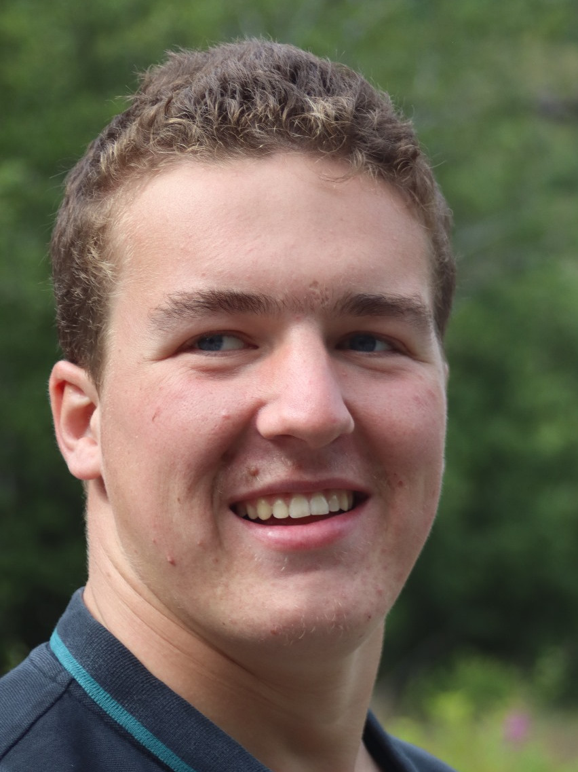
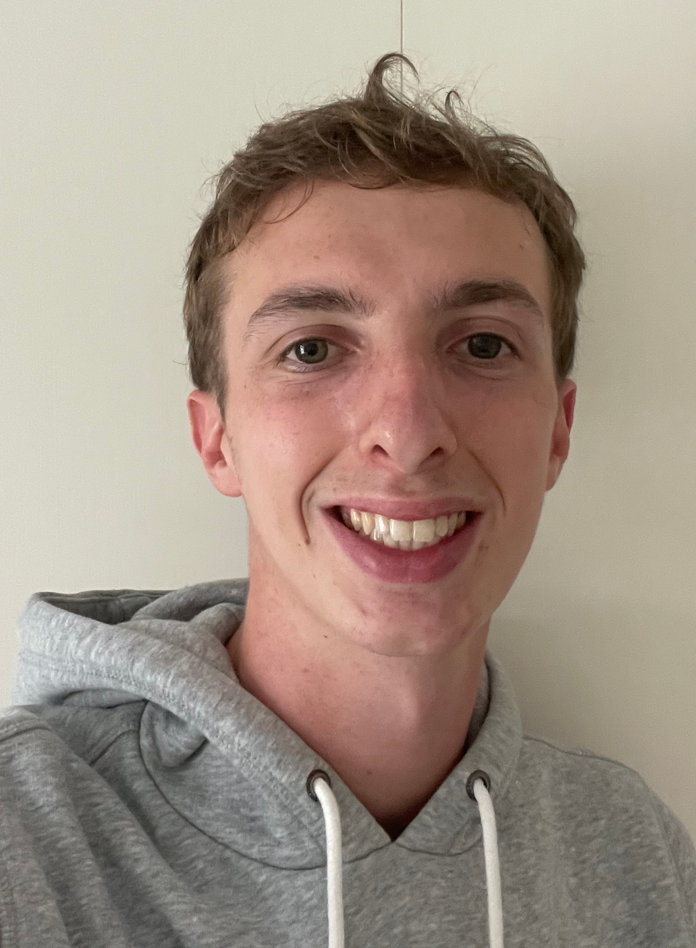
Office of international relations
Inbound mobility
Where: Kompasset – 1st floor
Student Assistants:
Elisha Adiburo Adimalara Joran Welling Romain Lefebvre

Slide 3

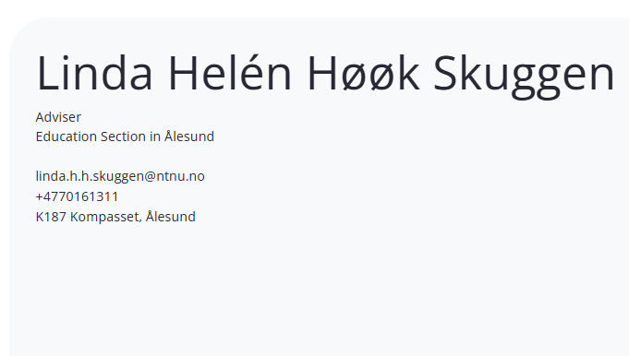

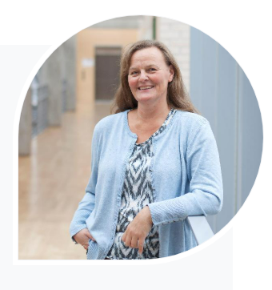
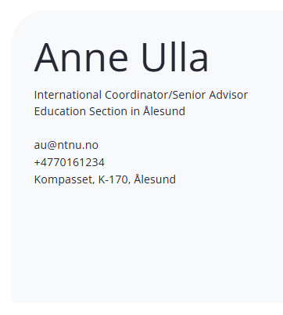
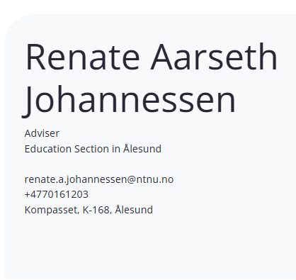
Office of international relations
Outbound mobility, Partnerships, PhDs, Staff Mobility
Where: Kompasset – 1st floor

Slide 4
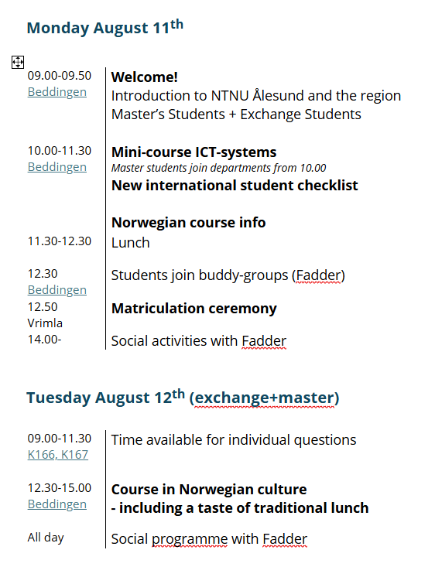
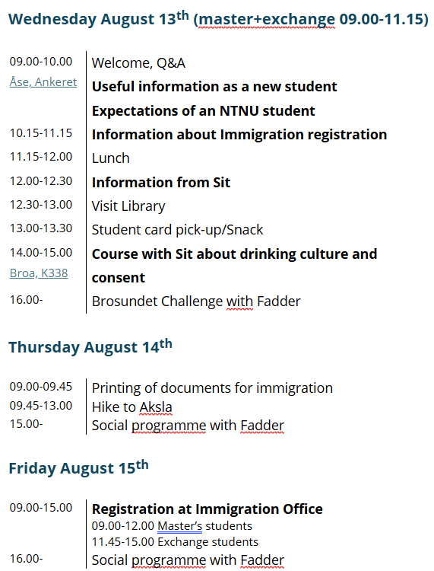
Program - International Orientation Week
Thursday, 8th of August

Slide 5


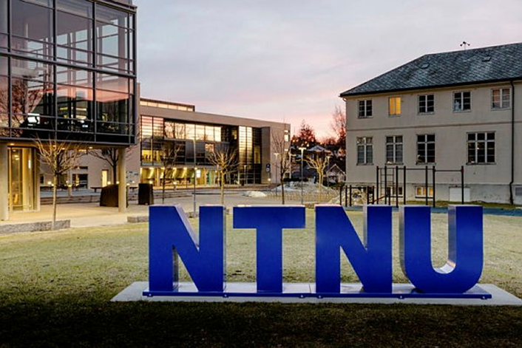

Slide 6
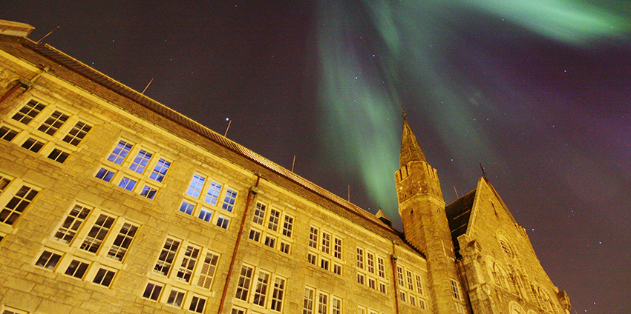
The Norwegian University of Science and Technology (NTNU)
Norway’s largest university, approx 43 500 students in total
Campuses in 3 cities; Trondheim, Gjøvik and Ålesund
Comprehensive university with specialization in technology and natural sciences
3870 (almost 9 per cent) of the students are international

Slide 7
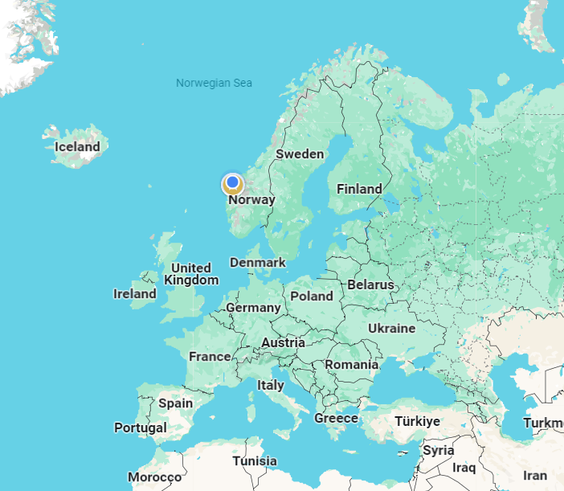
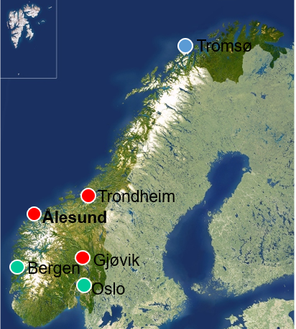
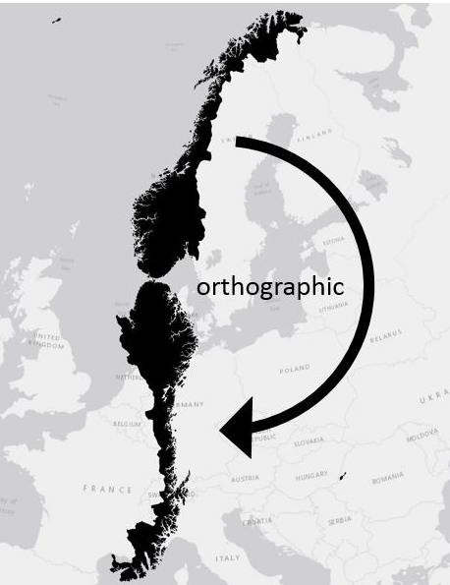
Where are you now?
Norway: Population 5,6 million
Møre & Romsdal county: Population 270 000
Ålesund: Population 59 000
Some distances:
  Oslo to Ålesund – 550 km
  Ålesund to Trondheim – 295 km
  Lindesnes to Kirkenes:
    2200km shortest route through Sweden/Finland
    3000km if traveling roads in Norway
By comparison – Oslo to Rome (Italy) is 2500km

Slide 8
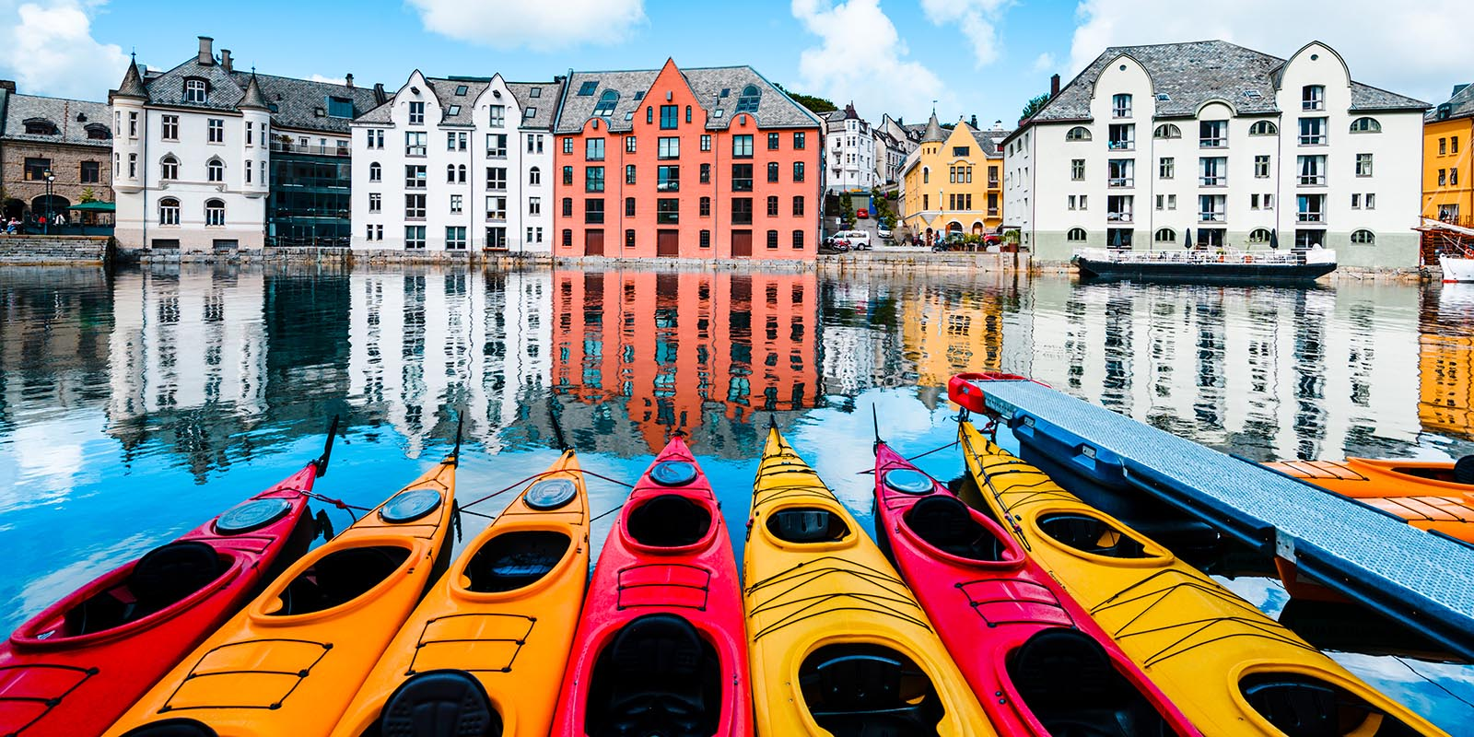
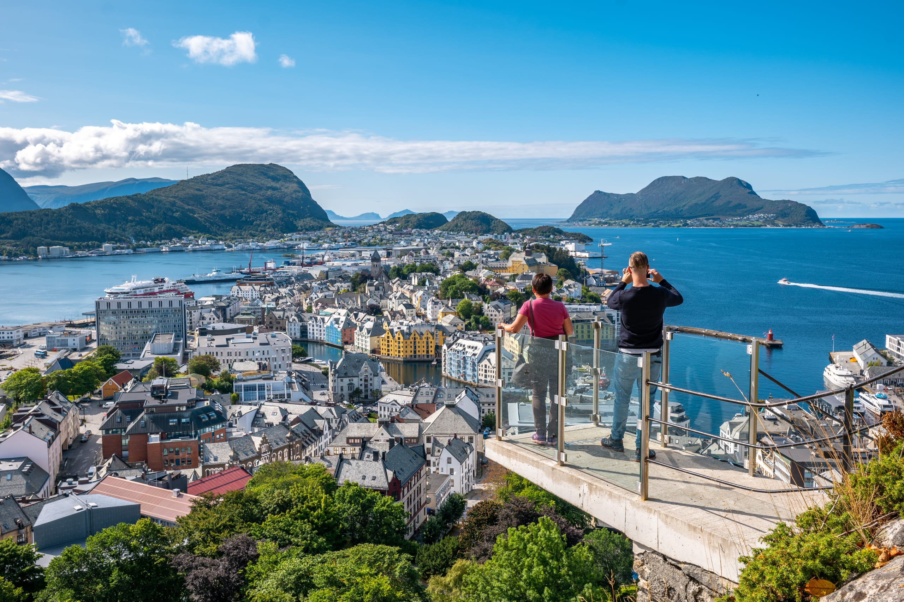
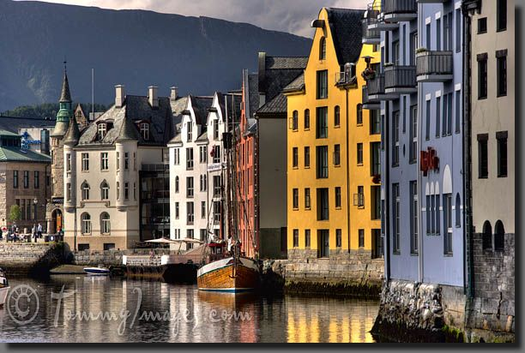
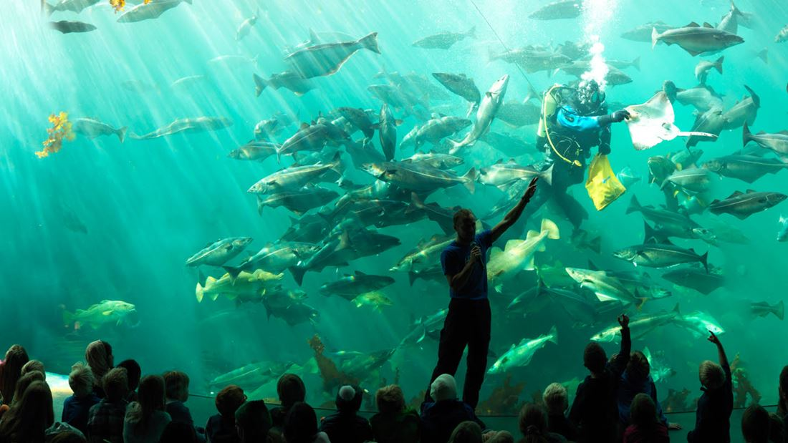
Ålesund

Slide 9

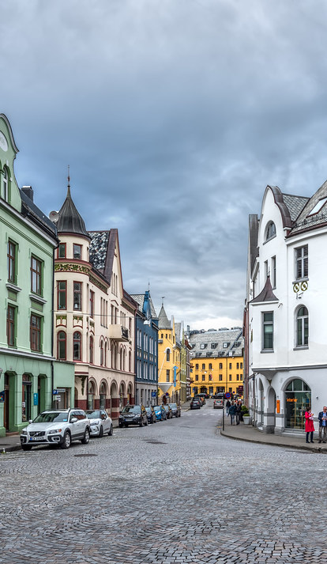
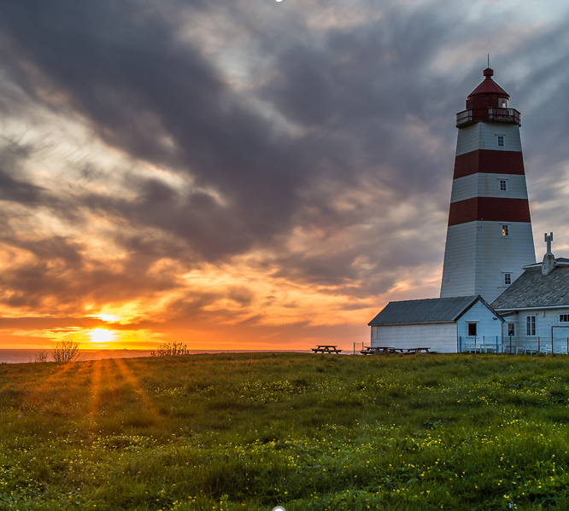
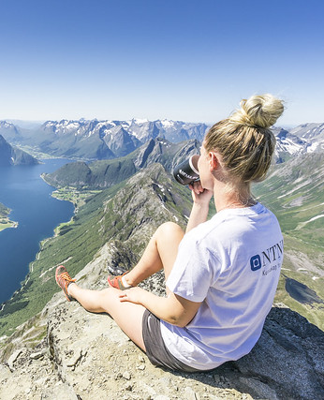
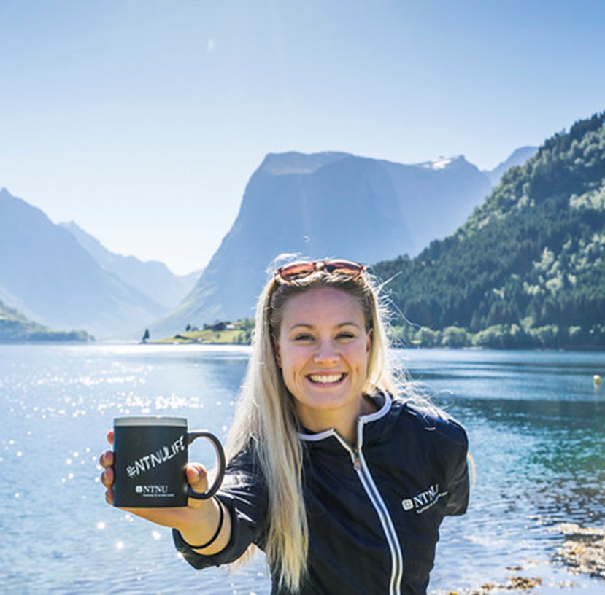
Ålesund
- famous for the Art Noveau architecture and beautiful location by the ocean
Sunnmøre
- famous for beautiful scenery – with the ocean, mountains and fjords

Slide 10
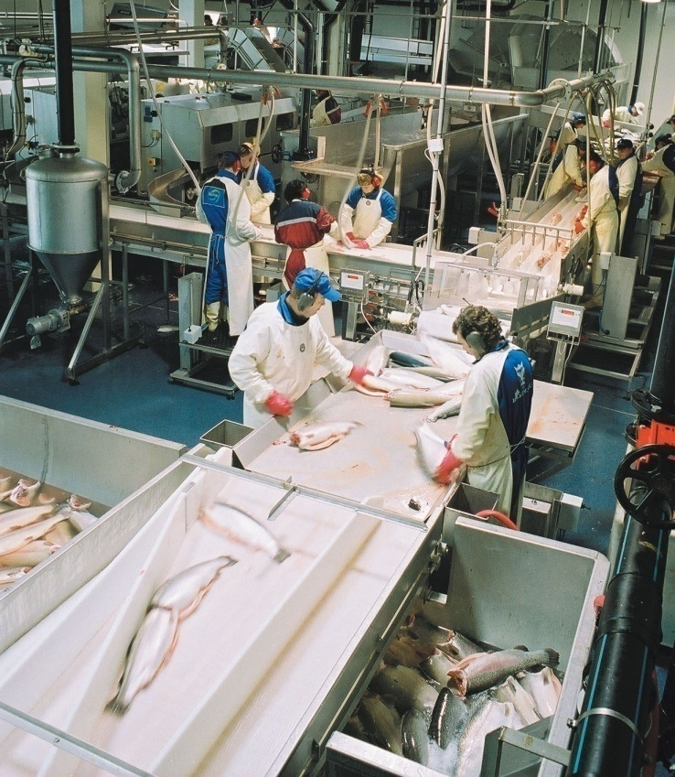
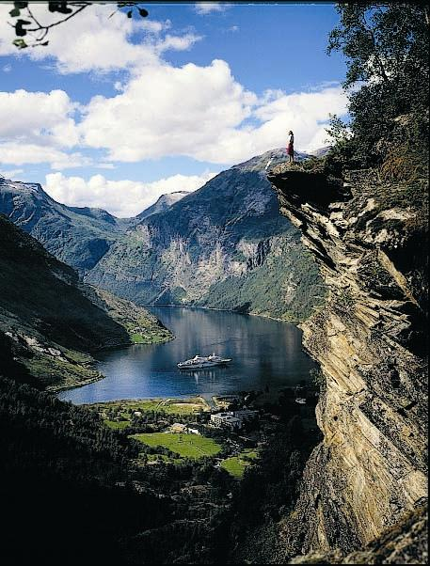
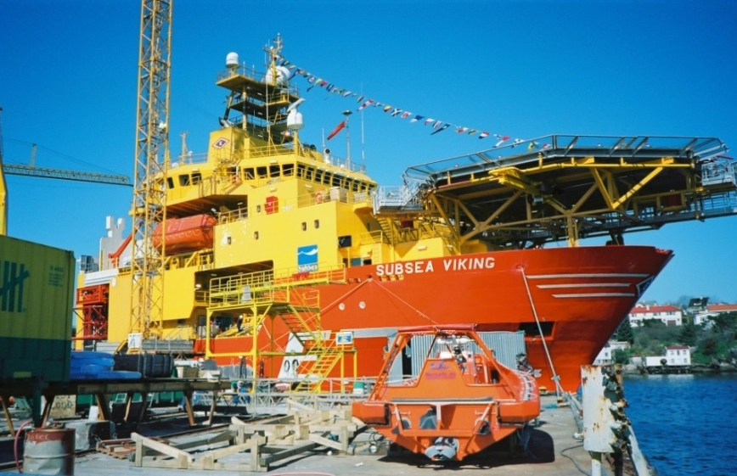
Sunnmøre is one of Norway’s most innovative regions with strong marine and maritime industrial clusters as well as furniture industry
and major tourism destinations
Important sectors
Ship building and equipment
Fisheries and aquaculture
Furniture industry
Tourism

Slide 11
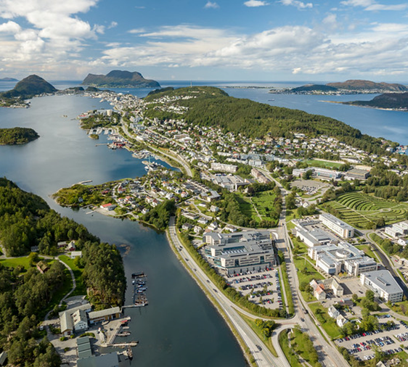
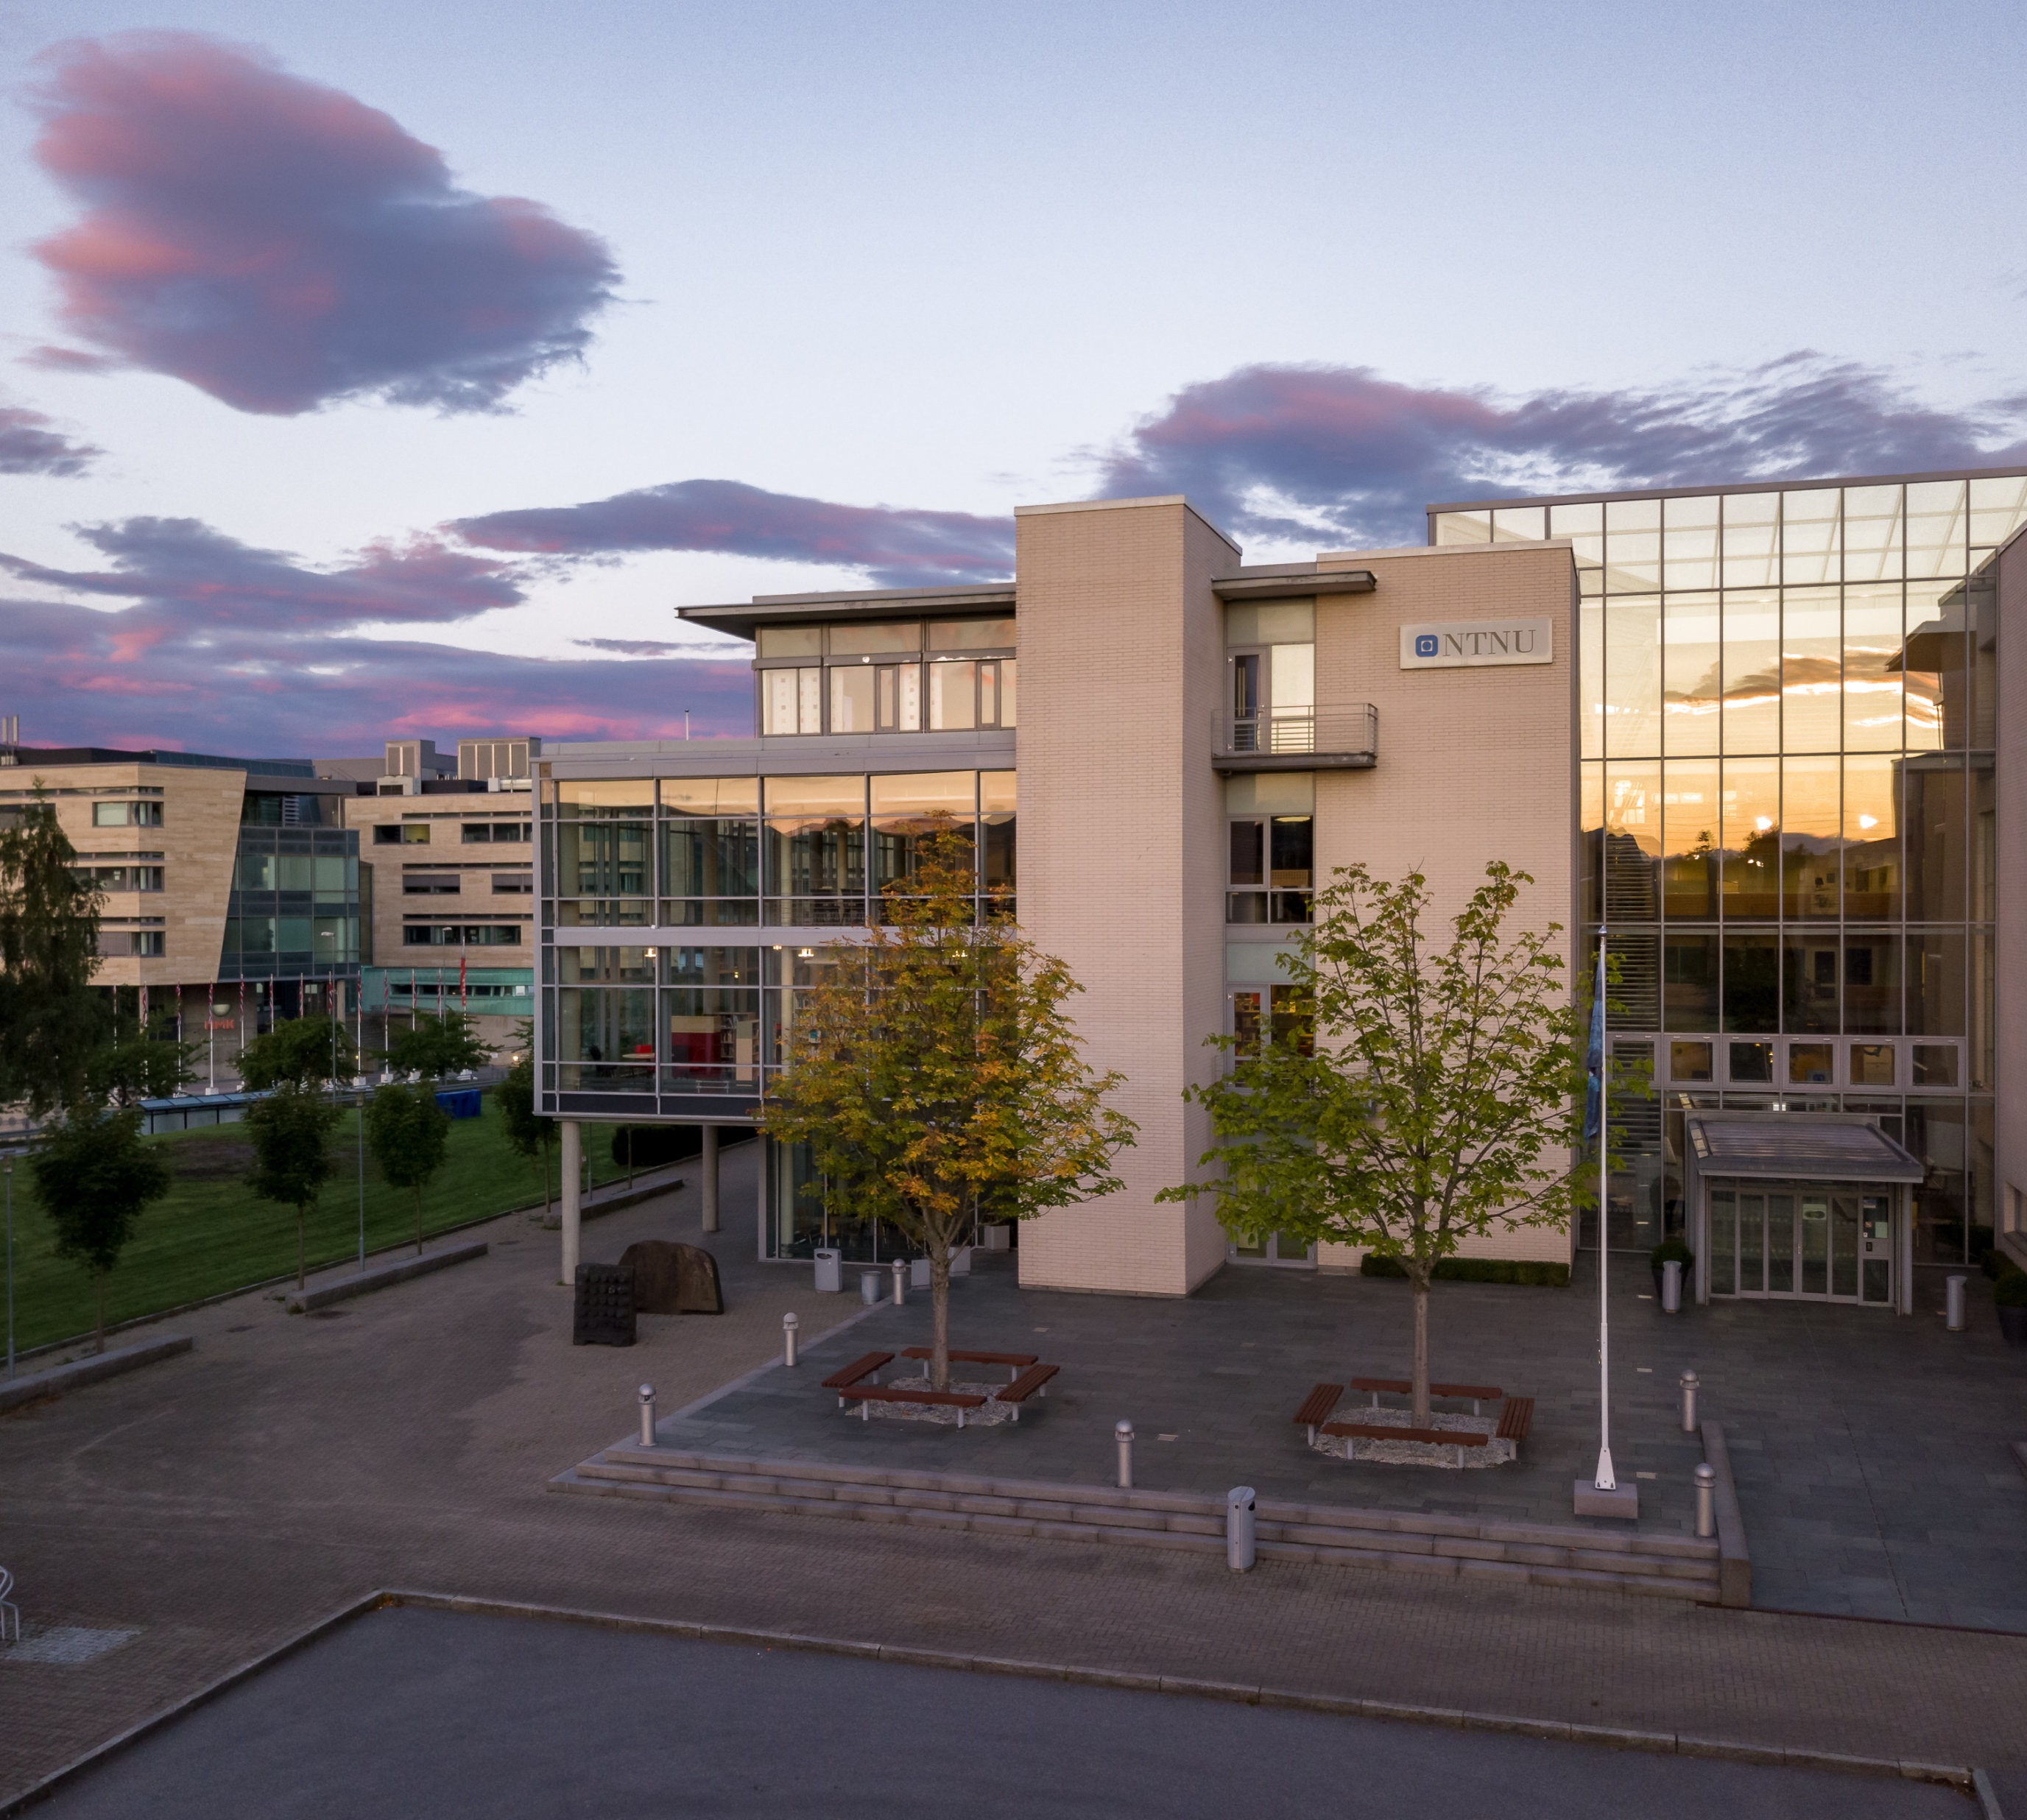
Ålesund Campus
The smallest of NTNU’s campuses
Approx 2600 students, 5 departments
Technology, engineering and natural sciences, business & marketing, health sciences, and maritime studies

Slide 12
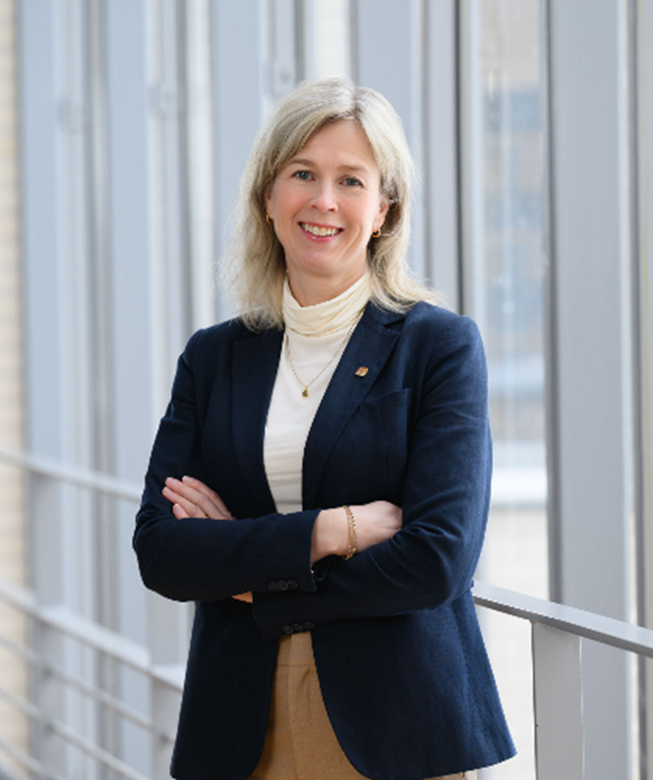

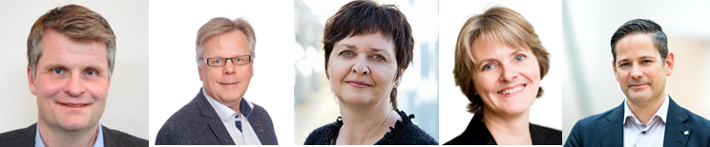

NTNU in Ålesund
Organization
Five departments:
- ICT and Natural Sciences (IIR)
  MSc Mechatronics and Automation – Robotics and Intelligent Systems
- Ocean Operations and Civil Engineering (IHB)
  MSc Mechatronics and Automation – Marine Systems
- Biological Sciences (IBA)
- Health Sciences (IHA)
- International Business (IIF)
  MSc International Business and Marketing
  MSc Management of Innovation and Sustainable Business Development
Anne-Lise Sagen Major
Vice-Rector

Slide 13

Strategic research areas
Influenced by the sustainability goals for Sunnmøre region

Slide 14
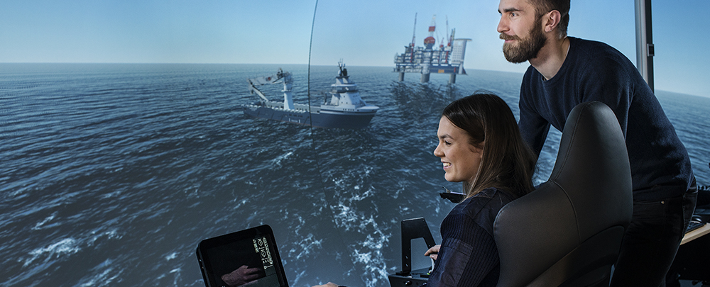
Why studying at NTNU Ålesund is a good choice
Sunnmøre area well-known for innovation and entrepreneurship
An export-minded and international industry
Study programmes closely linked to regional industry and businesses
World-class simulators
Student companies very good track records!
Small campus, approachable faculty

Slide 15

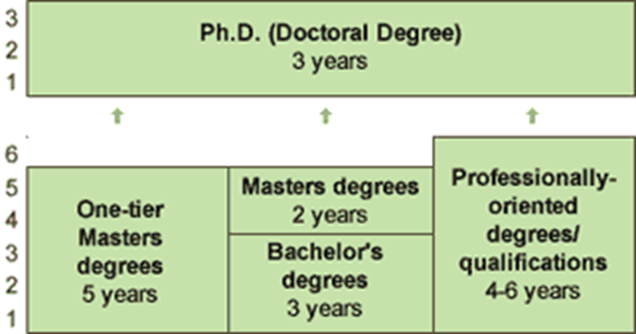
Degree structure
Academic year: normally from mid-August to early/mid June
Fulltime workload: 60 ECTS per academic year/30 ECTS pr semester
Grading scale: A (highest) to F (lowest), with E as the minimum pass grade
  Pass/fail mark is given for some courses

Slide 16
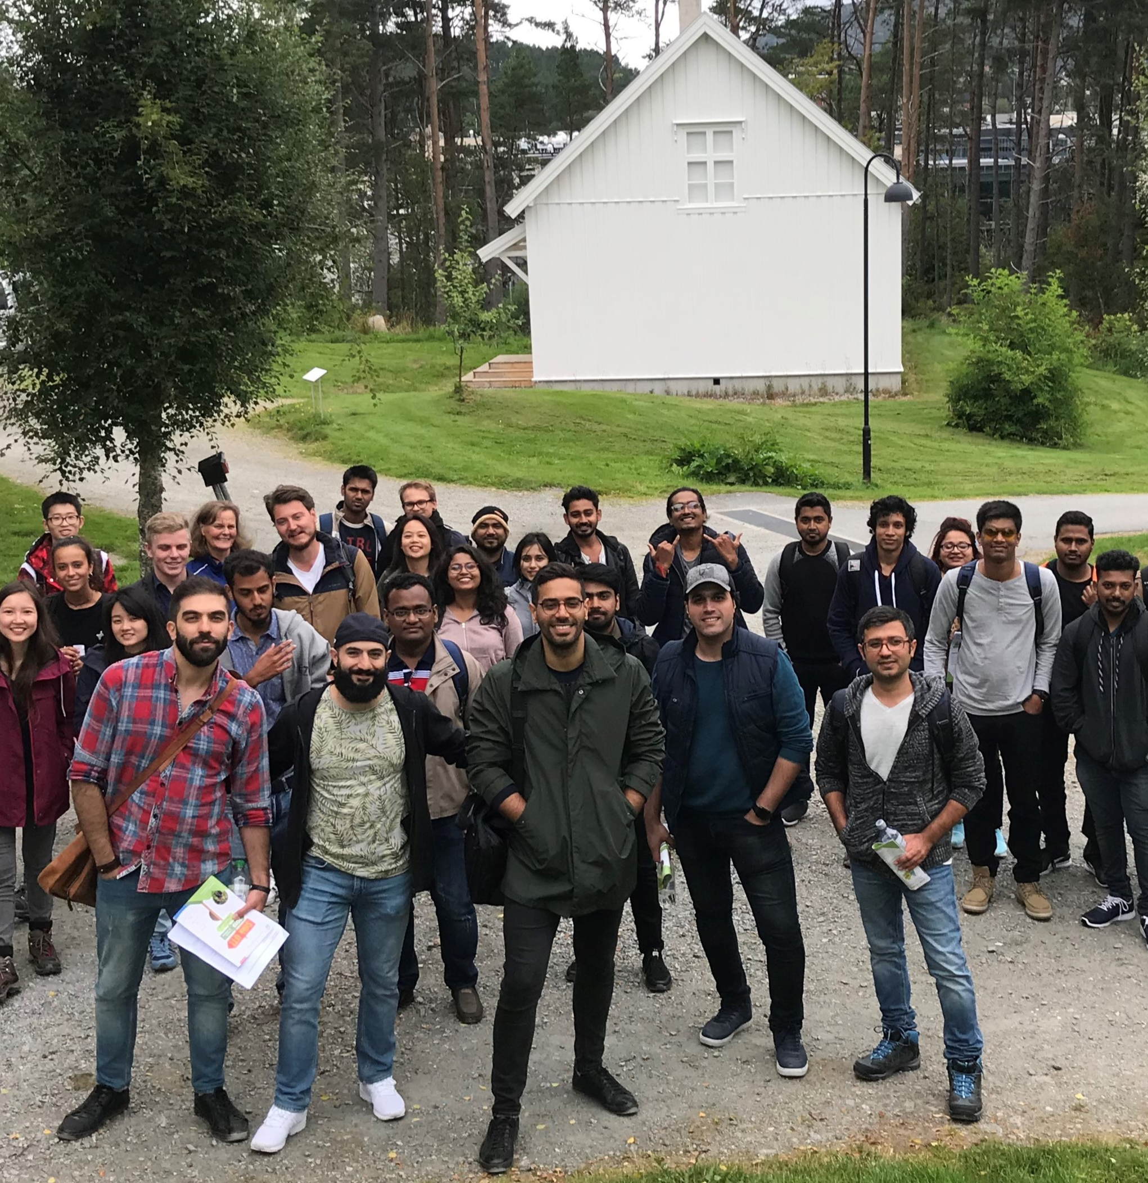
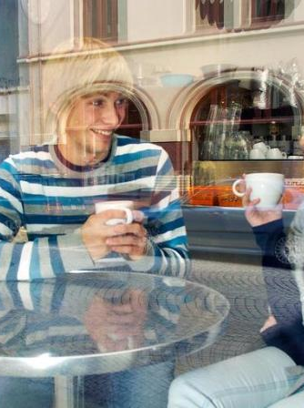
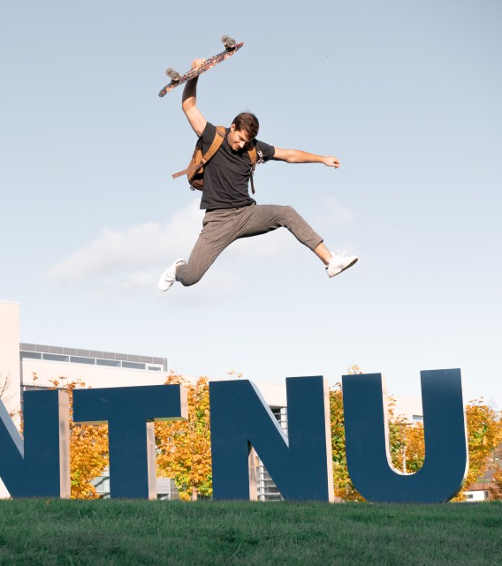
Being a student at NTNU Ålesund
ISÅ Ålesund – Instagram and What’s App
Fadder (buddy)
NTNUI – student sports
Various organizations and activity groups that students engage in
International Student Café
Free winter clothes market
“How to survive the Norwegian winter”- course
Sit – student welfare organization
Some of these links are to Norwegian web pages (English version does not exist)

Slide 17
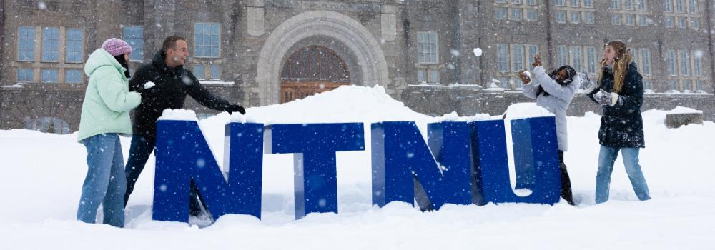
https://www.ntnu.edu/studies/
https://www.ntnu.edu/lifeandhousing/alesund

Slide 18
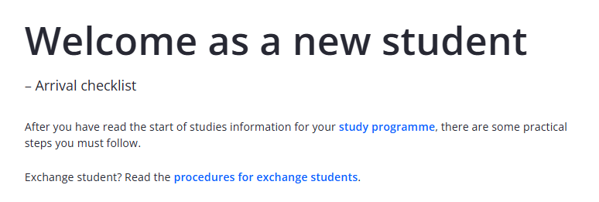
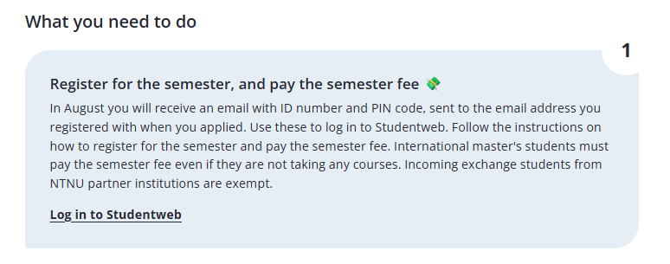
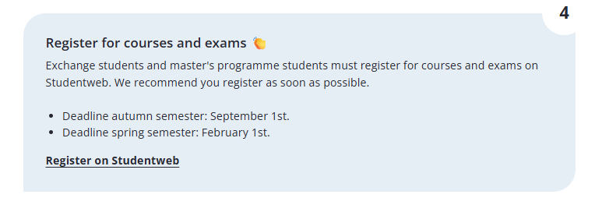
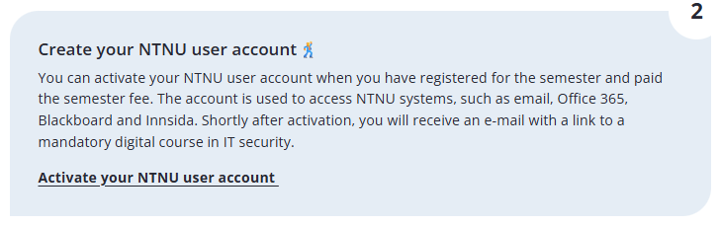
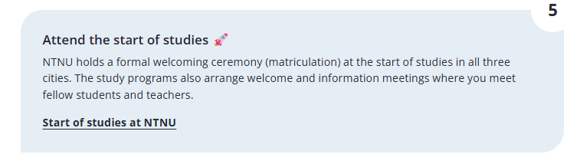
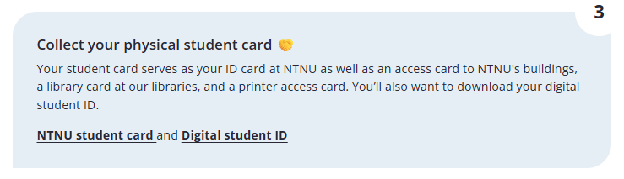
https://i.ntnu.no/ny-student
Master’s degree students
Exchange students

Slide 19
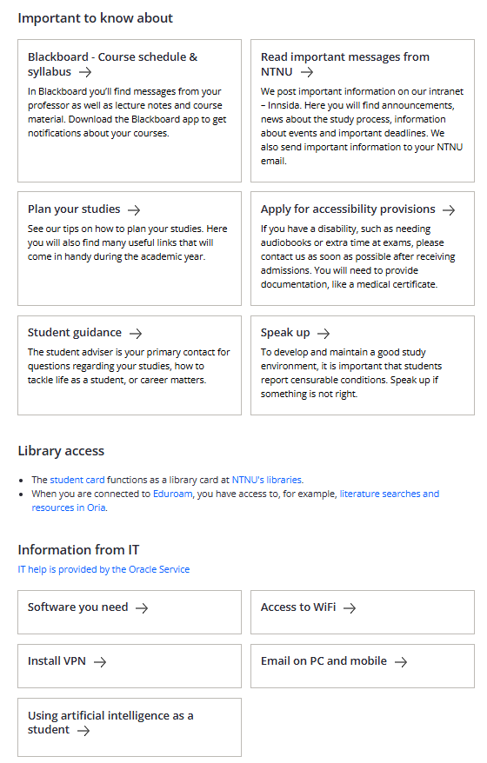


Slide 20
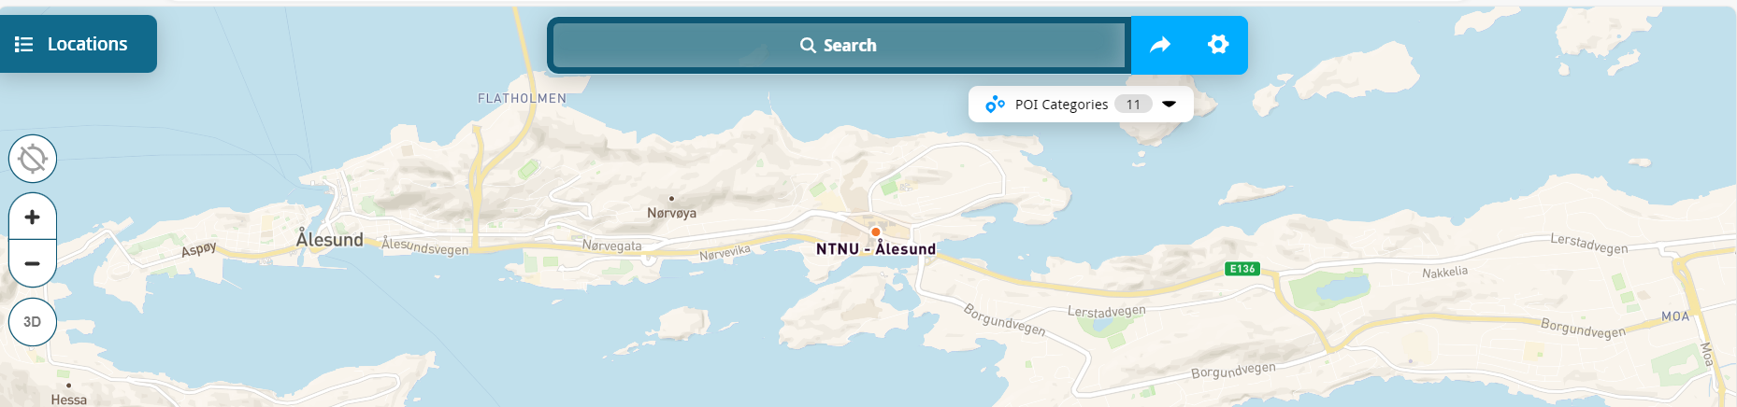
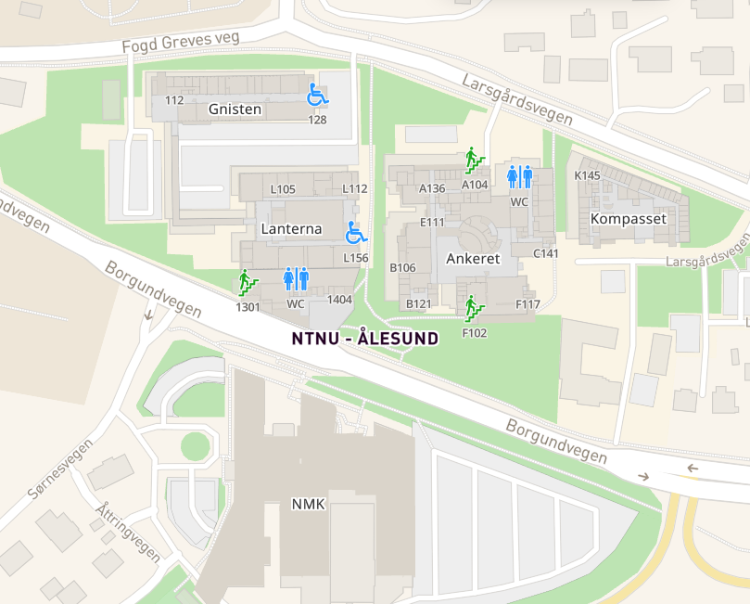
Some useful tools these first few days
NTNU map: Mazemap
Busses –Start checking out frammr.no
Class Schedules – «Timeplan» https://i.ntnu.no/timeplan
New student – check list: https://i.ntnu.no/ny-student
Check out the book store – or ask student assistants for ways to buy used books

Slide 21
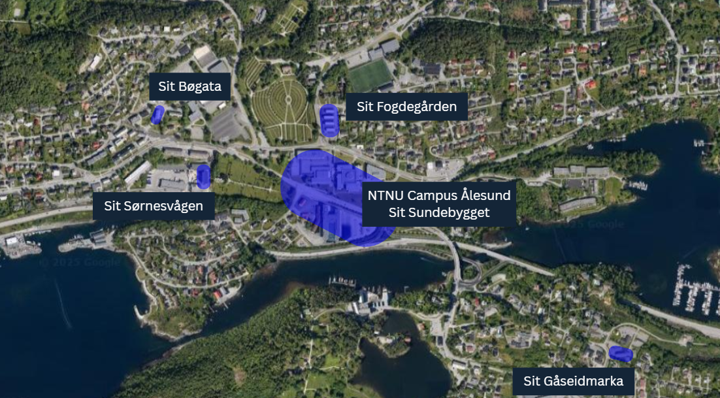
Sit housing locations:

Slide 22

Travel card
We recommend you obtain a travel card during your stay at NTNU.
You can either order a travel card online or visit the Bus terminal at Moa (5-6 km. from campus).
Check discounts and prices at Frammr.no
Age limits and discounts - FRAM (frammr.no)

Slide 23
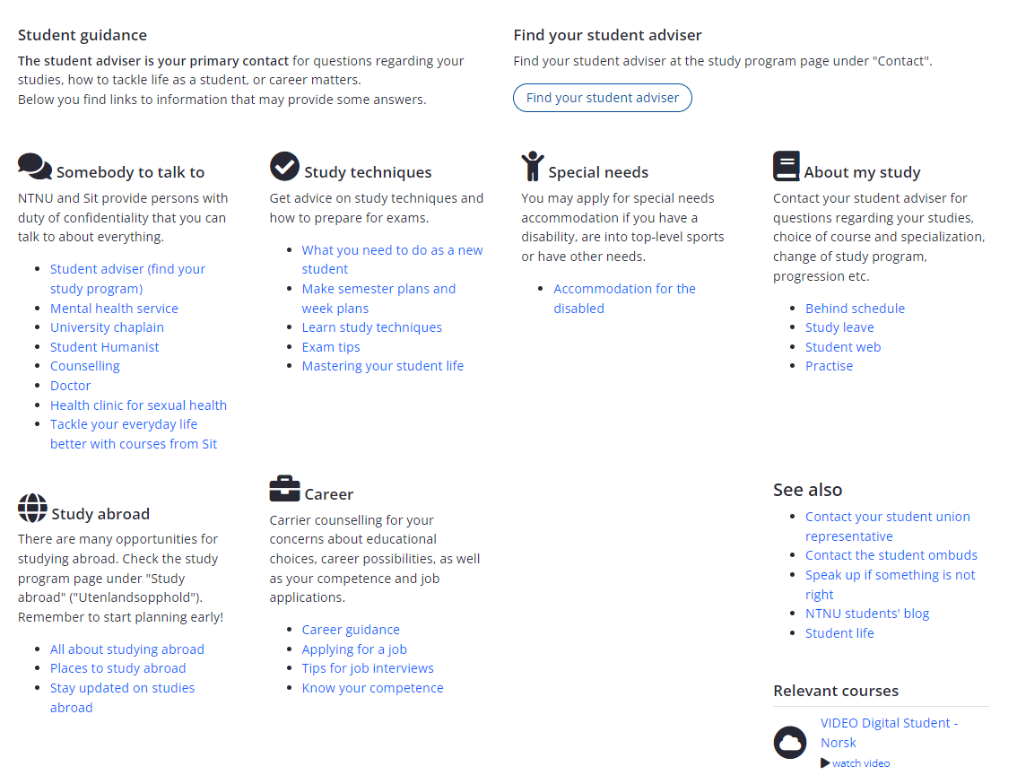
Student Guidance

Slide 24
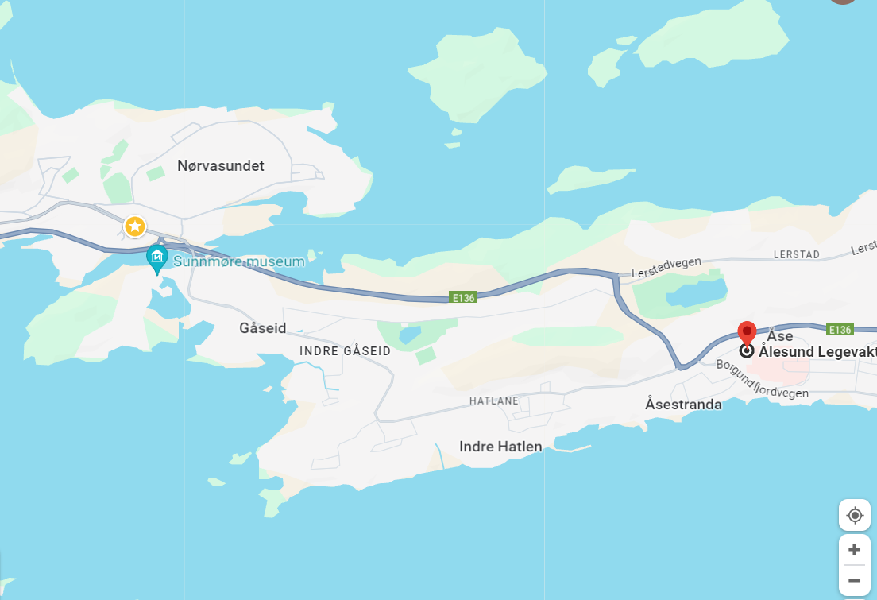

In case of illness
Emergency? – Call 113
Emergency/ambulance: 113
Police: 112
Fire/rescue: 110
(on the back of your student ID card)
Your doctor’s office is “Legevakt” (Emergency clinic)
Open 24/7
Recommend to go during day-time for regular issues.
Unless emergency, call before you go there phone number 116117
Bring passport, health insurance card (EU students), residence card (or paper)
Bring your student ID or documents confirming you are as student.
As an Erasmus+ student you have access to free health services while in Norway.
Note: Dentist is not included in national health plan – please contact private clinic for dental issues.

Slide 25


Slide 26


Slide 27



Keep warm and cozy in all weather
All weather jacket
Rain boots
Umbrella – NO!!!
Wool
Winter boots
Winter hat
Mittens/gloves
Layers
«There is no bad weather, only bad clothes»

Slide 28

Daylight Ålesund

Slide 29
Mørketid (time of darkness)
November – February
Dark when you go to class and dark when you get home
Make sure to get some daylight during class breaks
Go outside during daytime as much as you can – much higher lux
Do wintercozy activities indoor – Hygge
  Hot choclate, a good movie, lots of blankets, warm socks
  Make a nice meal with friends
  Go for a walk to spot the Aurora Borealis/Northern lights

Slide 30

Tourist attractions and bucket list

Slide 31
Ålesund
Jugendstilsenteret/Kube
Ålesund Museum
Fisheries Museum
Sunnmøre Museum
Atlanterhavsparken
Sukkertoppen
Aksla/Fjellstua
Hiking:
  Aksla
  Sukkertoppen
  Emblemsfjellet/Turheisa
  Sulafjellet
  Godøyfjellet
Visitalesund.com
A guide to art nouveau in Ålesund
gofjords.com
Fjordnorway.com - Ålesund and Geiranger
Visit Norway - Ålesund and Geiranger

Slide 32
Ålesund

Slide 33




Alnes fyr - Godøy

Slide 34

The region

Slide 35

Sunnmøre
Geiranger
Hjørundfjord
Sunnmøre Alps (hiking)
Atlanterhavsvegen (from last James Bond film ☺)
Strandafjellet (skiing/lift)
Fjellsætra (skiing)
Runde (bird sanctuary)
Stadtlandet
Valldal
Romsdalen (from Mission Impossible film)
DNT - Den Norske Turistforening
Stikk ut!
Sunnmørsalpene
Strandafjellet
Fjellsætra

Slide 36



Skiing

Slide 37

Important knowledge about Rights and Safety while exploring Norway
Right to Roam – Allemannsretten
The Norwegian Mountain Code - Fjellvettreglene

