Slide 1
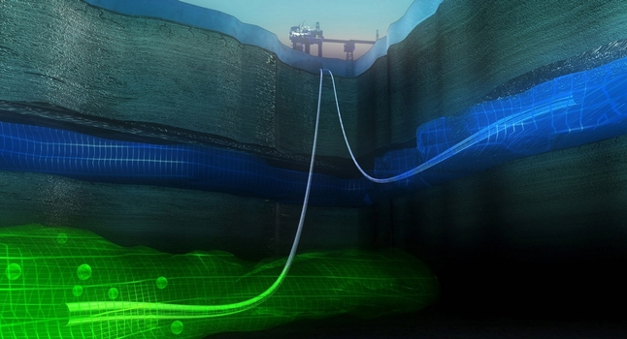
Mathematical Modeling of CO₂-Storage
Math Meets Industry
Daniel S. Olderkjær

Slide 2
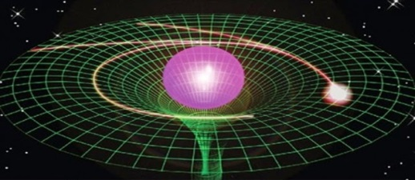
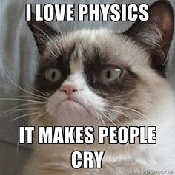
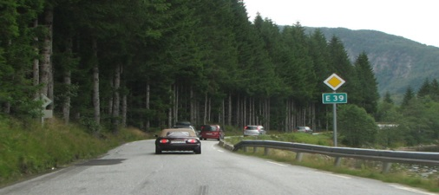
How did I end up here?
Physics?
NO
http://3.bp.blogspot.com/-mrPpTXUV9r8/VEeWgSHAAYI/AAAAAAAADZk/L2C4BuMHW1o/s1600/quantummatrix-640x354.jpg
https://s-media-cache-ak0.pinimg.com/236x/33/cd/55/33cd5531111988cb9d95a01d5ec49c10.jpg
Economy?
http://1.bp.blogspot.com/_9MvHZ59zz0c/S-CHr7n7HCI/AAAAAAAAAdk/ldQ7sSIp3Gs/s1600/math.png
NO
http://www.drcoell.com/wp-content/uploads/2013/08/cost-benefit.jpg
http://www.ofv.no/getfile.php/13990/Bilder/OFV/Veier/E39%2008_2009.jpg
Computer Science
Physics
Mathematics?
Mathematics/Statistics
Applied Mathematics
YES

Slide 3
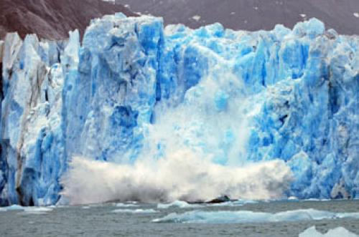
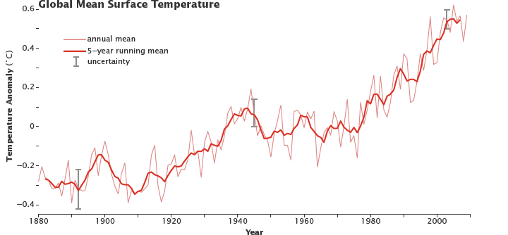
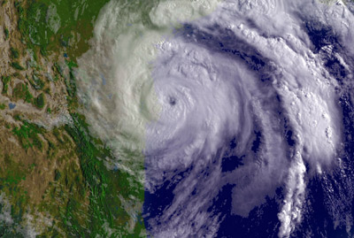
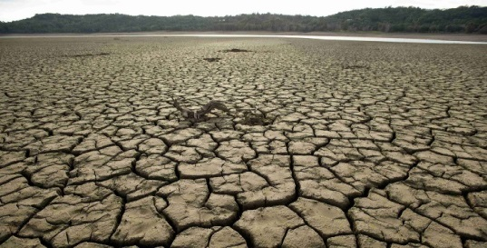
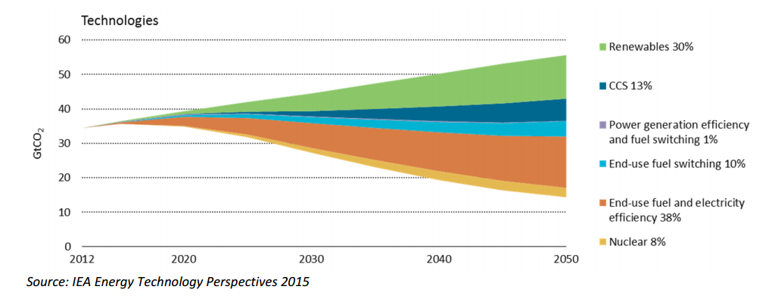
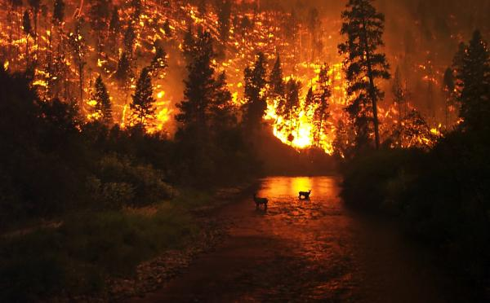
Subsurface storage of CO₂: Why?
Global mean temperature anomaly:
https://http://wilderness.org/sites/default/files/styles/blog_full/public/legacy/profiler/DawesGlacier-TongassNationalForestAlaska-istock_1.jpg?itok=XfN9BHkO
https://http://static.ddmcdn.com/gif/worst-effects-global-warming-5.jpg
http://earthobservatory.nasa.gov/Features/GlobalWarming/images/giss_temperature.png
Estimated contribution to reduction in global CO₂ emissions:
https://www.democracynow.org/images/story/74/27474/full_hd/California-Drought-Water-Global-Warming-1.jpg
https://http://15858-presscdn-0-65.pagely.netdna-cdn.com/wp-content/uploads/sites/default/files/images/Another-global-warming-effect---forest-fires-pictured-here-two-elks-caught-wildfire-Bitterroot-Natio.jpg
Notes:
Kvifor er eg interessert i dette:

Slide 4
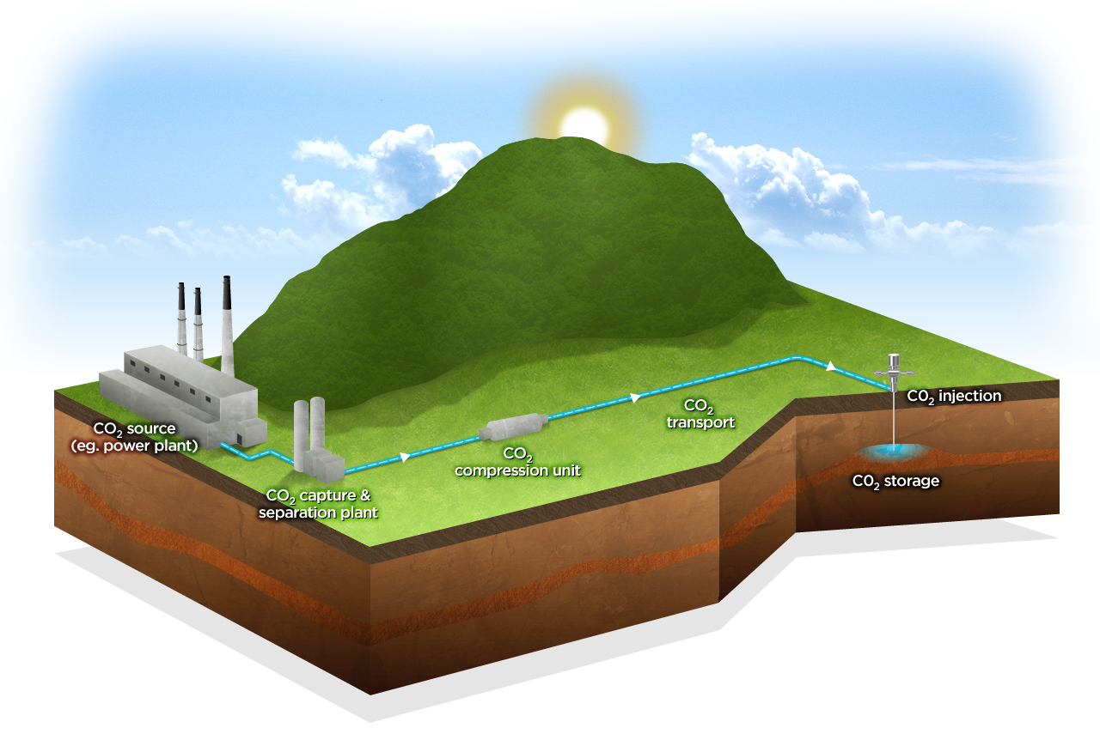
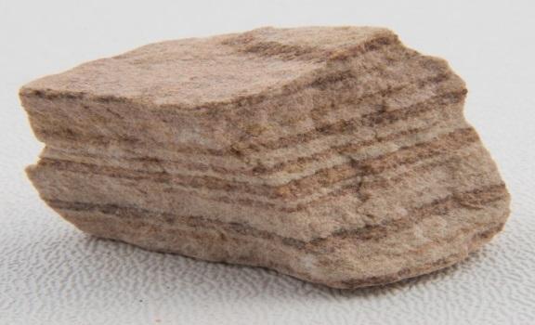
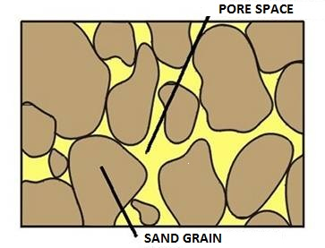
Subsurface storage of CO2: How?
http://www.abc.net.au/news/linkableblob/2796006/data/carbon-capture-process-data.jpg
Composition of the sandstone http://www.energy.alberta.ca/Tenure/graphics/Pore_Space.jpg
Sandstone
http://www.minimegeology.com/blog/wp-content/uploads/2013/12/20080130110622.jpg

Slide 5
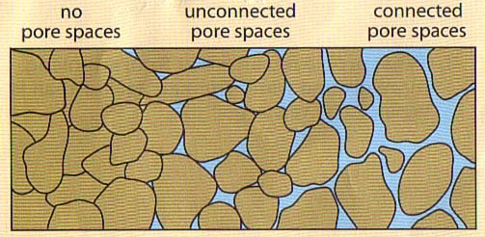
Subsurface storage of CO2: Challenges!
Risk of leakage
Geology is not an exact science
Expensive to fail
?
?
http://www.abc.net.au/news/linkableblob/2796006/data/carbon-capture-process-data.jpg
Groundwater
Faults/fractures
Old abandoned wells (cemented)
http://previews.123rf.com/images/kenbenner/kenbenner1206/kenbenner120600093/14236518-Explorer-holding-a-magnifying-glass-Stock-Vector-explorer-archaeologist-cartoon.jpg
https://s3-us-west-2.amazonaws.com/quizizz-source-bkt/a9e8a114-f1cd-48d6-bbcf-1228c2c0954e.jpg
Notes:
Kan måle hvordan det er ved brønnen, men hvordan er det eller?

Slide 6
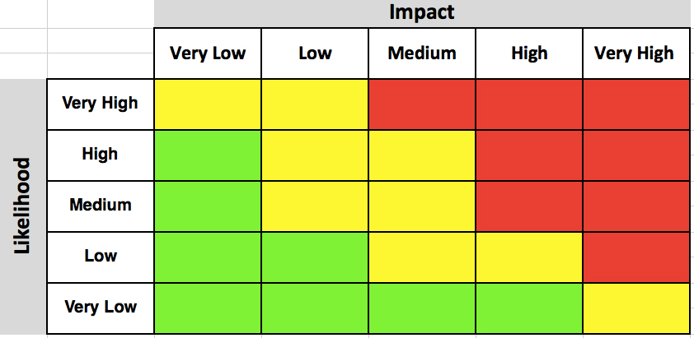
Solution: Mathematics
Cheap and no risk
Adjust input parameters for optimalization of conditions
Statistical input about the rock
Fluid properties
Programming and simulation
Prediction
Underlying physics
Cost
No drill zone
Chance
Drill baby, drill!
Risk Matrix
Notes:
Cheap!!!!!!!!

Slide 7
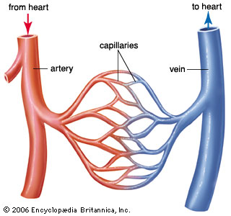
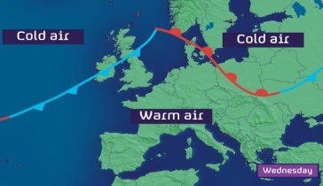
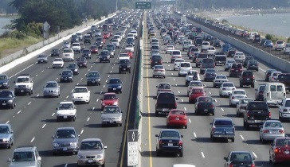
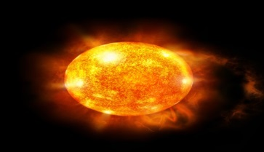
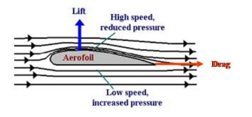
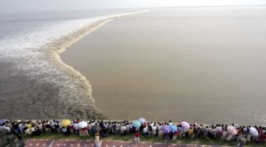
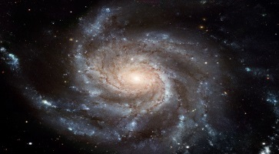
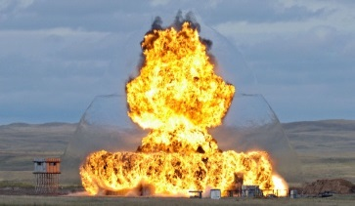
And if we solve the climate problem?
Here are just some examples of what the same equations as those in the CO₂-storage model can be used to model:
This flexibility is what I love about mathematics!
Flow of blood in capillaries
Traffic Flow
Airflow around airplane wings
Density in spiral galxies
Weather fronts
Dynamics of a star/plasma in a fusion reactor
Tidal waves
Shockwave of an explosion
https://media1.britannica.com/eb-media/06/92806-004-95B4D32F.jpg
http://blogs.channel4.com/liam-dutton-on-weather/wp-content/uploads/sites/27/2013/04/Z_europe_1_wp.jpg
http://www.improvetraffic.org/wp-content/uploads/2014/05/slider-4-1200x550.jpg
https://eblanchardblog.files.wordpress.com/2015/09/sun-image.jpg
http://www.skybrary.aero/images/Aerofoil1.jpg
http://www.artsurfcamp.com/blog/wp-content/uploads/2014/06/qiantang-river.jpg
https://upload.wikimedia.org/wikipedia/commons/thumb/c/c5/M101_hires_STScI-PRC2006-10a.jpg/1280px-M101_hires_STScI-PRC2006-10a.jpg
http://pop.h-cdn.co/assets/15/12/1280x640/landscape-1426601274-shockwave.jpg

Slide 8
Thank you for listening!
A special thanks to my high school teacher Jon Lund, for showing how interesting mathematics can be.
The CONQUER-project:
Participants:
Per Pettersson (Senior Researcher, Uni Research)
Ivar Aavatsmark (Principal Researcher, Uni Research)
Eirik Keilegavlen (Researcher, UiB)
Sarah Gasda (Senior Researcher, Uni Research)
Inga Berre (Professor, UiB)
Jan Nordbotten (Professor, UiB)
International Collaborators:
Alireza Doostan (Professor, University of Colorado, Boulder)
Daniel Meyer (Senior Lecturer, ETH Zürich)
Scientific Advisors:
Knut Bjørlykke (Professor Emeritius, UiO)
Christian Hermanrud (Statoil ASA & Adjoint Professor, UiB)
Øystein Pettersen (Principal Researcher, Uni Research)
Funded by the Research Council of Norway (2015-2018)
Daniel S. Olderkjær
daniel.olderkjer@uni.no
Allégt. 41, 5007 Bergen

