Slide 1

Speaker: M. Salman Siddiqui
Department of Mathematical Sciences, NTNU

Slide 2
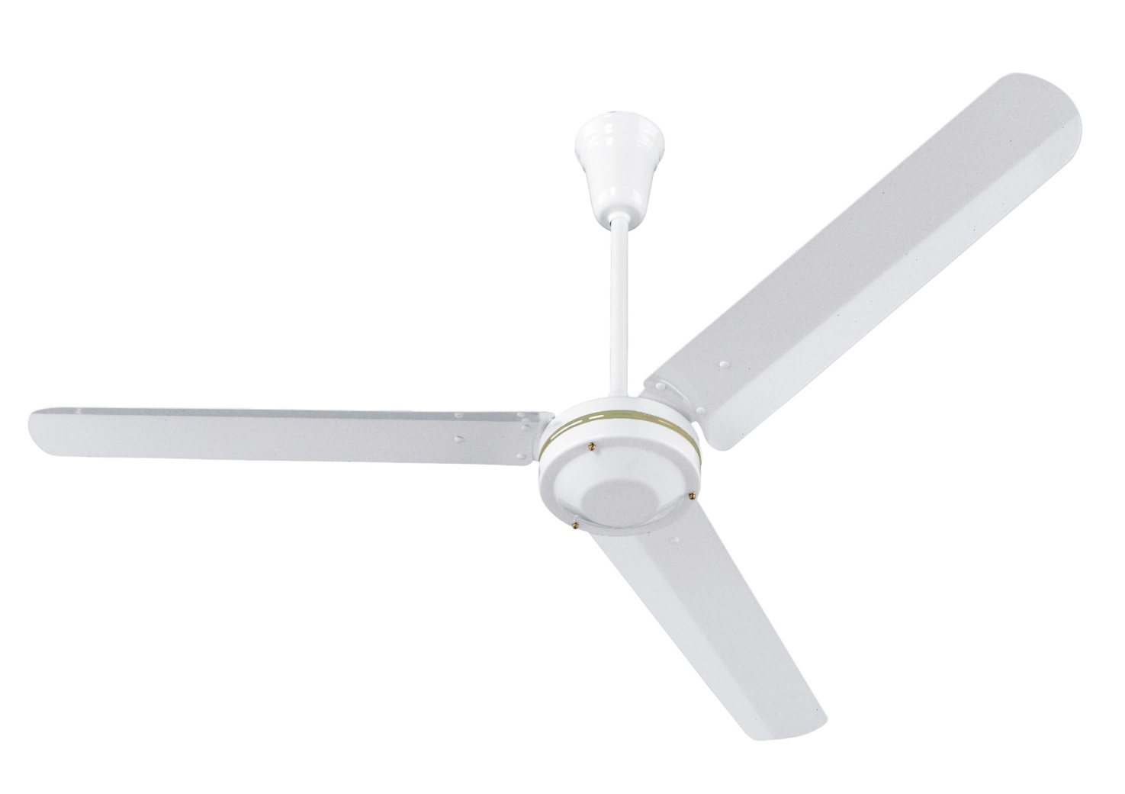
Ceiling Fan

Slide 3
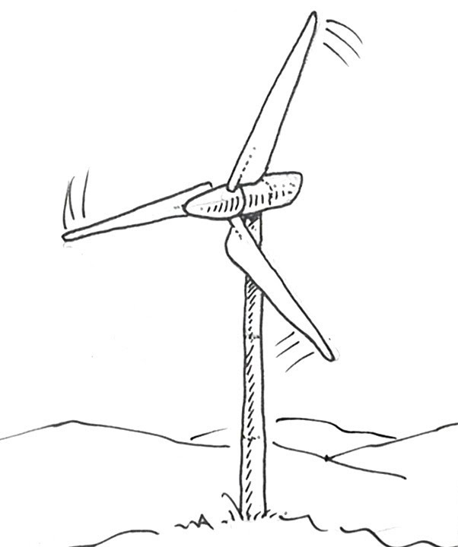
Wind Turbines are opposite to Ceiling Fan

Slide 4
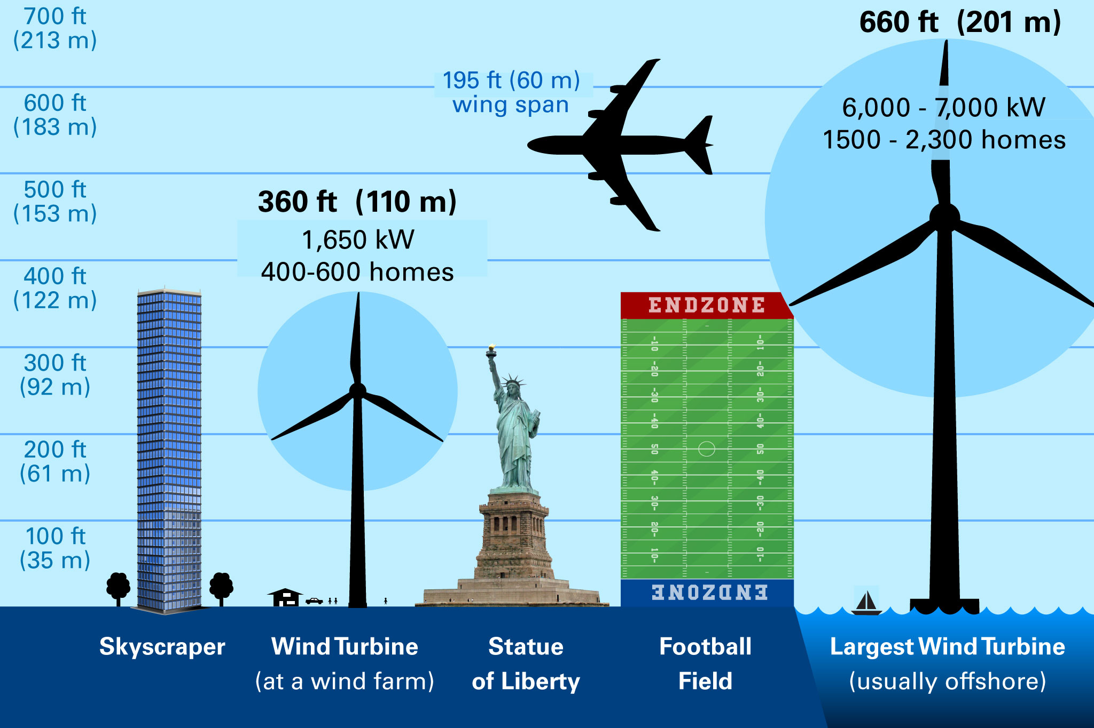
Wind Turbines are getting bigger and bigger!!!

Slide 5
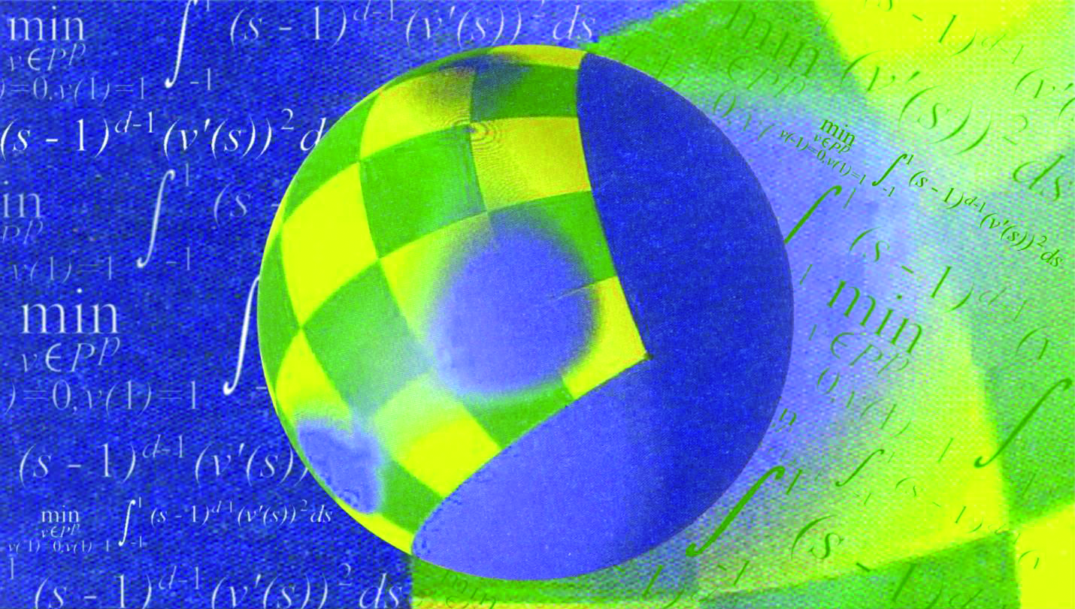
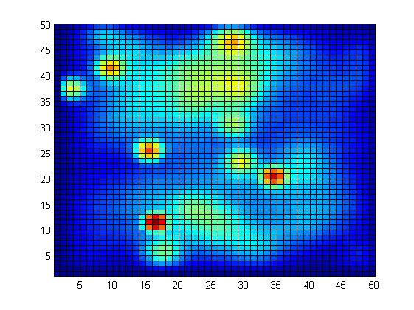
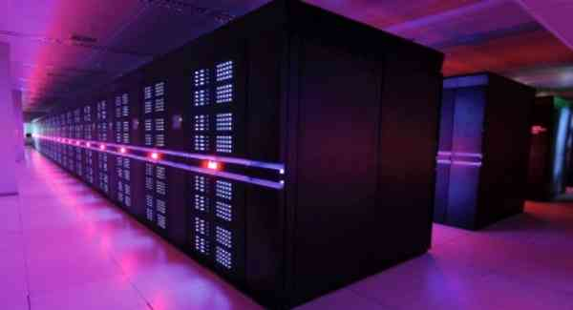
Computational Mathematics

Slide 6
Flow visualization

Slide 7
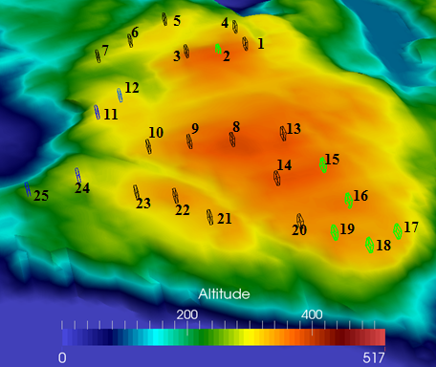
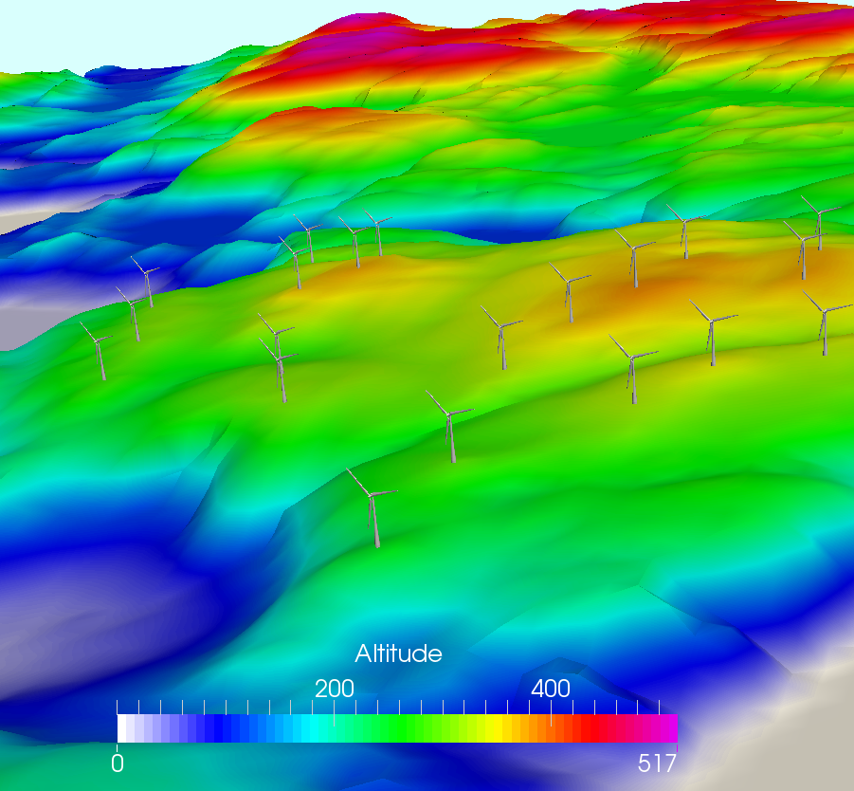
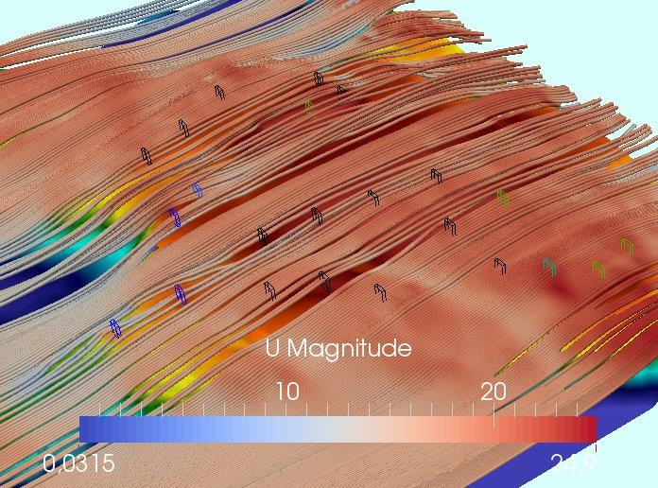
Turbine micro citing

Slide 8
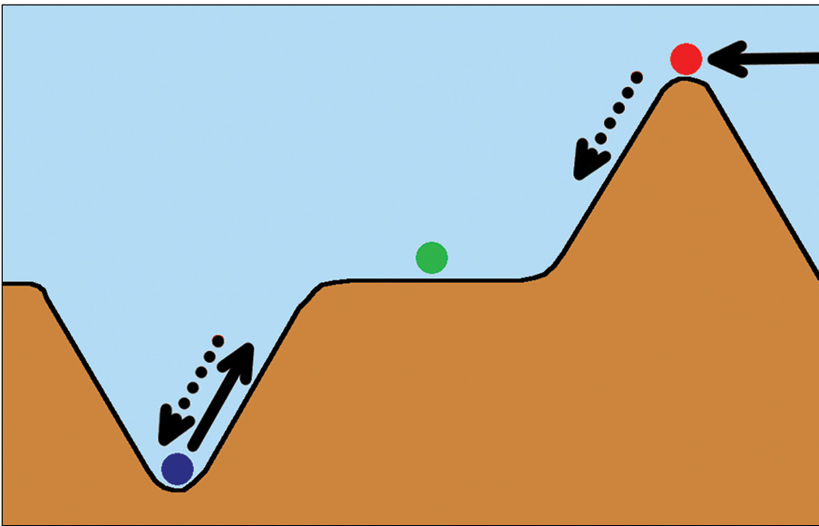
Atmospheric interaction (Stable, Neutral, Unstable)

Slide 9
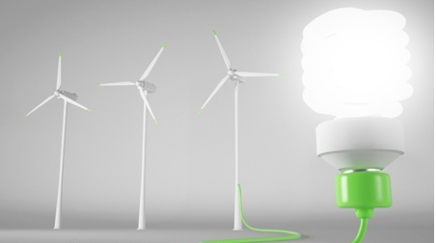
Thank you!

