Slide 1
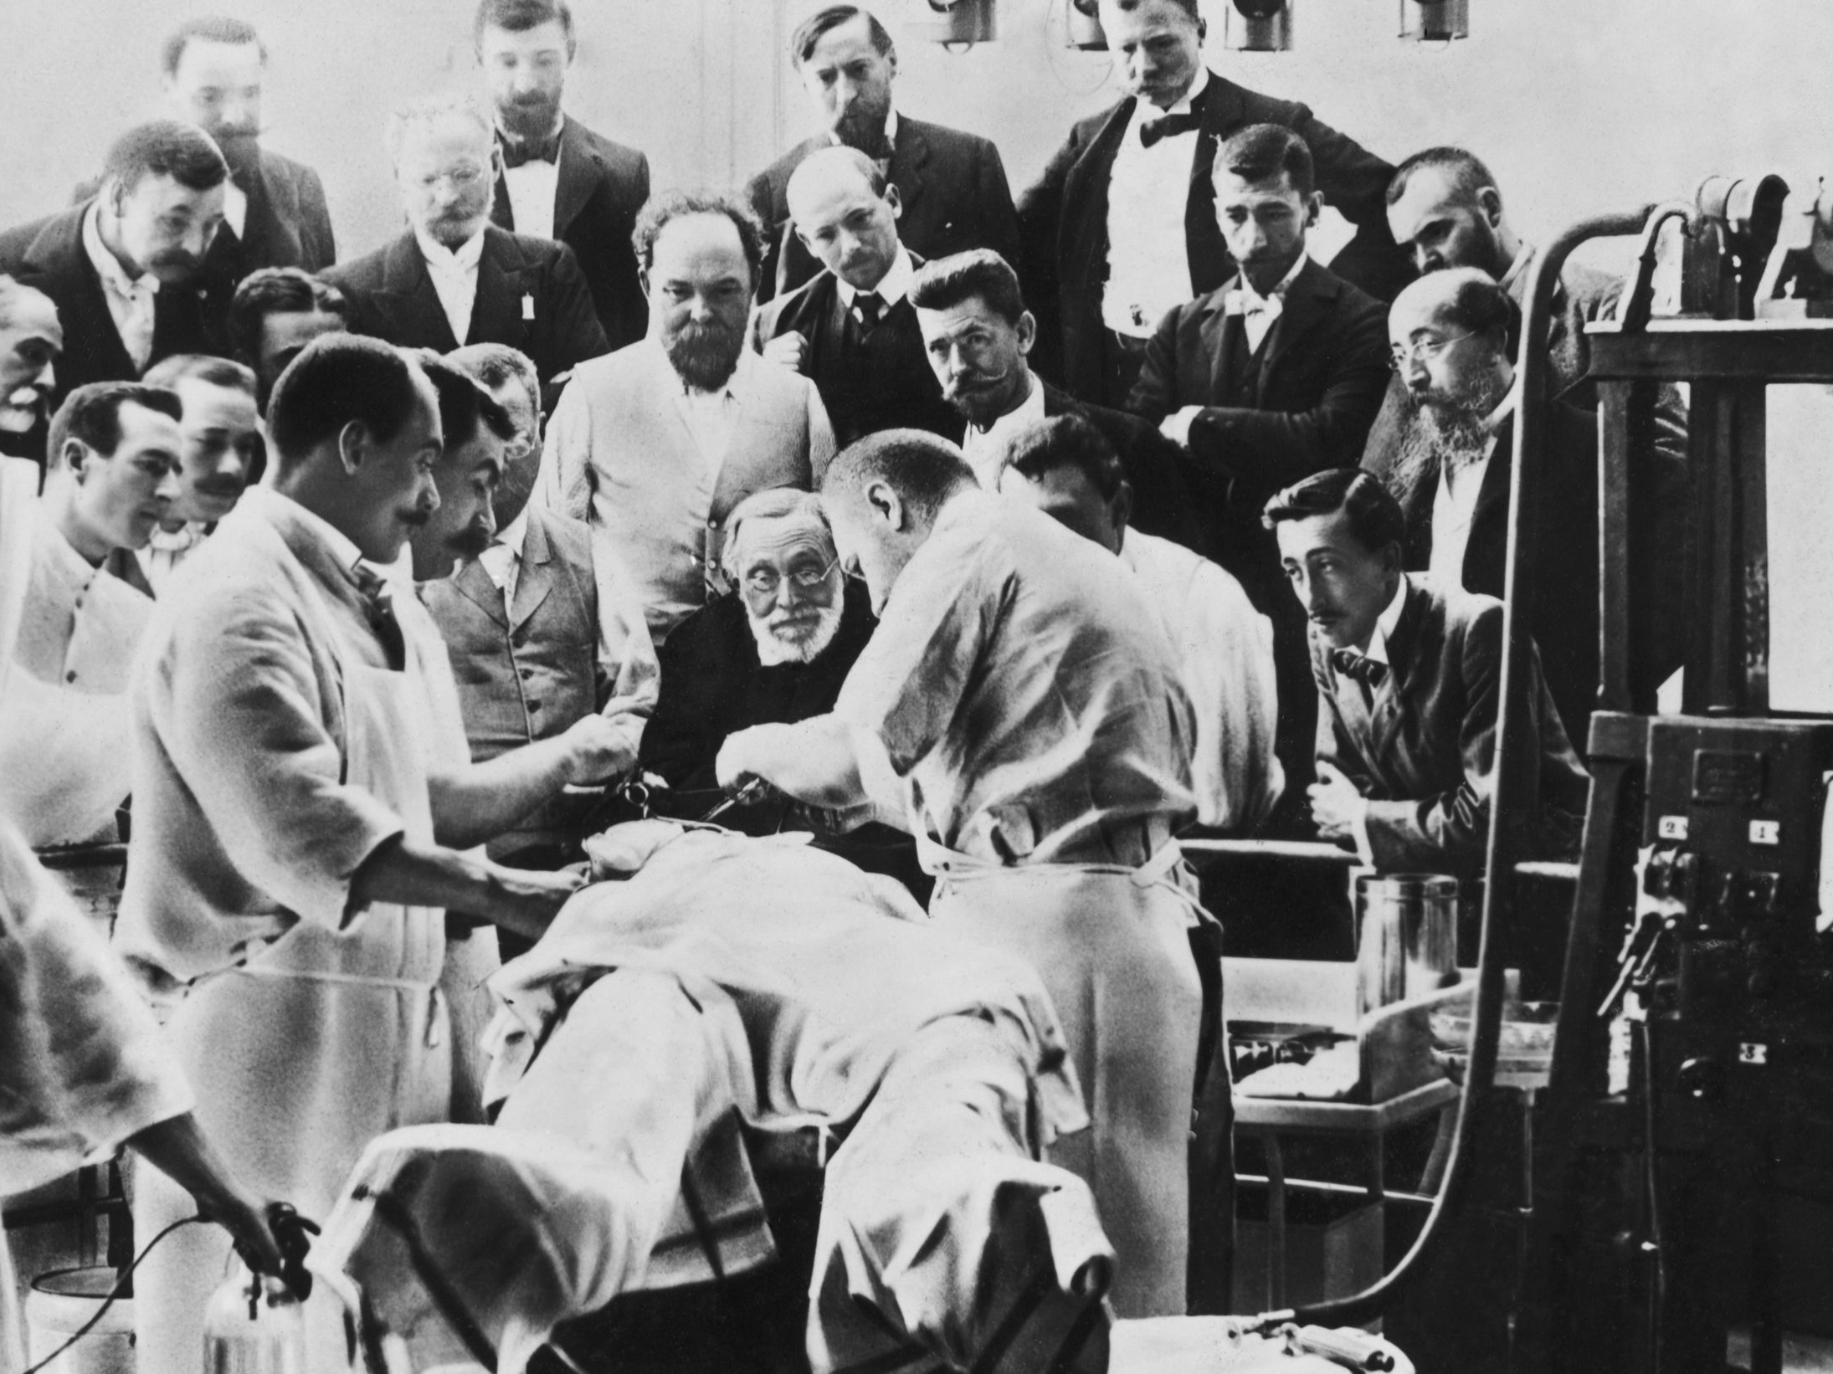
Health inequality and global health research: what role does theory play?
Emil Øversveen • 17.09.2010

Slide 2
Purpose and plan
About me: Qualitative researchers, PhD in sociology on health inequalities in the Norwegian health care system
What is the function of theory?
Biomedical epistemology and health inequality research
Current challenges in health inequality research

Slide 3
What is the function of theory?

Slide 4
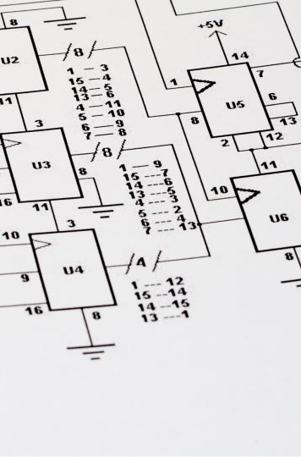
What is the function of theory?
Constructive: Provides coherent frameworks that facilitates and guides scientific inquiry
Cumulative: «Stores» and summarizes scientific knowledge

Slide 5

What is the function of theory?
Creative: Sensitizes us to the world around us, suggests topics for empirical observation
Therapeutic: Helps us ‘out of the fly bottle’ by dissolving vexing and potentially destructive questions

Slide 6

What is the function of theory?
Practical: Suggests ways to intervene in a given state of affairs
Political: Establishes possibilities for political action

Slide 7
Pragmatic conception of theory: Theory is a set of tools that help us observe, examine, interpret and act in the world

Slide 8
Biomedical epistemology
Mechanical metaphor of the body as a machine that is ‘repaired’ through medical intervention
Biological reductionism: The ‘real’ causes of disease comprise biophysical agents, genes and risk factors
Specific aetiology: all diseases can and should be traced back to a single cause
Methodological reductionism: All complex phenomena can and should be explained through their component parts (society -> biology -> chemistry -> physics)
Positivism: Truths are universal and independent of context, and can be discovered through empirical observation

Slide 9
Health inequality research
Highlights the social determinants of health at an ‘upstream’ social level
Emphasizes the complex, holistic and multi-causal nature of health
Tends to downplay the importance of biology, genetics and life-style factors

Slide 10
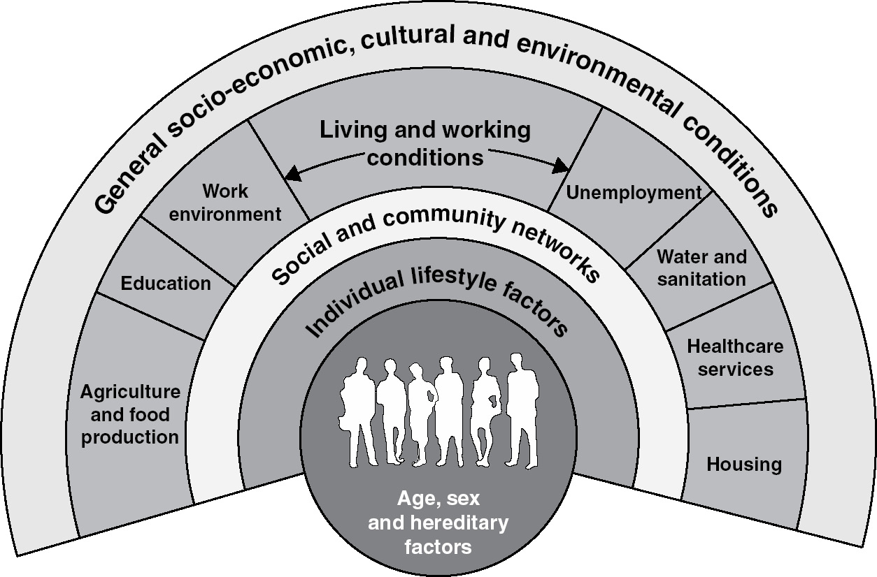

Slide 11
Health inequality research
Highlights the social determinants of health at an ‘upstream’ social level
Emphasizes the complex, holistic and multi-causal nature of health
Tends to downplay the importance of biology, genetics and life-style factors
Argues that health is most effectively improved through structural interventions and political reform
(Generally) positivist: Assumes that health can be objectively measured and observed, and that theoretical problems can be settled empirically

Slide 12
Current challenges within health inequality research

Slide 13
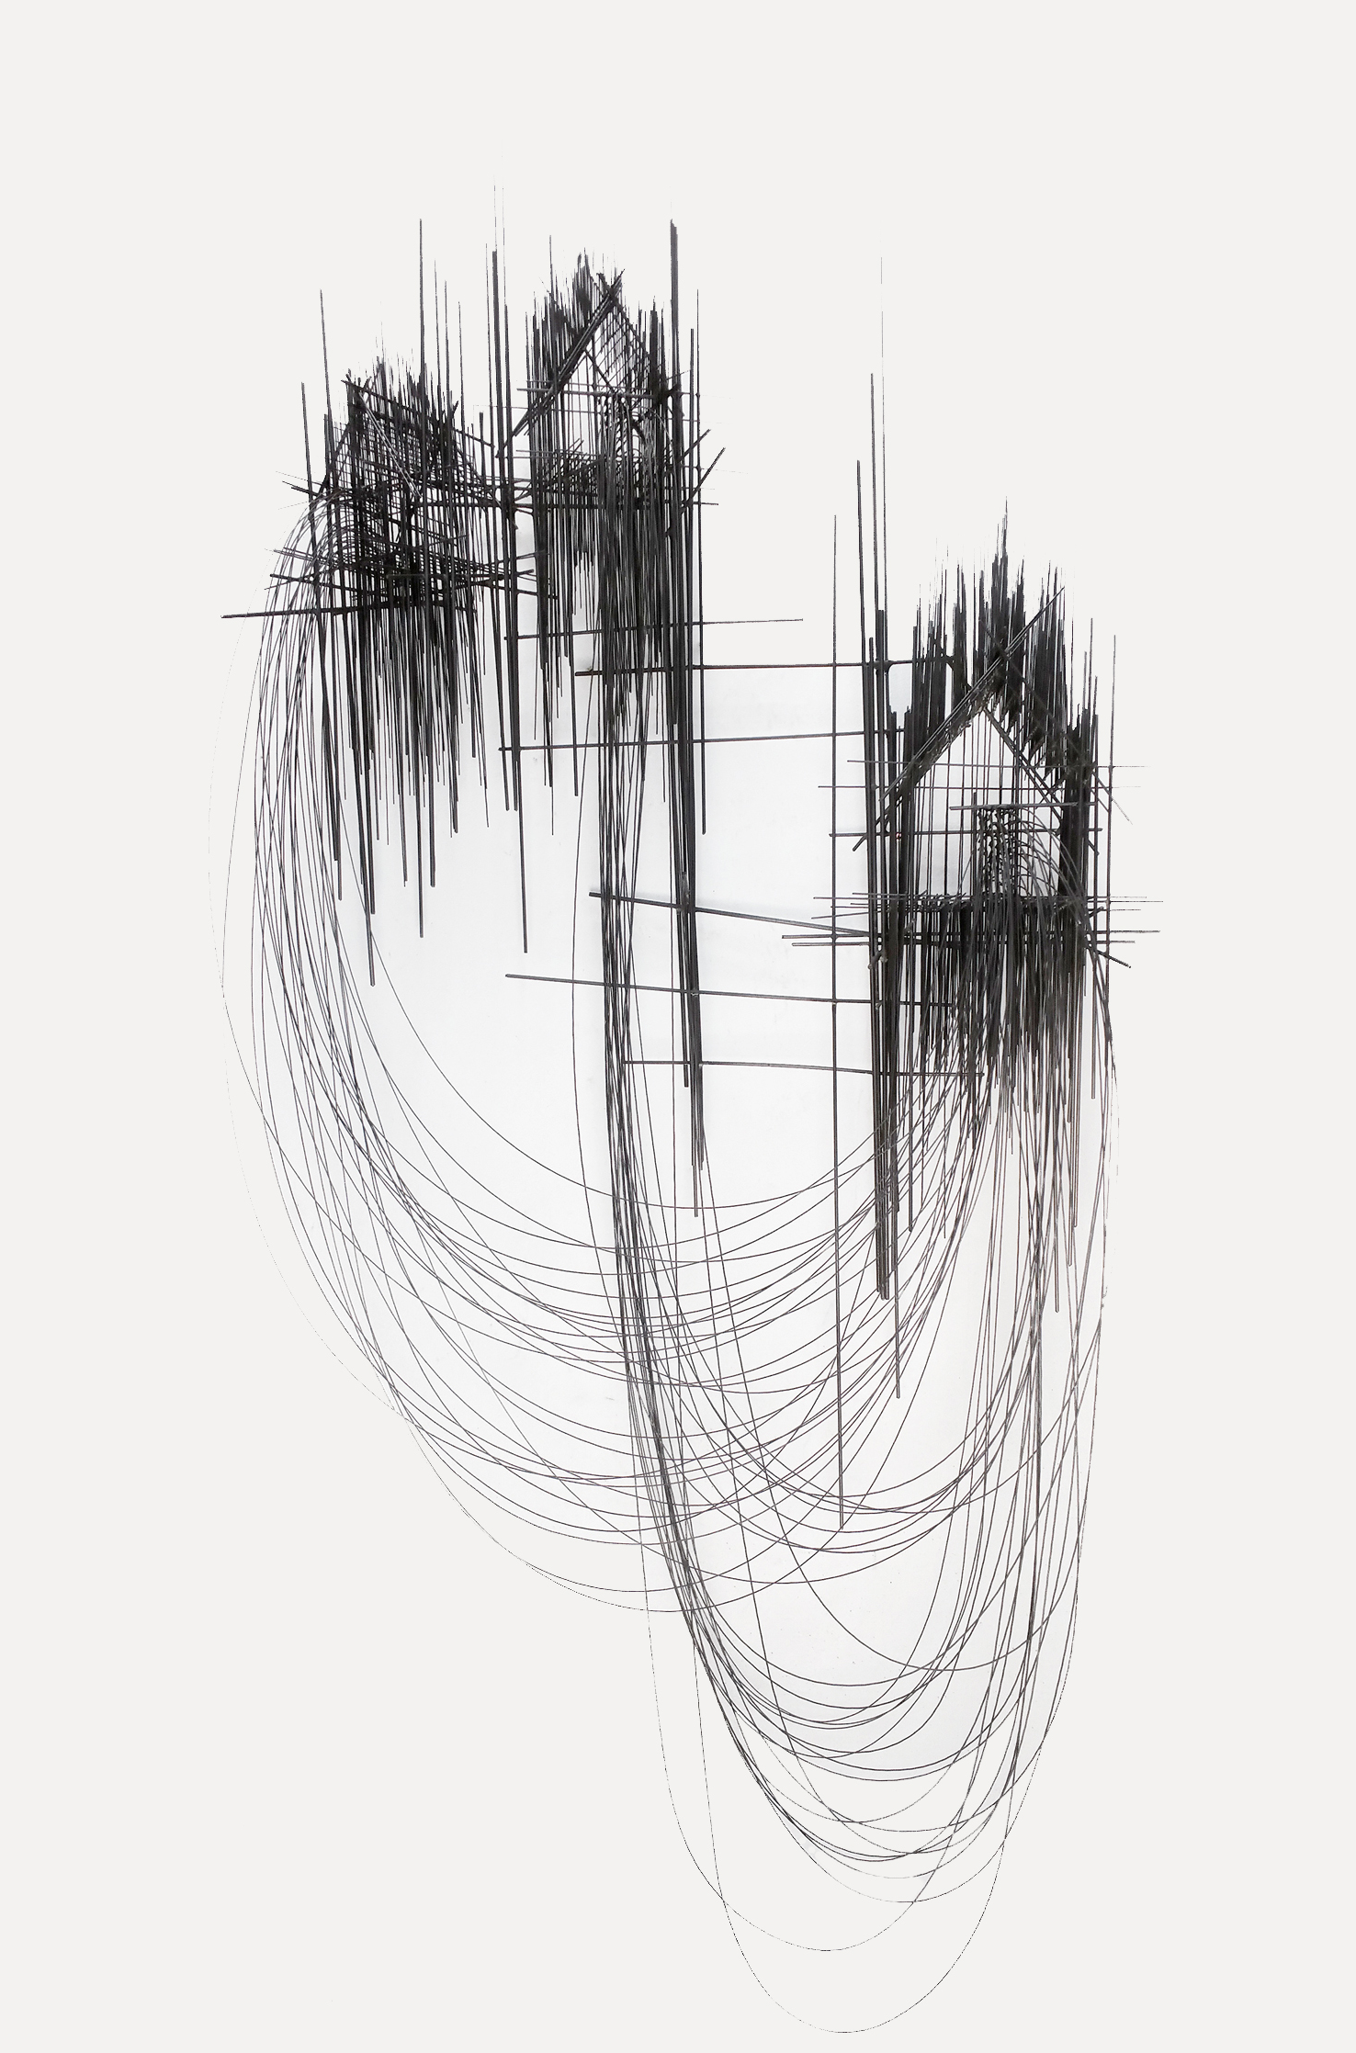
Theoretical challenges
General lack of integration between health inequality research and social theory
Thin understanding of key terms, notably ‘structure’ and ‘social inequality’

Slide 14
Health inequalities are caused by structural factors

Slide 15
Theoretical challenges
General lack of integration between health inequality research and social theory
Thin understanding of key terms, notably ‘structure’ and ‘social inequality’
Dependence on definitions that lists causally relevant factors rather than explaining how these factors are produced and why they matter

Slide 16


Slide 17
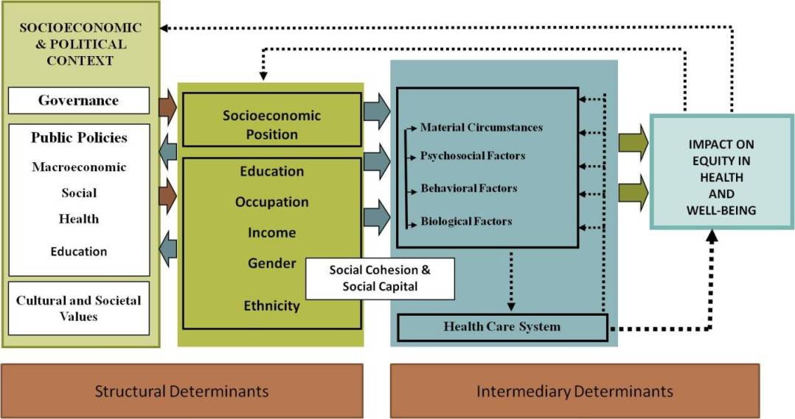

Slide 18
Governance: «System of values, policies and institutions by which society manages economic, political and social affairs through interactions within and among the state, civil society and private sector»
Solar and Irwing, 2010, p. 25-26

Slide 20
Governance: «System of values, policies and institutions by which society manages economic, political and social affairs through interactions within and among the state, civil society and private sector»
Solar and Irwing, 2010, p. 25-26

Slide 21
The theory of society in health inequality research
Substantialism: Tends to view society as composed of a set of pre-given, static and separate entities («culture», «policies», «institutions», «inequality»)
Tends to treat these entities as «things» that actually exist and can be observed directly
Generally studies interactions between entities rather than how they are produced, sustained or altered – thereby largely taking the social organization of society as a given
Entities are often defined by reference to other entities (structure = policy, values, governance, etc)

Slide 22
The theory of society in health inequality research (2)
Explanations often ‘point out’ of the field of health inequality research: Health inequalities are caused by social inequalities, which are left to the sociologists to explain
Limited attention to questions of social class, power, the importance of language and symbolic representation, structural sexism and racism, etc
Even less attention to the relationship between oppression and scientific production – view of science as a neutral activity that is not affected by class, power, sexism, racism, etc
Generally favors a political strategy of working within the system by appealing to established political and economic elites

Slide 23
Questions to consider
What are the central concepts of my research? What are their purpose, and how are they defined?
What is the status of the scientific research I produce? What knowledge claims does it make?
What underlying notions about health, society and individual agents shape the formulation of research questions, choice of methods, strategy for analysis and manner of making conclusions?
What is the relationship between theoretical orientation and choice of political strategy?

Slide 24
Literature
Canguilhem, G. (1966/2015) The Normal and the Pathological, Brooklyn: Zone Books.
Emirbayer, M. (1997) Manifesto for a Relational Sociology. American Journal of Sociology, 103:2, 281-317.
Federici, S. (2004) Caliban and the Witch. Women, the Body and Primitive Accumulation, New York: Autonomedia.
Foucault, M. (1999) Seksualitetens historie 1. Viljen til viten, Valdres: Pax Forlag.
Gramsci, A. (1971) Selections From the Prison Notebooks, New York: International Publishers.
Kuhn, T.S. (1996/1962) The Structure of Scientific Revolutions, Chicago: The University of Chicago Press.
Latour, B. (2005) Reassembling the Social. An Introduction to Actor-Network Theory, Oxford: Oxford University Press.
Marx, K. (1844/1978) For a Ruthless Criticism of Everything Existing (Marx to Arnold Ruge), In Tucker, R.C. (ed) The Marx-Engels Reader. Second Edition, New York: W.W. Norton & Company. pp. 12-16.
Marx, K. (1867/2008) Kapitalen. Kritikk av den politiske økonomien. Første bok. Kapitalens produksjonsprosess, Oslo: De norske bokklubbene.
Marx, K. (1978) The Grundrisse, In Tucker, R.C. (ed) The Marx-Engels Reader. Second Edition, New York: W.W. Norton & Company. pp. 12-16.
Marx, K. and Engels, F. (1846/1996) The German Ideology. Part one. With selections from parts two and three and supplementary texts, New York: International Publishers.
Nettleton, S. (2013) Sociology of Health and Illness. 3rd Edition. Cambridge: Polity Press
Scambler, G. (2012) Review article. Health Inequalities, Sociology of Health & Illness, 34, 1.
Scambler, G. and Scambler, S. (2015) Theorizing health inequalities: The untapped potential of dialectical critical realism, Social Theory & Health, 13, 3-4, 340-354

