Slide 1
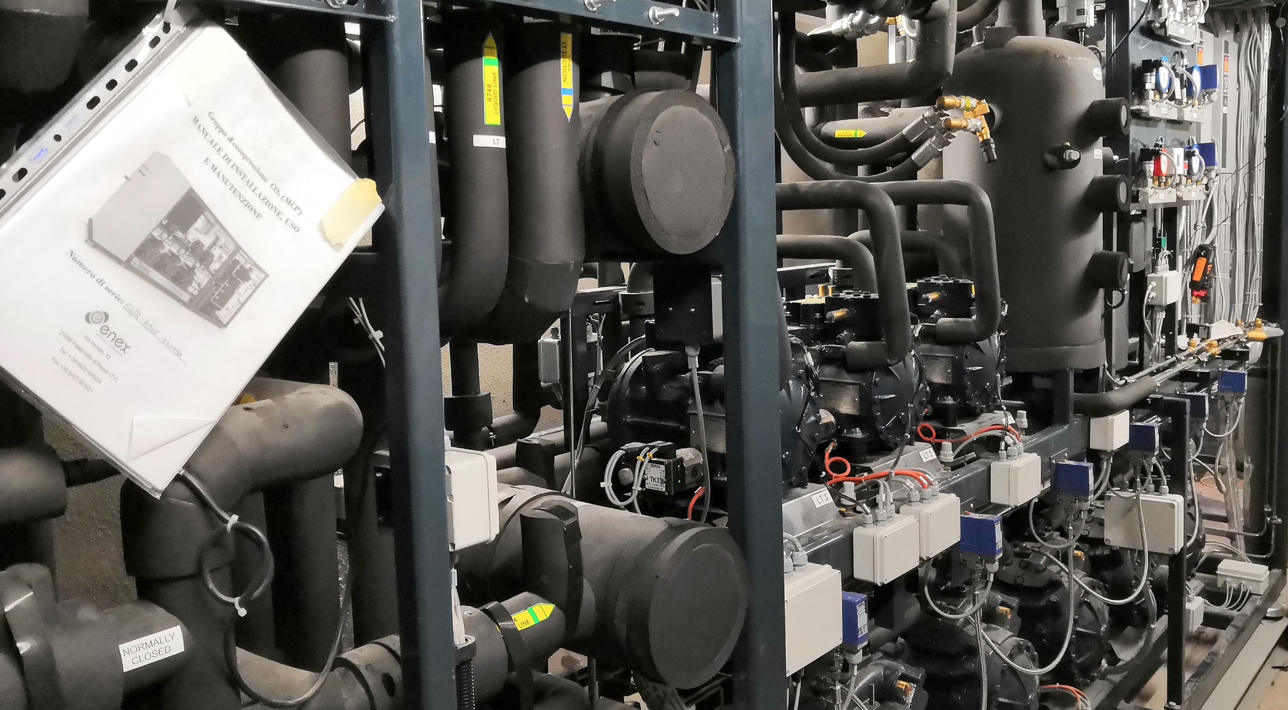
CO₂ units for supermarkets and efficient integration
Krzysztof Banasiak, Armin Hafner, Ángel Álvarez Pardiñas

Slide 2



Krzysztof Banasiak
Researcher at
SINTEF Energi
Armin Hafner
Professor NTNU
Ángel Álvarez Pardiñas
Researcher NTNU
Krysztof Banasiak is working with SINTEF Energi for over 5 years. His research interest lies in refrigerations and and he has a great interest and expretise with CO₂ refrigerant systems, ejectors and multilevel refrigerant systems.
Krysztof Banasiak reviews the Applied Thermal Engineering, the International Journal of Refrigeration and the International Journal of Thermal Sciences.
He holds a PhD in Mechnical Engineering/Refrigeration and wrote his dissertation about Heat Recovery.
Armin Hafner has worked with SINTEF Energi for nearly 20 years before becomming a Professor in refrigeration technology at NTNU in 2016.
He holds a PhD in Mechnical Engineering/Refrigeration. The dissertation was about reversibel mobile AC systems with CO₂ as working fluid.
The research focus lies in refrigeration with natural worling fluids, especialy integrated supermarket systems and advanced heat pump chillers.
Ángel Álvarez Pardiñas holds a PhD in Refrigeration and Heat Transfer from the University of Vigo (Spain). The main focus was on ammonia boiling processes on tubes.
He continued his career as researcher at NTNU (Norway) within the project SuperSmart-Rack. The project’s main purpose was to enhance the performance of R744 compressor racks for supermarkets using both experimental and numerical tools.

Slide 3
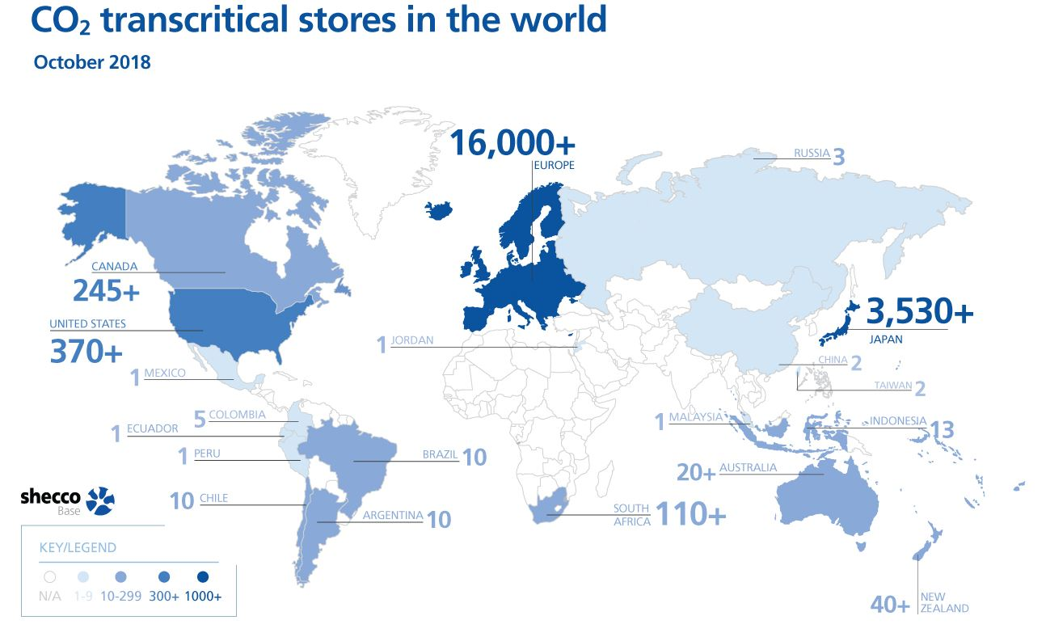
Energy Smart Supermarkets
CO₂ units for Supermarkets
https://www.regjeringen.no/contentassets/816c63dcb0ea49768ec03cd64828af5a/effekter_av_energiforskningen.pdf
Current state: +20000 supermarkets applying CO₂ as working fluid (R744)
annual reduction of 19 million metric tons of CO₂ _{equ}, due to replacement of HFC and energy efficiency improvement
1.6 TWh/a reduced energy demand
65 mill €/a reduced cost for energy

Slide 4

Energy Smart Supermarkets
Why integrated CO₂ units?
Safety
Energy savings
Reduced total costs of ownership
  CAPEX (≈)
  OPEX (+)
Reduced number of plug-ins
Improved reliability
Business opportunity
Notes:
Safety (refrigerant and legal)
Energy savings: performance at most outdoor temperatures, free heating, smart integration AC
Reduced cost ownership. CAPEX equal and almost lower. OPEX is an advantage due to energy efficiency, cost of refrigerant, maintenance single unit
Plug-ins: reduced AC load in the commercial area
Reliability. Several compressors per suction level.
Business opportunity. Commercialization of energy streams from the compressor pack.

Slide 5
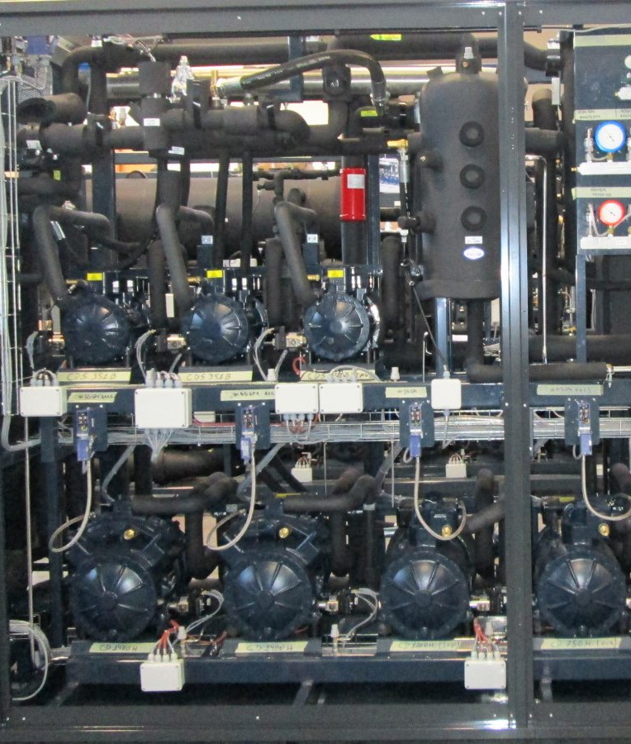
Energy Smart Supermarkets
Integrated CO₂ units for Supermarkets
Compressor Pack
Supermarket
LT Refrigeration
Freezing of foodstuff @-18°C
MT Refrigeration
Chilling of foodstuff @2°C
AC
@22°C
Heating
@45 / 55 °C
Domestic hot water
@≤90°C
Other users

Slide 6
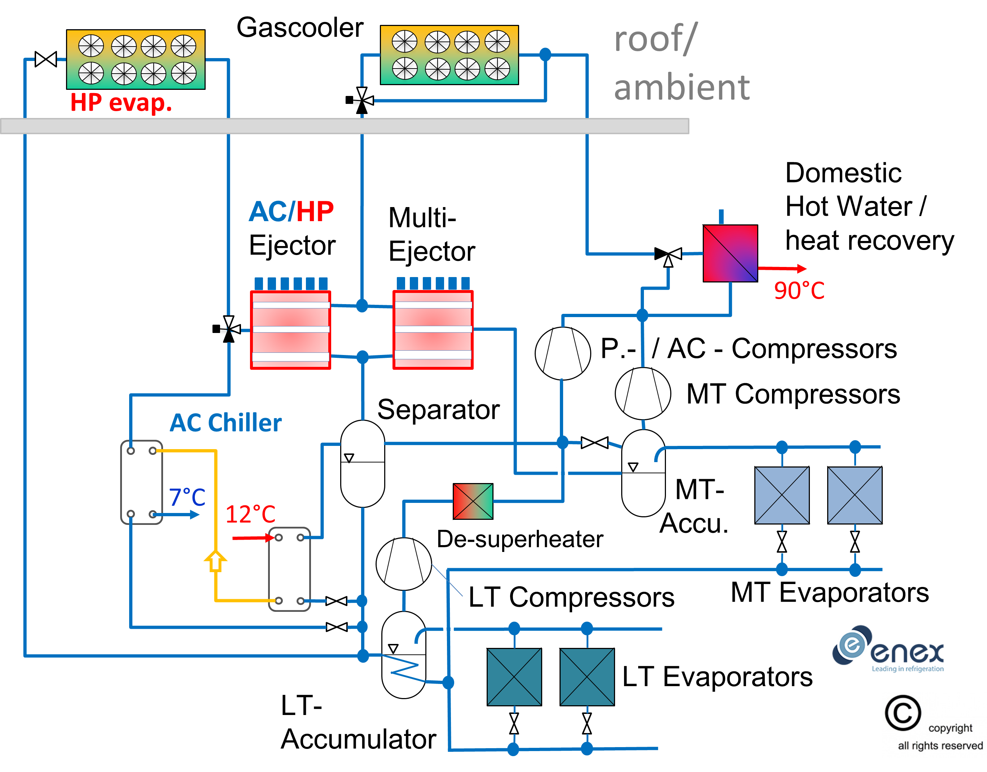


Energy Smart Supermarkets
Integrated CO₂ units for Supermarkets
www.ntnu.edu/multipack
MultiPACK Demo site for warm European regions
Parallel compression
AC/heat pump integration
Flooded evaporators
Vapor/liquid ejectors
Notes:
How to do it?
Baseline is a booster system, delivering refrigeration for chilling and freezing.
1st upgrade is parallel compression, this is the baseline for a warm climate.
Integration of other demands
AC and heat production.
Heat from the discharge of the compressors.
Not the last step. Boost up efficiency: flooded evaporators, ejectors
Multipack
Individual enhancements

Slide 7
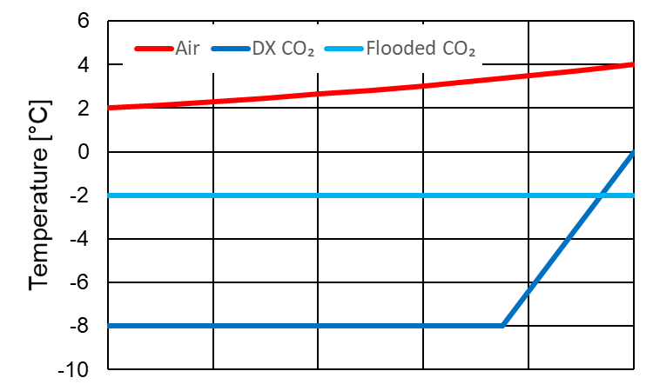
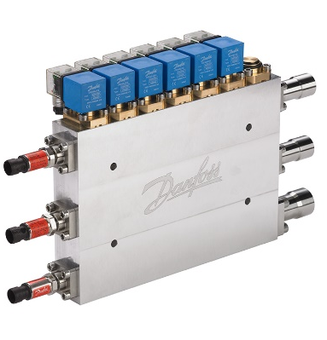
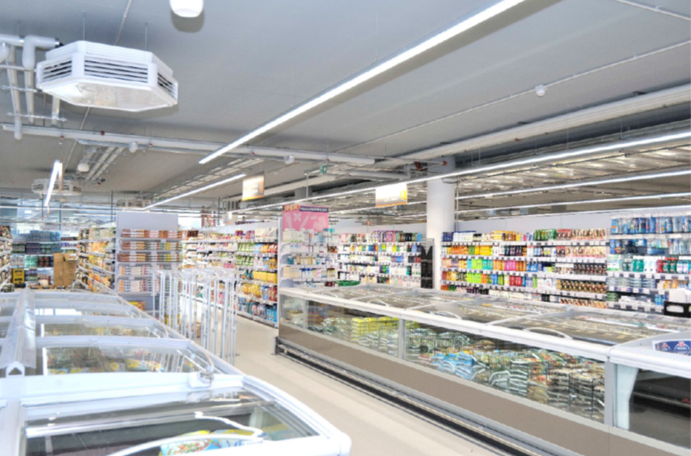
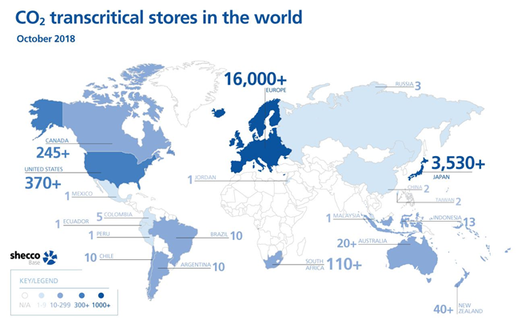
Energy Smart Supermarkets
Integrated CO₂ units for Supermarkets
Flooded evaporators
Ejector supported operation
Shifting load from MT to AUX
Liquid pumping
AC loop
Other uses: oil pumping, replacement LT compressors, open cabinets.
AC integration
Air to CO₂ evaporators
Ejector: ↑ Receiver pressure
Adaptation of compressor pack
Simple booster?
Parallel compression?
Ejector supported?
Consider:
Climate
Demands and integration
From Girotto. Direct space heating and cooling with CO₂ refrigerant. A new solution for commercial buildings. ATMOsphere EUROPE 2016

Slide 8
Energy Smart Supermarkets
KEY MESSAGES
Key Messages
CO₂ is a global, energy efficient working fluid for integrated supermarket units preserving foodstuff and delivering AC and heating
Significant energy savings can be achieved when applying integrated designs adapted to local conditions (climate and load profile)
No legal uncertainties or restrictions globally, avoiding costly replacements in the future

