Slide 1


Slide 2

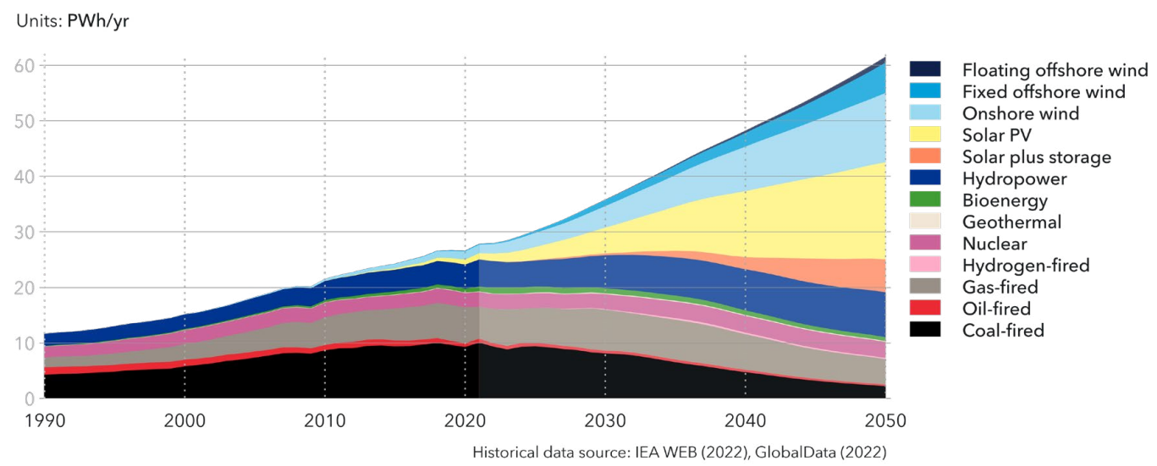
«In the future energy supply hydropower will play an important role»

Slide 3
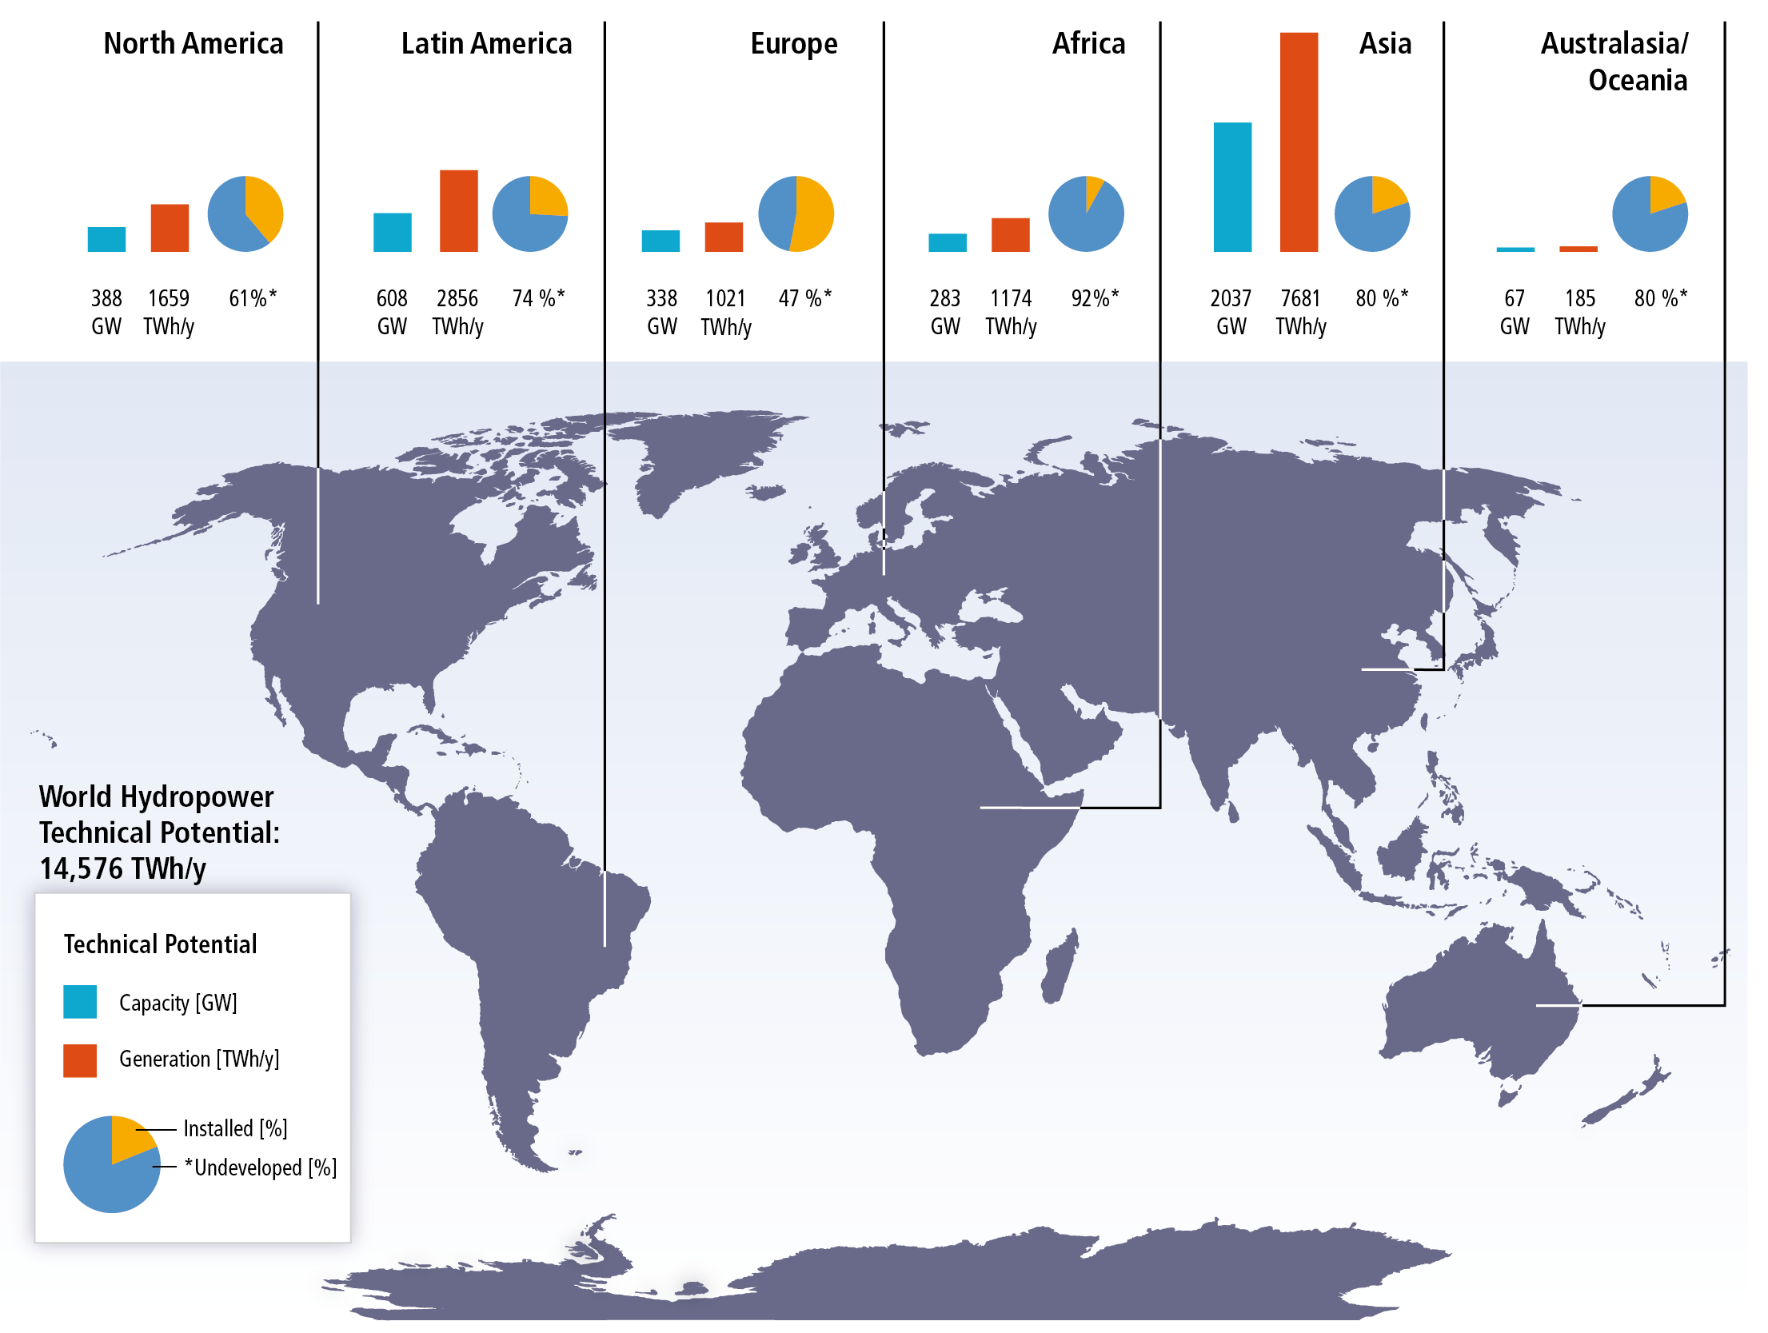
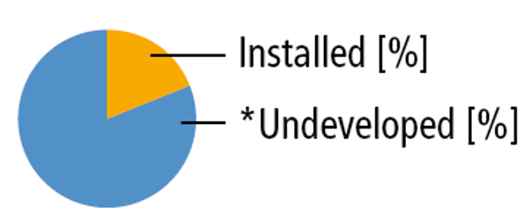

Slide 4

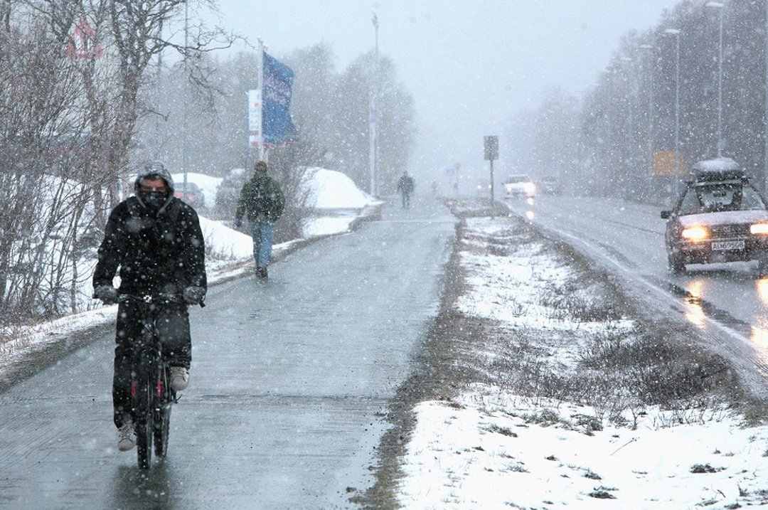
Why learn Hydropower In Norway

Slide 5
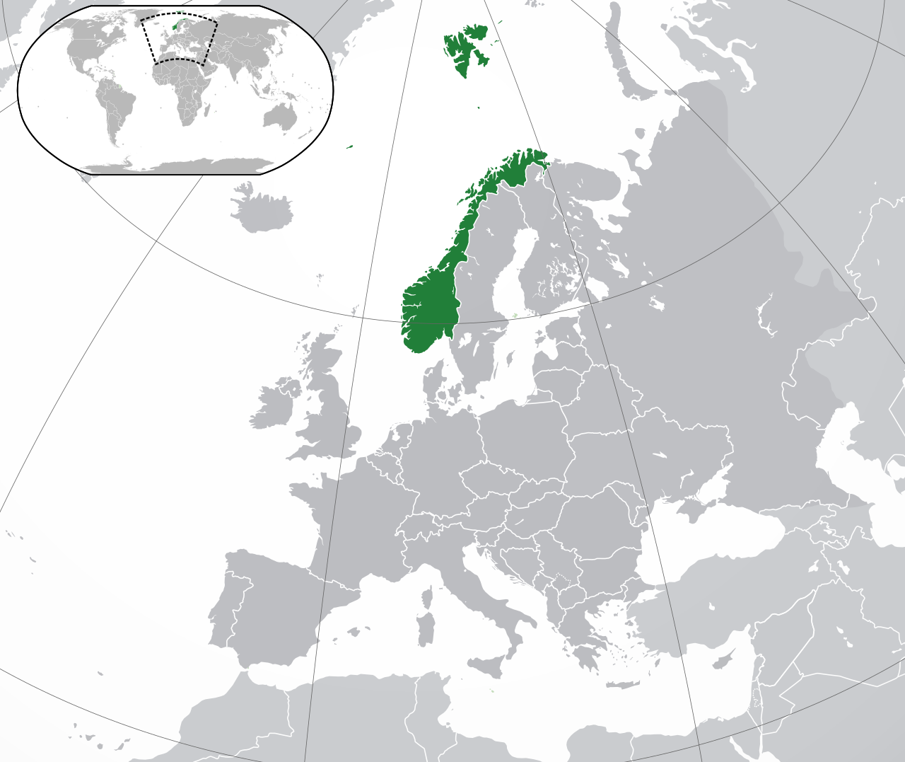
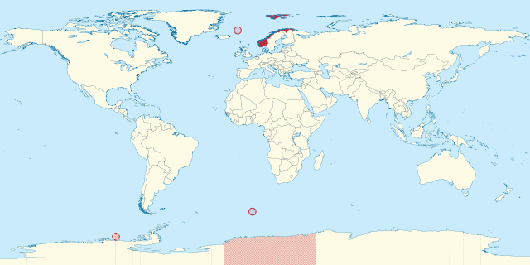
The Arctic
60 | Paraguay | 406 750 | km²
61 | Zimbabwe | 390 580 | km²
62 | Norway* | 385 250 | km²
63 | Japan | 377 835 | km²
64 | Germany | 357 021 | km²
*Queen Maud Land 2.7 Mill km² => # 7 (India #8)
114 | Slovakia | 5,426,252 | 0.073%
115 | Eritrea | 5,352,000 | 0.072%
116 | Norway | 5,252,166 | 0.07%
117 | Central African Republic | 4,998,000 | 0.067%
118 | Costa Rica | 4,890,379 | 0.065%

Slide 6
The Arctic
60 | Paraguay | 406 750 | km²
61 | Zimbabwe | 390 580 | km²
62 | Norway* | 385 250 | km²
63 | Japan | 377 835 | km²
64 | Germany | 357 021 | km²
*Queen Maud Land 2.7 Mill km² => # 7 (India #8)
114 | Slovakia | 5,426,252 | 0.073%
115 | Eritrea | 5,352,000 | 0.072%
116 | Norway | 5,252,166 | 0.07%
117 | Central African Republic | 4,998,000 | 0.067%
118 | Costa Rica | 4,890,379 | 0.065%

Slide 7
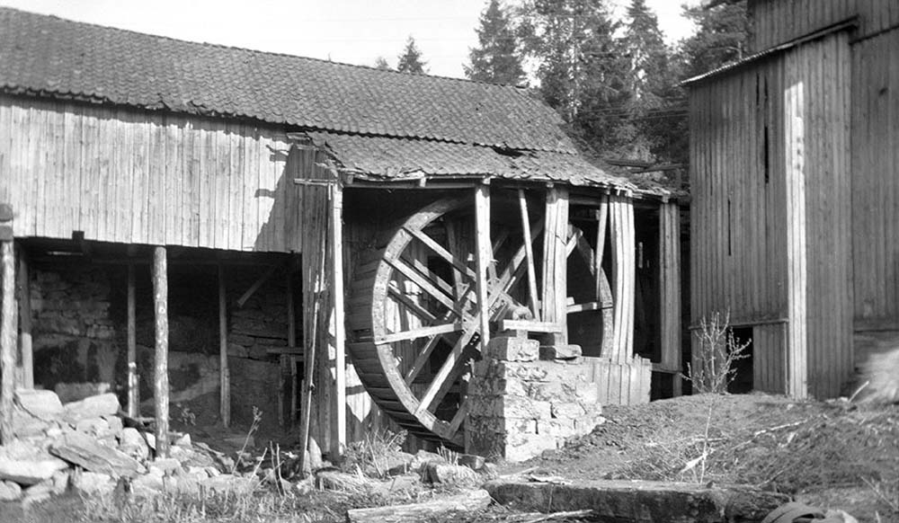
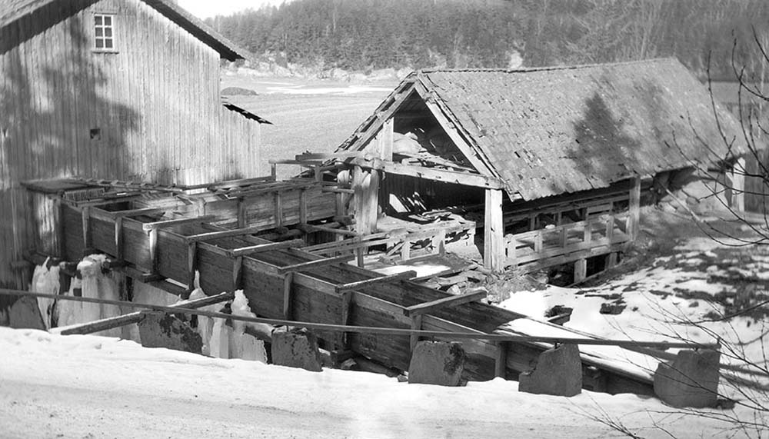
Long Hydroelectricity History
1300
1800
1900
2000
1700
1800
1900
2000
Notes:
1770’s - In the mid-1770s, French engineer Bernard Forest de Bélidor published Architecture Hydraulique which described vertical- and horizontal-axis hydraulic machines
1849 - The Francis turbine (https://en.wikipedia.org/wiki/Francis_turbine#cite_note-1) is a type of water turbine that was developed by James B. Francis in Lowell, Massachusetts.^{[1]} It is an inward-flow reaction turbine that combines radial and axial flow concepts
In 1853, (http://www.niagarafrontier.com/power.html) The Niagara Falls Hydraulic Power & Manufacturing Company had purchased the water rights and began construction of this canal. In 1860, construction of the hydraulic canal began. The canal was 35 feet (11m) wide and 8 feet (2.4m) deep. It transported water from the Niagara River above the Falls to the mill sites below the Falls. The canal construction was completed in 1861. Augustus Porter's vision became reality in 1875, when the first wheels began turning in the new powerhouse.
1878 - Armstrong created Debdon Lake to use the water running through his estate to supply the world's first hydroelectric power station. This powered various labour-saving devices in his house including a roasting spit, a dishwasher and (a wonderful innovation) a servants lift. Turkish baths were installed as part of the innovative provision of central heating for the house, electricity facilitated the installation of an arc lamp in 1878 and the first of his friend Joseph Swan's incandescent light bulbs were installed in time for christmas 1880.
In 1878, Edison formed the Edison Electric Light Company in New York City with several financiers, including J. P. Morgan, Spencer Trask,^{[60]} and the members of the Vanderbilt family. Edison made the first public demonstration of his incandescent light bulb on December 31, 1879, in Menlo Park. It was during this time that he said: "We will make electricity so cheap that only the rich will burn candles."^{[61]}
By 1881, the power company had built a small generating station and began providing a small amount of electricity to light the village of Niagara Falls and to provide power to several of the mills. This power plant became a tourist attraction. It operated a flour mill for two years before the company went bankrupt and all its assets were sold at public auction.
1882 - The Vulcan Street Plant (https://en.wikipedia.org/wiki/Vulcan_Street_Plant#cite_note-ref_5-5) was the first Edison hydroelectric central station.^{[1][2][3][4]} The plant was built on the Fox River in Appleton, Wisconsin and put into operation on September 30, 1882.^{[4][5]}
1882 – (http://www.vasskrafta.no/historie/category451.html) Vannkraftverk i Hamn i Senja, høsten 1882. Det er ganske oppsiktsvekkende. Dette vannkraftverket var blant de aller første vanndrevne elektrisitetsverk i verden, kanskje det første. Det har visstnok bare en konkurrent fra Wisconsin, USA, fra samme år.
1885 - Laugstol Brug var en treforedlings-bedrift med behov for egen strømforsyning, men ved hjelp av to dynamoer, hver med forsyning til 150 glødelamper, fikk kraftverket en så stor kapasitet at det også kunne forsyne andre abonnenter i Skien. Både dynamoene og glødelampene var utenlandske. En ny teknologi som i internasjonal sammenheng hadde vokst fram siden slutten av 1860-årene, hadde dermed for alvor blitt introdusert i Norge. Den driftige lederen av Laugstol Brug og initiativtakeren til elektrisitetsverket var ingeniør Gunnar Knudsen. Knudsen ble senere både stortingsmann og statsminister og fikk en betydelig rolle innen norsk elektrisitetsforsyning (https://www.nve.no/om-nve/nves-museumsordning/nves-historie/1885-laugstol-brug-i-skien-landets-forste-elektrisitetsverk-blir-offisielt-satt-i-drift-1-oktober/)
1899 - Verdens første kraftstasjon i fjellhall var Snoqualmie Falls Hydroelectric Plant i King County (Washington) fra 1899. Men av verdens rundt 400 undergrunns kraftstasjoner ligger over 200 i Norge
1905 - Svelgfoss kraftverk (oppført 1905-1907) og Såheim (oppført 1914-1916) er tidlige eksempel på kraftverk der den frittliggende rørgaten er lagt i tunnel i fjellet bak stasjonene
Trykksjakten ved Svelgen var på 152 meter og verdens lengste fram til Tafjord 3 kraftverk startet produksjonen i 1958 med en 286 meter råsprengt trykksjakt. (https://no.wikipedia.org/wiki/Vannkraftverk)
1906 – 757 Hydropower stations in Norway –Between 1906 and 1918, the Tysso I hydraulic power station – one of the largest high-pressure power stations in the world at the time – was constructed ((http://www.erih.net/i-want-to-go-there/getpage/4/site/show/norwegian-museum-of-hydro-power-and-industry/)
1911 - Vemork kraftverk som stod ferdig i 1911 og var verdens største kraftverk med 10 turbiner.
1928 - Nore 1 started operation 1928. It is recognized as the first hydropower project developed by Government (http://tunnel.no/wp-content/uploads/2014/01/Publication_22.pdf)
1970 - Mardøla-aksjonen var den første store miljøsaken der sivil ulydighet ble brukt i større skala. (https://no.wikipedia.org/wiki/Sivil_ulydighet).
1973 – Driva - Det første kraftverket i verden der dette ble gjort var Driva kraftverk i Møre og Romsdal i 1973. Dette høytrykks luftputekammeret (pressurized air cusion chamber) (https://no.wikipedia.org/wiki/Vannkraftverk)
1979 - The Alta development raised (1979-81) one of the first hot tempered campaigns against hydropower development in the country
1988 It was the world's first multinational exchange for trading electric power. (https://en.wikipedia.org/wiki/Nord_Pool_Spot)
1998 - The Bieudron Hydroelectric Power Station is a hydroelectric power plant located in the Swiss Alps in the Canton of Valais in Switzerland. The power plant is fed with water from the Grande Dixence Dam's reservoir, Lac des Dix and is part of the Cleuson-Dixence Complex. The 1269 MW power plant is operated by Grande Dixence SA.^{[1]}
Production began in 1998, with two world records set upon its completion: the world's most powerful Pelton turbine as well as the highest head used to produce hydro-electric energy. A penstock rupture in 2000 forced the closure of the power plant and it was operational again in 2010
(https://en.wikipedia.org/wiki/Bieudron_Hydroelectric_Power_Station)

Slide 8
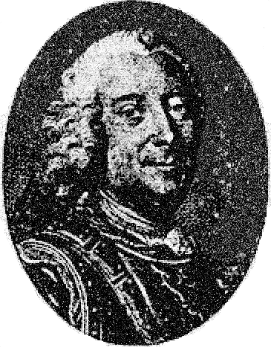
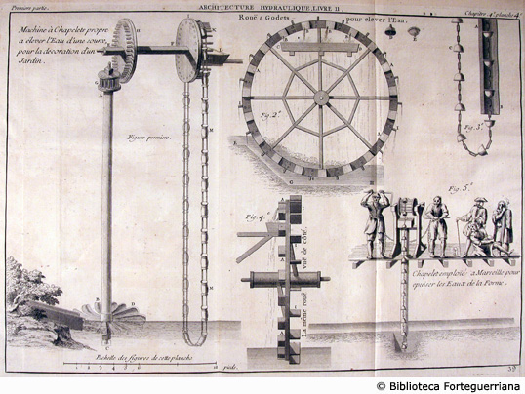
Long Hydroelectricity History
1700
1800
1900
2000
1770’s France First description of vertical- and horizontal-axis hydraulic machines
Notes:
1770’s - In the mid-1770s, French engineer Bernard Forest de Bélidor published Architecture Hydraulique which described vertical- and horizontal-axis hydraulic machines
1849 - The Francis turbine (https://en.wikipedia.org/wiki/Francis_turbine#cite_note-1) is a type of water turbine that was developed by James B. Francis in Lowell, Massachusetts.^{[1]} It is an inward-flow reaction turbine that combines radial and axial flow concepts
In 1853, (http://www.niagarafrontier.com/power.html) The Niagara Falls Hydraulic Power & Manufacturing Company had purchased the water rights and began construction of this canal. In 1860, construction of the hydraulic canal began. The canal was 35 feet (11m) wide and 8 feet (2.4m) deep. It transported water from the Niagara River above the Falls to the mill sites below the Falls. The canal construction was completed in 1861. Augustus Porter's vision became reality in 1875, when the first wheels began turning in the new powerhouse.
1878 - Armstrong created Debdon Lake to use the water running through his estate to supply the world's first hydroelectric power station. This powered various labour-saving devices in his house including a roasting spit, a dishwasher and (a wonderful innovation) a servants lift. Turkish baths were installed as part of the innovative provision of central heating for the house, electricity facilitated the installation of an arc lamp in 1878 and the first of his friend Joseph Swan's incandescent light bulbs were installed in time for christmas 1880.
In 1878, Edison formed the Edison Electric Light Company in New York City with several financiers, including J. P. Morgan, Spencer Trask,^{[60]} and the members of the Vanderbilt family. Edison made the first public demonstration of his incandescent light bulb on December 31, 1879, in Menlo Park. It was during this time that he said: "We will make electricity so cheap that only the rich will burn candles."^{[61]}
By 1881, the power company had built a small generating station and began providing a small amount of electricity to light the village of Niagara Falls and to provide power to several of the mills. This power plant became a tourist attraction. It operated a flour mill for two years before the company went bankrupt and all its assets were sold at public auction.
1882 - The Vulcan Street Plant (https://en.wikipedia.org/wiki/Vulcan_Street_Plant#cite_note-ref_5-5) was the first Edison hydroelectric central station.^{[1][2][3][4]} The plant was built on the Fox River in Appleton, Wisconsin and put into operation on September 30, 1882.^{[4][5]}
1882 – (http://www.vasskrafta.no/historie/category451.html) Vannkraftverk i Hamn i Senja, høsten 1882. Det er ganske oppsiktsvekkende. Dette vannkraftverket var blant de aller første vanndrevne elektrisitetsverk i verden, kanskje det første. Det har visstnok bare en konkurrent fra Wisconsin, USA, fra samme år.
1885 - Laugstol Brug var en treforedlings-bedrift med behov for egen strømforsyning, men ved hjelp av to dynamoer, hver med forsyning til 150 glødelamper, fikk kraftverket en så stor kapasitet at det også kunne forsyne andre abonnenter i Skien. Både dynamoene og glødelampene var utenlandske. En ny teknologi som i internasjonal sammenheng hadde vokst fram siden slutten av 1860-årene, hadde dermed for alvor blitt introdusert i Norge. Den driftige lederen av Laugstol Brug og initiativtakeren til elektrisitetsverket var ingeniør Gunnar Knudsen. Knudsen ble senere både stortingsmann og statsminister og fikk en betydelig rolle innen norsk elektrisitetsforsyning (https://www.nve.no/om-nve/nves-museumsordning/nves-historie/1885-laugstol-brug-i-skien-landets-forste-elektrisitetsverk-blir-offisielt-satt-i-drift-1-oktober/)
1899 - Verdens første kraftstasjon i fjellhall var Snoqualmie Falls Hydroelectric Plant i King County (Washington) fra 1899. Men av verdens rundt 400 undergrunns kraftstasjoner ligger over 200 i Norge
1905 - Svelgfoss kraftverk (oppført 1905-1907) og Såheim (oppført 1914-1916) er tidlige eksempel på kraftverk der den frittliggende rørgaten er lagt i tunnel i fjellet bak stasjonene
Trykksjakten ved Svelgen var på 152 meter og verdens lengste fram til Tafjord 3 kraftverk startet produksjonen i 1958 med en 286 meter råsprengt trykksjakt. (https://no.wikipedia.org/wiki/Vannkraftverk)
1906 – 757 Hydropower stations in Norway –Between 1906 and 1918, the Tysso I hydraulic power station – one of the largest high-pressure power stations in the world at the time – was constructed ((http://www.erih.net/i-want-to-go-there/getpage/4/site/show/norwegian-museum-of-hydro-power-and-industry/)
1911 - Vemork kraftverk som stod ferdig i 1911 og var verdens største kraftverk med 10 turbiner.
1928 - Nore 1 started operation 1928. It is recognized as the first hydropower project developed by Government (http://tunnel.no/wp-content/uploads/2014/01/Publication_22.pdf)
1970 - Mardøla-aksjonen var den første store miljøsaken der sivil ulydighet ble brukt i større skala. (https://no.wikipedia.org/wiki/Sivil_ulydighet).
1973 – Driva - Det første kraftverket i verden der dette ble gjort var Driva kraftverk i Møre og Romsdal i 1973. Dette høytrykks luftputekammeret (pressurized air cusion chamber) (https://no.wikipedia.org/wiki/Vannkraftverk)
1979 - The Alta development raised (1979-81) one of the first hot tempered campaigns against hydropower development in the country
1988 It was the world's first multinational exchange for trading electric power. (https://en.wikipedia.org/wiki/Nord_Pool_Spot)
1998 - The Bieudron Hydroelectric Power Station is a hydroelectric power plant located in the Swiss Alps in the Canton of Valais in Switzerland. The power plant is fed with water from the Grande Dixence Dam's reservoir, Lac des Dix and is part of the Cleuson-Dixence Complex. The 1269 MW power plant is operated by Grande Dixence SA.^{[1]}
Production began in 1998, with two world records set upon its completion: the world's most powerful Pelton turbine as well as the highest head used to produce hydro-electric energy. A penstock rupture in 2000 forced the closure of the power plant and it was operational again in 2010
(https://en.wikipedia.org/wiki/Bieudron_Hydroelectric_Power_Station)

Slide 9
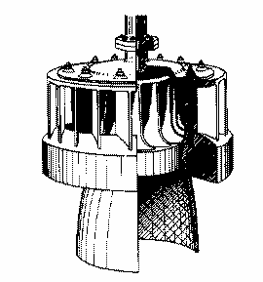
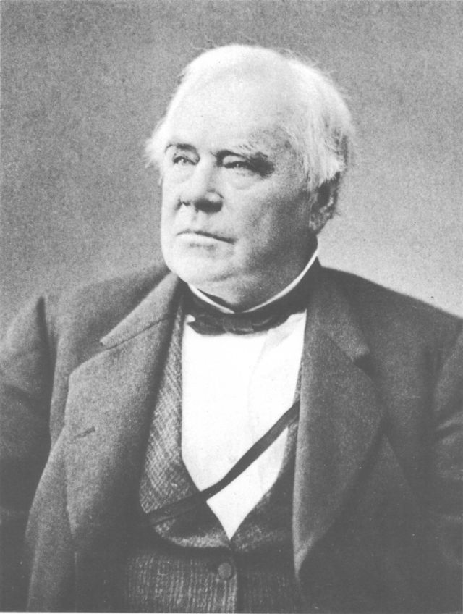
Long Hydroelectric History
1700
1800
1900
2000
1770’s France First description of vertical- and horizontal-axis hydraulic machines
1849 America
Francis turbine invented
Notes:
1770’s - In the mid-1770s, French engineer Bernard Forest de Bélidor published Architecture Hydraulique which described vertical- and horizontal-axis hydraulic machines
1849 - The Francis turbine (https://en.wikipedia.org/wiki/Francis_turbine#cite_note-1) is a type of water turbine that was developed by James B. Francis in Lowell, Massachusetts.^{[1]} It is an inward-flow reaction turbine that combines radial and axial flow concepts
In 1853, (http://www.niagarafrontier.com/power.html) The Niagara Falls Hydraulic Power & Manufacturing Company had purchased the water rights and began construction of this canal. In 1860, construction of the hydraulic canal began. The canal was 35 feet (11m) wide and 8 feet (2.4m) deep. It transported water from the Niagara River above the Falls to the mill sites below the Falls. The canal construction was completed in 1861. Augustus Porter's vision became reality in 1875, when the first wheels began turning in the new powerhouse.
1878 - Armstrong created Debdon Lake to use the water running through his estate to supply the world's first hydroelectric power station. This powered various labour-saving devices in his house including a roasting spit, a dishwasher and (a wonderful innovation) a servants lift. Turkish baths were installed as part of the innovative provision of central heating for the house, electricity facilitated the installation of an arc lamp in 1878 and the first of his friend Joseph Swan's incandescent light bulbs were installed in time for christmas 1880.
In 1878, Edison formed the Edison Electric Light Company in New York City with several financiers, including J. P. Morgan, Spencer Trask,^{[60]} and the members of the Vanderbilt family. Edison made the first public demonstration of his incandescent light bulb on December 31, 1879, in Menlo Park. It was during this time that he said: "We will make electricity so cheap that only the rich will burn candles."^{[61]}
By 1881, the power company had built a small generating station and began providing a small amount of electricity to light the village of Niagara Falls and to provide power to several of the mills. This power plant became a tourist attraction. It operated a flour mill for two years before the company went bankrupt and all its assets were sold at public auction.
1882 - The Vulcan Street Plant (https://en.wikipedia.org/wiki/Vulcan_Street_Plant#cite_note-ref_5-5) was the first Edison hydroelectric central station.^{[1][2][3][4]} The plant was built on the Fox River in Appleton, Wisconsin and put into operation on September 30, 1882.^{[4][5]}
1882 – (http://www.vasskrafta.no/historie/category451.html) Vannkraftverk i Hamn i Senja, høsten 1882. Det er ganske oppsiktsvekkende. Dette vannkraftverket var blant de aller første vanndrevne elektrisitetsverk i verden, kanskje det første. Det har visstnok bare en konkurrent fra Wisconsin, USA, fra samme år.
1885 - Laugstol Brug var en treforedlings-bedrift med behov for egen strømforsyning, men ved hjelp av to dynamoer, hver med forsyning til 150 glødelamper, fikk kraftverket en så stor kapasitet at det også kunne forsyne andre abonnenter i Skien. Både dynamoene og glødelampene var utenlandske. En ny teknologi som i internasjonal sammenheng hadde vokst fram siden slutten av 1860-årene, hadde dermed for alvor blitt introdusert i Norge. Den driftige lederen av Laugstol Brug og initiativtakeren til elektrisitetsverket var ingeniør Gunnar Knudsen. Knudsen ble senere både stortingsmann og statsminister og fikk en betydelig rolle innen norsk elektrisitetsforsyning (https://www.nve.no/om-nve/nves-museumsordning/nves-historie/1885-laugstol-brug-i-skien-landets-forste-elektrisitetsverk-blir-offisielt-satt-i-drift-1-oktober/)
1899 - Verdens første kraftstasjon i fjellhall var Snoqualmie Falls Hydroelectric Plant i King County (Washington) fra 1899. Men av verdens rundt 400 undergrunns kraftstasjoner ligger over 200 i Norge
1905 - Svelgfoss kraftverk (oppført 1905-1907) og Såheim (oppført 1914-1916) er tidlige eksempel på kraftverk der den frittliggende rørgaten er lagt i tunnel i fjellet bak stasjonene
Trykksjakten ved Svelgen var på 152 meter og verdens lengste fram til Tafjord 3 kraftverk startet produksjonen i 1958 med en 286 meter råsprengt trykksjakt. (https://no.wikipedia.org/wiki/Vannkraftverk)
1906 – 757 Hydropower stations in Norway –Between 1906 and 1918, the Tysso I hydraulic power station – one of the largest high-pressure power stations in the world at the time – was constructed ((http://www.erih.net/i-want-to-go-there/getpage/4/site/show/norwegian-museum-of-hydro-power-and-industry/)
1911 - Vemork kraftverk som stod ferdig i 1911 og var verdens største kraftverk med 10 turbiner.
1928 - Nore 1 started operation 1928. It is recognized as the first hydropower project developed by Government (http://tunnel.no/wp-content/uploads/2014/01/Publication_22.pdf)
1970 - Mardøla-aksjonen var den første store miljøsaken der sivil ulydighet ble brukt i større skala. (https://no.wikipedia.org/wiki/Sivil_ulydighet).
1973 – Driva - Det første kraftverket i verden der dette ble gjort var Driva kraftverk i Møre og Romsdal i 1973. Dette høytrykks luftputekammeret (pressurized air cusion chamber) (https://no.wikipedia.org/wiki/Vannkraftverk)
1979 - The Alta development raised (1979-81) one of the first hot tempered campaigns against hydropower development in the country
1988 It was the world's first multinational exchange for trading electric power. (https://en.wikipedia.org/wiki/Nord_Pool_Spot)
1998 - The Bieudron Hydroelectric Power Station is a hydroelectric power plant located in the Swiss Alps in the Canton of Valais in Switzerland. The power plant is fed with water from the Grande Dixence Dam's reservoir, Lac des Dix and is part of the Cleuson-Dixence Complex. The 1269 MW power plant is operated by Grande Dixence SA.^{[1]}
Production began in 1998, with two world records set upon its completion: the world's most powerful Pelton turbine as well as the highest head used to produce hydro-electric energy. A penstock rupture in 2000 forced the closure of the power plant and it was operational again in 2010
(https://en.wikipedia.org/wiki/Bieudron_Hydroelectric_Power_Station)

Slide 10
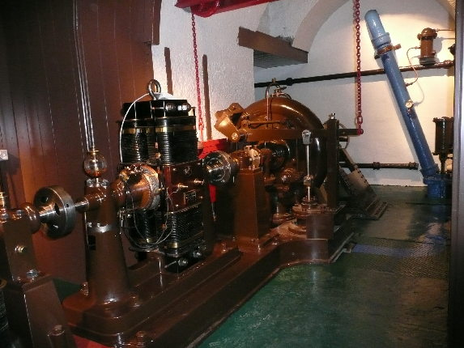
Long Hydroelectric History
1700
1800
1900
2000
1770’s France First description of vertical- and horizontal-axis hydraulic machines
1849 America
Francis turbine invented
1870 England
Sir Armstrong buildt the first hydroelectric power station.
Notes:
1770’s - In the mid-1770s, French engineer Bernard Forest de Bélidor published Architecture Hydraulique which described vertical- and horizontal-axis hydraulic machines
1849 - The Francis turbine (https://en.wikipedia.org/wiki/Francis_turbine#cite_note-1) is a type of water turbine that was developed by James B. Francis in Lowell, Massachusetts.^{[1]} It is an inward-flow reaction turbine that combines radial and axial flow concepts
In 1853, (http://www.niagarafrontier.com/power.html) The Niagara Falls Hydraulic Power & Manufacturing Company had purchased the water rights and began construction of this canal. In 1860, construction of the hydraulic canal began. The canal was 35 feet (11m) wide and 8 feet (2.4m) deep. It transported water from the Niagara River above the Falls to the mill sites below the Falls. The canal construction was completed in 1861. Augustus Porter's vision became reality in 1875, when the first wheels began turning in the new powerhouse.
1878 - Armstrong created Debdon Lake to use the water running through his estate to supply the world's first hydroelectric power station. This powered various labour-saving devices in his house including a roasting spit, a dishwasher and (a wonderful innovation) a servants lift. Turkish baths were installed as part of the innovative provision of central heating for the house, electricity facilitated the installation of an arc lamp in 1878 and the first of his friend Joseph Swan's incandescent light bulbs were installed in time for christmas 1880.
In 1878, Edison formed the Edison Electric Light Company in New York City with several financiers, including J. P. Morgan, Spencer Trask,^{[60]} and the members of the Vanderbilt family. Edison made the first public demonstration of his incandescent light bulb on December 31, 1879, in Menlo Park. It was during this time that he said: "We will make electricity so cheap that only the rich will burn candles."^{[61]}
By 1881, the power company had built a small generating station and began providing a small amount of electricity to light the village of Niagara Falls and to provide power to several of the mills. This power plant became a tourist attraction. It operated a flour mill for two years before the company went bankrupt and all its assets were sold at public auction.
1882 - The Vulcan Street Plant (https://en.wikipedia.org/wiki/Vulcan_Street_Plant#cite_note-ref_5-5) was the first Edison hydroelectric central station.^{[1][2][3][4]} The plant was built on the Fox River in Appleton, Wisconsin and put into operation on September 30, 1882.^{[4][5]}
1882 – (http://www.vasskrafta.no/historie/category451.html) Vannkraftverk i Hamn i Senja, høsten 1882. Det er ganske oppsiktsvekkende. Dette vannkraftverket var blant de aller første vanndrevne elektrisitetsverk i verden, kanskje det første. Det har visstnok bare en konkurrent fra Wisconsin, USA, fra samme år.
1885 - Laugstol Brug var en treforedlings-bedrift med behov for egen strømforsyning, men ved hjelp av to dynamoer, hver med forsyning til 150 glødelamper, fikk kraftverket en så stor kapasitet at det også kunne forsyne andre abonnenter i Skien. Både dynamoene og glødelampene var utenlandske. En ny teknologi som i internasjonal sammenheng hadde vokst fram siden slutten av 1860-årene, hadde dermed for alvor blitt introdusert i Norge. Den driftige lederen av Laugstol Brug og initiativtakeren til elektrisitetsverket var ingeniør Gunnar Knudsen. Knudsen ble senere både stortingsmann og statsminister og fikk en betydelig rolle innen norsk elektrisitetsforsyning (https://www.nve.no/om-nve/nves-museumsordning/nves-historie/1885-laugstol-brug-i-skien-landets-forste-elektrisitetsverk-blir-offisielt-satt-i-drift-1-oktober/)
1899 - Verdens første kraftstasjon i fjellhall var Snoqualmie Falls Hydroelectric Plant i King County (Washington) fra 1899. Men av verdens rundt 400 undergrunns kraftstasjoner ligger over 200 i Norge
1905 - Svelgfoss kraftverk (oppført 1905-1907) og Såheim (oppført 1914-1916) er tidlige eksempel på kraftverk der den frittliggende rørgaten er lagt i tunnel i fjellet bak stasjonene
Trykksjakten ved Svelgen var på 152 meter og verdens lengste fram til Tafjord 3 kraftverk startet produksjonen i 1958 med en 286 meter råsprengt trykksjakt. (https://no.wikipedia.org/wiki/Vannkraftverk)
1906 – 757 Hydropower stations in Norway –Between 1906 and 1918, the Tysso I hydraulic power station – one of the largest high-pressure power stations in the world at the time – was constructed ((http://www.erih.net/i-want-to-go-there/getpage/4/site/show/norwegian-museum-of-hydro-power-and-industry/)
1911 - Vemork kraftverk som stod ferdig i 1911 og var verdens største kraftverk med 10 turbiner.
1928 - Nore 1 started operation 1928. It is recognized as the first hydropower project developed by Government (http://tunnel.no/wp-content/uploads/2014/01/Publication_22.pdf)
1970 - Mardøla-aksjonen var den første store miljøsaken der sivil ulydighet ble brukt i større skala. (https://no.wikipedia.org/wiki/Sivil_ulydighet).
1973 – Driva - Det første kraftverket i verden der dette ble gjort var Driva kraftverk i Møre og Romsdal i 1973. Dette høytrykks luftputekammeret (pressurized air cusion chamber) (https://no.wikipedia.org/wiki/Vannkraftverk)
1979 - The Alta development raised (1979-81) one of the first hot tempered campaigns against hydropower development in the country
1988 It was the world's first multinational exchange for trading electric power. (https://en.wikipedia.org/wiki/Nord_Pool_Spot)
1998 - The Bieudron Hydroelectric Power Station is a hydroelectric power plant located in the Swiss Alps in the Canton of Valais in Switzerland. The power plant is fed with water from the Grande Dixence Dam's reservoir, Lac des Dix and is part of the Cleuson-Dixence Complex. The 1269 MW power plant is operated by Grande Dixence SA.^{[1]}
Production began in 1998, with two world records set upon its completion: the world's most powerful Pelton turbine as well as the highest head used to produce hydro-electric energy. A penstock rupture in 2000 forced the closure of the power plant and it was operational again in 2010
(https://en.wikipedia.org/wiki/Bieudron_Hydroelectric_Power_Station)

Slide 11
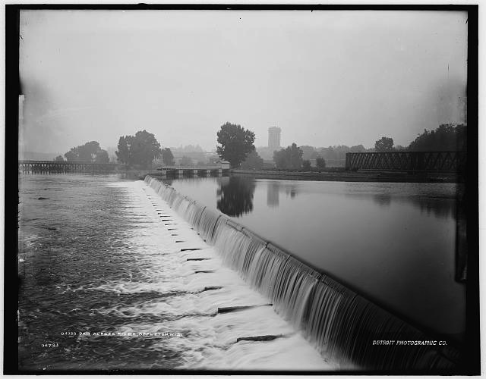
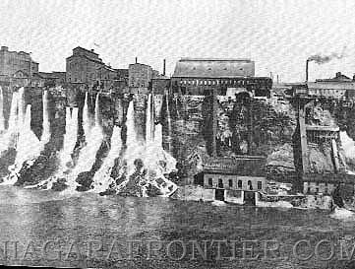
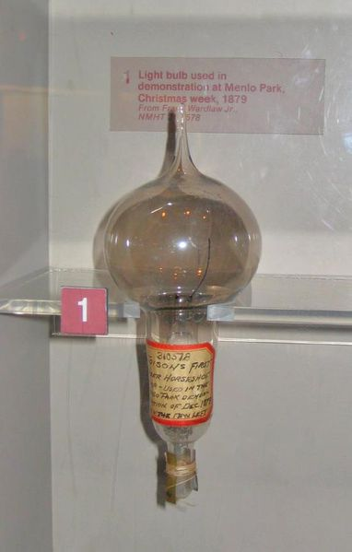
Long Hydroelectric History
1700
1800
1900
2000
1770’s France First description of vertical- and horizontal-axis hydraulic machines
1849 America
Francis turbine invented
1870 England
Sir Armstrong buildt the first hydroelectric power station.
1878 America
Edison formed the Electric Light Company
1881 America
Niagra Falls - Hydroelectric Plant supplying 16 electric Carbon Arc light
1882 America
Edison built the first commercial hydroelectric station
Notes:
1770’s - In the mid-1770s, French engineer Bernard Forest de Bélidor published Architecture Hydraulique which described vertical- and horizontal-axis hydraulic machines
1849 - The Francis turbine (https://en.wikipedia.org/wiki/Francis_turbine#cite_note-1) is a type of water turbine that was developed by James B. Francis in Lowell, Massachusetts.^{[1]} It is an inward-flow reaction turbine that combines radial and axial flow concepts
In 1853, (http://www.niagarafrontier.com/power.html) The Niagara Falls Hydraulic Power & Manufacturing Company had purchased the water rights and began construction of this canal. In 1860, construction of the hydraulic canal began. The canal was 35 feet (11m) wide and 8 feet (2.4m) deep. It transported water from the Niagara River above the Falls to the mill sites below the Falls. The canal construction was completed in 1861. Augustus Porter's vision became reality in 1875, when the first wheels began turning in the new powerhouse.
1878 - Armstrong created Debdon Lake to use the water running through his estate to supply the world's first hydroelectric power station. This powered various labour-saving devices in his house including a roasting spit, a dishwasher and (a wonderful innovation) a servants lift. Turkish baths were installed as part of the innovative provision of central heating for the house, electricity facilitated the installation of an arc lamp in 1878 and the first of his friend Joseph Swan's incandescent light bulbs were installed in time for christmas 1880.
In 1878, Edison formed the Edison Electric Light Company in New York City with several financiers, including J. P. Morgan, Spencer Trask,^{[60]} and the members of the Vanderbilt family. Edison made the first public demonstration of his incandescent light bulb on December 31, 1879, in Menlo Park. It was during this time that he said: "We will make electricity so cheap that only the rich will burn candles."^{[61]}
By 1881, the power company had built a small generating station and began providing a small amount of electricity to light the village of Niagara Falls and to provide power to several of the mills. This power plant became a tourist attraction. It operated a flour mill for two years before the company went bankrupt and all its assets were sold at public auction.
1882 - The Vulcan Street Plant (https://en.wikipedia.org/wiki/Vulcan_Street_Plant#cite_note-ref_5-5) was the first Edison hydroelectric central station.^{[1][2][3][4]} The plant was built on the Fox River in Appleton, Wisconsin and put into operation on September 30, 1882.^{[4][5]}
1882 – (http://www.vasskrafta.no/historie/category451.html) Vannkraftverk i Hamn i Senja, høsten 1882. Det er ganske oppsiktsvekkende. Dette vannkraftverket var blant de aller første vanndrevne elektrisitetsverk i verden, kanskje det første. Det har visstnok bare en konkurrent fra Wisconsin, USA, fra samme år.
1885 - Laugstol Brug var en treforedlings-bedrift med behov for egen strømforsyning, men ved hjelp av to dynamoer, hver med forsyning til 150 glødelamper, fikk kraftverket en så stor kapasitet at det også kunne forsyne andre abonnenter i Skien. Både dynamoene og glødelampene var utenlandske. En ny teknologi som i internasjonal sammenheng hadde vokst fram siden slutten av 1860-årene, hadde dermed for alvor blitt introdusert i Norge. Den driftige lederen av Laugstol Brug og initiativtakeren til elektrisitetsverket var ingeniør Gunnar Knudsen. Knudsen ble senere både stortingsmann og statsminister og fikk en betydelig rolle innen norsk elektrisitetsforsyning (https://www.nve.no/om-nve/nves-museumsordning/nves-historie/1885-laugstol-brug-i-skien-landets-forste-elektrisitetsverk-blir-offisielt-satt-i-drift-1-oktober/)
1899 - Verdens første kraftstasjon i fjellhall var Snoqualmie Falls Hydroelectric Plant i King County (Washington) fra 1899. Men av verdens rundt 400 undergrunns kraftstasjoner ligger over 200 i Norge
1905 - Svelgfoss kraftverk (oppført 1905-1907) og Såheim (oppført 1914-1916) er tidlige eksempel på kraftverk der den frittliggende rørgaten er lagt i tunnel i fjellet bak stasjonene
Trykksjakten ved Svelgen var på 152 meter og verdens lengste fram til Tafjord 3 kraftverk startet produksjonen i 1958 med en 286 meter råsprengt trykksjakt. (https://no.wikipedia.org/wiki/Vannkraftverk)
1906 – 757 Hydropower stations in Norway –Between 1906 and 1918, the Tysso I hydraulic power station – one of the largest high-pressure power stations in the world at the time – was constructed ((http://www.erih.net/i-want-to-go-there/getpage/4/site/show/norwegian-museum-of-hydro-power-and-industry/)
1911 - Vemork kraftverk som stod ferdig i 1911 og var verdens største kraftverk med 10 turbiner.
1928 - Nore 1 started operation 1928. It is recognized as the first hydropower project developed by Government (http://tunnel.no/wp-content/uploads/2014/01/Publication_22.pdf)
1970 - Mardøla-aksjonen var den første store miljøsaken der sivil ulydighet ble brukt i større skala. (https://no.wikipedia.org/wiki/Sivil_ulydighet).
1973 – Driva - Det første kraftverket i verden der dette ble gjort var Driva kraftverk i Møre og Romsdal i 1973. Dette høytrykks luftputekammeret (pressurized air cusion chamber) (https://no.wikipedia.org/wiki/Vannkraftverk)
1979 - The Alta development raised (1979-81) one of the first hot tempered campaigns against hydropower development in the country
1988 It was the world's first multinational exchange for trading electric power. (https://en.wikipedia.org/wiki/Nord_Pool_Spot)
1998 - The Bieudron Hydroelectric Power Station is a hydroelectric power plant located in the Swiss Alps in the Canton of Valais in Switzerland. The power plant is fed with water from the Grande Dixence Dam's reservoir, Lac des Dix and is part of the Cleuson-Dixence Complex. The 1269 MW power plant is operated by Grande Dixence SA.^{[1]}
Production began in 1998, with two world records set upon its completion: the world's most powerful Pelton turbine as well as the highest head used to produce hydro-electric energy. A penstock rupture in 2000 forced the closure of the power plant and it was operational again in 2010
(https://en.wikipedia.org/wiki/Bieudron_Hydroelectric_Power_Station)

Slide 12
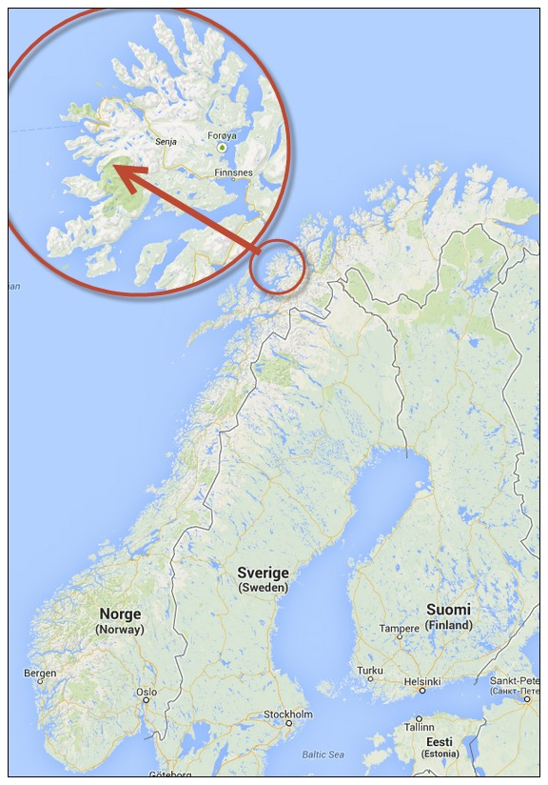
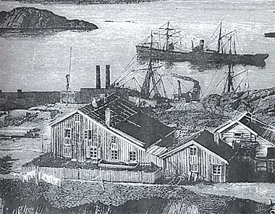
Long Hydroelectric History
1882 Senja
First Norwegian hydropower plant
1700
1800
1900
2000
1770’s France First description of vertical- and horizontal-axis hydraulic machines
1849 America
Francis turbine invented
1870 England
Sir Armstrong buildt the first hydroelectric power station.
1878 America
Edison formed the Electric Light Company
1881 America
Niagra Falls - Hydroelectric Plant supplying 16 electric Carbon Arc light
1882 America
Edison built the first commercial hydroelectric station
1899 America
Snoqualmie Falls - Worlds first underground hydropower station
Notes:
1770’s - In the mid-1770s, French engineer Bernard Forest de Bélidor published Architecture Hydraulique which described vertical- and horizontal-axis hydraulic machines
1849 - The Francis turbine (https://en.wikipedia.org/wiki/Francis_turbine#cite_note-1) is a type of water turbine that was developed by James B. Francis in Lowell, Massachusetts.^{[1]} It is an inward-flow reaction turbine that combines radial and axial flow concepts
In 1853, (http://www.niagarafrontier.com/power.html) The Niagara Falls Hydraulic Power & Manufacturing Company had purchased the water rights and began construction of this canal. In 1860, construction of the hydraulic canal began. The canal was 35 feet (11m) wide and 8 feet (2.4m) deep. It transported water from the Niagara River above the Falls to the mill sites below the Falls. The canal construction was completed in 1861. Augustus Porter's vision became reality in 1875, when the first wheels began turning in the new powerhouse.
1878 - Armstrong created Debdon Lake to use the water running through his estate to supply the world's first hydroelectric power station. This powered various labour-saving devices in his house including a roasting spit, a dishwasher and (a wonderful innovation) a servants lift. Turkish baths were installed as part of the innovative provision of central heating for the house, electricity facilitated the installation of an arc lamp in 1878 and the first of his friend Joseph Swan's incandescent light bulbs were installed in time for christmas 1880.
In 1878, Edison formed the Edison Electric Light Company in New York City with several financiers, including J. P. Morgan, Spencer Trask,^{[60]} and the members of the Vanderbilt family. Edison made the first public demonstration of his incandescent light bulb on December 31, 1879, in Menlo Park. It was during this time that he said: "We will make electricity so cheap that only the rich will burn candles."^{[61]}
By 1881, the power company had built a small generating station and began providing a small amount of electricity to light the village of Niagara Falls and to provide power to several of the mills. This power plant became a tourist attraction. It operated a flour mill for two years before the company went bankrupt and all its assets were sold at public auction.
1882 - The Vulcan Street Plant (https://en.wikipedia.org/wiki/Vulcan_Street_Plant#cite_note-ref_5-5) was the first Edison hydroelectric central station.^{[1][2][3][4]} The plant was built on the Fox River in Appleton, Wisconsin and put into operation on September 30, 1882.^{[4][5]}
1882 – (http://www.vasskrafta.no/historie/category451.html) Vannkraftverk i Hamn i Senja, høsten 1882. Det er ganske oppsiktsvekkende. Dette vannkraftverket var blant de aller første vanndrevne elektrisitetsverk i verden, kanskje det første. Det har visstnok bare en konkurrent fra Wisconsin, USA, fra samme år.
1885 - Laugstol Brug var en treforedlings-bedrift med behov for egen strømforsyning, men ved hjelp av to dynamoer, hver med forsyning til 150 glødelamper, fikk kraftverket en så stor kapasitet at det også kunne forsyne andre abonnenter i Skien. Både dynamoene og glødelampene var utenlandske. En ny teknologi som i internasjonal sammenheng hadde vokst fram siden slutten av 1860-årene, hadde dermed for alvor blitt introdusert i Norge. Den driftige lederen av Laugstol Brug og initiativtakeren til elektrisitetsverket var ingeniør Gunnar Knudsen. Knudsen ble senere både stortingsmann og statsminister og fikk en betydelig rolle innen norsk elektrisitetsforsyning (https://www.nve.no/om-nve/nves-museumsordning/nves-historie/1885-laugstol-brug-i-skien-landets-forste-elektrisitetsverk-blir-offisielt-satt-i-drift-1-oktober/)
1899 - Verdens første kraftstasjon i fjellhall var Snoqualmie Falls Hydroelectric Plant i King County (Washington) fra 1899. Men av verdens rundt 400 undergrunns kraftstasjoner ligger over 200 i Norge
1905 - Svelgfoss kraftverk (oppført 1905-1907) og Såheim (oppført 1914-1916) er tidlige eksempel på kraftverk der den frittliggende rørgaten er lagt i tunnel i fjellet bak stasjonene
Trykksjakten ved Svelgen var på 152 meter og verdens lengste fram til Tafjord 3 kraftverk startet produksjonen i 1958 med en 286 meter råsprengt trykksjakt. (https://no.wikipedia.org/wiki/Vannkraftverk)
1906 – 757 Hydropower stations in Norway –Between 1906 and 1918, the Tysso I hydraulic power station – one of the largest high-pressure power stations in the world at the time – was constructed ((http://www.erih.net/i-want-to-go-there/getpage/4/site/show/norwegian-museum-of-hydro-power-and-industry/)
1911 - Vemork kraftverk som stod ferdig i 1911 og var verdens største kraftverk med 10 turbiner.
1928 - Nore 1 started operation 1928. It is recognized as the first hydropower project developed by Government (http://tunnel.no/wp-content/uploads/2014/01/Publication_22.pdf)
1970 - Mardøla-aksjonen var den første store miljøsaken der sivil ulydighet ble brukt i større skala. (https://no.wikipedia.org/wiki/Sivil_ulydighet).
1973 – Driva - Det første kraftverket i verden der dette ble gjort var Driva kraftverk i Møre og Romsdal i 1973. Dette høytrykks luftputekammeret (pressurized air cusion chamber) (https://no.wikipedia.org/wiki/Vannkraftverk)
1979 - The Alta development raised (1979-81) one of the first hot tempered campaigns against hydropower development in the country
1988 It was the world's first multinational exchange for trading electric power. (https://en.wikipedia.org/wiki/Nord_Pool_Spot)
1998 - The Bieudron Hydroelectric Power Station is a hydroelectric power plant located in the Swiss Alps in the Canton of Valais in Switzerland. The power plant is fed with water from the Grande Dixence Dam's reservoir, Lac des Dix and is part of the Cleuson-Dixence Complex. The 1269 MW power plant is operated by Grande Dixence SA.^{[1]}
Production began in 1998, with two world records set upon its completion: the world's most powerful Pelton turbine as well as the highest head used to produce hydro-electric energy. A penstock rupture in 2000 forced the closure of the power plant and it was operational again in 2010
(https://en.wikipedia.org/wiki/Bieudron_Hydroelectric_Power_Station)

Slide 13
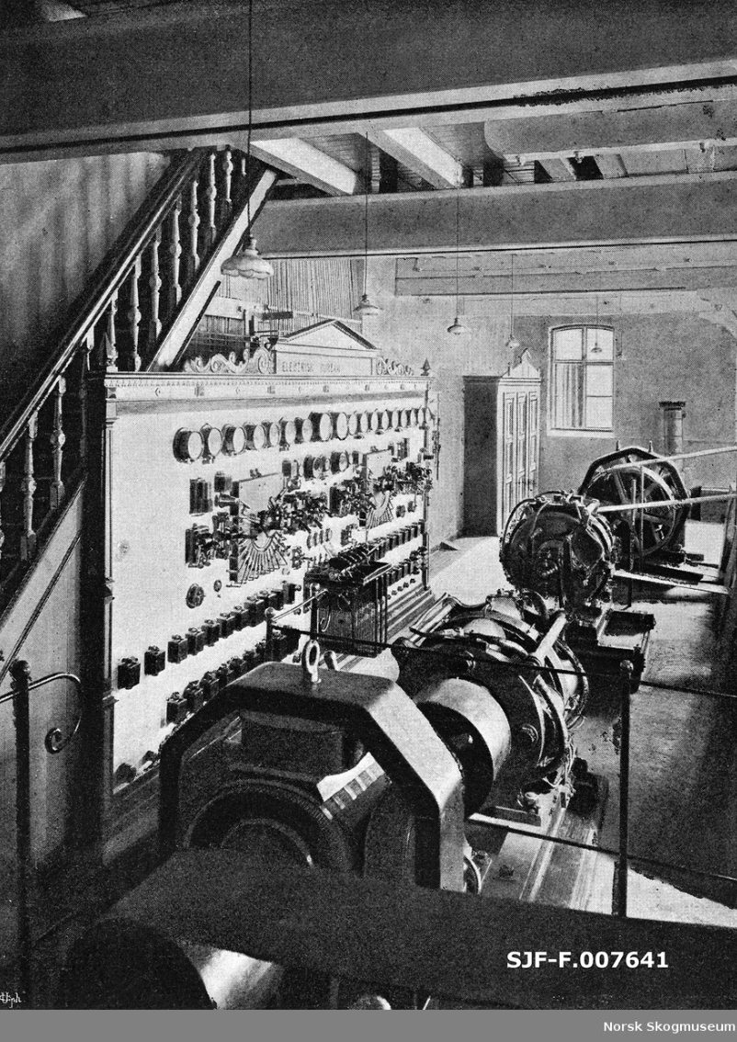
Long Hydroelectric History
1885 Skien
Laugstol Brug - First Norwegian commercial hydropower station
1882 Senja
First Norwegian hydropower plant
1700
1800
1900
2000
1770’s France First description of vertical- and horizontal-axis hydraulic machines
1849 America
Francis turbine invented
1870 England
Sir Armstrong buildt the first hydroelectric power station.
1878 America
Edison formed the Electric Light Company
1881 America
Niagra Falls - Hydroelectric Plant supplying 16 electric Carbon Arc light
1882 America
Edison built the first commercial hydroelectric station
1899 America
Snoqualmie Falls - Worlds first underground hydropower station
Notes:
1770’s - In the mid-1770s, French engineer Bernard Forest de Bélidor published Architecture Hydraulique which described vertical- and horizontal-axis hydraulic machines
1849 - The Francis turbine (https://en.wikipedia.org/wiki/Francis_turbine#cite_note-1) is a type of water turbine that was developed by James B. Francis in Lowell, Massachusetts.^{[1]} It is an inward-flow reaction turbine that combines radial and axial flow concepts
In 1853, (http://www.niagarafrontier.com/power.html) The Niagara Falls Hydraulic Power & Manufacturing Company had purchased the water rights and began construction of this canal. In 1860, construction of the hydraulic canal began. The canal was 35 feet (11m) wide and 8 feet (2.4m) deep. It transported water from the Niagara River above the Falls to the mill sites below the Falls. The canal construction was completed in 1861. Augustus Porter's vision became reality in 1875, when the first wheels began turning in the new powerhouse.
1878 - Armstrong created Debdon Lake to use the water running through his estate to supply the world's first hydroelectric power station. This powered various labour-saving devices in his house including a roasting spit, a dishwasher and (a wonderful innovation) a servants lift. Turkish baths were installed as part of the innovative provision of central heating for the house, electricity facilitated the installation of an arc lamp in 1878 and the first of his friend Joseph Swan's incandescent light bulbs were installed in time for christmas 1880.
In 1878, Edison formed the Edison Electric Light Company in New York City with several financiers, including J. P. Morgan, Spencer Trask,^{[60]} and the members of the Vanderbilt family. Edison made the first public demonstration of his incandescent light bulb on December 31, 1879, in Menlo Park. It was during this time that he said: "We will make electricity so cheap that only the rich will burn candles."^{[61]}
By 1881, the power company had built a small generating station and began providing a small amount of electricity to light the village of Niagara Falls and to provide power to several of the mills. This power plant became a tourist attraction. It operated a flour mill for two years before the company went bankrupt and all its assets were sold at public auction.
1882 - The Vulcan Street Plant (https://en.wikipedia.org/wiki/Vulcan_Street_Plant#cite_note-ref_5-5) was the first Edison hydroelectric central station.^{[1][2][3][4]} The plant was built on the Fox River in Appleton, Wisconsin and put into operation on September 30, 1882.^{[4][5]}
1882 – (http://www.vasskrafta.no/historie/category451.html) Vannkraftverk i Hamn i Senja, høsten 1882. Det er ganske oppsiktsvekkende. Dette vannkraftverket var blant de aller første vanndrevne elektrisitetsverk i verden, kanskje det første. Det har visstnok bare en konkurrent fra Wisconsin, USA, fra samme år.
1885 - Laugstol Brug var en treforedlings-bedrift med behov for egen strømforsyning, men ved hjelp av to dynamoer, hver med forsyning til 150 glødelamper, fikk kraftverket en så stor kapasitet at det også kunne forsyne andre abonnenter i Skien. Både dynamoene og glødelampene var utenlandske. En ny teknologi som i internasjonal sammenheng hadde vokst fram siden slutten av 1860-årene, hadde dermed for alvor blitt introdusert i Norge. Den driftige lederen av Laugstol Brug og initiativtakeren til elektrisitetsverket var ingeniør Gunnar Knudsen. Knudsen ble senere både stortingsmann og statsminister og fikk en betydelig rolle innen norsk elektrisitetsforsyning (https://www.nve.no/om-nve/nves-museumsordning/nves-historie/1885-laugstol-brug-i-skien-landets-forste-elektrisitetsverk-blir-offisielt-satt-i-drift-1-oktober/)
1899 - Verdens første kraftstasjon i fjellhall var Snoqualmie Falls Hydroelectric Plant i King County (Washington) fra 1899. Men av verdens rundt 400 undergrunns kraftstasjoner ligger over 200 i Norge
1905 - Svelgfoss kraftverk (oppført 1905-1907) og Såheim (oppført 1914-1916) er tidlige eksempel på kraftverk der den frittliggende rørgaten er lagt i tunnel i fjellet bak stasjonene
Trykksjakten ved Svelgen var på 152 meter og verdens lengste fram til Tafjord 3 kraftverk startet produksjonen i 1958 med en 286 meter råsprengt trykksjakt. (https://no.wikipedia.org/wiki/Vannkraftverk)
1906 – 757 Hydropower stations in Norway –Between 1906 and 1918, the Tysso I hydraulic power station – one of the largest high-pressure power stations in the world at the time – was constructed ((http://www.erih.net/i-want-to-go-there/getpage/4/site/show/norwegian-museum-of-hydro-power-and-industry/)
1911 - Vemork kraftverk som stod ferdig i 1911 og var verdens største kraftverk med 10 turbiner.
1928 - Nore 1 started operation 1928. It is recognized as the first hydropower project developed by Government (http://tunnel.no/wp-content/uploads/2014/01/Publication_22.pdf)
1970 - Mardøla-aksjonen var den første store miljøsaken der sivil ulydighet ble brukt i større skala. (https://no.wikipedia.org/wiki/Sivil_ulydighet).
1973 – Driva - Det første kraftverket i verden der dette ble gjort var Driva kraftverk i Møre og Romsdal i 1973. Dette høytrykks luftputekammeret (pressurized air cusion chamber) (https://no.wikipedia.org/wiki/Vannkraftverk)
1979 - The Alta development raised (1979-81) one of the first hot tempered campaigns against hydropower development in the country
1988 It was the world's first multinational exchange for trading electric power. (https://en.wikipedia.org/wiki/Nord_Pool_Spot)
1998 - The Bieudron Hydroelectric Power Station is a hydroelectric power plant located in the Swiss Alps in the Canton of Valais in Switzerland. The power plant is fed with water from the Grande Dixence Dam's reservoir, Lac des Dix and is part of the Cleuson-Dixence Complex. The 1269 MW power plant is operated by Grande Dixence SA.^{[1]}
Production began in 1998, with two world records set upon its completion: the world's most powerful Pelton turbine as well as the highest head used to produce hydro-electric energy. A penstock rupture in 2000 forced the closure of the power plant and it was operational again in 2010
(https://en.wikipedia.org/wiki/Bieudron_Hydroelectric_Power_Station)

Slide 14
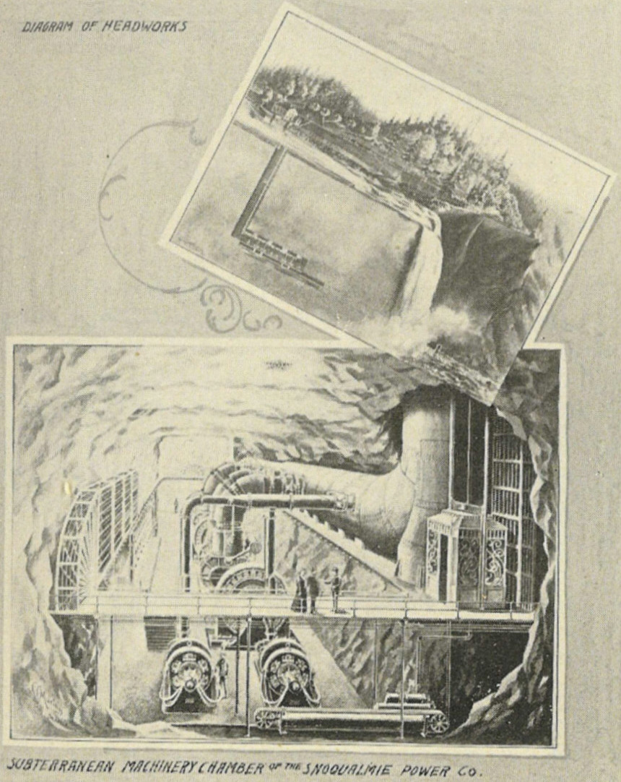
Long Hydroelectric History
1906 Svelgfoss
First Norwegian underground hydropower tunnels –
Svelgen 152 m the longest tunnel in the world until 1958 (Tafjord 286m)
1885 Skien
Laugstol Brug - First Norwegian commercial hydropower station
1882 Senja
First Norwegian hydropower plant
1700
1800
1900
2000
1770’s France First description of vertical- and horizontal-axis hydraulic machines
1849 America
Francis turbine invented
1870 England
Sir Armstrong buildt the first hydroelectric power station.
1878 America
Edison formed the Electric Light Company
1881 America
Niagra Falls - Hydroelectric Plant supplying 16 electric Carbon Arc light
1882 America
Edison built the first commercial hydroelectric station
1899 America
Snoqualmie Falls - Worlds first underground hydropower station
Notes:
1770’s - In the mid-1770s, French engineer Bernard Forest de Bélidor published Architecture Hydraulique which described vertical- and horizontal-axis hydraulic machines
1849 - The Francis turbine (https://en.wikipedia.org/wiki/Francis_turbine#cite_note-1) is a type of water turbine that was developed by James B. Francis in Lowell, Massachusetts.^{[1]} It is an inward-flow reaction turbine that combines radial and axial flow concepts
In 1853, (http://www.niagarafrontier.com/power.html) The Niagara Falls Hydraulic Power & Manufacturing Company had purchased the water rights and began construction of this canal. In 1860, construction of the hydraulic canal began. The canal was 35 feet (11m) wide and 8 feet (2.4m) deep. It transported water from the Niagara River above the Falls to the mill sites below the Falls. The canal construction was completed in 1861. Augustus Porter's vision became reality in 1875, when the first wheels began turning in the new powerhouse.
1878 - Armstrong created Debdon Lake to use the water running through his estate to supply the world's first hydroelectric power station. This powered various labour-saving devices in his house including a roasting spit, a dishwasher and (a wonderful innovation) a servants lift. Turkish baths were installed as part of the innovative provision of central heating for the house, electricity facilitated the installation of an arc lamp in 1878 and the first of his friend Joseph Swan's incandescent light bulbs were installed in time for christmas 1880.
In 1878, Edison formed the Edison Electric Light Company in New York City with several financiers, including J. P. Morgan, Spencer Trask,^{[60]} and the members of the Vanderbilt family. Edison made the first public demonstration of his incandescent light bulb on December 31, 1879, in Menlo Park. It was during this time that he said: "We will make electricity so cheap that only the rich will burn candles."^{[61]}
By 1881, the power company had built a small generating station and began providing a small amount of electricity to light the village of Niagara Falls and to provide power to several of the mills. This power plant became a tourist attraction. It operated a flour mill for two years before the company went bankrupt and all its assets were sold at public auction.
1882 - The Vulcan Street Plant (https://en.wikipedia.org/wiki/Vulcan_Street_Plant#cite_note-ref_5-5) was the first Edison hydroelectric central station.^{[1][2][3][4]} The plant was built on the Fox River in Appleton, Wisconsin and put into operation on September 30, 1882.^{[4][5]}
1882 – (http://www.vasskrafta.no/historie/category451.html) Vannkraftverk i Hamn i Senja, høsten 1882. Det er ganske oppsiktsvekkende. Dette vannkraftverket var blant de aller første vanndrevne elektrisitetsverk i verden, kanskje det første. Det har visstnok bare en konkurrent fra Wisconsin, USA, fra samme år.
1885 - Laugstol Brug var en treforedlings-bedrift med behov for egen strømforsyning, men ved hjelp av to dynamoer, hver med forsyning til 150 glødelamper, fikk kraftverket en så stor kapasitet at det også kunne forsyne andre abonnenter i Skien. Både dynamoene og glødelampene var utenlandske. En ny teknologi som i internasjonal sammenheng hadde vokst fram siden slutten av 1860-årene, hadde dermed for alvor blitt introdusert i Norge. Den driftige lederen av Laugstol Brug og initiativtakeren til elektrisitetsverket var ingeniør Gunnar Knudsen. Knudsen ble senere både stortingsmann og statsminister og fikk en betydelig rolle innen norsk elektrisitetsforsyning (https://www.nve.no/om-nve/nves-museumsordning/nves-historie/1885-laugstol-brug-i-skien-landets-forste-elektrisitetsverk-blir-offisielt-satt-i-drift-1-oktober/)
1899 - Verdens første kraftstasjon i fjellhall var Snoqualmie Falls Hydroelectric Plant i King County (Washington) fra 1899. Men av verdens rundt 400 undergrunns kraftstasjoner ligger over 200 i Norge
1905 - Svelgfoss kraftverk (oppført 1905-1907) og Såheim (oppført 1914-1916) er tidlige eksempel på kraftverk der den frittliggende rørgaten er lagt i tunnel i fjellet bak stasjonene
Trykksjakten ved Svelgen var på 152 meter og verdens lengste fram til Tafjord 3 kraftverk startet produksjonen i 1958 med en 286 meter råsprengt trykksjakt. (https://no.wikipedia.org/wiki/Vannkraftverk)
1906 – 757 Hydropower stations in Norway –Between 1906 and 1918, the Tysso I hydraulic power station – one of the largest high-pressure power stations in the world at the time – was constructed ((http://www.erih.net/i-want-to-go-there/getpage/4/site/show/norwegian-museum-of-hydro-power-and-industry/)
1911 - Vemork kraftverk som stod ferdig i 1911 og var verdens største kraftverk med 10 turbiner.
1928 - Nore 1 started operation 1928. It is recognized as the first hydropower project developed by Government (http://tunnel.no/wp-content/uploads/2014/01/Publication_22.pdf)
1970 - Mardøla-aksjonen var den første store miljøsaken der sivil ulydighet ble brukt i større skala. (https://no.wikipedia.org/wiki/Sivil_ulydighet).
1973 – Driva - Det første kraftverket i verden der dette ble gjort var Driva kraftverk i Møre og Romsdal i 1973. Dette høytrykks luftputekammeret (pressurized air cusion chamber) (https://no.wikipedia.org/wiki/Vannkraftverk)
1979 - The Alta development raised (1979-81) one of the first hot tempered campaigns against hydropower development in the country
1988 It was the world's first multinational exchange for trading electric power. (https://en.wikipedia.org/wiki/Nord_Pool_Spot)
1998 - The Bieudron Hydroelectric Power Station is a hydroelectric power plant located in the Swiss Alps in the Canton of Valais in Switzerland. The power plant is fed with water from the Grande Dixence Dam's reservoir, Lac des Dix and is part of the Cleuson-Dixence Complex. The 1269 MW power plant is operated by Grande Dixence SA.^{[1]}
Production began in 1998, with two world records set upon its completion: the world's most powerful Pelton turbine as well as the highest head used to produce hydro-electric energy. A penstock rupture in 2000 forced the closure of the power plant and it was operational again in 2010
(https://en.wikipedia.org/wiki/Bieudron_Hydroelectric_Power_Station)

Slide 15
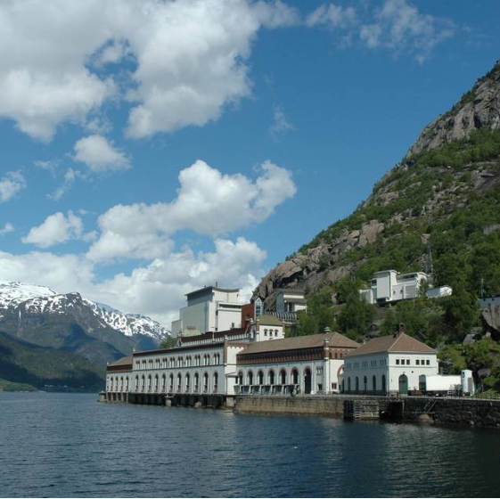
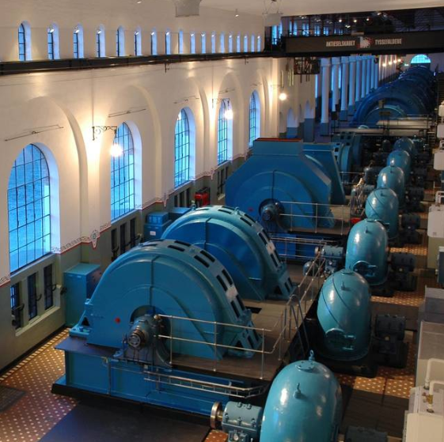
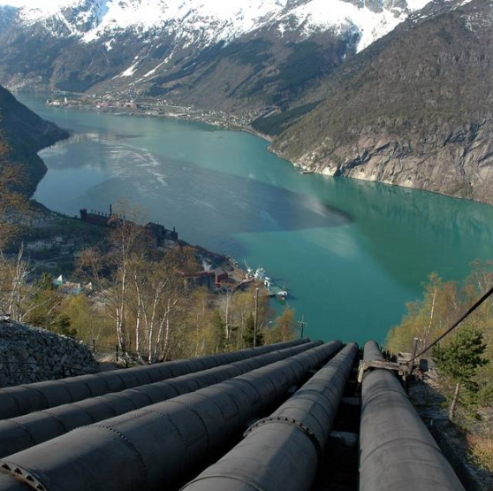
Long Hydroelectric History
1906 Tysso
The largest high pressure power station in the world
757 power stations in Norway
1906 Svelgfoss
First Norwegian underground hydropower tunnels –
And in Svelgen 152 m the longest in the world until 1958 (Tafjord 286m)
1885 Skien
Laugstol Brug - First Norwegian commercial hydropower station
1882 Senja
First Norwegian hydropower plant
1700
1800
1900
2000
1770’s France First description of vertical- and horizontal-axis hydraulic machines
1849 America
Francis turbine invented
1870 England
Sir Armstrong buildt the first hydroelectric power station.
1878 America
Edison formed the Electric Light Company
1881 America
Niagra Falls - Hydroelectric Plant supplying 16 electric Carbon Arc light
1882 America
Edison built the first commercial hydroelectric station
1899 America
Snoqualmie Falls - Worlds first underground hydropower station
Notes:
1770’s - In the mid-1770s, French engineer Bernard Forest de Bélidor published Architecture Hydraulique which described vertical- and horizontal-axis hydraulic machines
1849 - The Francis turbine (https://en.wikipedia.org/wiki/Francis_turbine#cite_note-1) is a type of water turbine that was developed by James B. Francis in Lowell, Massachusetts.^{[1]} It is an inward-flow reaction turbine that combines radial and axial flow concepts
In 1853, (http://www.niagarafrontier.com/power.html) The Niagara Falls Hydraulic Power & Manufacturing Company had purchased the water rights and began construction of this canal. In 1860, construction of the hydraulic canal began. The canal was 35 feet (11m) wide and 8 feet (2.4m) deep. It transported water from the Niagara River above the Falls to the mill sites below the Falls. The canal construction was completed in 1861. Augustus Porter's vision became reality in 1875, when the first wheels began turning in the new powerhouse.
1878 - Armstrong created Debdon Lake to use the water running through his estate to supply the world's first hydroelectric power station. This powered various labour-saving devices in his house including a roasting spit, a dishwasher and (a wonderful innovation) a servants lift. Turkish baths were installed as part of the innovative provision of central heating for the house, electricity facilitated the installation of an arc lamp in 1878 and the first of his friend Joseph Swan's incandescent light bulbs were installed in time for christmas 1880.
In 1878, Edison formed the Edison Electric Light Company in New York City with several financiers, including J. P. Morgan, Spencer Trask,^{[60]} and the members of the Vanderbilt family. Edison made the first public demonstration of his incandescent light bulb on December 31, 1879, in Menlo Park. It was during this time that he said: "We will make electricity so cheap that only the rich will burn candles."^{[61]}
By 1881, the power company had built a small generating station and began providing a small amount of electricity to light the village of Niagara Falls and to provide power to several of the mills. This power plant became a tourist attraction. It operated a flour mill for two years before the company went bankrupt and all its assets were sold at public auction.
1882 - The Vulcan Street Plant (https://en.wikipedia.org/wiki/Vulcan_Street_Plant#cite_note-ref_5-5) was the first Edison hydroelectric central station.^{[1][2][3][4]} The plant was built on the Fox River in Appleton, Wisconsin and put into operation on September 30, 1882.^{[4][5]}
1882 – (http://www.vasskrafta.no/historie/category451.html) Vannkraftverk i Hamn i Senja, høsten 1882. Det er ganske oppsiktsvekkende. Dette vannkraftverket var blant de aller første vanndrevne elektrisitetsverk i verden, kanskje det første. Det har visstnok bare en konkurrent fra Wisconsin, USA, fra samme år.
1885 - Laugstol Brug var en treforedlings-bedrift med behov for egen strømforsyning, men ved hjelp av to dynamoer, hver med forsyning til 150 glødelamper, fikk kraftverket en så stor kapasitet at det også kunne forsyne andre abonnenter i Skien. Både dynamoene og glødelampene var utenlandske. En ny teknologi som i internasjonal sammenheng hadde vokst fram siden slutten av 1860-årene, hadde dermed for alvor blitt introdusert i Norge. Den driftige lederen av Laugstol Brug og initiativtakeren til elektrisitetsverket var ingeniør Gunnar Knudsen. Knudsen ble senere både stortingsmann og statsminister og fikk en betydelig rolle innen norsk elektrisitetsforsyning (https://www.nve.no/om-nve/nves-museumsordning/nves-historie/1885-laugstol-brug-i-skien-landets-forste-elektrisitetsverk-blir-offisielt-satt-i-drift-1-oktober/)
1899 - Verdens første kraftstasjon i fjellhall var Snoqualmie Falls Hydroelectric Plant i King County (Washington) fra 1899. Men av verdens rundt 400 undergrunns kraftstasjoner ligger over 200 i Norge
1905 - Svelgfoss kraftverk (oppført 1905-1907) og Såheim (oppført 1914-1916) er tidlige eksempel på kraftverk der den frittliggende rørgaten er lagt i tunnel i fjellet bak stasjonene
Trykksjakten ved Svelgen var på 152 meter og verdens lengste fram til Tafjord 3 kraftverk startet produksjonen i 1958 med en 286 meter råsprengt trykksjakt. (https://no.wikipedia.org/wiki/Vannkraftverk)
1906 – 757 Hydropower stations in Norway –Between 1906 and 1918, the Tysso I hydraulic power station – one of the largest high-pressure power stations in the world at the time – was constructed ((http://www.erih.net/i-want-to-go-there/getpage/4/site/show/norwegian-museum-of-hydro-power-and-industry/)
1911 - Vemork kraftverk som stod ferdig i 1911 og var verdens største kraftverk med 10 turbiner.
1928 - Nore 1 started operation 1928. It is recognized as the first hydropower project developed by Government (http://tunnel.no/wp-content/uploads/2014/01/Publication_22.pdf)
1970 - Mardøla-aksjonen var den første store miljøsaken der sivil ulydighet ble brukt i større skala. (https://no.wikipedia.org/wiki/Sivil_ulydighet).
1973 – Driva - Det første kraftverket i verden der dette ble gjort var Driva kraftverk i Møre og Romsdal i 1973. Dette høytrykks luftputekammeret (pressurized air cusion chamber) (https://no.wikipedia.org/wiki/Vannkraftverk)
1979 - The Alta development raised (1979-81) one of the first hot tempered campaigns against hydropower development in the country
1988 It was the world's first multinational exchange for trading electric power. (https://en.wikipedia.org/wiki/Nord_Pool_Spot)
1998 - The Bieudron Hydroelectric Power Station is a hydroelectric power plant located in the Swiss Alps in the Canton of Valais in Switzerland. The power plant is fed with water from the Grande Dixence Dam's reservoir, Lac des Dix and is part of the Cleuson-Dixence Complex. The 1269 MW power plant is operated by Grande Dixence SA.^{[1]}
Production began in 1998, with two world records set upon its completion: the world's most powerful Pelton turbine as well as the highest head used to produce hydro-electric energy. A penstock rupture in 2000 forced the closure of the power plant and it was operational again in 2010
(https://en.wikipedia.org/wiki/Bieudron_Hydroelectric_Power_Station)

Slide 16
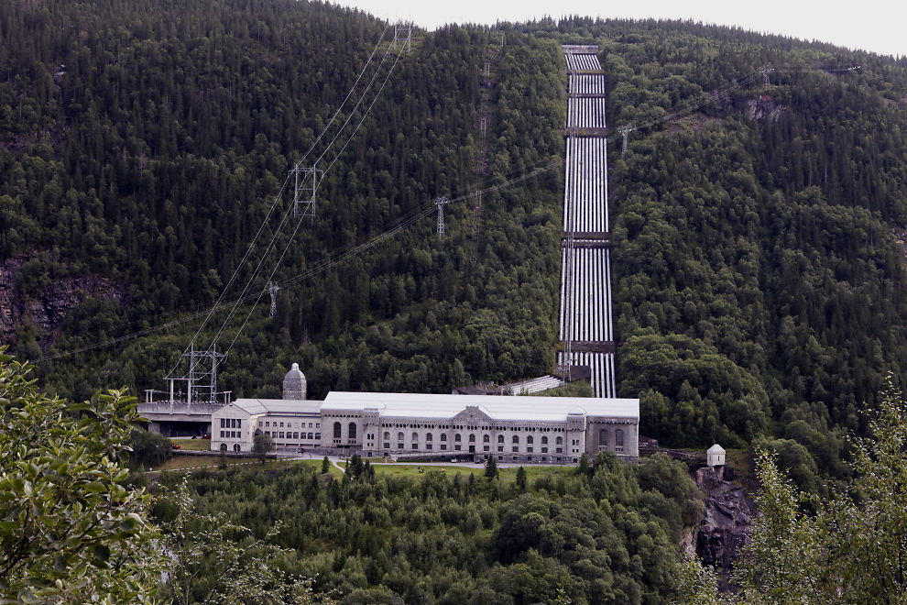

Long Hydroelectric History
1906 Tysso
The largest high pressure power station in the world
757 power stations in Norway
1911 Vemork
The worlds largest hydropower station so far with 10 turbines
1906 Svelgen
First Norwegian underground hydropower tunnels –
152 m and the longest in the world until 1958 (Tafjord 286m)
1885 Skien
Laugstol Brug - First Norwegian commercial hydropower station
1882 Senja
First Norwegian hydropower plant
1700
1800
1900
2000
1770’s France First description of vertical- and horizontal-axis hydraulic machines
1849 America
Francis turbine invented
1870 England
Sir Armstrong buildt the first hydroelectric power station.
1878 America
Edison formed the Electric Light Company
1881 America
Niagra Falls - Hydroelectric Plant supplying 16 electric Carbon Arc light
1882 America
Edison built the first commercial hydroelectric station
1899 America
Snoqualmie Falls - Worlds first underground hydropower station
Notes:
1770’s - In the mid-1770s, French engineer Bernard Forest de Bélidor published Architecture Hydraulique which described vertical- and horizontal-axis hydraulic machines
1849 - The Francis turbine (https://en.wikipedia.org/wiki/Francis_turbine#cite_note-1) is a type of water turbine that was developed by James B. Francis in Lowell, Massachusetts.^{[1]} It is an inward-flow reaction turbine that combines radial and axial flow concepts
In 1853, (http://www.niagarafrontier.com/power.html) The Niagara Falls Hydraulic Power & Manufacturing Company had purchased the water rights and began construction of this canal. In 1860, construction of the hydraulic canal began. The canal was 35 feet (11m) wide and 8 feet (2.4m) deep. It transported water from the Niagara River above the Falls to the mill sites below the Falls. The canal construction was completed in 1861. Augustus Porter's vision became reality in 1875, when the first wheels began turning in the new powerhouse.
1878 - Armstrong created Debdon Lake to use the water running through his estate to supply the world's first hydroelectric power station. This powered various labour-saving devices in his house including a roasting spit, a dishwasher and (a wonderful innovation) a servants lift. Turkish baths were installed as part of the innovative provision of central heating for the house, electricity facilitated the installation of an arc lamp in 1878 and the first of his friend Joseph Swan's incandescent light bulbs were installed in time for christmas 1880.
In 1878, Edison formed the Edison Electric Light Company in New York City with several financiers, including J. P. Morgan, Spencer Trask,^{[60]} and the members of the Vanderbilt family. Edison made the first public demonstration of his incandescent light bulb on December 31, 1879, in Menlo Park. It was during this time that he said: "We will make electricity so cheap that only the rich will burn candles."^{[61]}
By 1881, the power company had built a small generating station and began providing a small amount of electricity to light the village of Niagara Falls and to provide power to several of the mills. This power plant became a tourist attraction. It operated a flour mill for two years before the company went bankrupt and all its assets were sold at public auction.
1882 - The Vulcan Street Plant (https://en.wikipedia.org/wiki/Vulcan_Street_Plant#cite_note-ref_5-5) was the first Edison hydroelectric central station.^{[1][2][3][4]} The plant was built on the Fox River in Appleton, Wisconsin and put into operation on September 30, 1882.^{[4][5]}
1882 – (http://www.vasskrafta.no/historie/category451.html) Vannkraftverk i Hamn i Senja, høsten 1882. Det er ganske oppsiktsvekkende. Dette vannkraftverket var blant de aller første vanndrevne elektrisitetsverk i verden, kanskje det første. Det har visstnok bare en konkurrent fra Wisconsin, USA, fra samme år.
1885 - Laugstol Brug var en treforedlings-bedrift med behov for egen strømforsyning, men ved hjelp av to dynamoer, hver med forsyning til 150 glødelamper, fikk kraftverket en så stor kapasitet at det også kunne forsyne andre abonnenter i Skien. Både dynamoene og glødelampene var utenlandske. En ny teknologi som i internasjonal sammenheng hadde vokst fram siden slutten av 1860-årene, hadde dermed for alvor blitt introdusert i Norge. Den driftige lederen av Laugstol Brug og initiativtakeren til elektrisitetsverket var ingeniør Gunnar Knudsen. Knudsen ble senere både stortingsmann og statsminister og fikk en betydelig rolle innen norsk elektrisitetsforsyning (https://www.nve.no/om-nve/nves-museumsordning/nves-historie/1885-laugstol-brug-i-skien-landets-forste-elektrisitetsverk-blir-offisielt-satt-i-drift-1-oktober/)
1899 - Verdens første kraftstasjon i fjellhall var Snoqualmie Falls Hydroelectric Plant i King County (Washington) fra 1899. Men av verdens rundt 400 undergrunns kraftstasjoner ligger over 200 i Norge
1905 - Svelgfoss kraftverk (oppført 1905-1907) og Såheim (oppført 1914-1916) er tidlige eksempel på kraftverk der den frittliggende rørgaten er lagt i tunnel i fjellet bak stasjonene
Trykksjakten ved Svelgen var på 152 meter og verdens lengste fram til Tafjord 3 kraftverk startet produksjonen i 1958 med en 286 meter råsprengt trykksjakt. (https://no.wikipedia.org/wiki/Vannkraftverk)
1906 – 757 Hydropower stations in Norway –Between 1906 and 1918, the Tysso I hydraulic power station – one of the largest high-pressure power stations in the world at the time – was constructed ((http://www.erih.net/i-want-to-go-there/getpage/4/site/show/norwegian-museum-of-hydro-power-and-industry/)
1911 - Vemork kraftverk som stod ferdig i 1911 og var verdens største kraftverk med 10 turbiner.
1928 - Nore 1 started operation 1928. It is recognized as the first hydropower project developed by Government (http://tunnel.no/wp-content/uploads/2014/01/Publication_22.pdf)
1970 - Mardøla-aksjonen var den første store miljøsaken der sivil ulydighet ble brukt i større skala. (https://no.wikipedia.org/wiki/Sivil_ulydighet).
1973 – Driva - Det første kraftverket i verden der dette ble gjort var Driva kraftverk i Møre og Romsdal i 1973. Dette høytrykks luftputekammeret (pressurized air cusion chamber) (https://no.wikipedia.org/wiki/Vannkraftverk)
1979 - The Alta development raised (1979-81) one of the first hot tempered campaigns against hydropower development in the country
1988 It was the world's first multinational exchange for trading electric power. (https://en.wikipedia.org/wiki/Nord_Pool_Spot)
1998 - The Bieudron Hydroelectric Power Station is a hydroelectric power plant located in the Swiss Alps in the Canton of Valais in Switzerland. The power plant is fed with water from the Grande Dixence Dam's reservoir, Lac des Dix and is part of the Cleuson-Dixence Complex. The 1269 MW power plant is operated by Grande Dixence SA.^{[1]}
Production began in 1998, with two world records set upon its completion: the world's most powerful Pelton turbine as well as the highest head used to produce hydro-electric energy. A penstock rupture in 2000 forced the closure of the power plant and it was operational again in 2010
(https://en.wikipedia.org/wiki/Bieudron_Hydroelectric_Power_Station)

Slide 17
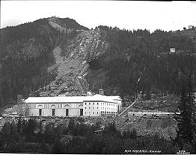
Long Hydroelectric History
1906 Tysso
The largest high pressure power station in the world
757 power stations in Norway
1911 Vemork
The worlds largest hydropower station so far with 10 turbines
1928 Nore I
The first governmental build hydropower station
1906 Svelgen
First Norwegian underground hydropower tunnels –
152 m and the longest in the world until 1958 (Tafjord 286m)
1885 Skien
Laugstol Brug - First Norwegian commercial hydropower station
1882 Senja
First Norwegian hydropower plant
1700
1800
1900
2000
1770’s France First description of vertical- and horizontal-axis hydraulic machines
1849 America
Francis turbine invented
1870 England
Sir Armstrong buildt the first hydroelectric power station.
1878 America
Edison formed the Electric Light Company
1881 America
Niagra Falls - Hydroelectric Plant supplying 16 electric Carbon Arc light
1882 America
Edison built the first commercial hydroelectric station
1899 America
Snoqualmie Falls - Worlds first underground hydropower station
Notes:
1770’s - In the mid-1770s, French engineer Bernard Forest de Bélidor published Architecture Hydraulique which described vertical- and horizontal-axis hydraulic machines
1849 - The Francis turbine (https://en.wikipedia.org/wiki/Francis_turbine#cite_note-1) is a type of water turbine that was developed by James B. Francis in Lowell, Massachusetts.^{[1]} It is an inward-flow reaction turbine that combines radial and axial flow concepts
In 1853, (http://www.niagarafrontier.com/power.html) The Niagara Falls Hydraulic Power & Manufacturing Company had purchased the water rights and began construction of this canal. In 1860, construction of the hydraulic canal began. The canal was 35 feet (11m) wide and 8 feet (2.4m) deep. It transported water from the Niagara River above the Falls to the mill sites below the Falls. The canal construction was completed in 1861. Augustus Porter's vision became reality in 1875, when the first wheels began turning in the new powerhouse.
1878 - Armstrong created Debdon Lake to use the water running through his estate to supply the world's first hydroelectric power station. This powered various labour-saving devices in his house including a roasting spit, a dishwasher and (a wonderful innovation) a servants lift. Turkish baths were installed as part of the innovative provision of central heating for the house, electricity facilitated the installation of an arc lamp in 1878 and the first of his friend Joseph Swan's incandescent light bulbs were installed in time for christmas 1880.
In 1878, Edison formed the Edison Electric Light Company in New York City with several financiers, including J. P. Morgan, Spencer Trask,^{[60]} and the members of the Vanderbilt family. Edison made the first public demonstration of his incandescent light bulb on December 31, 1879, in Menlo Park. It was during this time that he said: "We will make electricity so cheap that only the rich will burn candles."^{[61]}
By 1881, the power company had built a small generating station and began providing a small amount of electricity to light the village of Niagara Falls and to provide power to several of the mills. This power plant became a tourist attraction. It operated a flour mill for two years before the company went bankrupt and all its assets were sold at public auction.
1882 - The Vulcan Street Plant (https://en.wikipedia.org/wiki/Vulcan_Street_Plant#cite_note-ref_5-5) was the first Edison hydroelectric central station.^{[1][2][3][4]} The plant was built on the Fox River in Appleton, Wisconsin and put into operation on September 30, 1882.^{[4][5]}
1882 – (http://www.vasskrafta.no/historie/category451.html) Vannkraftverk i Hamn i Senja, høsten 1882. Det er ganske oppsiktsvekkende. Dette vannkraftverket var blant de aller første vanndrevne elektrisitetsverk i verden, kanskje det første. Det har visstnok bare en konkurrent fra Wisconsin, USA, fra samme år.
1885 - Laugstol Brug var en treforedlings-bedrift med behov for egen strømforsyning, men ved hjelp av to dynamoer, hver med forsyning til 150 glødelamper, fikk kraftverket en så stor kapasitet at det også kunne forsyne andre abonnenter i Skien. Både dynamoene og glødelampene var utenlandske. En ny teknologi som i internasjonal sammenheng hadde vokst fram siden slutten av 1860-årene, hadde dermed for alvor blitt introdusert i Norge. Den driftige lederen av Laugstol Brug og initiativtakeren til elektrisitetsverket var ingeniør Gunnar Knudsen. Knudsen ble senere både stortingsmann og statsminister og fikk en betydelig rolle innen norsk elektrisitetsforsyning (https://www.nve.no/om-nve/nves-museumsordning/nves-historie/1885-laugstol-brug-i-skien-landets-forste-elektrisitetsverk-blir-offisielt-satt-i-drift-1-oktober/)
1899 - Verdens første kraftstasjon i fjellhall var Snoqualmie Falls Hydroelectric Plant i King County (Washington) fra 1899. Men av verdens rundt 400 undergrunns kraftstasjoner ligger over 200 i Norge
1905 - Svelgfoss kraftverk (oppført 1905-1907) og Såheim (oppført 1914-1916) er tidlige eksempel på kraftverk der den frittliggende rørgaten er lagt i tunnel i fjellet bak stasjonene
Trykksjakten ved Svelgen var på 152 meter og verdens lengste fram til Tafjord 3 kraftverk startet produksjonen i 1958 med en 286 meter råsprengt trykksjakt. (https://no.wikipedia.org/wiki/Vannkraftverk)
1906 – 757 Hydropower stations in Norway –Between 1906 and 1918, the Tysso I hydraulic power station – one of the largest high-pressure power stations in the world at the time – was constructed ((http://www.erih.net/i-want-to-go-there/getpage/4/site/show/norwegian-museum-of-hydro-power-and-industry/)
1911 - Vemork kraftverk som stod ferdig i 1911 og var verdens største kraftverk med 10 turbiner.
1928 - Nore 1 started operation 1928. It is recognized as the first hydropower project developed by Government (http://tunnel.no/wp-content/uploads/2014/01/Publication_22.pdf)
1970 - Mardøla-aksjonen var den første store miljøsaken der sivil ulydighet ble brukt i større skala. (https://no.wikipedia.org/wiki/Sivil_ulydighet).
1973 – Driva - Det første kraftverket i verden der dette ble gjort var Driva kraftverk i Møre og Romsdal i 1973. Dette høytrykks luftputekammeret (pressurized air cusion chamber) (https://no.wikipedia.org/wiki/Vannkraftverk)
1979 - The Alta development raised (1979-81) one of the first hot tempered campaigns against hydropower development in the country
1988 It was the world's first multinational exchange for trading electric power. (https://en.wikipedia.org/wiki/Nord_Pool_Spot)
1998 - The Bieudron Hydroelectric Power Station is a hydroelectric power plant located in the Swiss Alps in the Canton of Valais in Switzerland. The power plant is fed with water from the Grande Dixence Dam's reservoir, Lac des Dix and is part of the Cleuson-Dixence Complex. The 1269 MW power plant is operated by Grande Dixence SA.^{[1]}
Production began in 1998, with two world records set upon its completion: the world's most powerful Pelton turbine as well as the highest head used to produce hydro-electric energy. A penstock rupture in 2000 forced the closure of the power plant and it was operational again in 2010
(https://en.wikipedia.org/wiki/Bieudron_Hydroelectric_Power_Station)

Slide 18

Long Hydroelectric History
1906 Tysso
The largest high pressure power station in the world
757 power stations in Norway
1911 Vemork
The worlds largest hydropower station so far with 10 turbines
1928 Nore I
The first governmental build hydropower station
1906 Svelgen
First Norwegian underground hydropower tunnels –
152 m and the longest in the world until 1958 (Tafjord 286m)
1885 Skien
Laugstol Brug - First Norwegian commercial hydropower station
1970 Mardøla
First civil disobedience against hydropower
1882 Senja
First Norwegian hydropower plant
1700
1800
1900
2000
1770’s France First description of vertical- and horizontal-axis hydraulic machines
1849 America
Francis turbine invented
1870 England
Sir Armstrong buildt the first hydroelectric power station.
1878 America
Edison formed the Electric Light Company
1881 America
Niagra Falls - Hydroelectric Plant supplying 16 electric Carbon Arc light
1882 America
Edison built the first commercial hydroelectric station
1899 America
Snoqualmie Falls - Worlds first underground hydropower station
Notes:
1770’s - In the mid-1770s, French engineer Bernard Forest de Bélidor published Architecture Hydraulique which described vertical- and horizontal-axis hydraulic machines
1849 - The Francis turbine (https://en.wikipedia.org/wiki/Francis_turbine#cite_note-1) is a type of water turbine that was developed by James B. Francis in Lowell, Massachusetts.^{[1]} It is an inward-flow reaction turbine that combines radial and axial flow concepts
In 1853, (http://www.niagarafrontier.com/power.html) The Niagara Falls Hydraulic Power & Manufacturing Company had purchased the water rights and began construction of this canal. In 1860, construction of the hydraulic canal began. The canal was 35 feet (11m) wide and 8 feet (2.4m) deep. It transported water from the Niagara River above the Falls to the mill sites below the Falls. The canal construction was completed in 1861. Augustus Porter's vision became reality in 1875, when the first wheels began turning in the new powerhouse.
1878 - Armstrong created Debdon Lake to use the water running through his estate to supply the world's first hydroelectric power station. This powered various labour-saving devices in his house including a roasting spit, a dishwasher and (a wonderful innovation) a servants lift. Turkish baths were installed as part of the innovative provision of central heating for the house, electricity facilitated the installation of an arc lamp in 1878 and the first of his friend Joseph Swan's incandescent light bulbs were installed in time for christmas 1880.
In 1878, Edison formed the Edison Electric Light Company in New York City with several financiers, including J. P. Morgan, Spencer Trask,^{[60]} and the members of the Vanderbilt family. Edison made the first public demonstration of his incandescent light bulb on December 31, 1879, in Menlo Park. It was during this time that he said: "We will make electricity so cheap that only the rich will burn candles."^{[61]}
By 1881, the power company had built a small generating station and began providing a small amount of electricity to light the village of Niagara Falls and to provide power to several of the mills. This power plant became a tourist attraction. It operated a flour mill for two years before the company went bankrupt and all its assets were sold at public auction.
1882 - The Vulcan Street Plant (https://en.wikipedia.org/wiki/Vulcan_Street_Plant#cite_note-ref_5-5) was the first Edison hydroelectric central station.^{[1][2][3][4]} The plant was built on the Fox River in Appleton, Wisconsin and put into operation on September 30, 1882.^{[4][5]}
1882 – (http://www.vasskrafta.no/historie/category451.html) Vannkraftverk i Hamn i Senja, høsten 1882. Det er ganske oppsiktsvekkende. Dette vannkraftverket var blant de aller første vanndrevne elektrisitetsverk i verden, kanskje det første. Det har visstnok bare en konkurrent fra Wisconsin, USA, fra samme år.
1885 - Laugstol Brug var en treforedlings-bedrift med behov for egen strømforsyning, men ved hjelp av to dynamoer, hver med forsyning til 150 glødelamper, fikk kraftverket en så stor kapasitet at det også kunne forsyne andre abonnenter i Skien. Både dynamoene og glødelampene var utenlandske. En ny teknologi som i internasjonal sammenheng hadde vokst fram siden slutten av 1860-årene, hadde dermed for alvor blitt introdusert i Norge. Den driftige lederen av Laugstol Brug og initiativtakeren til elektrisitetsverket var ingeniør Gunnar Knudsen. Knudsen ble senere både stortingsmann og statsminister og fikk en betydelig rolle innen norsk elektrisitetsforsyning (https://www.nve.no/om-nve/nves-museumsordning/nves-historie/1885-laugstol-brug-i-skien-landets-forste-elektrisitetsverk-blir-offisielt-satt-i-drift-1-oktober/)
1899 - Verdens første kraftstasjon i fjellhall var Snoqualmie Falls Hydroelectric Plant i King County (Washington) fra 1899. Men av verdens rundt 400 undergrunns kraftstasjoner ligger over 200 i Norge
1905 - Svelgfoss kraftverk (oppført 1905-1907) og Såheim (oppført 1914-1916) er tidlige eksempel på kraftverk der den frittliggende rørgaten er lagt i tunnel i fjellet bak stasjonene
Trykksjakten ved Svelgen var på 152 meter og verdens lengste fram til Tafjord 3 kraftverk startet produksjonen i 1958 med en 286 meter råsprengt trykksjakt. (https://no.wikipedia.org/wiki/Vannkraftverk)
1906 – 757 Hydropower stations in Norway –Between 1906 and 1918, the Tysso I hydraulic power station – one of the largest high-pressure power stations in the world at the time – was constructed ((http://www.erih.net/i-want-to-go-there/getpage/4/site/show/norwegian-museum-of-hydro-power-and-industry/)
1911 - Vemork kraftverk som stod ferdig i 1911 og var verdens største kraftverk med 10 turbiner.
1928 - Nore 1 started operation 1928. It is recognized as the first hydropower project developed by Government (http://tunnel.no/wp-content/uploads/2014/01/Publication_22.pdf)
1970 - Mardøla-aksjonen var den første store miljøsaken der sivil ulydighet ble brukt i større skala. (https://no.wikipedia.org/wiki/Sivil_ulydighet).
1973 – Driva - Det første kraftverket i verden der dette ble gjort var Driva kraftverk i Møre og Romsdal i 1973. Dette høytrykks luftputekammeret (pressurized air cusion chamber) (https://no.wikipedia.org/wiki/Vannkraftverk)
1979 - The Alta development raised (1979-81) one of the first hot tempered campaigns against hydropower development in the country
1988 It was the world's first multinational exchange for trading electric power. (https://en.wikipedia.org/wiki/Nord_Pool_Spot)
1998 - The Bieudron Hydroelectric Power Station is a hydroelectric power plant located in the Swiss Alps in the Canton of Valais in Switzerland. The power plant is fed with water from the Grande Dixence Dam's reservoir, Lac des Dix and is part of the Cleuson-Dixence Complex. The 1269 MW power plant is operated by Grande Dixence SA.^{[1]}
Production began in 1998, with two world records set upon its completion: the world's most powerful Pelton turbine as well as the highest head used to produce hydro-electric energy. A penstock rupture in 2000 forced the closure of the power plant and it was operational again in 2010
(https://en.wikipedia.org/wiki/Bieudron_Hydroelectric_Power_Station)

Slide 19
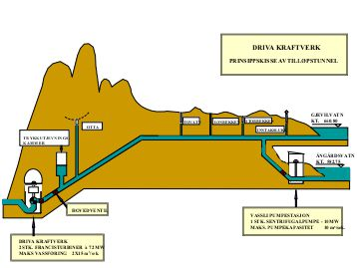
Long Hydroelectric History
1906 Tysso
The largest high pressure power station in the world
757 power stations in Norway
1911 Vemork
The worlds largest hydropower station so far with 10 turbines
1928 Nore I
The first governmental build hydropower station
1906 Svelgen
First Norwegian underground hydropower tunnels –
152 m and the longest in the world until 1958 (Tafjord 286m)
1973 Driva
The first pressurized cushion chamber
1885 Skien
Laugstol Brug - First Norwegian commercial hydropower station
1970 Mardøla
First civil disobedience against hydropower
1882 Senja
First Norwegian hydropower plant
1700
1800
1900
2000
1770’s France First description of vertical- and horizontal-axis hydraulic machines
1849 America
Francis turbine invented
1870 England
Sir Armstrong buildt the first hydroelectric power station.
1878 America
Edison formed the Electric Light Company
1881 America
Niagra Falls - Hydroelectric Plant supplying 16 electric Carbon Arc light
1882 America
Edison built the first commercial hydroelectric station
1899 America
Snoqualmie Falls - Worlds first underground hydropower station
Notes:
1770’s - In the mid-1770s, French engineer Bernard Forest de Bélidor published Architecture Hydraulique which described vertical- and horizontal-axis hydraulic machines
1849 - The Francis turbine (https://en.wikipedia.org/wiki/Francis_turbine#cite_note-1) is a type of water turbine that was developed by James B. Francis in Lowell, Massachusetts.^{[1]} It is an inward-flow reaction turbine that combines radial and axial flow concepts
In 1853, (http://www.niagarafrontier.com/power.html) The Niagara Falls Hydraulic Power & Manufacturing Company had purchased the water rights and began construction of this canal. In 1860, construction of the hydraulic canal began. The canal was 35 feet (11m) wide and 8 feet (2.4m) deep. It transported water from the Niagara River above the Falls to the mill sites below the Falls. The canal construction was completed in 1861. Augustus Porter's vision became reality in 1875, when the first wheels began turning in the new powerhouse.
1878 - Armstrong created Debdon Lake to use the water running through his estate to supply the world's first hydroelectric power station. This powered various labour-saving devices in his house including a roasting spit, a dishwasher and (a wonderful innovation) a servants lift. Turkish baths were installed as part of the innovative provision of central heating for the house, electricity facilitated the installation of an arc lamp in 1878 and the first of his friend Joseph Swan's incandescent light bulbs were installed in time for christmas 1880.
In 1878, Edison formed the Edison Electric Light Company in New York City with several financiers, including J. P. Morgan, Spencer Trask,^{[60]} and the members of the Vanderbilt family. Edison made the first public demonstration of his incandescent light bulb on December 31, 1879, in Menlo Park. It was during this time that he said: "We will make electricity so cheap that only the rich will burn candles."^{[61]}
By 1881, the power company had built a small generating station and began providing a small amount of electricity to light the village of Niagara Falls and to provide power to several of the mills. This power plant became a tourist attraction. It operated a flour mill for two years before the company went bankrupt and all its assets were sold at public auction.
1882 - The Vulcan Street Plant (https://en.wikipedia.org/wiki/Vulcan_Street_Plant#cite_note-ref_5-5) was the first Edison hydroelectric central station.^{[1][2][3][4]} The plant was built on the Fox River in Appleton, Wisconsin and put into operation on September 30, 1882.^{[4][5]}
1882 – (http://www.vasskrafta.no/historie/category451.html) Vannkraftverk i Hamn i Senja, høsten 1882. Det er ganske oppsiktsvekkende. Dette vannkraftverket var blant de aller første vanndrevne elektrisitetsverk i verden, kanskje det første. Det har visstnok bare en konkurrent fra Wisconsin, USA, fra samme år.
1885 - Laugstol Brug var en treforedlings-bedrift med behov for egen strømforsyning, men ved hjelp av to dynamoer, hver med forsyning til 150 glødelamper, fikk kraftverket en så stor kapasitet at det også kunne forsyne andre abonnenter i Skien. Både dynamoene og glødelampene var utenlandske. En ny teknologi som i internasjonal sammenheng hadde vokst fram siden slutten av 1860-årene, hadde dermed for alvor blitt introdusert i Norge. Den driftige lederen av Laugstol Brug og initiativtakeren til elektrisitetsverket var ingeniør Gunnar Knudsen. Knudsen ble senere både stortingsmann og statsminister og fikk en betydelig rolle innen norsk elektrisitetsforsyning (https://www.nve.no/om-nve/nves-museumsordning/nves-historie/1885-laugstol-brug-i-skien-landets-forste-elektrisitetsverk-blir-offisielt-satt-i-drift-1-oktober/)
1899 - Verdens første kraftstasjon i fjellhall var Snoqualmie Falls Hydroelectric Plant i King County (Washington) fra 1899. Men av verdens rundt 400 undergrunns kraftstasjoner ligger over 200 i Norge
1905 - Svelgfoss kraftverk (oppført 1905-1907) og Såheim (oppført 1914-1916) er tidlige eksempel på kraftverk der den frittliggende rørgaten er lagt i tunnel i fjellet bak stasjonene
Trykksjakten ved Svelgen var på 152 meter og verdens lengste fram til Tafjord 3 kraftverk startet produksjonen i 1958 med en 286 meter råsprengt trykksjakt. (https://no.wikipedia.org/wiki/Vannkraftverk)
1906 – 757 Hydropower stations in Norway –Between 1906 and 1918, the Tysso I hydraulic power station – one of the largest high-pressure power stations in the world at the time – was constructed ((http://www.erih.net/i-want-to-go-there/getpage/4/site/show/norwegian-museum-of-hydro-power-and-industry/)
1911 - Vemork kraftverk som stod ferdig i 1911 og var verdens største kraftverk med 10 turbiner.
1928 - Nore 1 started operation 1928. It is recognized as the first hydropower project developed by Government (http://tunnel.no/wp-content/uploads/2014/01/Publication_22.pdf)
1970 - Mardøla-aksjonen var den første store miljøsaken der sivil ulydighet ble brukt i større skala. (https://no.wikipedia.org/wiki/Sivil_ulydighet).
1973 – Driva - Det første kraftverket i verden der dette ble gjort var Driva kraftverk i Møre og Romsdal i 1973. Dette høytrykks luftputekammeret (pressurized air cusion chamber) (https://no.wikipedia.org/wiki/Vannkraftverk)
1979 - The Alta development raised (1979-81) one of the first hot tempered campaigns against hydropower development in the country
1988 It was the world's first multinational exchange for trading electric power. (https://en.wikipedia.org/wiki/Nord_Pool_Spot)
1998 - The Bieudron Hydroelectric Power Station is a hydroelectric power plant located in the Swiss Alps in the Canton of Valais in Switzerland. The power plant is fed with water from the Grande Dixence Dam's reservoir, Lac des Dix and is part of the Cleuson-Dixence Complex. The 1269 MW power plant is operated by Grande Dixence SA.^{[1]}
Production began in 1998, with two world records set upon its completion: the world's most powerful Pelton turbine as well as the highest head used to produce hydro-electric energy. A penstock rupture in 2000 forced the closure of the power plant and it was operational again in 2010
(https://en.wikipedia.org/wiki/Bieudron_Hydroelectric_Power_Station)

Slide 20
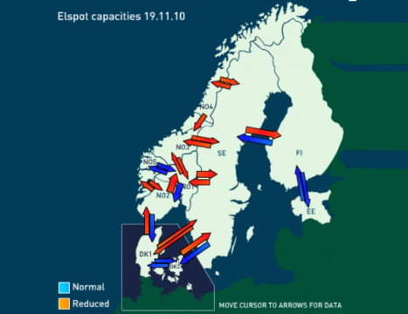
Long Hydroelectric History
1906 Tysso
The largest high pressure power station in the world
757 power stations in Norway
1911 Vemork
The worlds largest hydropower station so far with 10 turbines
1928 Nore I
The first governmental build hydropower station
1906 Svelgen
First Norwegian underground hydropower tunnels –
152 m and the longest in the world until 1958 (Tafjord 286m)
1988 NordPool
world's first multinational exchange for trading electric power
1973 Driva
The first pressurized cushion chamber
1885 Skien
Laugstol Brug - First Norwegian commercial hydropower station
1970 Mardøla
First civil disobedience against hydropower
1882 Senja
First Norwegian hydropower plant
1700
1800
1900
2000
1770’s France First description of vertical- and horizontal-axis hydraulic machines
1849 America
Francis turbine invented
1870 England
Sir Armstrong buildt the first hydroelectric power station.
1878 America
Edison formed the Electric Light Company
1881 America
Niagra Falls - Hydroelectric Plant supplying 16 electric Carbon Arc light
1882 America
Edison built the first commercial hydroelectric station
1899 America
Snoqualmie Falls - Worlds first underground hydropower station
Notes:
1770’s - In the mid-1770s, French engineer Bernard Forest de Bélidor published Architecture Hydraulique which described vertical- and horizontal-axis hydraulic machines
1849 - The Francis turbine (https://en.wikipedia.org/wiki/Francis_turbine#cite_note-1) is a type of water turbine that was developed by James B. Francis in Lowell, Massachusetts.^{[1]} It is an inward-flow reaction turbine that combines radial and axial flow concepts
In 1853, (http://www.niagarafrontier.com/power.html) The Niagara Falls Hydraulic Power & Manufacturing Company had purchased the water rights and began construction of this canal. In 1860, construction of the hydraulic canal began. The canal was 35 feet (11m) wide and 8 feet (2.4m) deep. It transported water from the Niagara River above the Falls to the mill sites below the Falls. The canal construction was completed in 1861. Augustus Porter's vision became reality in 1875, when the first wheels began turning in the new powerhouse.
1878 - Armstrong created Debdon Lake to use the water running through his estate to supply the world's first hydroelectric power station. This powered various labour-saving devices in his house including a roasting spit, a dishwasher and (a wonderful innovation) a servants lift. Turkish baths were installed as part of the innovative provision of central heating for the house, electricity facilitated the installation of an arc lamp in 1878 and the first of his friend Joseph Swan's incandescent light bulbs were installed in time for christmas 1880.
In 1878, Edison formed the Edison Electric Light Company in New York City with several financiers, including J. P. Morgan, Spencer Trask,^{[60]} and the members of the Vanderbilt family. Edison made the first public demonstration of his incandescent light bulb on December 31, 1879, in Menlo Park. It was during this time that he said: "We will make electricity so cheap that only the rich will burn candles."^{[61]}
By 1881, the power company had built a small generating station and began providing a small amount of electricity to light the village of Niagara Falls and to provide power to several of the mills. This power plant became a tourist attraction. It operated a flour mill for two years before the company went bankrupt and all its assets were sold at public auction.
1882 - The Vulcan Street Plant (https://en.wikipedia.org/wiki/Vulcan_Street_Plant#cite_note-ref_5-5) was the first Edison hydroelectric central station.^{[1][2][3][4]} The plant was built on the Fox River in Appleton, Wisconsin and put into operation on September 30, 1882.^{[4][5]}
1882 – (http://www.vasskrafta.no/historie/category451.html) Vannkraftverk i Hamn i Senja, høsten 1882. Det er ganske oppsiktsvekkende. Dette vannkraftverket var blant de aller første vanndrevne elektrisitetsverk i verden, kanskje det første. Det har visstnok bare en konkurrent fra Wisconsin, USA, fra samme år.
1885 - Laugstol Brug var en treforedlings-bedrift med behov for egen strømforsyning, men ved hjelp av to dynamoer, hver med forsyning til 150 glødelamper, fikk kraftverket en så stor kapasitet at det også kunne forsyne andre abonnenter i Skien. Både dynamoene og glødelampene var utenlandske. En ny teknologi som i internasjonal sammenheng hadde vokst fram siden slutten av 1860-årene, hadde dermed for alvor blitt introdusert i Norge. Den driftige lederen av Laugstol Brug og initiativtakeren til elektrisitetsverket var ingeniør Gunnar Knudsen. Knudsen ble senere både stortingsmann og statsminister og fikk en betydelig rolle innen norsk elektrisitetsforsyning (https://www.nve.no/om-nve/nves-museumsordning/nves-historie/1885-laugstol-brug-i-skien-landets-forste-elektrisitetsverk-blir-offisielt-satt-i-drift-1-oktober/)
1899 - Verdens første kraftstasjon i fjellhall var Snoqualmie Falls Hydroelectric Plant i King County (Washington) fra 1899. Men av verdens rundt 400 undergrunns kraftstasjoner ligger over 200 i Norge
1905 - Svelgfoss kraftverk (oppført 1905-1907) og Såheim (oppført 1914-1916) er tidlige eksempel på kraftverk der den frittliggende rørgaten er lagt i tunnel i fjellet bak stasjonene
Trykksjakten ved Svelgen var på 152 meter og verdens lengste fram til Tafjord 3 kraftverk startet produksjonen i 1958 med en 286 meter råsprengt trykksjakt. (https://no.wikipedia.org/wiki/Vannkraftverk)
1906 – 757 Hydropower stations in Norway –Between 1906 and 1918, the Tysso I hydraulic power station – one of the largest high-pressure power stations in the world at the time – was constructed ((http://www.erih.net/i-want-to-go-there/getpage/4/site/show/norwegian-museum-of-hydro-power-and-industry/)
1911 - Vemork kraftverk som stod ferdig i 1911 og var verdens største kraftverk med 10 turbiner.
1928 - Nore 1 started operation 1928. It is recognized as the first hydropower project developed by Government (http://tunnel.no/wp-content/uploads/2014/01/Publication_22.pdf)
1970 - Mardøla-aksjonen var den første store miljøsaken der sivil ulydighet ble brukt i større skala. (https://no.wikipedia.org/wiki/Sivil_ulydighet).
1973 – Driva - Det første kraftverket i verden der dette ble gjort var Driva kraftverk i Møre og Romsdal i 1973. Dette høytrykks luftputekammeret (pressurized air cusion chamber) (https://no.wikipedia.org/wiki/Vannkraftverk)
1979 - The Alta development raised (1979-81) one of the first hot tempered campaigns against hydropower development in the country
1988 It was the world's first multinational exchange for trading electric power. (https://en.wikipedia.org/wiki/Nord_Pool_Spot)
1998 - The Bieudron Hydroelectric Power Station is a hydroelectric power plant located in the Swiss Alps in the Canton of Valais in Switzerland. The power plant is fed with water from the Grande Dixence Dam's reservoir, Lac des Dix and is part of the Cleuson-Dixence Complex. The 1269 MW power plant is operated by Grande Dixence SA.^{[1]}
Production began in 1998, with two world records set upon its completion: the world's most powerful Pelton turbine as well as the highest head used to produce hydro-electric energy. A penstock rupture in 2000 forced the closure of the power plant and it was operational again in 2010
(https://en.wikipedia.org/wiki/Bieudron_Hydroelectric_Power_Station)

Slide 21
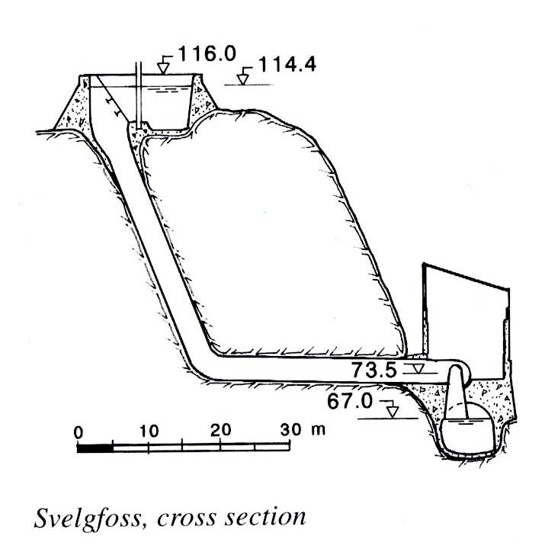
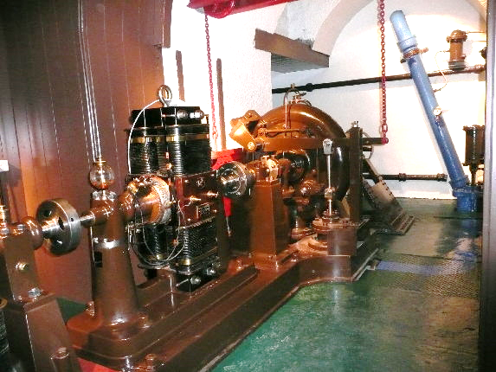
Long Hydroelectric History
1906 Tysso
The largest high pressure power station in the world
757 power stations in Norway
1911 Vemork
The worlds largest hydropower station so far with 10 turbines
1928 Nore I
The first governmental build hydropower station
1906 Svelgfoss
First Norwegian underground hydropower tunnels –
In Svelgen 152 m and the longest in the world until 1958 (Tafjord 286m)
1988 NordPool
world's first multinational exchange for trading electric power
1973 Driva
The first pressurized cushion chamber
1885 Skien
Laugstol Brug - First Norwegian commercial hydropower station
1970 Mardøla
First civil disobedience against hydropower
1882 Senja
First Norwegian hydropower plant
1700
1800
1900
2000
1770’s France First description of vertical- and horizontal-axis hydraulic machines
1849 America
Francis turbine invented
1870 England
Sir Armstrong buildt the first hydroelectric power station.
1878 America
Edison formed the Electric Light Company
1881 America
Niagra Falls - Hydroelectric Plant supplying 16 electric Carbon Arc light
1882 America
Edison built the first commercial hydroelectric station
1899 America
Snoqualmie Falls - Worlds first underground hydropower station
Notes:
1770’s - In the mid-1770s, French engineer Bernard Forest de Bélidor published Architecture Hydraulique which described vertical- and horizontal-axis hydraulic machines
1849 - The Francis turbine (https://en.wikipedia.org/wiki/Francis_turbine#cite_note-1) is a type of water turbine that was developed by James B. Francis in Lowell, Massachusetts.^{[1]} It is an inward-flow reaction turbine that combines radial and axial flow concepts
In 1853, (http://www.niagarafrontier.com/power.html) The Niagara Falls Hydraulic Power & Manufacturing Company had purchased the water rights and began construction of this canal. In 1860, construction of the hydraulic canal began. The canal was 35 feet (11m) wide and 8 feet (2.4m) deep. It transported water from the Niagara River above the Falls to the mill sites below the Falls. The canal construction was completed in 1861. Augustus Porter's vision became reality in 1875, when the first wheels began turning in the new powerhouse.
1878 - Armstrong created Debdon Lake to use the water running through his estate to supply the world's first hydroelectric power station. This powered various labour-saving devices in his house including a roasting spit, a dishwasher and (a wonderful innovation) a servants lift. Turkish baths were installed as part of the innovative provision of central heating for the house, electricity facilitated the installation of an arc lamp in 1878 and the first of his friend Joseph Swan's incandescent light bulbs were installed in time for christmas 1880.
In 1878, Edison formed the Edison Electric Light Company in New York City with several financiers, including J. P. Morgan, Spencer Trask,^{[60]} and the members of the Vanderbilt family. Edison made the first public demonstration of his incandescent light bulb on December 31, 1879, in Menlo Park. It was during this time that he said: "We will make electricity so cheap that only the rich will burn candles."^{[61]}
By 1881, the power company had built a small generating station and began providing a small amount of electricity to light the village of Niagara Falls and to provide power to several of the mills. This power plant became a tourist attraction. It operated a flour mill for two years before the company went bankrupt and all its assets were sold at public auction.
1882 - The Vulcan Street Plant (https://en.wikipedia.org/wiki/Vulcan_Street_Plant#cite_note-ref_5-5) was the first Edison hydroelectric central station.^{[1][2][3][4]} The plant was built on the Fox River in Appleton, Wisconsin and put into operation on September 30, 1882.^{[4][5]}
1882 – (http://www.vasskrafta.no/historie/category451.html) Vannkraftverk i Hamn i Senja, høsten 1882. Det er ganske oppsiktsvekkende. Dette vannkraftverket var blant de aller første vanndrevne elektrisitetsverk i verden, kanskje det første. Det har visstnok bare en konkurrent fra Wisconsin, USA, fra samme år.
1885 - Laugstol Brug var en treforedlings-bedrift med behov for egen strømforsyning, men ved hjelp av to dynamoer, hver med forsyning til 150 glødelamper, fikk kraftverket en så stor kapasitet at det også kunne forsyne andre abonnenter i Skien. Både dynamoene og glødelampene var utenlandske. En ny teknologi som i internasjonal sammenheng hadde vokst fram siden slutten av 1860-årene, hadde dermed for alvor blitt introdusert i Norge. Den driftige lederen av Laugstol Brug og initiativtakeren til elektrisitetsverket var ingeniør Gunnar Knudsen. Knudsen ble senere både stortingsmann og statsminister og fikk en betydelig rolle innen norsk elektrisitetsforsyning (https://www.nve.no/om-nve/nves-museumsordning/nves-historie/1885-laugstol-brug-i-skien-landets-forste-elektrisitetsverk-blir-offisielt-satt-i-drift-1-oktober/)
1899 - Verdens første kraftstasjon i fjellhall var Snoqualmie Falls Hydroelectric Plant i King County (Washington) fra 1899. Men av verdens rundt 400 undergrunns kraftstasjoner ligger over 200 i Norge
1905 - Svelgfoss kraftverk (oppført 1905-1907) og Såheim (oppført 1914-1916) er tidlige eksempel på kraftverk der den frittliggende rørgaten er lagt i tunnel i fjellet bak stasjonene
Trykksjakten ved Svelgen var på 152 meter og verdens lengste fram til Tafjord 3 kraftverk startet produksjonen i 1958 med en 286 meter råsprengt trykksjakt. (https://no.wikipedia.org/wiki/Vannkraftverk)
1906 – 757 Hydropower stations in Norway –Between 1906 and 1918, the Tysso I hydraulic power station – one of the largest high-pressure power stations in the world at the time – was constructed ((http://www.erih.net/i-want-to-go-there/getpage/4/site/show/norwegian-museum-of-hydro-power-and-industry/)
1911 - Vemork kraftverk som stod ferdig i 1911 og var verdens største kraftverk med 10 turbiner.
1928 - Nore 1 started operation 1928. It is recognized as the first hydropower project developed by Government (http://tunnel.no/wp-content/uploads/2014/01/Publication_22.pdf)
1970 - Mardøla-aksjonen var den første store miljøsaken der sivil ulydighet ble brukt i større skala. (https://no.wikipedia.org/wiki/Sivil_ulydighet).
1973 – Driva - Det første kraftverket i verden der dette ble gjort var Driva kraftverk i Møre og Romsdal i 1973. Dette høytrykks luftputekammeret (pressurized air cusion chamber) (https://no.wikipedia.org/wiki/Vannkraftverk)
1979 - The Alta development raised (1979-81) one of the first hot tempered campaigns against hydropower development in the country
1988 It was the world's first multinational exchange for trading electric power. (https://en.wikipedia.org/wiki/Nord_Pool_Spot)
1998 - The Bieudron Hydroelectric Power Station is a hydroelectric power plant located in the Swiss Alps in the Canton of Valais in Switzerland. The power plant is fed with water from the Grande Dixence Dam's reservoir, Lac des Dix and is part of the Cleuson-Dixence Complex. The 1269 MW power plant is operated by Grande Dixence SA.^{[1]}
Production began in 1998, with two world records set upon its completion: the world's most powerful Pelton turbine as well as the highest head used to produce hydro-electric energy. A penstock rupture in 2000 forced the closure of the power plant and it was operational again in 2010
(https://en.wikipedia.org/wiki/Bieudron_Hydroelectric_Power_Station)

Slide 22
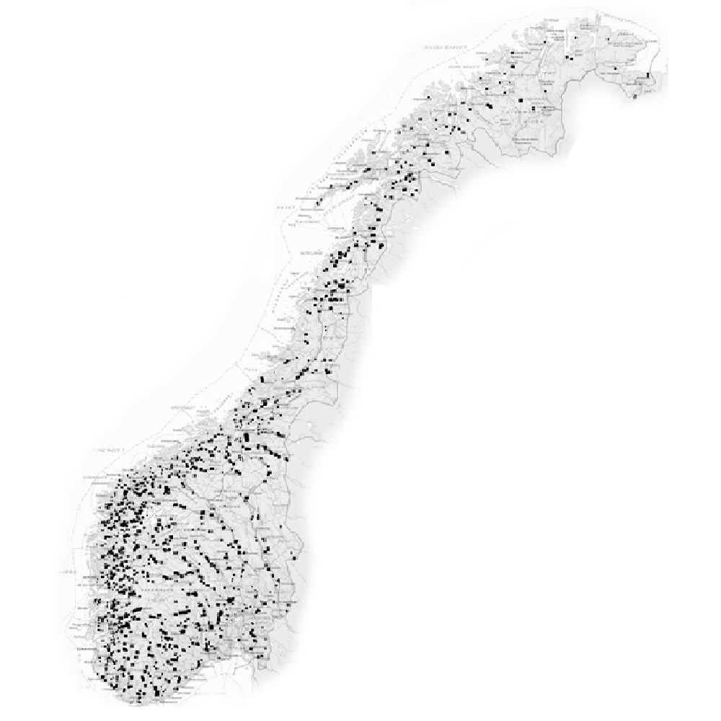
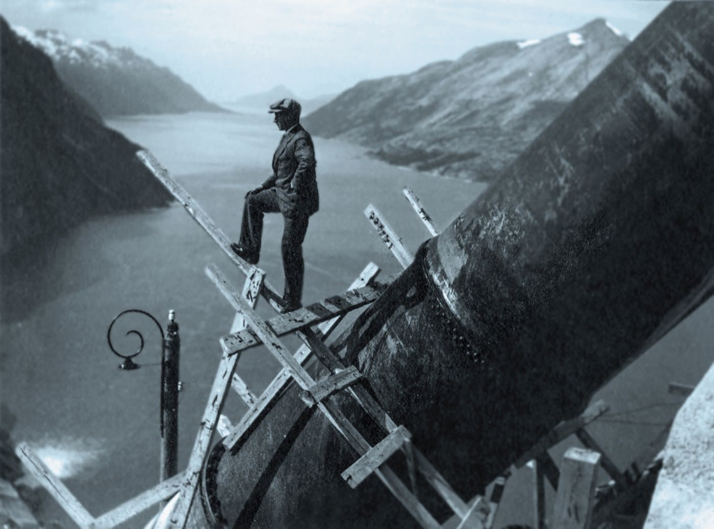
100 years experience

Slide 23

Average 21 MW
Mikro
Sum 8,4 MW
Sum 31,5 GW
Large
Sum 29,1 GW
Small
Sum 2,26 GW
Mini
Sum 0,185 GW

Slide 24
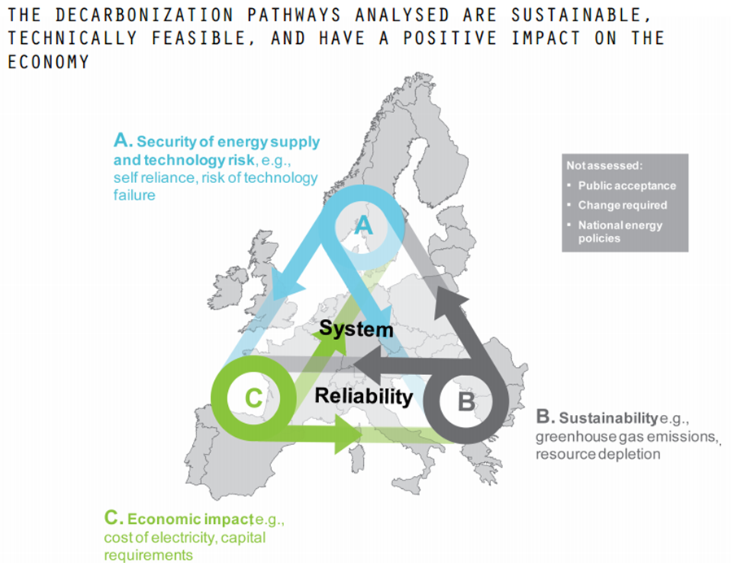
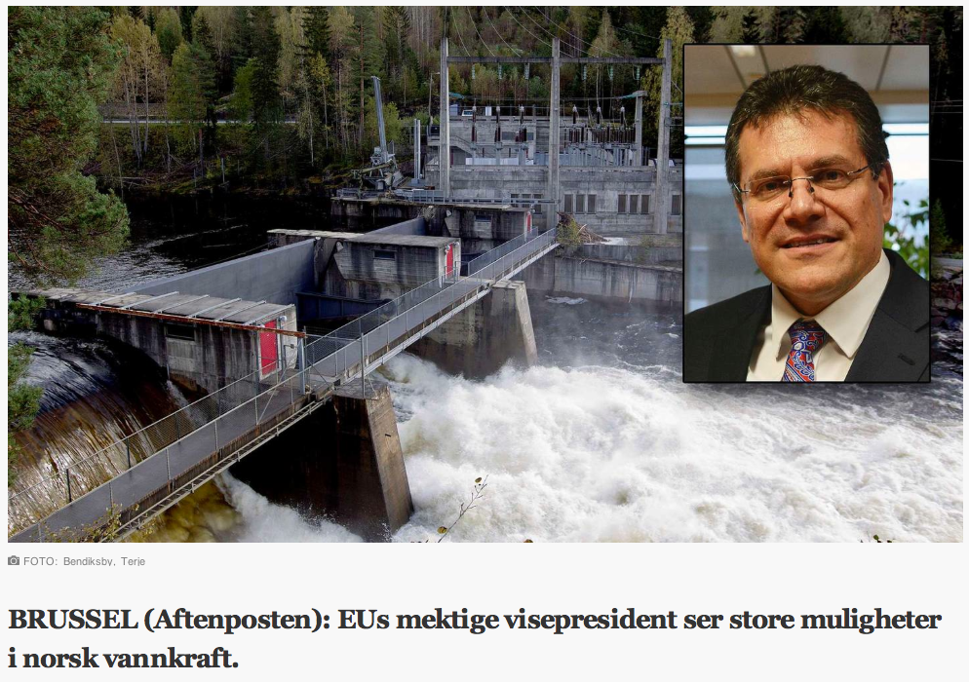
Maros Sefcovic,
EU-commisjonens vicepresident responsible for the energyunion
"My impression is that Norway is ready to play an even more strategic role in Europe's energy mix."

Slide 25
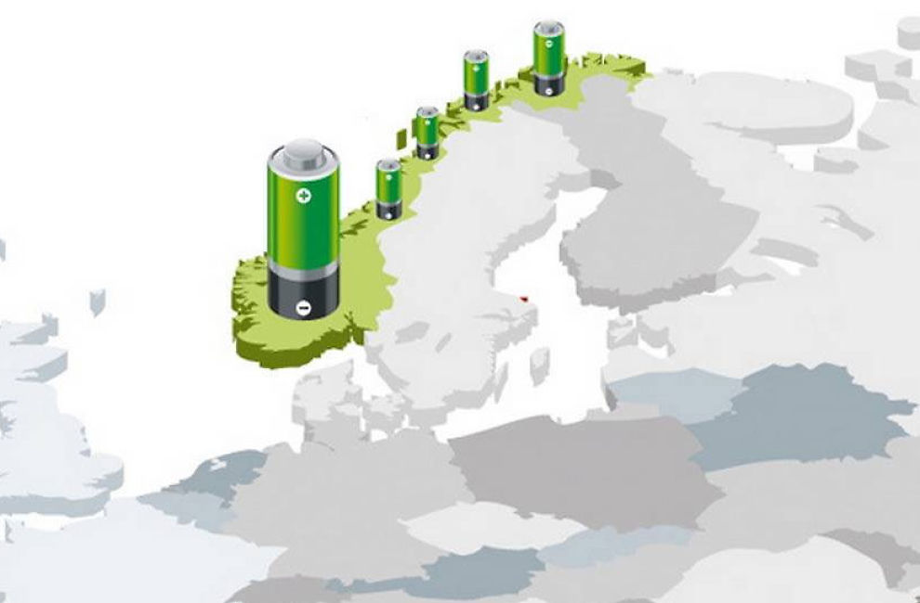
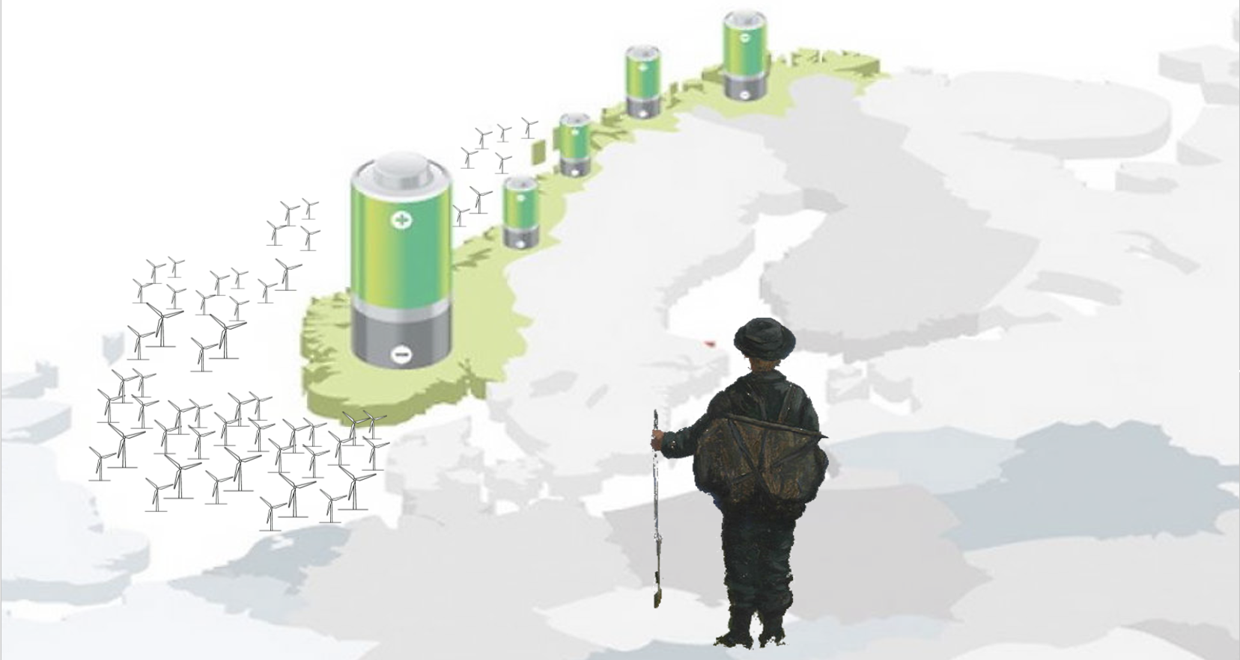
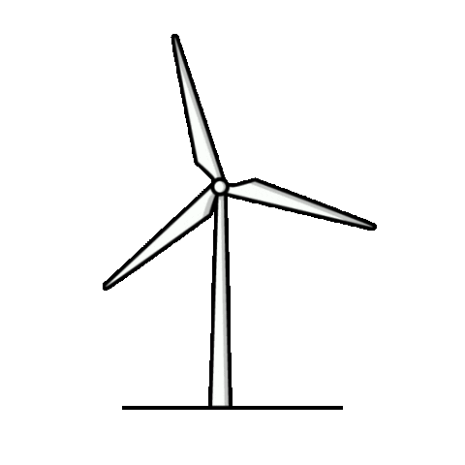


Slide 26




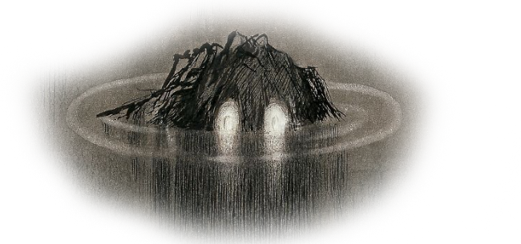
Challanges for future development of Hydropower
How do the future market look like?
Do you have adapted Technology?
What about the environment?
Notes:
Då er spørsmålet om vi skuar eit soria moria i horisonten eller om vi ser ein hallusinasjon….

Slide 27
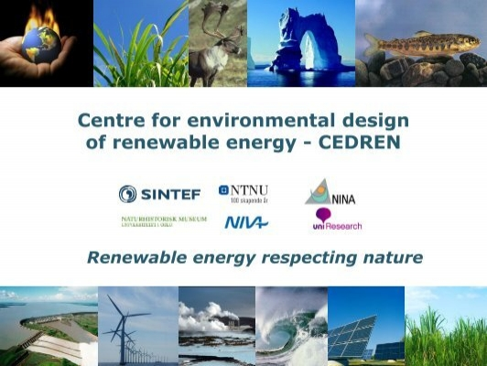
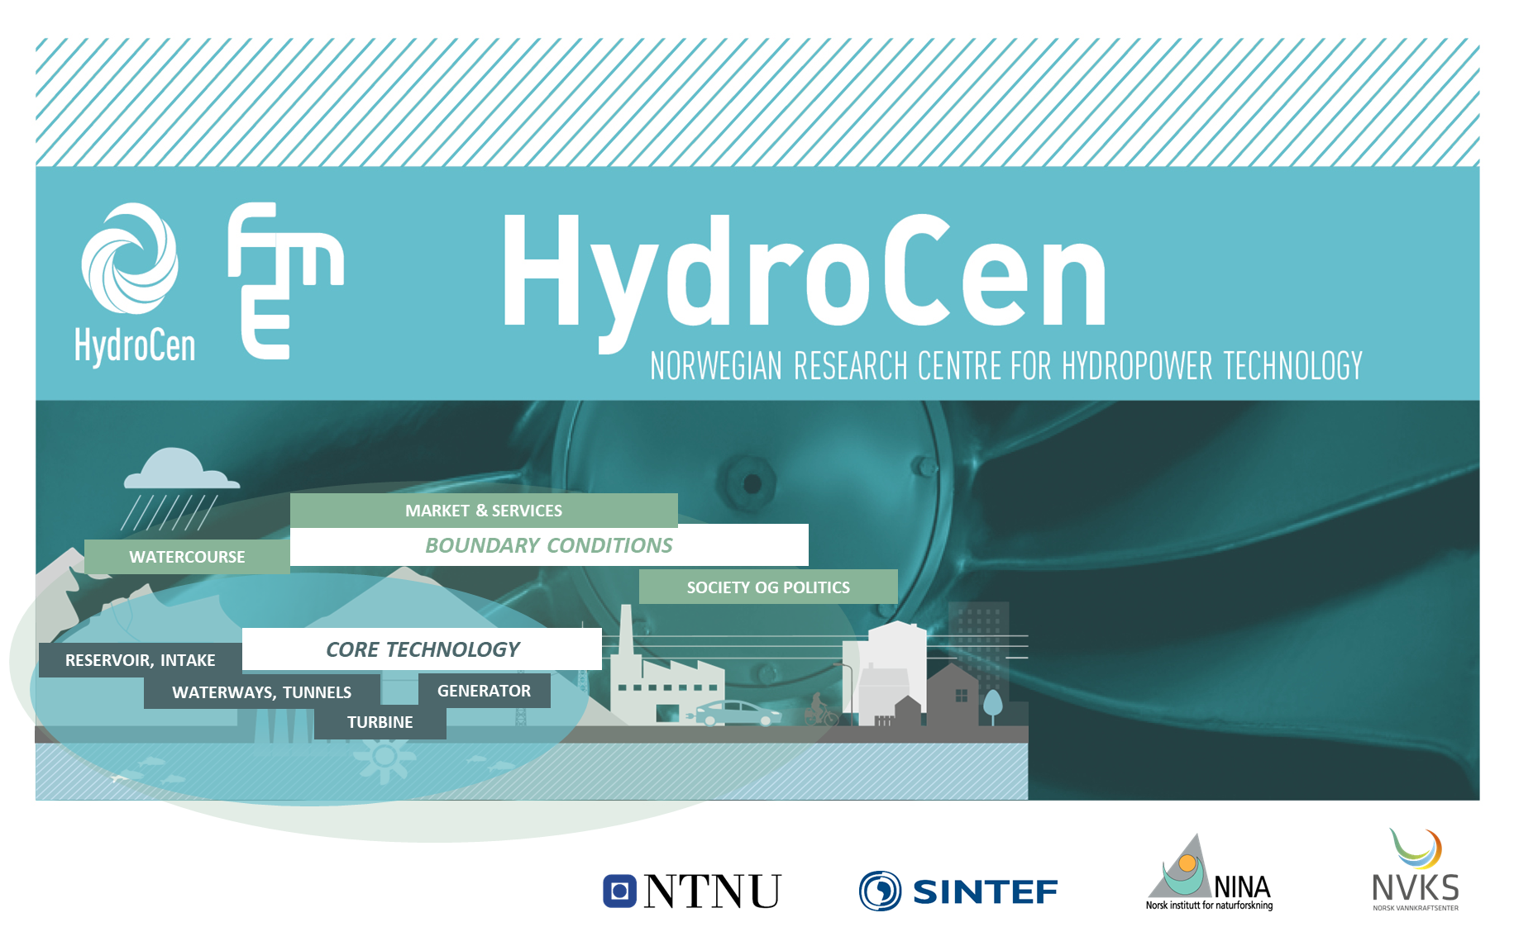
Closely linked to our research centers for "Research on Environmentally Friendly Energy" FME

Slide 28



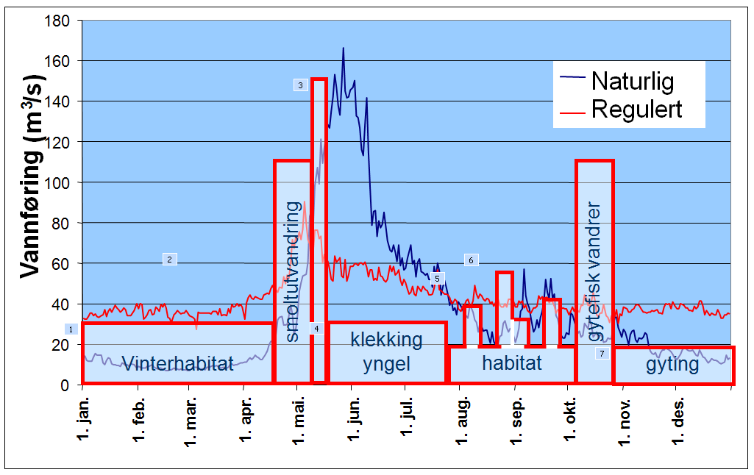








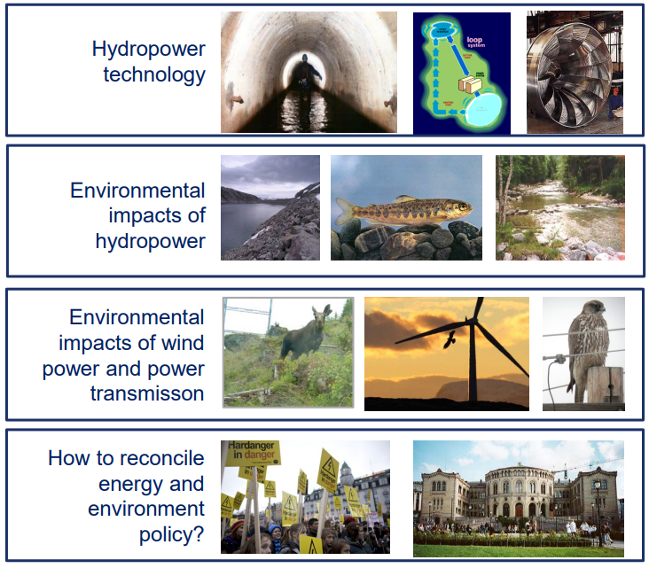
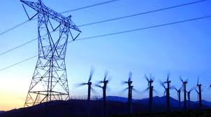
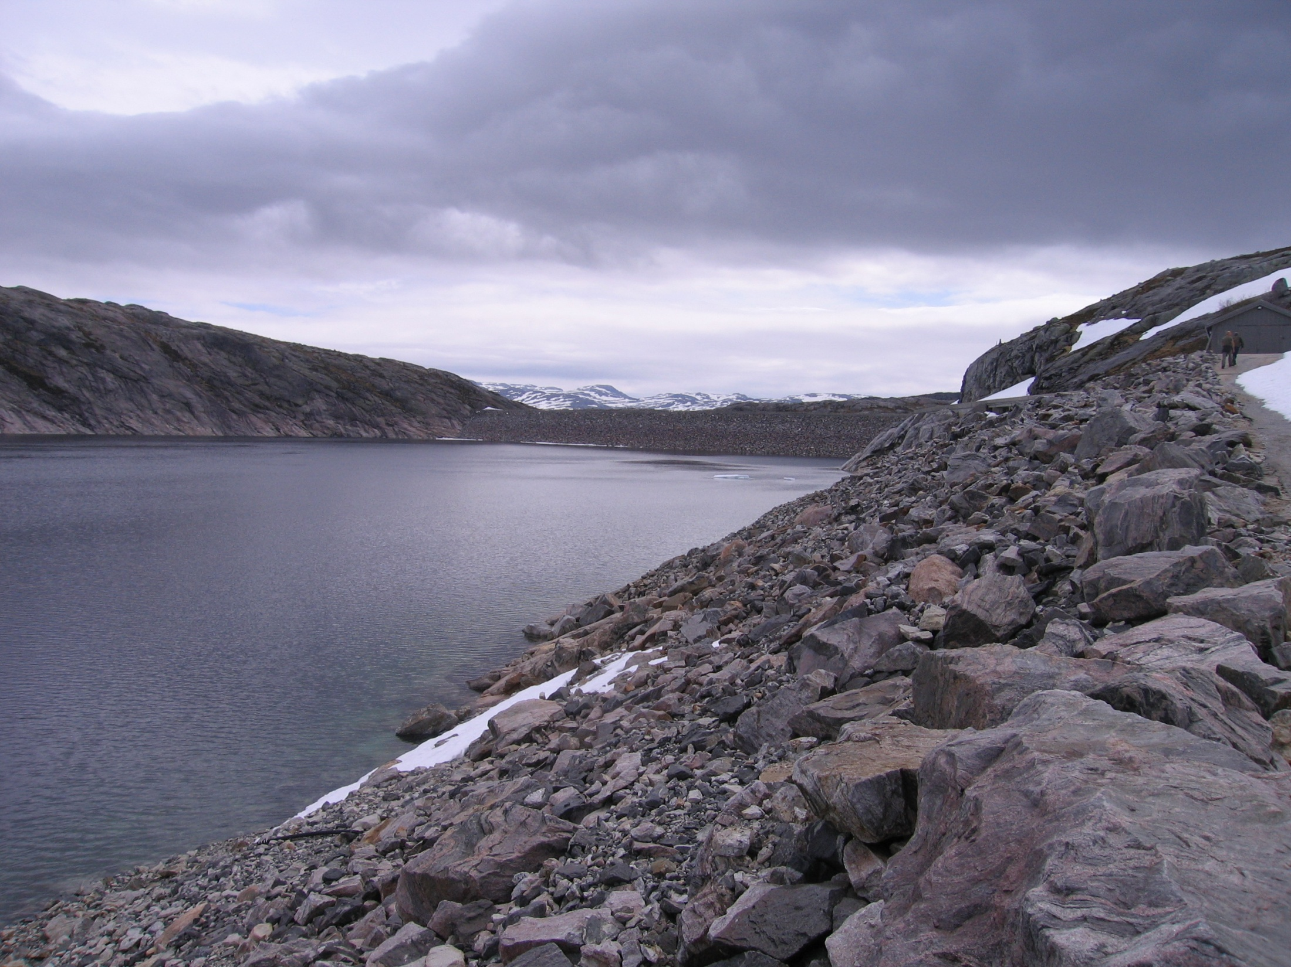

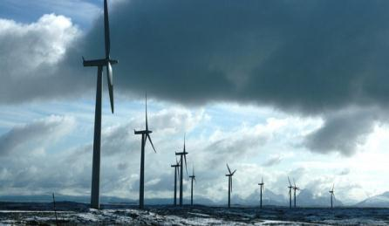

In numbers:
12 large research projects
7 Norwegian research partners
16 Industry partners and 2 management partners
Budget: ~350 MNOK
30 PhD, 7 Post-doc positions, 100 Master thesis
International student and professional exchange
170 scientific publications
500 ++ conference presentations
32 specific innovations identified
Renewable energy respecting nature

Slide 29
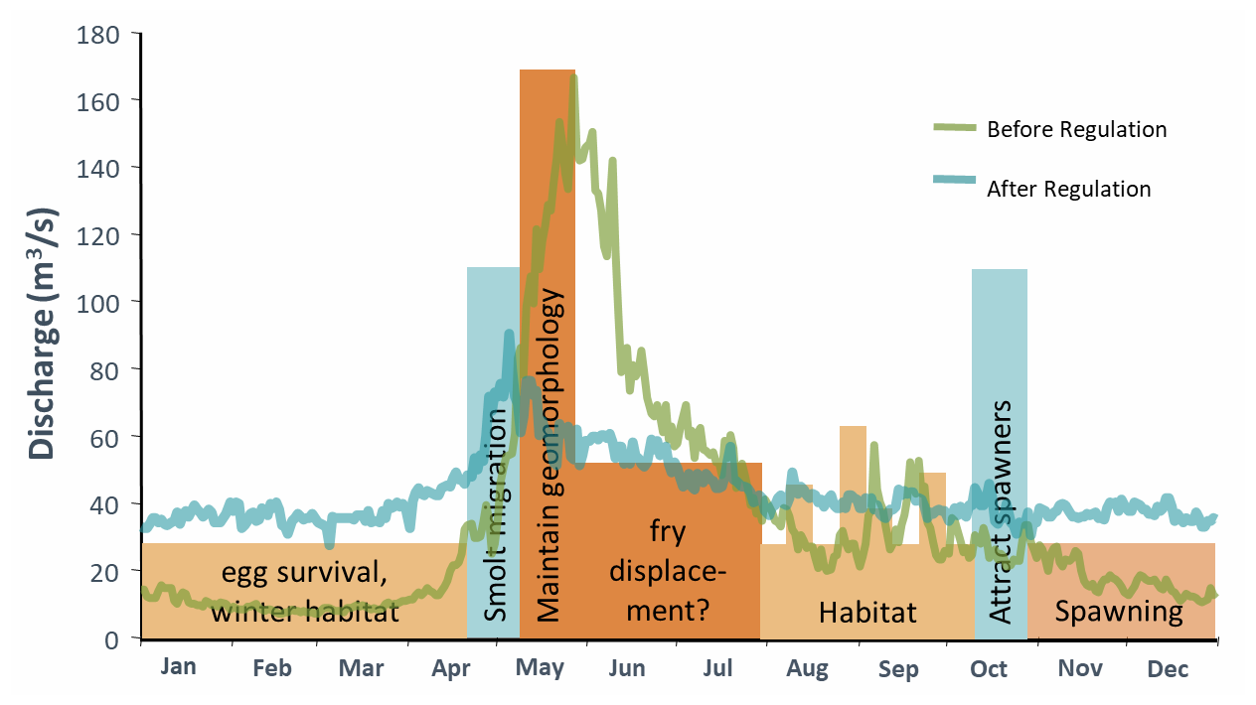
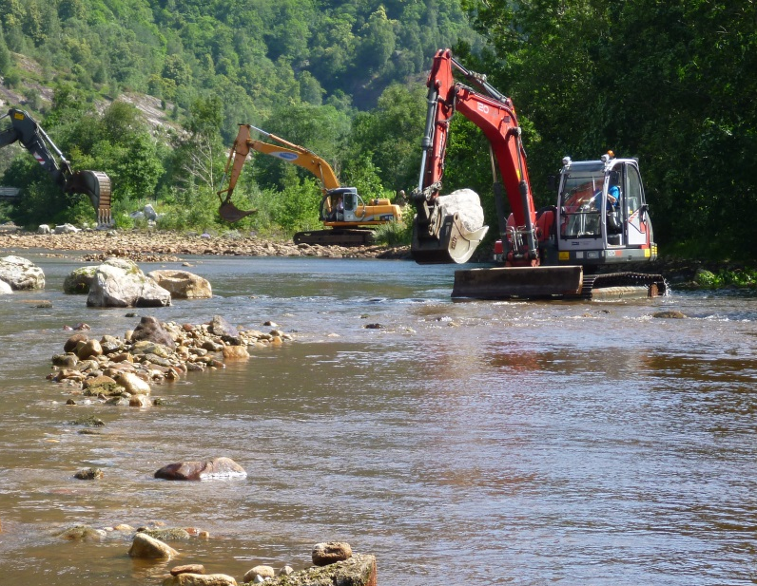
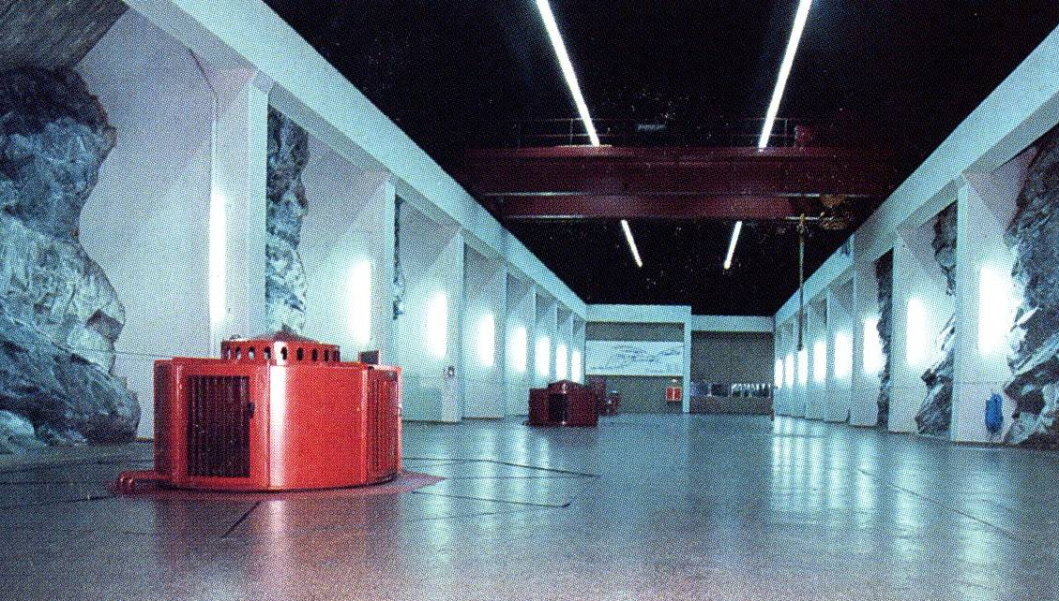

+
Wateruse
Habitat measures
+
=
Environmental design
Hydropower production

Slide 30



Slide 31
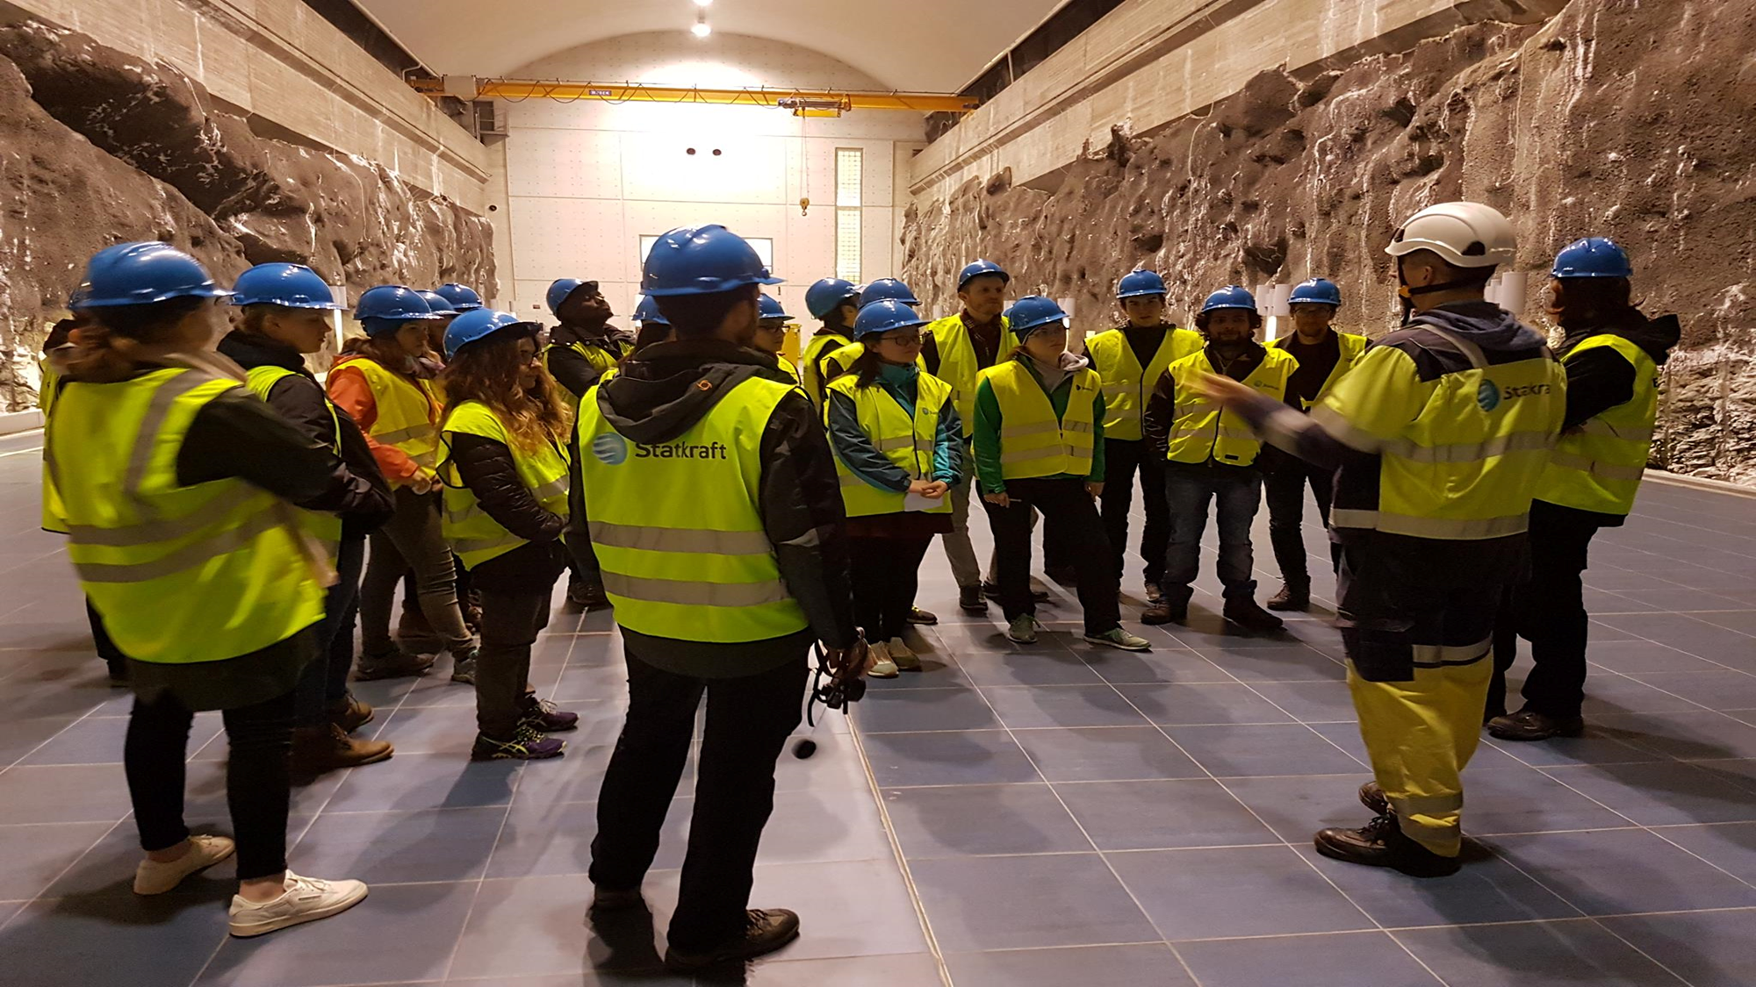
The HydroPower Development Program
HPD - program

Slide 32

About the HPD Program
Norwegian Agency for Development Cooperation
The HPD program has a history back to the 1970’s when NORAD started to purchase places from Norwegian Academic Institutions
Until 1993 this was a one year study
The HydroPower Development master program was formally initiated in 1994
The only program offering Hydropower education to this extend in the world

Slide 33

Amirul | Islam Khan | Bangladesh | Executive Engineer LGED, Gazipur, Bangladesh
Telila Buli | Assefa | Etiopia
Rajeev | Sachdeva | India | Engineer, NHPC Ltd
Weicheng | Jin | Kina
Hui | Wang | Kina
Krishna Prasad | Aryal | Nepal
Surendra Mananda | Bajracharya | Nepal | Senior Divisional Engineer. Dep. of Electricity Dev. (DOED), Ministry of Water Resources
Sahibzada Mian | Muhammad Qadir | Pakistan
Khan | Noor Qasim | Pakistan | Executive Officer, Water and Sanitation Services Company Pakistan
Chandana Janahanda de Silva | Ahangama Widanalage | Sri Lanka
Grace Meshack | Kidega | Tanzania
Elineema Nelson Kilyoma | Mkumbo | Tanzania
Frederick | Mukasa | Uganda | Ag. Manager Planning & Investments UETCL
Romas | Kamanga | Zambia | Senior Manager - Generation Support Services ZESCO

Slide 34
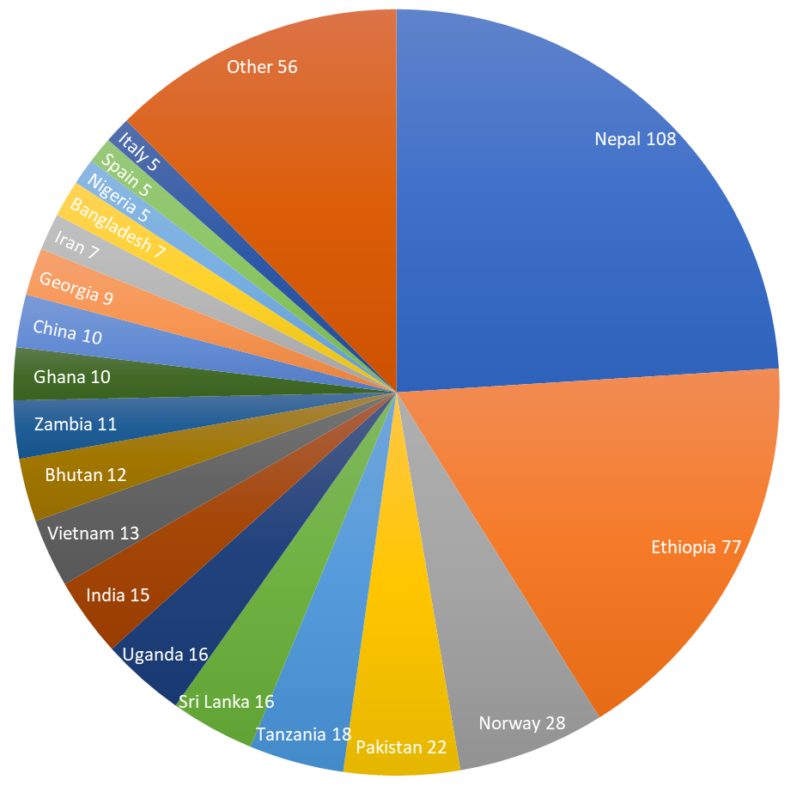


Where are the students from….
$$\sum_{k=1993}^{2023}{450}$$

Slide 35
Statistics – of 92 students since year 2000
60 – Returned to homeland 65%
16 – Student or Job in Norway 17%
16 – Other 17%

Slide 36
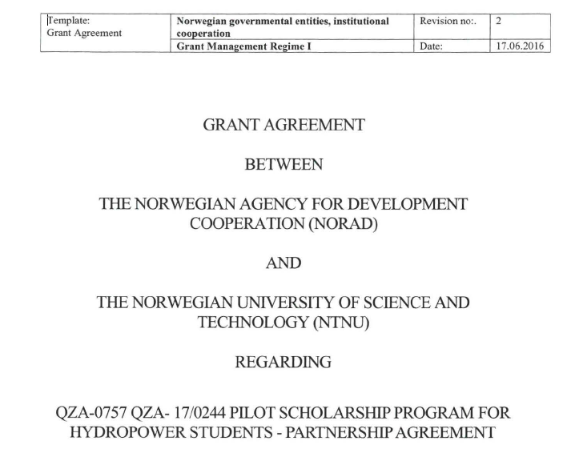











Slide 37



The hydropower development programme
Notes:
Hydrology
The hydrological cycle. Cimate. Hydrological processes, precipitation, infiltration, evaporation, groundwater and runoff. Theory for runoff generation. Water in saturated and unsaturated zone. Snowhydrology. Ice on lakes and in rivers. Measurement and calculation of hydrological processes. Numerical models. Floods. Urban hydrology. Hydrological prognosis. The course focuses on quantitative hydrology.
Planning and Design of Dams
Planning and design of dams in the context of hydropower development. The course covers the basics in dam engineering for civil engineers, including concrete and embankment dams, soil mechanics for dams and concrete technology for dams.
Hydraulic Design
The course covers the basics in hydraulics of open channel flow, hydraulic design of energy dissipation structures, spillways and outlets, turbines and surge tanks, hydraulic steel works and pipe hydraulics.
Engineering Geology and Tunnelling, Basic Course
The course is a basic level course taught in English. The course mainly covers material properties of rocks and rock mass; stress and groundwater in the rock mass; classification of rock mass, support and lining for tunnels and caverns; engineering geological investigation methods; design approach for tunnels, caverns and pressure shafts; rock slope stability; drill and blast tunnels: excavation method, blast design, time and cost estimation; TBM tunnels: excavation method, TBM performance, time and cost estimation.

Slide 38
The hydropower development programme
Semester | 7,5 stp | 7,5 stp | 7,5 stp | 7,5 stp
1st | Hydrology | Planning and Design of Dams | Hydraulic Design | Engineering Geology and Tunnelling, Basic Course
2nd | Engineering Geology of Rocks, Advanced Course | (Elective course) | Planning of Hydropower | Experts in Teamwork
 | TEP4200 Mechanical Design, Operation and Maintenance of Hydraulic Machinery
 | TVM4155 Numerical Models and Hydraulics
3rd | Prefeasibility Study in Hydropower Development | Hydrological Modelling | Water Recourses Management | Headworks and Sedimentation Engineering
4th | Master's thesis - Rock Engineering / Hydropower Development
Notes:
Hydrology
The hydrological cycle. Cimate. Hydrological processes, precipitation, infiltration, evaporation, groundwater and runoff. Theory for runoff generation. Water in saturated and unsaturated zone. Snowhydrology. Ice on lakes and in rivers. Measurement and calculation of hydrological processes. Numerical models. Floods. Urban hydrology. Hydrological prognosis. The course focuses on quantitative hydrology.
Planning and Design of Dams
Planning and design of dams in the context of hydropower development. The course covers the basics in dam engineering for civil engineers, including concrete and embankment dams, soil mechanics for dams and concrete technology for dams.
Hydraulic Design
The course covers the basics in hydraulics of open channel flow, hydraulic design of energy dissipation structures, spillways and outlets, turbines and surge tanks, hydraulic steel works and pipe hydraulics.
Engineering Geology and Tunnelling, Basic Course
The course is a basic level course taught in English. The course mainly covers material properties of rocks and rock mass; stress and groundwater in the rock mass; classification of rock mass, support and lining for tunnels and caverns; engineering geological investigation methods; design approach for tunnels, caverns and pressure shafts; rock slope stability; drill and blast tunnels: excavation method, blast design, time and cost estimation; TBM tunnels: excavation method, TBM performance, time and cost estimation.

Slide 39















The HPD Book Series

Slide 40
Challanges for future of the Hydropower Developement Program
Will there be new scholarships?
Who can afford the Tution fees ?
Will the Nowegian competency deminish?
Notes:
Då er spørsmålet om vi skuar eit soria moria i horisonten eller om vi ser ein hallusinasjon….

Slide 41











1 professor
10 PhD’s
100 masters

Slide 42



