Slide 1
Digital transformation of the process industry
Håvard Moe
Trondheim, 8 June 2021

Slide 2











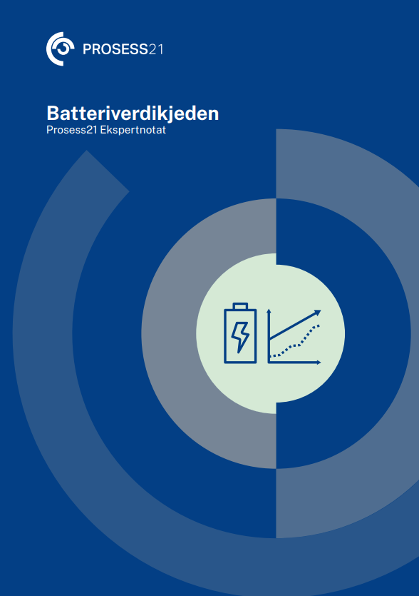
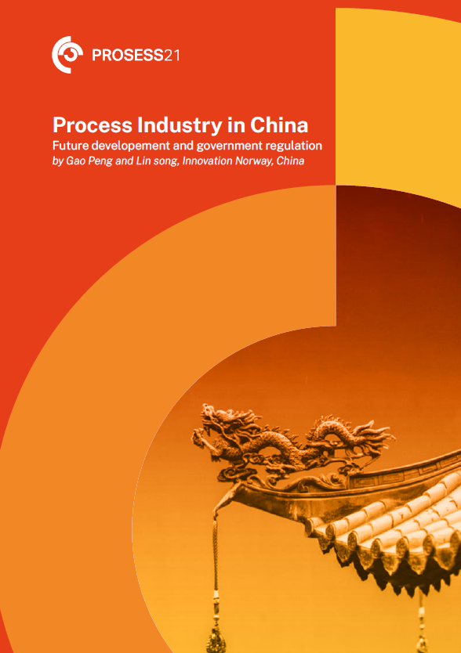




Process21 – Increased value creation with zero emissions
10 expert group reports
Contributions from industry and academia
More than 1200 persons from over 300 organizations has participated in meetings, workshops and webinars
and since 2018
Over 20.000 hours used by employees of private companies
Over 7.500 hours used by employees of universities, public offices and governmental bodies
Process21 Roadmap
4 reports on selected topics
Main report (in Norwegian)
Notes:
Process21 was established in 2018 by the Norwegian Ministry of Trade, Industry and Fisheries, wit the mandate to provide strategic advice and recommendations on how the Norwegian process industry can reduce emissions and at the same time achieve sustainable profitable growth

Slide 3

Process21 organisation
Ministry of Trade, Industry and Fisheries
Process21
Steering committee
Head of secretariat
Communication council
Secretariat
Research Council, Innovation Norway
Gassnova, Enova, Siva,
Norwegian Environmental Agency
Entrepreneurship
Biobased
Process industry
New Process technology
With lower carbon emissions
incl. CCU
Digitalization
Competence
Power &
Power market
Product and services
development
Circular
economy
Carbon Capture
Foreign investments
Supplier development
Notes:
The digital stream within Process21 serves the same mandate. The digital expert group has reviewed current digitalization status in the process industry in Norway, best practices locally and globally, and initiatives that will allow the Norwegian process industry to use digital as a driver for reduced emissions and growth

Slide 4
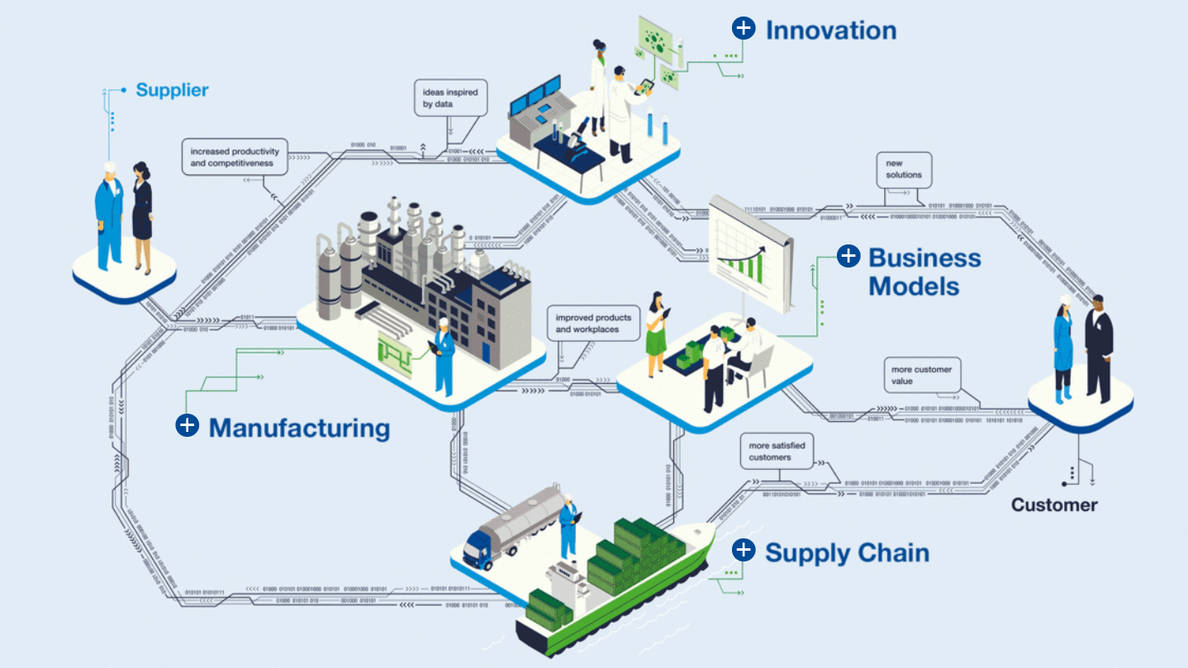
Compared with global frontrunners, the Norwegian process industry express less ambitious digitalization strategies
The global frontrunners have defined digital agendas that span their entire delivery system with defined benefit targets.
Typical benefit targets:
Substantial cost reductions
Improved customer loyalty and customer value
New business models across the value chain
Improved feedstock availability and price, including circular economy
Improved climate and environmental footprint
Source: https://www.basf.com/en/company/about-us/digitalization-at-basf.html
Notes:
Several good examples, but not expressed ambitions at the level of global frontrunners

Slide 5
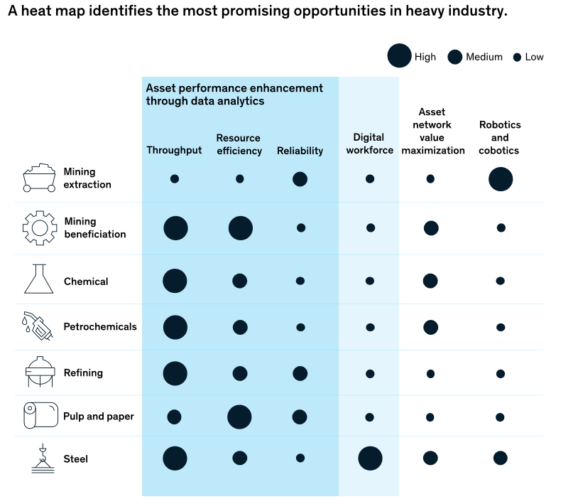
The Norwegian process industry is in a good position for rapid benefit realization within operations
Upstream Digital opportunities
Characteristics of the upstream industry
The business potentials are closely interlinked with the characteristics of the business:
Large capital intensive production facilities
Utilization of maximum plant production capacity (throughput)
Raw materials and energy represent a substantial part of the total cost base
Raw material yield
Energy efficiency
Manual operations
Maintenance
Decision / Operator support
Climate gas emissions from production
Energy and resource efficiency

Slide 6
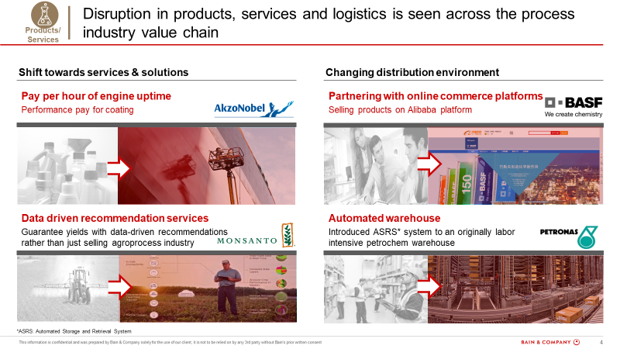
In average, the Norwegian process industry is behind global competitors in digital marketing, sales and services

Slide 7
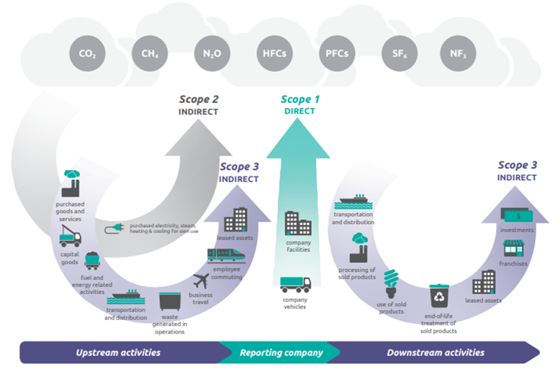
Carbon intensity / Product carbon footprint
How to deliver on future stakeholder requirements?
Mapping, reporting and improvement of product carbon footprint will not be possible without advanced digital solutions
Illustration: https://www.wri.org/initiatives/greenhouse-gas-protocol

Slide 8
Summary
Process21 has mobilized a digital expert group to map and review current digitalization status in the Norwegian process industry, best practices locally and globally, and initiatives that may allow the Norwegian process industry to use digital as a driver for reduced emissions and sustainable profitable growth.
There are several good examples in the Norwegian process industry of how the combination of digital tools and new work processes have enabled improved operations, especially related to improved raw material yields and energy efficiency.
In average, the Norwegian process industry is behind global competitors in digital marketing, sales and services.
Future stakeholder¹ requirements for mapping, reporting and improvement of product carbon footprint will not be possible without deployment of new digital tools.
To avoid being left behind, the Norwegian process industry should be inspired by global frontrunners and define digital strategies that span their entire delivery system with defined benefit targets.

Slide 9
Digital expert group

