Slide 1

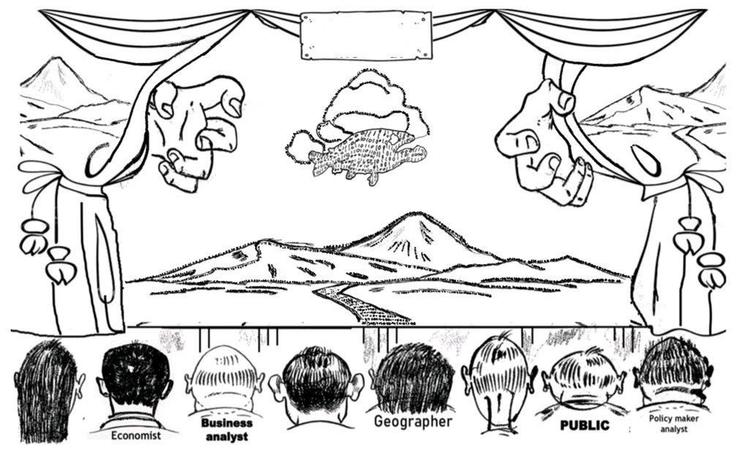
Dramatic
rehearsal
101010101
1101010
1001011010101101
10101010101
1101010010101010
10101101
10101010101
11010100
10010101010100101011010101101
101010101010
101010101
1010101
10100101101010
101010100100000001010
100001010101010101
10010111
10010110
10010191911010100101010
1001011010101101011101011101010101001001010101010101011010100010101
1001011010101101011101011101010101001001010101010101011010100010101
1001011010101101011101011101010101001001010101010101011010100010101
100101101010110101110101110101101010101100101001001010101010101011010100010101
10010110101011010111010111010101010010100101010101001010101010101010101010101011010100010101
1001011011100101101011101011101010101010101010101001010100101010101001010101010101010101010101011010100010101
100101101010101010101010101010101001010101010101010101010101011010100010101
10010110101011010111010101010100101010101001010101010101010101010101011010100010101
10010110101010101010101010101010100101010101010101010101010101010110101000101
1001011010101101010101010100101010101001010101010101010101010101011010100010101
1001011010101010101010101010101010010101010101010101010101010101011010100010101
10010110101010101010101001010101010101010101010101011010100010101
1001011010101010101010101010101010010101010101010101010101010101011010100010101
10010110101010101010101010101010100101010101010101011010100010101
100101101010101010101010101010101001010101010101010101010100010101
11001010
1010110
10011001010
1001111000
110
010
01110010
010
1010110
11010
111
110
10110
1001111000
11010
Biologist
Engineer
Philosopher
Notes:
Dramatic rehearsal (…)
The world is a stage
this stage is a dramatic rehearsal
of the present – of the past,
and an envision of a brave new world
We are humans
we are the imaginers
we anticipate through scenarios
scenarios are uncertain
beauty lies in the eye of the imaginer.

