Slide 1







Engaging in critical research within institutions - Gap between intentions and outcomes in research
Rohit Agarwal – UiT (PhD)
Judy Huang - UiS (PhD)
Mathias Venning - NORCE/UiB (PhD)
Aistė Klimašauskaitė – UiB (PostDoc)
Hafiz Wajahat Hassan – OsloMet (Phd)

Slide 2
Objective: what and why?
In this group exercise, we used a private group chat on Messenger and humor to explore and address intentions, outcomes, and potential solutions in doing research/being a researcher:
- The audience was following a live chat on the board.
- The chat was a mix of conversations and memes.
- We used memes as a central point of the chat among colleagues.
- The memes were used to humorously address the mismatch between our own intentions in doing research and the outcomes that we had little or no control.
- The end of the chat thematically was geared to share potential solutions.
Wrapping up: What the audience saw was a coping example. Ironically, it did not give a lesson to the people of how one creates a similar conversation space at work. Similarly, we show an example that happens among friends, meaning that the worries that people might have are not address with those who can help to impact change – the supervisor, the PI, the head of a department and similar.
Reactions from the school participants: (i) Joaquin mentioned that the live chat happen with the audience being in silence and it reminded him of the silence as this worrying part of doing PhD (in his case he lives far away from his university and therefore often feels isolated and stuck in silence); (ii) Anne suggested that it was touching to follow how the chat unfolds and that the humor, even though light, it delved into deep issues; (iii) Some people mentioned that they liked the format of presentation – a live chat.

Slide 3
Conversation: Rohit/Judy/Mats/Aiste (in order of appearance)
Rohit: Hi Guys. I just had an update meeting with my supervisors, and I don’t think I can complete my PhD in time 😭

Slide 4
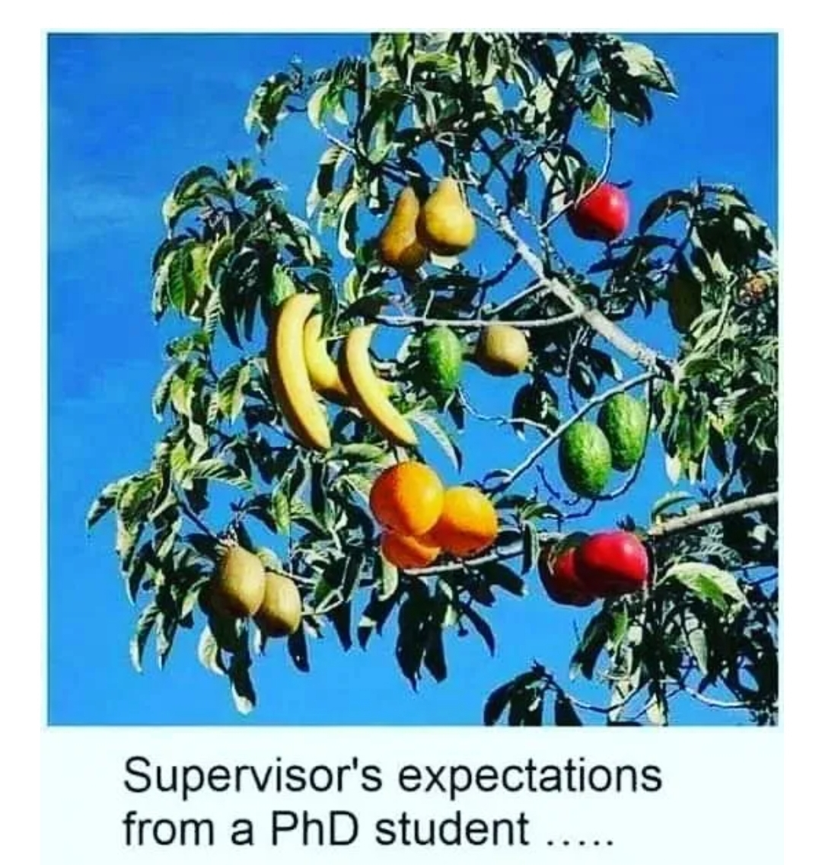
Judy: I feel you...

Slide 5
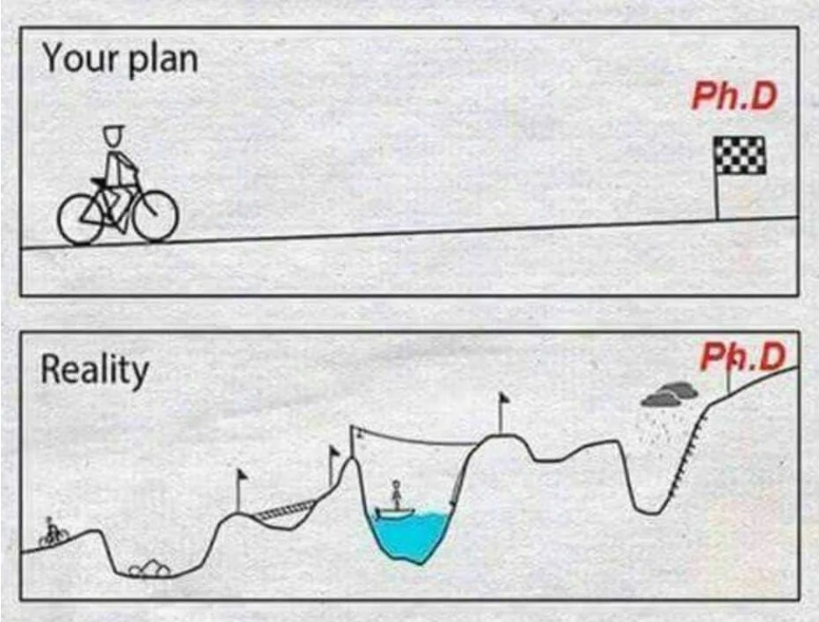
Mats: Yes, I was thinking about it today too. I found this, which made me laugh. I thought it would be such an easy ride!

Slide 6
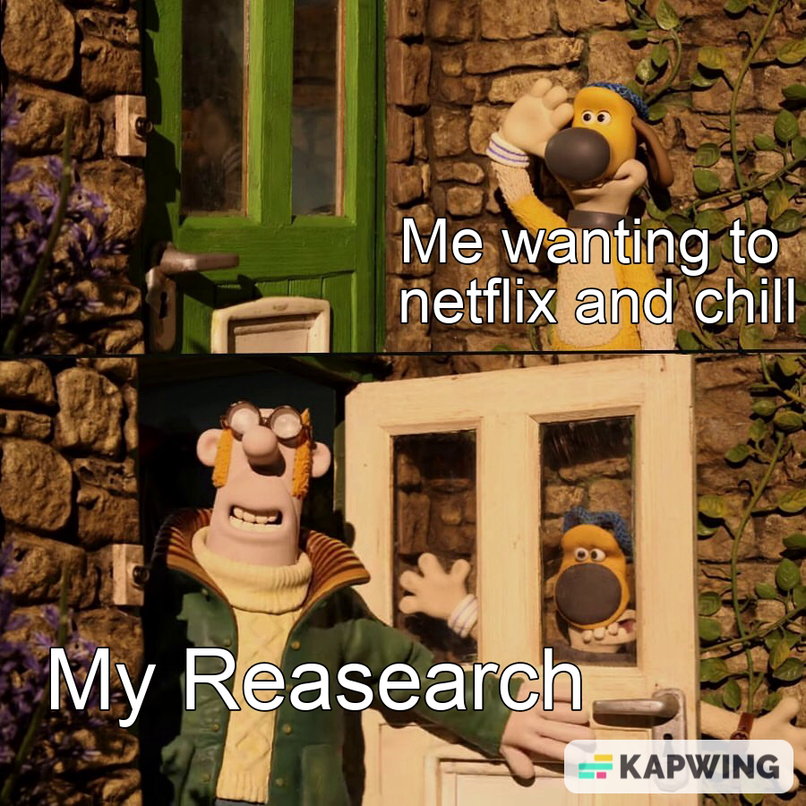
Aiste: So, it turns out doing a PhD is harder than we expected, you don’t say? ​But why?

Slide 7
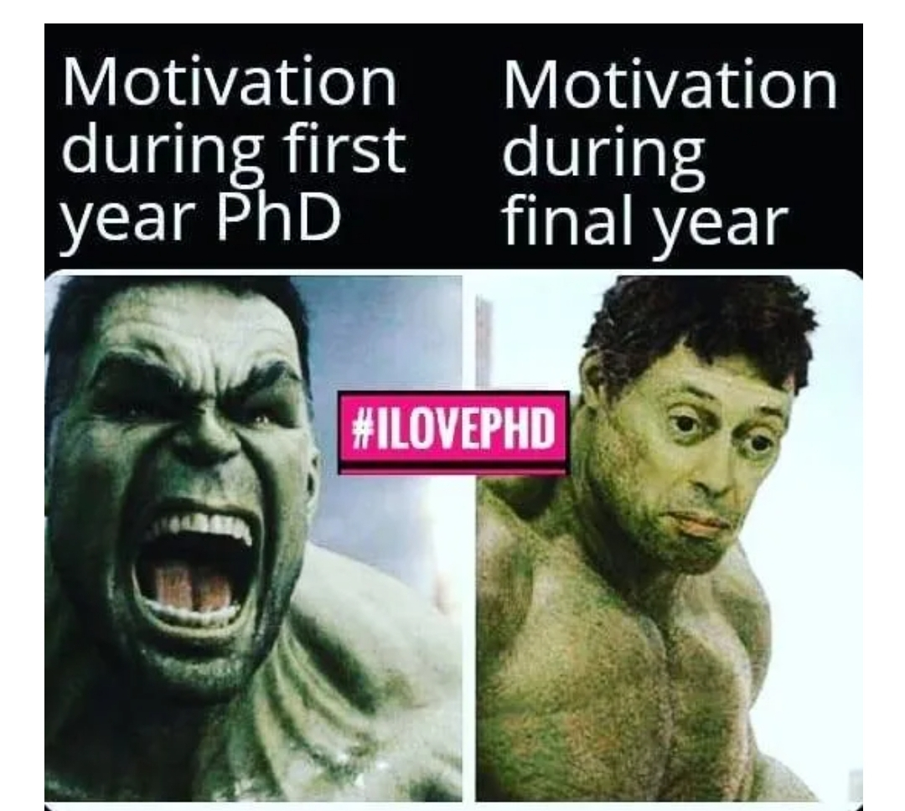
Rohit: For one thing, I feel like my motivation has gone way down
Mats: What's happened?

Slide 8
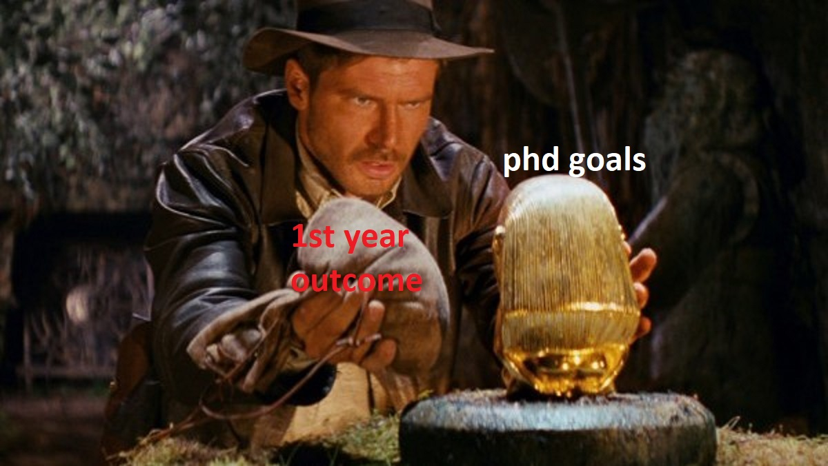
Rohit: I just feel like I've got nowhere near my proposal, that thing was so perfectly written.

Slide 9
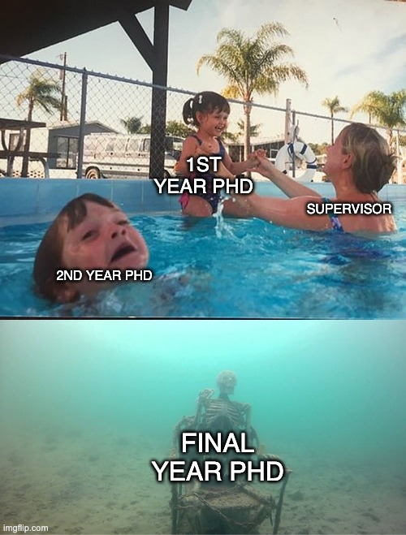
Aiste: I've been through all of this, brace yourselves.

Slide 10
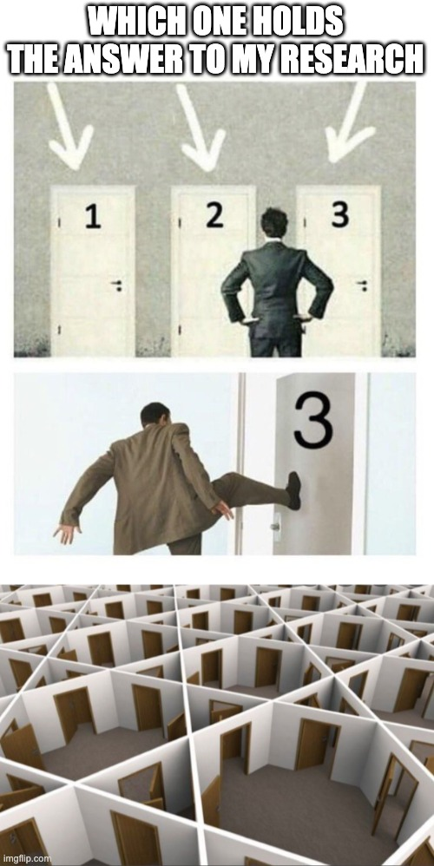
Judy: Don't worry, you're not the only one that feels lost! This sums me up perfectly

Slide 11
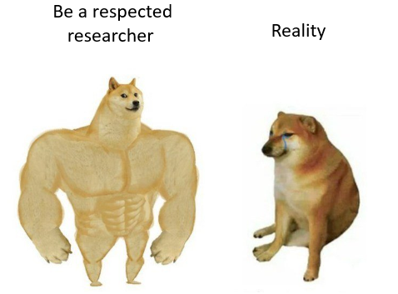
Mats: So why did we get into it in the first place? Are we idiots?
Rohit: I genuinely thought it would be a good career choice

Slide 12
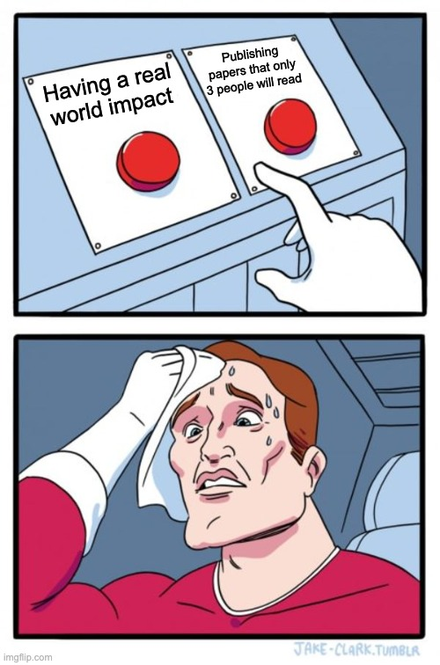
Judy: I wanted to have a real-world impact, but there's so much pressure on publishing articles!

Slide 13
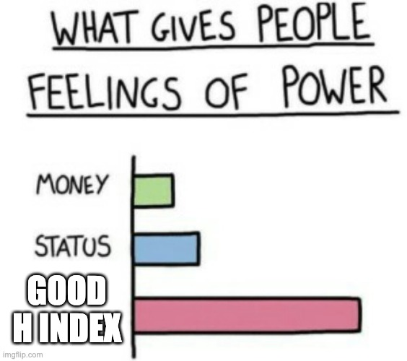
Aiste: This is what it is really all about:

Slide 14
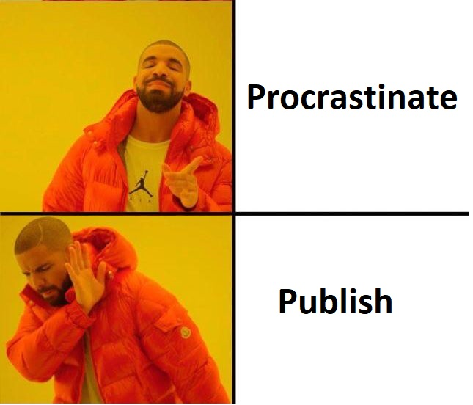
Mats: Don't even get me started on publishing!!

Slide 15
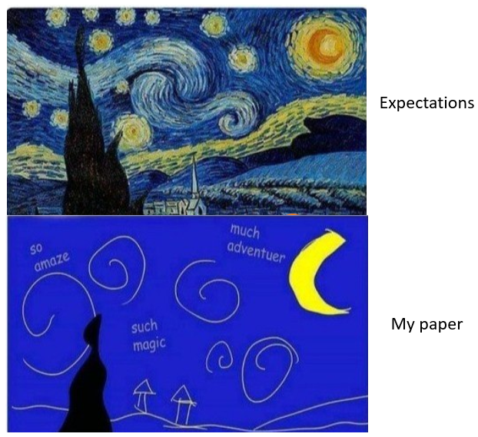
Rohit: Agree! There is too much pressure to publish at all costs regardless of impact!! I just don't feel like I have the time to do my research justice. Got me feeling like:

Slide 16
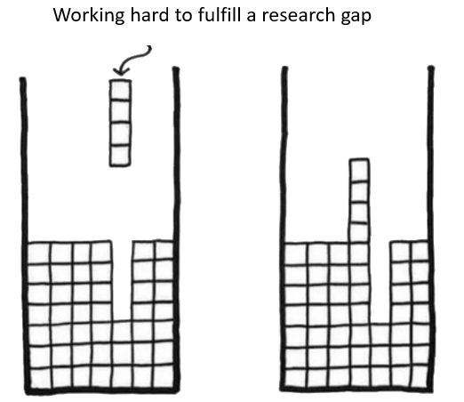
Aiste: Nothing ever turns out as expected

Slide 17
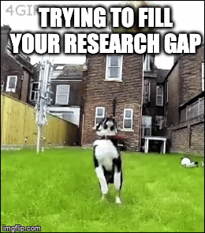
Judy:

Slide 18
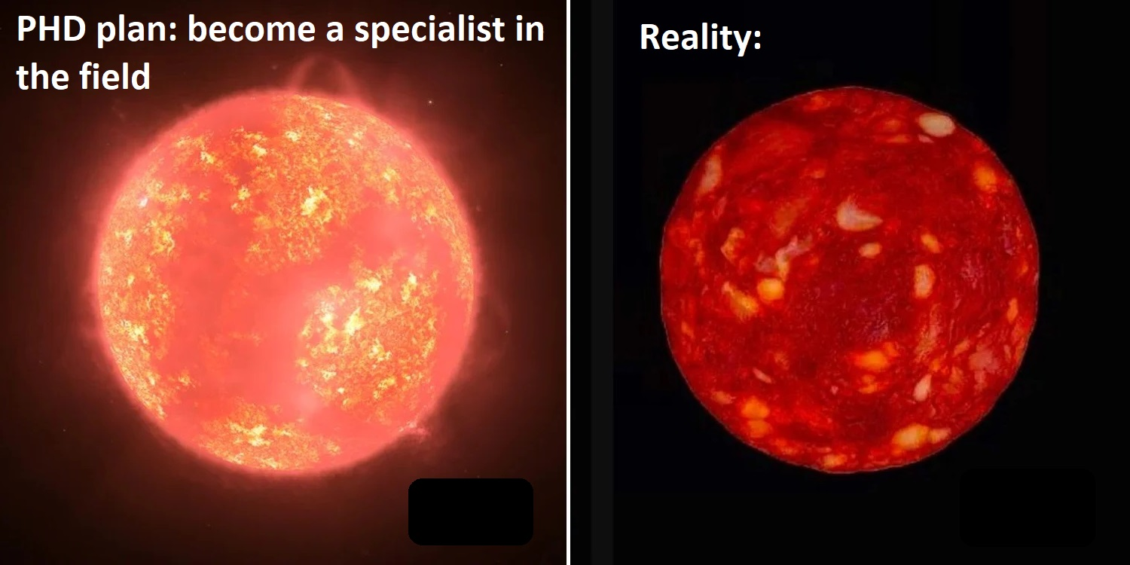
Mats: I'm so far from achieving that. Even though I'm meant to be an expert

Slide 19
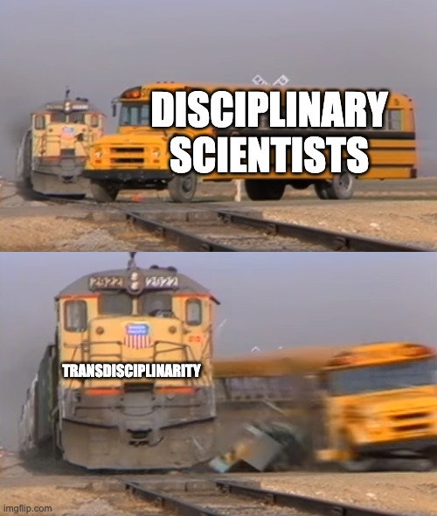
Rohit: You can't even be an expert in just one field these days...

Slide 20
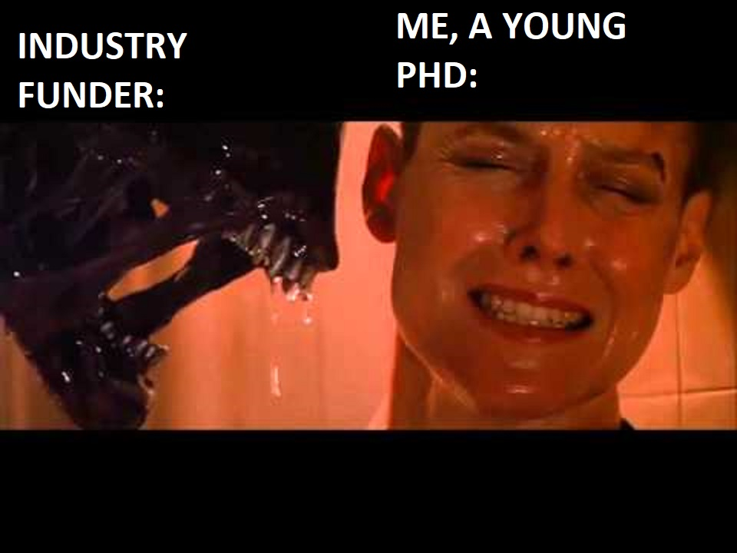
Judy: It is all about transdisciplinary now. With great industry funding, comes a great many different objectives

Slide 21
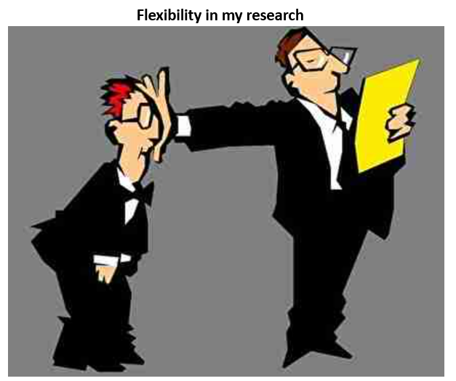
Aiste: Yeah, but the department can still be stuck in their ways. They always want you to specialize.

Slide 22
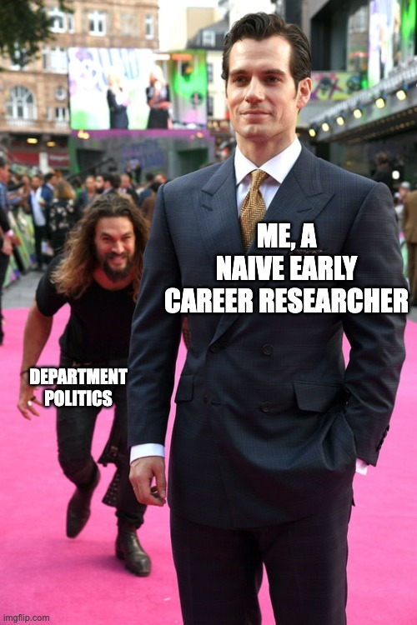
Mats: Dealing with the department can be the hardest thing

Slide 23
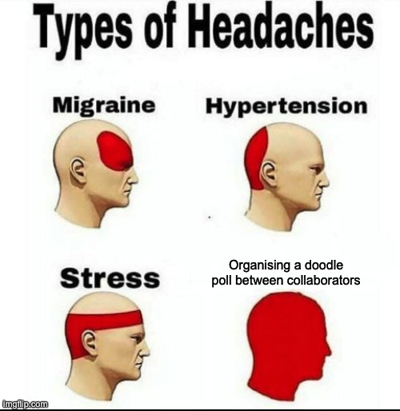
Judy: Not just the department, but the people I work with

Slide 24
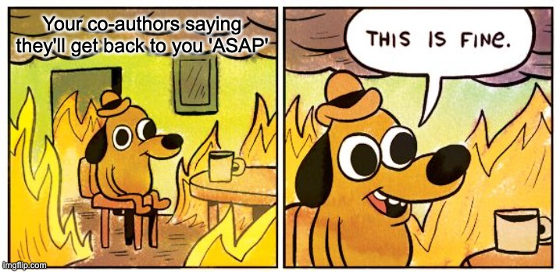
Rohit: And co-authors!

Slide 25
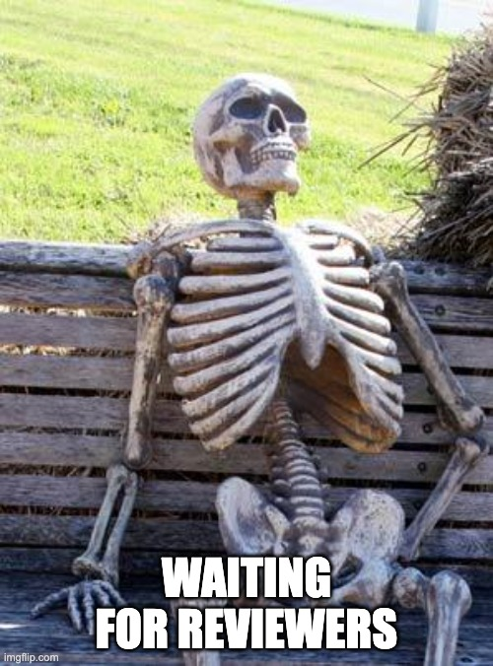
Aiste: And reviewers!

Slide 26
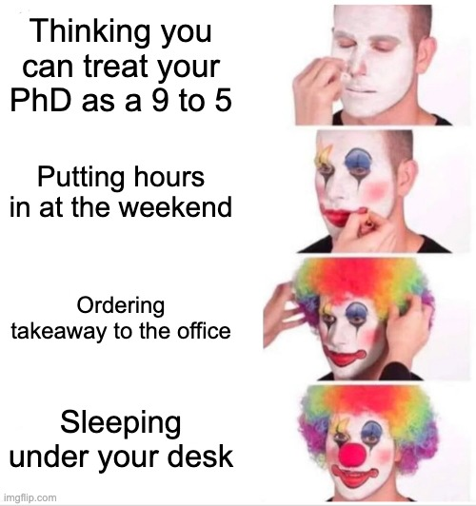
Mats: It's never ending. There's not enough hours in the day

Slide 27
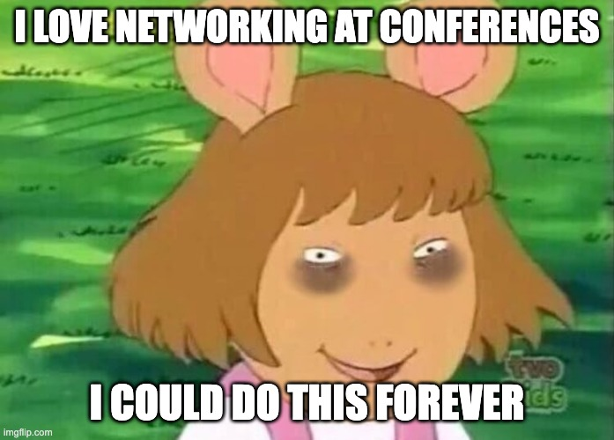
Judy: You think you're tired? I've just got back from 3 days at the AFINO school. Then, I am going to another conference in Pisa...

Slide 28
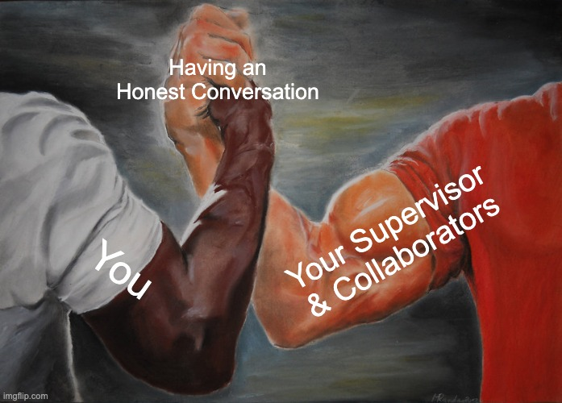
Rohit: So, we know about all these problems. What about any solutions?
Judy: For me, I always feel better after having made my expectations clear with the people I'm working with.

Slide 29
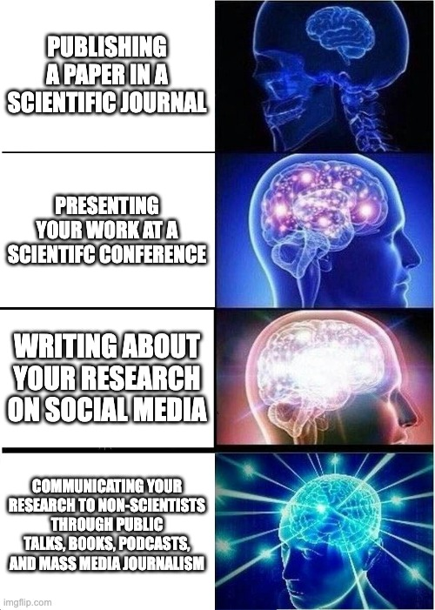
Aiste: For me, the thing that makes it all worth it is ensuring I link my research to the real world

Slide 30
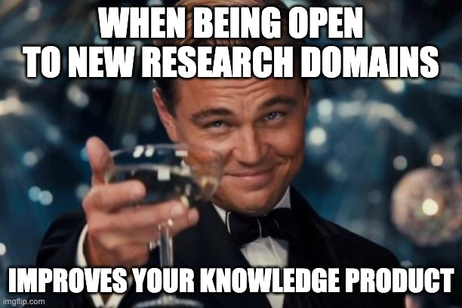
Mats: And we're the next generation of researchers. I guess we should be open to new ways of thinking

Slide 31
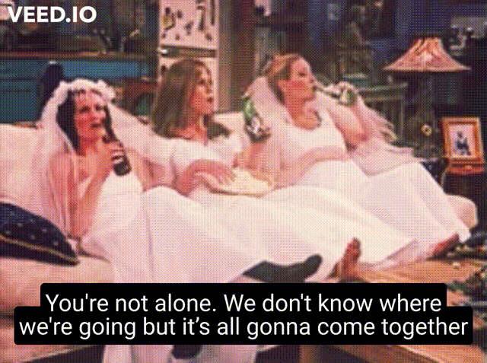
Rohit: PhD is long. Just trust the process.

Slide 32
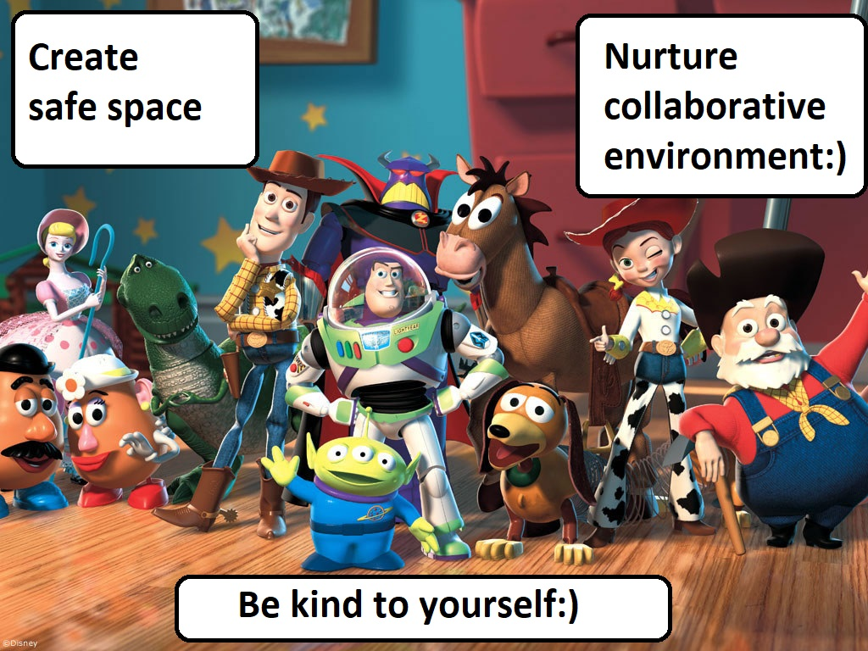
Aiste: This conversation really helped me; you are my team!

Slide 33
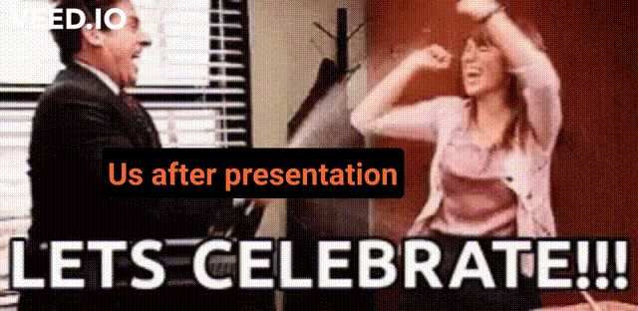
Judy:

Slide 34


