Slide 1
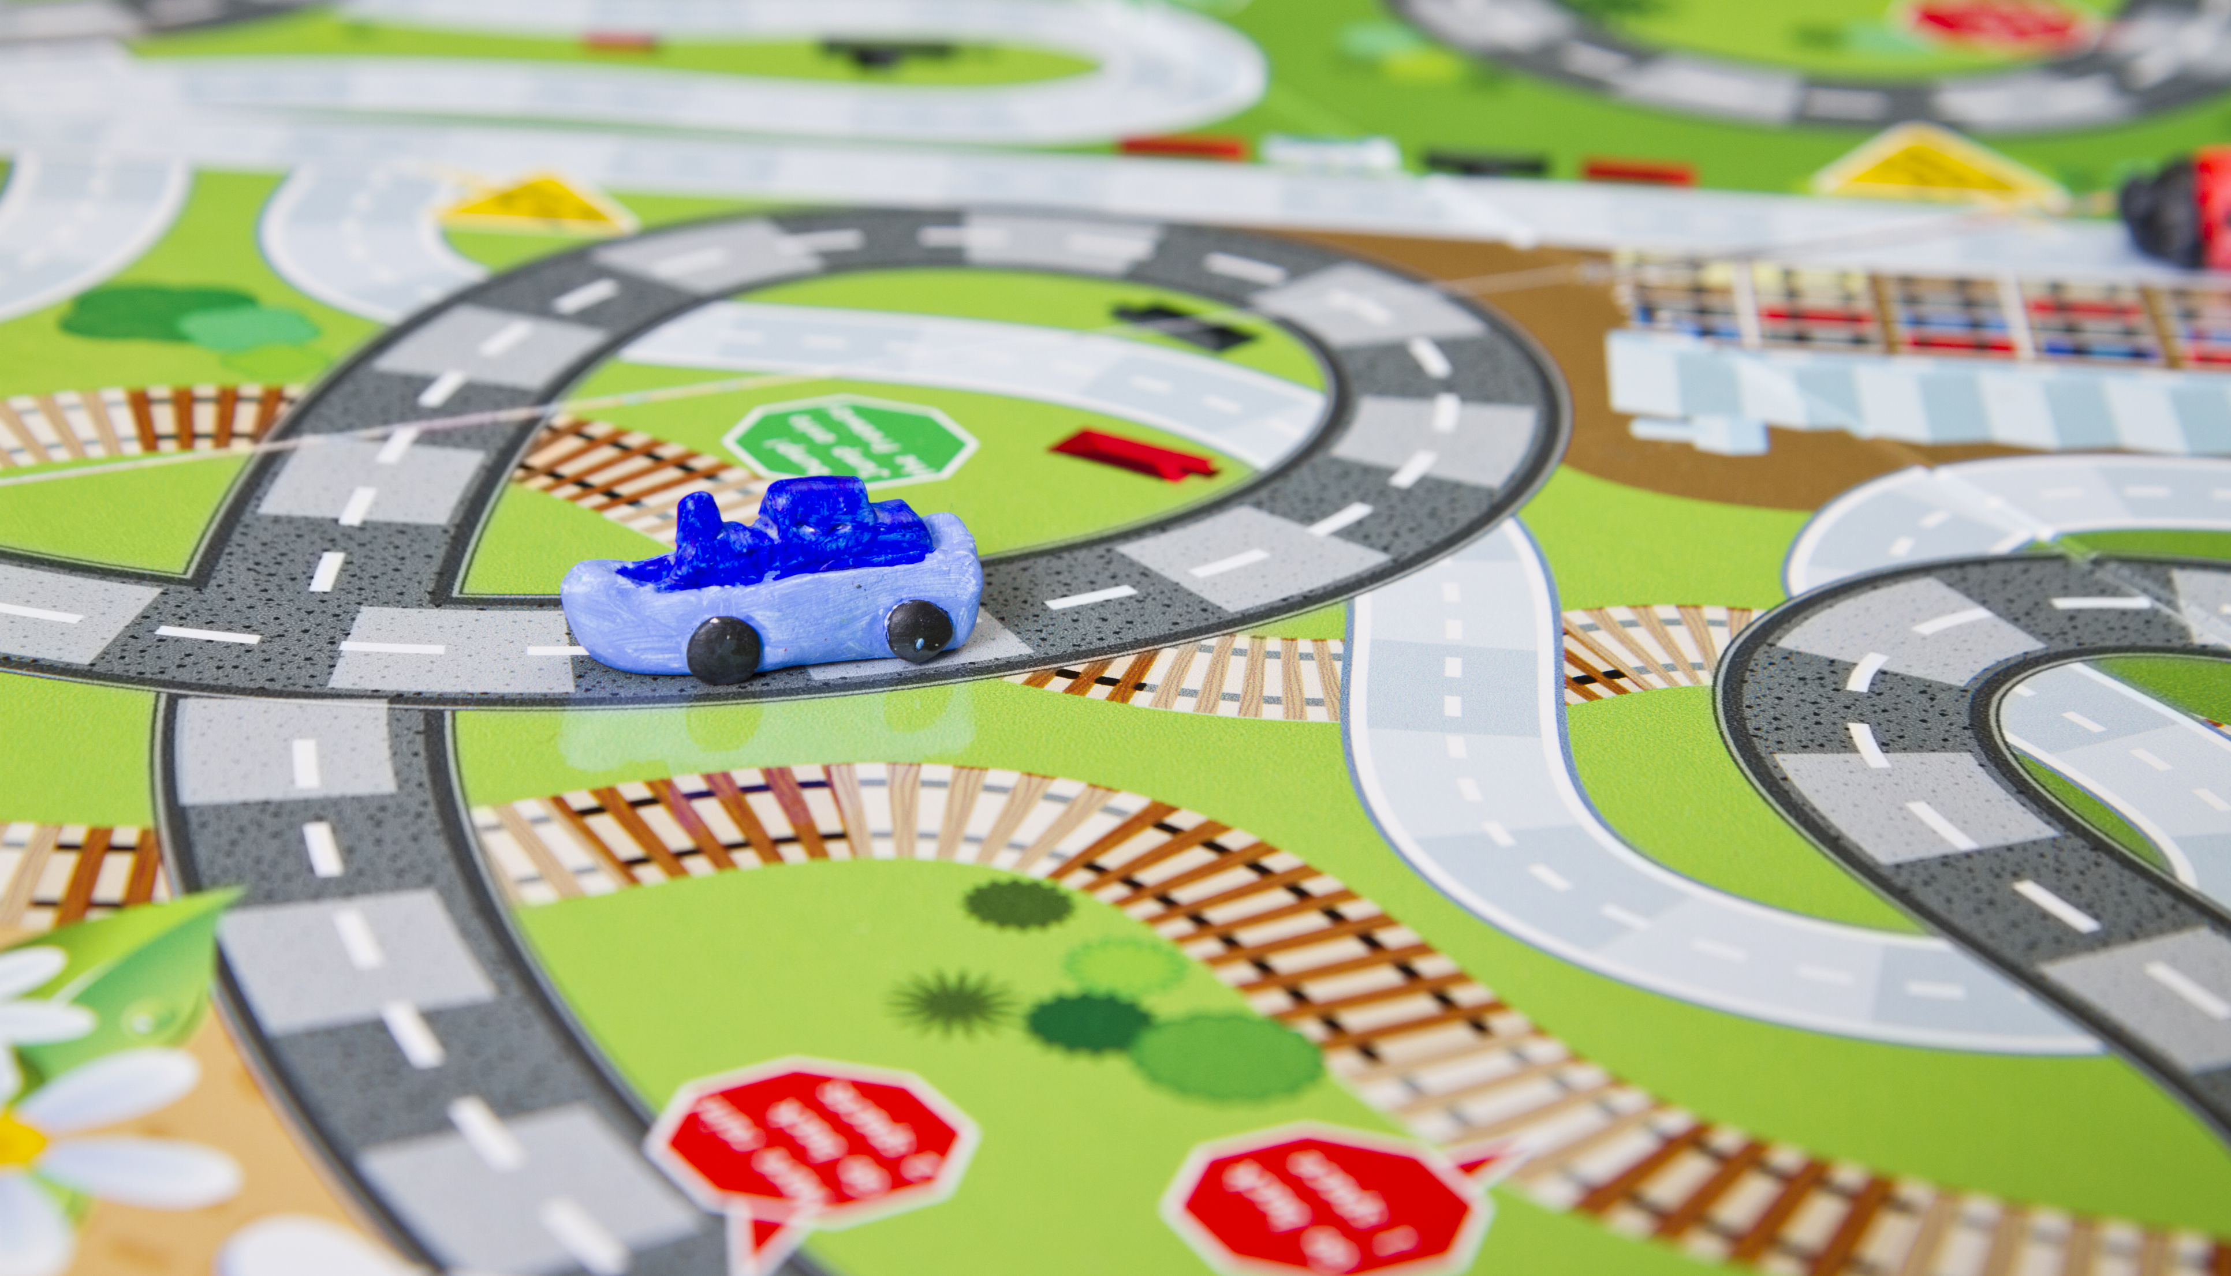




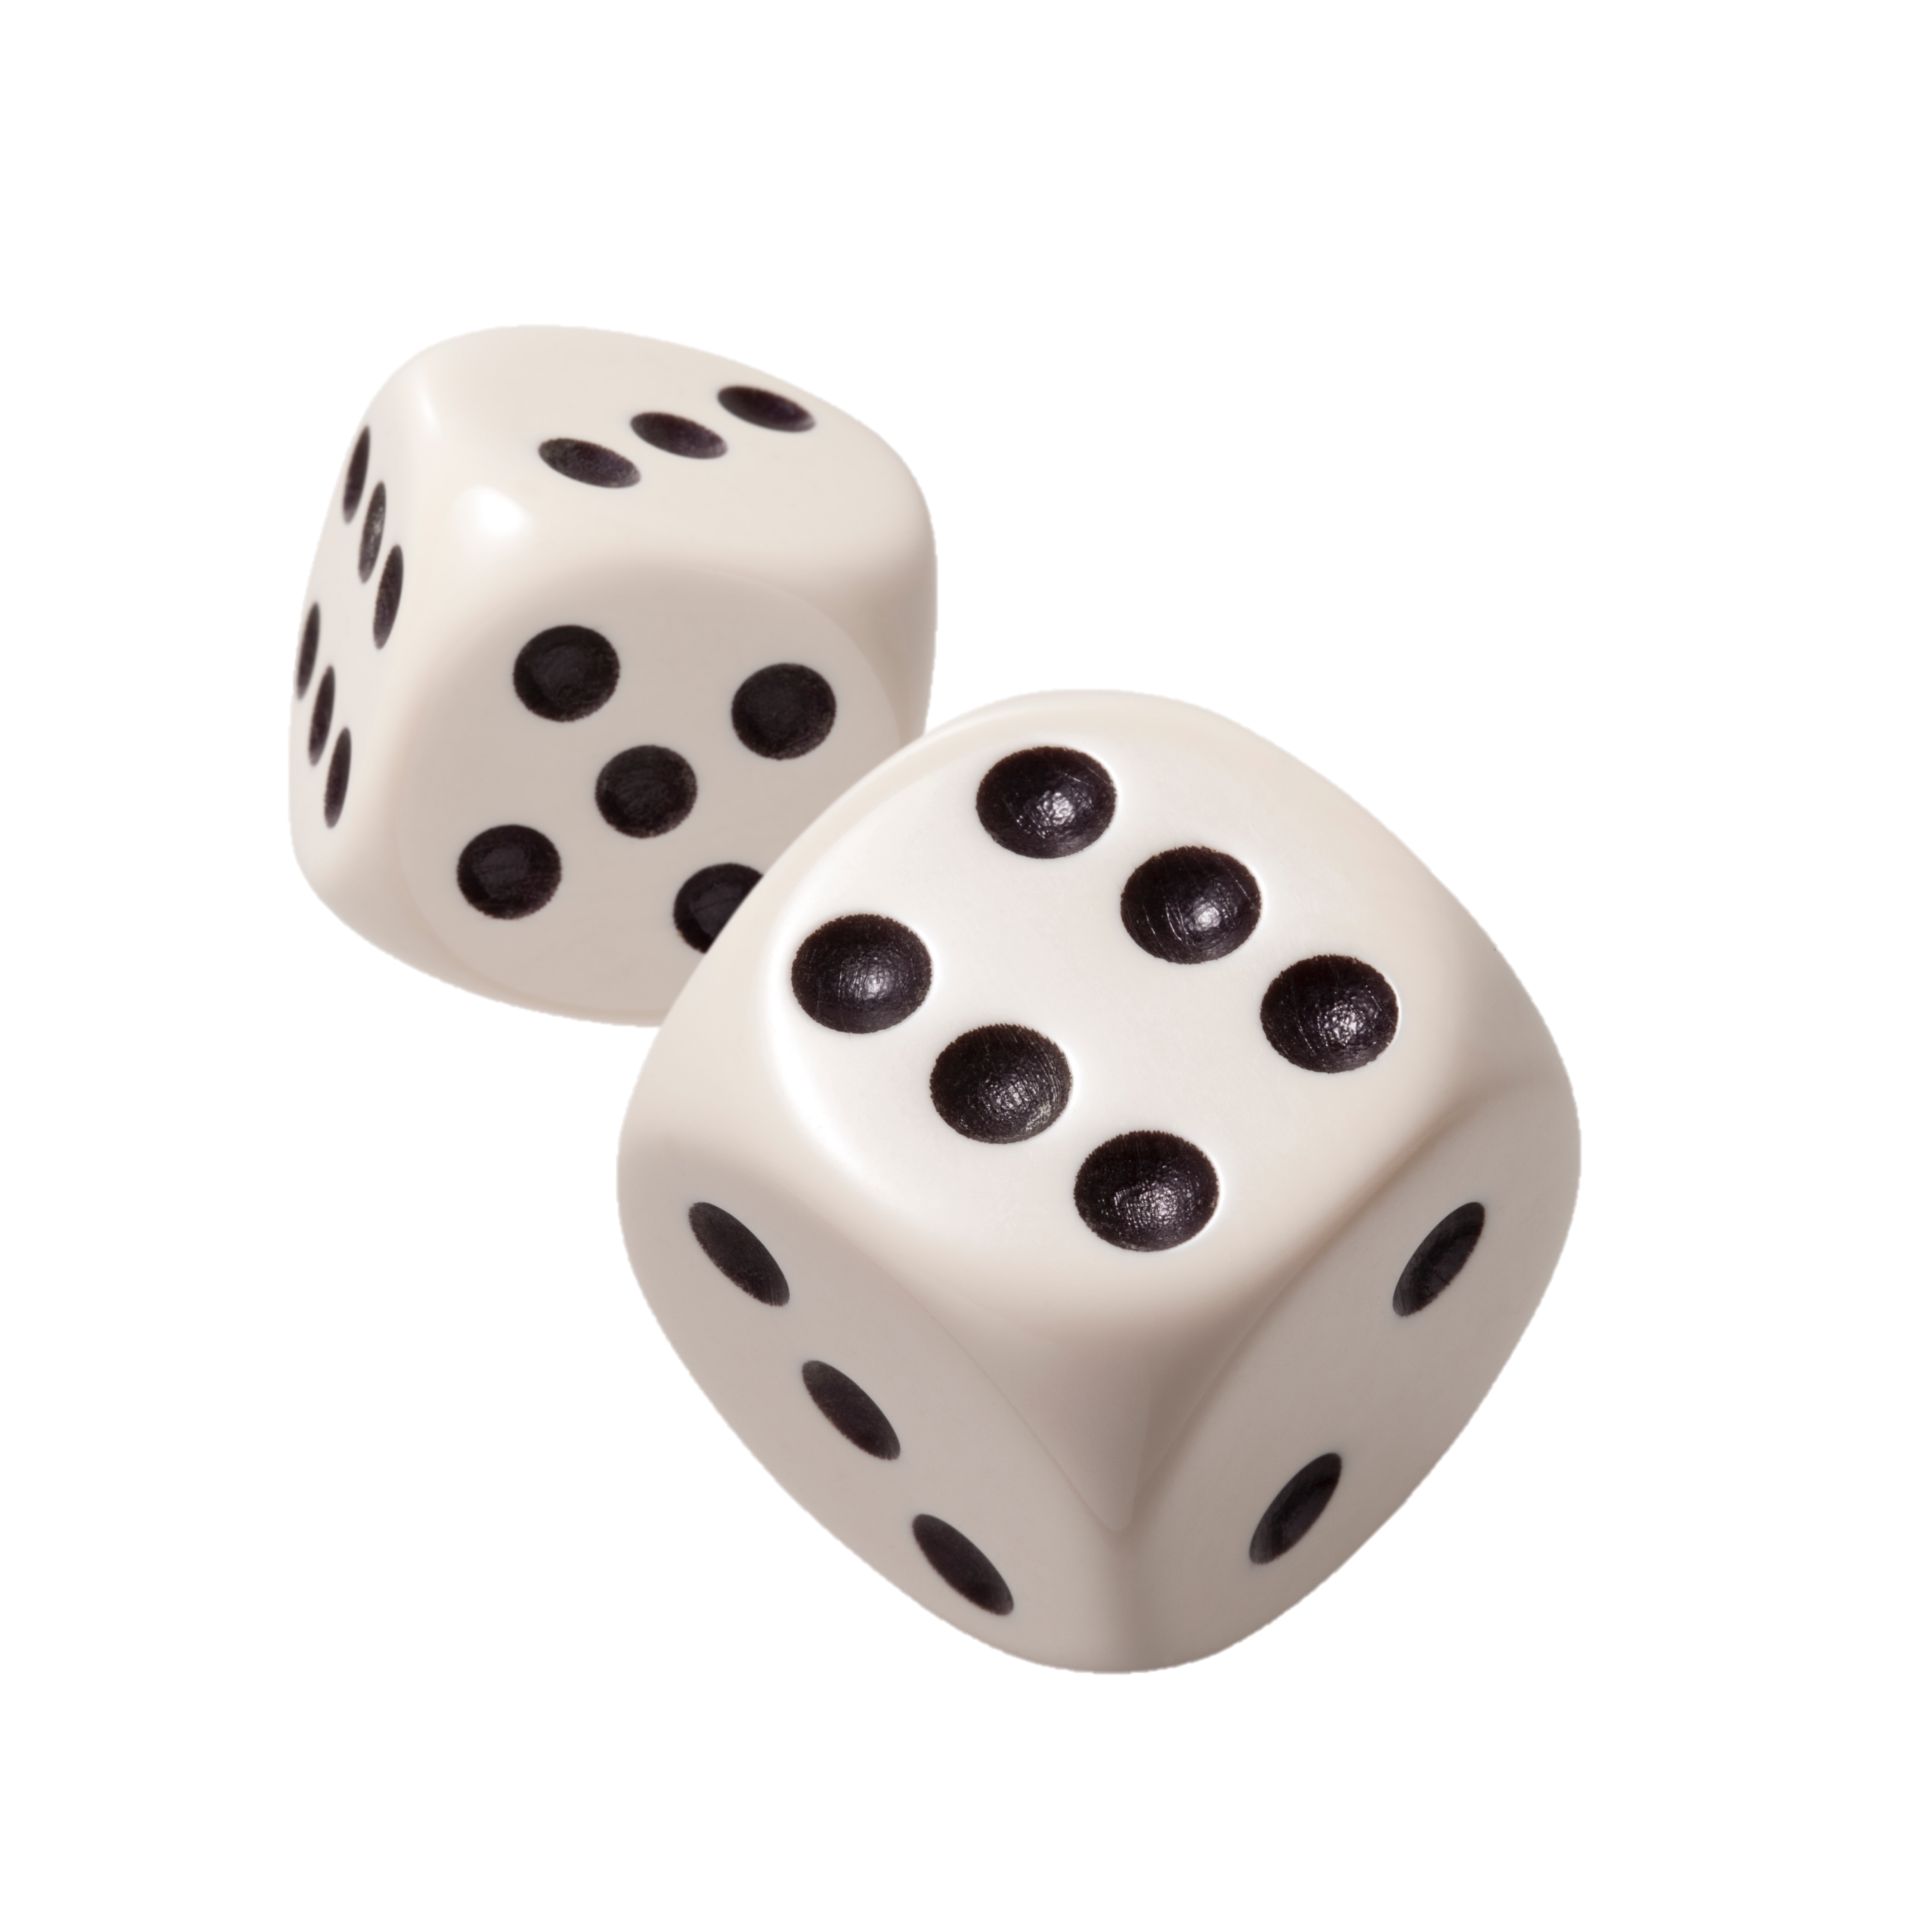

Challenge of RRI implementation
AfINO/DLN Summer School

Slide 2
We Dream Loud
We Inspire Change
We Team without Limit
We are Force of Good
We Choose Excitement
* We followed this quotes during the session.

Slide 3
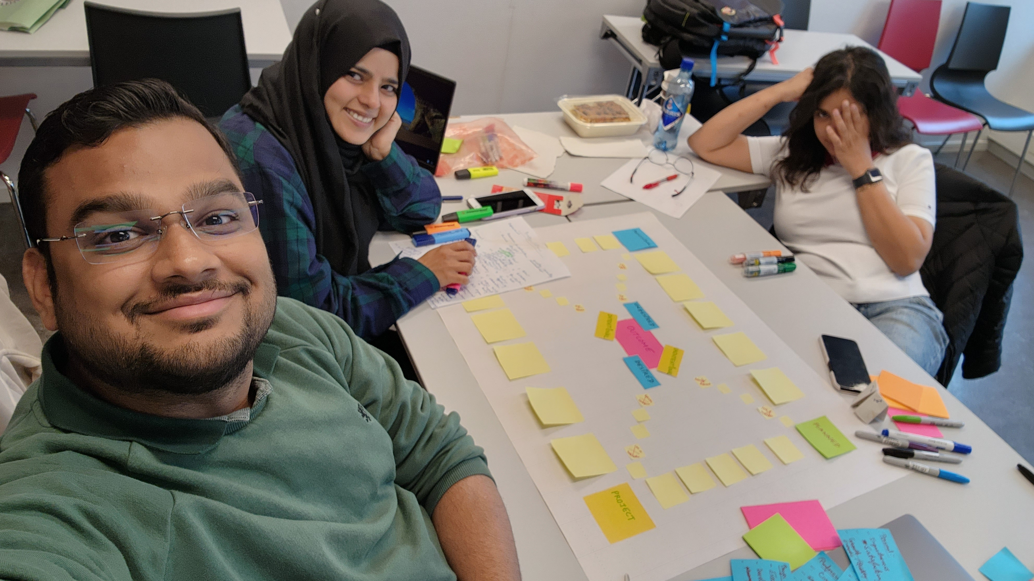
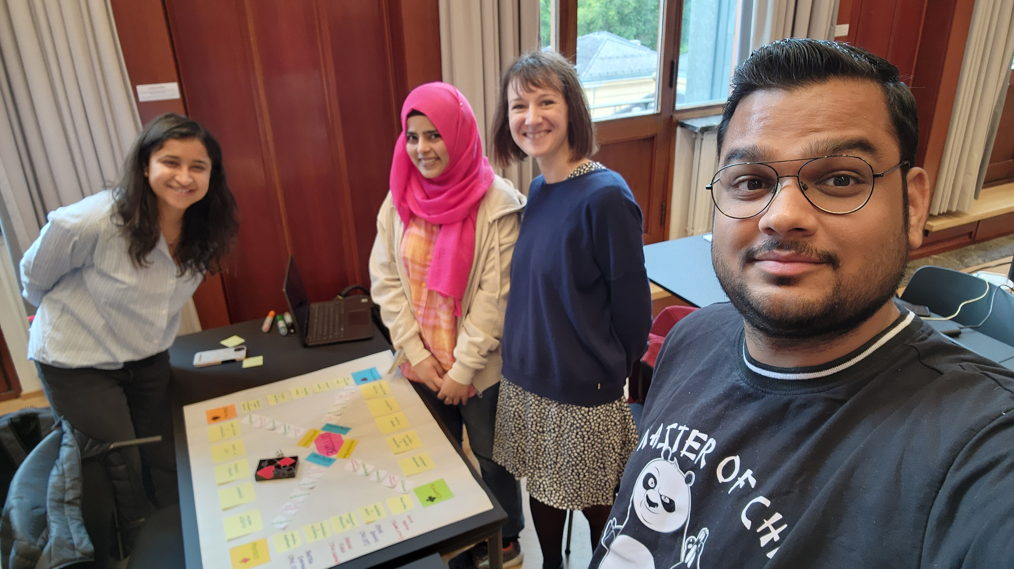
Introduction
Lot of work coming forth.
Laugh and entertain yourself as we follow through the struggle of controlling ourself not to go with the flow.
The game is made by few PhD Nerds, so don’t worry if you feel it too complex.
We shall make the rules, as the game proceeds. So, beware to be caught in the trap.
Life is never easy, so shall be the Game.

Slide 4
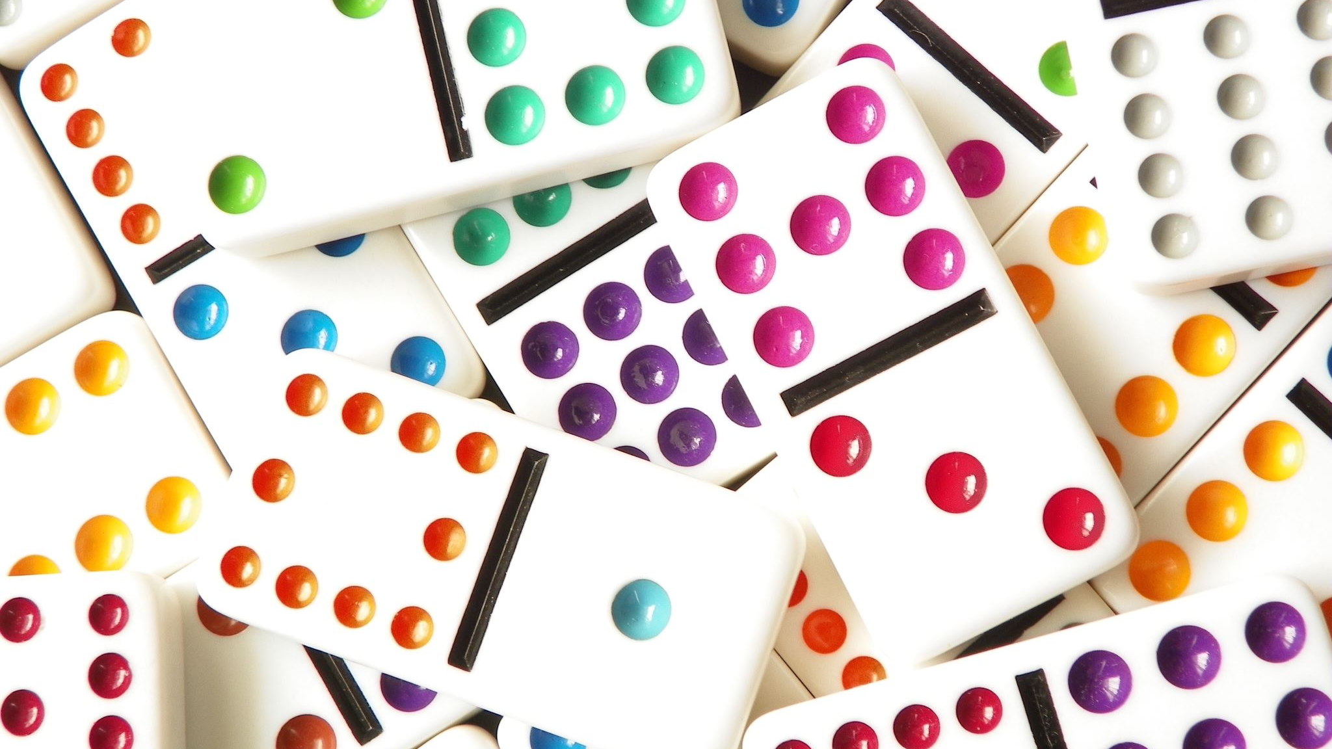
The Dicey Do
We Present

Slide 5
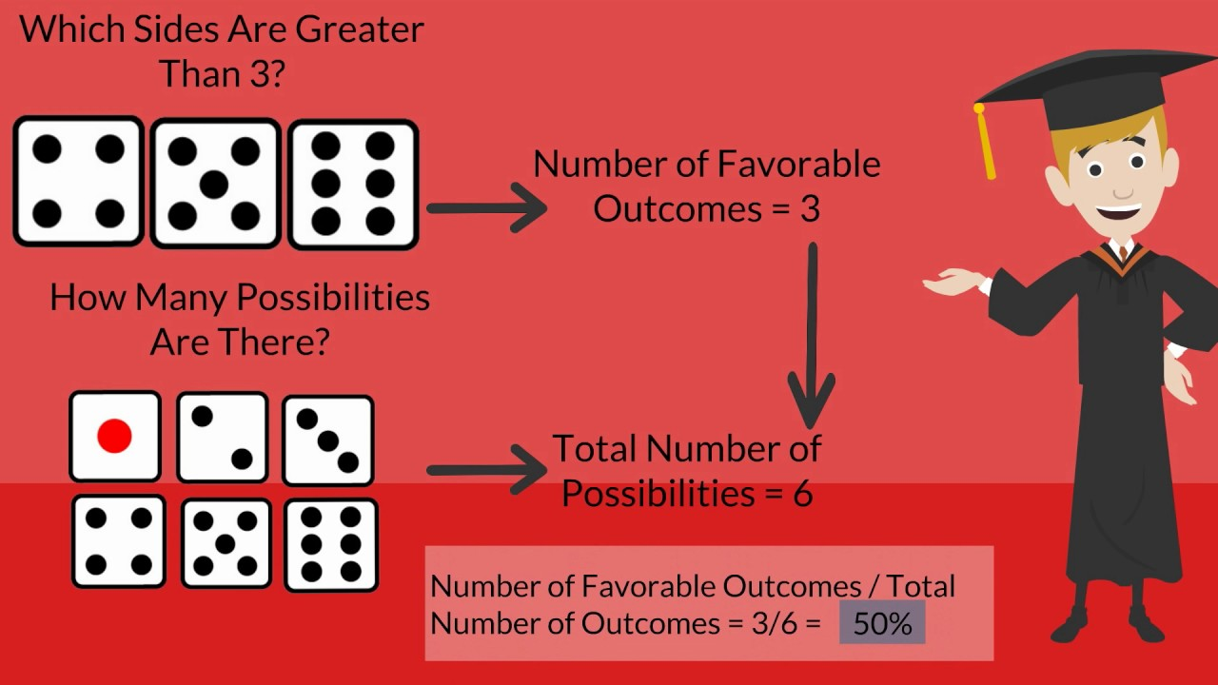
Why: The Dicey DO?
This is used as a Metaphor for LIKELYHOOD OF PRODUCTIVITY:
As we do not know how each day will unfold.
Regardless of the intention to excel, not every day is equally fruitful.
We determine the most productive day to be a six of the dice roll.
And, the very unproductive / unproductive day will be a roll of one in the dice.
The toss of the dice shows the likelihood that a period will go well or poorly.
This Photo by Unknown Author is licensed under CC BY-SA

Slide 6

Knowing the Rules
Free to interpret the board, as we have different outlook towards Life
The outcome of the game has no serious implications on your real life. However, it might allow you reflect on the Intention vs effort in daily life.
Engage in this fun game made to challenge monopoly in a day’s Time. ☺

Slide 7
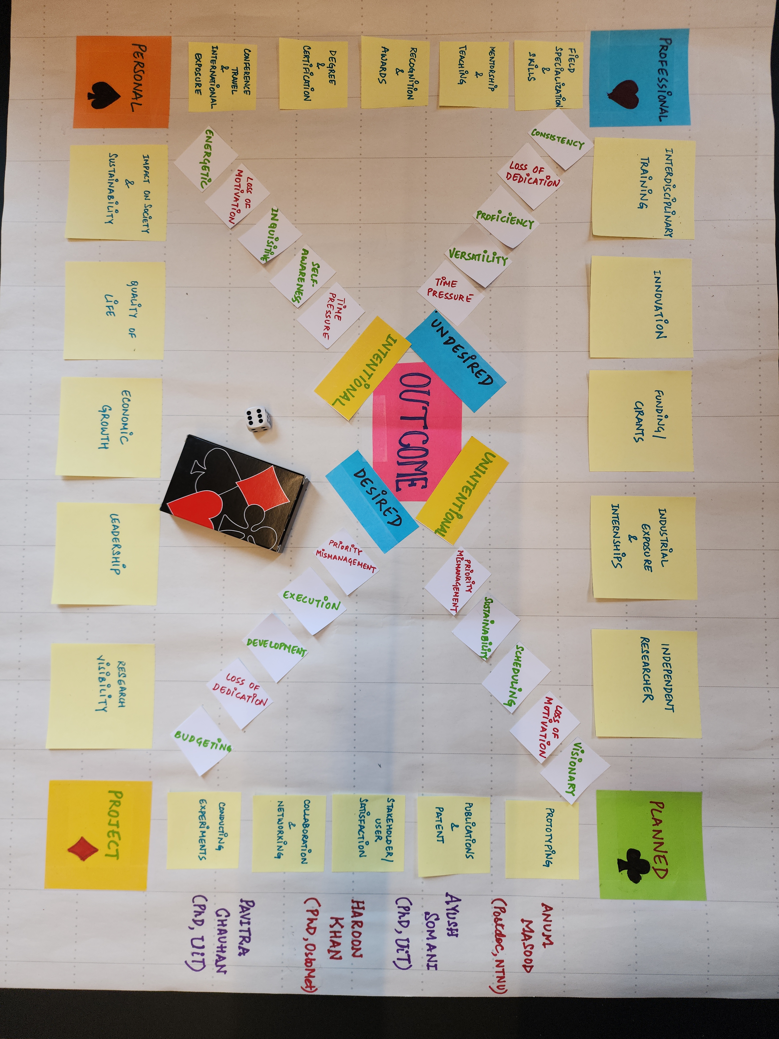

Slide 8
Summary
We commonly as researcher should reflect not only the productivity of professional work but to get an overall betterment of self-being and society in whole.

Slide 9

Photo Gallery
It was fun to be part of this session.

Slide 10
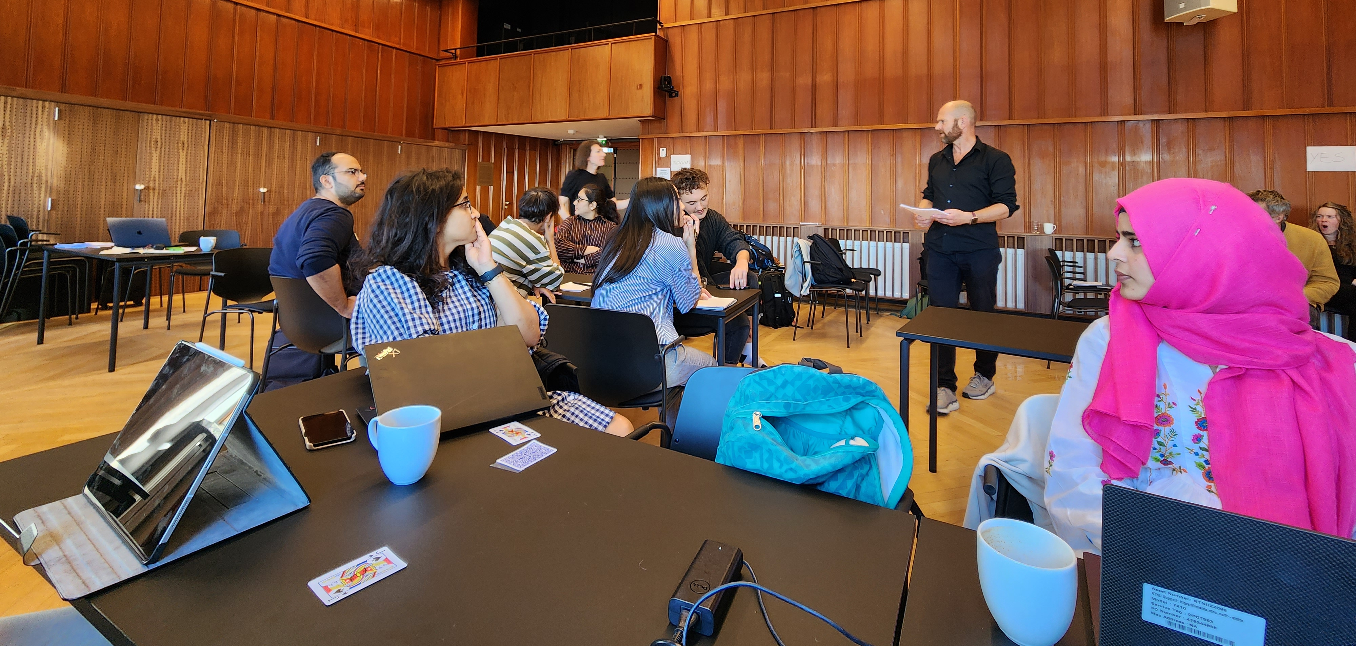
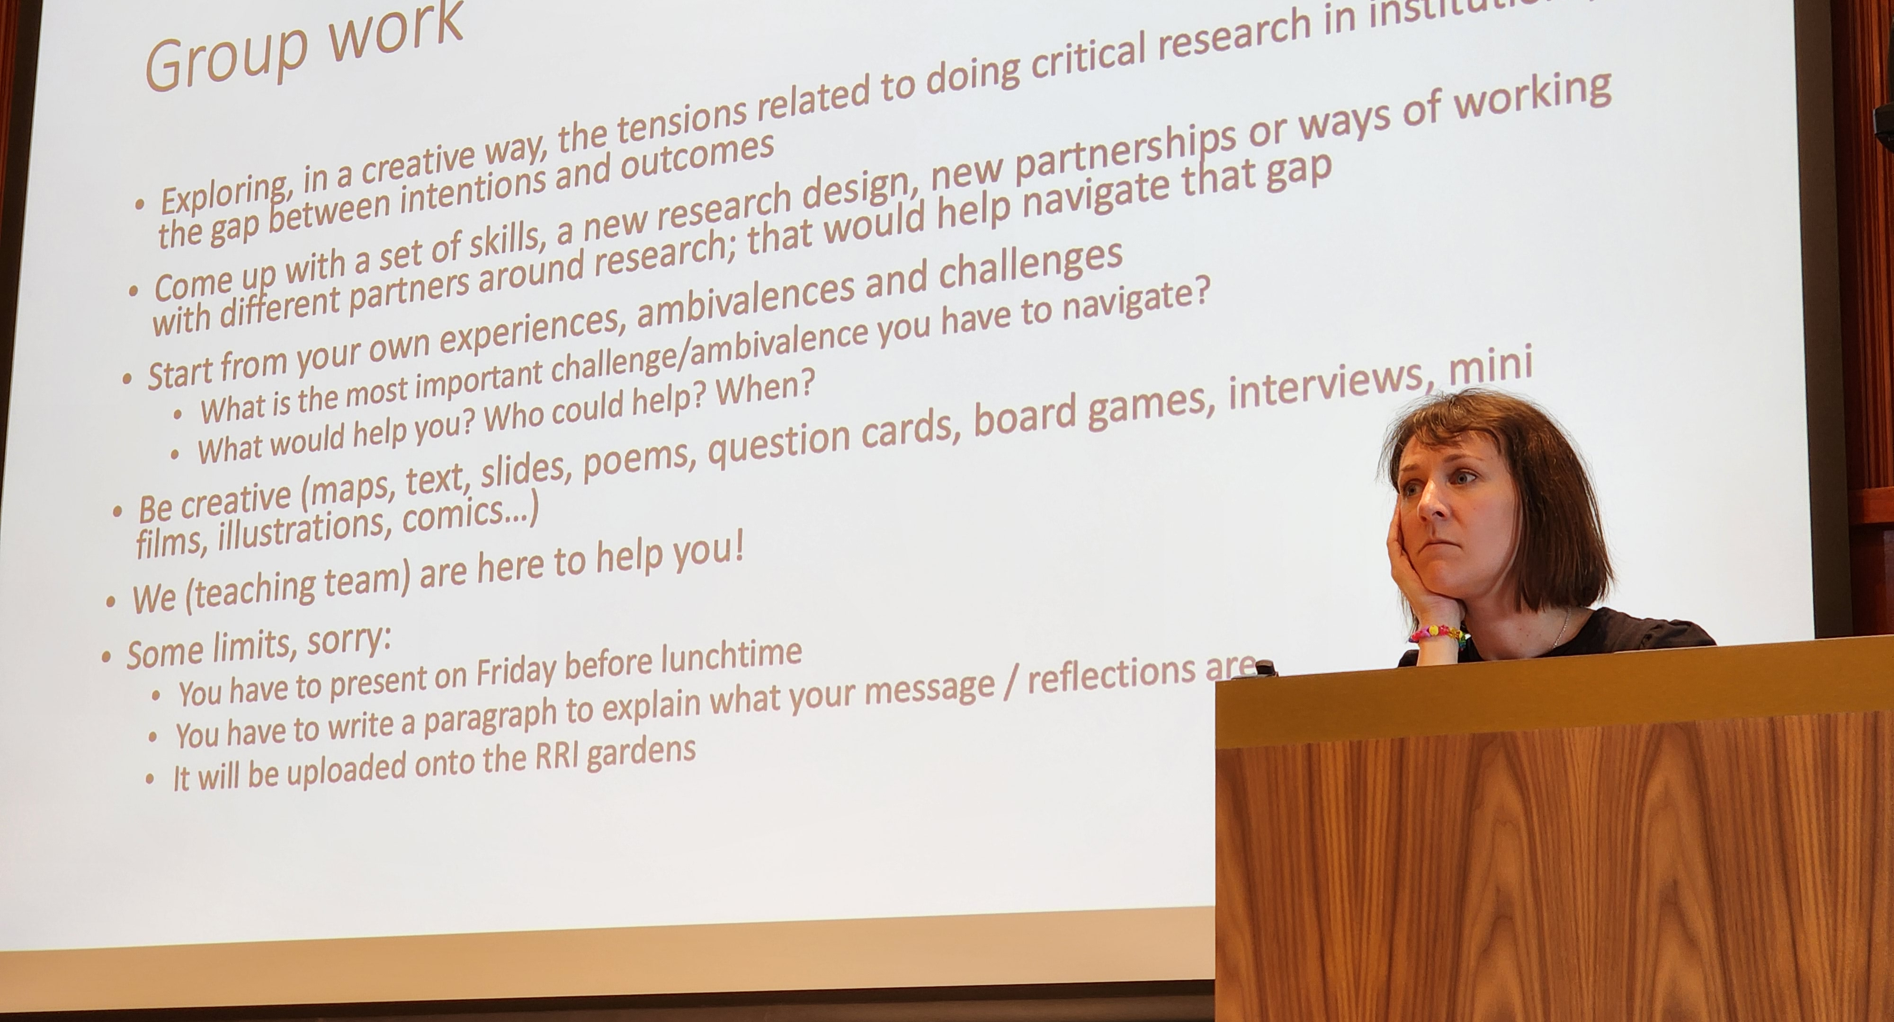
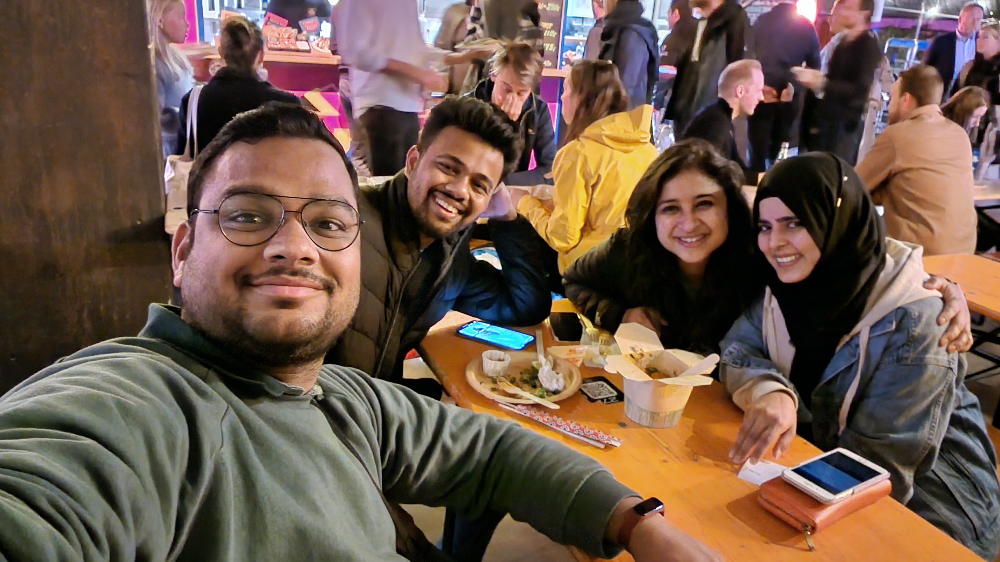
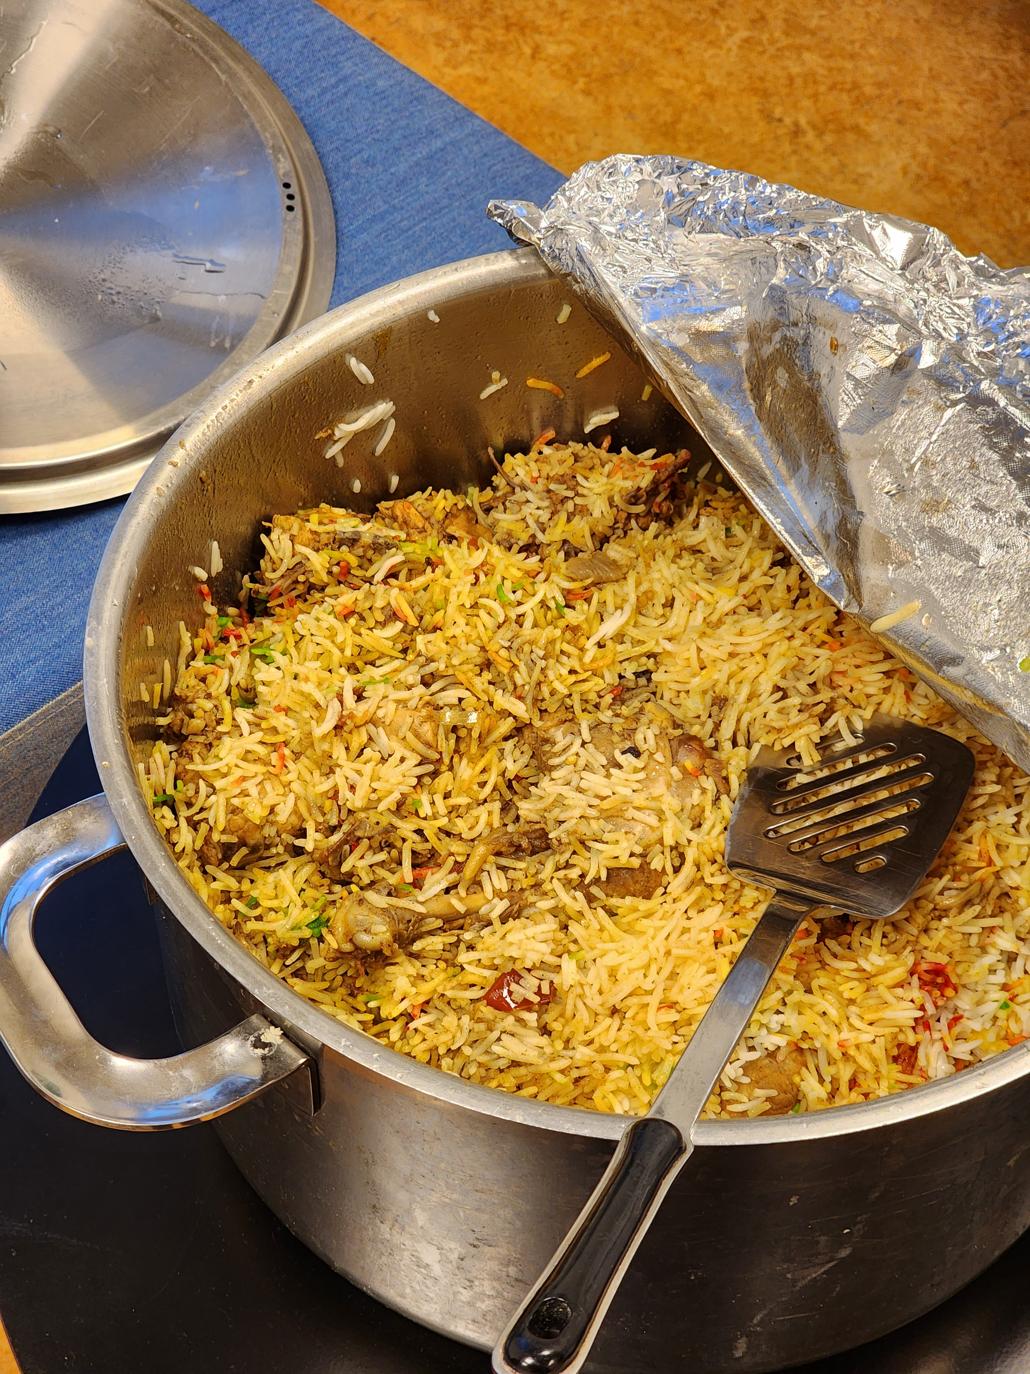
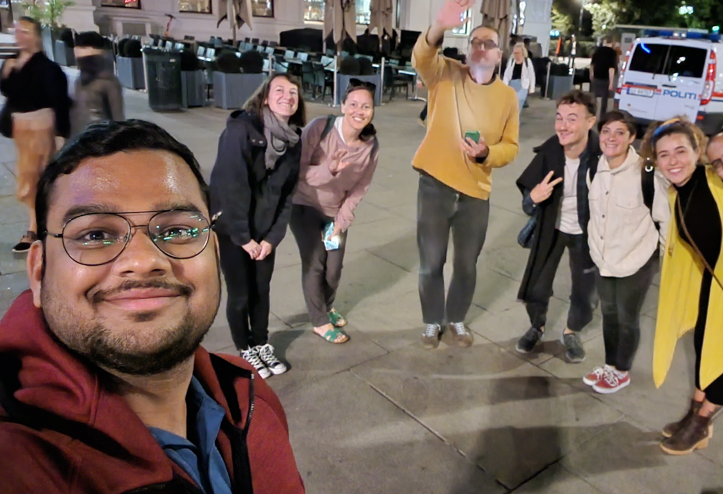
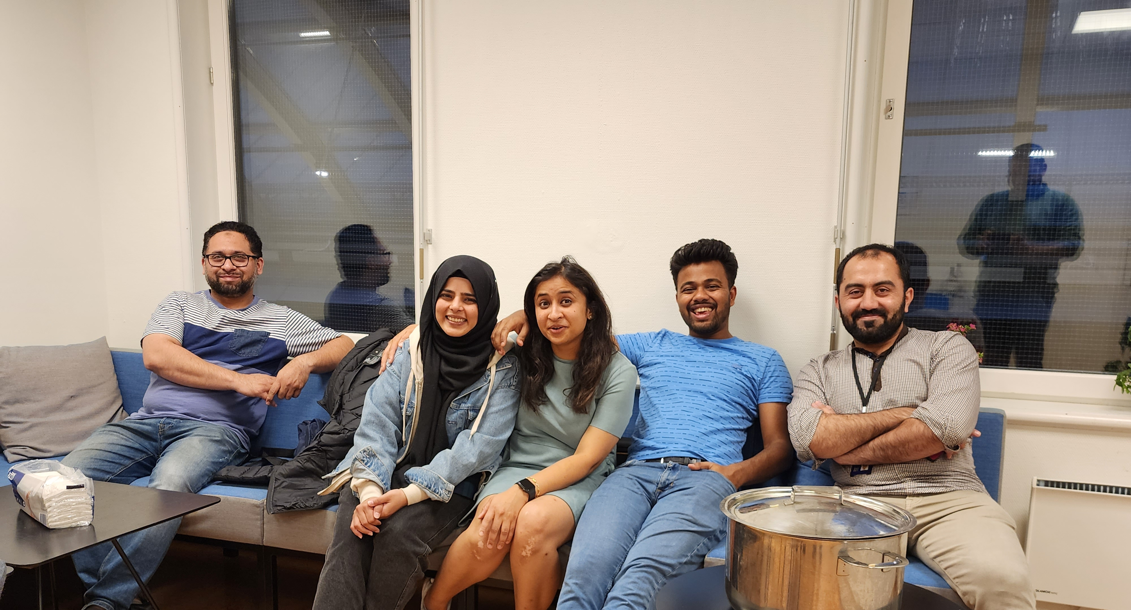
Engaging in Critical Research

Slide 11

Group Members:
ANUM Masood
(Postdoc Candidate at NTNU)
Ayush Somani,
(PhD Candidate at UiT Tromsø)
Pavitra Chauhan
(PhD Candidate at UiT Tromsø)
Haroon khan
(PhD Candidate at OlsoMet)

