Slide 1

The Challenges of RRI Evaluation
Rethink Food Waste Management
Madeleine Julia Gundersen
Olga Mikhailova
Nhat Strøm-Andersen
Mai Nguyen
Yu Cheng

Slide 2

FOOD WASTE IS A PROBLEM. I SHOULD STUDY THIS!

Slide 3
FOOD WASTE IS A PROBLEM. I SHOULD STUDY THIS!
What should be included in the RRI discussion?

Slide 4
RRI discussion
What do we talk about?
How do we do it?
How often do we meet?
Who should be involved?
FOOD WASTE IS A PROBLEM. I SHOULD STUDY THIS!
What should be included in the RRI discussion?

Slide 5






How can I engage different stakeholders?
How can we ensure the quality of the food received?
Different actors are involved
Will the project produce practical solutions?
I want to be eaten!
Evaluation is the discussion
Will I still have a varierty of food products?
How can our company reduce waste and cost at the same time?
Can I promise the voters a 50% food waste reduction?

Slide 6
Stakeholder
Stakeholder
Stakeholder
Stakeholder
Stakeholder
Anticipation
Inclusion
Evaluation is the discussion
Reflexivity
Responsiveness

Slide 7
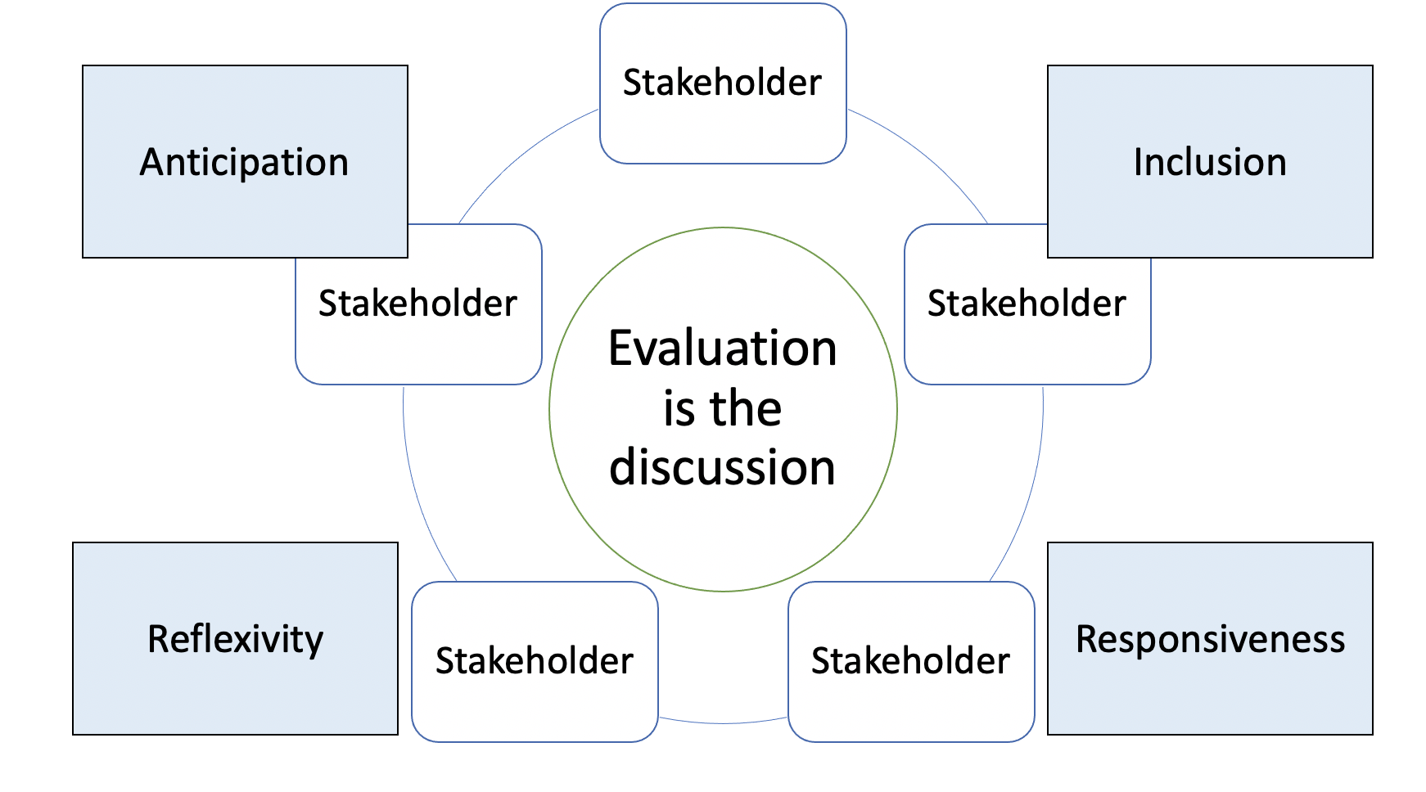

Slide 8

Major evaluation challenges
Different stakeholders have different intentions and expectations
  Stakeholders evaluate outcomes and outputs differently
Are finality and intentionality aligning?
Stakeholders don’t have common knowledge

