Slide 1
EXTENDING RRI TO NON-HUMAN ANIMALS?
AFINO AUTUMN SCHOOL 2023
Anne-Laure Legendre, Natalia Doloisio &Tanguy Sandré

Slide 2
MOBILIZING DIVERSE EXPERIENCES OF BEING IN THE WORLD WITH OTHER NON-HUMAN ANIMALS
EXTENDING REFLEXIVITY ON EPISTEMIC DIVERSITIES
ETHICAL CONSIDERATIONS

Slide 3
The word "animal" comes from the Latin animalis, meaning 'having breath', 'having soul' or 'living being'.

Slide 4
“The animal is a word, it is an appellation that men have instituted, a name they have given themselves the right and the authority to give to”
Jacques Derrida, The Animal That Therefore I Am (2008:23).

Slide 5
The specificity of humans is their ability to suffer and feel joy.

Slide 6
The specificity of sentient beings is their ability to suffer and feel joy.

Slide 7
Shedding light on oppressions is emancipatory (for us)
Antispecism, the aknowledgement that our Western(ized) societies are organized towards specism (as they are still organized around racism or sexism), and that emancipation should be expended to other-than-human.
Speciesm perform categories that perpetuate (sometimes invisible) dominations.
Unfolding those category foster our own emancipation – and our ability to reduce sufferings?

Slide 8
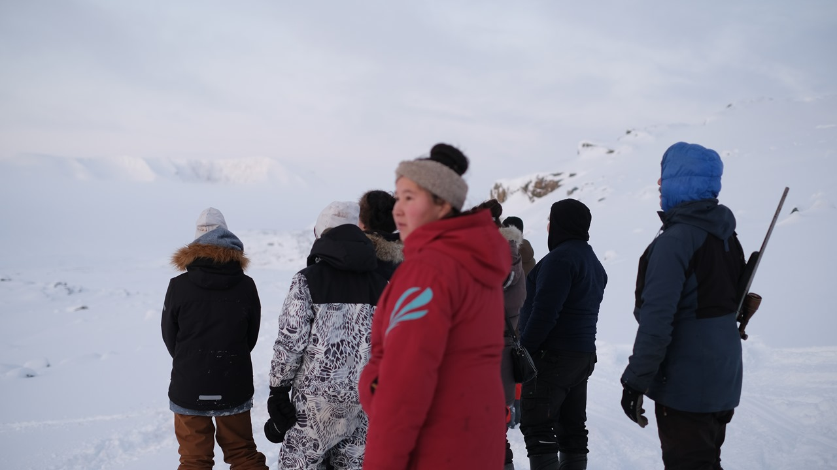
Thinking with subsistance hunting
“At the mouth of winter, the fjord is unusually free of ice. I am walking through the streets of the city; it is not yet noon. An inhabitant I know well stops near me and tells me that hunters have caught several narwhals not far from the town. He offers me a ride on the back of his snowmobile, I accept. When I arrived at the hunting site, several dozen inhabitants were gathered and men began to pull a rope in rhythm to bring the cetaceans onto dry land. The children are dazzled by the scene, the spectators, some of them very moved and definitely happy, are already eager to fill their freezers for the winter. I feel the atmosphere of the community change, become adorned with a collective joy. I watch the gigantic, warm and bloody bodies of the narwhals lined up on the icy beach. I feel within me this collective euphoria, this moment of solidarity and communion. I watch with attention the way the animals are butchered, shared. An inhabitant gives me a piece of mattak, the narwhal's skin, which is eaten raw here, to taste.”

Slide 9
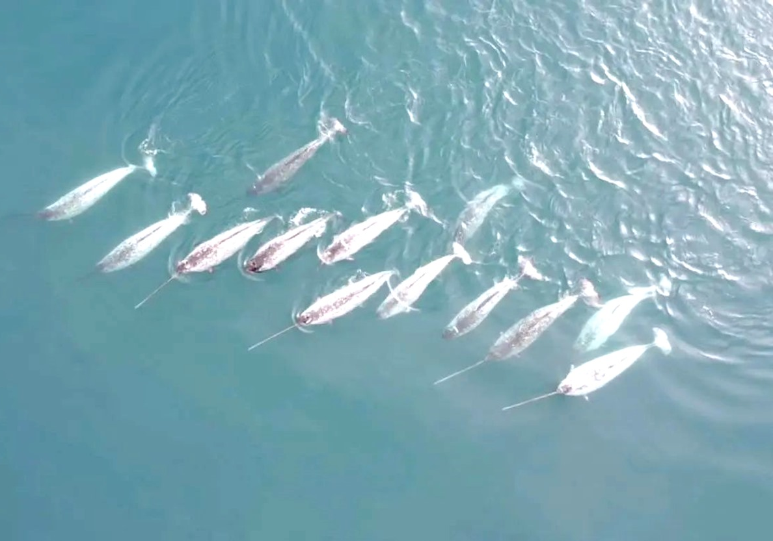
Ontologic plurality, positionality and the intersection of dominations

Slide 10
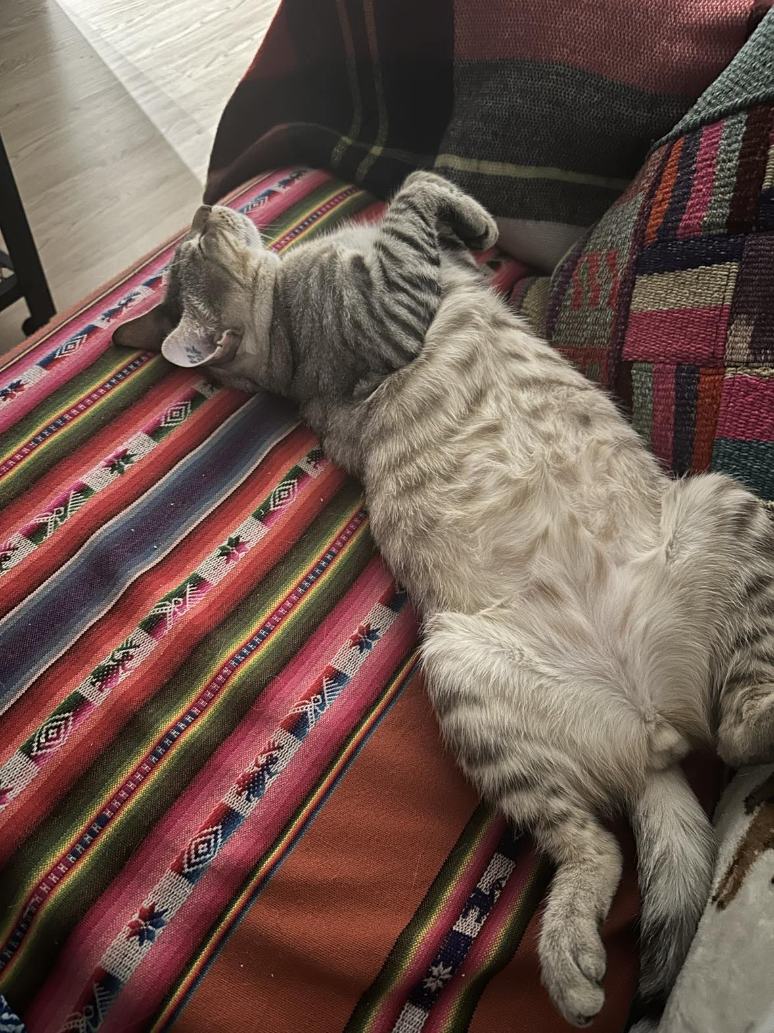
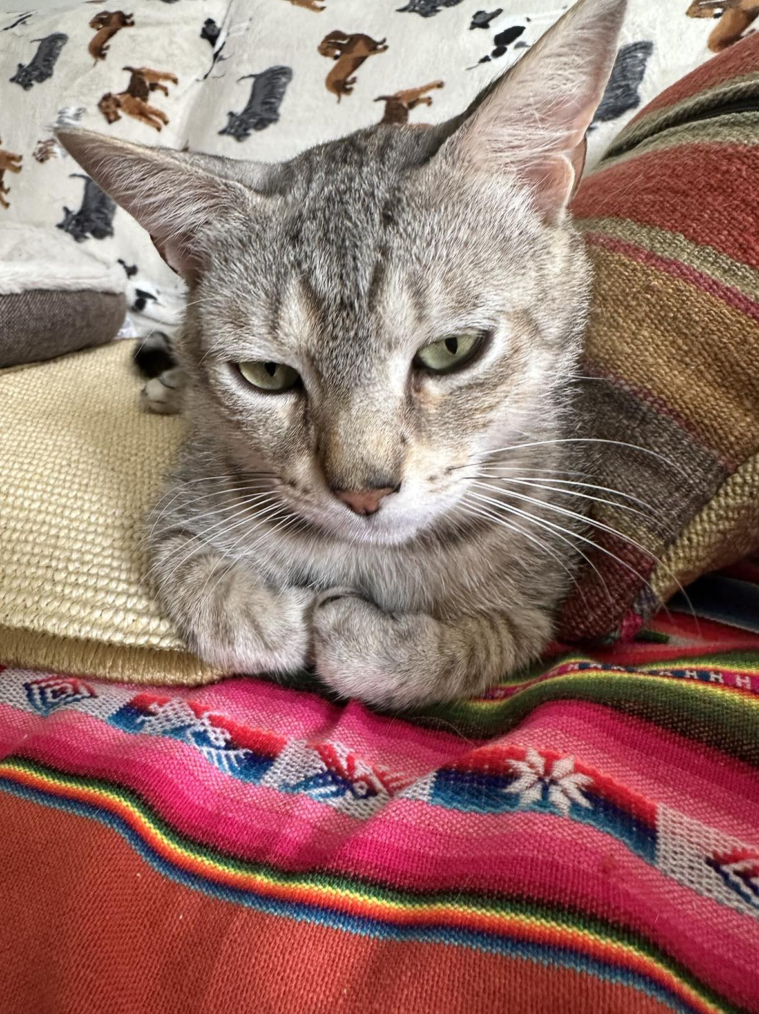
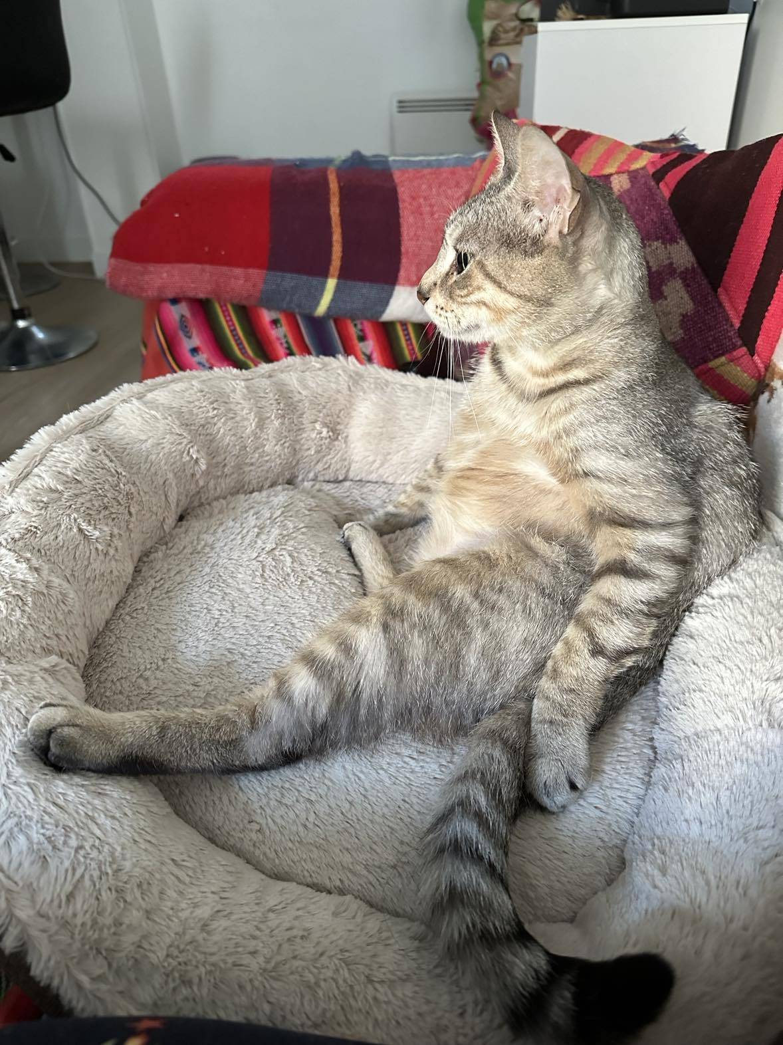
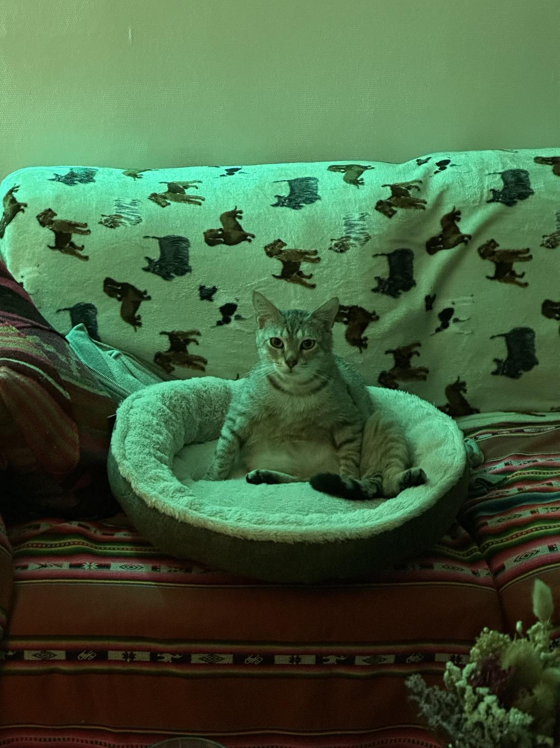
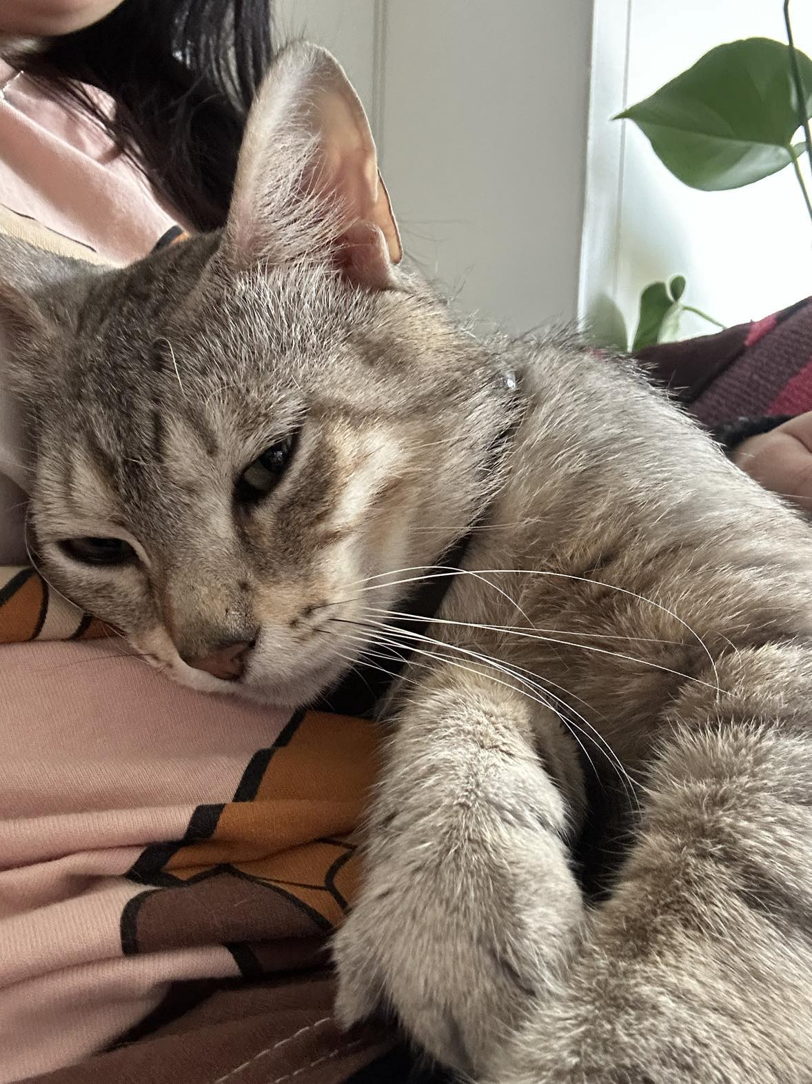
This is Cookies, the cat that my partner and I adopted in May. He is one year and a half. He’s been rescued by two women from a building’s cellar situated in the Parisian suburbs where he was abandoned and from where he could not escape. He has a shy and scaredly nature (probably due to his past experiences). He is capable to communicate us in clear ways when he is happy, upset, scared, hungry or willing to play. In his own way, with his own signs, he communicates what he wants and what he doesn’t. He is equally aware of my emotions and really sensitive to what is happening in his surrounding environment: for example when I’m not happy after he spreads his litter in the lounge.

Slide 11
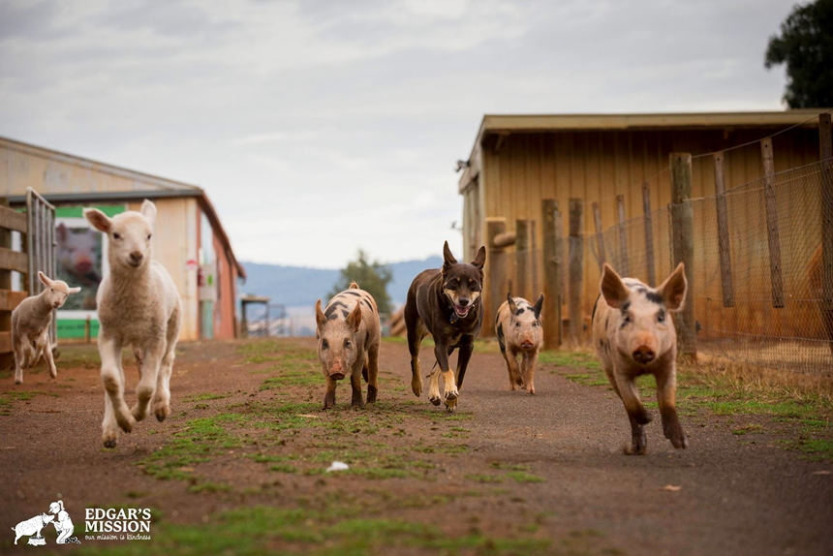
Daily exchanges with Cookies made me realize that as humans we are capable to love and care about our “pets”. However, other animals as “farm animals”, zoo animals, fish, entertainment animals, animals used in laboratories, etc don’t, despite of having a nervous system, feeling emotions (including pain) and being capable to establish bonds with other animals (including us) – just like our pets-.
Practical and ethical implications: different categories provide some animals rights (love and care for cats and dogs) but condemn others that are exploited and killed (situation of polysemy).

Slide 12
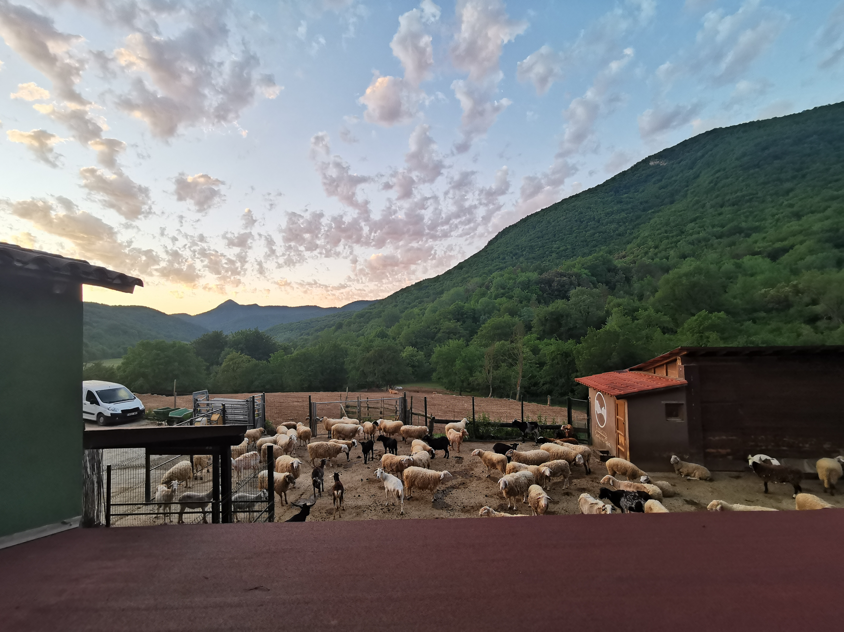
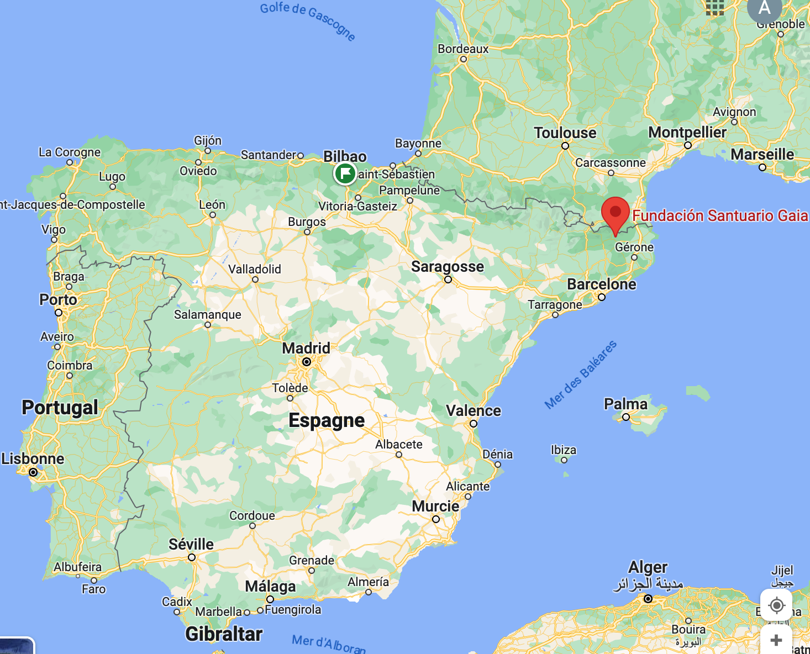
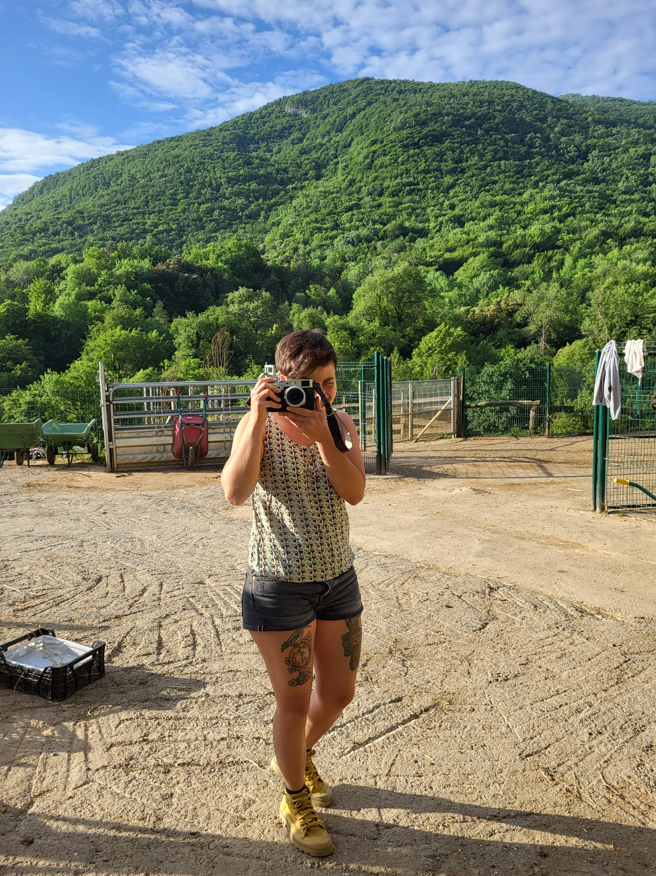

Changing our relations to animals: from commodification to restorative justice ?
The sanctuary was funded in 2012 by Ismael Lopez and Coque Fernandez.
Approx. 2 000 animals rescued
Today, around 500 « inhabitants » (sheeps, goats, cows, horses, ducks, chickens, wild boars, cats, etc.)
My Experience of particpatory-observation as a volunteer at the Sanctuary in June 2022
Notes:
So the story that I want to share with you, comes from my experience as a volunteer in a sanctuary for commonly known farmed-animals….
So I am taking you to Santuario Gaia in Spain, in a beautiful region in the Pyrenean mountains.
The sanctuary was founded in 2013 by two persons, and now it is the biggest in Europe, in terms of number of animals leaving there.
I want to use it to navigate on the diversity

Slide 13
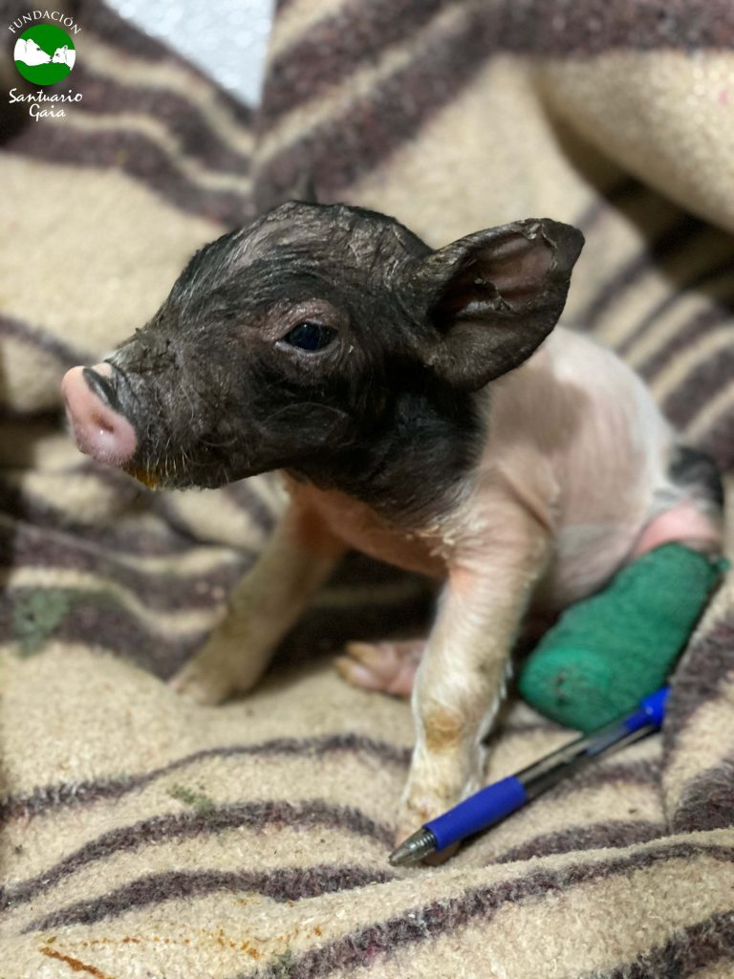
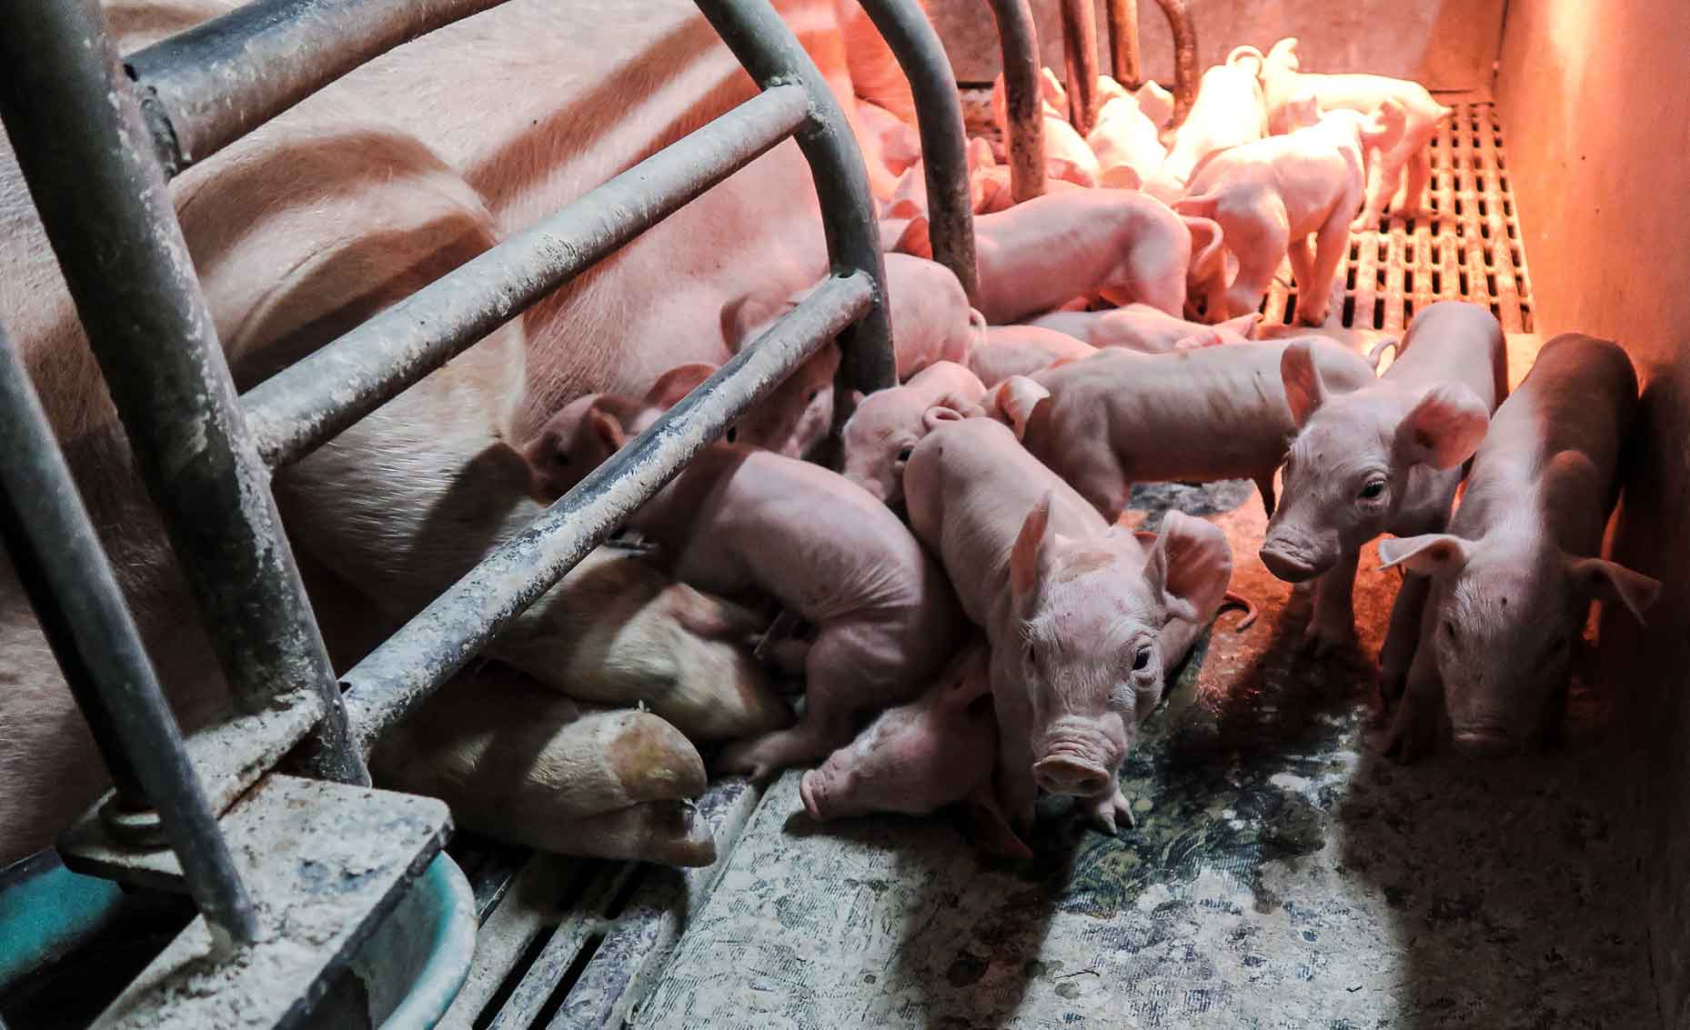
Comodification of animals: life as a cost and price
Liam was born in 2020 in an intensive farm in Spain
A relation based on power asymetries : humans deciding on their rights over birth, life, and death of animals ?
In Spain, in 2017, 50.7 million pigs were killed.
Notes:
Moving around the epistemic diversity of the word animal
In our western world,industrial farming is killing billions and billions of animals every year.
For instance in Spain, the growth of pig farming is enormous. 50.7 million pigs were killed in 2017.
95% of pigs are raised in intensive farms.
One of the usual practice is to have female pigs that give birth to an average of 12-14 piglets per litter. They have power on birth
A common practice in the pork industry is also to cut their tails (tail docking), in order to reduce tail biting in groups, mainly because of the promiscuity conditions. So in this system we have power over life. Life as a quality, but also as a duration…
We decide when animals are big enough to be sent to slaughterhouses, generally before the age of two…. Power over their death.
Liam was born in one of these intensive farm, and he was born with a problem with its back legs : they were open and he couldn’t stand. What farmers do in this situation, is they put a ribbon to keep the legs together.
But as Liam was growing, the ribbon got nailed in the flesh. It provocated an infection and they had to amputate his leg. They probably did that without anestesia.
In this story, animal’s life is commodified. Liam’s life does not belong to him, but to a farmer. The farmer expect to get a salary, but he also knows he might face economic losses. farmer. Liam’s disability has a cost, so he was about to be killed at the farm.
But in that case, the farmer got in contact with the founders of Sanctuary Gaia, and accepted to let him go…

Slide 14
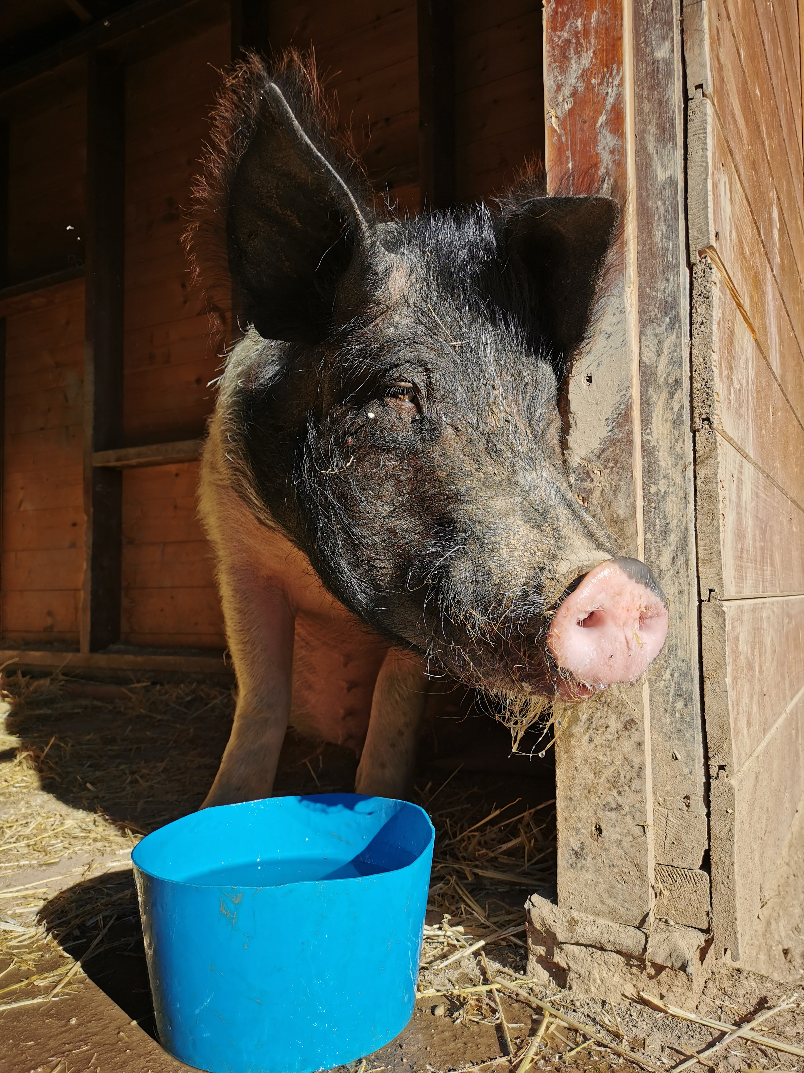
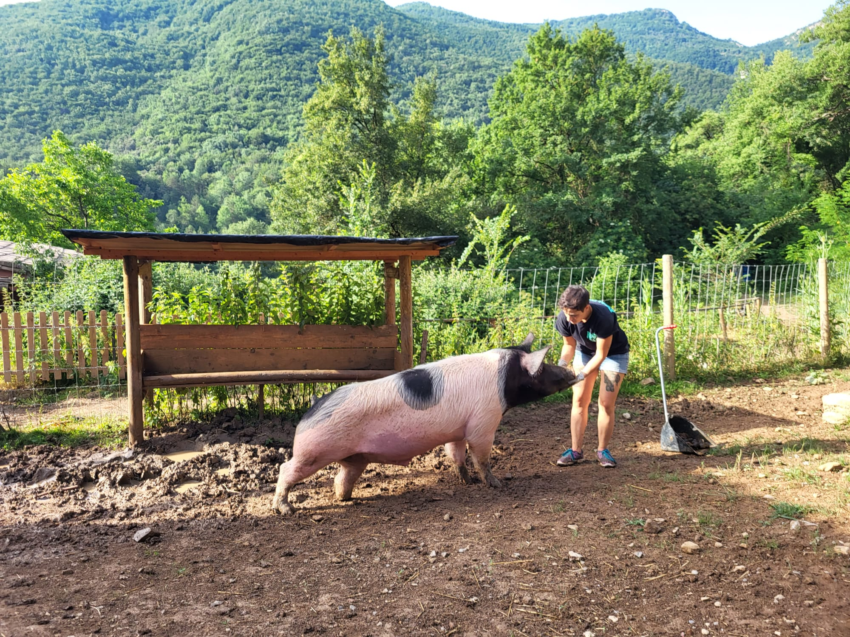
Liam is now 4 years old. He is taken care of in a non-violent environment, where he is recognised as a sentient being.
Can we consider this situation has reduced suffering?
What about emancipation?
Restorative justice for an exploited animal: life as a value
Notes:
Contesting this category of animal as a commodity…. The sanctuary is now considering Liam’s life as a value.
His life counts for him, as much as it may count for us.
Liam is now 4 years old.
He is fed, he gets cures everyday for his stump leg, he is taken care of in a non-violent environment.
Can we consider this situation has reduced his suffering ? I would argue so I have spent some time with him,
He likes standing at the doorway, looking outside at Miguel his flatmate… he loves to tip his bucket of water and lay in wet hay in hot summers.
He used to run when he was little.
But getting bigger, it was more difficult. When I was there last year, he basically dragged his back legs to move in his enclosure to the pond and back to the shed.
Have we contributed to emancipation from Liam’s perspective ? Emancipation from the exploitation system… but he is not « free » per se. He lives with humans…

Slide 15
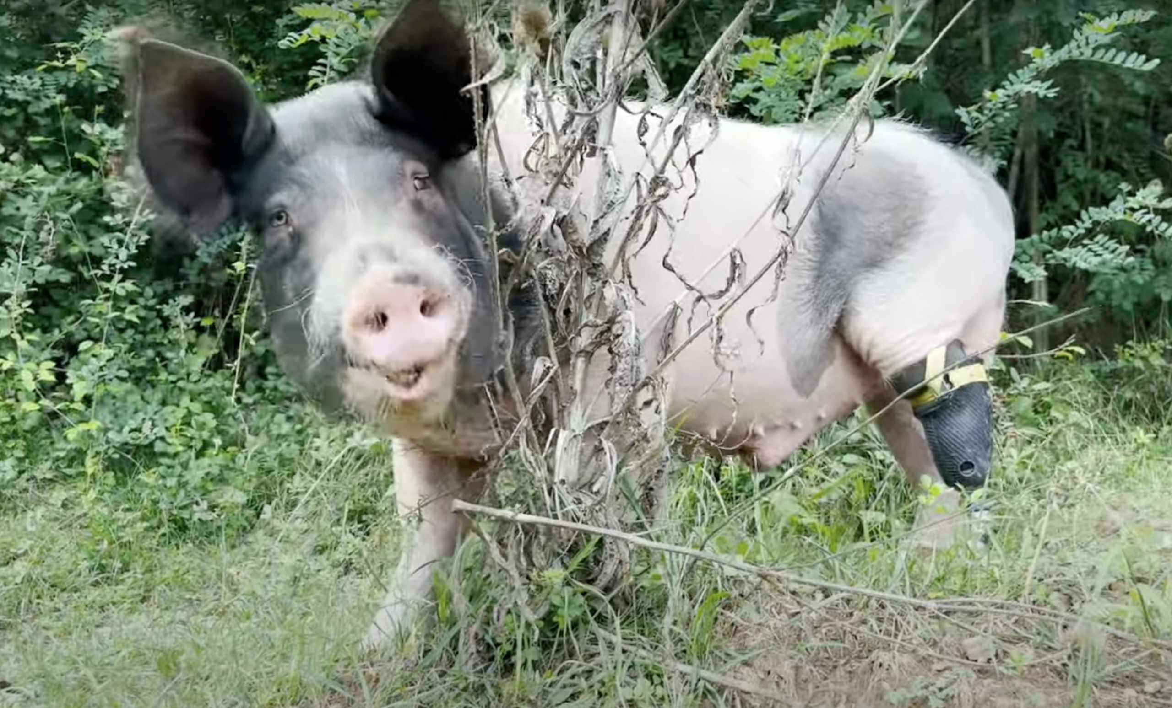
Restorative justice for an exploited animal: reflecting on living conditions, and what a « good life » can mean
Notes:
But as I said, people in the sanctuary are trying to push the principles of care…
They had this opportunity to get a prothesis for him and also for a cow…
It was made by disabled people with amputated legs, who developed new technologies of protesis…
We don’t know how Liam feels, we will never read his mind…
We can only see how he reacts and his daily practices…
He is roaming around now…
We can reflect around Liam’s living conditions, and its mobility which basically a physical condition to push the boundaries of his freedom…
This also means reflection on wellbeing and what a good life can mean

Slide 16
FINAL THOUGHTS:
OUR OWN PERSONAL EXPERIENCES TO EXTEND REFLEXIVITY, RESPONSIVENESS & INCLUSION TOWARDS NON-HUMAN ANIMALS.
Who created subcategories (e.g: pets vs farm animals)?
At what point of our lives have we learnt that some animals have the right to live while others don’t?
How do we justify these categories from an ethical perspective?
If such categories are socially learnt, can we also learn to extend our love and care to all animals?

