Slide 1


Why do we have an IPR policy?
What does this mean for you?

Slide 2
Knowledge management for a better world
As a university, we have a responsibility to ensure that the knowledge we produce benefits society.
This is one of several modules describing how effective knowledge management supports NTNU’s mission “Knowledge for a Better World”.
NTNU’s IPR policy is one of the tools we can use.
From knowledge to solution

Slide 3

IPR
IPR policy
Knowledge management
Intellectual property rights (IPR) are the formal rights related to the research, dissemination and innovation we produce at the university.
NTNU’s rules and guidelines for safeguarding employees’ rights in issues related to sharing, distribution and commercialization of the knowledge we produce.
Use of IPR and other means to protect knowledge and share knowledge.

Slide 4

What is this module about?
NTNU’s policy on intellectual property states that NTNU has various rights to the work of its employees.
Why? And what does it mean for you as an employee?

Slide 5
In brief
NTNU wants to get as many good ideas out into society as it can. Effective knowledge management makes this easier to achieve.
NTNU also wants opportunities for employees to succeed both as academics and as entrepreneurs.
Notes:
Funker siste setningen i hovedbolken?

Slide 6

NTNU stands behind you
This is why NTNU is keen to assist employees who are researchers, disseminators and innovators in developing their ideas.
You’ll get support, guidance, facilities and time to work on your ideas and research projects.
In other words, you’ll have NTNU behind you.

Slide 7

The law changed in 2003
In 2003, Norway changed the Act on Employee Inventions. The new law gave NTNU rights to more of what is created at the university, including what you produce as an employee.

Slide 8

Public information
A long-standing principle states that the public must have access to research results that society has paid for, and this is still a key concept today.
Society funds our work and so it is our duty to give something back to society.

Slide 9
Clearer IPR policy
NTNU has various rights to what you create as an employee, especially when it is relevant to the university’s core tasks.
You can read more about what this entails in Section 4.3 of the IPR policy.

Slide 10

What does this mean for you?
NTNU has various rights to what you create as an employee, especially when it is relevant to the university’s core tasks.
You can read more about what this entails in Section 4.3 of the IPR policy.
Notes:
Funker siste setningen i hovedbolken?

Slide 11
What does this mean for you?
You always have the moral rights to your work. These include the right of attribution and protection against alteration of the work in a way that harms your reputation as the author.
You also have ownership rights to material with a clearly personal touch, as long as the university can use it in its core activities.
Notes:
Funker siste setningen i hovedbolken?

Slide 12

Focus on innovation
Since the law changed in 2003, the focus on innovation in academia has sharpened.
With the new IPR policy, we hope to continue this trend.
The aim is to get more and better innovation and research out into society.

Slide 13

What is innovation?
Innovation can mean many things, but NTNU’s main definition is that innovation is something new, useful and utilized.
It could be anything from new teaching methods to software to concrete screws.

Slide 14
What does this mean for you?
NTNU will ensure that employees get help and guidance to pursue ideas and results that could benefit society – through commercialization, further research and teaching that apply new knowledge.
Notes:
Funker siste setningen i hovedbolken?

Slide 15
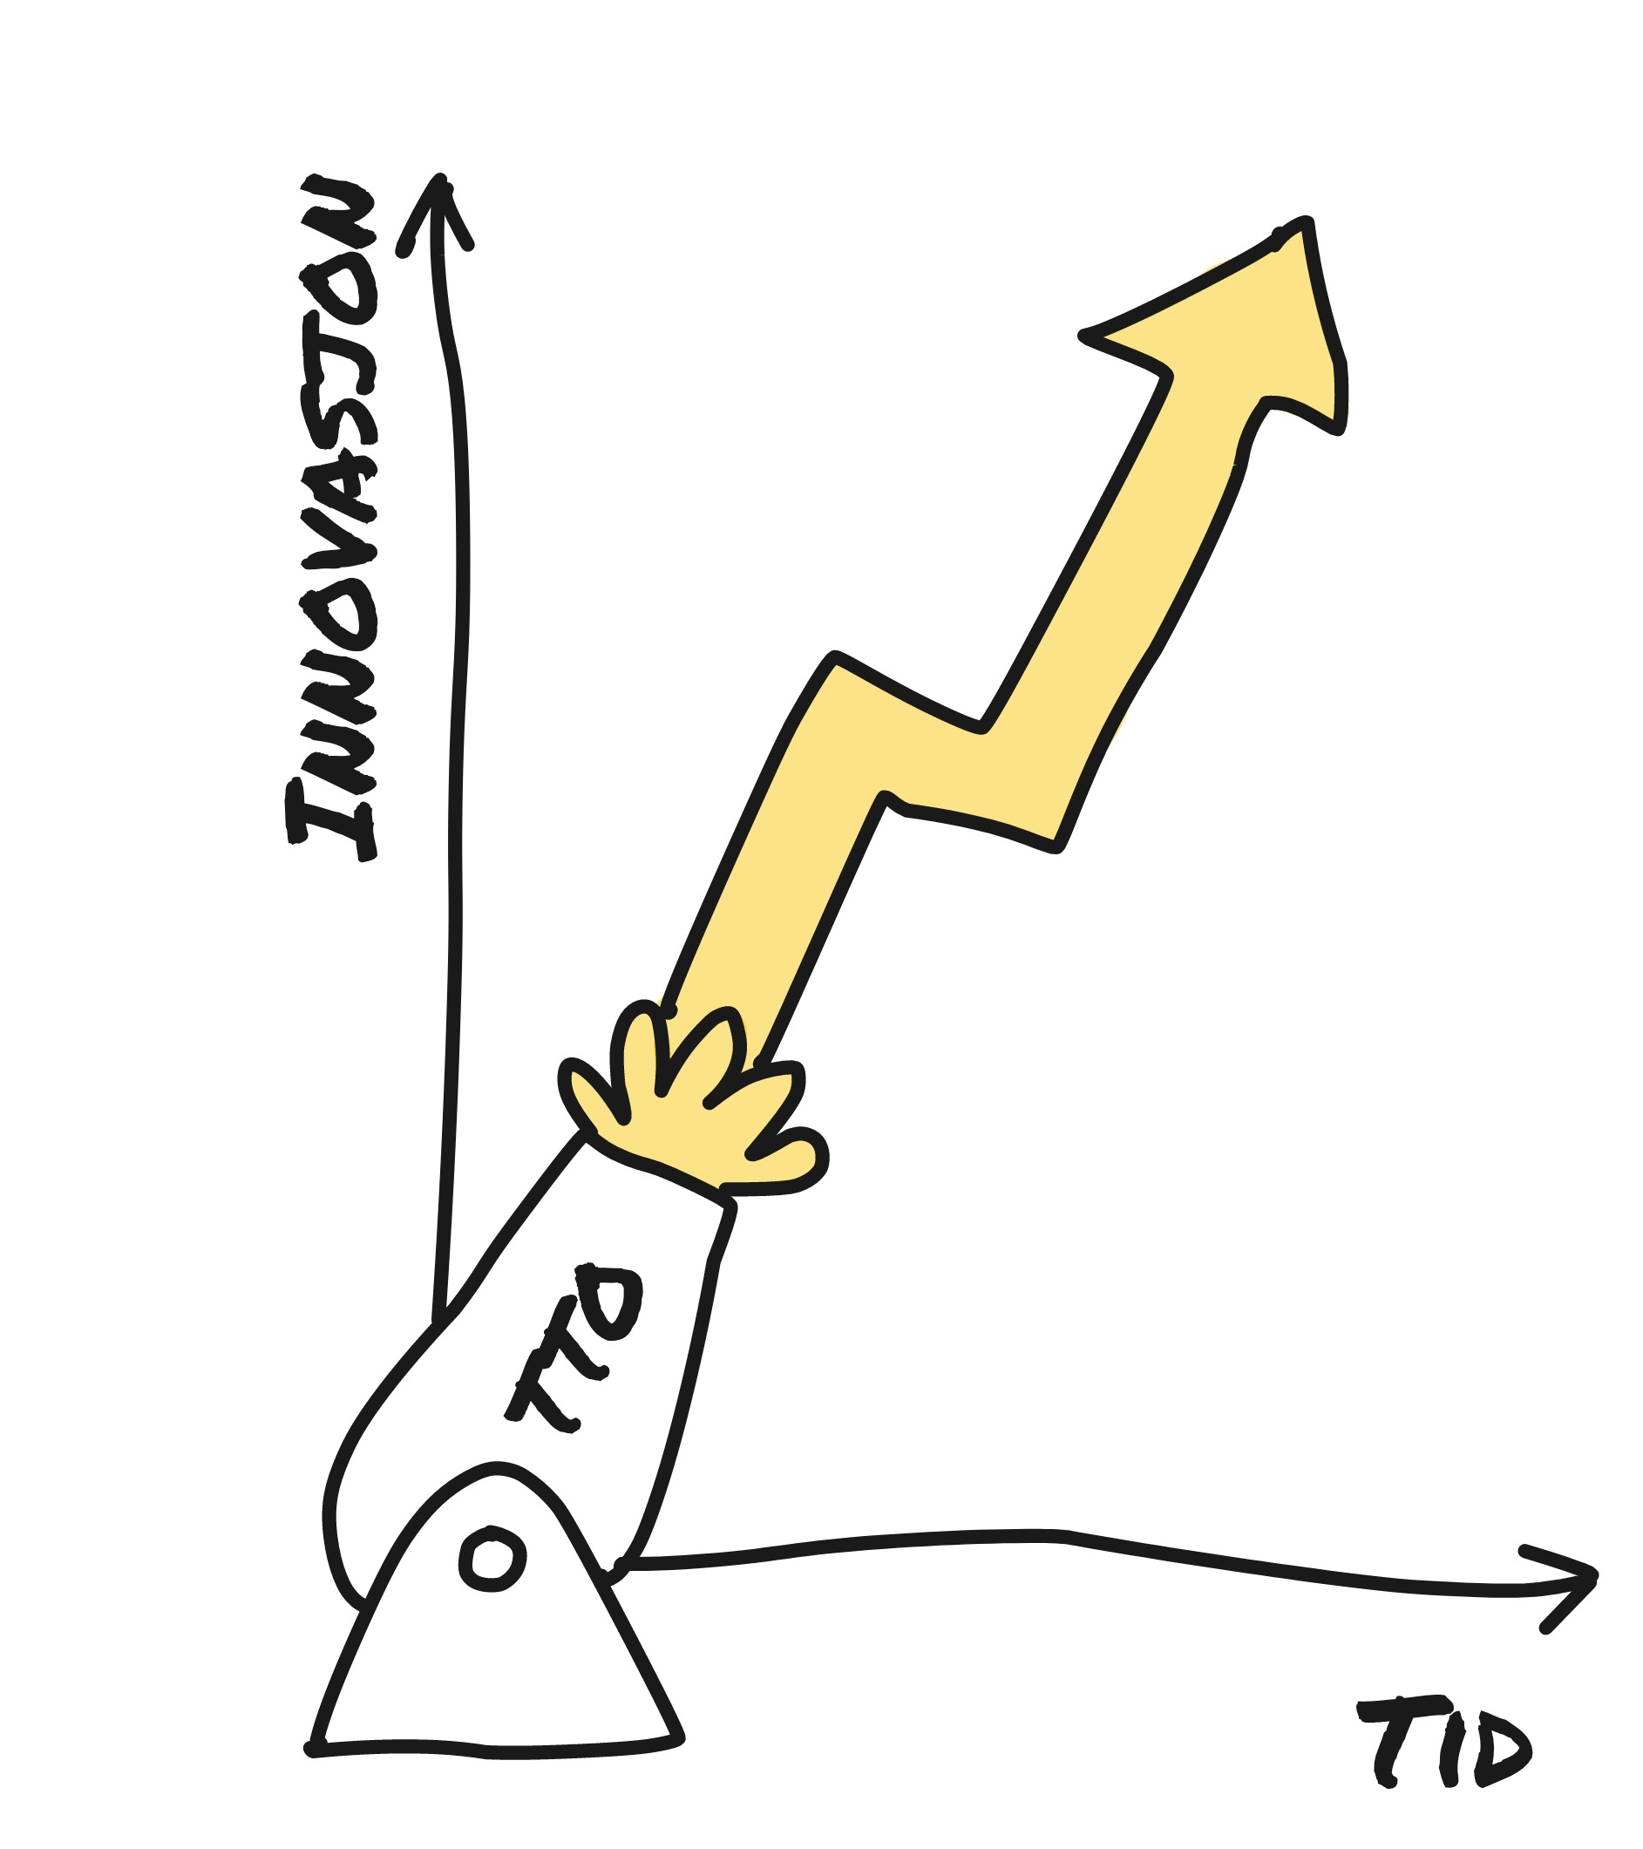
Technology Transfer
NTNU Technology Transfer AS is the university’s technology transfer office (TTO), which helps employees with the development and commercialization of ideas and research results.
With its expertise in knowledge management and commercialization, Technology Transfer has an important support function in such projects.

Slide 16
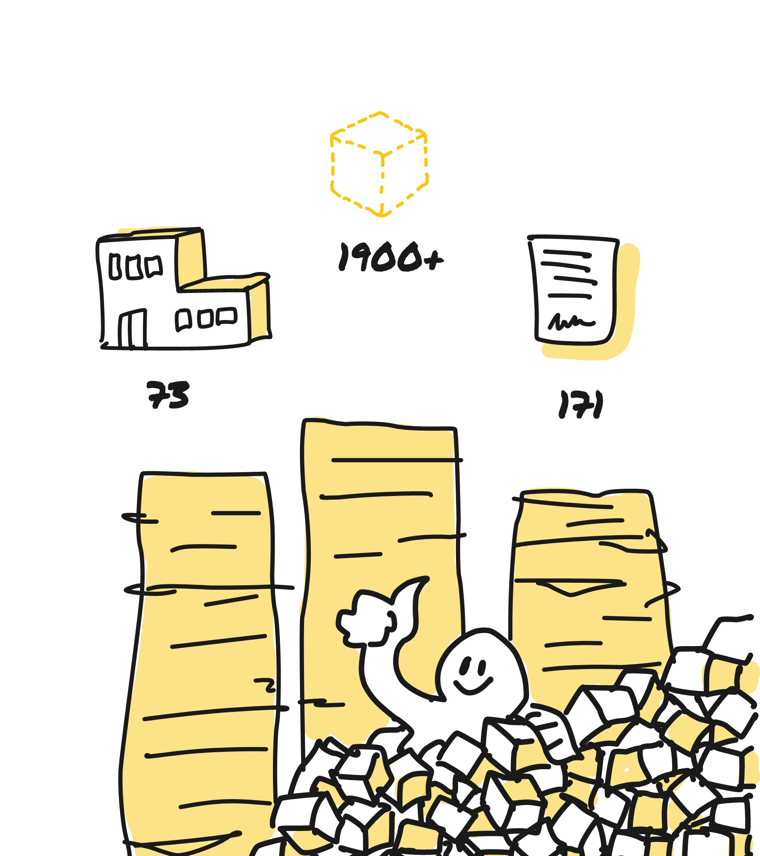
More innovation
1900+
With effective support schemes, we achieve more innovation and more commercialization.
Since its launch, Technology Transfer has received over 1900 ideas which have resulted in 73 spin-offs and 171 licensing agreements.
73
171
Notes:
Minitanke: skulle vi byttet ut den blå boksen med en stiplet, kanskje gul en? For å vise at det er ideer, ikke produkter.

Slide 17

So why do we have IPR?
To make sure that good NTNU ideas can benefit the world!

Slide 18

Read more at ntnu.no/ipr

