Slide 1


Realizing ideas
From idea to distributed innovation

Slide 2
Managing knowledge for a better world
As a university, we have a responsibility to ensure that the knowledge we produce benefits society.
This is one of several modules describing how effective knowledge management supports NTNU’s mission “Knowledge for a Better World”.
NTNU’s IPR policy is one of the tools we can use.
From knowledge to solution

Slide 3

IPR
IPR policy
Knowledge management
Intellectual property rights (IPR) are the formal rights related to the research, dissemination and innovation we produce at the university.
NTNU’s rules and guidelines for safeguarding employees’ rights in issues related to sharing, distribution and commercialization of the knowledge we produce.
Use of IPR and other means to protect knowledge and share knowledge.

Slide 4
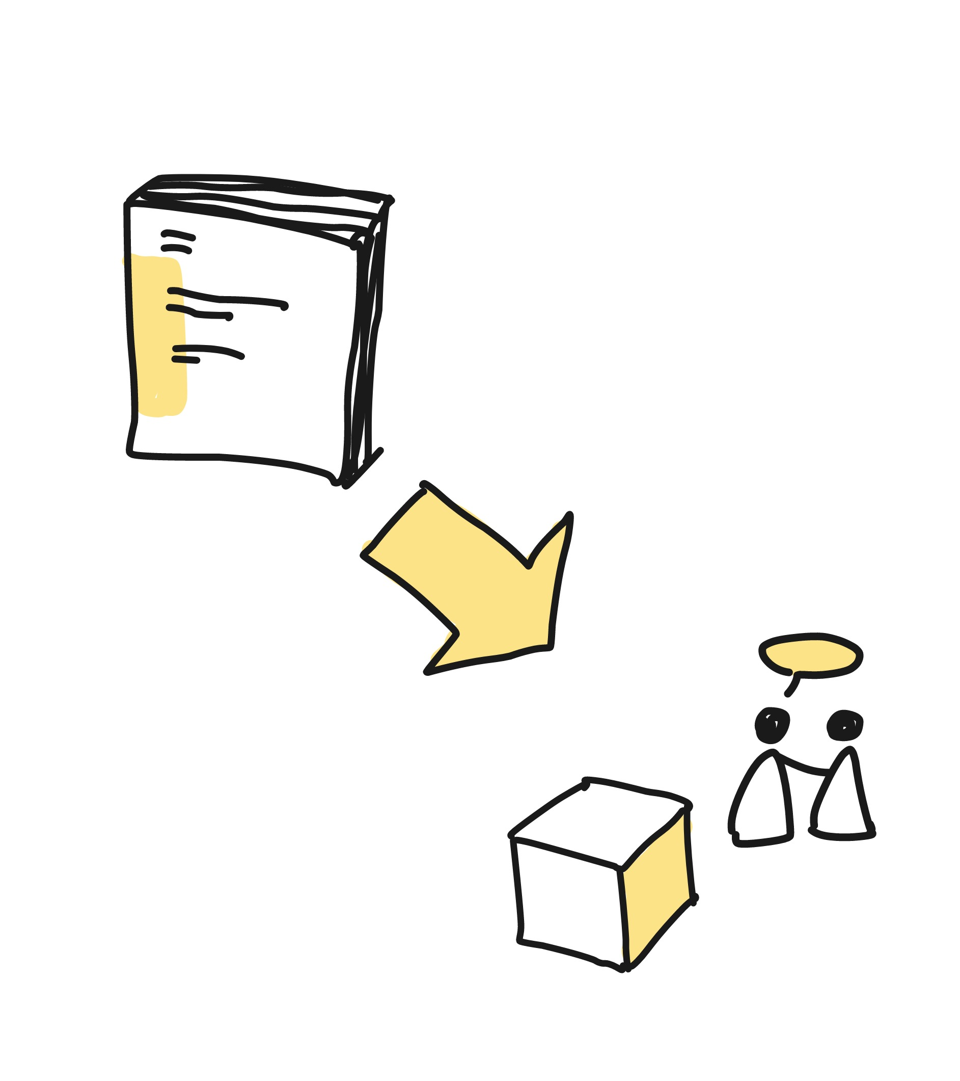
New, useful, utilized
NTNU’s mission is to foster new knowledge and ensure it is put to good use.
Innovation can mean many things, but NTNU’s main definition is that innovation is something new, useful and utilized.
This could be anything from new teaching methods to software to concrete screws.

Slide 5
New, useful, utilized
For something to be an innovation, we need to get it out into society.
One way to do this is by commercializing new products and services based on research results.

Slide 6

NTNU Technology Transfer
NTNU Technology Transfer (TTO) is the university’s main tool for IPR management and technology transfer to society and industry.
Commercialization can be time-consuming, challenging and expensive, but with good help, many things become possible.

Slide 7
Before you register an idea with Technology Transfer
Commercialization is not the only way to ensure that ideas benefit society.
The head of your department, and perhaps an innovation manager, can help to evaluate which approach would be best for your idea.

Slide 8
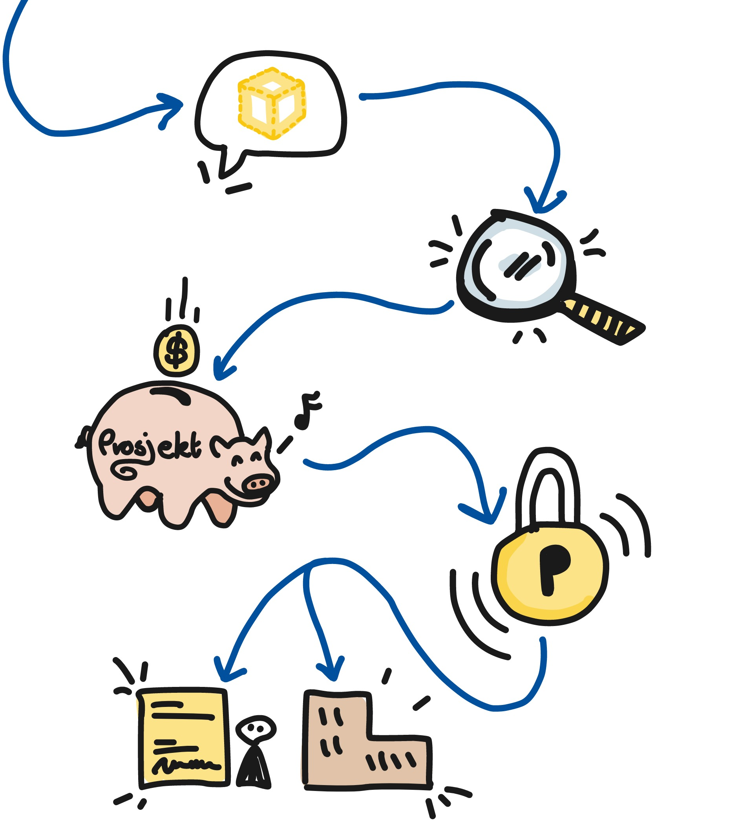
The commercialization pathway has five steps
1. You submit your idea to the TTO and your department
2. TTO assesses the potential of your idea
3. Development and funding of the project
4. Patenting or other protection
5. Set up a spin-off company or licensing

Slide 9

Submit good ideas
As an employee, you must submit ideas and results with commercial potential to the TTO and your department.
This helps ensure that good ideas are discovered as early as possible and can benefit society.
Submit an idea

Slide 10
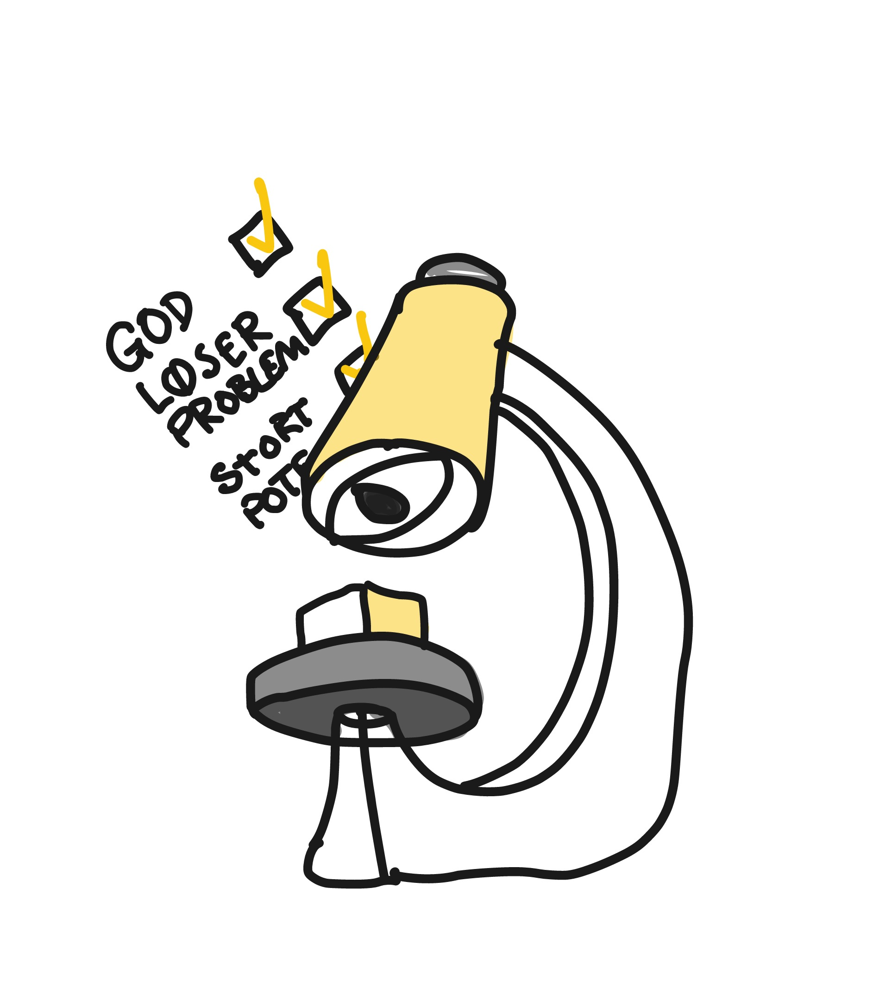
Assessment of an idea
TTO assesses ideas based on how suitable they will be commercialization. If an idea is good, meets a need and has great potential as a commercialized product or service, it will be moved forward.
Read more about the TTO's assessment of ideas

Slide 11
Assessment of an idea
If TTO does not go ahead with an idea, the department or idea originator, for example, may choose to proceed on their own.
Ideas may offer great benefits even if they are not suitable for a paying market.

Slide 12

Publication
Research and commercialization may well go hand in hand, but it is important to do things in the right order. For example, one should not publish anything that could become the basis for a patent later.
This is another advantage of submitting ideas early – it avoids complications.

Slide 13
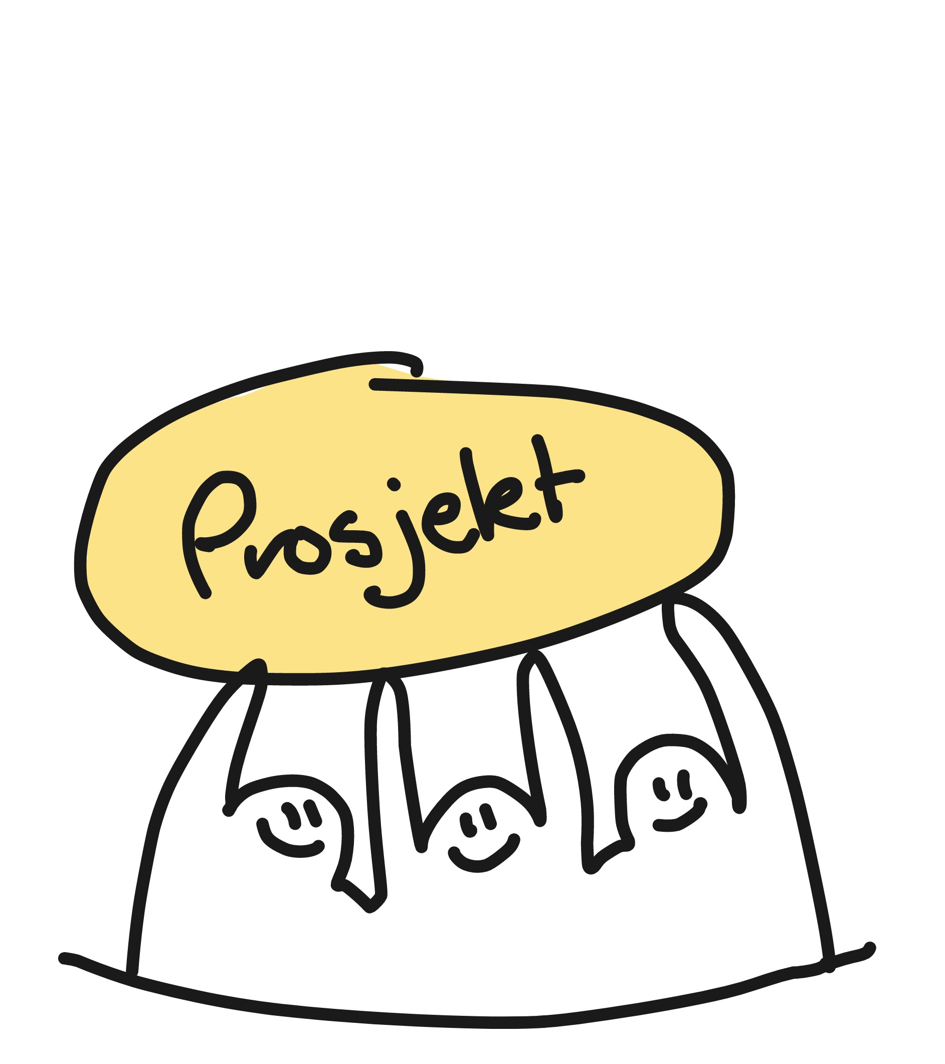
Development of the idea
If your idea is assessed as good, considerable resources will be invested in validating it.
These resources will be used to develop the idea towards a market-ready product or service.
If the TTO proceeds with the project, they can also finance time off for you to work on it.
Read more about project development

Slide 14
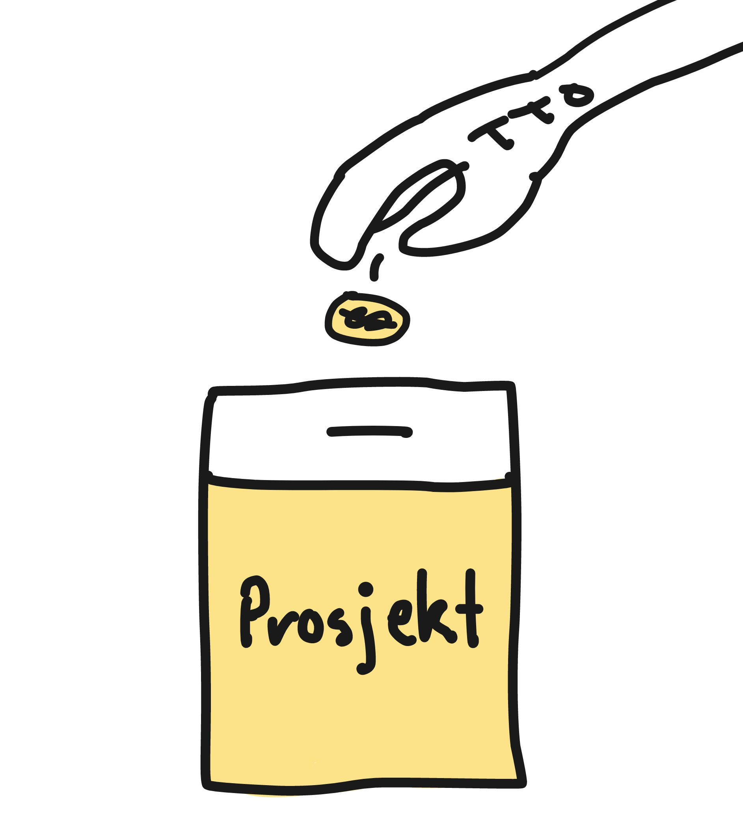
Funding
An innovation project has many related costs. The TTO has a wealth of knowledge about and access to funding of innovation projects and can help you to navigate this process.
Read more about project funding
So far, the TTO has raised more than NOK 1 billion for innovation projects based on research from NTNU.

Slide 15

Patenting
For some ideas, patenting will be relevant. A patent enables you to create value and share the idea with lower risk. This also gives you control over who can use the technology, how and for what.
Read more about patents
Read more about NTNU's IPR policy
Up to 2020, the TTO had submitted 800 patent applications

Slide 16

Other protection
If patenting is not possible, design protection, trademark registration, trade secrets and copyright may be good methods to control use.
The TTO can also help you with these types of protection.

Slide 17
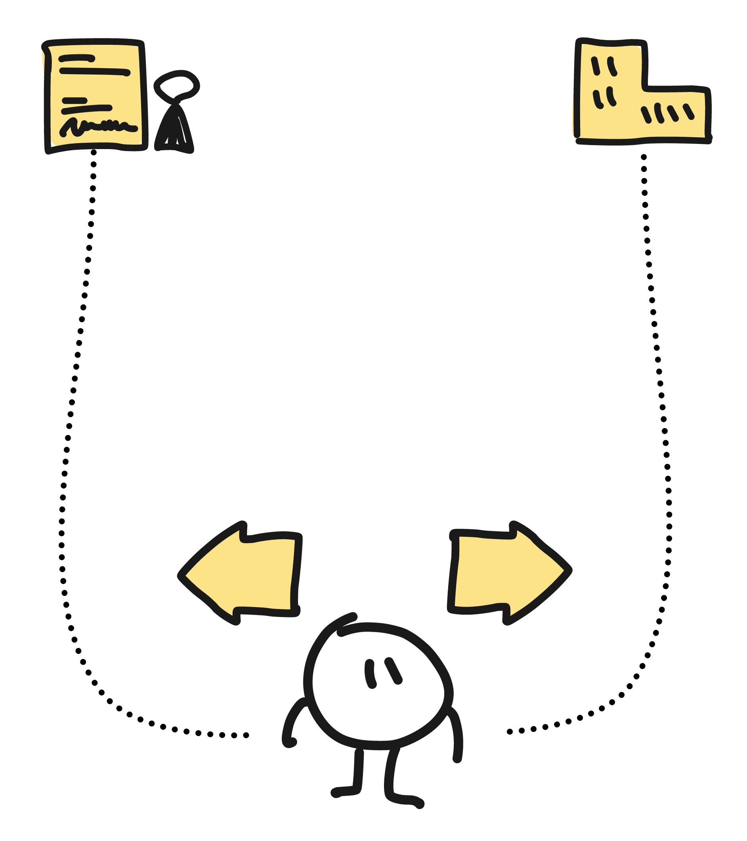
Options for development
There are two ways forward in the commercialization process. An idea can form the basis for a start-up or it can be leased to existing companies through a licensing agreement.
The TTO will choose the alternative that fits your idea best depending on the prerequisites for the idea and what similar solutions already exist on the market.

Slide 18

Start-up
When your idea results in a start-up, you can choose to be employed full-time or part-time by the company. If you do not want an active role in the company, a board position may be a relevant alternative.
But the chances of success are much greater if the originator of the idea has a central role in the project.
Read more about starting new companies
See examples of spin-off companies
Up to 2020, TTO had established 246 start-up companies together with inventors.

Slide 19

Licensing agreements
When a licensing agreement is signed, it is the licensee who develops the invention further into a product or service.
The inventor and other contributors are then paid a fair share of the financial gain that the licensee receives from the use of the invention.
Up to 2018, TTO had entered into more than 128 licensing agreements.

Slide 20
Licensing agreement
Such agreements also safeguard NTNU’s right to further use in research and teaching and the right to publication.
Up to 2018, TTO had entered into more than 128 licensing agreements.

Slide 21

Read more at ntnutto.no

