Slide 1
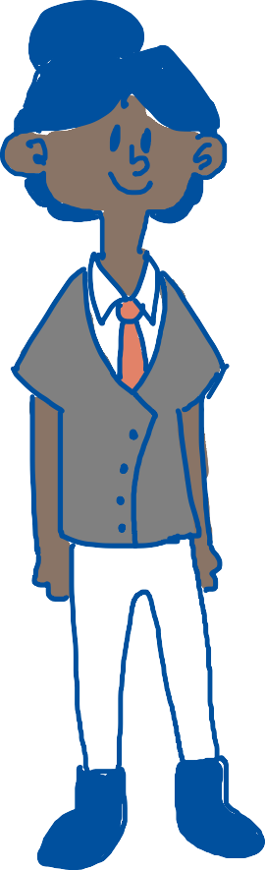
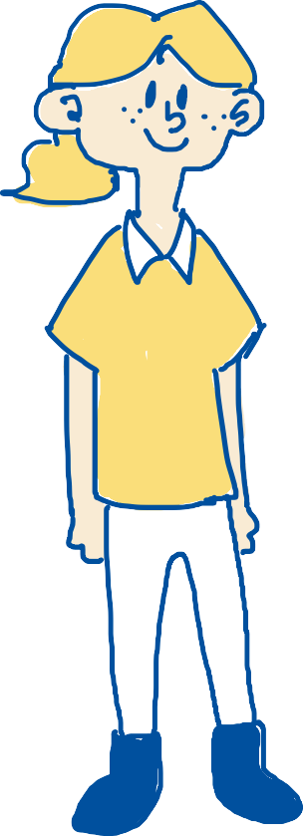




Template
These numbers indicate the clause in the contract for which the information is relevant.
1
Subchapter
Question
Answer
Tip
This guide is intended for students who plan to write a thesis or paper in cooperation with an external organization. This cooperation requires you to sign a standard agreement, which safeguards your rights to the results of yourwork.
You can find the standard agreement for cooperation with an external organization here
Explanation
Definition
Explanation

Slide 2

Student work in cooperation with an external organization

Slide 3
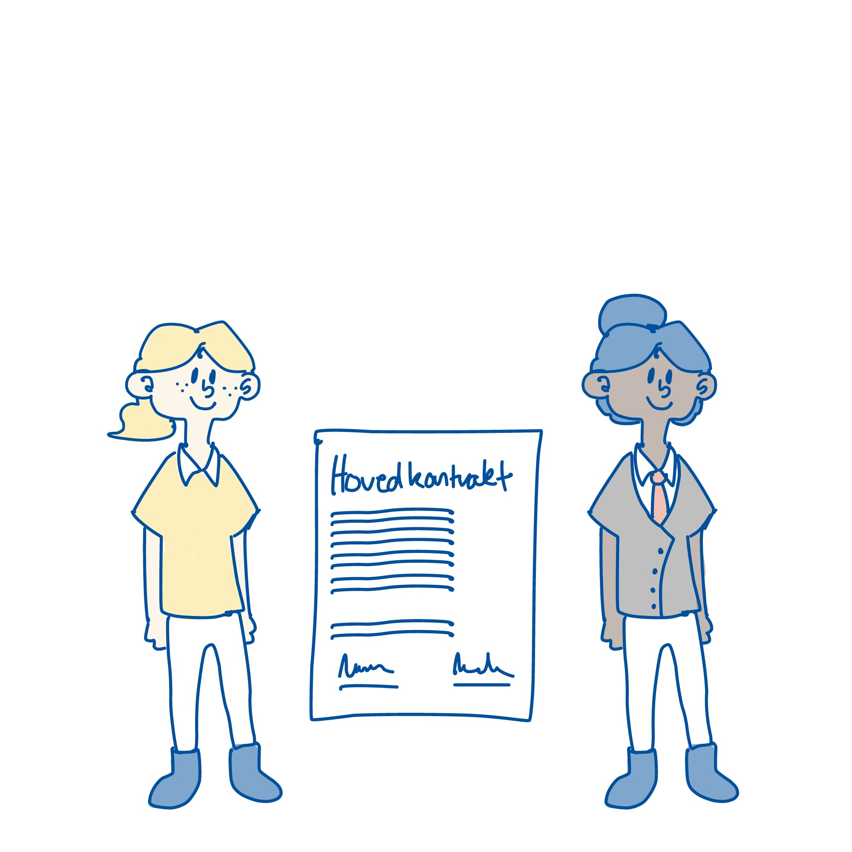
Introduction
1
These numbers indicate the clause in the contract for which the information is relevant.
This guide is intended for students who plan to write a thesis or paper in cooperation with an external organization. This cooperation requires you to sign a standard agreement, which safeguards your rights to the results of your work.
You can find the standard agreement for cooperation with an external organization here:
Standard agreement

Slide 4

Introduksjon
It is important to have a clear understanding of the agreement.
To give you an overview, this guide describes the key aspects of the agreement.
You can find more information about working together with external organizations here:
Student and business cooperative agreements

Slide 5
1. General

Slide 6
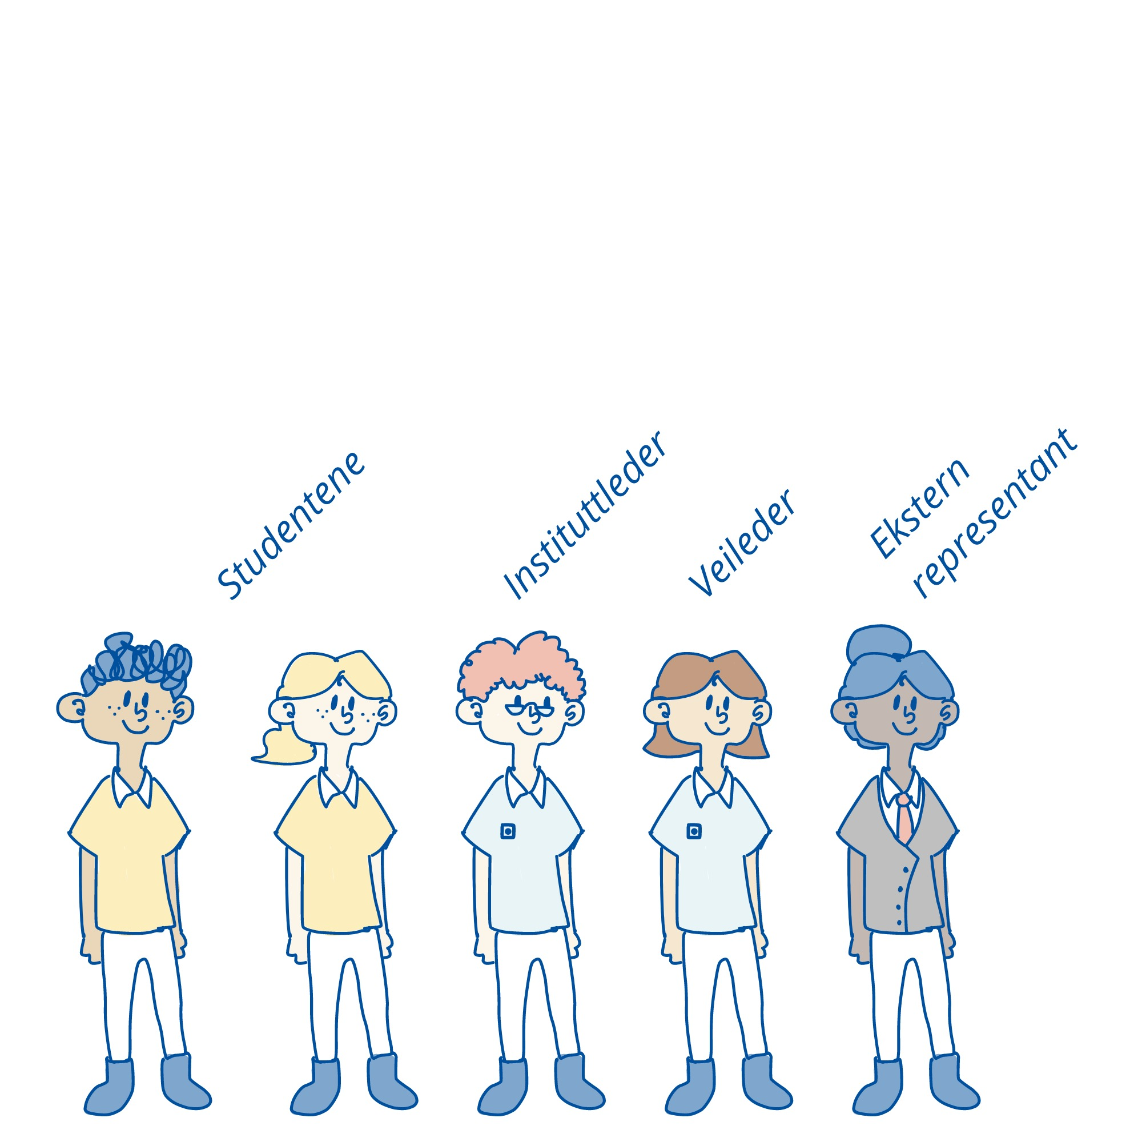
General
1
Who is involved?
Why is this necessary?
You are responsible for protecting your own rights in the collaboration. The standard agreement is a tool for this.
The Head of Department signs on behalf of NTNU. The supervisor has the overall academic responsibility and insight into the project on behalf of NTNU.
One representative signs on behalf of the external organization.
The student(s) sign on their own behalf.
External representative
Head of department
The students
Supervisor

Slide 7
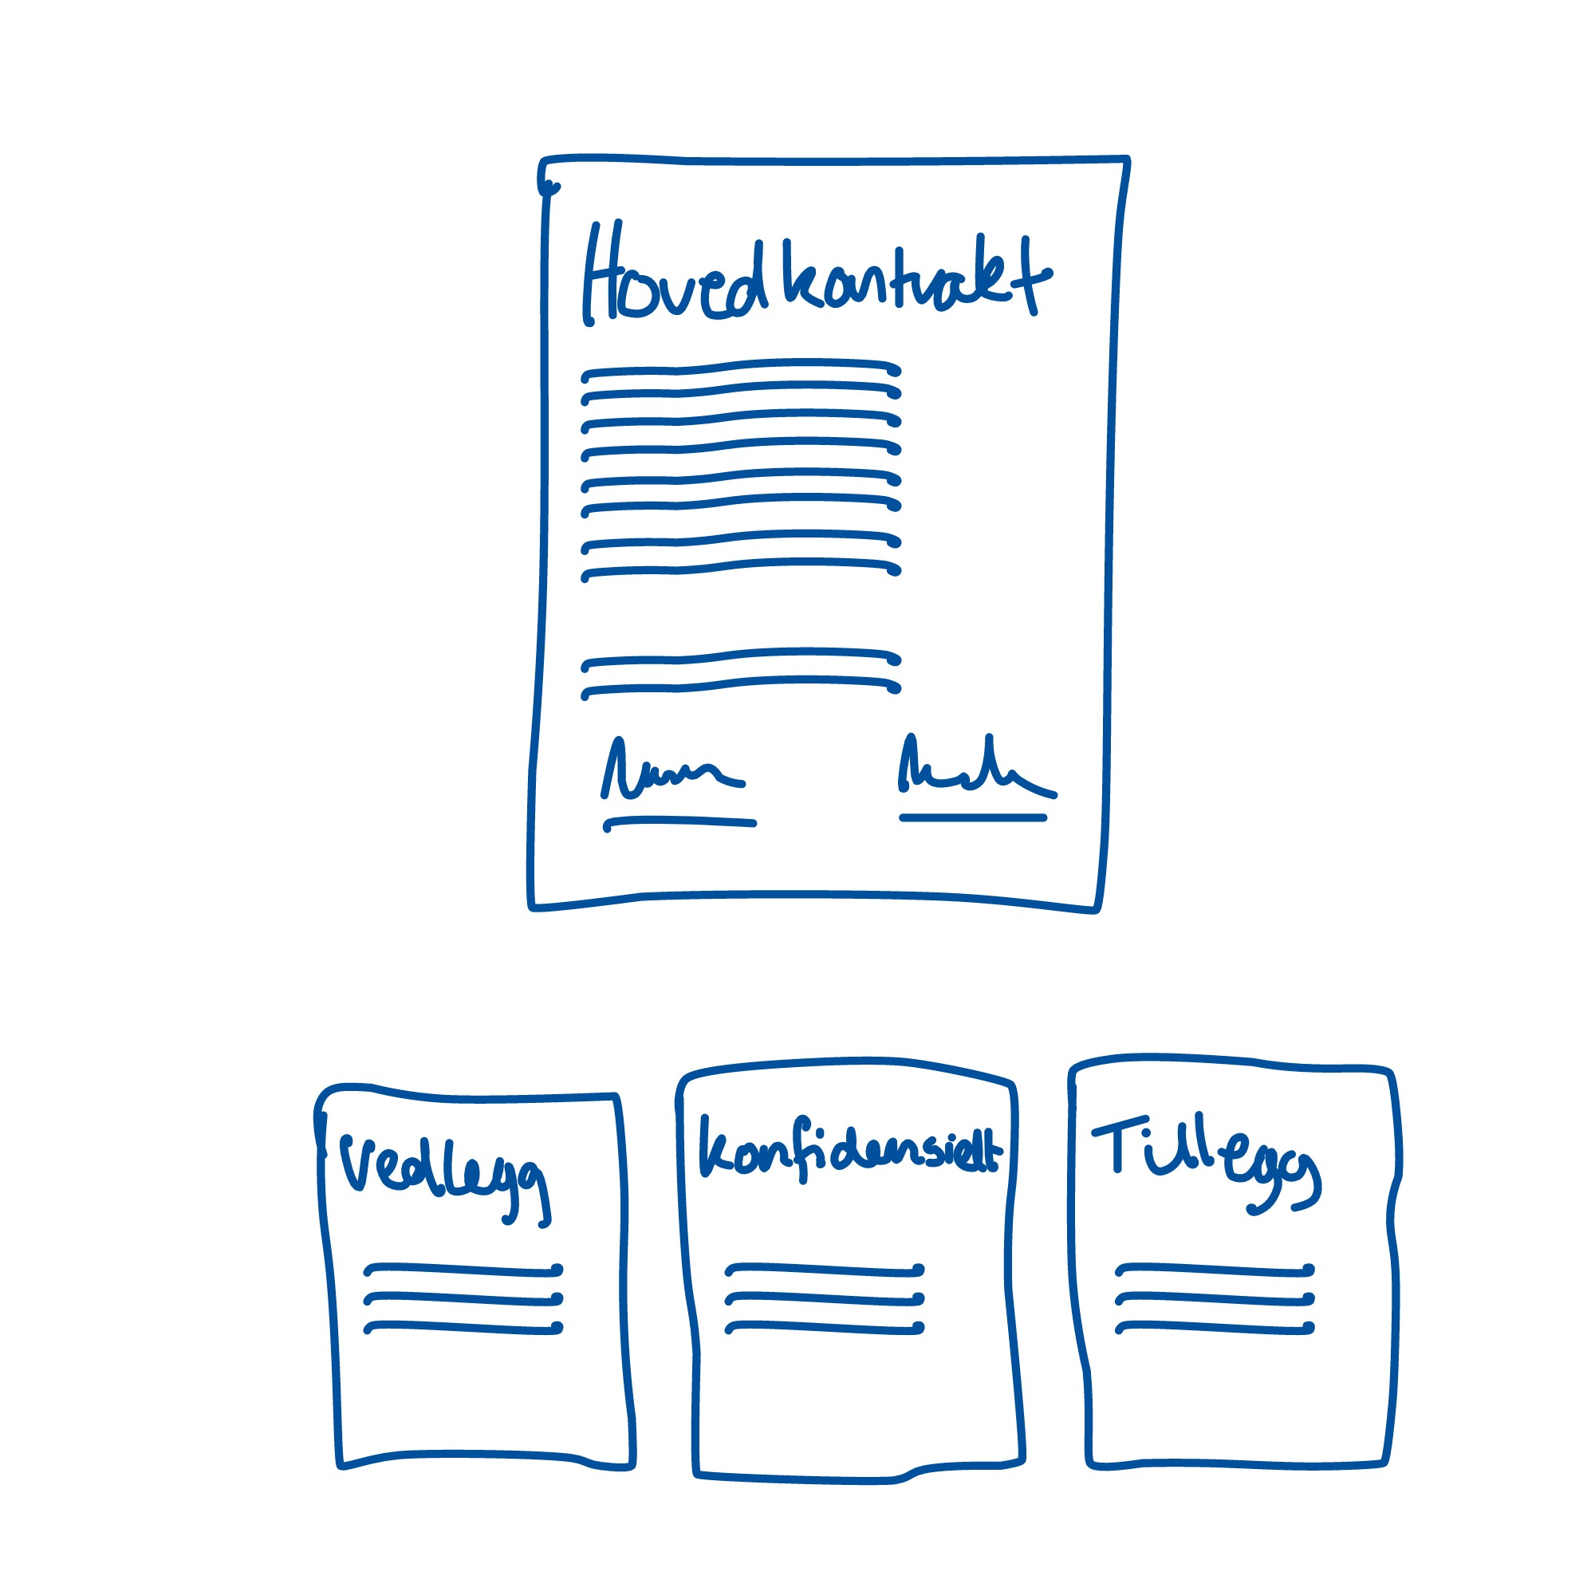
General
1
Main contract and appendices
The standard agreement consists of a main section – the standard agreement concerning work on a thesis in cooperation with a company or organization outside NTNU – and any appendixes.
Appendixes may include a confidentiality agreement, specification of project background owned by a party to the agreement or third parties, or a supplementary agreement with the company.

Slide 8
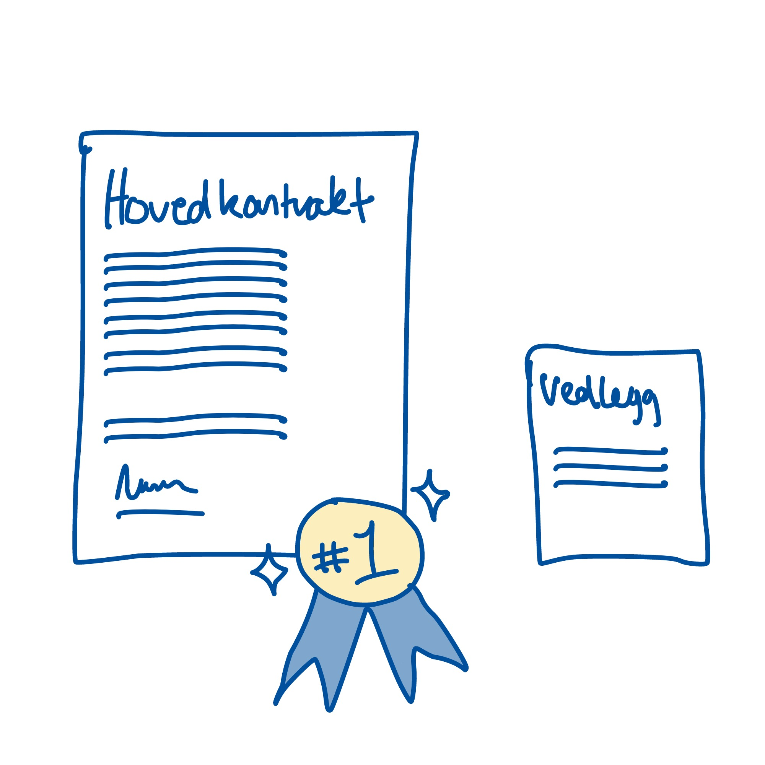
General
9
Precedence over other agreements
The standard agreement must take precedence over any appendixes and other agreements established between the parties to the agreement.
This is to prevent conflicting agreements being made, for example between the student and the external organization, which bypass the standard agreement and may lead to uncertainty about what applies.

Slide 9
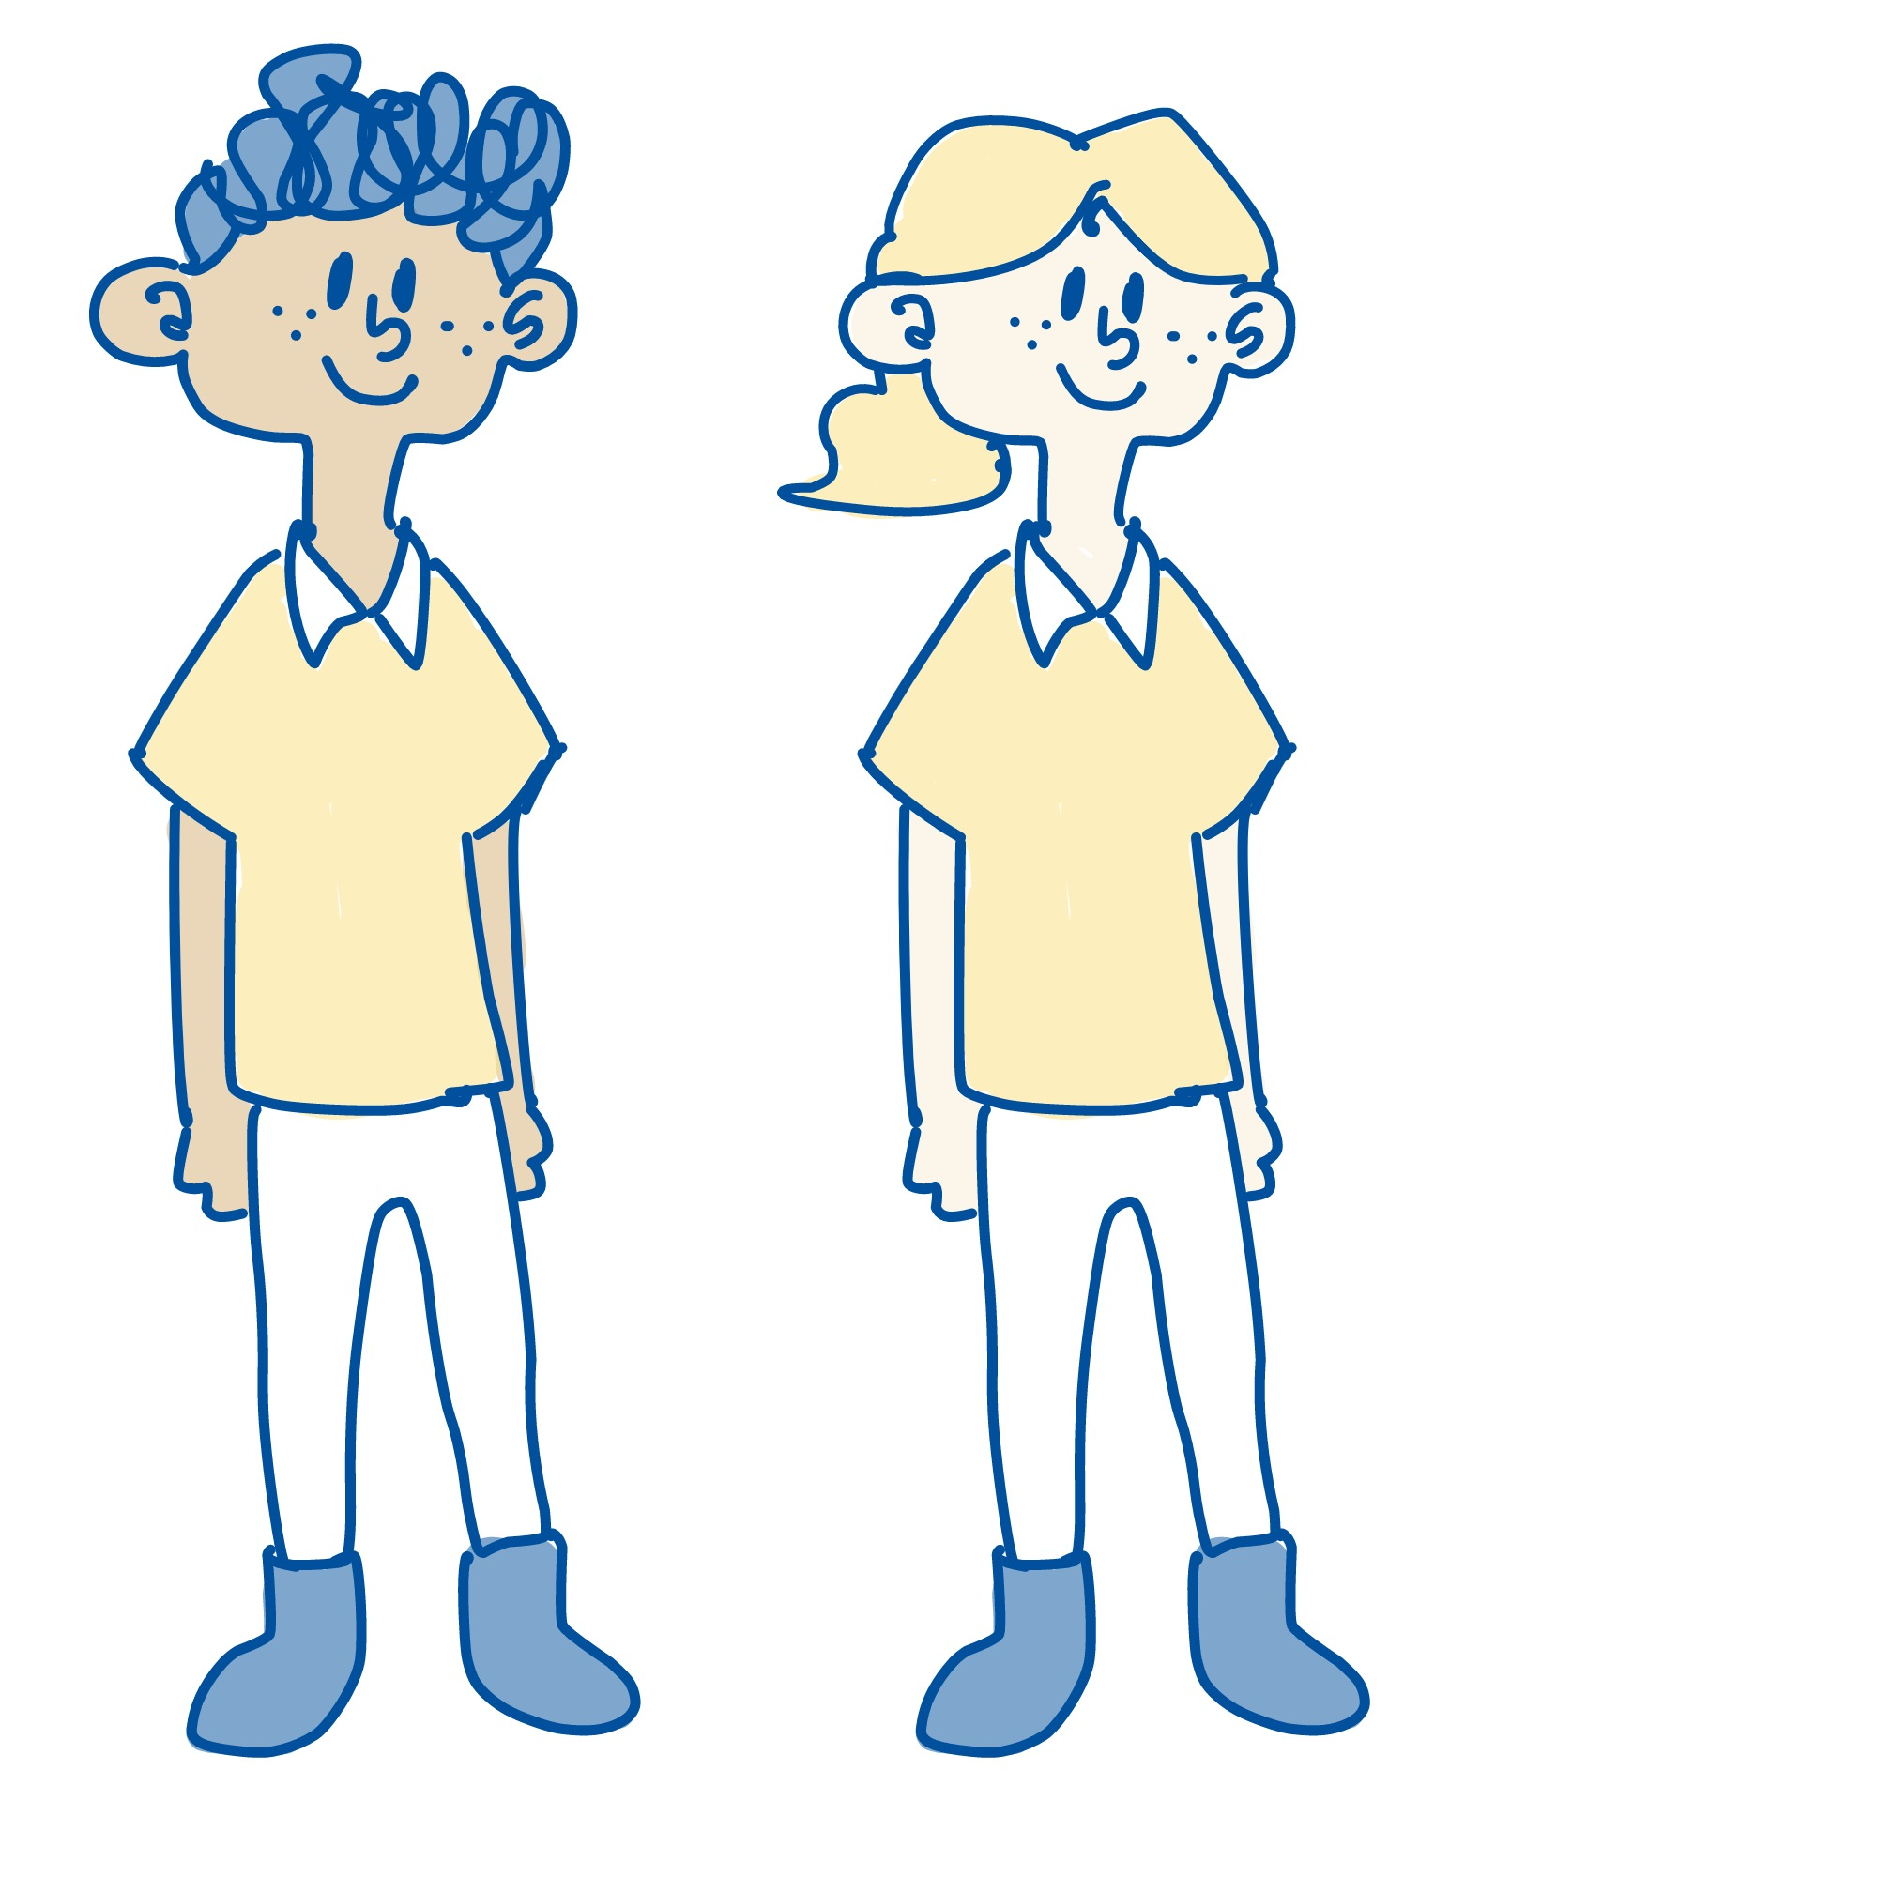
General
2
When several students write together
Do we have equal rights?
Yes. Unless otherwise agreed, students working together are legally on an equal footing. This may be adjusted, for example if the thesis is based on results from a previous project owned by one of the students.
In principle, each master’s degree student should write an agreement with the organization, but if you write the thesis in cooperation with others, all of you can also enter into this agreement jointly.
The prerequisite is that the external party accepts a joint agreement.

Slide 10

General
1
Clarification of Intellectual Property Rights
Project background?
Examples include data collected in another project or data from the external organization.
If the thesis is based on project background to which you or someone else have intellectual property rights, this must be clarified in advance and specified in a separate appendix.
The appendix specifies the content of the project background and the limitations that this entails.

Slide 11
General
9
Confidentiality agreement – part 1
What can I say about the thesis?
If you are unsure about what you can say to other people, you should talk to the contact person at the enterprise for some practical examples of where the boundaries are. Confidential information should also be specified in a confidentiality agreement.
If you gain access to information that is important for the external party to keep secret, you can enter into a confidentiality agreement. Here, you undertake not to disclose information to others if the external party has defined it as confidential.
NTNU has made a template that can be used for this.
Own confidentiality agreement?
The external organization can also use its own confidentiality agreement if it does not conflict with the standard agreement for the thesis. If there is any conflict, NTNU’s standard agreement for the thesis takes precedence.
Confidentiality agreement template

Slide 12
General
9
Confidentiality agreement – part 2
What can I say about the thesis?
If you are unsure about what you can say to other people, you should talk to the contact person at the enterprise for some practical examples of where the boundaries are. Confidential information should also be specified in a confidentiality agreement.
You undertake not to disclose the confidential information for 5 years, and the agreement must be attached to the standard agreement for the thesis.
When you sign a confidentiality agreement, you will be subject to the general rules on penalties and compensatory damages for any breach of confidentiality.
Own confidentiality agreement?
The external organization can also use its own confidentiality agreement if it does not conflict with the standard agreement for the thesis. If there is any conflict, NTNU’s standard agreement for the thesis takes precedence.
Confidentiality agreement template

Slide 13
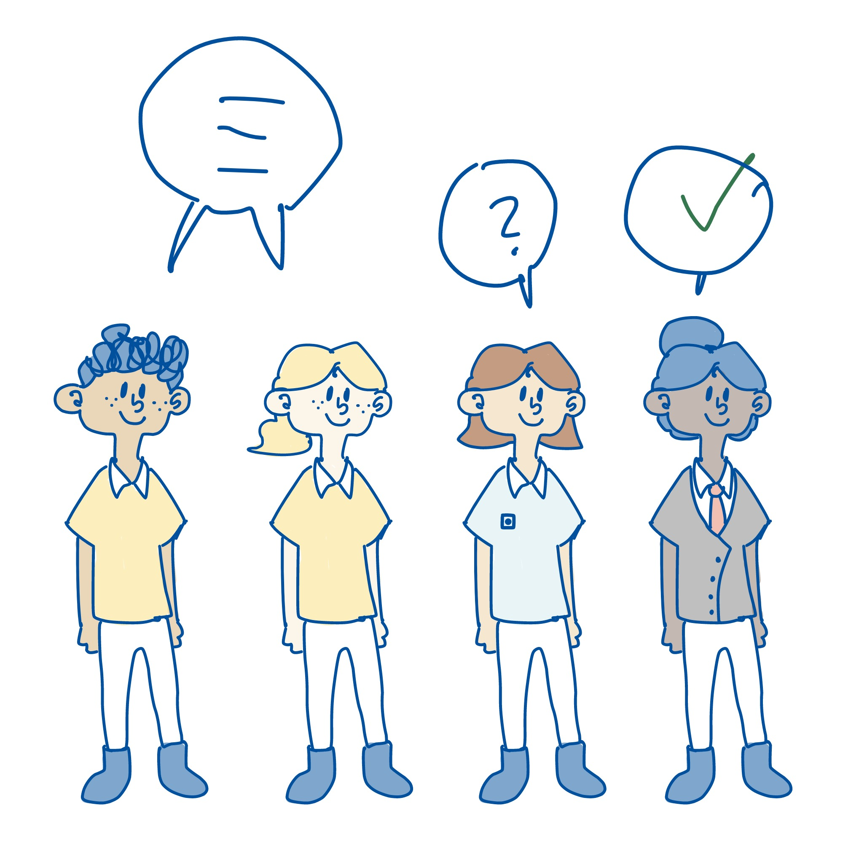
General
9
Disagreements
Arbitration
This is a private procedure for resolving disputes outside the courts, but with proceedings largely similar to a court case.
The parties must first try to resolve disagreements through negotiations with each other. If this does not succeed, the dispute must be settled by arbitration.
The advantage of arbitration is that the case can be resolved more quickly and that, in general, the decision cannot be appealed, which also helps to speed up the process of getting a final decision.

Slide 14
2. The Student’s Rights

Slide 15
The Student’s rights
4
General
Copyright
The right of the creator of a literary, scientific or artistic work to produce copies of the work and make it available to the public.
Whatever happens, you hold the copyright to your thesis, and you keep the moral rights regardless of who has been granted user rights or ownership rights to the results. You are entitled to be named and to be protected against infringing use.
You also own the results, but by agreement you can grant others the right to use or own the results.
Right of use
The owner of the results can grant others a right to use the results. For example, a student can grant the external organization the right to use the results of the student thesis.
Ownership rights
The owner of the results decides over them. The basic principle is that students own the results from their student work. By agreement, ownership rights may also be transferred to others.

Slide 16
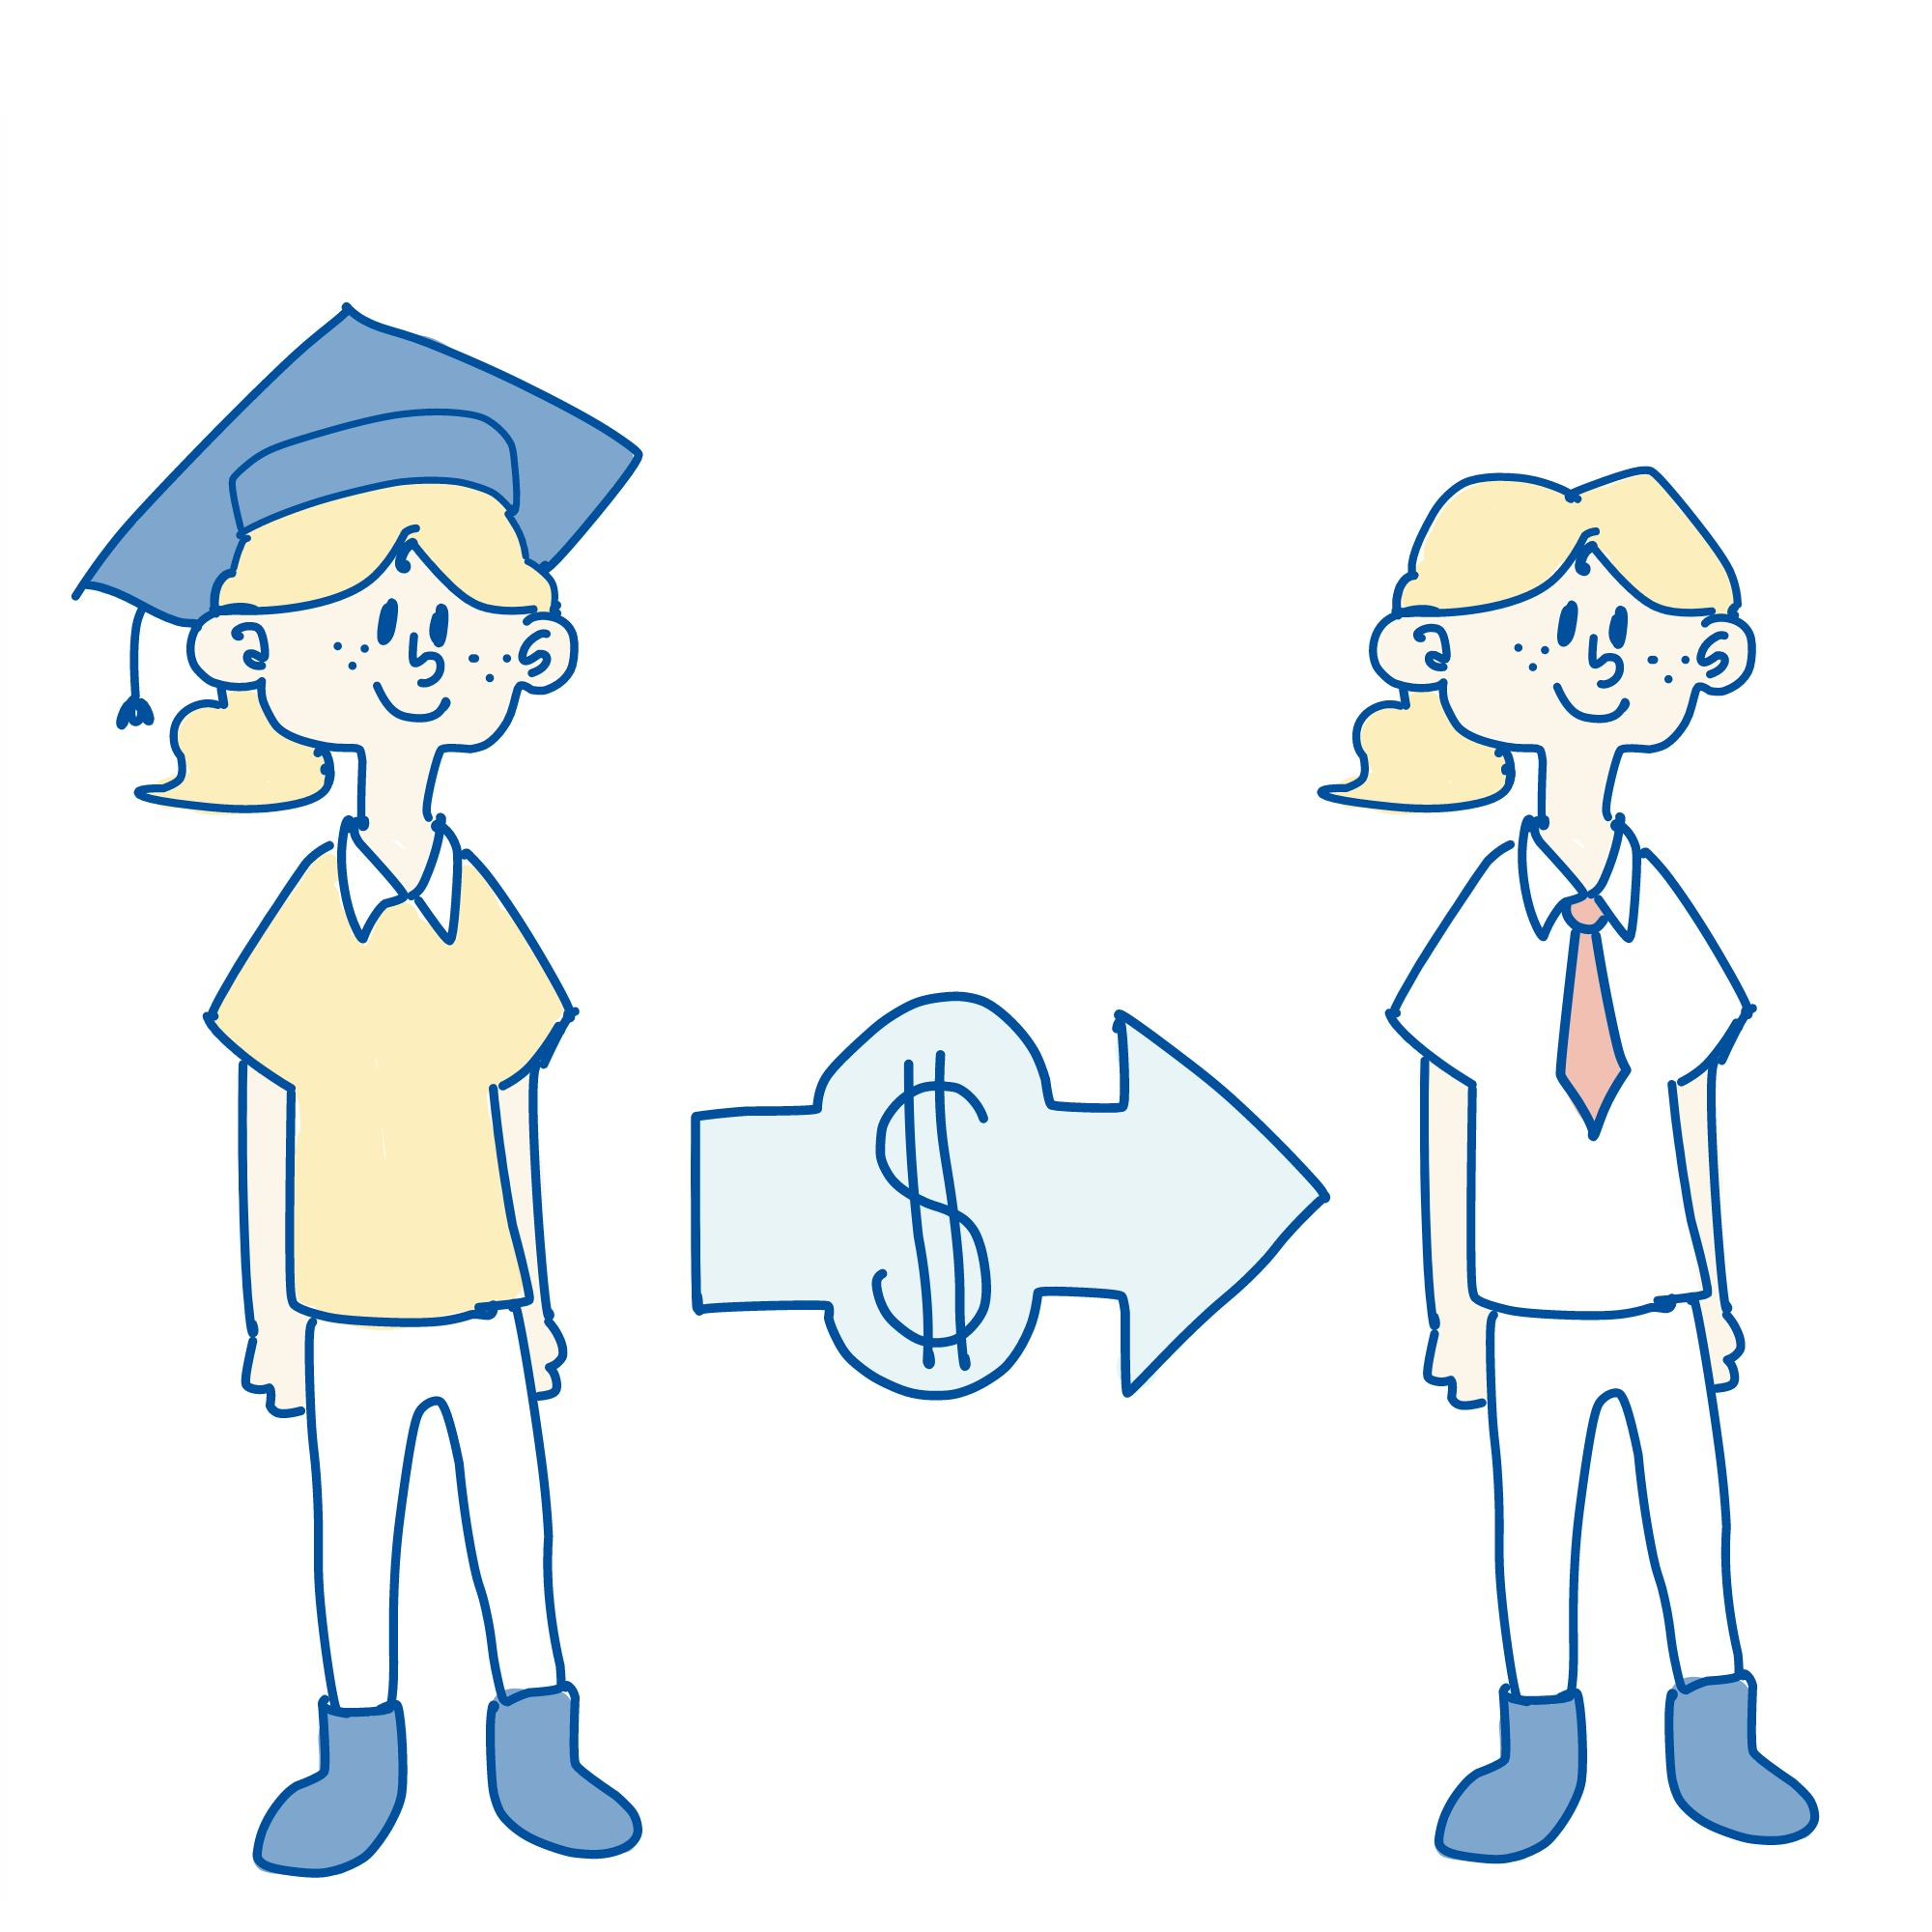
The Student’s rights
3
Can I earn income for my thesis?
The thesis must be an independent piece of student work. If you earn a salary for your thesis, you are in an employment relationship, and other rights apply – for example, the external party may own your results.
In order for your thesis to be independent student work, you cannot get a salary from an external organization during the thesis period.

Slide 17

The Student’s Rights
5
Transferring ownership rights – General
Why should I transfer?
The external organization must provide specific reasons for why a transfer is necessary. For example, the project is part of a larger collaborative project or is critical to the company's activities.
The standard agreement allows you to transfer ownership to the external organization before starting your thesis.
This transfer may be a condition for the collaboration, but it may be possible to nuance the agreement to protect the rights you may need in the future.

Slide 18
The Student’s Rights
5
Transferring ownership rights – Example
In doubt about transfer?
If you have any doubts about whether you should transfer ownership, or about which results you should transfer to the external organization, you should discuss this with your supervisor.
For example, you can transfer ownership of a computer program that you have developed. Then it will be the new owner who makes decisions about the program in the future.
You will no longer have the right to commercialize the program, because the new owner will have taken over this right.

Slide 19
3. Patentable Inventions

Slide 20
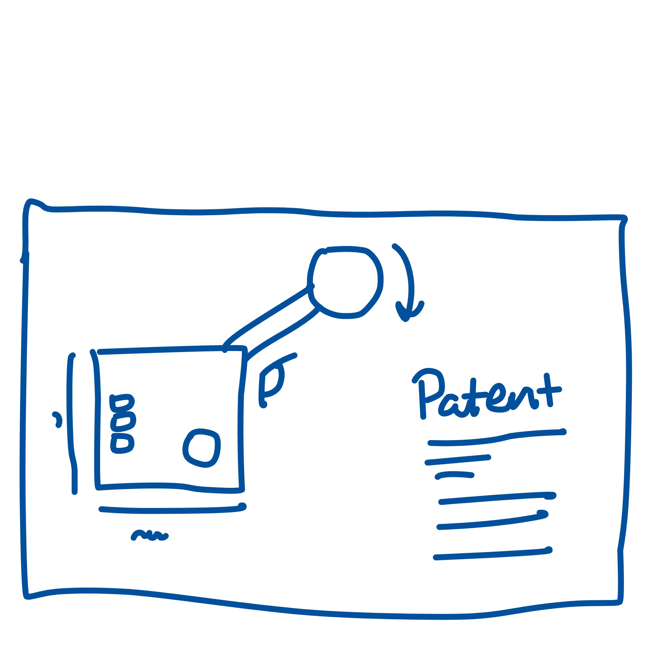
Patentable Inventions
6
What is a patent?
What can be patented?
Concrete technical solutions or inventions can be patented. The idea must also be new, and you must have the right to patent it.
Patent protection gives you an exclusive right to exploit an invention commercially for a limited period, usually 20 years. In some cases, the result of student theses may be a patentable invention.
The Norwegian Industrial Property Office (Patentstyret) registers patents in Norway. This involves some fees and generally takes a while, often several years.

Slide 21

Patentable Inventions
6
Transfer of the right to patent an invention
Why should I transfer?
The external organization must provide specific reasons for why such a transfer is necessary. If the student is granted a patent for something that the company needs, this could cause problems for other related projects.
By agreement, the student can transfer the right to patent an invention to the external party if the invention falls under the external party’s area of activity.
The external organization may also require this as a condition for collaboration. In this case, the student must be fairly compensated.

Slide 22

Patentable Inventions
6
Payment for patentable inventions
In doubt about transfer?
If you have any doubts about whether you should transfer your ownership to the external organization, you should discuss this with your supervisor.
Under the Act on Employee Inventions, if you transfer the right to patent your invention, you must get reasonable compensation.
The amount to be paid must take into account the value of the invention and the extent of the right that the external organization will take over.

Slide 23
4. The External Organization

Slide 24
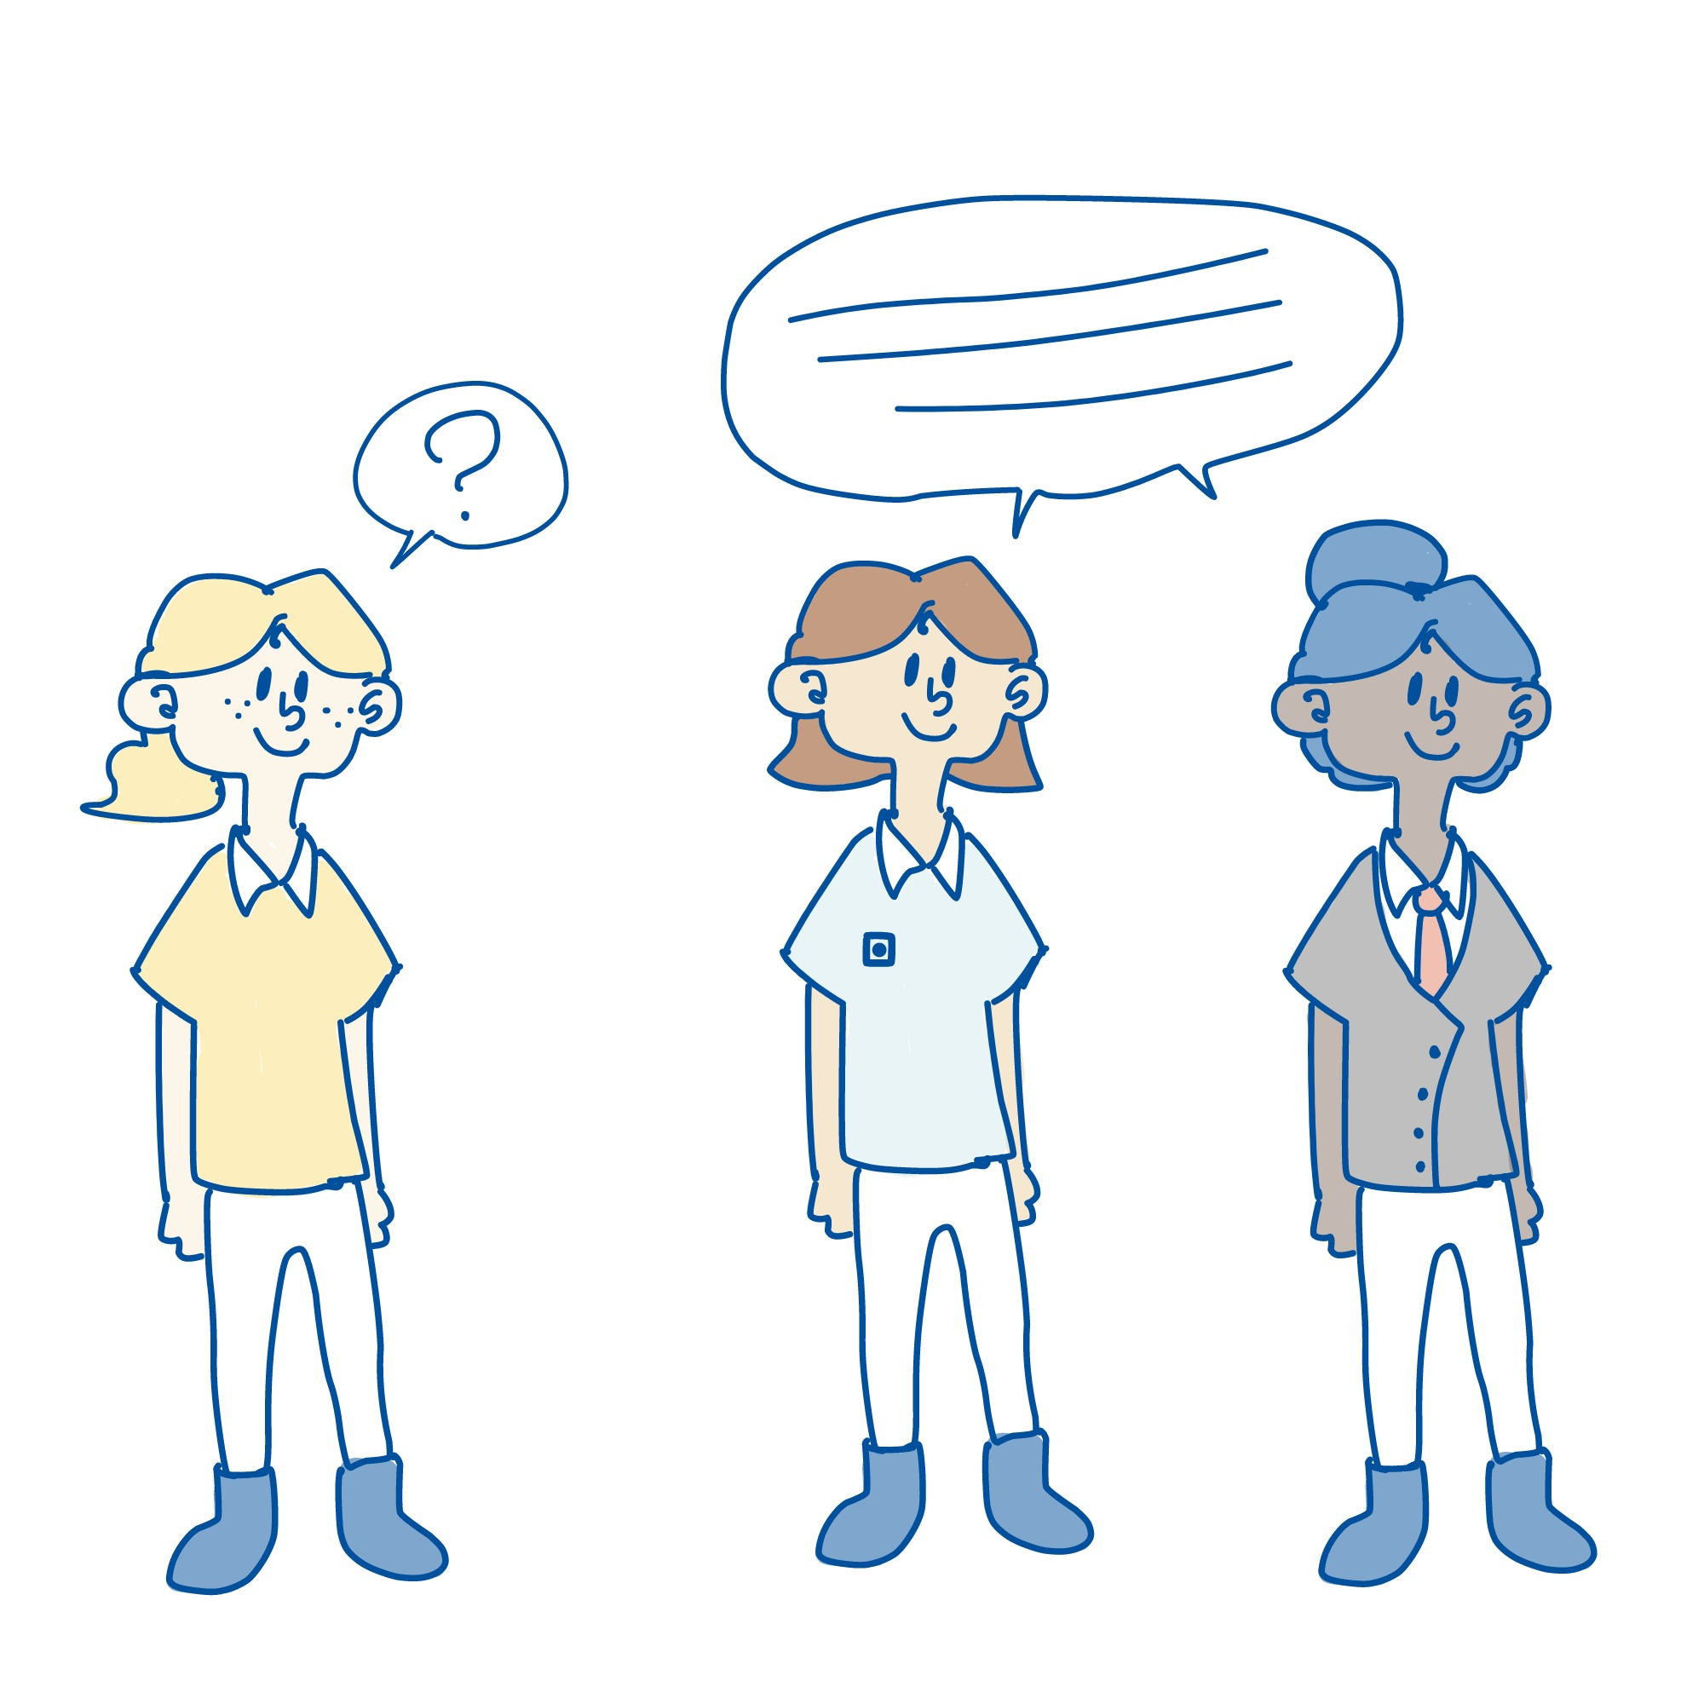
The External Organization
3
Competence
Competence
Here, the organization undertakes to provide you with the basis for writing a good thesis on your topic. If the collaboration is not working out, you must discuss this with your supervisor.
Your contact person at the external organization must have the necessary competence in the subject area to give you guidance in developing your thesis, together with your supervisor from NTNU.
No specific education is required, but the contact person must have an education and/or professional experience enabling them to guide you in your particular thesis.

Slide 25

The External Organization
3
Expenses for completing your thesis
Which expenses can be covered?
Examples include travel, materials for building prototypes, expenses for data collection, purchase of samples, lab tests, chemicals, etc.
The external organization usually covers your expenses for completing your thesis.
There is scope for clarifying expenses during the project, but it is an advantage to provide a rough specification when you start your thesis.
Always remember to clarify expenses in advance.

Slide 26
The External Organization
5
General rule on rights
Right of use
The owner of the results can grant others a right to use the results. For example, a student can grant the external organization the right to use the results of the student thesis.
The standard agreement gives the external organization the right of use. Students generally keep the right of ownership, and later they can also give other actors the right of use.
When you keep the ownership rights, you can later choose to commercialize the results yourself or transfer ownership to someone else.
Ownership rights
The owner of the results decides over them. The basic principle is that students own the results from their student work. By agreement, ownership rights may also be transferred to others.

Slide 27

The External Organization
5
Exceptions – Part 1
In exceptional cases, the external organization can take over ownership of the results. It will then be the external organization that decides on further use in the future.
The external organization must specifically explain why there is a need for transfer of ownership rights in the agreement.

Slide 28

The External Organization
5
Exceptions – Part 2
Some organizations may want to transfer the ownership rights because the student is one of several parties working on the same project. It will be difficult to exploit the results if the student has ownership rights to a smaller part of the project. So this might be a prerequisite for the student to be able to complete the thesis.

Slide 29
5. NTNU’s Rights

Slide 30

NTNU’s Rights
7
The university’s right of use
NTNU is an educational institution and builds knowledge based on knowledge. For collaboration with external parties, NTNU must always be ensured the right of use for teaching and research purposes, regardless of who has ownership rights.

Slide 31
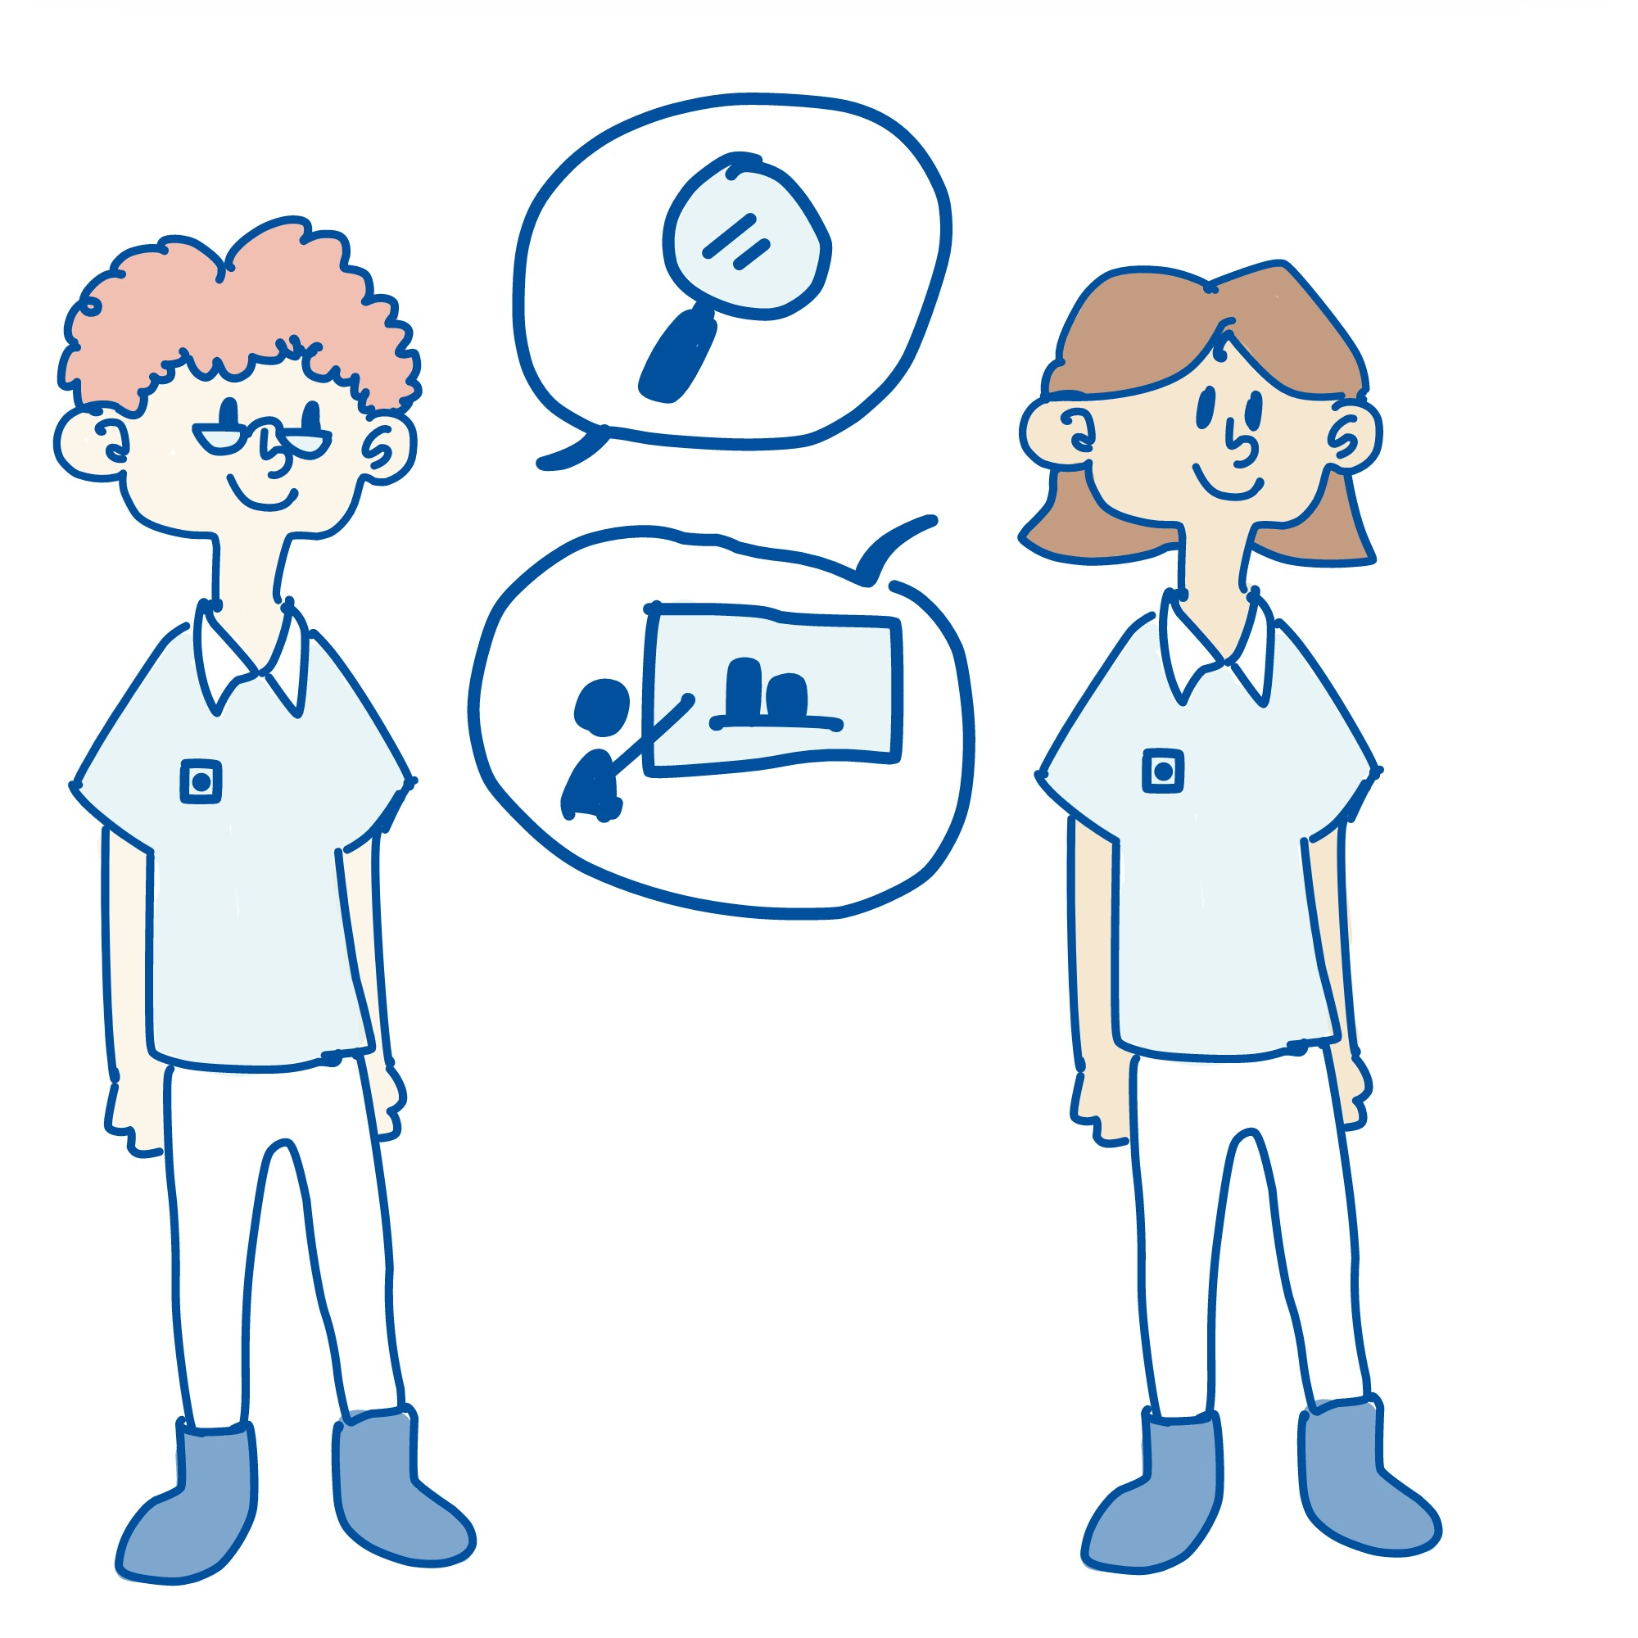
NTNU’s Rights
7
NTNU’s use of results
NTNU only has the right to use the results for its core activities and cannot use them for commercial purposes unless ownership is transferred to the university.
An example where this might be relevant is if the project is part of a larger research project funded by an external actor.

Slide 32
6. Publication

Slide 33
Publication
8
Open knowledge at NTNU
NTNU Open
This is the university’s database for publications by students and staff at NTNU. Here, for example, you can find all master’s theses written at NTNU. Some of them are entirely or partially locked and thus exempt from public access.
NTNU aims to ensure the greatest possible openness about the basis for awarding an academic degree – for example, the reason that a student has achieved a master’s degree.
Enabling publication of student work in NTNU Open makes this knowledge available to everyone, with potential benefits for society.
NTNU Open

Slide 34

Publication
8
Fully or partially postponed publication
Confidential information
If the thesis is based on information that the external organization wants to keep secret, it will also be natural to sign a confidentiality agreement.
Publication of the whole or part of the thesis is postponed for a maximum of three years. One reason for this might be to protect the external party’s trade secrets.
If an agreement on postponed publication (embargo) has been signed at the start of the thesis, the parties should consider whether this is still needed at the time of submission.
Reasons explaining the need for the embargo must be provided.

Slide 35
Publication
8
Postponement for more than 3 years
Absolute need?
If a longer embargo is needed, one can look at the possibility of reformulating or limiting the thesis so that publication within three years is possible.
Changes take place so fast that three years should be enough to consider commercialization or a patent application.
If the external organization believes there will be need for a longer embargo period, the thesis may not be suitable as a piece of student work.

Slide 36
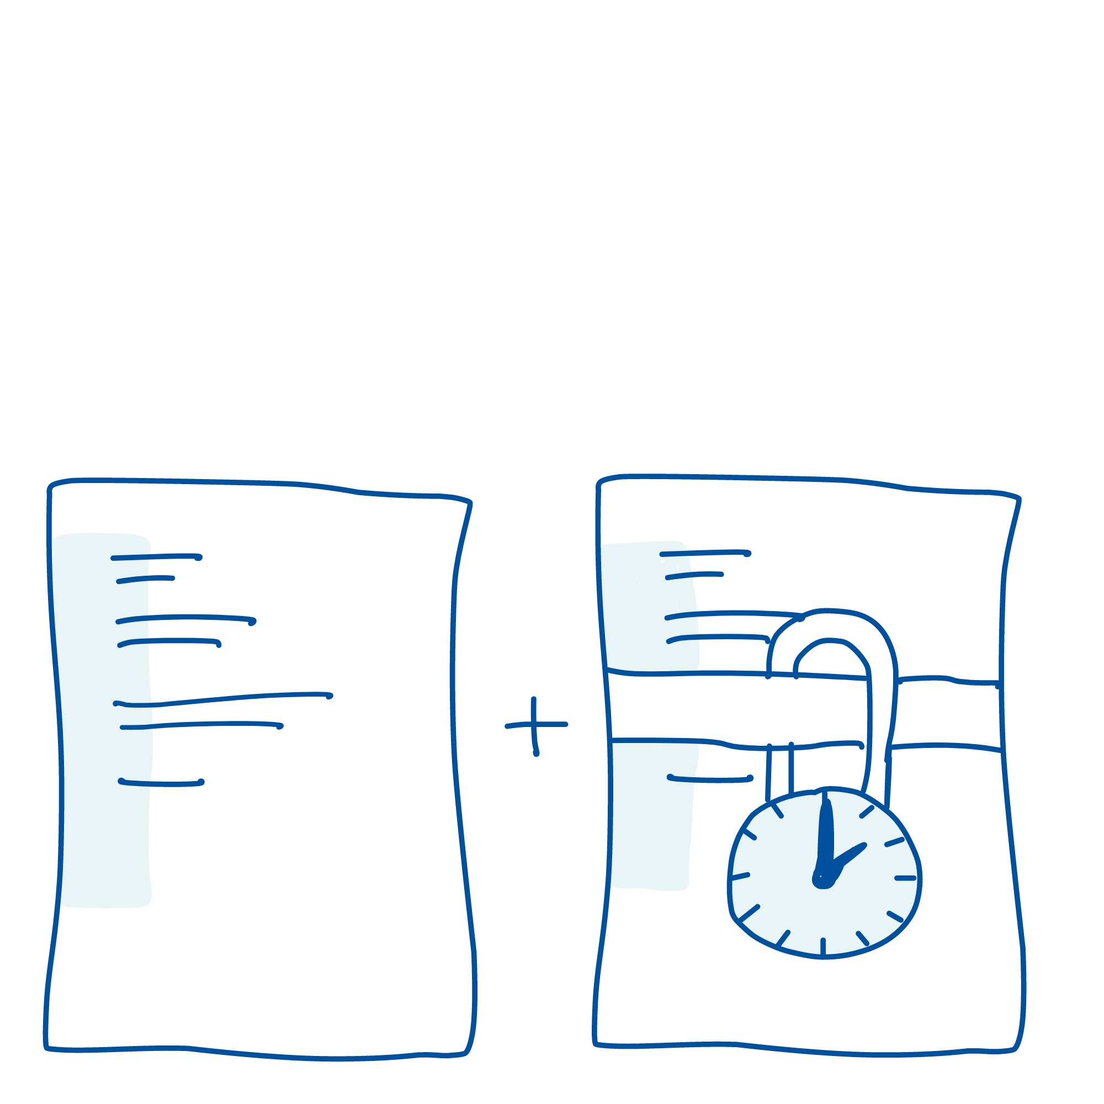
Publication
8
Confidential information in appendices
If confidential information, such as trade secrets, is to be included in the thesis, one can consider providing the confidential information in an appendix to the thesis so that the appendix can be excluded while the rest of the thesis is published.
The attachment can be exempted from public disclosure for longer than three years if necessary.

Slide 37
Publication
8
Access and use
What can I say about the thesis
If you are unsure about what you can say to other people, you should talk to the contact person at the enterprise for some practical examples of where the boundaries are. Confidential information should also be specified in a confidentiality agreement.
If the thesis is not public, only the student, supervisor, external organization, and examiner will have access to it. You cannot publish the thesis in NTNU Open during this period.
The external organization must still make it possible for you to use all or part of the thesis in connection with job applications or further academic work.
What about the examiners?
Both internal examiners at NTNU and external examiners will have a duty of confidentiality under Section 13 of the Public Administration Act. This also covers identifiable personal data.

Slide 38
7. Summary

Slide 39
Summary
The three most important things
The purpose of the standard agreement is to safeguard your rights. It is therefore the main agreement that applies in any conflicts with appendixes or other agreements.
You have the copyright to your thesis. You also have ownership rights, but they can be transferred to the external organization if this is appropriate for the purpose.
NTNU can use your results for further research and teaching, but not commercialization.

Slide 40
Summary
Resources
Standard agreement
Student and business cooperative agreements
NTNU Open
Confidentiality agreement template

