Slide 1


Slide 2
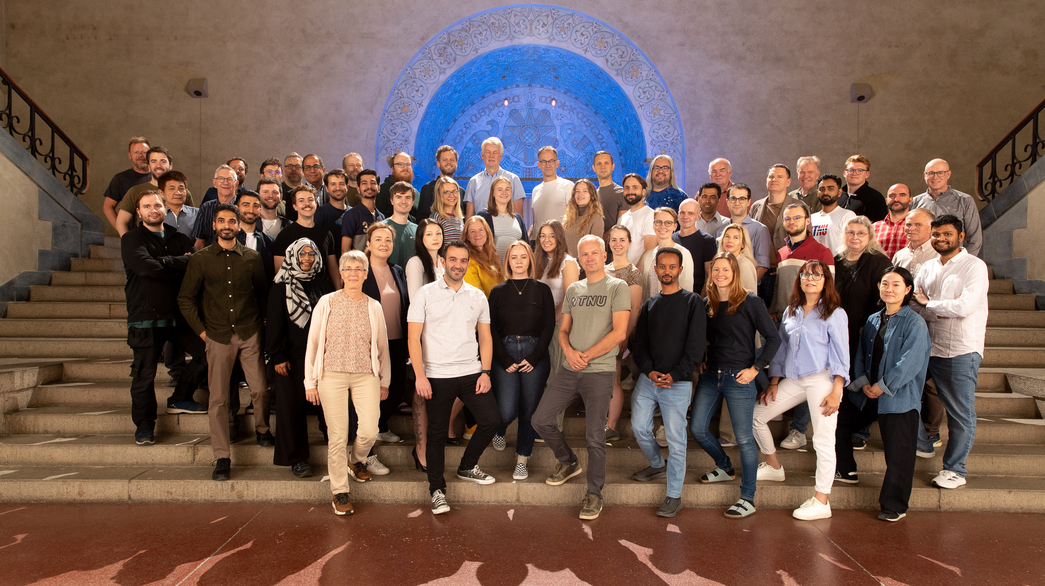
Utdanningsportefølje
Educational Portfolio
Institutt for elektrisk energi (IEL)
Department of Electric Energy

Slide 3

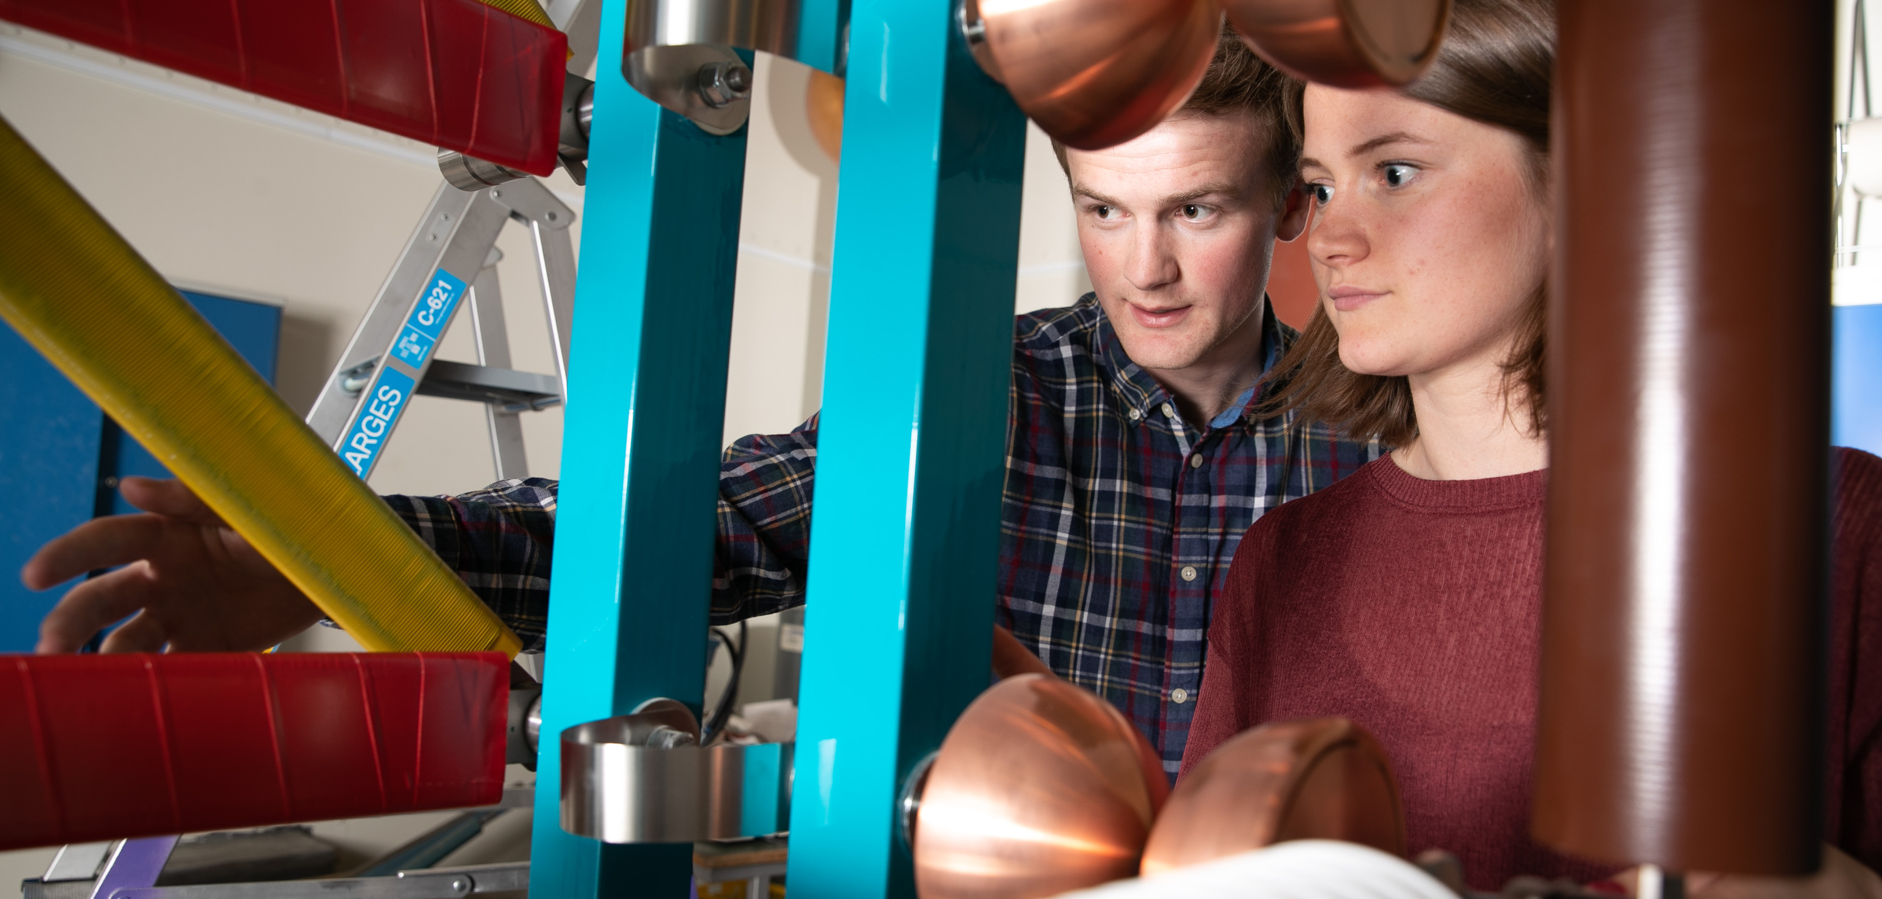

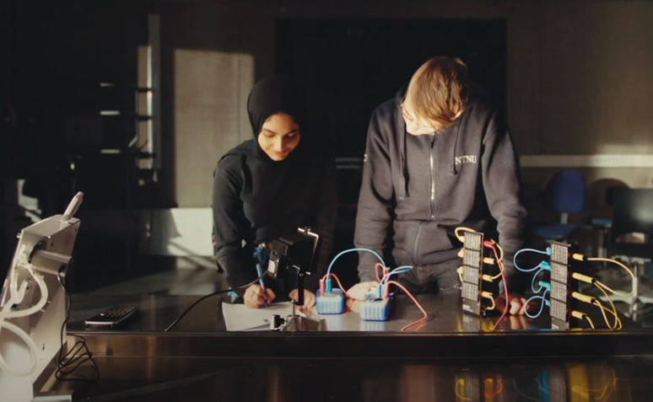

PhD Electric Power Engineering (3 to 4 yeras)
MSc Electric Power Engineering (2-year)
MSc Energy and the Environment (2-year)
MSc Energy and the Environment (5-year)
Our Study Programmes
BSc Electrification and digitalisation (3-year)
BSc Electrical Engineering (3-year) (Gjøvik)

Slide 4
Study Programmes
(One 5-year Master’s, Two 2-year Master’s, Two 3-year Bachelor’s, One 3-year PhD)
https://www.ntnu.edu/iel/studies
Name of the Study Programme | Degree | Duration (Years)
Energy and the Environment | Master’s (Collaboration between two Faculties – IE and IV) | 5
Electrification and Digitalisation | Bachelor’s | 3
Electrical Engineering | Bachelor’s | 3
Electric Power Engineering | Master’s | 2
Energy and the Environment | Master’s | 2
European Wind Energy | Erasmus Mundus Master’s | 2 (last edition at NTNU in 2025)
Renewable Energy in the Marine Environment | Erasmus Mundus Master’s | 2 (last edition at NTNU in 2025)
Electric Power Engineering | PhD | 3 to 4 years

Slide 5
Admission Statistics - Trondheim
MTENERG
(5-year Master’s)
Intake between 130 & 140.
MSELPOWER
(2-year Intl. Master’s)
Intake of around 20.
BIELDIG
(3-year Bachelor’s)
Intake between 40 & 50.
MIENERG
(2-year Master’s)
Intake of around 50.

Slide 6
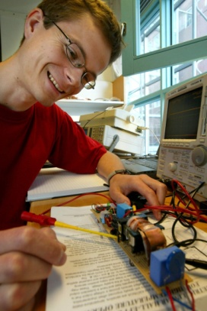

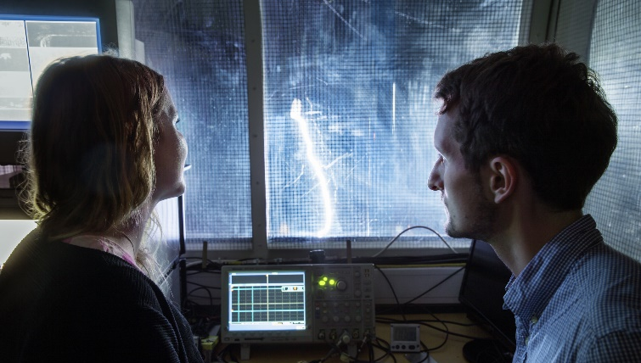


Five Research Groups
EME – Electrical Machines and Electromagnetics
PESC – Power Electronic Systems and Components
HVT – High Voltage Technology
EMESP – Electricity Markets and Energy System Planning
PSOA – Power System Operation and Analysis

Slide 7
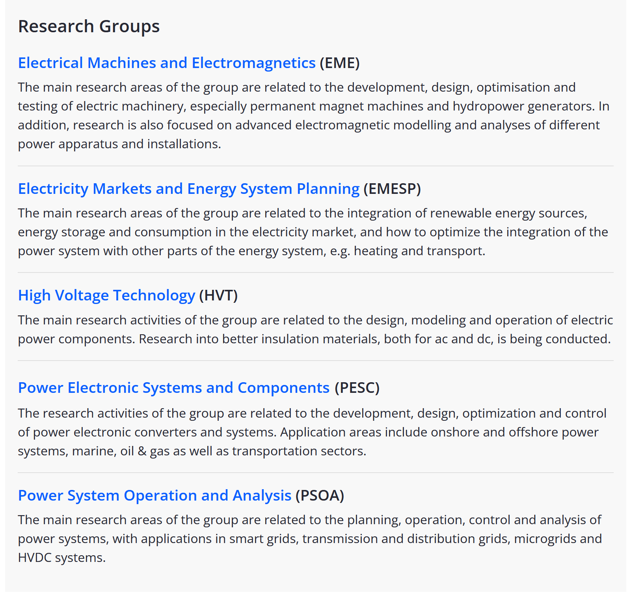
https://www.ntnu.edu/iel/research

Slide 8
Study Tracks
(Year 3)
HVT
Common
(Years 1 & 2)
EME/PESC
PSOA/EMESP
Main Profiles
(Years 4 & 5)
5-year Study Programme – Energy and the Environment
https://www.ntnu.no/studier/mtenerg/
Notes:
A study programme has several study tracks.
Each study track has several main profiles.

Slide 9
Study Tracks
(Year 3)
Main Profiles
(Years 4 & 5)
Common
(Years 1 & 2)
EMESP/PSOA
5-year Study Programme – Energy and the Environment
https://www.ntnu.no/studier/mtenerg/

Slide 10
Educational Competence Ladders in Each Research Group
Competence area
PhD
Continuing Education
Specialization course
MSc (4-5 y)
BSc (1-3 y)
Basis

Slide 11
Competeance Ladder Example for EME Research Group

Slide 12
These are courses given by members of the PSOA Research Group. Keywords in course titles:
System,
Operation,
Control,
Analysis.
Power System Operation & Control (ET8105)
Power System Reliability (ET8207)
PhD
MSc (5 y)
Specialization Course: Power Systems – Operation & Analysis (TET4575)
Power System Dynamics & Control (TET4180)
Power System Protection & Control (TET4215)
MSc (4 y)
Another Example:
PSOA - Competence Ladder of Discipline Courses
Power System Analysis 2 (TET4205)
BSc (3 y)
MSc (3 y)
Power System Analysis 1 (TET4105)
Digital Control Systems (IELET2102)
BSc (1-2 y)
Electric Circuits – Modelling & Analysis
12

Slide 13

Educational Quality

Slide 14

FTS – Fremtidens teknologistudier
The goal is to integrate FTS principles holistically in our study programmes

Slide 15
Study Programme Councils
Bachelor in Electrical Engineering
Gjøvik
Elektroingeniør på Gjøvik tilbyr to studieretninger:
Energy
Bachelor i ingeniørfag, elektrifisering og digitalisering
Master in Electric Power Engineering
Master i energi og miljø (5-årig
Elektronikk og sensorsystemer
Elkraft og bærekraftig energi
Master i energi og miljø (2-årig)

Slide 16
Study Programme Leadership - Trondheim
Study Programme Council ‘Energy’ Led by Halsten Aastebøl
MTENERG
Ivar Ertesvåg (EPT)
MSELPOWER
Halsten Aastebøl (IEL)
BIELDIG
Eilif Hugo Hansen (IEL)
MIENERG
Ivar Ertesvåg (EPT)

Slide 17
Study Programme Leadership - Gjøvik
BIELEKTRO
Knut Wold (IES)
Intake around 45 students

