Slide 1
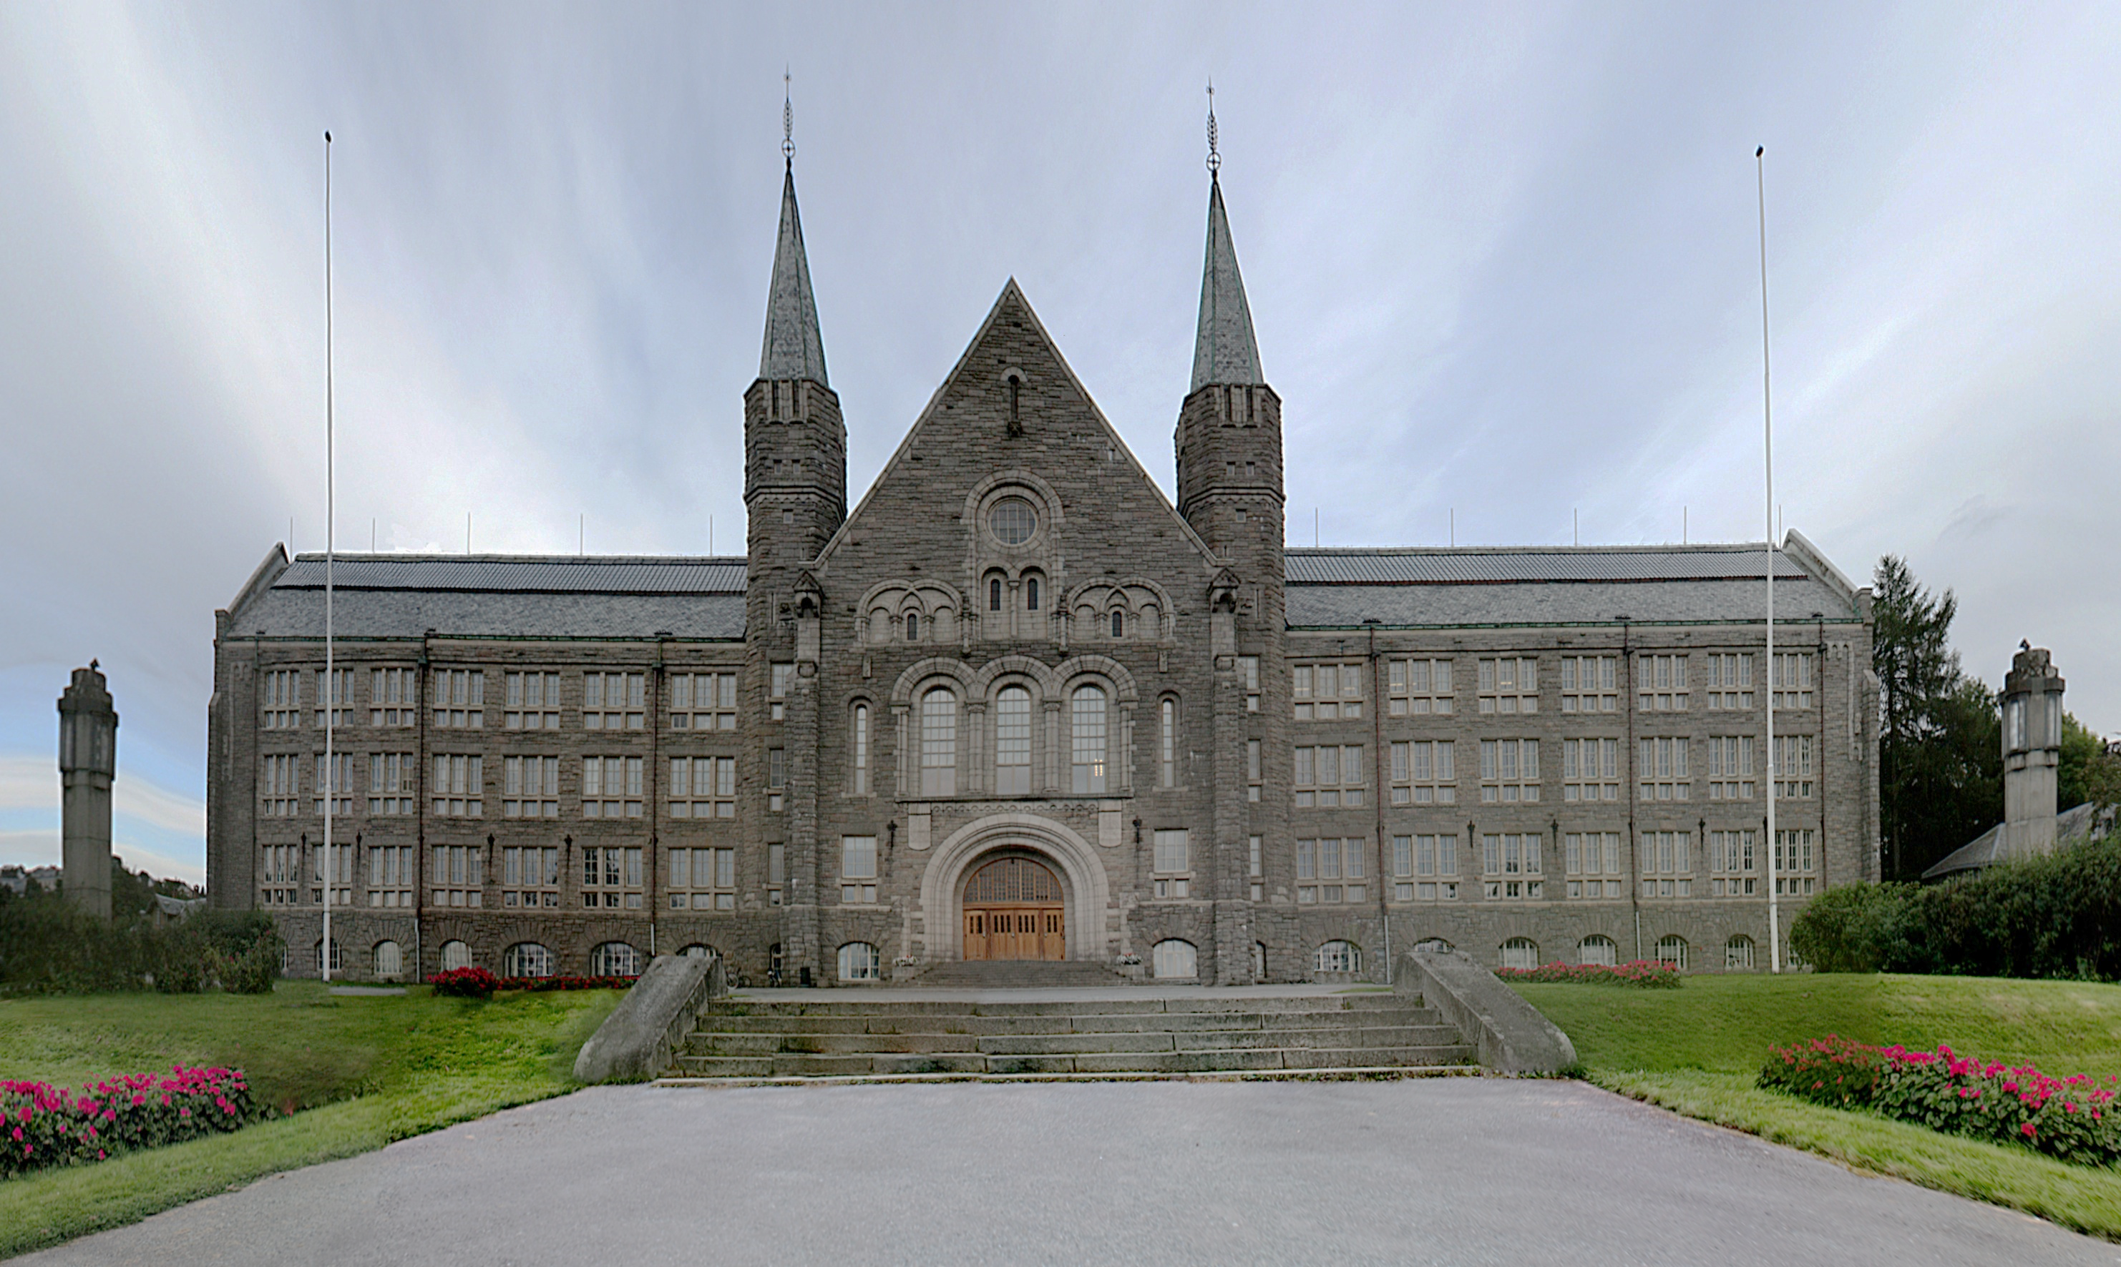
Welcome to NTNU

Slide 2
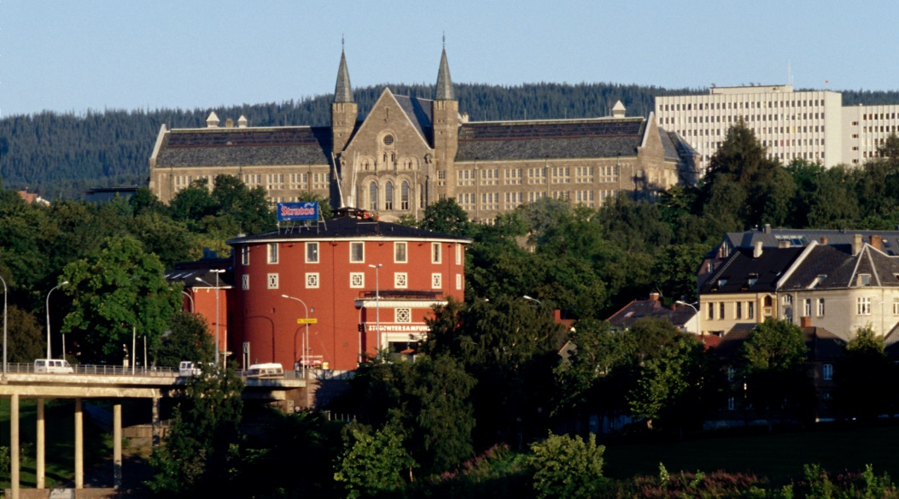

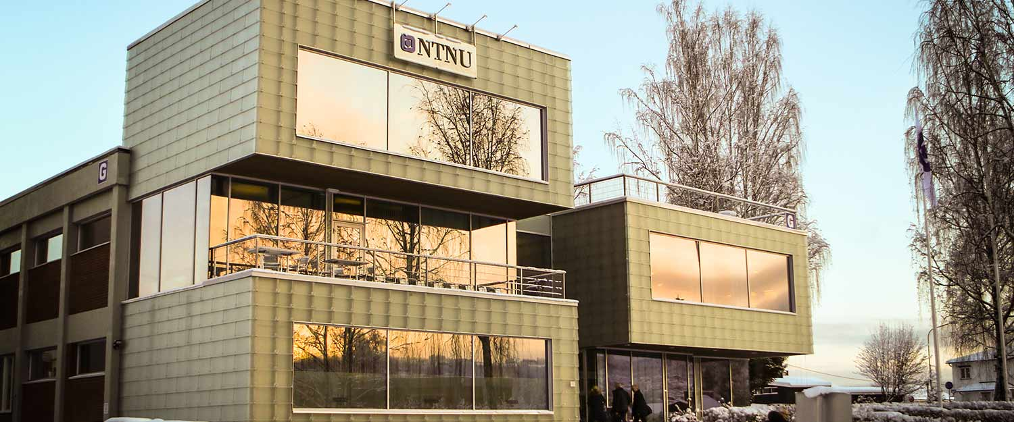
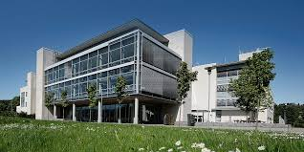
Main profile in science and technology
Academic breadth: humanities, social sciences, medicine, health sciences, science of education, architecture, fine arts and performing arts
Headquarters in Trondheim with campuses in Gjøvik and Ålesund

Slide 3
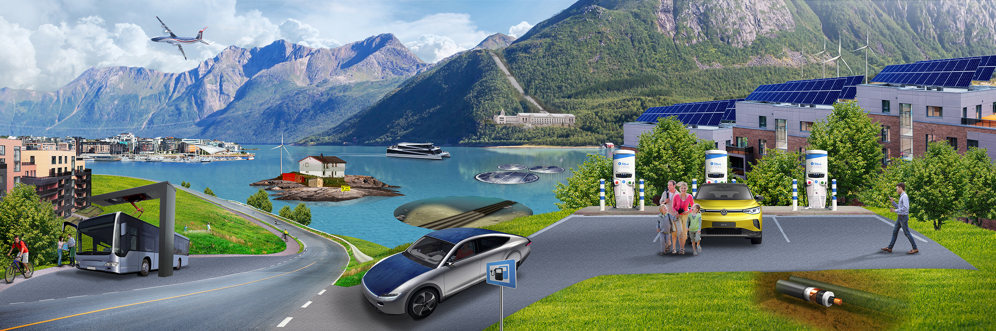
Department of Electric Energy

Slide 4


Slide 5
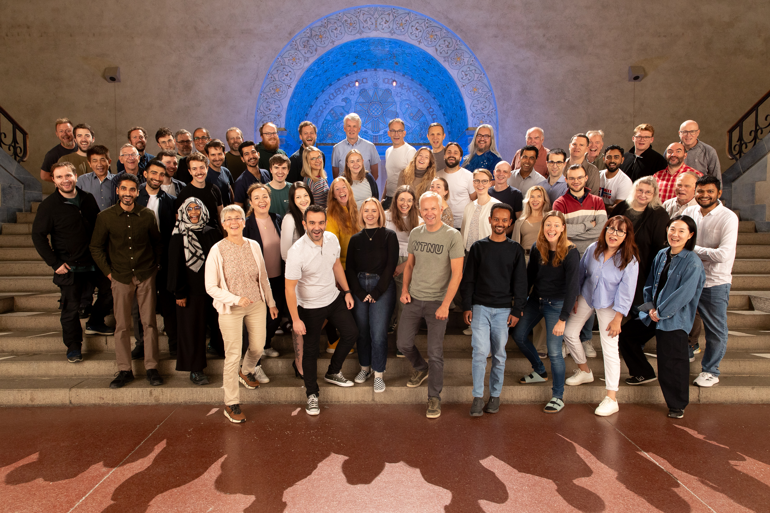
The Department (Photo by: Kai T. Dragland 11.09.25)
15 professors
11 associate professors
7 adjunct professors/associate professors
2 university lecturers
3 researchers
9 in technical staff
8 in administrative staff
Ca 70 PhD/post docs

Slide 6
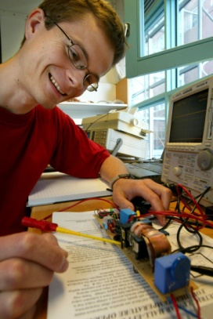

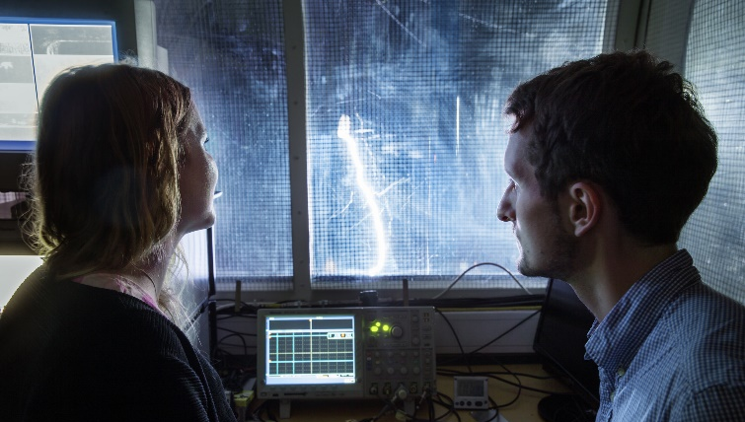


Research groups
EME – Electric machines and electromagnetism
PESC - Power electronics – systems and components
HVT – High Voltage Technology
EMESP - Electricity markets and energy system planning
PSOA - Power systems – operation and analysis

Slide 7

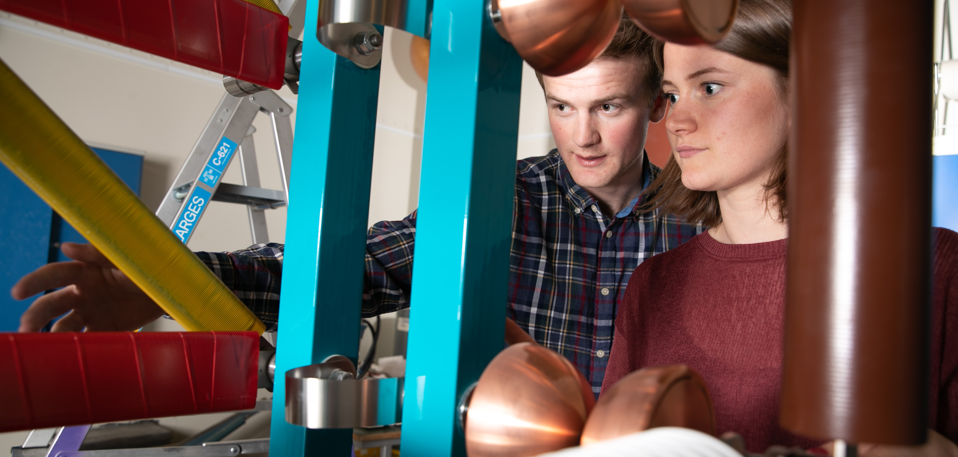
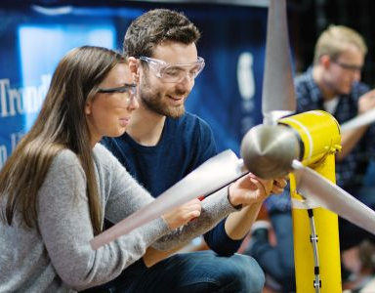
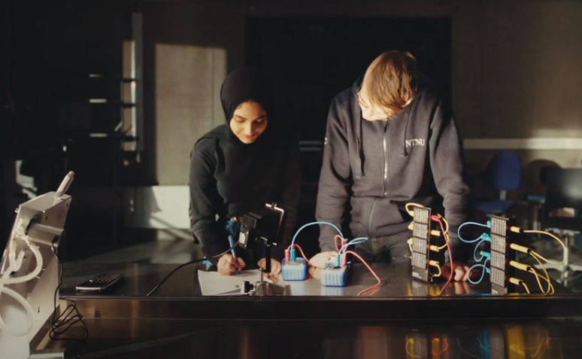

PhD Electric Power Engineering (3 or 4 years)
MSc Energy & Environment (5 years)
MSc Electric Power Eng.
(2 years)
Our study programs
BSc Electrification and digitalisation (3 years)
BSc Electrical Eng.
(3 years)

Slide 8
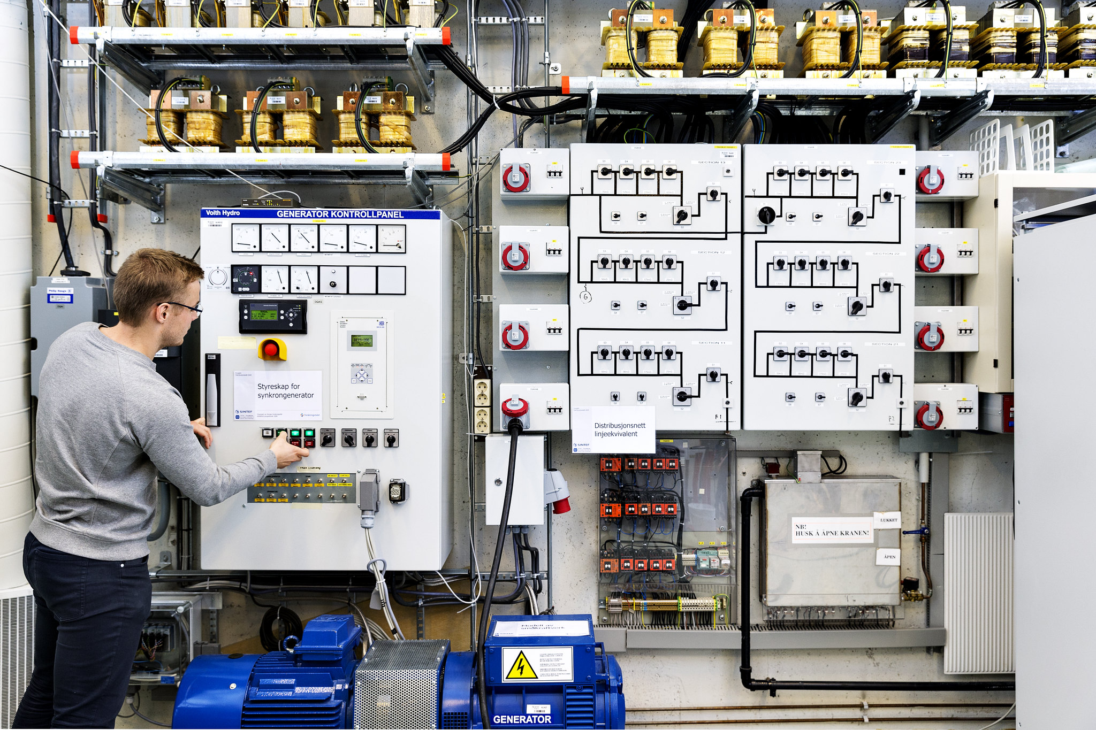
Laboratories
Notes:
LABORATORIENE VÅRE:
Høyspenningslaboratorier og høystrømlaboratorier
Smartgridlab
Elektriske maskinerlab
Kraftelektronikklab

