Slide 2
Introduction to plagiarism
and how to avoid doing it
(by accident)
Thorsten Hamann
Thorsten.hamann@ntnu.no
http://images6.fanpop.com/image/photos/34300000/Mona-Lisa-by-Leonardo-da-Vinci-fine-art-34373132-1920-2861.jpg
http://en.wikipedia.org/wiki/Isleworth_Mona_Lisa#mediaviewer/File:Mona_Lisa,_by_Leonardo_da_Vinci,_from_C2RMF_retouched.jpg
http://en.wikipedia.org/wiki/Isleworth_Mona_Lisa#mediaviewer/File:The_Isleworth_Mona_Lisa.jpg
http://monalisa.org/wp-content/uploads/2012/09/02-ml-cc-fml-oml-03-700x500.jpg

Slide 3
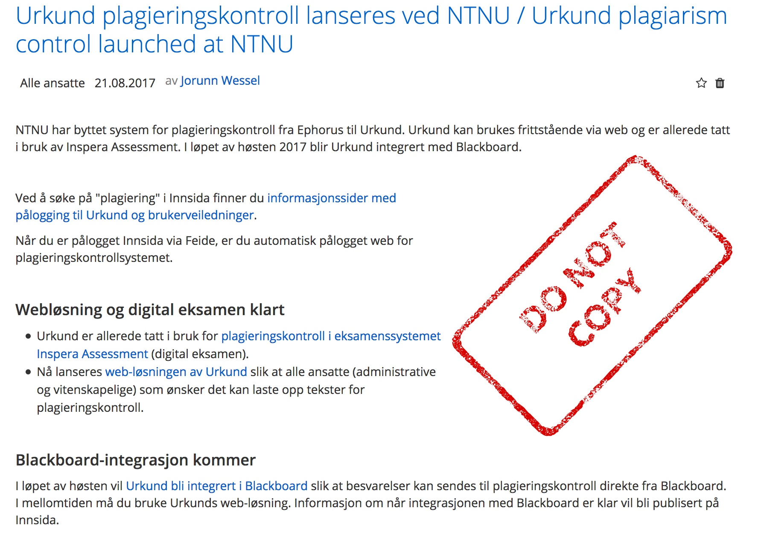

Slide 5
Official position of NTNU on plagiarism
and cheating during exams I
http://www.ntnu.edu/studies/examinations/cheating

Slide 6
Official position of NTNU on plagiarism
and cheating during exams II
http://www.ntnu.no/c/document_library/get_file?uuid=afc7f5d3-1388-492f-aceb-046b4a2e3f62&groupId=10578

Slide 7
- General considerations
- What is plagiarism?
- How to avoid it?

Slide 8
What is theft?
What do people steal?
Why steal?

Slide 9
So what is plagiarism?
(in reality)

Slide 10
http://www.turnitin.com/assets/en_us/media/plagiarism_spectrum.php

Slide 11
http://www.turnitin.com/assets/en_us/media/plagiarism_spectrum.php

Slide 12
http://www.turnitin.com/assets/en_us/media/plagiarism_spectrum.php

Slide 13
http://www.turnitin.com/assets/en_us/media/plagiarism_spectrum.php

Slide 14
http://www.turnitin.com/assets/en_us/media/plagiarism_spectrum.php

Slide 15
http://www.turnitin.com/assets/en_us/media/plagiarism_spectrum.php

Slide 16
The top -10 of plagiarism
Frequency
Problematic
Less frequent
More frequent
Less concern
More concern
Clone
Clone
Mashup
CTRL-C
CTRL-C
Mashup
Remix
Aggregator
Recycle
Recycle
Re-Tweet
404 Error
Find-Replace
Find-Replace
Aggregator
Hybrid
404 Error
Remix
Hybrid
Re-Tweet
Ranking based on data from 879 educators from around the world.
71% college educators
http://www.turnitin.com/assets/en_us/media/plagiarism_spectrum.php

Slide 17
Plagiarism example 1 (harmless)

Slide 18
Plagiarism example 2 (problematic)

Slide 19
How to avoid plagiarism?
1) Put everything directly copied from somewhere else in quotation marks and
provide a citation / the source from where it comes in your text.
2) Paraphrase: Read the text, understand the idea / concept, write it out in your own
words, then check if your text is really different from the original and provide a
citation to indicate where the original idea comes from.
(3) If in doubt, ask your teacher.)

Slide 20
Take home messages:
- Plagiarism is intellectual theft
- Plagiarising / cheating is easy...
- Not getting caught requires a lot of work!
(so one may as well do the writing in the 1st place)
- It is the responsibility of the student to familiarize
him/herself with the rules/regulations.
➔ so: "I did not know", does not work...

Slide 21
Group work:
Develop a set of rules for dealing with Plagiarism offences!

