Slide 1
Basement Thermite Fire: Group 6
Pot Tap Out: Molten aluminium spilled out of the cathode into the basement.
Local concrete has a high limestone (Calcium Carbonate) aggregate content.
Reaction of molten aluminium with concrete to cause extremely large, hot thermite fire (>2,000°C).
Thermite Reaction with molten aluminium and Limestone rock (Calcium Carbonate):
Step #1: Heat from molten aluminium decomposes limestone to release carbon dioxide (CO2) gas:
CaCO3 => CO2 + CaO
Step #2: Molten aluminium reacts with CO2 gas in thermite reaction:
3CO2 + 2AL => Al2O3 + 3CO

Slide 2
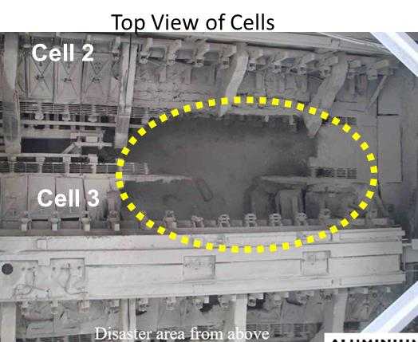
Basement Thermic Fire
Thermite fire damaged the cathode shell and the aluminium busbar system on two adjacent pots
Potline power is turned off.
  - Potline will freeze up in 4 to 5 hours!

Slide 3
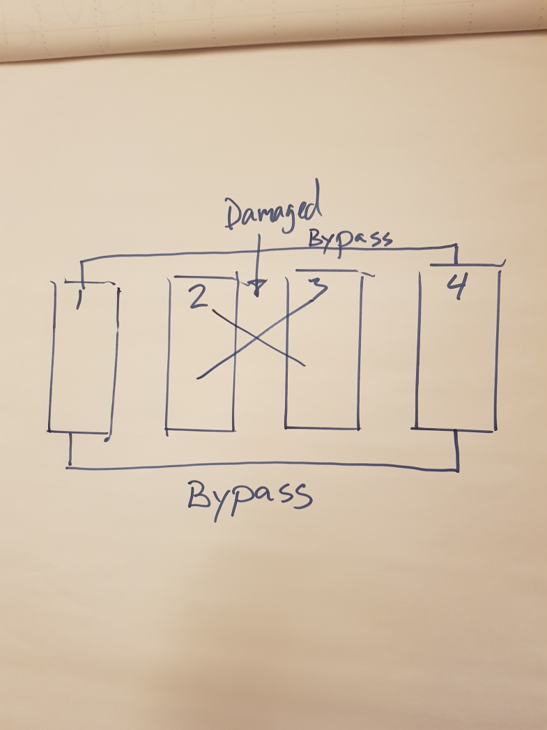
Basement Thermic Fires
How to extinguish the basement thermite fire?
  Cover fire with a thick layer of alumina or anode cover material.
  Do not use water!
How to bypass the damaged cells and damaged bus system (in less than 4-5 hours)?
  Install an “emergency” bypass busbar system around the tap & duct ends of damage cells.
  Pour molten aluminum to make connections around damaged cells.
  Welded long end-to-end billets to make a bypass around damaged cells.

Slide 4
Basement Thermite Fires
3&4. How to repair the busbar and cathode in damaged cells?
  We have no time limits, but should repair busbar ASAP (cathodes later) to prevent overheating of connections; cool with fans. Once the busbar is repaired then you can use wedges to bypass cells before restart.
How to prevent future basement thermic fires?
  Problem with thermite fires is due to the use of limestone (calcium carbonate) in the cement.
  Make a shield for the concrete using bricks, or other materials not containing limestone.
  Cover & maintain concrete with a thick layer of alumina, or anode cover materials.

