Slide 1

The Challenge of Carbon Neutral Settlements:
User Participation in the Planning and Development Process of a Residential Area
Car or no car?
Erica Löfström
erica.lofstrom@ntnu.no
&
Judith Thomsen
Judith.thomsen@sintef.no
Name, title of the presentation

Slide 2
The Brøset case: approximately 1200 households on 350 da to be built
Ongoing research project “Brøset, towards carbon neutral settlements” in the city of Trondheim, Norway
Project involves Trondheim Municipality and Researchers at NTNU and SINTEF
Focus Group Interviews – as part of ambitious goals for user participation
Data from Focus Groups to be used in the Plan- process
Learning for the future
And … seeing how far we can take it socio-technically, today
Notes:
This is a work in process. I have collected Focus Group Data, and analyzed parts of it. It is a work that is performed in close cooperation with the Municipality of Trondheim and a number of researchers in different areas of expertise. My project handles ”the role of users” or participation, and it is at least partly what I would call action research-based. We have arranged public meetings, focus group interviews with people in the vicinity of the area and others as well as with young people. We learn during the way, but also for the future... And of course,we can learn from previous ambitious international examples.

Slide 3
The Future Carbon Neutral Settlements of Brøset: Why users?
End-users are an important factor in the creation and maintenance of a long-term sustainable resource use
How and when resources are consumed obviously determines the ability to create long-term sustainable systems
Users are also ultimately the ones who profit or suffer from the successful or failing transformation of socio-technical systems, which increases their importance as a key component of the system
Notes:
The role of users in the design of residential buildings and areas is far from self-evident. Although today, we seem to know quite a lot about how to make residents of standard residential areas feel comfortable and enjoy their everyday home life. User preferences are constantly being molded into the processes of planning and building our cities, making life - at least in Norway and other wealthier countries - easy. However, facing the fairly new threat of global warming and the energy- and resource saving political targets of today, we need to change direction into a new way of building and living in future cities. User participation in creating these new kinds of “carbon-neutral” residential areas becomes even more crucial than for ordinary projects, since the households will need to adapt not only to new kinds of buildings and infrastructure, but also to adjust and adapt their general lifestyle and consumption patterns. Previous examples of the planning and building of “green” villages and residential areas has shown that if the users are not involved in the process, the projects are less likely to succeed. This is why Bröset has a research-project for user participation in the process

Slide 4
the Focus Group participants have been chosen to cover relevant groups that are familiar (living in the vicinity of the area) with the area and/or interested in moving in to the area in the future.
2 groups of 6-8 persons that met on 3 different occasions
And
2 groups of 5-7 young adults (living in the vicinity of the area) on 1 separate occasion each
( all Focus Group Interviews ca 1 hour 40 mins)

Slide 5
  If users are not actively participating in the technology developed, they might even “sabotage” the technological system, installing separate technologies (ventilation, heating etc.) competing with the system, or try to “manipulate the system” into giving them what they want…
- even if they are positive to the system!

Slide 6
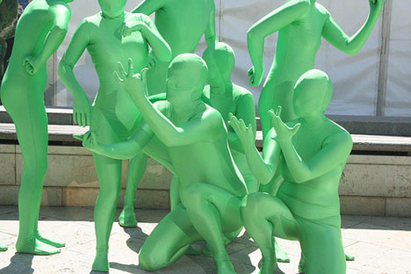
Carbon Neutrality & New Ways of Living cannot be only for a chosen few… But for all!
In building eco-villages for environmentally engaged people, so called green people, this is not as much of a challenge since the users are already involved and interested in the project of greening their lives as well as their built environment.
Notes:
The challenges of global warming makes it a necessity not only for a chosen few enthusiasts to change their lifestyle, transports and housing, but for all to adapt to new ways of handling natural resources as a whole. Consumption patterns need to be adjusted as well as the production of goods; the recycling of materials needs to be efficient and that means that people will have to actively recycle the household waste; not only the technical system for heating houses will need to be different, but people living in these houses need to learn to live with their new heating system

Slide 7
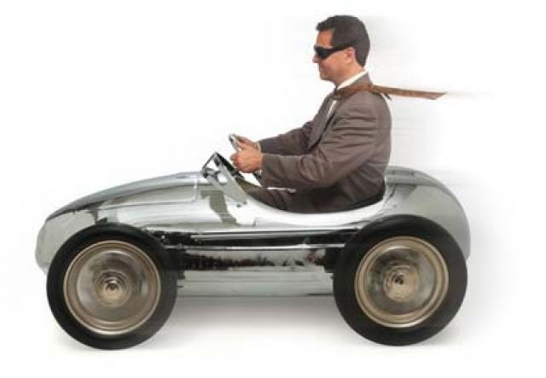
But… Brøset is to be built for ”everybody” young people, old people, students, families with children etc.
And it is to be car-free or nearly car-free…
Notes:
Even people who are interested in changing life style are having problems taking the intentions into action. For those who are trying to change, new tools are needed. Tools that are usable and comprehensable. But first, one important question: are we irrational?

Slide 8
Main Challenges for the carbon-neutral settlement of Brøset:
Creating a well functioning car-free neighborhood
Building a comparably dense residential area that will work for people in Norway (in the Trondheim area).
Making the technology and residents compatible. (Creating technology that works for users and motivating and instructing the users to live in accordance with the technologies in use).
Notes:
However, the challenges for building a carbon-neutral residential area are not the same for all projects. Also, we need to know what is applicable and preferable for our particular setting, the area of Bröset, in Trondheim, Norway. Based both on previous research in the field of sustainable or green residential areas and on early focus group interview data, the main challenges for the future carbon-neutral settlement of Brøset can be gathered within the three categories of; living without a car, living dense and making technology and people compatible in the long run to achieve the ambitious goals of the area.

Slide 9
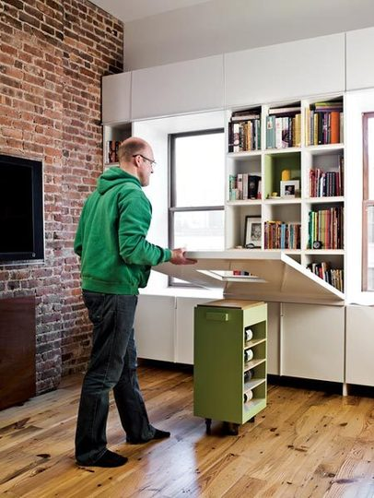
Background:
Norwegians are used to private cars and Big Apartments – What is Normal?
”Compact living?
The planned project is considered ”densely populated”
Notes:
In connection to the two first categories, living without a car and living in a dense (sub-)urban area, these are both quite challenging for the Norwegians, due to a combination of relatively high demands in relation to comfort and a good personal economy. The Norwegians, as many other countries, are gradually getting used an increasing number of square meters per household at the same time as the total number of household members is steadily decreasing.

Slide 10

In a joint effort, we (Löfström and Thomsen) focus on the potential of promoting walking, cycling, and improved public transport for reducing the amount of motorized transportation in housing settlements. The background for this interest is the ongoing research project (Brøset).
Notes:
We do not always act the way we intend to. One reason is that we are so busy living our lives, we do things by routine. Everyday, we do things that we do not reflect much about. This makes it difficult for us to change.

Slide 11
Research in the field of transport shows that urban form has an important influence on people’s preferred modes of transport, identifying urban form aspects relevant for planning car-free or nearly car-free housing settlements.
1) distances to daily destinations such as schools and grocery stores, 2) Routes: the accessibility of destinations given by short and direct connections through walk and cycle paths, and 3) residential density which provides the basis for retail and public transport.
However, academic and policy discussions on the influence of urban form on travel behaviour are sometimes controversial.

Slide 12
An Urban Form Analysis of the current situation at Brøset has been conducted using f ex SpaceScape (2009) and the results are consistent with that of the Focus Group Interview Data.
-The results show that there is a lack of local services, especially of grocery stores and schools within the 500 - 1000 m radius around Brøset, which is defined as a convenient walking distance.
-There is a great potential for improvements of the cycle network, both in terms of network distance and of the standard of the cycle lanes.
- In addition, there is also no direct connection to the closest neighborhood centre, which is stated to have a negative effect on traveling there by walking or cycling.

Slide 13
Convincing people to give up their cars has proven to be a difficult task and it clearly is not a question of urban form alone. Focus Group Interviews with people living in the vicinity of the actual building site have been performed in order to find out what the main challenges will be for a car-free or nearly car-free residential area at Brøset. The collected data will be used to pinpoint the main challenges of living in a car-free area, as perceived by the future residents^{[1]}. Two Focus Group interviews^{[2]} with young adults (5-7 high school pupils/each + interviewer) have been performed focusing on the participants view on their future life style, housing and transports and possibilities for change. Also, two different Focus Groups (5-8 persons/each + interviewer) have been gathered at three separate occasions each discussing the future residential area of Brøset. One occasion for each group focused specifically on choices and possibilities for everyday transports^{[3]}.
Urban Form: Overcoming these Obstacles is Not the Whole Story:
Convincing people to give up their cars has proven to be a difficult task and it clearly is not a question of urban form alone
The main obstacle of people joining a car-pool as an alternative to a privately owned car may be to “become a person without a car”. (Harold Wilhite)
Questions that we are currently working on:
What are the preferred modes of travel of the future residents of Brøset , and how can we influence these preferences.
What would be possible to obtain and how?
And not least, how should the car-free, carbon-neutral residential area be marketed?

Slide 14

”Why not dig out the whole 350 da and build a garage for cars under the whole area?” (Everyone agrees)
- Informants expect a garden and a car with parking facilities close by
”No parking spaces?
But where shall I park my car then?”
“Trondheims whole Public Transport System needs to be transformed”
“When I grow up I expect to have at least one car, maybe two… and a detached house, and a summer house…”
” Nowhere to park your car:
You can forget about that!”
”But then you might have to walk more than 200 meters to your car”
Notes:
Illustrating the difficulties in imagining a car-free life style for the informants, it was suggested in the focus group interviews that, although it was to be ”Carbon neutral and all”, we should build a garage under the whole resídential area so that you always had your car nearby...

Slide 15
Hardest for families with children living at home
Situations of Opportunity:
-Shift of Stage of Life
Student life... Retired Life... Green Life (being in the forefront)
Positive not to have to Own a car Car free = Care free?
How does it become Normal Not to Own a Car?

Slide 16
Data is currently being analyzed, but starting with the obvious...

Slide 17

Brøset – for everybody?
Yes (eventually) and No (not just yet)
We might need to adjust this target group for the area:
I suggest that it should be for everybody, but with a target group and sales pitch aiming towards more “green people”
So easy?
To be continued...
Notes:
Who should live at Bröset? In the plan, it has been stated that Bröset should be a residential area for “everybody”, where living carbon neutral should be “easy”. However, we may need to adjust this target group? Early data, from the focus group interviews, indicates that the identity of the future residential area of Brøset might need to be reconsidered or at least further developed. The profile, or identity, of the area needs to be clarified and developed further. If the ambitious goals and car-free neigbourhood is to be kept, we might need the target group to be more of the “green people” or eco-village people type. These will then lead the way and show that carbon-neutral car-free living in Trondheim is the way of the future. Bröset can then work as a half-way house for carbon-neutrality.

Slide 18
Thanks for Your Attention!
Erica.Lofstrom@ntnu.no
&
Judith.Thomsen@sintef.no
Name, title of the presentation

