Slide 2
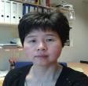
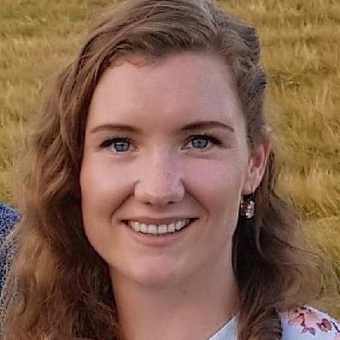
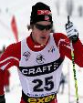
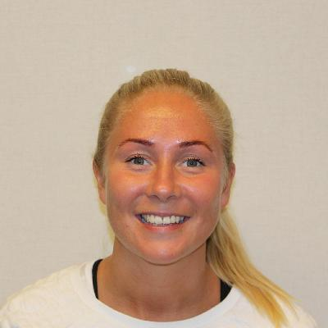
Organization
INB and ISB
Scientific leader
Beatrix Vereijken 20%
Daily manager
Arnt E. Tjønna
Movement
Exercise
Neurophysiology
ESS
Xiang Chun Tan
25% INB
Ane Øverness
50% INB
Thomas Fremo
50% ISB
30% HMN
Lisbeth Røe
Xiang Chun Tan
25% INB

Slide 3
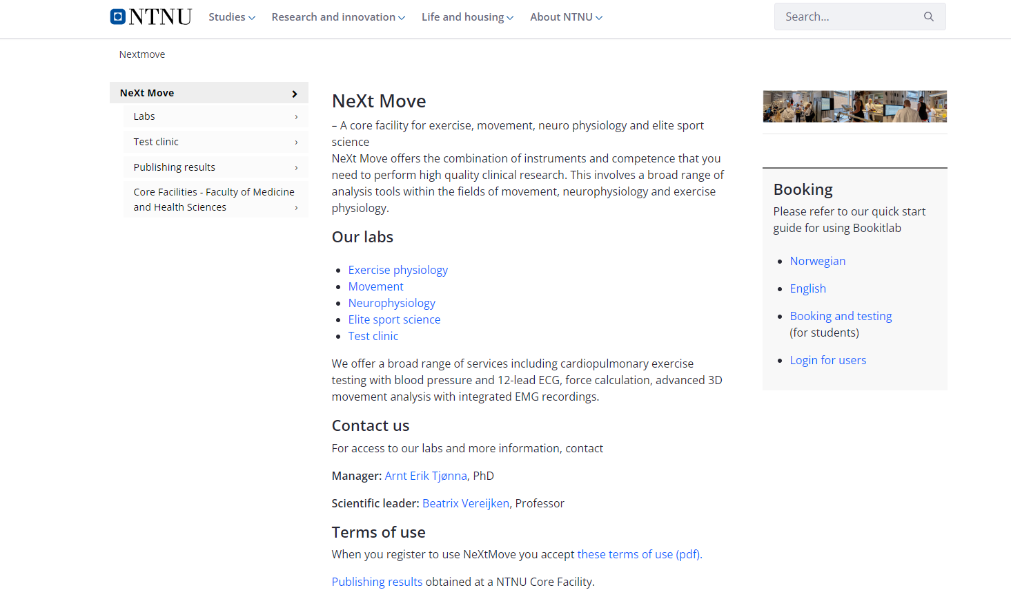
https://www.ntnu.edu/mh/nextmove

Slide 4
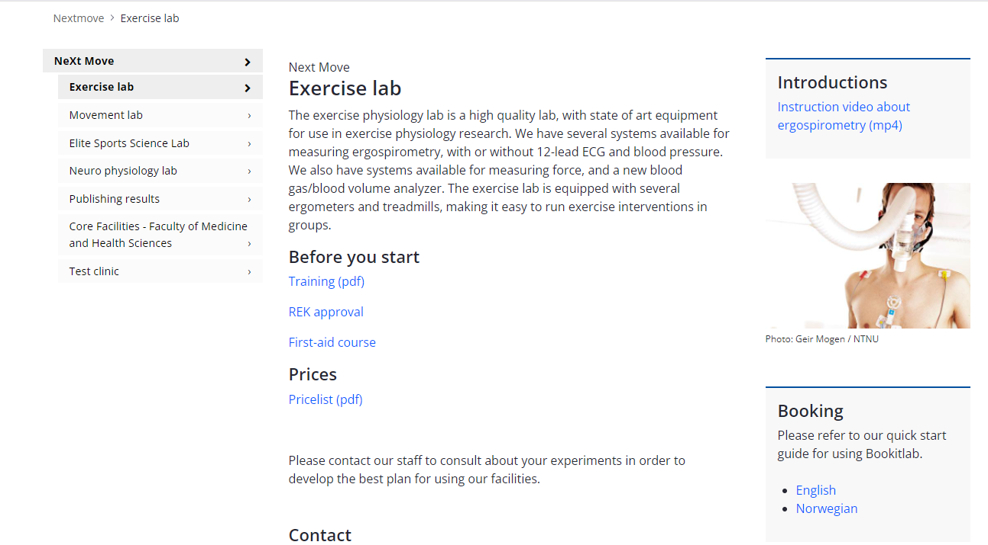
MSc observation and teaching before use of lab
In order to activate your user in Bookitlab, you need to complete the following steps:
Observe the required amount of testing and other lab procedures for the lab and equipment you are planning to use (refer to a Next Move engineer or your supervisor for details) this can start before you have a project number (if ongoing
projects are testing).
https://www.ntnu.edu/mh/nextmove/exercise
Training

Slide 5
MSc observation and teaching before use of lab
Obtain your Master Thesis Approval from INB/ISB (deadline medio.april)
Log on to Bookitlab with Feide one time (and do nothing), because you will automaticly be registerd in Bookitlab on the first-time login. And this is mandatory for many of the following steps.
Receive a project number containing your student funds, for subsequent booking in Bookitlab. Send an email to the economy controller at the department you belong to (ask your supervisor for reference). Inform the controller about what master program you are on and that you need a project number for booking lab and equipment. Total budget for booking in bookitlab are 20 000kr (but this needs to be clarified with supervisor). When funding are finished you will automatically get a notice in bookitlab when you are trying to book.
Contact technicians at NeXt Move if you need practice as soon as possible, then we can arrange groups (5-6 individuals).

Slide 6
Bookitlab
Bookitlab

Slide 7
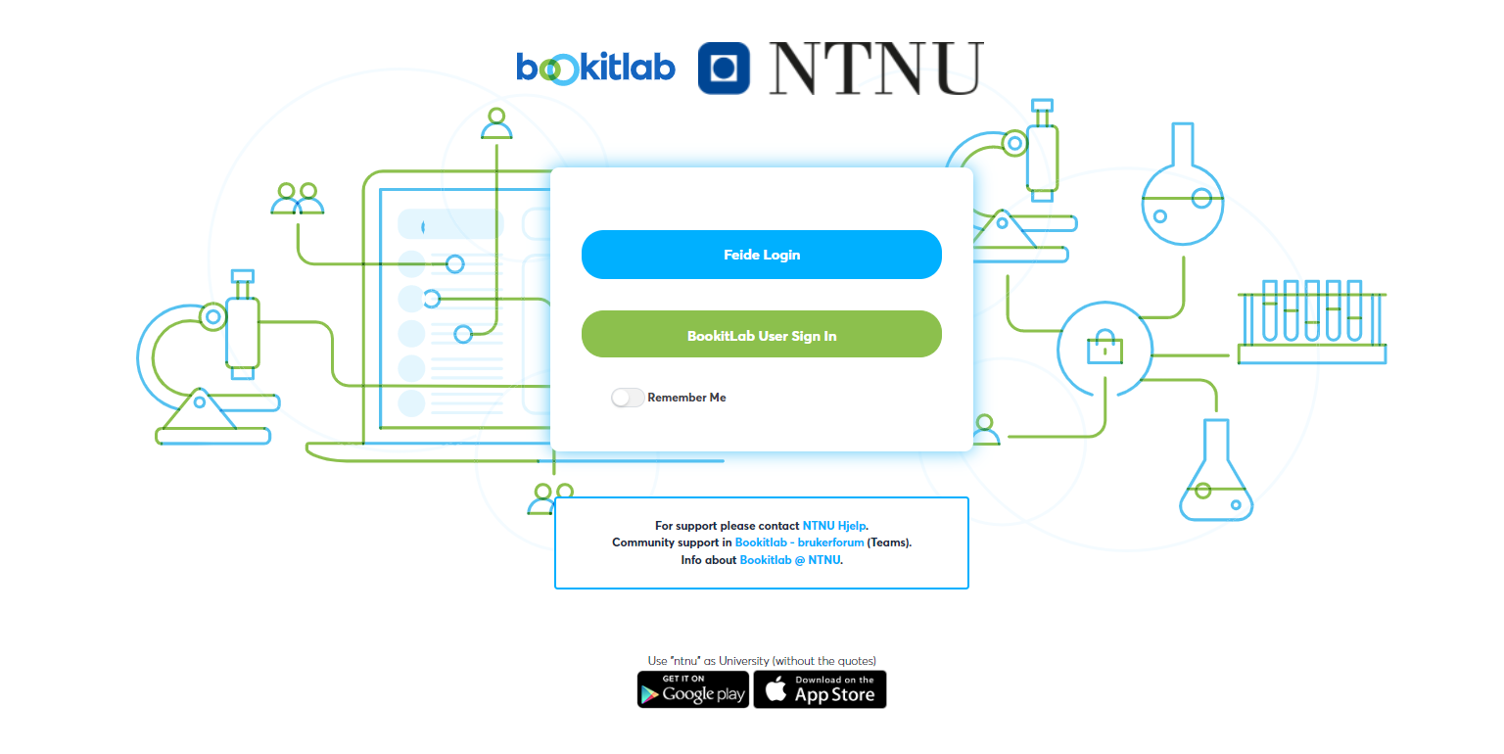

Slide 8
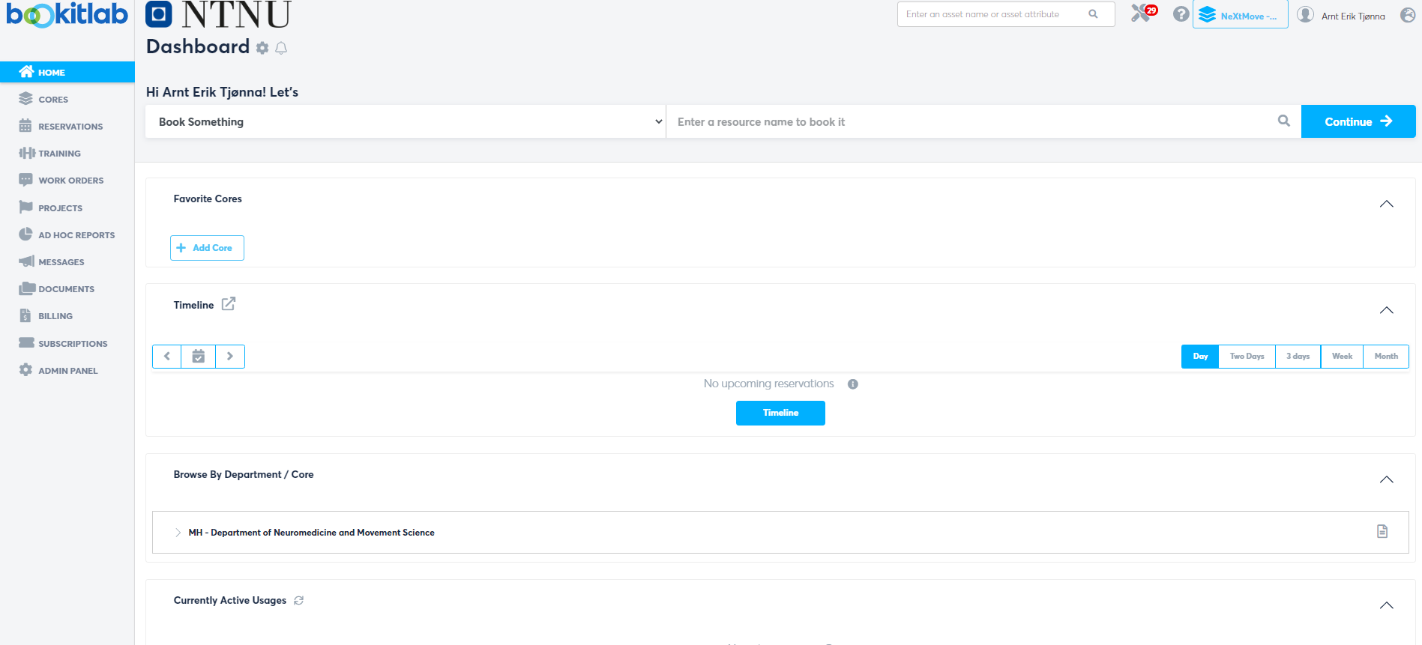
Start writing NeXt Move:
And then select the right
Lab where you are going to do testing.

Slide 9
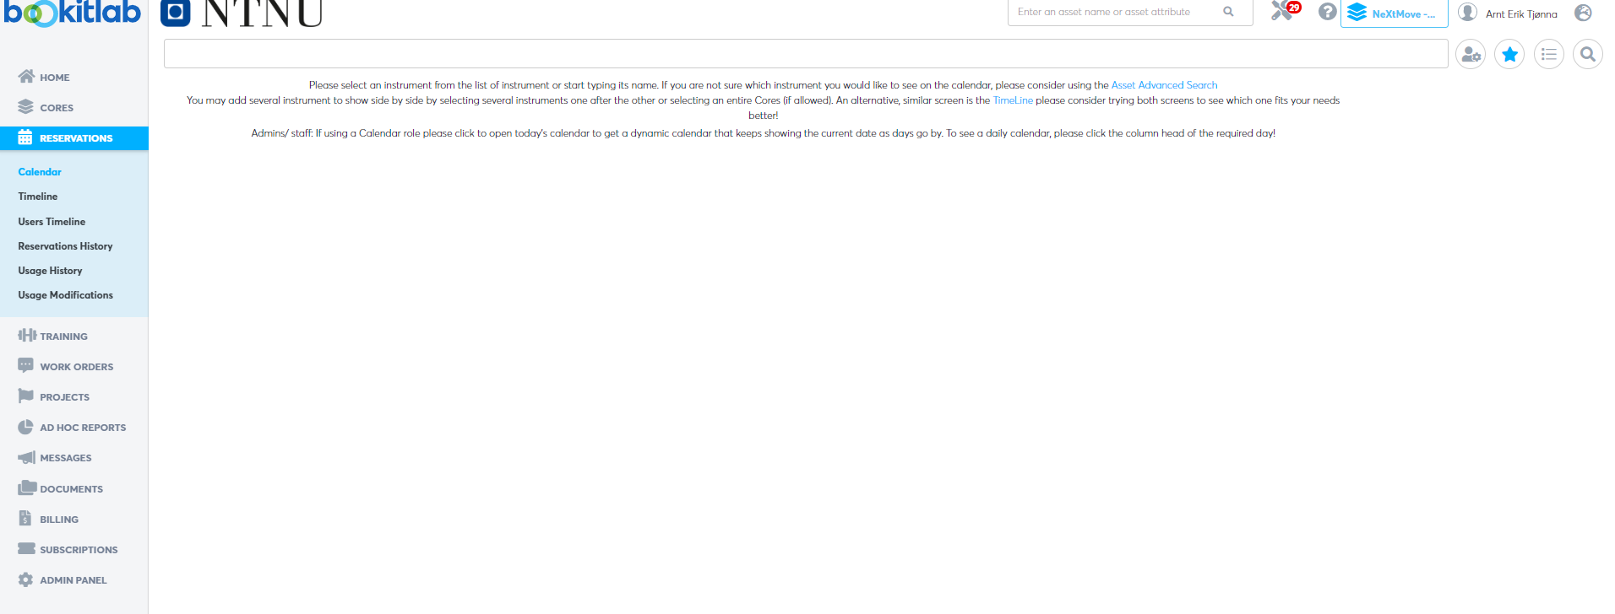
Select Reservation and Calendar

Slide 10
Write in the name of the lab you are going to use

Slide 11
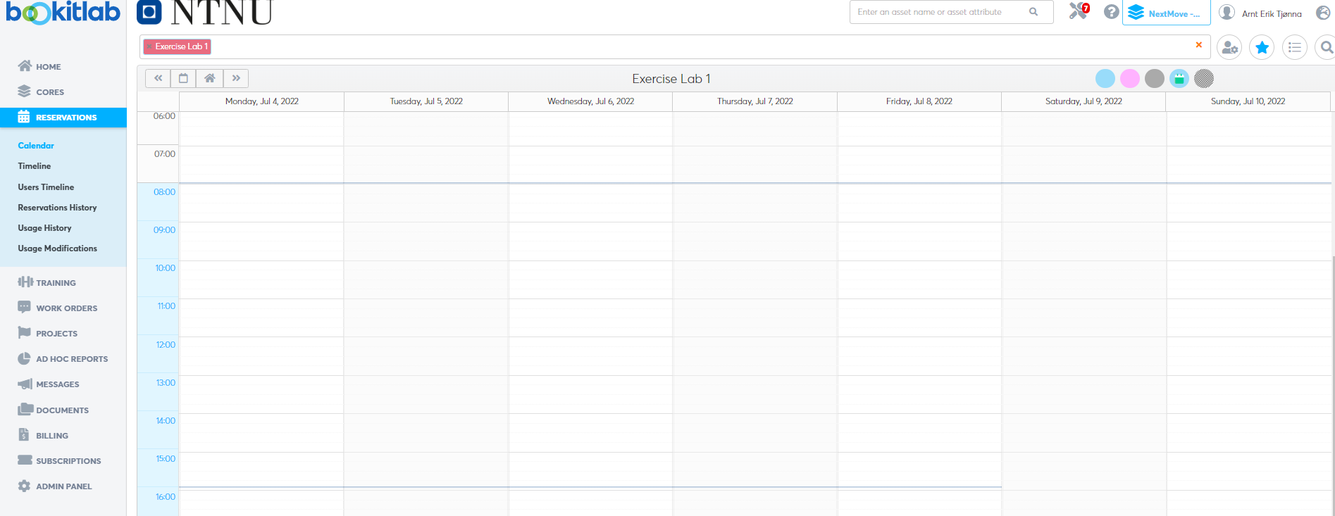
Then you mark the time you are going to use the lab

Slide 12
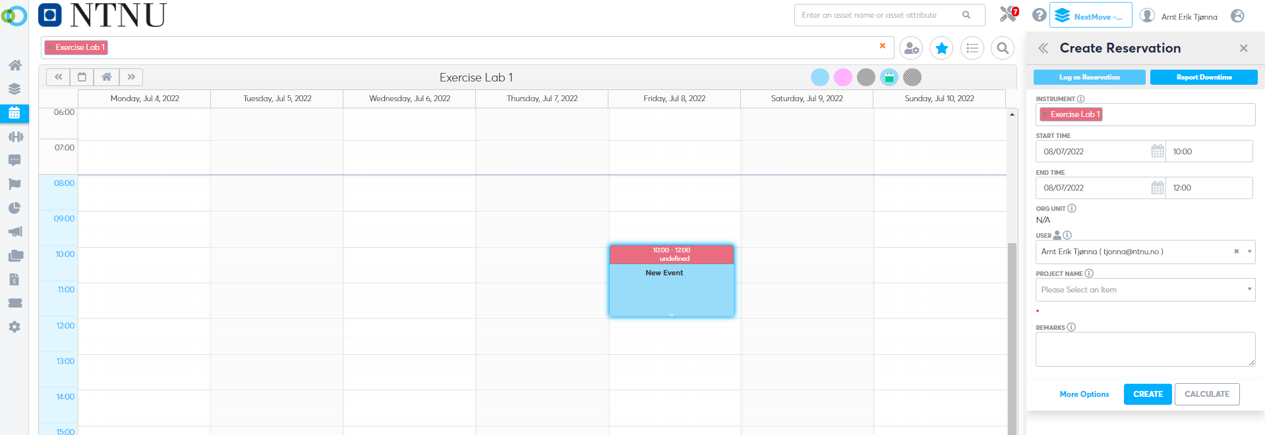
Here you can add
equipment,
just write the name
of the equipment you
are using. (several can
be added to the same booking
Important to select
project name, it should
only be one option
Then create reservation☺

Slide 13
Then you have created a booking☺
If there are any questions contact arnt.e.tjonna@ntnu.no or one of the technicians working at the lab.
GOOD LUCK☺

