Slide 1

How to get started as a user
Kunnskap for en bedre verden
Labstyringsprosjektet (Anne M. Vik), høst 2020

Slide 2
Content
Login
Search
Booking
Service requests
NB! Most of the equipments requires a project when booking. You can check yourself whether you are added to a project in Bookitlab (see how later in this guide). If you're not added, contact your project financial officer or project leader.
Why require a project number?
A lot of the equipment charge per use. A project number is therefore required for the cost to be charged correctly.
This guideline shows just a limited amount of all the functionality available for users in Bookitlab.

Slide 3
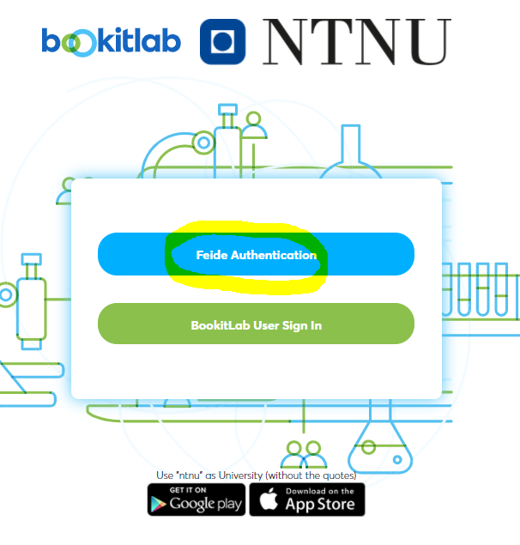
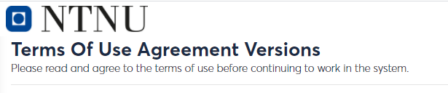
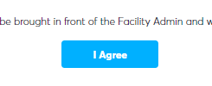
Login
Go to https://core.bookitlab.com/ntnu
Choose «Feide Authentication»
Choose «NTNU» if asked for «Affiliation»
You're asked to accept the «Terms of Agreement"

Slide 4
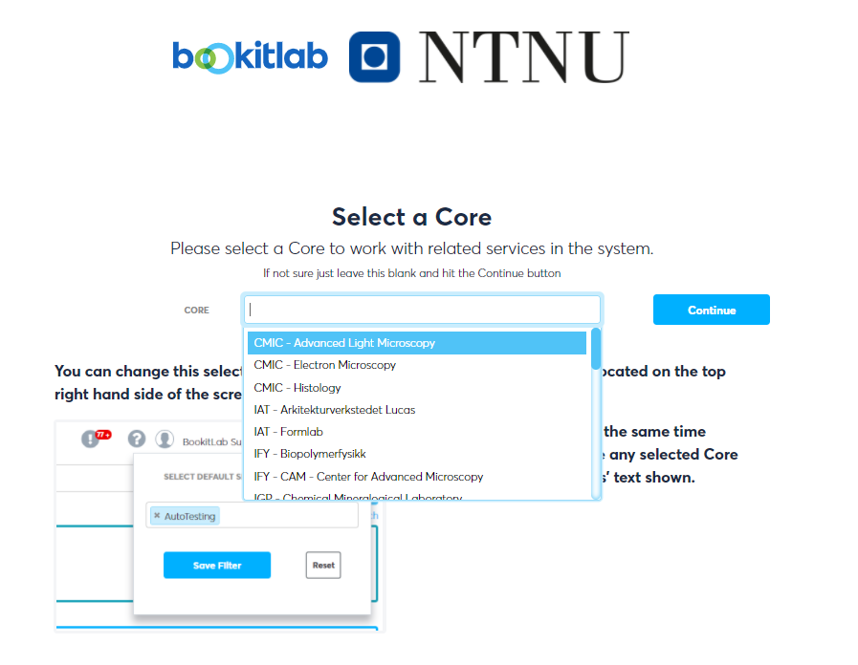
Login
You're now asked to choose core*:
Search for the core which is most relevant for you.
This is just a filter and can be changed after login.

Slide 5
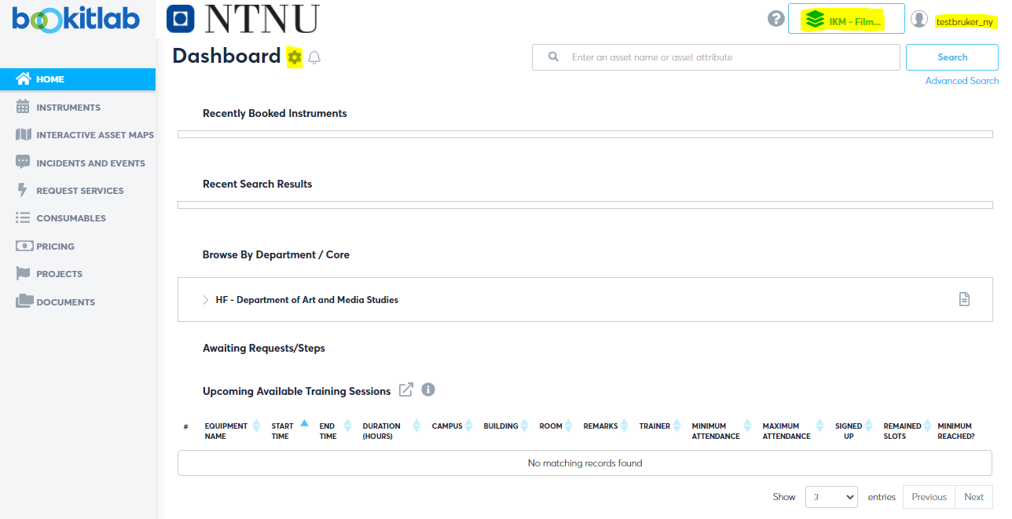
Login
Here you can change what core you want to filter on
Click here to see your user details
You can configure your dashboard here
Search for equipment by writing here. If you would like to search on specific parameters, click on «Advanced Search» --
Open this to see the equipment in this unit
Nå er det bare å sette i gang! På de neste sidene finner du noen tips.

Slide 6
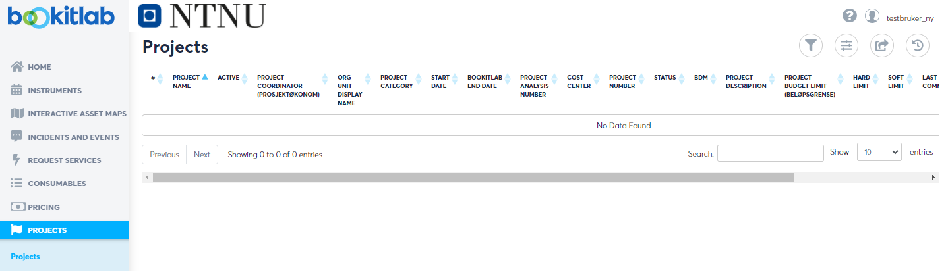
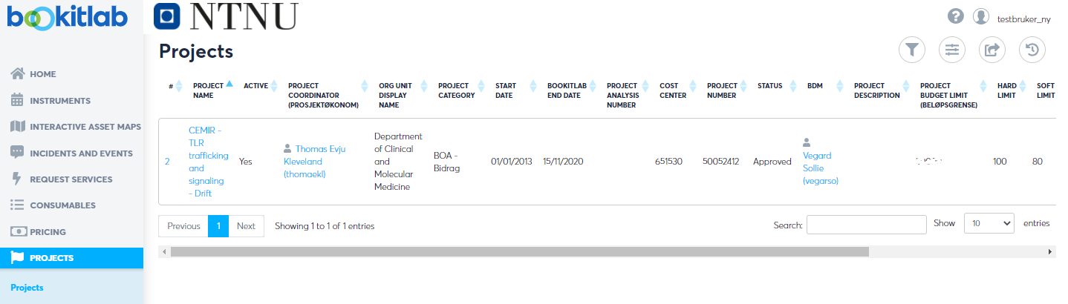
Am I added to a project?
Click on «Projects» in the left menu. If I'm not added to any projects, my screen is empty. Then I need to contact my project financial controller or project leader. Only the project financial controller can add me to a project.
If I'm added to a project, I will find it here. Not the correct one? Contact your project financial controller.

Slide 7
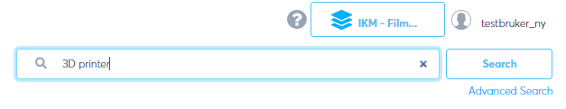
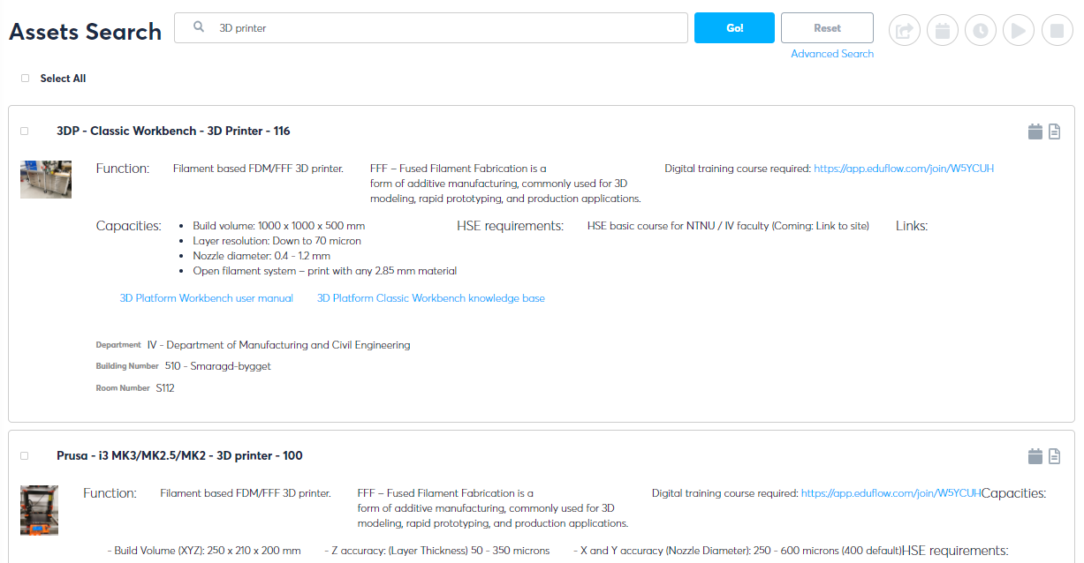
Search - general
Search by entering the word in the search field and click «Search»:
You'll get a list of results:
Click on the title or on the icons to the right to move further.

Slide 8
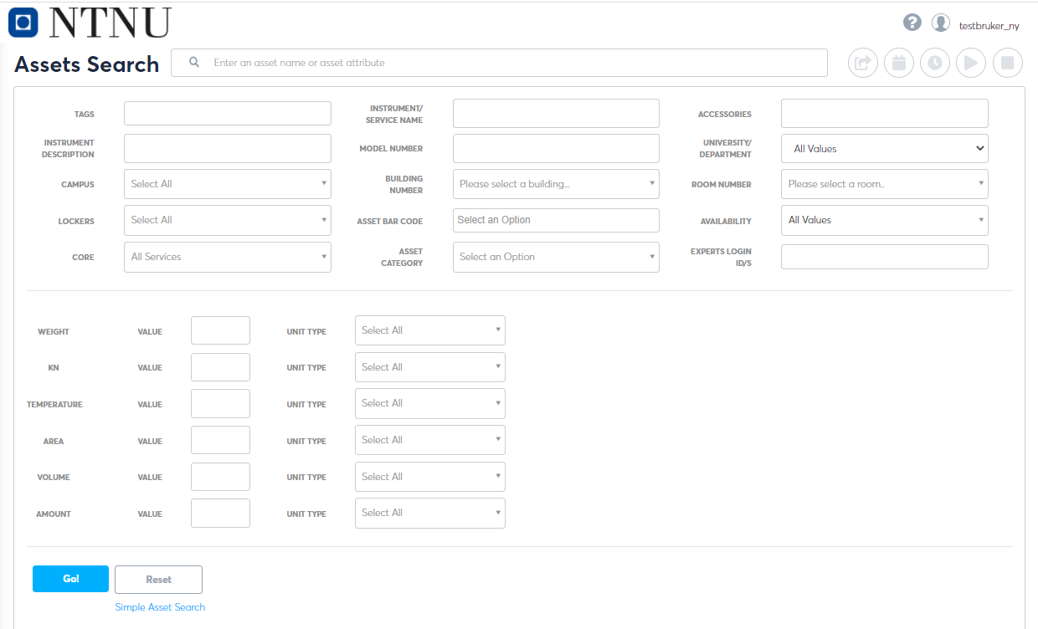
Search – advanced search
Click on «Advanced Search» at the top right on the front page. You'll get to this screen:

Slide 9
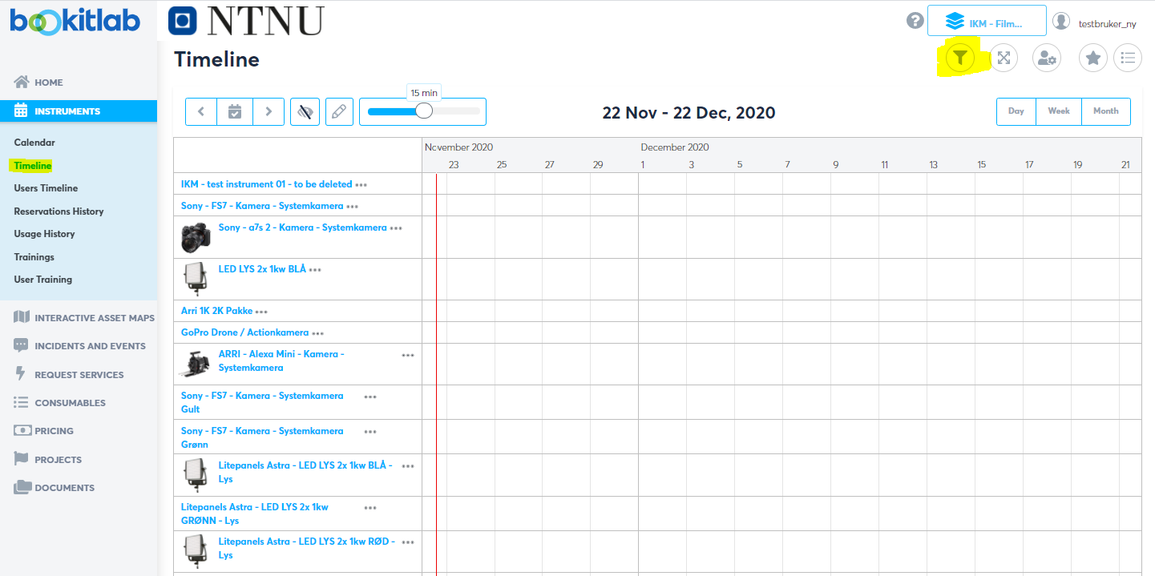
Search – timeline
Click on «Instruments» in the left meny to get to the timeline. What you see here is decided by the top filter «IKM – Film production». This can be changed.
Open the filter to narrow youe view
Click directly in the timeline to create a booking
"Now ime"

Slide 10
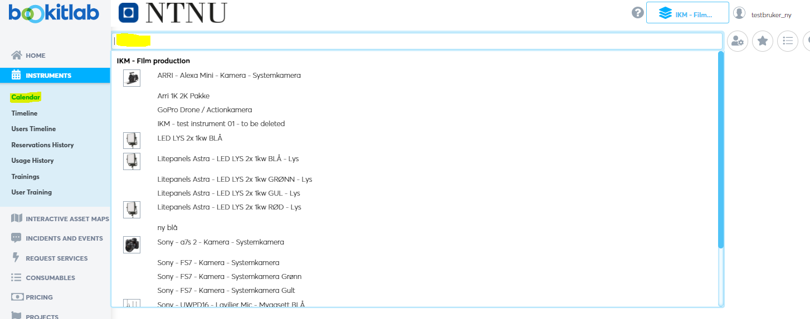
Search - calendar
To get to the calendar, click on the "Calendar" in the left meny. Here you can view the weekly schedule of any instrument as per your top right filter.

Slide 11
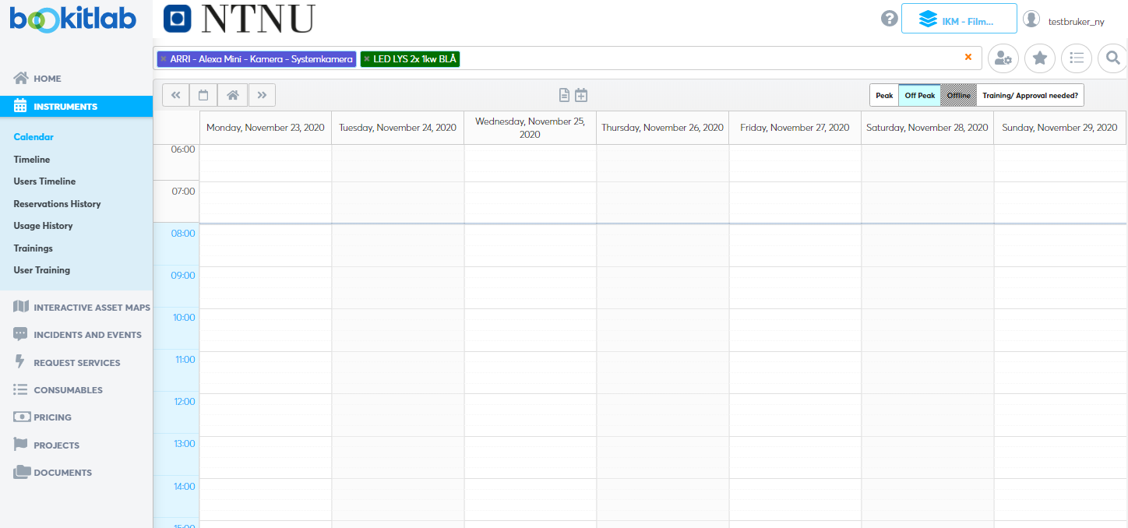
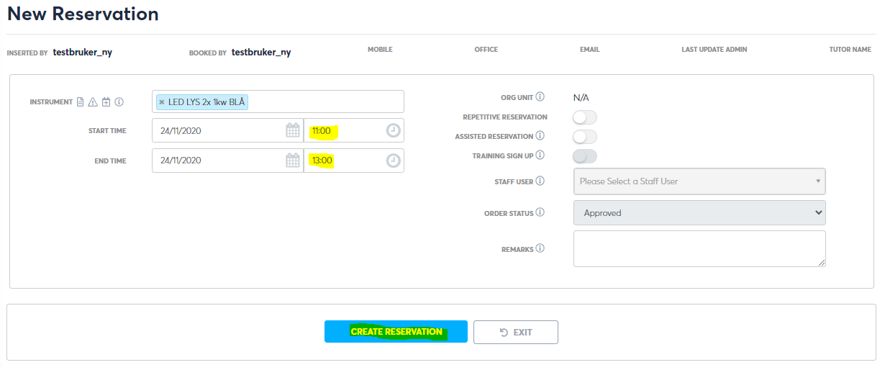
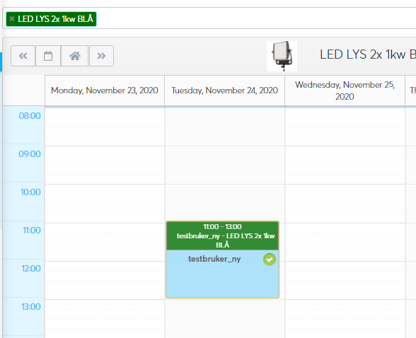
Booking from calendar
Choose the equipment you want to book and create a booking by marking the relevant timeframe.
You're sent to a screen where you can enter the reservation details, as your project.
Back in the calendar my reservation will look like this:
*This equipment does not require a project number. If it does, your asked to enter one.

Slide 12
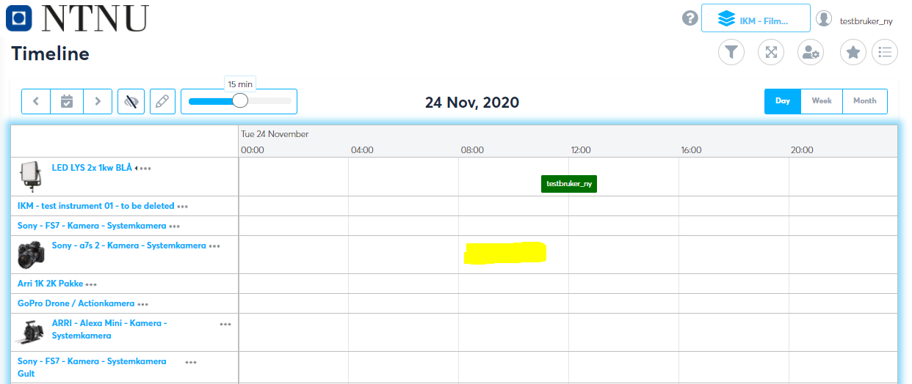
Booking – from timeline
Booking can be made in the timeline as well. Click on the frame so that it gets a blue lining, and then click on the time and instrument where you want to create a booking.
You can drag the reservation to move it.

Slide 13
So far, so good!
Some equipment requires training. You will either be asked to join a training session, or your reservation will have status as "pending". Core staff will be notified.
Booking says "You don't have sufficient permissions to book this equipment"? Contact core staff.
For questions regarding booking and equipment, contact core staff.
For questions regarding projects, contact your project financial controller.

Slide 14
Requests
In addition to reservations, users can make service requests
The lab designs different request forms according to the services provided
You as a user choose the service request form according to your needs and submits this to the lab

Slide 15
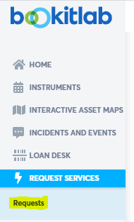
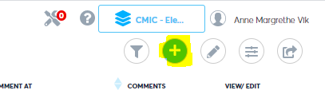
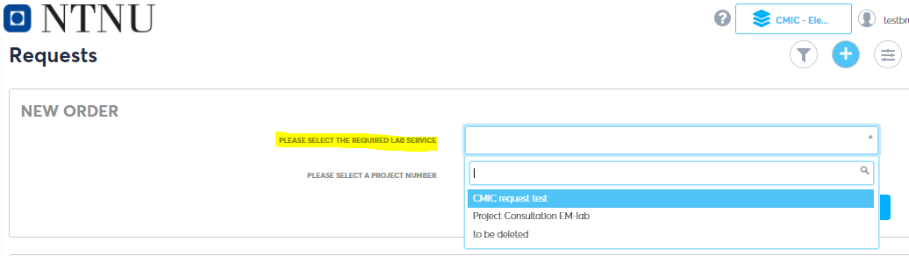
Submitting a request
1) Click on the left menu item «Request»:
2) Click on the plus icon to start a new request:
3) Select the request form from the dropdown according to your needs, in addition to you project:
(The top right filter decides what you see in this list. If no filter on, then you will see all available forms at NTNU)

Slide 16
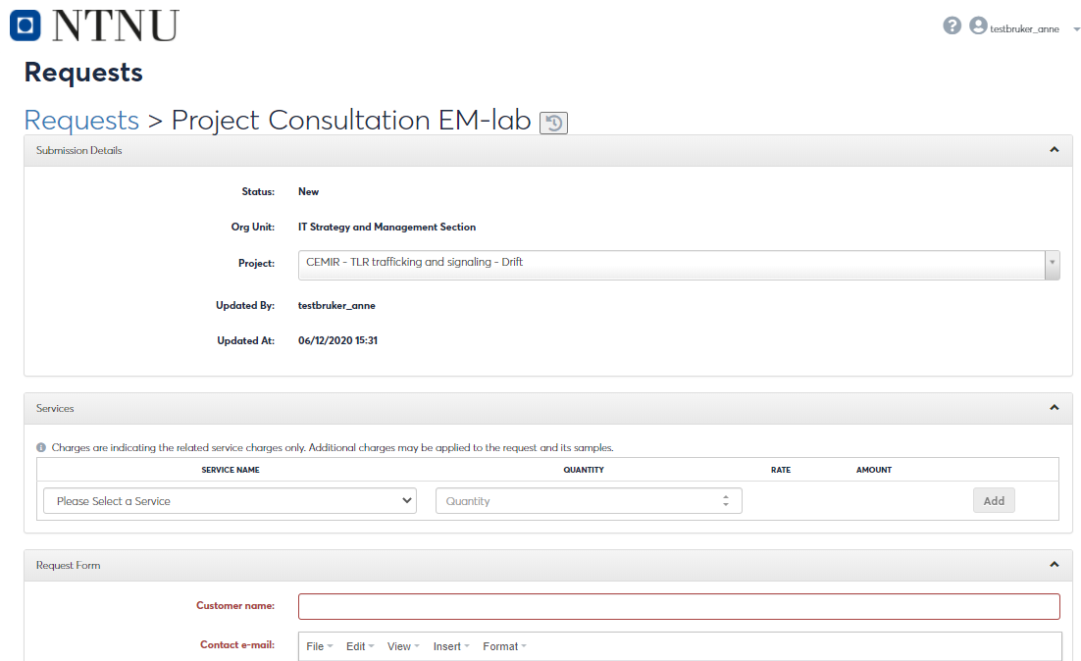
Submitting a request
Fill inn the form accordingly and click «Submit» at the bottom. Core staff will be notified, and you will get an email as confirmation.
Form example:

Slide 17
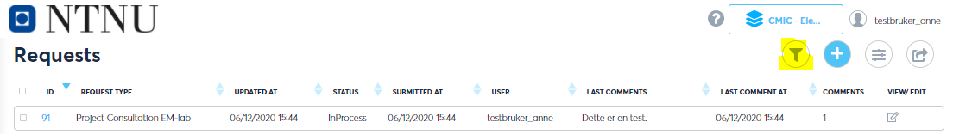
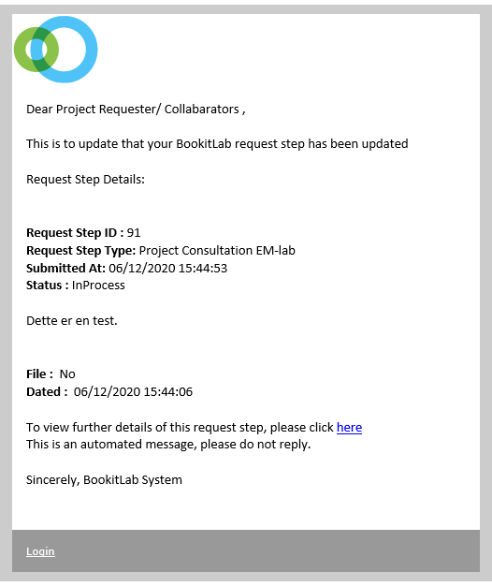
Submitting a request
After submitting the request, it will get status as «In Process». You can see all your requests in the request list.
Open filters if you wish to filter your view
Email confirmation:

